Slide 1

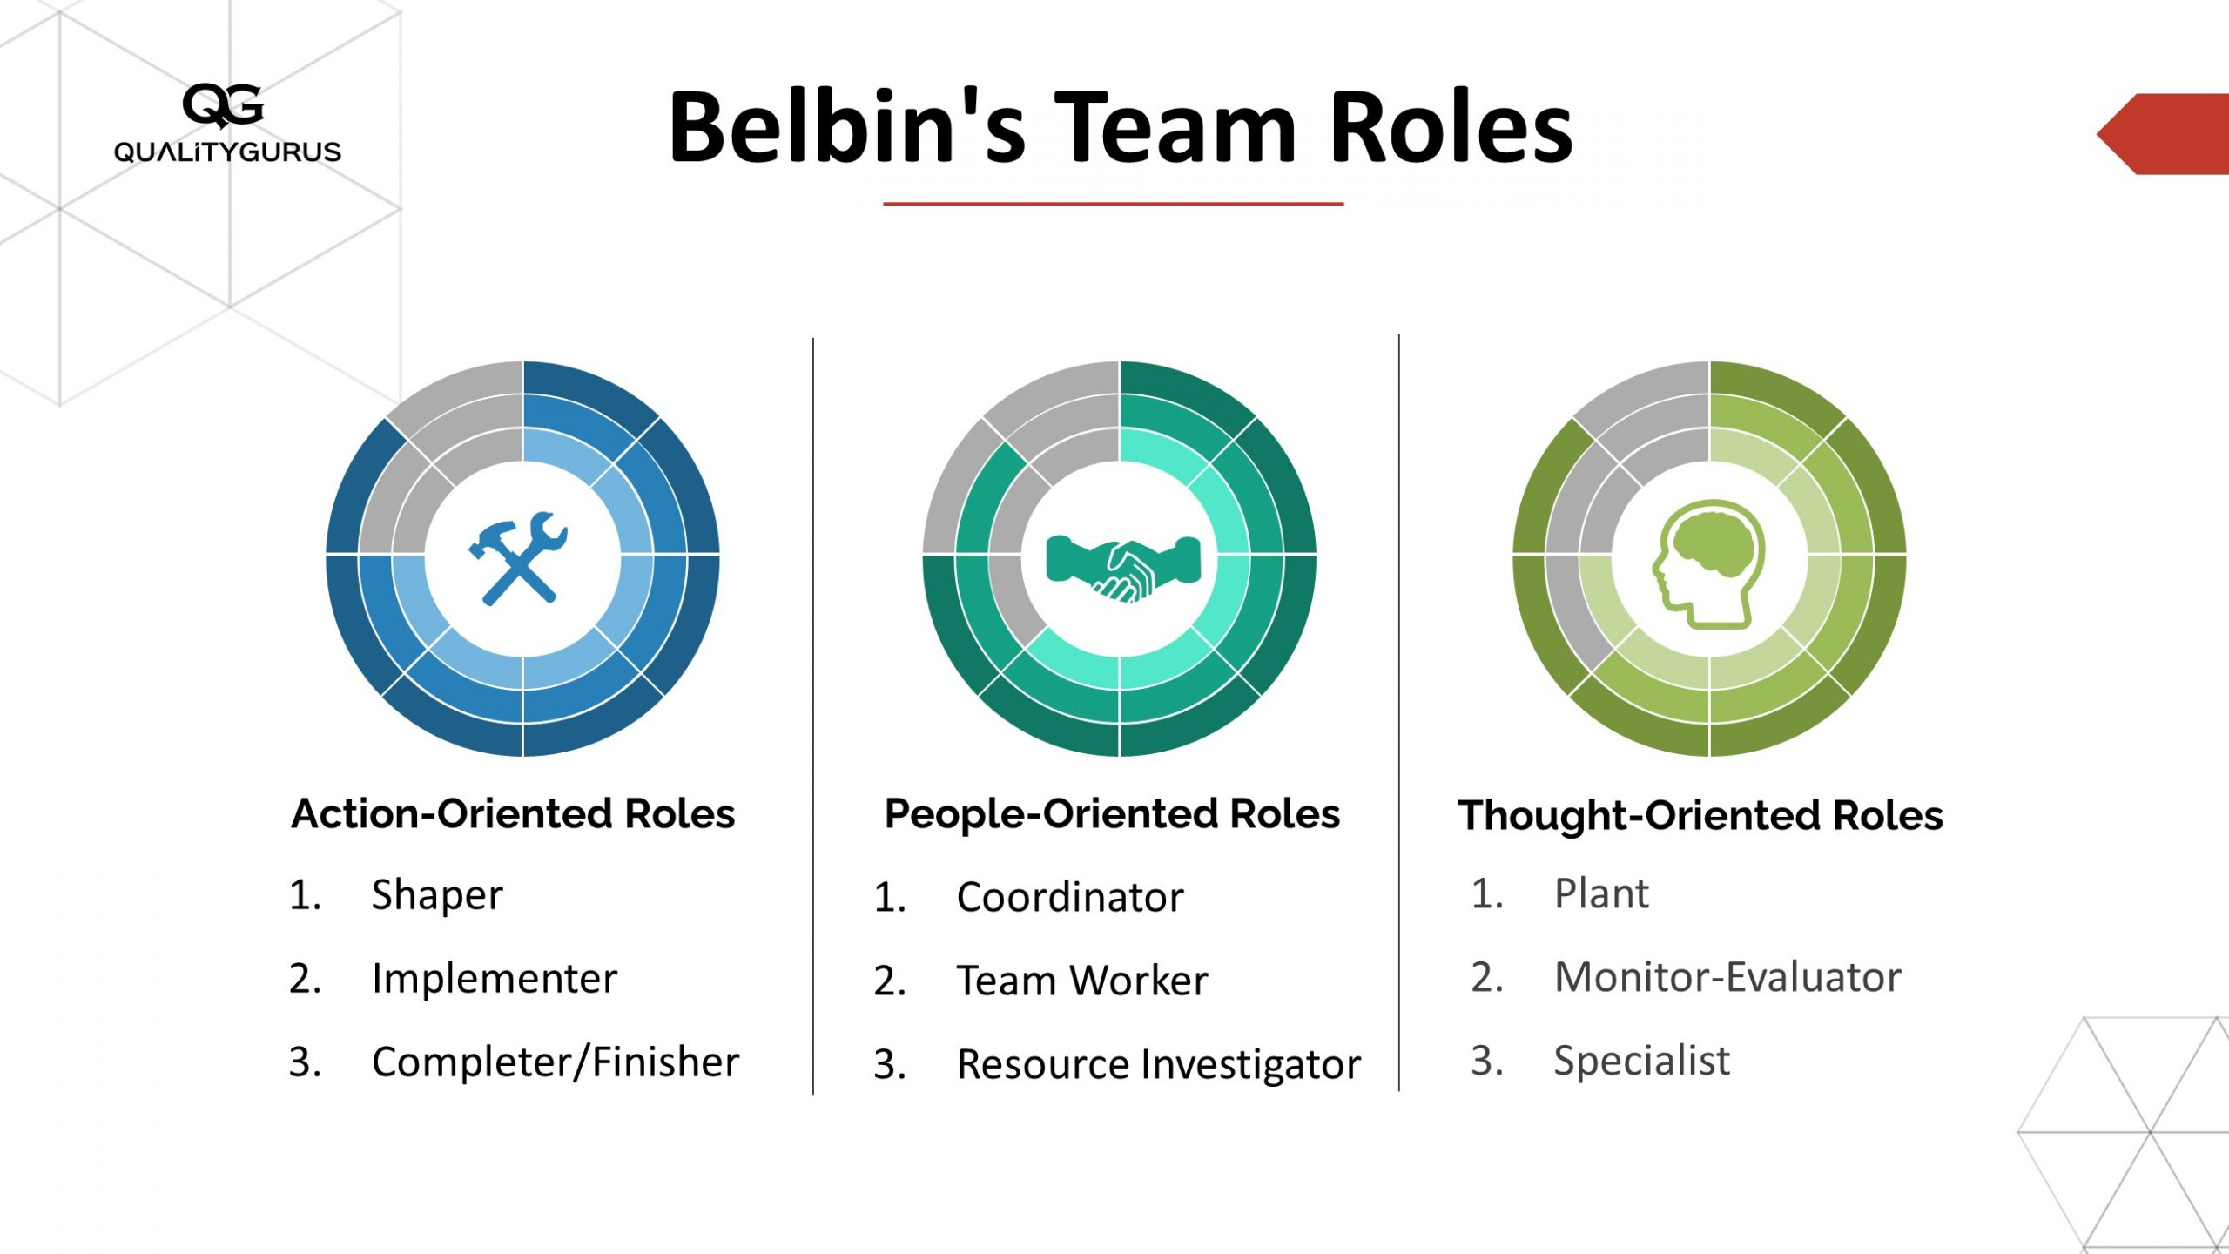
Reward, Recognition & Delegation in Teamwork
Effective Team work and communication
BMSW4009
Lecturer: Muhammad Cassamo
By Simona Caldare
Student number:2438920
-Belbin Team Role- Shaper(Action Role)
Reward and recognition help motivate team members and improve teamwork (Herzberg, 2021).
Delegation builds confidence, trust and shared responsibility in teams (Adair, 2020).
Conflict is normal, but teams work better with strong communication and structured strategies (Kilmann, 2021).
This presentation focuses on how these skills improve teamwork and reduce stress in the workplace.

Slide 2

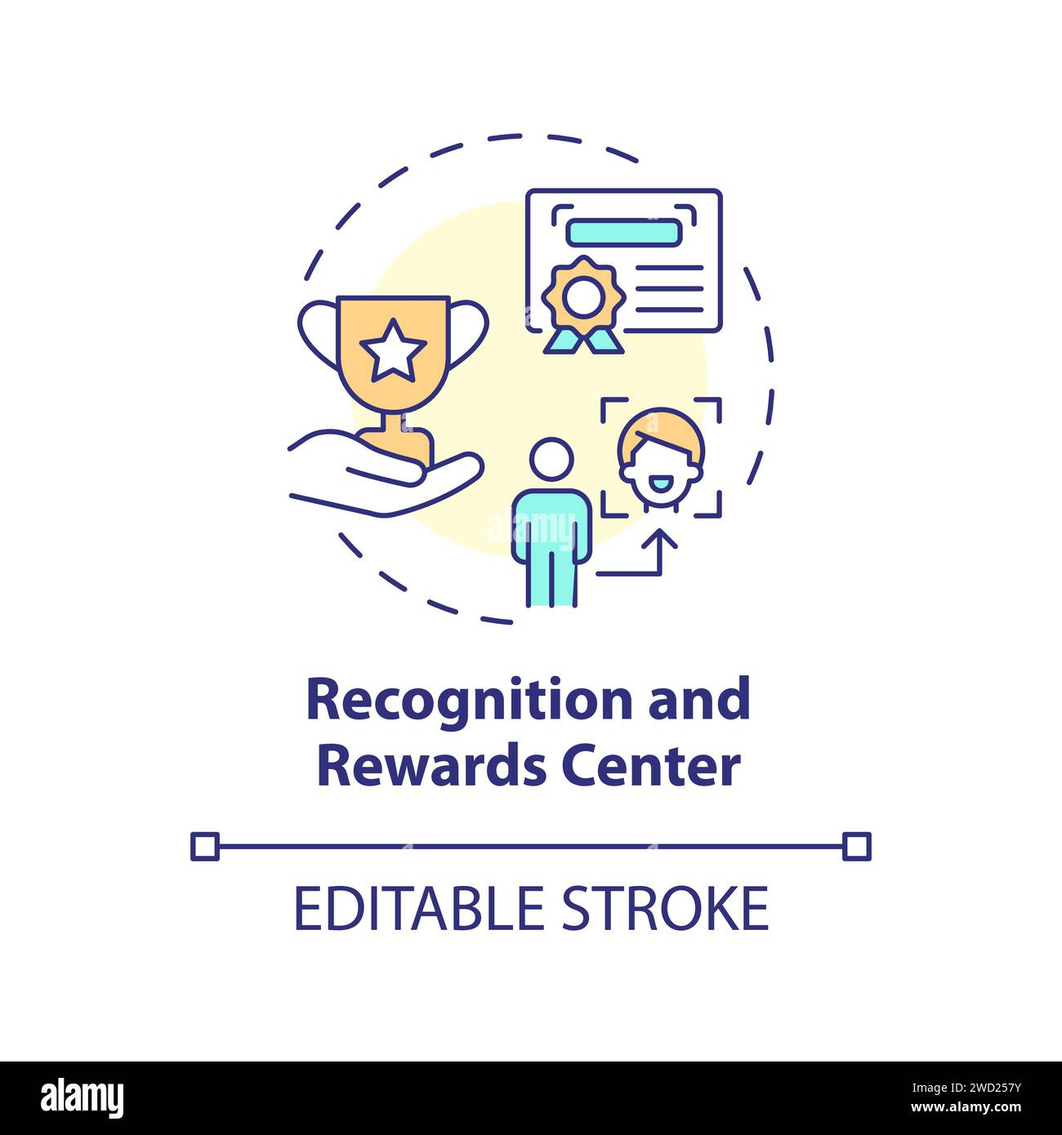
Reward & Recognition
What it means:
Reward and recognition show appreciation for good work, performance and positive behaviour.
Why it matters:
Helps meet Maslow’s “esteem” and “belonging” needs, making people feel valued (Green, 2020).
Increases motivation and job satisfaction (Herzberg, 2021).
Creates a positive team culture where people support each other.
Examples:
Verbal praise
Positive feedback
Highlighting good performance in team meetings
Small rewards or appreciation messages
Impact:
Better morale → better teamwork → better customer service.

Slide 3
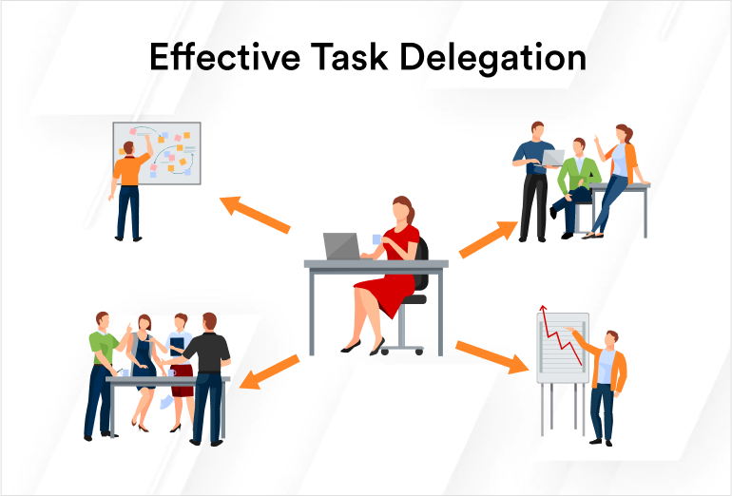
Delegation in Teamwork
What delegation is:
Giving responsibility or tasks to team members based on their skills and strengths.
Why it matters:
Builds trust within the team (Adair, 2020).
Helps employees grow new skills and confidence (Northouse, 2021).
Reduces workload stress on supervisors and improves teamwork efficiency.
Improves time management during busy periods.
Examples in workplace:
Letting a skilled colleague handle colour-mixing
Asking someone confident with customers to handle questions
Sharing tasks fairly based on ability

Slide 4
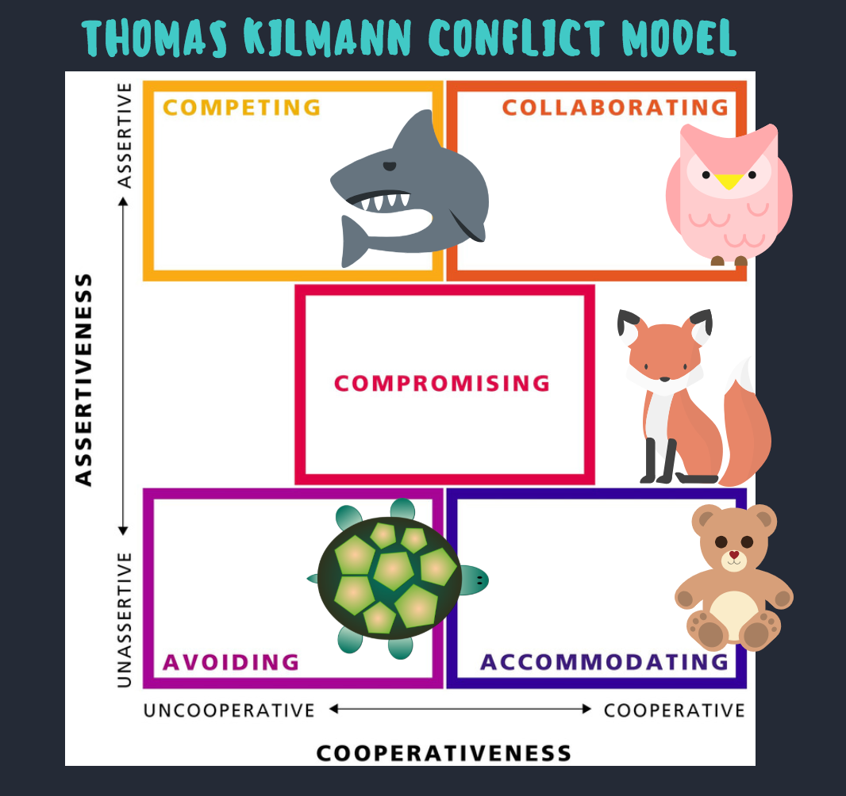
Conflict Management & Resolution Strategies
Why conflict happens:
Busy environments, stress, misunderstandings, unclear roles.
Useful theory: Thomas-Kilmann Conflict Styles (Kilmann, 2021)
Shark (Forcing) – pushing own way
Turtle (Avoiding)
Teddy Bear (Accommodating)
Fox (Compromising)
Owl (Collaborating) → best for teamwork
Best strategies for resolving conflict:
Use collaboration (Owl) instead of forcing
Active listening and clear communication
Staying in the “Adult” state of the PAC model to avoid emotional reactions (Larsen, 2023)
Recognising early signs of conflict and addressing them professionally
Result:
Better relationships, less stress, and stronger teamwork.

Slide 5
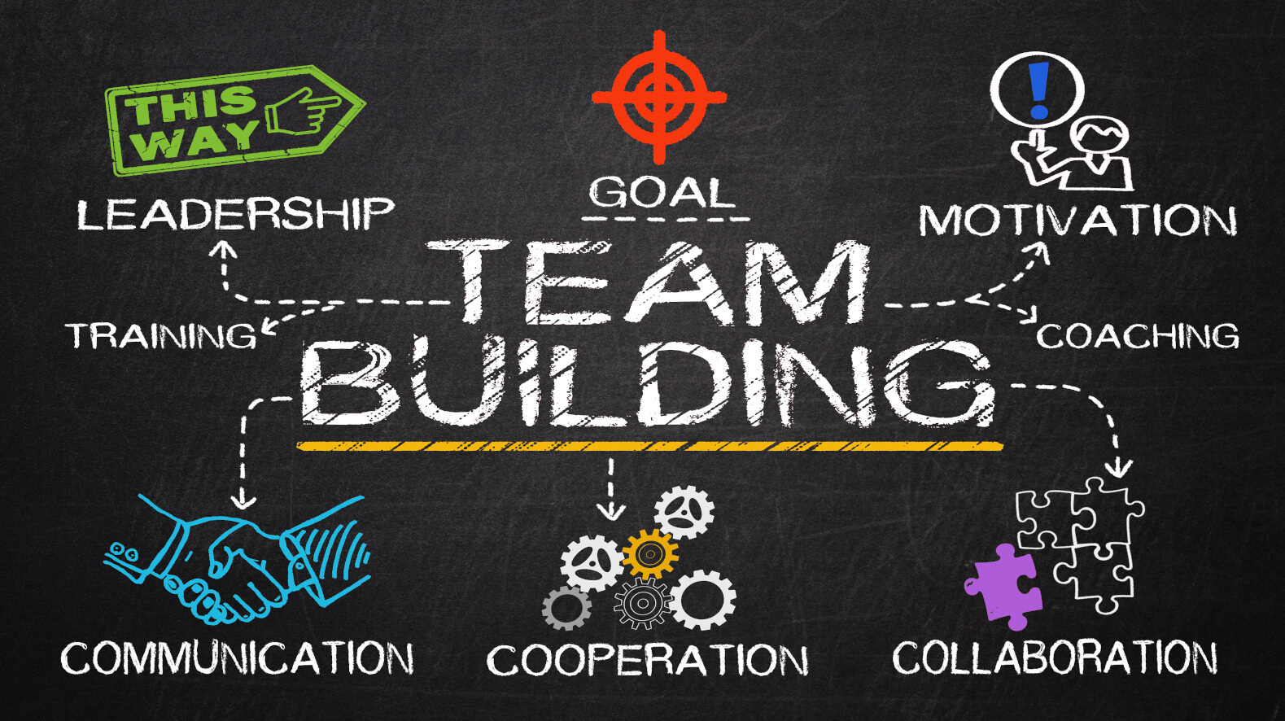
Building a Strong Team
To improve teamwork, teams should:
Use reward and recognition to motivate and support people
Delegate tasks fairly and based on skill
Manage conflict early using collaboration and calm communication
Apply teamwork theories such as Maslow, Herzberg, Adair and Thomas-Kilmann
Encourage clear communication to avoid misunderstandings
Overall message:
Strong teamwork is created through respect, motivation, trust and good communication.

Slide 6
REFERENCES:
Adair, J. (2020) Action-Centred Leadership for Today’s Workplace. London: Kogan Page.
Green, T. (2020) ‘Maslow’s needs in workplace communication’, Workplace Behaviour Review, 11(2), pp. 30–39.
Hartley, S. (2021) ‘Herzberg’s motivation theory in retail environments’, International Journal of Modern Management, 14(1), pp. 88–97.
Kilmann, R. (2021) Applying the Thomas-Kilmann Conflict Styles. California: TK Publications.
Larsen, P. (2023) ‘Using the PAC model to improve communication at work’, Journal of Applied Psychology, 18(1), pp. 71–83.
Northouse, P. (2021) Leadership: Theory and Practice. 10th ed. London: Sage.

