Slide 1

BA Management Skills for the Workplace
EMPL5003
Understanding & Engaging in the Customer Experience
Session 1

Slide 2

THE CUSTOMER CONUNDRUM
Service, servility, satisfaction, and then what?
Piercy, N. (2002 Market led strategic change)

Slide 3
EMPL5003
Critically analyse the factors that impact on your organisations ability to maximise customer value.
(40%)

Slide 4
EMPL5003
What is Critically?
What Factors?
Who said what about Factors?
What maximises customer value?
What is customer value? Who said?
Where does your own organisation fit in?

Slide 5
EMPL5003
Critical understanding of your organisations quality processes and its effectiveness in meeting customer requirements.
(40%)

Slide 6
EMPL5003
What is Critical Understanding?
What quality systems do your organisation and others have?
How do they work? Do they work? Are they effective?
What do the customers want?
Who are your customers?

Slide 7
EMPL5003
Evidence of wide reading and research, encompassing application of relevant academic theories and models.
(10%)

Slide 8
EMPL5003
Evidence in depth
High quality research has been demonstrated throughout the assignment
Using relevant theorists
Using a variety of quality resources (web, book, article, newspaper, TV, etc)

Slide 9
EMPL5003
Citation/ referencing, report structure, syntax, grammar and punctuation.
(10%)

Slide 10
EMPL5003
Correct citation in the text
Good and quality Bibliography
Laid out well, including a front page
Runs logically throughout
Spelling, grammar and punctuation correct

Slide 11
The Customer Is Always Right-Handed – The Comments
If company boards do not care about customers, why should anyone else?
Customer service is bad just about everywhere
  “we know better than the customer”
  “customers are stupid”
  What happened to carriage makers & ship builders?
What is it like dealing with our company?
Try the Service Encounter Diary

Slide 12
The Customer Is Always Right-Handed – Service Encounter Diary
Starbucks | Silver Spring (Metro Station) USA
Nothing like stopping in a place, early Monday morning, to get your favorite beverage, where not only do they know your name, but they know what your drink as well.
That’s exactly what this place provides, an experience that leaves me feeling refreshed and refueled all day.
Can’t seem to remember that special concoction that the Barista whipped up for you the following week? No Problem— these professionals got it covered, remembering every detail, down to Soy Milk or Non-Fat.
I am happy to use that service anytime.

Slide 13
Customer Satisfaction and Customer Loyalty
The goal is really customer loyalty/retention because?
  retention enhances profitability dramatically
  costs of acquiring new customers are higher than costs of retaining old customers
  it maximizes customer lifetime value
  the causes of customer defection are often directly actionable

Slide 14
Customer Satisfaction and Customer Loyalty
The result has been massive growth in customer loyalty programmes- such as?
There are two problems with this?
  customer satisfaction and customer loyalty are not the same thing?
  you cannot buy real loyalty that easily?

Slide 15
The Big Fat Lie About Satisfaction and Loyalty
The big fat lie was that satisfied customers will be loyal customers
In most markets, customer satisfaction drives loyalty only for some customers, not all.
Give examples?

Slide 16
The Big Fat Lie About Satisfaction and Loyalty
Customer loyalty?
is about how long we keep a customer (or the share we take of their business)
Customer satisfaction?
is what people think/feel about us.

Slide 17
The Big Fat Lie About Satisfaction and Loyalty
Combining the behaviour (customer loyalty) with the attitude (customer satisfaction) identifies:
  Satisfied stayers
  Happy wanderers
  Hostages
  Dealers

Slide 18
Customer Satisfaction Versus Customer Loyalty
Customer Loyalty
High
Low
Satisfied
Stayers
Happy
Wanderers
High
Customer
Satisfaction
Low
Hostages
Dealers

Slide 19
Customer Satisfaction Versus Customer Loyalty – You & your shop
Think of one of your favourite shops
Where is it / where do you live?
What makes you go back there?
Think of one of your worst shops
Where is it / where do you live?
What makes you go there?

Slide 20
The Reality of Customer Satisfaction and Loyalty?
Investments in customer satisfaction produce loyalty only for a sub-set of customers?
But customer dissatisfaction is a good predictor of customer defection?
Satisfaction and dissatisfaction are different things (not either end of the same scale)

Slide 21
The Reality of Customer Satisfaction and Loyalty?
We need to understand better why some customers leave and others stay?
Avoid simplistic assumptions about customer satisfaction and loyalty
This is the basis for making effective investments in customer satisfaction, relationship marketing and loyalty programmes

Slide 22



Any Questions
22

Slide 23

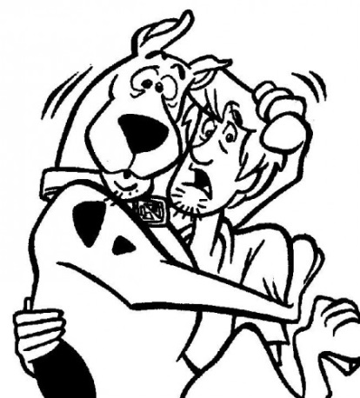
By Next Session
Watch P&O Get hot on service for discussion at the next session, looking at the what, where, why, who, etc. Discuss thoughts.
Discuss your “feelings” about the customer service of your organisation.
Remember that if you do what you do, you’ll get what you always got

