Slide 1

Patients’ perspective on the therapeutic relationship and session quality: the central role of alliance - Frontiers in Psychology.
Stefana et al.(2024)
By Ruby Bretos

Slide 2
Background of study
The discussion is based on a study conducted by Stefana and colleagues, published by Frontiers in Psychology.
From the patient's perspective, this relationship is shaped by numerous key components, including the work alliance, the real relationship and both positive and negative affective reactions toward the therapist.
Therapeutic relationships also offer essential support and can protect clients from potential negative effects associated with therapeutic services.
Clients' subjective experiences of the alliance provide valuable insight into how therapy is perceived and whether it is experienced as effective.

Slide 3
Objectives of the study
To examine the association between key components of the therapeutic relationship and session outcomes from the patients’ perspective.
To investigate how each of these components individually connects with session quality, as well as how they interact as a system within patients’ experiences of therapy.
To identify whether items measuring different components of the therapeutic relationship could be congregated into distinct underlying factors, and how these factors might characterise meaningful dimensions of the therapeutic relationship as perceived by patients.

Slide 4
Method – partcipants
The study consisted of 700 adults who had received psychotherapy in the United States. Most of the participants (70%) received treatment in private practice settings. 11% of participants were treated in private health institutions, 10% of the participants were treated within public health settings, and lastly, 9% of participants were treated in other settings, such as university counselling centres.
The study included 564 females and 136 males. The primary age groups represented were 23-29 years and 30-39 years. The majority of participants were Caucasian, comprising 556 participants.
A large number of the participants have previously received a diagnosis of at least one psychiatric ailment. 66% of participants stated they have anxiety, and 56% of participants stated they have unipolar depression, these being the most prevalent conditions. The participants have all experienced different types of psychotherapy.

Slide 5
Method – Procedure
Data was collected from September to November 2023 through two online patient registries, Research for Me and Research Match.
Participants had to be over 18 to participate in the study, and all participants experienced individual psychotherapeutic treatment.
All participants had to be fluent in English and capable of providing informed consent.
After consenting, participants underwent a baseline evaluation of their most recent therapy session. The survey was carried out using Qualtrics software.

Slide 6

Method – measures
Patients firstly completed the Working Alliance Inventory-Short Revised, WAI-SR, which obtained information on agreement to tasks, goals and the affective bond between the patient and the therapist.
Secondly, they completed the Real Relationship Inventory-Client-Short Form; WA-ISR, which measured the perception of strength of the real relationship between the patient and therapist from the perspective of the patient.
The cross-sectional design used correlational and regression analyses to assess relationships among the variables, and EFA to explore factor structure. Although not longitudinal, the sample size and use of validated tools strengthen the study’s empirical value.

Slide 7
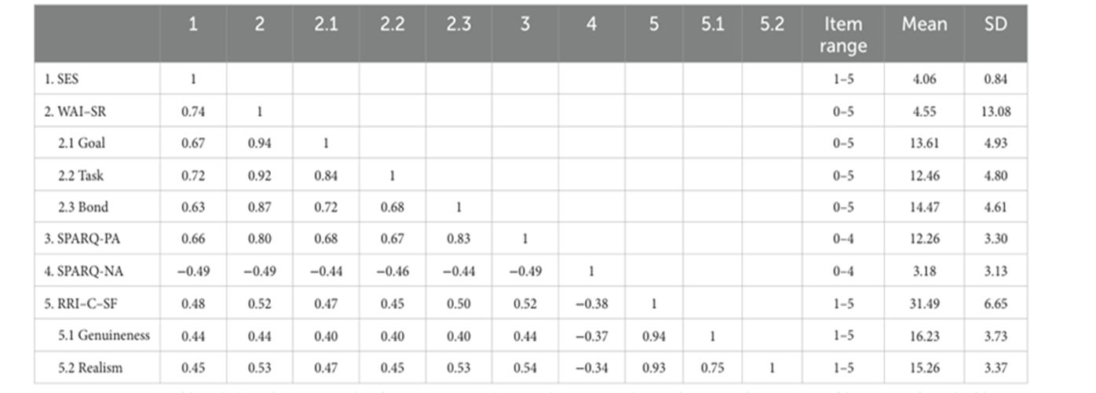
Results
The results show that participants generally reported moderate to high levels of working alliance, real relationship and positive affective reactions toward the therapist. Negative affective reactions were reported at relatively lower levels. Overall, patients rated their most recent therapy as positive, demonstrating commonly positive perceptions of session quality across the sample.
The means, variable ranges and SDs for the variables included in this study are presented in Table 1 below.

Slide 8
Results – Pearson correlation analyses
Working alliance, real relationship and positive affective reactions were all positively associated with session quality, showing that greater perceived relational quality was correlated with positive evaluations of the therapy session.
Negative affective reactions toward the therapist were negatively associated with session quality, indicating that feelings such as discomfort, mistrust and tension were correlated with inadequate session experiences.
Strong positive correlations were discovered within relational variables themselves. Working alliance was positively correlated with both real relationship and positive affective reactions, while, in contrast, negative affective reactions were associated with all other components of the therapeutic relationship.

Slide 9

Results – regression analysis
A multiple regression analysis was performed to examine the unique contribution of each component of each relational component to session quality. The four components collectively explained 30% of the variance in session outcome, with working alliance showing the strongest predictor of session quality.
Positive reactions made a significant positive contribution, while negative affective reactions contributed negatively to the session outcome.
The real relationship was positively associated with session quality at the correlational level, indicating a weaker unique contribution when other relational variables were controlled.

Slide 10

Results – Explatory factor analysis
An exploratory factor analysis was used to examine the underlying structure of the therapeutic relationship measures. The four components were analysed, displaying that items related to the bond component of the working alliance present an overlap with positive affective reactions, indicating that emotional closeness and warmth may be experienced by patients as affective rather than purely collaborative aspects of the alliance.
Overall, the results show that patients’ perceptions of session quality are strongly associated with numerous dimensions of the therapeutic relationship. While emotional and authentic aspects of the relationship are significant, the working alliance, specifically agreement on tasks and goals, plays a central role in shaping how patients evaluate the effectiveness of the therapy session

Slide 11
Discussion
Firstly, from a psychodynamic perspective, the strong link between therapeutic alliance and session quality is not surprising. There is much literature which states that alliance is seen as essential for creating a safe space, and when patients experience a strong working alliance, they are more likely to feel secure enough to explore difficult feelings and relational patterns.
. Negative feelings towards the therapist may reflect transference responses rather than simply poor therapy. The study was cross-sectional, so it cannot show whether these negative reactions were later explored and resolved in a way that improved therapy. This limits the ability to understand the longer-term consequences of discomfort, which psychodynamic counselling views as essential for change.
The findings of the study greatly align with person-centred counselling, where the therapeutic relationship is considered a necessity to change. The value of the real relationship in predicting session quality supports Carl Roger’ emphasis on genuineness and congruence. When clients recognise the therapist as authentic and emotionally present, sessions are more likely to be positively experienced.

Slide 12
Discussion - strengths
One of the central contributions of the study was its focus on the patient’s perspective. This is consistent with both psychodynamic and person-centred values and reflects ethical practice in counselling.
The large sample size and use of validated measures also strengthen the reliability of the findings.
Furthermore, considering various aspects of the therapeutic relationship provides a more nuanced understanding than studies that focus specifically on the working alliance.

Slide 13
Discussion - limiations
The cross-sectional design means we cannot conclude causality or how the therapeutic relationship develops over time. This is particularly important for relational therapies, where depth and trust are often progressively built.
The reliance on self-report measures may oversimplify complex relational dynamics, and the lack of therapist perspectives can potentially limit an advanced understanding of the therapeutic process.
Within this study, the majority of participants were Caucasian and based in the United States, which reflects Western individualistic values that prioritise emotional expression and collaborative goal setting. These societal norms may not apply consistently across different cultures, particularly in collectivist contexts where authority and restraint are valued differently.

Slide 14

Conclusion
The findings demonstrate that multiple dimensions of the therapeutic relationship, including working alliance, real relationship and affective reactions towards the therapist, are significantly linked with patients’ perceptions of session quality. The working alliance arose as the strongest predictor, emphasising its key role in the therapeutic session.
The findings also reinforce the clinical and ethical importance of prioritising the therapeutic relationship in counselling practice, while encouraging therapists to remain flexible and culturally responsive.
Future research should address limitations by adopting longitudinal designs that track changes in the therapeutic relationship and session quality across sessions. Additionally, future research should include culturally diverse samples and observe how cultural values influence perceptions of alliance, authentic and affective reactions.

