Slide 1

Change and Stability Management - 759 store
Leung Hon To (2133985)

Slide 2
Table of Content
Background of 759 store
Business environment of 759 store
Change Approach: Kotter's Eight-Step Plan
Evaluation of the change program
Effects on organizational operation
Summary
Reference

Slide 3
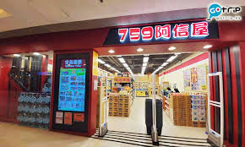
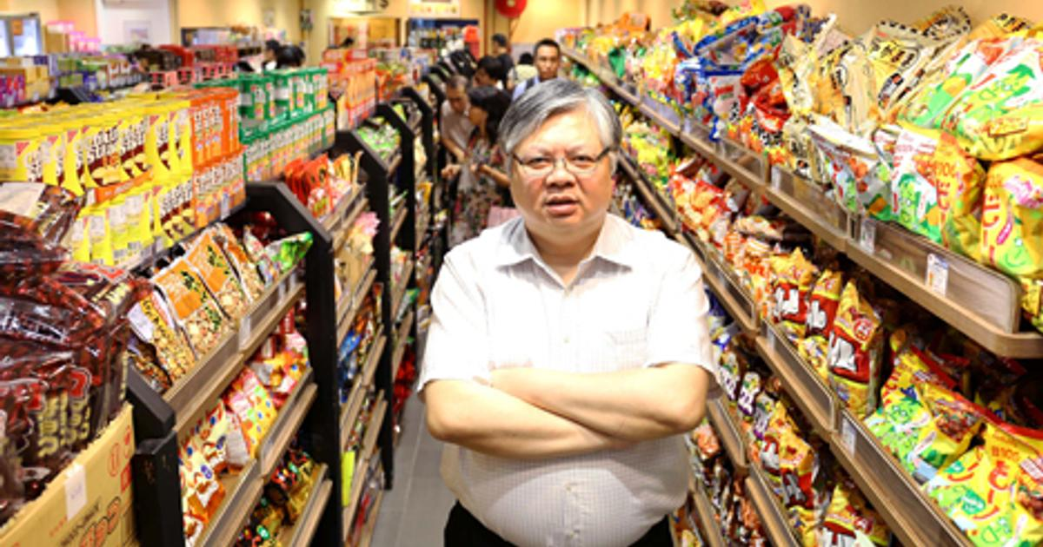
1. Background of 759 store
759 Store derives its name from the HKEx stock code of its parent company, CEC International Holdings Limited, which has been listed on the Main Board of the HK Stock Exchange since 1999 (759 Store Limited, 2023)
Hong Kong-based chain of convenience stores
Founded in 2010 (759 Store Limited, 2023)
Offers a wide range of products, including snacks, drinks, household items
Stores are mainly located in residential areas or shopping malls (CEC-COILS, 2022)
As of the end of 2022, it operated a total of 166 stores. During the period, 9 stores were closed and 3 new stores were opened, with an actual net decrease of 6 stores (759 Store Limited, 2023)

Slide 4
1. Background of 759 store
Talbe1: 759 store performance after COVID 19
(In million HKD) | 2018 | 2022
 | (Before COVID19) | (After COVID 19)
Total store number | 206 stores | 166 stores (-19%)
Total staff number | 1900 staff | 855 staff (-55%)
Revenue HK$’000 | 1,979,674 | 2,008,967 (+1%)
Revenue per store | 9,610 | 12102 (+26%)
Revenue per staff | 1,042 | 2350 (+126%)
Source: Constructed by the author.
Source: Constructed by the author.
Before COVID-19, 759 Store expanded excessively and affecting the cash flow. During COVID-19, they closed low-profit stores and reduced manpower to maintain profitability (CEC-COILS, 2022).

Slide 5

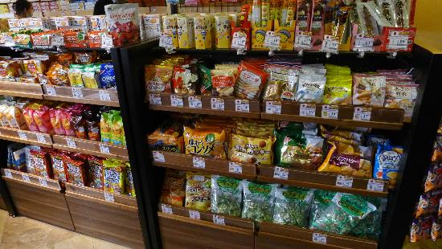

2. Business environment of 759 store: COVID-19 & online shopping
In Hong Kong, the retail industry has been significantly impacted by the COVID-19 pandemic. The Bread, Pastry, Confectionery and Biscuits sales volume in February 2023 decreased by 5.5% year-on-year(Census and Statistics Department, 2023).
The pandemic has also accelerated the shift towards online shopping in Hong Kong. According to a survey conducted by Statista, 31% of respondents in Hong Kong stated that they were shopping more frequently online since the outbreak of COVID-19 (Statista, 2021).
The rapid digitalization and changing consumer behavior have also posed significant challenges to the company. With the rise of e-commerce and online shopping, consumers have more options to purchase products at competitive prices. Moreover, the COVID-19 pandemic has accelerated the shift towards online shopping, resulting in a decline in foot traffic for physical stores (Statista, 2023).

Slide 6
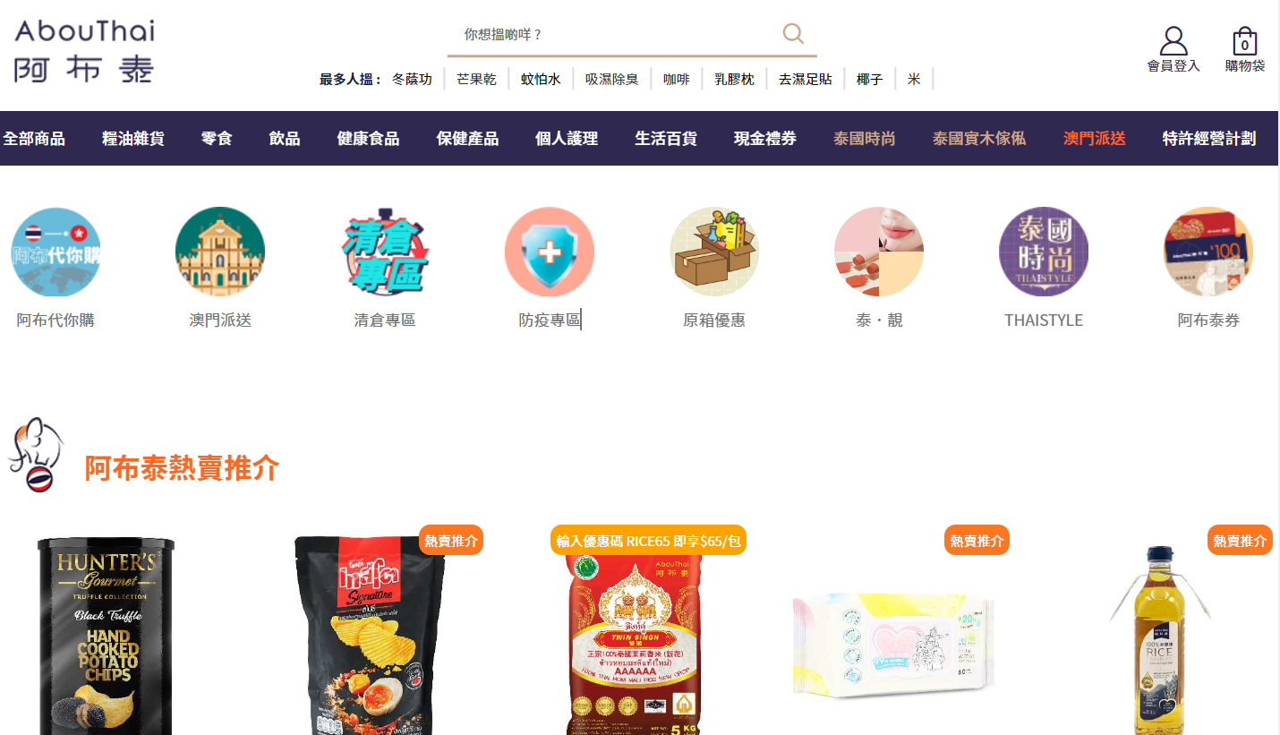
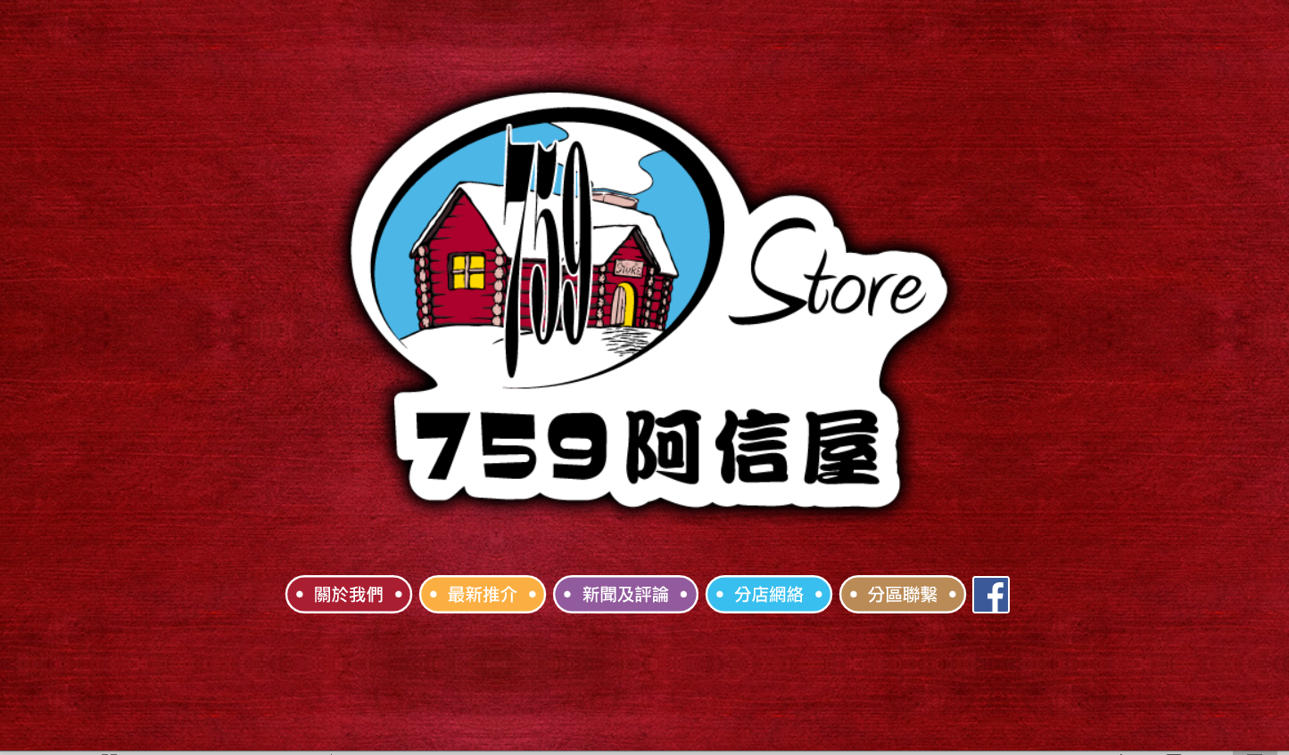
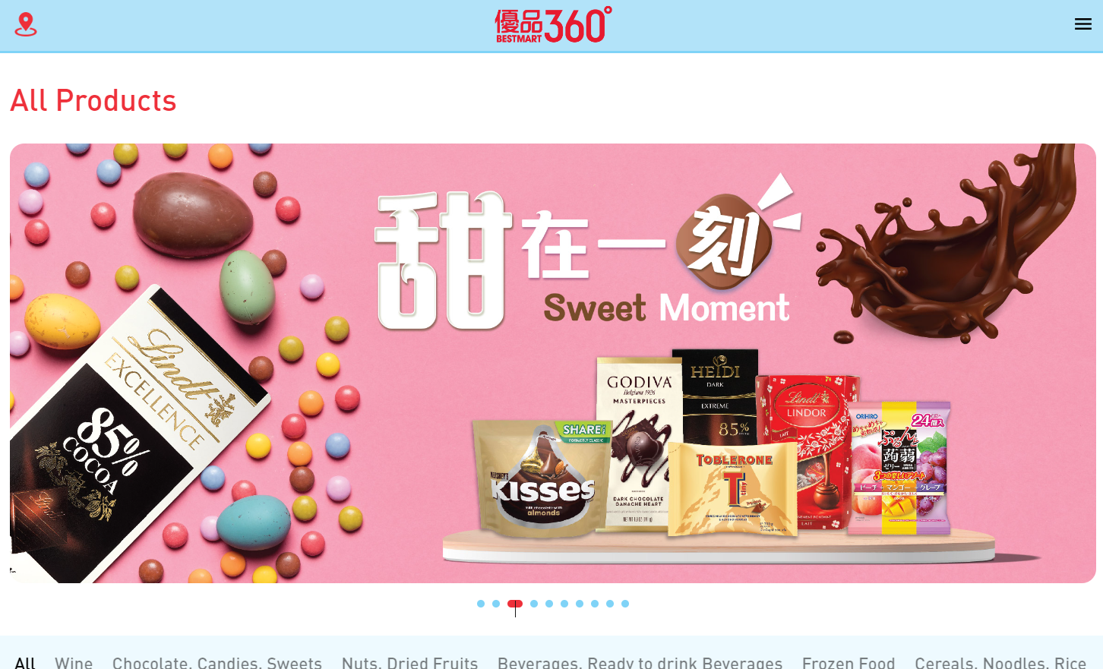
2. Business environment of 759 store: Competitors
With rise of e-commerce and changing consumer preferences. 759 Store, in particular, has faced increased competition from convenience stores such as AbouThai and Bestmart360, which offer a wider range of products and more convenience to customers in their online shop (AbouThai, 2023) (Best Mart 360˚, 2023).

Slide 7

2. Business environment of 759 store: Why it happen? “The Death Spiral"
"The Death Spiral" is a term used to describe a situation where a company experiences declining revenue and profit, which leads to cost-cutting measures such as reducing staff and store closures, which in turn leads to further decline in revenue and profit. This creates a vicious cycle that can ultimately lead to the company's demise (Christensen, 2013).
In the case of 759 store, the company had expanded aggressively before the COVID-19 pandemic, but was forced to close low-profit stores during the pandemic and reduce staff to maintain profitability. This has resulted in declining revenue and profit, which could potentially lead to a death spiral if the company is unable to turn things around (CEC-COILS, 2022).
This decline can also lead to further negative consequences, such as reduced capacity to invest in marketing, supply chain optimization and employee training, making it more difficult for 759 store to adapt and compete in the market. This cycle of decline and negative consequences may ultimately lead to the demise of 759 store as it becomes increasingly unable to compete with other companies that have successfully adapted to the changing business environment.
In the case of 759 Store, the shift to online sales and the implementation of a change program may have been a response to external challenges, such as the growth of e-commerce and the COVID-19 effect. By implementing a change program and moving towards online sales, 759 Store may able to break free from this potential death spiral and regain its footing in the market. This change program likely included efforts to improve the company‘s online presence, optimize its supply chain and logistics, and develop new marketing strategies such as online shop to reach a wider customer base and offer a seamless shopping experience to its customers. These efforts may help the company stay competitive in the face of new challenges and avoid a decline that could have ultimately led to its demise.

Slide 8
3. Change Approach: Kotter's Eight-Step Plan – create a climate for change
To manage the external challenges and adapt to the changing business environment, 759 Store can consider using Kotter's Eight-Step Plan for Implementing Change and provides insights into why change efforts often fail and how the framework can help address common pitfalls. (Kotter, 2007).
Create urgency
The initial step is to establish a sense of urgency among stakeholders by effectively communicating the necessity for change and the negative consequences of not taking action. Kotter highlights that neglecting to create a sense of urgency is the most significant mistake organizations make when attempting to implement change (Kotter, 2008).
Form a powerful coalition
The next step involves creating a coalition of important stakeholders, with a particular focus on executive director such as Ms. TANG Fung Kwan (Chairman and Managing Director) and Mr. HO Man Lee, who are responsible for the Group's IT development and implementation (CEC-COILS, 2022).
To committed to the change initiative and can provide the necessary leadership and resources. This coalition also include top management, department heads, and key employees who can drive the change initiative.
To apply this step to 759 Store, the urgency could be conveyed by emphasizing the impact of the COVID-19 pandemic and the rising trend of online shopping on the Hong Kong retail industry.

Slide 9
3. Change Approach: Kotter's Eight-Step Plan – create a climate for change
Create a vision for change
The third step in the change process involves establishing a well-defined and persuasive vision that is consistent with the strategic objectives and values of 759 Store. This may involve outlining the company's digital transformation objectives and determining the specific measures that must be taken to achieve these goals. Creating a vision and receiving support for projects was not particularly contentious. This is due to the widespread recognition of the need for change (Cao, Clarke, and Lehaney, 2004).
Communicate the vision
The fourth step in the change process is to communicate the vision and the importance of change to all stakeholders through various channels such as town hall meetings, emails, and other forms of internal communication. This will facilitate understanding and ensure that everyone in the organization, including 759 Store, is aware of the vision and the reasoning behind the change program..
Offering additional choices of snacks, food groceries, household and personal care products to customers online and offline. This vision should be communicated to all stakeholders to ensure alignment and buy-in.
This step is one of the most critical stages in Kotter's process is the need to effectively communicate the change to all stakeholders (Ansari and Bell, 2009).

Slide 10
3. Kotter's Eight-Step Plan – engaging & enabling the organization
Empower action
The fifth step involves enabling employees to act on the vision by eliminating barriers, providing the required resources and training, and appointing a coach. In 759 case could be providing online store training to front-line staff to promote the online store, as well as ensuring that the success of the online store is shared with physical store staff. This step is critical in empowering employees to take ownership of the change initiative and ensuring its success.
Create quick wins
The next step involves creating short-term successes that showcase the progress of the change initiative and encourage employees to remain committed. For instance, this could involve launching the online store or app and meeting sales goals within the first few months, as well as sharing commission with physical store staff as a way of incentivizing them to promote the online store.
Attending training sessions by all coaches is crucial to ensure their performance and to build momentum towards effective implementation of the change initiative (Lubit, 2001).

Slide 11
3. Kotter's Eight-Step Plan: implementing & sustaining for change
Build on change
The seventh step is to consolidate the gains achieved through the change initiative and build on them by producing more change. This could include expanding the product offerings or optimizing the supply chain to improve efficiency.
Make it part of the culture
The last step is to integrate the new approaches into the company's culture by incorporating them into the organization's values, policies, and procedures. To ensure the sustainability of the change initiative in the long run. However, it should be noted that evaluating stages 7 and 8 are hard to evaluate (Appelbaum et al. 2012).

Slide 12
4. Evaluation of the change program
Improved customer experience: By moving online, 759 Store was able to provide customers with a more convenient and accessible shopping experience. This could lead to increased customer satisfaction and loyalty (Briedis et al. 2020).
Increased agility: By successfully adapting to the changing business environment, 759 Store has shown that it can be agile and responsive to new challenges, which is essential for long-term success.
Improved operational efficiency: Moving online may have also allowed 759 Store to improve its operational efficiency, such as through automated processes or reduced overhead costs (Hwangbo, Kim and Cha, 2017).
Conflict with physical store: Revenue per store may decrease and led to lost of commission of physical store staff -> Must ensure the success of online store share with physical store staff
Resource requirements: Moving online can require significant resources, including investments in technology, marketing, and logistics. If the company did not allocate sufficient resources to the change program, it may not have been able to achieve its intended goals.
Cons
Pros
Improved customer experience
Conflict with physical store
Increased agility
Resource requirements
Improved operational efficiency

Slide 13

5. Effects on organizational operation
1. Shift in resources and operations to manage both the existing physical stores and the new online platform:
This required changes in the way the company managed its supply chain, inventory management, and logistics, as well as changes in staffing and training to ensure that the company's employees were equipped to handle the new demands of the online platform.
2. Required the company to invest in new technologies and infrastructure to support its online presence:
This included the development of an online platform, digital marketing campaigns, and new payment and delivery systems. These investments required a significant financial commitment from the company and a willingness to take risks in order to succeed in the new online market.
3. More flexible and adaptive approach to business operations required changes in the way the company managed its workforce:
The company had to foster a culture of innovation and experimentation, which required a shift towards a more collaborative and open approach to decision-making. This helped to create a more dynamic and fast-paced environment that encouraged creativity and risk-taking.

Slide 14

5. Summary
With the rise of e-commerce and online shopping, consumers have more options to purchase products at competitive prices. Furthermore, the COVID-19 pandemic has accelerated the trend towards online shopping.
759 store is on a - “The Death Spiral" - the company had expanded aggressively before the COVID-19 pandemic, but was forced to close low-profit stores during the pandemic and reduce staff to maintain profitability.
759 Store can launch an online store to reach a wider customer base and offer a seamless shopping experience to its customers By using the change Approach: Kotter's Eight-Step Plan.
The benefit of the change program can enhance customer experience, boosting agility, and improving operational efficiency in 759 store.
The change will affect the operation by shifting in resources, require investment, create a new young company image

Slide 15
6. References
AbouThai (2023) All Products Available at: https://www.abouthai.com/search?zserialid=NAV202201120016&caption=%25E5%2585%25A8%25E9%2583%25A8%25E5%2595%2586%25E5%2593%2581 (Accessed: 12 April 2023).
Ansari, S. and Bell, J. (2009) Five easy pieces: a case study of cost management as organizational change. Journal of Accounting & Organizational Change.
Appelbaum, S. H., Habashy, S., Malo, J. L., and Shafiq, H. (2012). Back to the future: revisiting Kotter's 1996 change model. Journal of Management development, 31(8), 764-782. Available at: https://www.researchgate.net/profile/Steven-Appelbaum/publication/242339672_Back_to_the_future_Revisiting_Kotter's_1996_change_model/links/0f31752f14502e718d000000/Back-to-the-future-Revisiting-Kotters-1996-change-model.pdf (Accessed: 19 April 2023).
Best Mart 360˚ (2023) All Products Available at: https://www.bestmart360.com/index.php?route=product/category (Accessed: 12 April 2023).
Briedis, H., Kronschnabl, A., Rodriguez, A., and Ungerman, K. (2020). Adapting to the next normal in retail: The customer experience imperative. Available at: http://dln.jaipuria.ac.in:8080/jspui/bitstream/123456789/1510/1/Adapting-to-the-next-normal-in-retail-the-customer-experience-imperative.pdf (Accessed: 19 April 2023).

Slide 16
6. References
Cao, G., Clarke, S. and Lehaney, B. (2004) The Need for a Systemic Approach to Change Management - A Case Study. Systemic Practice and Action Research 17:103-126.
CEC-COILS (2022) 2021/2022 Anual Report Available at: http://www.0759.com/doc/art/finance/2022082201/202208220001.pdf (Accessed: 12 April 2023).
Census and Statistics Department (2023) Report on Monthly Survey of Retail Sales Available at: https://www.censtatd.gov.hk/en/data/stat_report/product/B1080003/att/B10800032023MM02B0100.pdf (Accessed: 12 April 2023).
Christensen, C. M. (2013) The innovator's dilemma: when new technologies cause great firms to fail Harvard Business Review Press. Available at: http://dspace.vnbrims.org:13000/jspui/bitstream/123456789/4699/1/The%20Innovator%27s%20Dilemma%20When%20New%20Technologies%20Cause%20Great%20Firms%20to%20Fail%20%28Management%20of%20Innovation%20and%20Change%20Series%29.pdf (Accessed: 12 April 2023).
Hwangbo, H., Kim, Y. S., and Cha, K. J. (2017). Use of the smart store for persuasive marketing and immersive customer experiences: A case study of Korean apparel enterprise. Mobile Information Systems, 2017. Available at: https://www.hindawi.com/journals/misy/2017/4738340/ (Accessed: 19 April 2023).

Slide 17
6. References
Kotter, J. P. (2007). Leading change: Why transformation efforts fail. In Museum management and marketing (pp. 20-29). Routledge. Available at: https://www.scinapse.io/papers/2134648895 (Accessed: 12 April 2023).
Kotter, J. P. (2008) A sense of urgency. Harvard Business Press Available at: https://kingdomwayministries.net/wp-content/uploads/2016/12/A_Sense_Of_Urgency_Change_Final.pdf (Accessed: 15 April 2023).
Lubit, R. (2001). Tacit knowledge and knowledge management: The keys to sustainable competitive advantage. Organizational dynamics.
Statista (2021) Share of consumers who increased their online shopping frequency and amount during coronavirus COVID-19 in Hong Kong in 2020, by category Available at: https://www.statista.com/statistics/1222612/hong-kong-change-in-frequency-and-amount-of-online-shopping-during-covid/ (Accessed: 12 April 2023).
Statista (2023) eCommerce - Hong Kong Available at: https://www.statista.com/outlook/dmo/ecommerce/hong-kong (Accessed: 12 April 2023).
759 Store Limited (2023) About Us Available at: https://www.759store.com/aboutus.php (Accessed: 12 April 2023).

