Slide 1
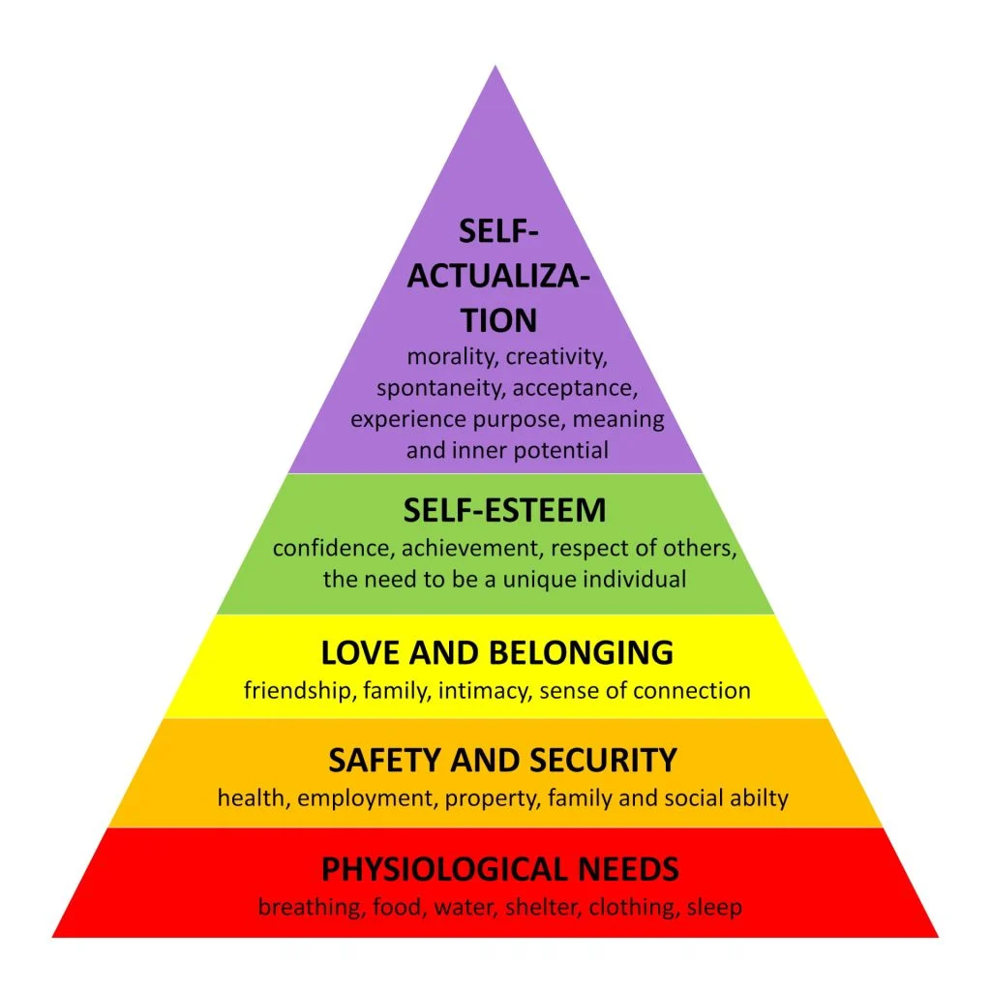
2218320
Health, Well-being and lifestyles
Word count: 2169
Introduction
The following poster will consider and identify the meanings of health, well-being and lifestyles and why these concepts are important in the early years. Additionally, throughout this poster there will be relevant links to different theorists and their models and how early years practitioners can implement and help to support children’s health, well-being and lifestyles through practice in order to help develop children’s holistic development. The poster will also discuss the linking between health, well-being and lifestyles and how they all connect. Berlinski and Norbert (2015) highlight that by early years practitioners having a good bond with young children this can create a foundation for positive well-being for young children.
Health
Defining what is meant by the word health can be challenging. Part of the difficulty related with the understanding of health is the fact that there is no general definition of what it is (Musgrave, 2017). The World Health Organization (WHO) (2023) health is not only described as an absence of chronic illness or disease but having complete state of mental, physical, social and well-being. However, Bradshaw (2016) implies that mental health in children include their psychological, emotional and social well-being, all of these will affect how a child is feeling and thinking, this all contributes to how a child will also behave.
According to Action for children (2023) young children living in low deprived areas or living in poverty can face several effects on their physical and mental health. Action for children (2023) highlight how families living in poverty will be less likely to be able to provide young children with the necessities such as food and heating. Children will also face food uncertainties and may be living in cramp situations, all these issues will have an impact on young children’s mental and physical health (Action for Children, 2023). Likewise, Musgrave (2017) indicates that children whose families are living in poverty tend to have poor health. The lower the socioeconomic background the child comes from, the higher the risk is for poor health (Musgrave, 2017). If young children live in more deprived areas and their parents or carers are on a low income then it is expected that they will be feeling stressed and worried which will then have a negative effect on their mental health, this can also have a negative effect on a child’s physical health (Maholmes, 2014).
The Marmot Review (2010) suggest that what young children are exposed to in their early years life lays down a foundation for the remainder of their lives up to adolescence. Children’s physical, social, cognitive and emotional development during their childhood years have a strong impact in their school and educational years (the Marmot Review 2010). Research shows that if young children who fall behind in their cognitive development when they are younger are more likely to fall behind in school with their education (The Marmot Review 2010). Evidence shows that young children who develop early cognitive ability are more likely to be successful in their education and maintain better health as adults (The Marmot Review 2010).
It is significant for young children to have good health at a young age as research from World Health Organisation (2022) recommends that children must be living in a stable environment where they can thrive and be nourished properly and cared for in order to help them to develop properly and have a good start in life. Providing young children with a strong emotional support system at a young age reduces the risk of delayed growth and development and therefore decreases the possibility of having poor physical health as well as poor cognitive and emotional health in adulthood (Musgrave, 2017).
(Source: Simply Psychology, 2022)
Well-being
Musgrave (2017) defines the state of well-being as being, relaxed, happy or healthy. Statham and Chase (2010) define the concept of well-being as a multi-dimensional, including children’s physical, emotional and social well-being and focusing on children’s early years development as well as their future lives as adults. To be deemed as fit and well, it is vital for none of these areas to be rejected or mistreated bythe child’s parents or early years settings. Welsh Government (2016) describes well-being as a means that you are coping well in all areas of your life including being happy, healthy and safe. WHO (1986 cited in Musgrave, 2017, p.4) suggest that health and well-being are linked, meaning that emotional well-being can be dependent on our social communication with others around us. Therefore, this emphasises the importance of young children developing self-resilience in order to develop and promote good well-being and help to support their mental health (WHO 1986). Musgrave (2017) implies that well-being is a personal matter to each individual, meaning it cannot be measured and could mean numerous things to different people. Moreover, Zacher and Rudolph (2021) considered that young children’s emotional well-being is just as significant as their physical health as by young children developing good mental health this will support them to improve on their resilience to accomplish different issues or problems that life may give them and become experienced, healthy adults. Likewise, Bradshaw (2016) agrees with Zacher and Rudolph (2021) by expressing that young children’s well-being is significant in ensuring that a young child feels comfortable in their environment and being spontaneous and free of emotional tensions. Bradshaw (2016) also emphasises on young children’s social well-being by suggesting they maintain positive relationships with others around them whether this is parents or early years practitioners, this will help prevent young children from experiencing negative behaviour issues, such as becoming disruptive to others around them (Bradshaw, 2016).

Slide 2
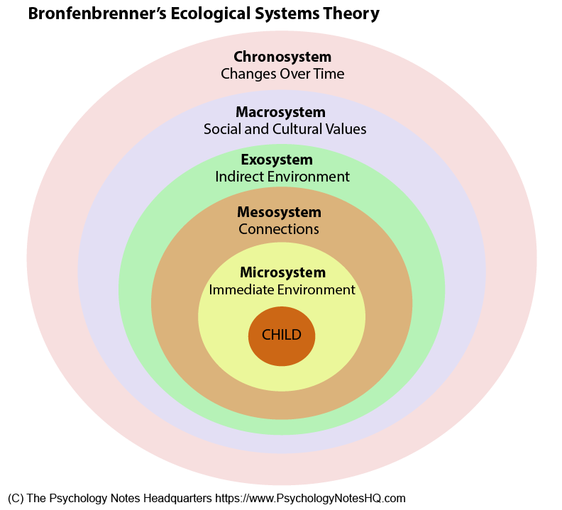
Lifestyle
Barnados (2023) specifies that the meaning a healthy lifestyle contains many aspects including having a healthy and good balance of food as well as having a high standard of good hygiene and exercise, both physically and mentally. By developing a positive relationship with food and drink this is helps to develop a healthy lifestyle for both children and adults (Barnados, 2023) furthermore by increasing positive behaviours early in life this will allow young children to make beneficial choices as they grow up (Barnados, 2023).
According to research by Antony (2022) different types of environmental factors influence young children’s up bringing which will have an impact on how they develop. Antony (2022) studies the theorist Bronfenbrenner and his ecological system theory that considers young children’s development in a system of relationships affected by numerous areas of the child’s close environment, from the child’s direct family and early years settings to wider range of social values, laws and customs. Furthermore, Antony (2022) emphases that when young children live in an environment that they feel they are protected, and they feel secure with their parents or carers, children can then create good strong relationships with them. Parents who can care for and nurture young children will impact positively on their health and well-being (Antony, 2022). Similarly, Bradshaw (2016) agrees with Antony (2022) suggesting that young children living in a safe environment with their parents or carers the young child will feel secure, loved and will be motivated to learn with a positive attitude and develop correctly. Moreover, Musgrave (2017) agrees and believes that young children who have a healthy lifestyle at home and in settings will make positive and healthy decisions concerning what food and drink they eat, by children doing physical exercise throughout the day, this will not only help to keep healthy but is also helpful for young children’s mental health and help to increase their bone structure and strengthen their muscles which is important for their overall health. By parents and practitioners encouraging children to stay motivated in their school environment this can have positive impacts on a young child’s well-being and healthy lifestyle and will give the child a sense of accomplishment (Musgrave, 2017). Marques et al. (2019) proposes that if a young child does not have a positive and healthy lifestyle, then this could create negative impacts on their overall health and well-being. Stating that young children with poor health could have a higher chance of having diseases or serious illness, this could also have an impact on their mental health due to stress or worry (Marques et al. 2019).
(Source: University of Stavanger, 2023)
Application to early years Practice
Musgrave (2017) identifies different ways in which early years practitioners could develop on young children’s well-being, early years practitioners provide opportunities for young children to play outdoors in their settings and also to let them discover things themselves and be imaginative in a safe and harmless environment. Practitioners should allow young children to take their own risks without fear or consequence, in agreement with the United Nations Conventions on the Rights of the Child (UNCRC) article 31 which suggests that all young children have a right to being outdoors in leisure and to be able to rest and engage freely in play (UNICEF, 2021). Additionally, Bradshaw (2016) agrees that children being able to use the outdoor environment in their settings helps to teach young children how to calm their mind and body and become relaxed. Young children developing a positive outdoor environment in early years can benefit children’s communication, behaviour and emotional regulation which are useful skills for children to learn at a young age. Welsh Government (2020) the new curriculum for Wales also suggests that early years practitioners can support young children’s development by giving young children the experiences they need to develop their imagination and encourage them to engage in outdoor activities, which is a significant factor of learning and developing in early years (Welsh Government 2020)
Waite and Ryan (2020) emphasise that exposure to childhood adversity impacts I high number of young children and be one of the most damaging effects on a young child’s health and well-being development. ACE’s include experiences such as neglect and abuse, as well as young children being exposed to violence between parents or carers (Waite and Ryan 2020). Boullier and Blair (2018) highlight how practitioners should take a reasonable approach when a child needs support due to being exposed to ACE’s. Early years practitioners can be a supportive person for a child who suffers from adverse childhood experiences. Practitioners should be able to recognise a child who has been exposed to ACE’s, it may look like a child is not wanting to engage in any activities around them and may appear as being shut off or out of character (Waite and Ryan 2020). According to results from the Welsh Adverse Childhood Experience, Welsh Government (2022) indicate when comparing young children who have been exposed to four or more harmful experiences compared to young children who have not been exposed to any, children who suffered more are more likely to experience a higher risk of drug and alcohol misuse in later adulthood. They will also be more prone to be involved in violence and suffer from mental health issues like anxiety and depression (Welsh Government 2022).
Conclusion
To conclude this poster, there is strong evidence that well-being health and lifestyles are all interlinked and have impacts on one another. As reviewed in this poster it is extremely important for young children to have positive relationships with parents and carers as well as early years practitioners to help young children’s growth and development. As discussed in the poster it is clear that practitioners in early years settings play a significant role in the development of young children’s health and well-being by supporting them and encouraging positive decisions when it comes to their development. Through researching different theorists and their models throughout the poster, it is apparent that parents and practitioners need to take a more holistic approach when it comes to the development of young children. Parents and practitioners will be able to support children and ensure that they have a positive well-being. With further guidance from Welsh Government on how to promote health and well-being within early years practice.

Slide 3
Reference list for poster
Action for children (2023) How poverty affects children’s mental health. Available at: https://www.actionforchildren.org.uk/blog/how-poverty-affects-childrens-mental-health/ (accessed on 8th December 2023)
.
Antony, E. M. (2022). ‘Framing Childhood Resilience Through Bronfenbrenner’s Ecological Systems Theory:’ A Discussion Paper. Cambridge Educational Research e-Jounal, 9, 244-257. Available at: https://cerj.educ.cam.ac.uk/currentissue/v9_2022/v9_18_244-257_antony.pdf (accessed on 10th December 2023).
Barnados (2023) Healthy lifestyle for pre-schoolers. Available at: https://families.barnardos.org.uk/pre-school/healthy-lifestyles (accessed on 10th December 2023).
Berlinski, S. and Norbert, S. (2015) The Early Years: Child Well-Being and The Role of Public Policy. New York: Springer Open.
Boullier, M. and Blair, M. (2018) ‘Adverse Childhood Experiences’, Paediatrics and Child Health, 28(3), pp. 132-137. Available at: https://www.sciencedirect.com/science/article/abs/pii/S1751722217302913 (accessed on 10th December 2023).
Bradshaw, J. (2016) The Well-Being of Children in the UK. 4th edn. Bristol: Policy Press. https://www.who.int/data/gho/data/major-themes/health-and-well-being#:~:text=The%20WHO%20constitution%20states%3A%20%22Health,of%20mental%20disorders%20or%20disabilities. (accessed on 3rd December 2023).
Maholmes, V. (2014) Fostering resilience and well-being in children and families in poverty: why hope still matters. New York: Oxford University Press.
Marques, A., Peralta, M., Martins, J., Loureiro, V., Almanzar, C, P., Matos, G,M. (2019) ‘Few European Adults are Living a Healthy Lifestyle’, American Journal of Health Promotion, 33(3), pp. 391-398.
Musgrave, J. (2017) Supporting children’s mental health and well-being. London: Sage Publications.
Simply Psychology (2023) Available at: https://www.simplypsychology.org/maslow.html [digital photograph] (accessed on 10th December 2023).
Statham, J and Chase, E (2010) Childhood Wellbeing: A brief overview. Loughborough: Childhood Wellbeing Research Centre.
The Marmot Review (2010) Fair society, Healthy Lives. Available at: https://www.parliament.uk/globalassets/documents/fair-society-healthy-lives-full-report.pdf (accessed on 9th December 2023).
UNICEF (2021) United Nations Convention on the Rights of the Child. Available at: https://www.unicef.org.uk/wp-content/uploads/2010/05/UNCRC_united_nations_convention_on_the_rights_of_the_child.pdf (accessed on 10th December 2023).
University of Stavanger (2023) Available at: https://msw.project.nettopuis.live/systems-and-eco-systems-theory/ecological-systems-key-concepts/ [Digital photograph] (accessed on 10th December 2023).
Waite, R. and Ryan, R (2020) Adverse childhood Experiences. Oxon: Routledge.

Slide 4
Waite, R. and Ryan, R (2020) Adverse childhood Experiences. Oxon: Routledge.
Welsh Government (2016) Your Well-Being. Available at: https://www.gov.wales/sites/default/files/publications/2019-05/well-being-statement-for-people-who-need-care-and-support-and-carers-who-need-support-childrens-version.pdf (accessed on 9th December 2023).
Welsh Government (2020) Health and well-being. Available at: https://hwb.gov.wales/curriculum-for-wales/health-and-well-being/ (accessed on 10th December 2023).
World Health Organisation. (2022) Children’s Health. Available at: https://www.who.int/health-topics/child-health#tab=tab_1 (accessed on 9th December 2023).
World health Organization, (2023) Health and well-being. Available at:
Zacher, H. and Rudolph, C. W. (2021) ‘Individual differences and changes in subjective well-being during the early stages of the COVID-19 pandemic’, American Psychological Association, 76(1), pp. 50-62. Available at: https://web-s-ebscohost-com.ezproxy.uwtsd.ac.uk/ehost/pdfviewer/pdfviewer?vid=0&sid=1f1ab7f7-1fc9-47c8-befe-c2b34dae74ec%40redis (accessed on 9th December 2023).

Slide 5
Reference List for Presentation
Early Years Wales (2020) Physical activity guidelines for under 5’s. Available at: https://www.earlyyears.wales/en/active-together-wales#:~:text=Pre%2Dschoolers%20should%20spend%20at,to%2Dvigorous%20intensity%20physical%20activity. (accessed on 7th December 2023).
Gov.uk, (2021) Early years high impact area 4: Supporting healthy weight and nutrition. Available at: https://www.gov.uk/government/publications/commissioning-of-public-health-services-for-children/early-years-high-impact-area-4-supporting-healthy-weight-and-nutrition (accessed on 3rd December 2023).
HM Government, (2018) Childhood Obesity: A Plan for Action chapter 2. Available at: https://assets.publishing.service.gov.uk/media/5b30a40de5274a55c78cef32/childhood-obesity-a-plan-for-action-chapter-2.pdf (accessed on 3rd December 2023).
Hussain, R., Mohammed, A-E. R and Ahmed, H,. I (2020) ‘The scientific Journal of Al-Azhar Medical Faculty’, Psychological impact of obesity in children. 17(4), pp.17-21. Available at: https://applications.emro.who.int/imemrf/427/Sci-J-Al-Azhar-Med-Fac-Girls-2020-4-1-17-21-eng.pdf (Accessed on 5th December 2023).
Musgrave, J. (2017) Supporting children’s health and well-being. London: SAGE publications.
National Health Service (NHS) wales (no date) Designed to smile. Available at: https://phw.nhs.wales/services-and-teams/designed-to-smile/ (accessed on 8th December 2023).
NHS (2023) Obesity. Available at: https://www.nhs.uk/conditions/obesity/ (accessed on 7th December 2023).
NHS 111 Wales (2022) Obesity. Available at: https://111.wales.nhs.uk/encyclopaedia/o/article/obesity/#:~:text=In%20Wales%3A,old)%20are%20living%20with%20obesity. (accessed on 4th December 2023).
NHS Wales Every child (no date) Helping children to be a healthy weight. Available at: https://everychildwales.co.uk/professionals/ (accessed on 7th December 2023).
Public Health England (2015) The relationship between dental caries and obesity in children: an evidence summary. Available at: https://assets.publishing.service.gov.uk/media/5a804bffed915d74e33f99cc/Caries_obesity_Evidence_SummaryOCT2015FINAL.pdf (accessed on 8th December 2023).
Tiwari, A. and Daley, F. Sharon and Balasundaram, P. (2023) ‘Stat Pearls’, Obesity in paediatric Patients. Article 34033388. Available at: https://www.ncbi.nlm.nih.gov/books/NBK570626/#:~:text=Obesity%20is%20defined%20as%20having,equal%20to%20the%20120th%20percentile. (accessed on 3rd December 2023).
Welsh Government (2018) New guidance to support Wales childcare settings provide healthy food and drink to children. Available at: https://www.gov.wales/new-guidance-support-wales-childcare-settings-provide-healthy-food-and-drink-children-0 (accessed on 8th December 2023).

Slide 6
Welsh Government (2020) NHS dental charges and exemptions. Available at: https://www.gov.wales/nhs-dental-charges-and-exemptions (accessed on 8th December 2023).
Welsh Government (2023) Free school Meals: Information for parents and carers. Available at: https://www.gov.wales/free-school-meals-information-parents-and-carers (Accessed on 7th December 2023).
Welsh Government The New Curriculum for Wales (2020) Health and Well-being. Available at: https://hwb.gov.wales/curriculum-for-wales/health-and-well-being/ (accessed on 7th December 2023).
Welsh Government, (2021) Welsh index of multiple deprivation 2019: deprivation analysis relating to young children. Available at: https://www.gov.wales/welsh-index-multiple-deprivation-2019-deprivation-analysis-relating-young-children-html#78679 (Accessed on 4th December 2023).
Welsh Local Government Association (2023) Healthy Eating in schools. Available at: https://www.wlga.wales/healthy-eating-in-schools (accessed on 8th December 2023).

