Slide 2
Academic Project –
Assignment and
Literature Review
Module Name: Group Project
Module Code: ACBA4014
Applied Computing - WISA

Slide 3

Assignment Writing
Some factors to consider:
Planning your project
Planning your report
  Structure:-
    Introduction – Say what you are going to be saying.
    Body – Say it.
    Conclusion – Say it again (summarise it)

Slide 4
Planning Your Project
Other considerations:
  Time Management
  Notes
  Drafts and rewrites

Slide 5

Project Objectives
Objectives for research are a very important consideration.
  Aim – The general statement.
  Objectives – Specific statements to be evaluated (to meet the aim)
    Generally have objectives OR hypothesis
    An hypothesis is a specific statement of prediction.
    An hypothesis describes terms that you expect will happen in your study

Slide 6
Simple example
The effect of taking tranquillisers on the exam performance of students in computer networks and security.
Hypothesis: Students will benefit from them
Methods
Before the exam, students who had requested tranquillisers were identified and formed the experimental group.
Students from the same class were also selected and matched with students in the experimental group on such variables as previous exam results, IQ, gender and medical records. These formed the control group.

Slide 7
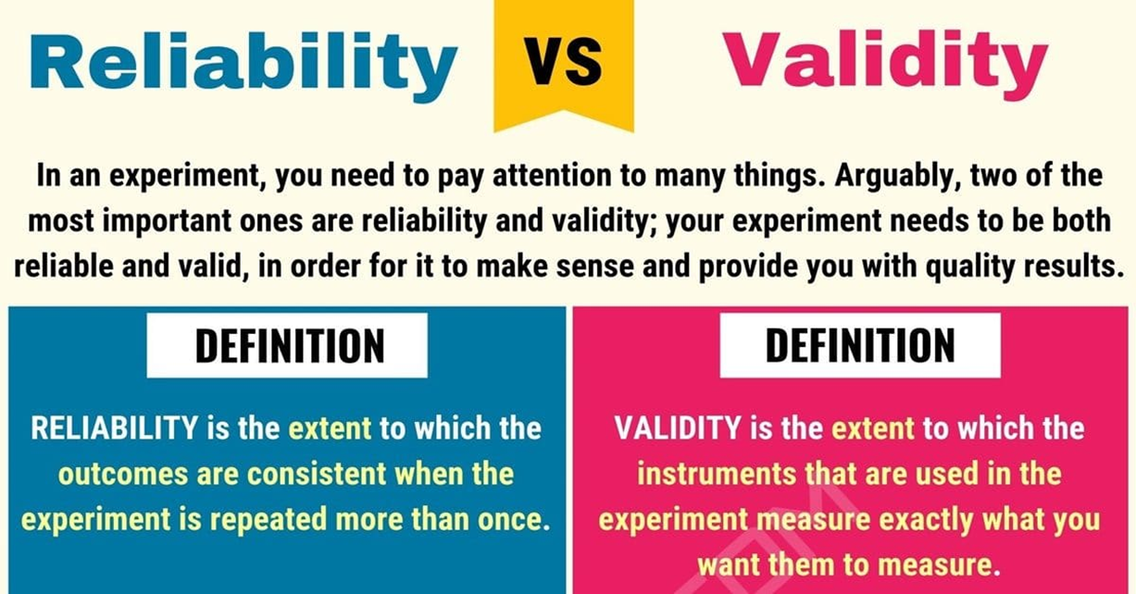
Good Research Consideration – Reliability
Results should be consistent
The results of an experiment should be the same when re-tested on the same people at different times.
If they are not consistent it indicates random error

Slide 8
Good Research Consideration – Validity
The measuring device must measure what it’s supposed to measure.
  Internal validity - The extent to which the observed relationship reflects the actual relationship between the variables in a study.
  External validity - The extent to which the results generalise to other participants and other situations.

Slide 9
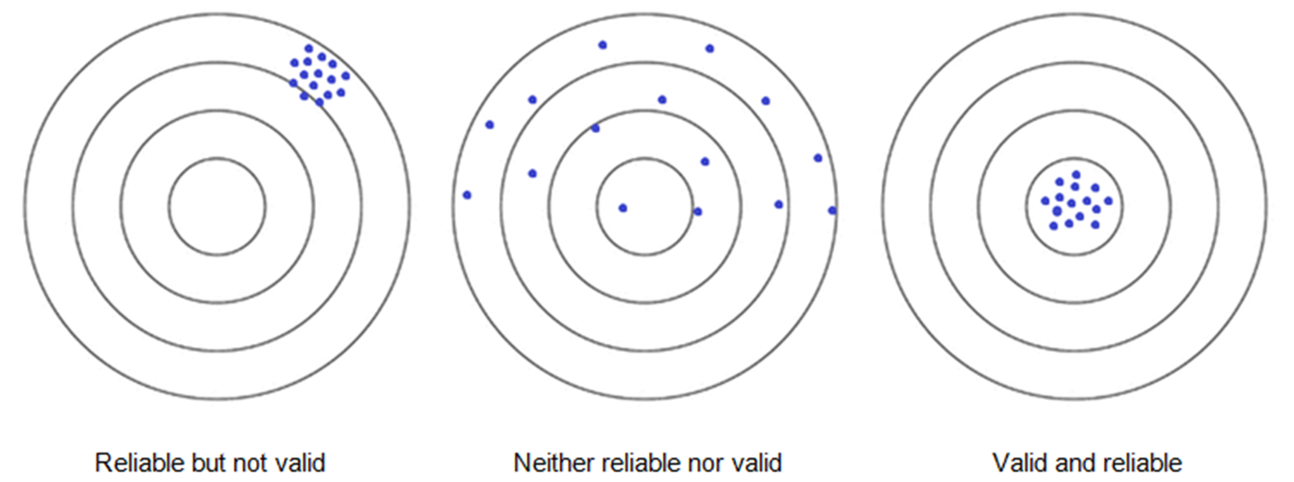
Good Research Consideration – Comparison

Slide 10
Good Research Consideration
How should research be done?
  Imaginative
  Underestimate / overestimate
  ‘workmanlike’
    ‘Genius is 1% inspiration and 99% perspiration’ Henry Ford
  Demonstrate: understanding of the wider academic debate within your ‘field’ and contribute to that ‘field’
  Apprenticeship

Slide 11
Good Research Consideration
How should research be done?
  Professional
  Independent critical thought is vital
    Developing a concept/method (need for a conceptual framework)
    Think critically about your research
    Develop existing research
  Does not require genius

Slide 12
The Literature Review
Setting your work within an academic and vocational arena:
  Q. What is the purpose of a literature review?
  Q. Where do you begin?
  The internet has changed the very meaning of research.
    https://www.pewresearch.org/internet/2012/11/01/how-teens-do-research-in-the-digital-world/
    https://www.pewresearch.org/internet/2012/05/07/main-report-16/

Slide 13
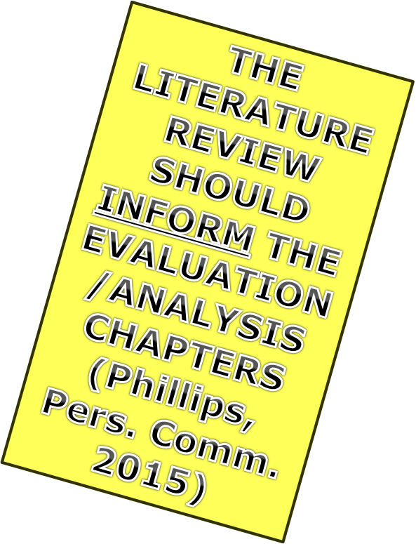
The Literature Review – General Aim and Scope
Aim
  Broad understanding
  Help identify research questions
  Help develop methodology
  Varies between Qual. & Quant.
Scope
  No formula
  New areas of research
  Traditional areas of research

Slide 14

The Literature Review – Consideration of Literature
Source Educational Evaluation Rubric (SEER)
Authority: Is the site well regarded, cited, and written by experts in the field?
Educational Value: Does the site content help advance educational goals?
Intent: Is the site a well-respected source of content intended to inform users?
Originality: Is the site a source of original content and viewpoints?
Quality: Is the site highly vetted with good coverage of the topical area?

Slide 15


The Literature Review – Consideration of Literature
Be logical and systematic
Start with recent articles (work backwards)
Check abstract/summary
Record (VITAL)
  Ref software, Index cards/excel etc.
    referencing details
    main points / results / methods
    additional refs
    colour coding
    location (class mark/website)
    Data base
      Refworks (University supported), Zotero, Mendeley etc

Slide 16
The Literature Review – Consideration of Literature
Finding the literature
Check your time frame
College library
  ILL
  Data bases: Science Direct
  Google scholar
Computer search
Check for theoretical and empirical sources
Reference lists of contemporary articles

Slide 17
The Literature Review – Consideration of Literature
Assess your literature – Is it CRAAP?
The CRAAP Test:
  Currency
  Relevance
  Accuracy
  Authority
  Purpose
https://researchguides.ben.edu/source-evaluation

Slide 18
The Literature Review – Consideration of Literature
Assess your literature – Is it CRAAP?
  Currency
    When was the information published or posted?
    Has the information been revised or updated?
    Is the information current or out-of date for your topic?
    Are the links functional?
https://researchguides.ben.edu/source-evaluation

Slide 19
The Literature Review – Consideration of Literature
Assess your literature – Is it CRAAP?
  Relevance
    Does the information relate to your topic or answer your question?
    Who is the intended audience?
    Is the information at an appropriate level (i.e. not too elementary or advanced for your needs)?
    Have you looked at a variety of sources before determining this is one you will use?
    Would you be comfortable using this source for a research paper?
https://researchguides.ben.edu/source-evaluation

Slide 20
The Literature Review – Consideration of Literature
Assess your literature – Is it CRAAP?
  Accuracy
    Where does the information come from?
    Is the information supported by evidence?
    Has the information been reviewed or refereed?
    Can you verify any of the information in another source or from personal knowledge?
    Does the language or tone seem biased and free of emotion?
    Are there spelling, grammar, or other typographical errors?
https://researchguides.ben.edu/source-evaluation

Slide 21
The Literature Review – Consideration of Literature
Assess your literature – Is it CRAAP?
  Authority
    Who is the author/publisher/source/sponsor?
    Are the author's credentials or organizational affiliations given?
    What are the author's credentials or organizational affiliations given?
    What are the author's qualifications to write on the topic?
    Is there contact information, such as a publisher or e-mail address?
    Does the URL reveal anything about the author or source?
      examples:
        .com (commercial), .edu (educational), .gov (U.S. government)
        .org (nonprofit organization), or
        .net (network)
https://researchguides.ben.edu/source-evaluation

Slide 22
The Literature Review – Consideration of Literature
Assess your literature – Is it CRAAP?
  Purpose
    What is the purpose of the information? to inform? teach? sell? entertain? persuade?
    Do the authors/sponsors make their intentions or purpose clear?
    Is the information fact? opinion? propaganda?
    Does the point of view appear objective and impartial?
    Are there political, ideological, cultural, religious, institutional, or personal biases?
https://researchguides.ben.edu/source-evaluation

Slide 23
The Literature Review – Consideration of Writing
  Outline the topic- e.g.. Hist., subject area
  Briefly explain how the material was selected
  Describe the work that has been done
    Critical (where appropriate)
    Summarise and synthesise the main directions / contradictions
    Balanced
    Note methods and results used
    Note areas not adequately covered
    Critique and critical thought

Slide 24

The Literature Review – Characteristics
  A good literature review should be characterised by:
  Purposes of a review being accomplished
  Evidence of a critique (analysis and synthesis)
  Primary sources
  Number of references used
  Paraphrase rather than quote
  Logical structure and reasoning
  [Wood, 2014]

Slide 25
The Literature Review – Final Thought
  A literature review is a piece of evaluative and interpretive prose, not a list describing or summarising one piece of literature after another (Gammon, 2016)
  Synthesise and evaluate in relation to your conceptual framework.

Slide 26
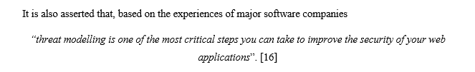
Referencing
  Using Citations
    Always use speech marks and italics for direct citations
    Always reference a direct citation
    Citations are used when the context is important and cannot be paraphrased (They also do not count towards the word count).

Slide 27
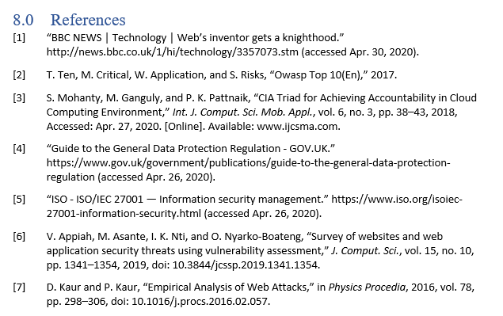
Referencing
  Listing References
  Use a bibliography tool.
  For journals and books:
    Names, separated by commas
    Title, in speech marks
    Paper name / Publisher
    Volume / edition / pages
  For websites:
    Website name / title
    url / address
    IMPORTANT – when accessessed

Slide 28
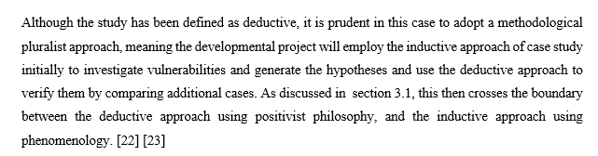
Referencing
  More than one publication
  It is good practice to back up your research with multiple publications
  Always include all numbers of references to literature in the text
  This can be done either by all numbers in one bracket or individual brackets for each reference. Both are acceptable

Slide 29

Referencing – Final Thoughts
  Correct referencing is important and so it is essential to get it right.
  Try and replicate journal standards in your own work.
  All references in the text [numbered in square brackets] should be in the reference list / bibliography and vice versa.

Slide 30
Any Questions?

