Slide 1
Electromagnetic
Radiation
(ACDC5009)
Lecture

Slide 2
Content
Material Properties
Magnetisation and Hysteresis
Maxwells Equation
Inductance and Mutual inductance

Slide 3
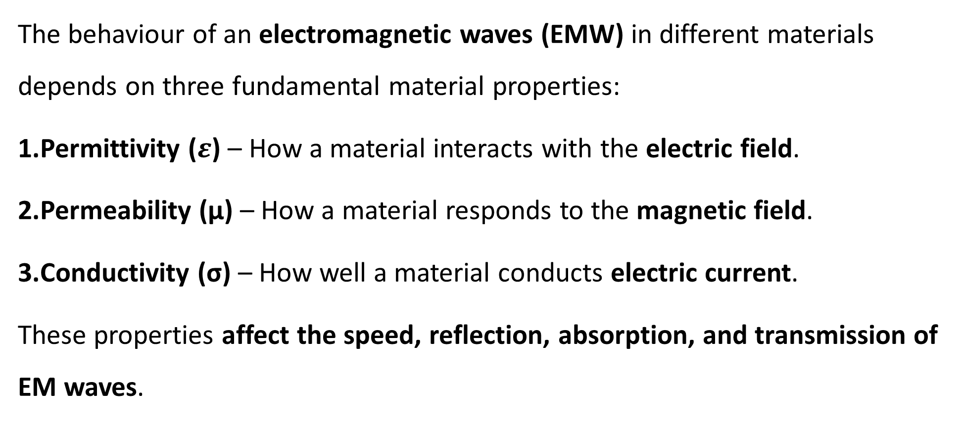
Material Properties
The behaviour of an electromagnetic waves (EMW) in different materials depends on three fundamental material properties:
Permittivity ($ε$) – How a material interacts with the electric field.
Permeability (μ) – How a material responds to the magnetic field.
Conductivity (σ) – How well a material conducts electric current.
These properties affect the speed, reflection, absorption, and transmission of EM waves.

Slide 4
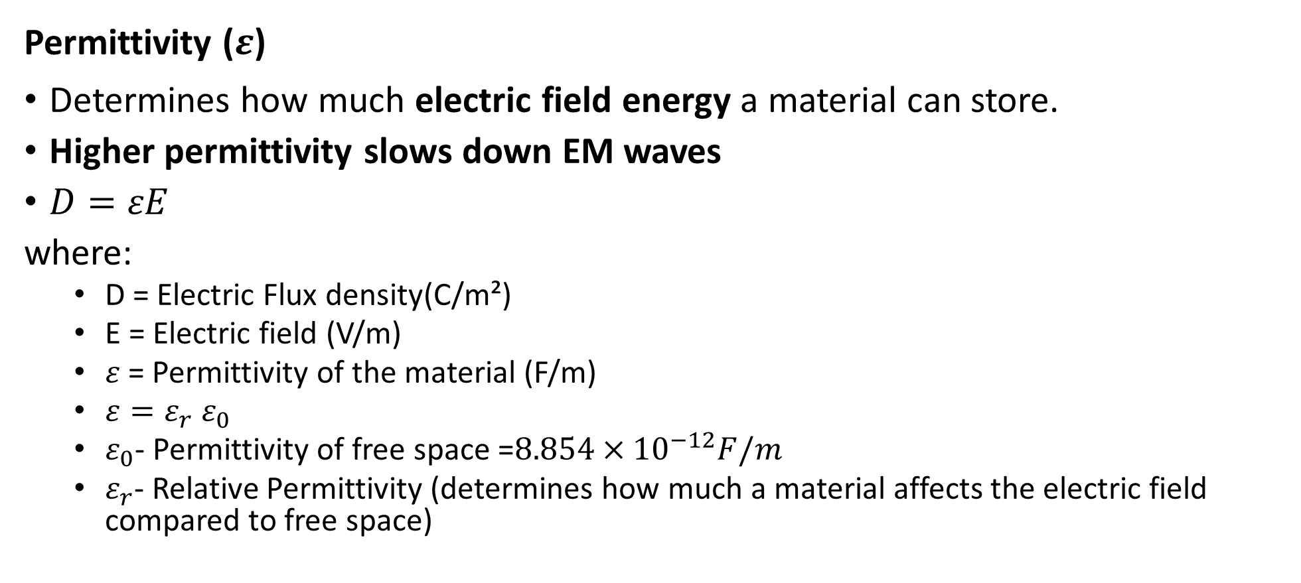
Material Properties
Permittivity ($ε$)
Determines how much electric field energy a material can store.
Higher permittivity slows down EM waves
$D=εE$
where:
  D = Electric Flux density(C/m²)
  E = Electric field (V/m)
  $ε$ = Permittivity of the material (F/m)
  $ε=ε_{r}$ $ε_{0}$
  $ε_{0}$- Permittivity of free space =$8.854×{10}^{−12}F/m$
  $ε_{r}$- Relative Permittivity (determines how much a material affects the electric field compared to free space)

Slide 5
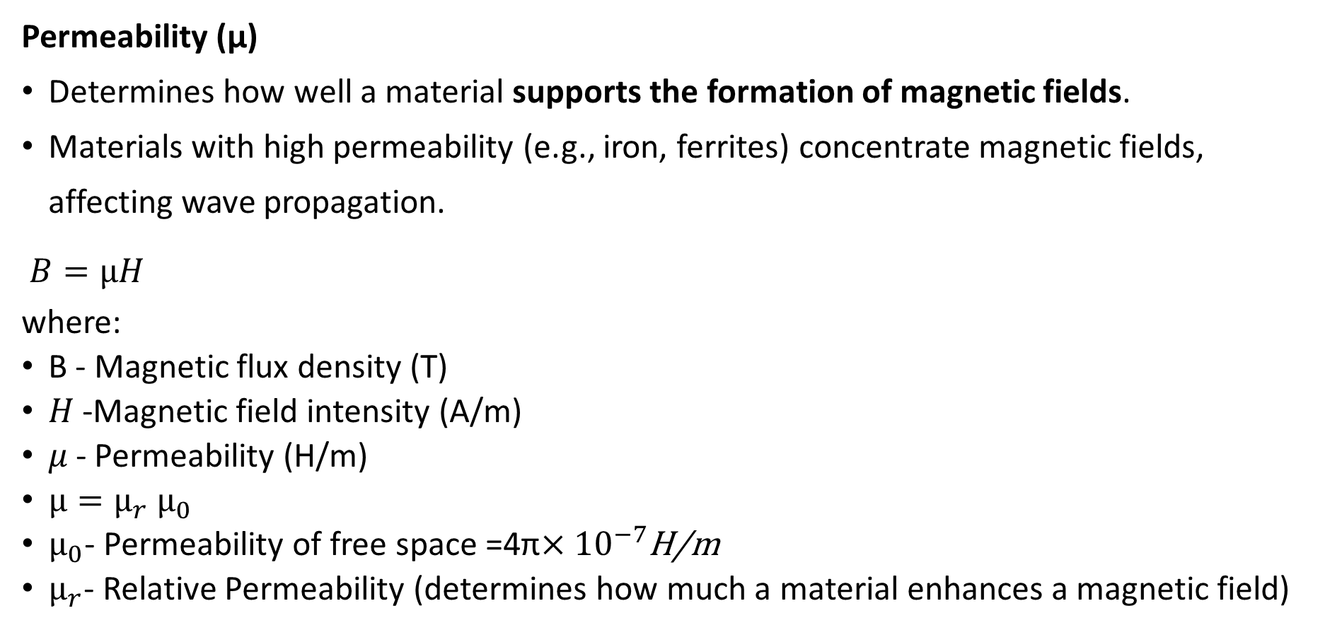
Material Properties
Permeability (μ)
Determines how well a material supports the formation of magnetic fields.
Materials with high permeability (e.g., iron, ferrites) concentrate magnetic fields, affecting wave propagation.
$B=μH$
where:
B - Magnetic flux density (T)
𝐻 -Magnetic field intensity (A/m)
𝜇 - Permeability (H/m)
$μ=μ_{r}$ $μ_{0}$
$μ_{0}$- Permeability of free space =4π$×{10}^{−7}$H/m
$μ_{r}$- Relative Permeability (determines how much a material enhances a magnetic field)

Slide 6
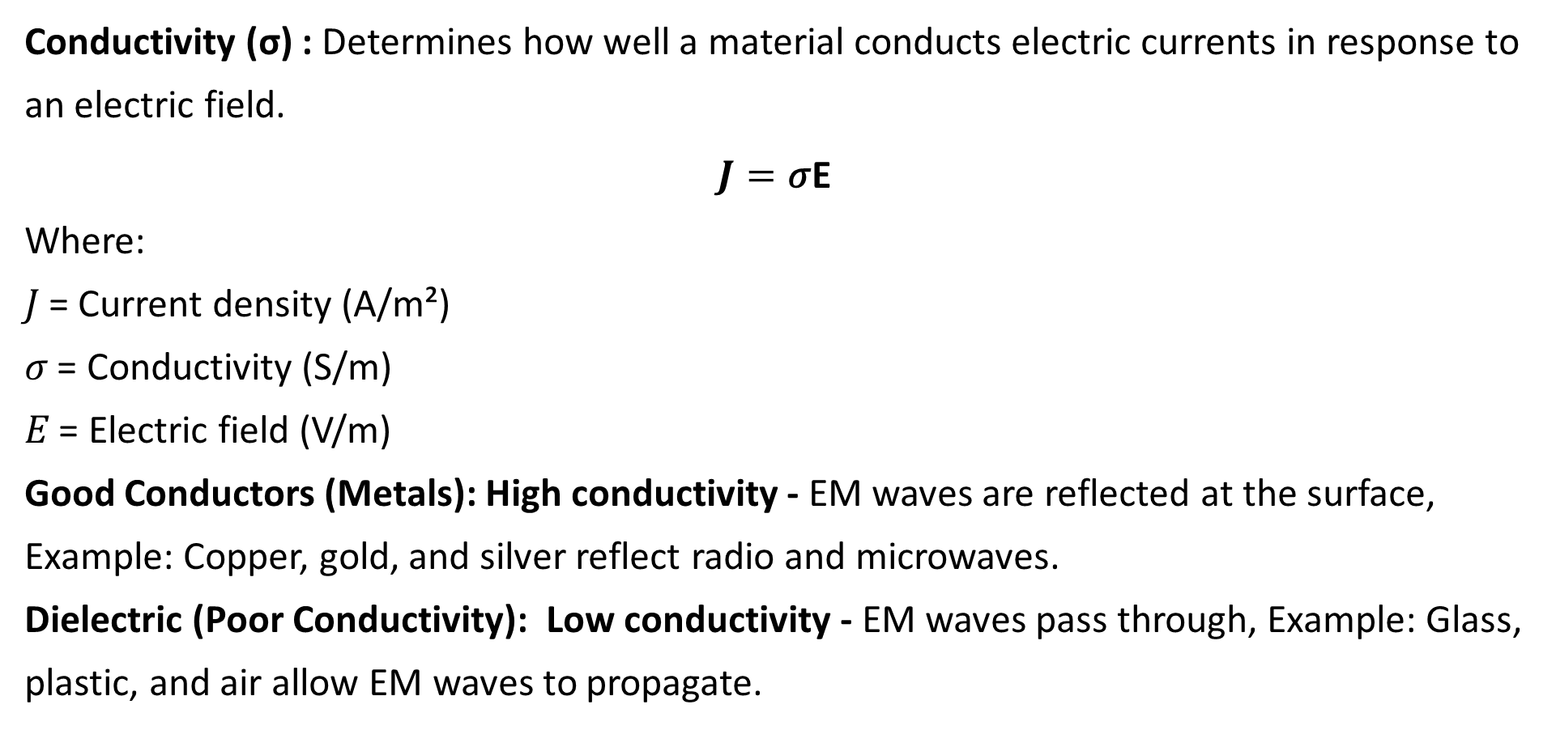
Material Properties
Conductivity (σ) : Determines how well a material conducts electric currents in response to an electric field.
$$J=\text{σ}\text{E}$$
Where:
𝐽 = Current density (A/m²)
𝜎 = Conductivity (S/m)
𝐸 = Electric field (V/m)
Good Conductors (Metals): High conductivity - EM waves are reflected at the surface, Example: Copper, gold, and silver reflect radio and microwaves.
Dielectric (Poor Conductivity): Low conductivity - EM waves pass through, Example: Glass, plastic, and air allow EM waves to propagate.

Slide 7
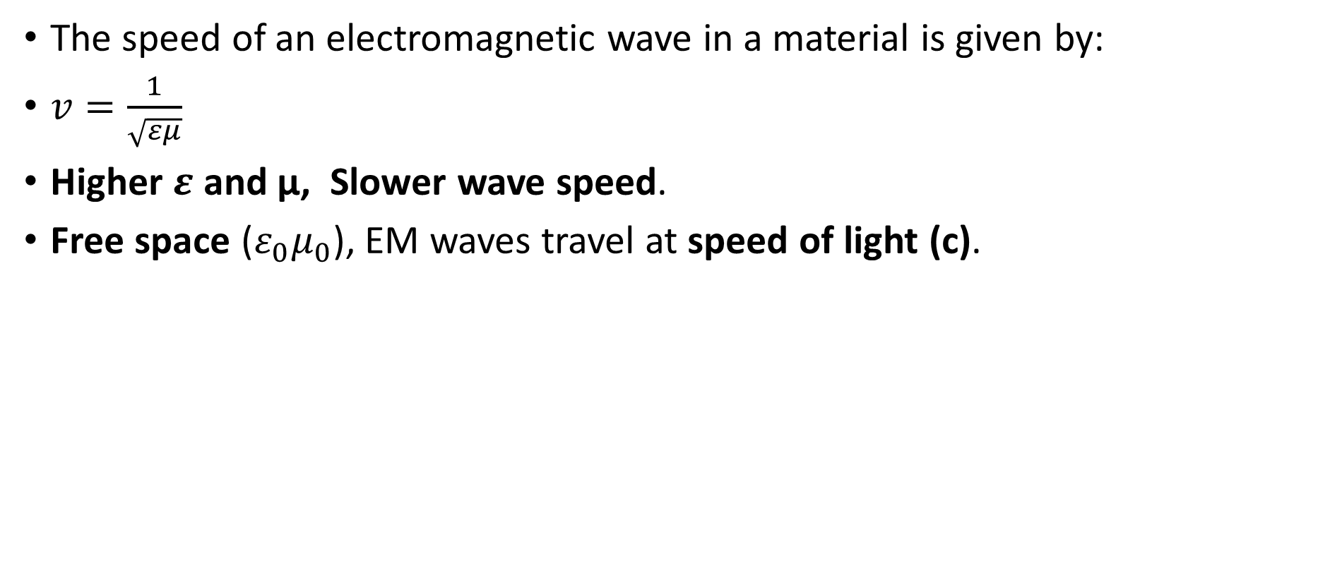
Material Properties
The speed of an electromagnetic wave in a material is given by:
$v=\frac{1}{\sqrt{εμ}}$
​Higher $ε$ and μ, Slower wave speed.
Free space (${ε_{0}μ}_{0}$​), EM waves travel at speed of light (c).

Slide 8
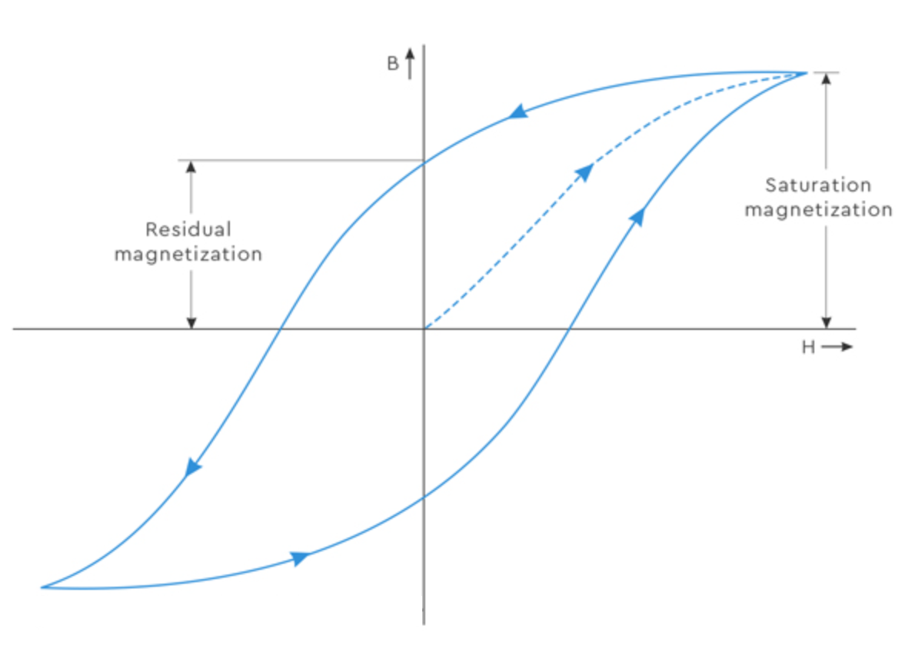
Magnetisation and Hysteresis
Magnetisation : Describes how a material responds to an applied magnetic field (H).
Hysteresis: When a magnetic field (H) is applied to a material, the magnetisation does not increase or decrease immediately. Instead, it follows a looped path forming a hysteresis loop.
When a material is first exposed to a magnetic field, it gradually magnetises. Then material reaches maximum magnetisation and reaches saturation. Even after removing the magnetic field, some magnetisation remains. A reverse field must be applied to fully demagnetise the material.

Slide 9
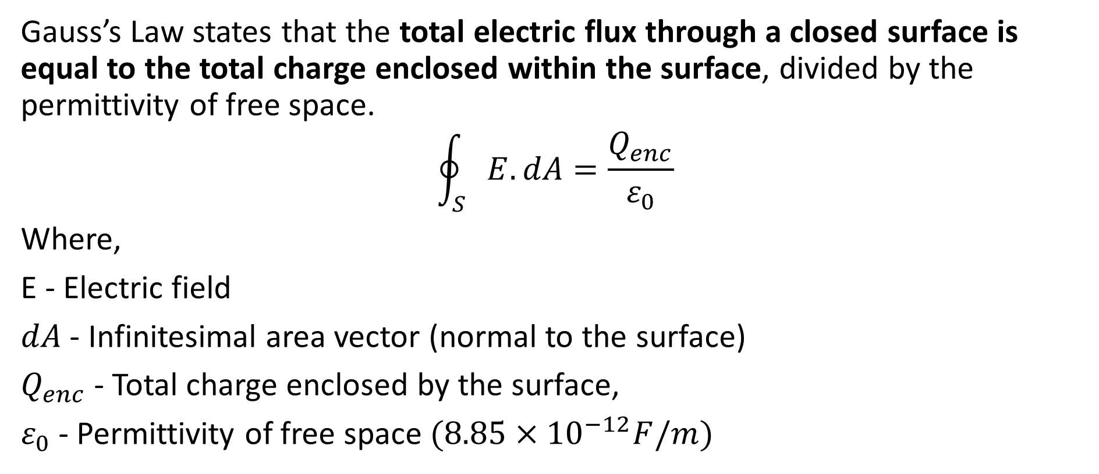
Maxwells Equation- Gauss’s law (Electrostatics)
Gauss’s Law states that the total electric flux through a closed surface is equal to the total charge enclosed within the surface, divided by the permittivity of free space.
$$\oint_{S}{E.dA}=\frac{Q_{enc}}{ε_{0}}$$
Where,
E - Electric field
$dA$ - Infinitesimal area vector (normal to the surface)
$Q_{enc}$- Total charge enclosed by the surface,
$ε_{0}$- Permittivity of free space $(8.85×{10}^{−12}F/m)$

Slide 10
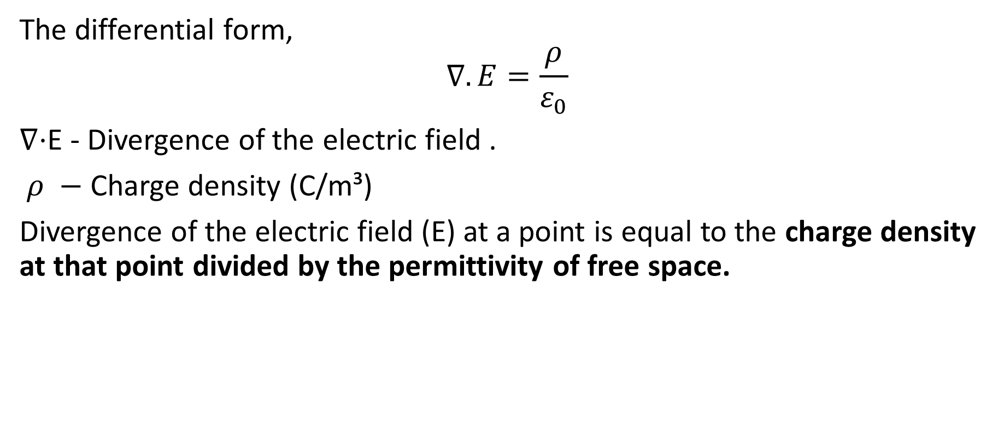
Maxwells Equation- Gauss’s law (Electrostatics)
The differential form,
$$∇.E=\frac{ρ}{ε_{0}}$$
∇⋅E - Divergence of the electric field .
​ $ρ −$ Charge density (C/m³)
Divergence of the electric field (E) at a point is equal to the charge density​ at that point divided by the permittivity of free space.

Slide 11
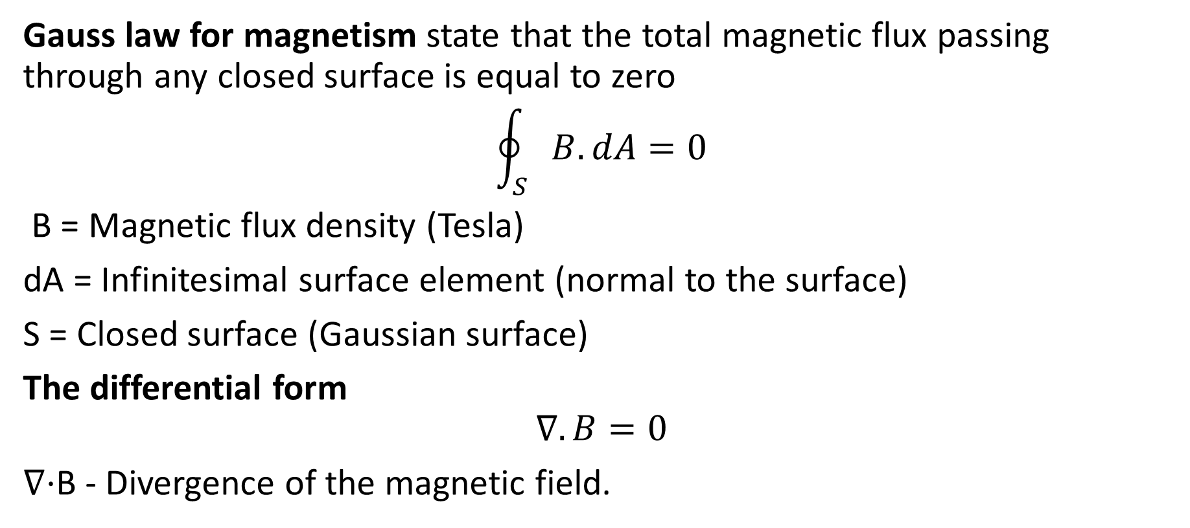
Maxwells Equation- Gauss’s law (Magnetism)
Gauss law for magnetism state that the total magnetic flux passing through any closed surface is equal to zero
$$\oint_{S}{B.dA=0}$$
B = Magnetic flux density (Tesla)
dA = Infinitesimal surface element (normal to the surface)
S = Closed surface (Gaussian surface)
The differential form
$$∇.B=0$$
∇⋅B - Divergence of the magnetic field.

Slide 12
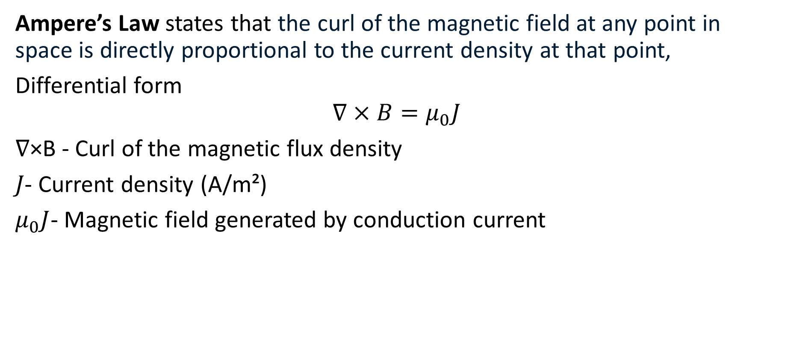
Maxwells Equation- Amperes law
Ampere’s Law states that the curl of the magnetic field at any point in space is directly proportional to the current density at that point,
Differential form
$$∇×B=μ_{0}J$$
∇×B - Curl of the magnetic flux density
𝐽- Current density (A/m²)
$μ_{0}J$- Magnetic field generated by conduction current

Slide 13
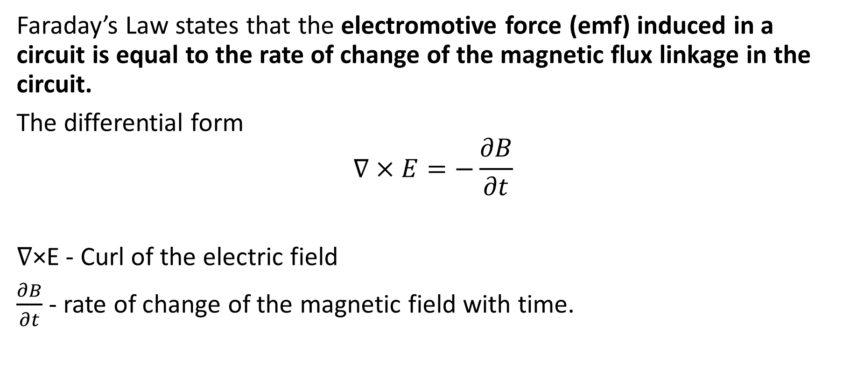
Maxwells Equation- Faraday’s law
Faraday’s Law states that the electromotive force (emf) induced in a circuit is equal to the rate of change of the magnetic flux linkage in the circuit.
The differential form
$$∇×E=−\frac{∂B}{∂t}$$
∇×E - Curl of the electric field
$\frac{∂B}{∂t}$- rate of change of the magnetic field with time.

Slide 14
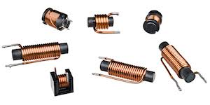
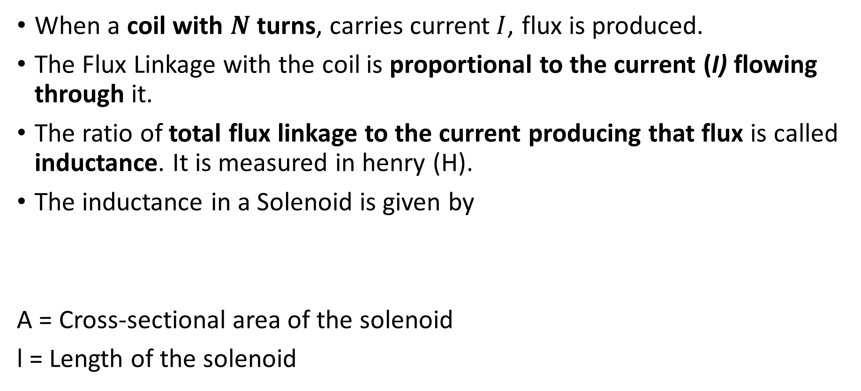

Inductance and Mutual inductance
When a coil with $N$ turns, carries current$I$, flux is produced.
The Flux Linkage with the coil is proportional to the current (I) flowing through it.
The ratio of total flux linkage to the current producing that flux is called inductance. It is measured in henry (H).
The inductance in a Solenoid is given by
A = Cross-sectional area of the solenoid
l = Length of the solenoid
$$L=\frac{μN^{2}A}{l}$$

Slide 15
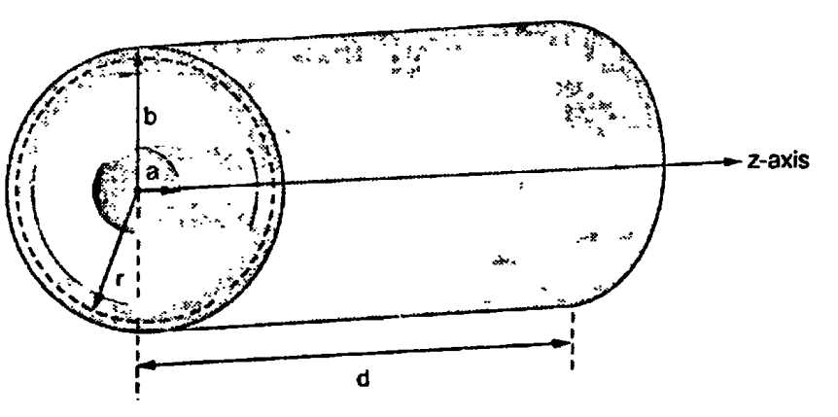
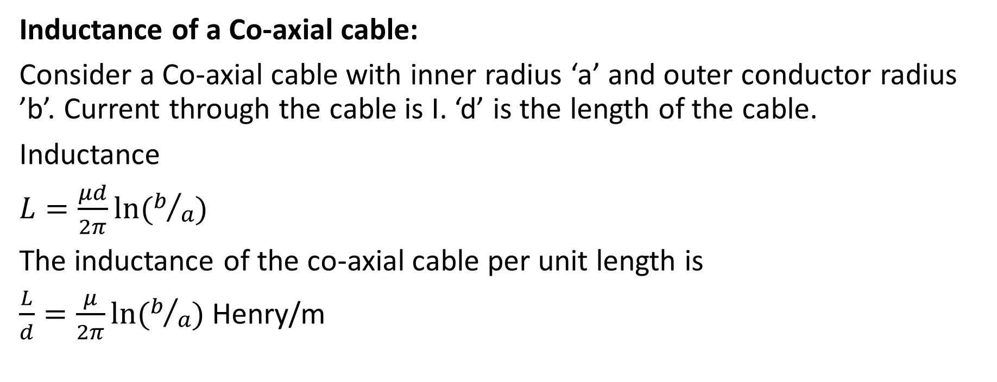
Inductance and Mutual inductance
Inductance of a Co-axial cable:
Consider a Co-axial cable with inner radius ‘a’ and outer conductor radius ’b’. Current through the cable is I. ‘d’ is the length of the cable.
Inductance
$L=\frac{μd}{2π}ln⁡(b/a)$
The inductance of the co-axial cable per unit length is
$\frac{L}{d}=\frac{μ}{2π}ln⁡(b/a)$ Henry/m

Slide 16
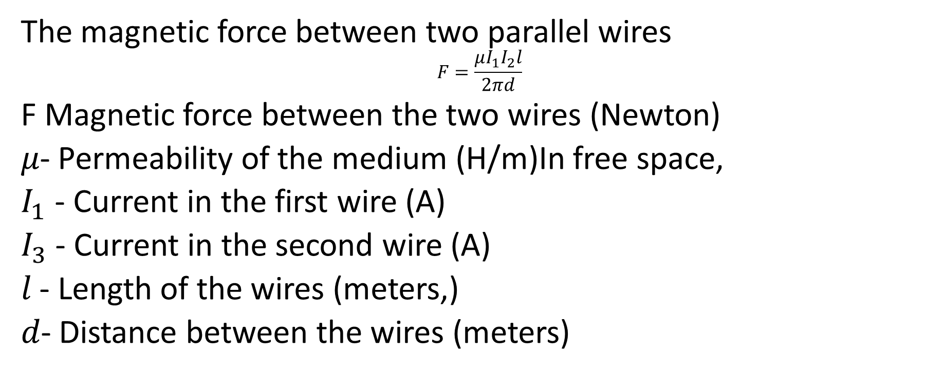
Inductance and Mutual inductance
The magnetic force between two parallel wires
$$F=\frac{μI_{1}I_{2}l}{2πd}$$
F Magnetic force between the two wires (Newton)
𝜇- Permeability of the medium (H/m)In free space,
$I_{1}$​ - Current in the first wire (A)
$I_{3}$​ - Current in the second wire (A)
𝑙 - Length of the wires (meters,)
𝑑- Distance between the wires (meters)

Slide 17

Thank You

