Slide 1
BMPE7003 Motivation & Physical Activity – Part 2
Dr Dylan Blain
Academic Director Sport & Healthy Living
Darlithydd Cysylltiol y Coleg Cymraeg Cenedlaethol

Slide 2
Outline of weekend
Welcome back
Tutorials
Assignment 1 – presentation
Motivation & PA - Part 2:
  Critical evaluation of motivational theories
  Judging quality of evidence
  Integrating theories
  Extending theories
  Assignment 2 workshop

Slide 3
Saturday
9:00am - Assignment 1 presentations
9:45am - Start work on Motivation & PA part 2
1:00pm – Lunch
2:00pm - Mini-movers and motivation & behaviour change (Alan Samual)
3:00pm - Group Task
4:30pm - Tutorial with Programme lead (Dr Nalda Wainwright)

Slide 4
Assignment 2
Using work covered within the module and your own personal research, produce an essay in response to the following title:
Critically evaluate different theories of motivation reflecting on the role motivation plays in promoting positive outcomes within a range of physical activity contexts.

Slide 5
Critical Evaluation of Motivational Theories
Motivation
Outcomes
Behavioural (e.g., PA, sport performance)
Affective (e.g., thoughts, feelings, emotional experience)
Cognitive (e.g., knowledge and understanding, cognitive engagement)
Physical Activity Contexts
Sport
Active Travel
Work
Exercise
School Physical Education
Play
Young People
Adulthood
Older Adults (Ageing)
Physical Activity Behaviour – (Frequency, Intensity, Time, Type)

Slide 6
Recap - Theories of Motivation

Slide 7
Theory
Provide an overview of how different factors operate to explain specific behaviours.
Operate at level of inferred constructs.
Psychological variables.
causal explanations operating at varying levels such as physical/material, cognitive, emotional and social (Ryan, 2014).
Notes:
Motivation is a complex phenomena
Rarely if ever a single cause at work
Complex
Regnant causal analysis – most significant or functionally relevant to a problem

Slide 8
Psychological Theory (Ryan & Deci, 2017)
Organised description and explanation of circumstances
Afford generalisations and that can address new events, as well as illuminate past ones.
Provide a common language for investigators allowing them to better anticipate events, and observe, refine, compare and extend understanding and prediction.

Slide 9
Psychological Theory (Ryan & Deci, 2017)
Help us:
  select information that is important
  provide useful principles for practice
Good theory makes sense of phenomena
  Allows an understanding of mediating processes – useful for intervention.

Slide 10
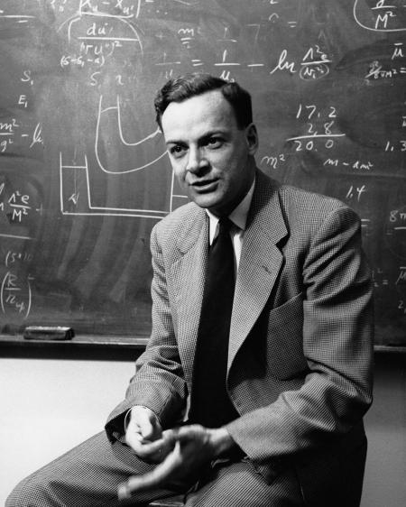
Richard Feynman on theory…
“It doesn’t matter how beautiful your theory is, it doesn’t matter how smart you are. If it doesn’t agree with experiment, it’s wrong.”
Notes:
American theoretical physicist

Slide 11


Slide 12
Theory to Practice
Good theory can reliably guide action and intervention (Ryan & Deci, 2017)
“Nothing so practical as a good theory”
(Kurt Lewin)

Slide 13
Motivational Theories
Self-determination theory (Ryan & Deci)
Achievement goal theory (Nicholls)
Theory of planned behaviour (Azjen)
Self efficacy theory (Bandura)

Slide 14
Critical Analysis
Notes:
What is critical analysis? Whiteboard workshop.

Slide 15
Motivational Theories
A critical analysis:
  Judging the strength of research evidence
    Systematic review and meta-analysis
    Correlational design v intervention/experimental
  Comparing and contrasting
  Integrating & extending theory

Slide 16
Judging the Quality of Research Evidence

Slide 18
A Brief look at Measurement
How to measure – examples from SDT (www.selfdeterminationtheory.org)
  BREQ-2 (complete and interpret results)
  Need satisfaction/frustration scale
  Outcomes
    Physical Activity
    Exercise
    Engagement in PE
Notes:
Input data to excel/spss to analyse?

Slide 20
SDT Evidence
Systematic review & meta-analysis:
  Texiera et al. (2012) - Adults
  Owen et al. (2014) – Children & Adolescents
  White et al. (2021) – PE – Qualitative studies
  Vasconcellos et al. (2020) PE
  Ntoumanis et al. (2021) – health interventions
Intervention/Experiments

Slide 21
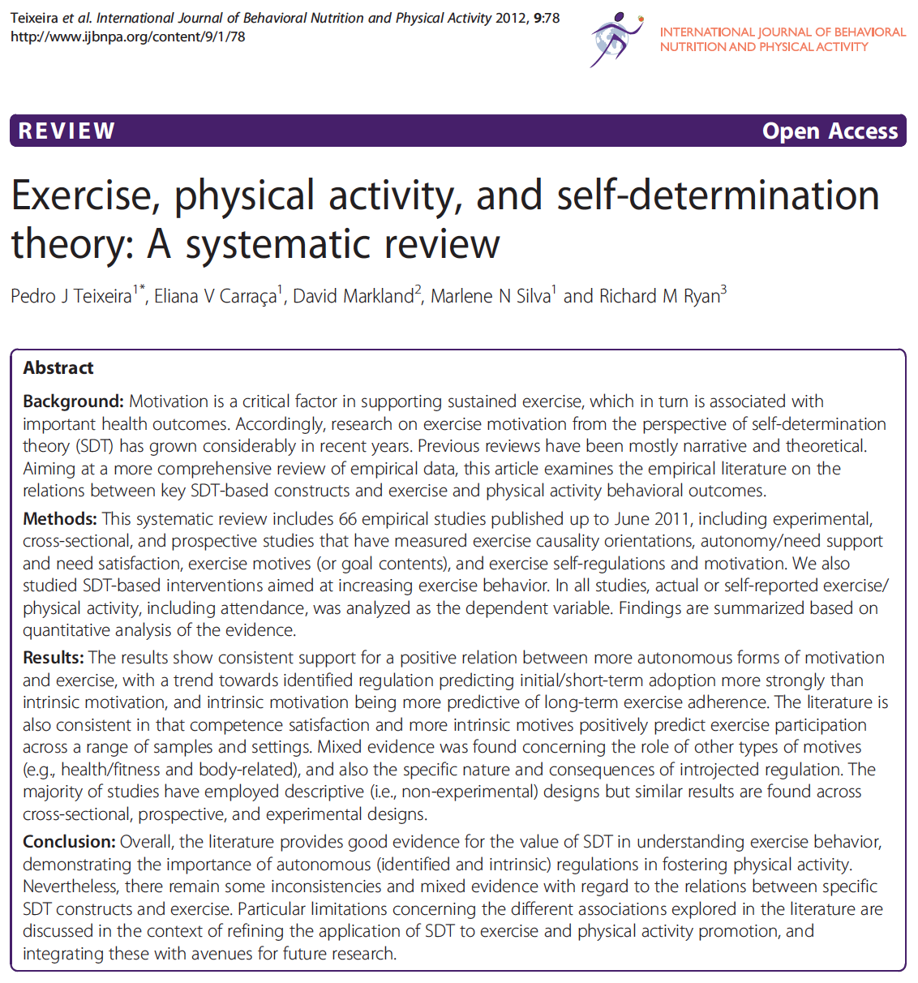

Slide 22
Teixeira et al. (2012) – SDT and PA (adults)
More autonomous forms of motivation consistently related to PA
Controlled forms of regulation not related to PA
Identified regulation predicted short adoption of PA more strongly than Intrinsic Motivation
Intrinsic motivation more predictive of long-term exercise adherence

Slide 23
Teixeira et al. (2012) – SDT and PA (adults)
Needs – competence most-commonly examined and consistent positive predictor of PA
More mixed findings for autonomy & PA
Absence of association for relatedness and PA (can do PA on your own/may be more relevant in group exercise settings)

Slide 24
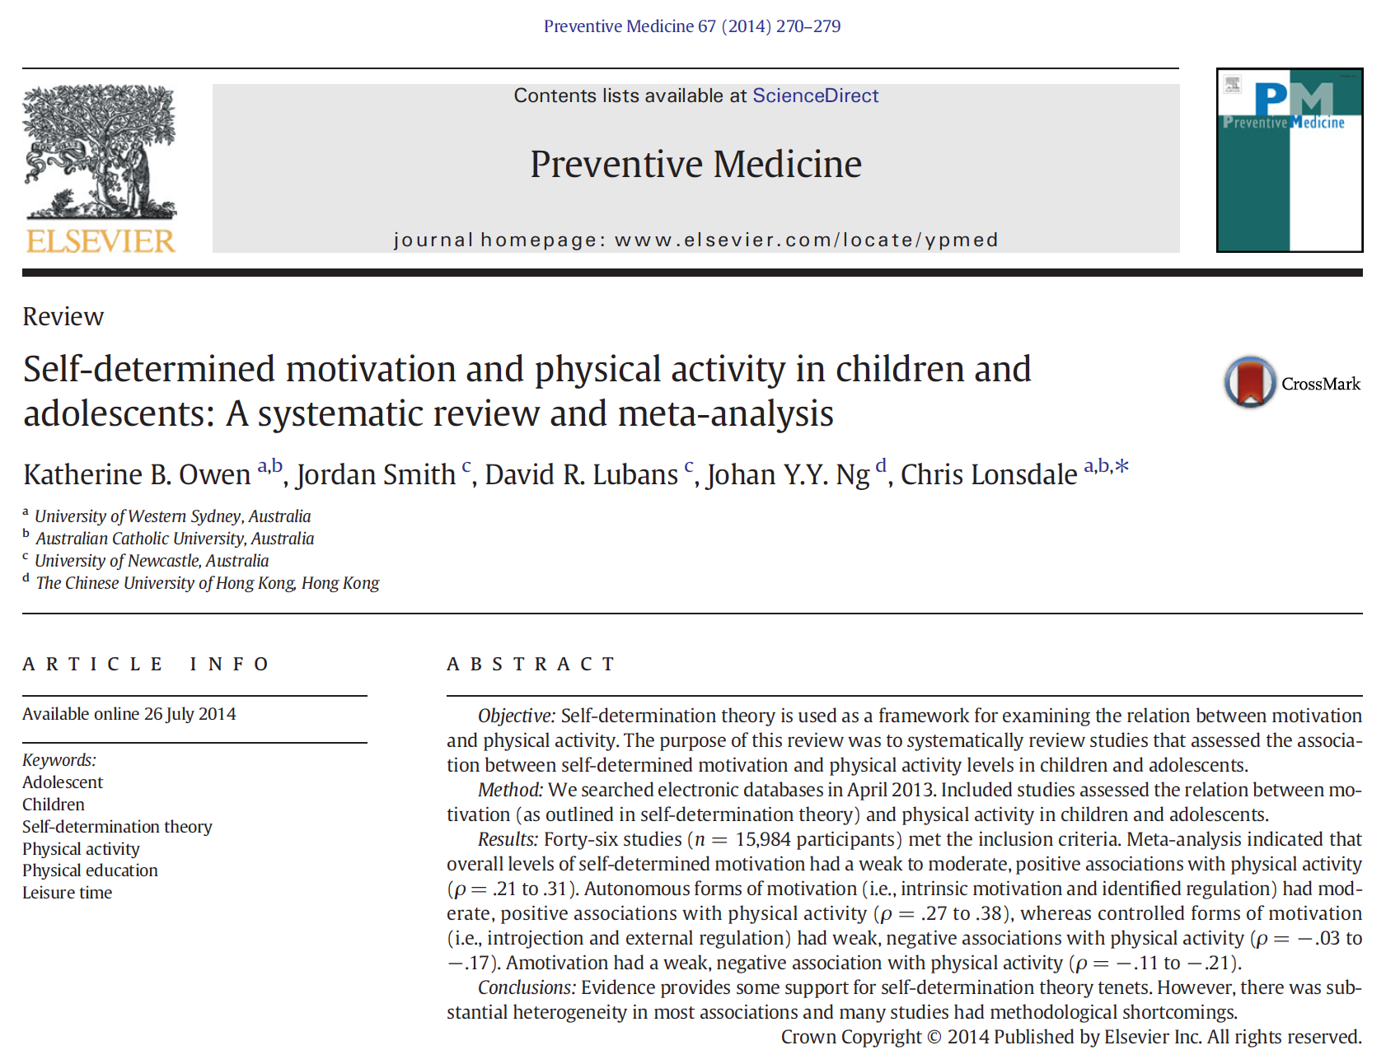

Slide 25
Owen et al. (2014) – SDT and PA (children & adolescents)
Overall levels of self-determined motivation weak to moderate positive relationships with AP (ρ = .21 to .31)
Autonomous forms of motivation (i.e., intrinsic motivation and identified regulation) moderate, positive associations with PA (ρ = .27 to .38)
Controlled forms of motivation (i.e., introjected and external regulation) had weak, negative associations to PA (ρ = − .03 to −.17).

Slide 26
SDT based experimental studies
SDT interventions can enhance PA
  Fortier, Sweet, O’Sullivan & Williams (2007) – PA counselling
Leaders of group exercise can be trained in need-supportive communication styles which lead to subsequent positive outcomes for group members
  Cheon, Reeve & Moon (2012) – PE teachers
  Ntoumanis, Thogersen-Ntoumani, Quested & Hancox (2017) – Exercise class instructors

Slide 27
SDT – critiques
Only 3 needs?
  e.g., Variety, self-esteem, pleasure, security (Sheldon, Elliot, Kim, & Kasser, 2001; Sylvester et al., 2016)
  Needs v motives (Ryan, Patrick, Deci & Williams, 2008) – needs promote growth, integrity, & wellness

Slide 28
SDT – critiques
Only 4 types of extrinsic regulation?
One continuum of motivation?
  If so, should fall on one point of this, however can be motivated for PA by more than one reason therefore 6 continuums may better reflect
  Motivational profiles (e.g., Gourlan et al., 2016)

Slide 29
SDT – critiques
Factors other than motivation may be important correlates of PA behavior.
Similar to intention-behavior gap (TPB) (Rhodes & de Bruijn, 2013; Rhodes & Dickau, 2012a; 2012b)

Slide 30
Group Task
Having examined motivational theory – what are our current thoughts:
  How do they compare?
  Which are best?
  Which are most valuable?
  WHY?

Slide 31
Integrating Theories

Slide 32
Integrating Theories
AGT & SDT (Standage, Duda & Ntoumanis, 2003)
SDT & TPB (Trans-contextual model, Hagger & Chatsizarantis, 2014)

Slide 33
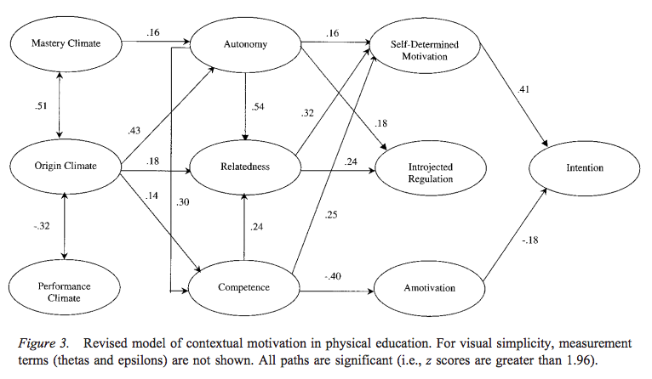
SDT & AGT
(Standage, Duda & Ntoumanis, 2003)

Slide 34
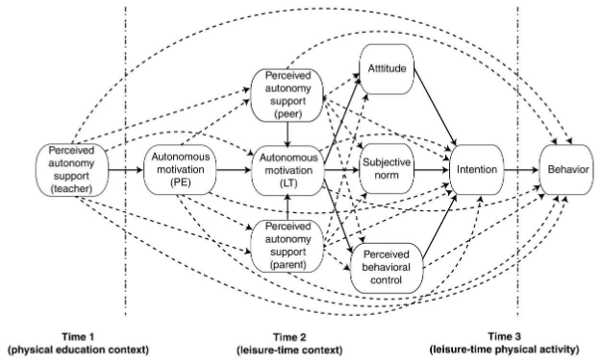
Trans-contextual model of autonomous motivation (Hagger & Chatzisarantis, 2007; 2015)

Slide 35
Extending Theories (Additional Constructs)

Slide 36
Extending Theories
Additional constructs (e.g., Automatic processes, planning).
Motivational & post-motivational stages (Rhodes & de Bruijn, 2013)
Examples:
  Integrated model (Hagger & Chatzisarantis, 2014)

Slide 37
Intention-Behaviour Gap
Rhodes & de Bruijn (2013):
  Non-intenders
  Non-intenders who then become active
  Unsuccessful indenters (36% - intention-behaviour gap)
  Successful intenders

Slide 38
Factors influencing translation of intention to behaviour
Rhodes & Dickau (2013):
  38 potential moderators from 57 studies
  Strongest evidence - Intention stability
  Some evidence for - Anticipated regret & conscientiousness

Slide 39
Extending Theories
Motivational stage
Post motivational stage
  Convert motivation to action
  Rhodes & Yao (2015) - intention-behavior gap

Slide 40
Automatic/non-conscious Processes

Slide 41
Automatic/Non-conscious Processes
Influence of pre-existing mental associations (automatic associations) (Rebar et al., 2016)
spontaneously activated
  behavioural impulses
  evaluations
  cognitions

Slide 42
Automatic/Non-conscious Processes
Dual process models:
  Automatic route – characterized by environmentally cued response, absence of effort, volitional control and awareness (Type 1 processing)
  Deliberative route – involves thought & cognitive effort (Type 2 processing)

Slide 43
Dual Process Models
Conscious – (e.g., deliberative, reflective, reasoned, planned, intentional, slow, systematic)
Non-conscious (e.g., implicit, spontaneous, automatic, impulsive, fast, heuristic)
(Hagger, 2016)

Slide 44
Habits
Habit:
  behavioral patterns learned through context dependent repetition (Gardner, de Bruijn & Lally, 2011)
  Triggered by environment
  Self-report habit index (Verplanken & Orbell, 2003)
  Habit → Physical Activity (r = 0.43, p < .01) (Gardner, de Bruijn, and Lally, 2011).

Slide 45
Automatic/Non-conscious Processes
Automatic evaluations (Implicit attitudes)
  Strength of association between physical activity and feelings of pleasantness or unpleasantness
  Predispose approach or avoidance
Issues with measurement & terminology
(Rebar et al., 2016)

Slide 46
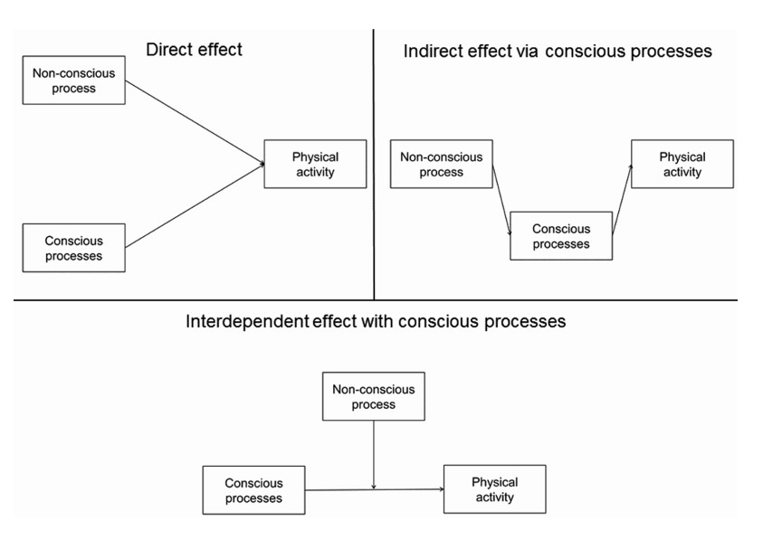
Automatic/Non-conscious Processes
(Rebar et al., 2016)

Slide 47
Affect

Slide 48
Affect
Feeling state, enjoyment, & pleasure.
Anticipated feelings of regret of missing event (Rhodes & Dickau, 2013)
Closely aligns with automatic processes - affective experience

Slide 49
Core Affect
“core affective valence characterizes all states in which a person feels good or bad, including free-floating pleasure and displeasure, as well as pleasant or unpleasant moods and emotions; it is experienced constantly although its nature and intensity can vary over time”
(Ekkekakis, 2013, p.38)

Slide 50
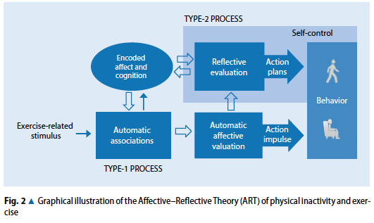
Affective-Reflective Theory of physical inactivity and exercise (Brand & Ekkekakis, 2017)
https://www.youtube.com/watch?v=CO_t2lbcoU0)

Slide 51
Planning

Slide 52
Planning
Motivation / intention to act important
Having effective plans to carry out the behavior may also be important
  Implementation intentions (if then plans…)
  Action planning (where, when & how...)
Hagger & Luszczynska (2014)

Slide 53
Implementation Intentions
Self-regulatory strategies that involve specifying when, how and where performance of the behavior will take place (Gollwitzer, 1999)
Help people move from motivational (intentional) stage to volitional (behavioural) stage (e.g., Health Action Process Approach, Schwarzer, 1992; 2001)

Slide 54
Implementation Intentions
Moderate to large effect size (0.65) found between implementation intentions and behaviour in meta-analysis (Gollwitzer & Sheeran, 2006).
Need to consider:
  Adoption (getting started)
  Maintenance (keeping it going)

Slide 55
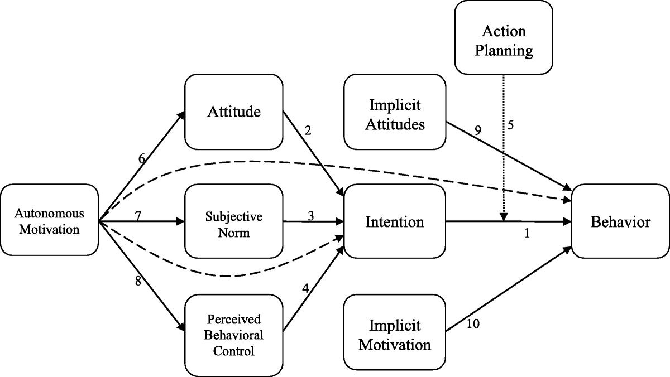
Integrated Behavior Change Model for Physical Activity (Hagger & Chatzisarantis, 2014)

Slide 56
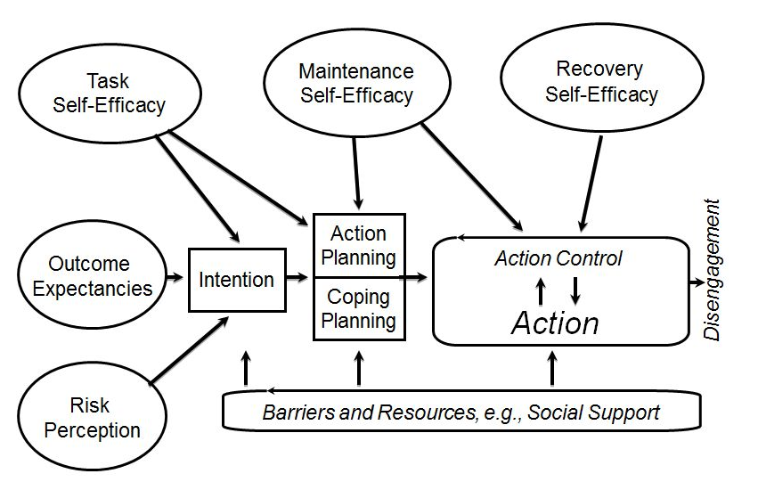
Health Action Process Approach (HAPA; Schwarzer, 1992; 2001)
http://www.hapa-model.de/

Slide 57
Motivation & Physical Literacy

Slide 58
Task
Read Whitehead (2010) – Motivation and the significance of physical literacy for every individual from Physical Literacy through the lifecourse.
  Read & highlight links (contrasting, complimentary factors) to the motivational theories you have studied within the module

Slide 59
Physical Literacy
“Physical literacy can be described as the motivation, confidence, physical competence, knowledge and understanding to value and take responsibility for engagement in physical activities for life.” (IPLA, 2017)

Slide 60
Physical Literacy
“Physical literacy can be described as the motivation, confidence, physical competence, knowledge and understanding to value and take responsibility for engagement in physical activities for life.” (IPLA, 2017)

Slide 61
Physical Literacy
“Physical literacy can be described as the motivation, confidence, physical competence, knowledge and understanding to value and take responsibility for engagement in physical activities for life.” (IPLA, 2017)

Slide 62
Motivation & Competence
Actual Competence
Perceived Competence
Confidence
Competence Need satisfaction
Self-efficacy
Perceived Behavioural Control

Slide 63
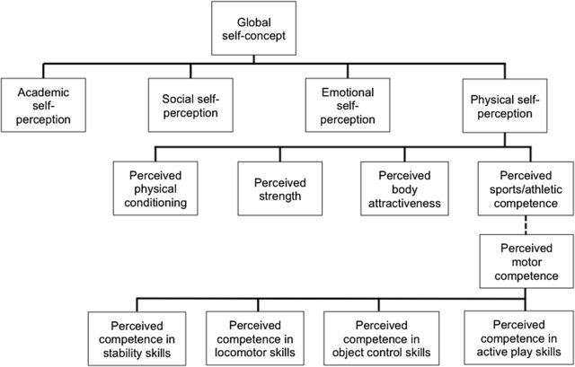
Hierarchical model of the multidimensional structure of self-perception (Estevan & Barnett, 2018)

Slide 64
Interventions
Motivational based interventions
  School Gym/School Fitness 3T (Blain & Bellamy, 2018)
  Lubans et al. (2017)
  Many more…

Slide 66
School Gym/School Fitness 3T
Motivational based, multi-component, health and fitness intervention for secondary school Physical Education
(Blain & Bellamy, 2018)

Slide 67
Assignment Workshop
See moodle page for assignment outline and marking scheme

Slide 68
References
Blain, D. & Bellamy, M. (2018). School Gym and Physical Physical Activity. In Draper, N. & Stratton, G. (Eds.). Physical Activity: A multi-disciplinary introduction. Abingdon: Routledge.
Cheon, S.H., Reeve, J., Moon. I.S. (2012). Experimentally based, longitudinally designed, teacher-focused intervention to help physical education teachers be more autonomy supportive toward their students, Journal of Sport & Exercise Psychology, 34, pp. 365-396.
Gourlan, M., Bernard, P., Bortolon, C., Romain, A.J., Lareyre, O., Carayol, M., ..., Boiché, J. (2016). Efficacy of theory-based interventions to promote physical activity. A meta-analysis of randomised controlled trials, Health Psychology Review, 10, pp. 50-66.
Estevan, I., & Barnett, L. (2018). Considerations Related to the Definition, Measurement and Analysis of Perceived Motor Competence, Sports Medicine, 48(12).
Gardner, B., de Briujn, G.J., & Lally, P. (2011). A Systematic Review and Meta-analysis of Applications of the Self-Report Habit Index to Nutrition and Physical Activity Behaviours. Annals of Behavioural Medicine, 42(2), 174-187.
Hagger, M. S., & Chatzisarantis, N. L. (2015). The trans-contextual model of autonomous motivation in education: Conceptual and empirical issues and meta-analysis. Review of Educational Research, doi:10.3102/0034654315585005

Slide 69
References
Hagger, M. S., & Chatzisarantis, N. L. (2014). An Integrated Behavior Change Model for Physical Activity. Exercise and Sport Sciences Reviews, 42(2), 62-69.
Hagger, M. (2016). Non-Conscious Processes and Dual-Process Theories in Health Psychology. Health Psychology Review, 10 (4), 375-380.
Hagger, M. S., & Luszczynska, A. (2014). Implementation intention and action planning Interventions in health contexts: State of the research and proposals for the way forward. Applied Psychology: Health and Well-Being, 6(1), 1-47.
Ntoumanis, N., Thøgersen‐Ntoumani, C., Quested, E., Hancox, J. (2017). The effects of training group exercise class instructors to adopt a motivationally adaptive communication style, Scandinavian Journal of Medicine & Science in Sports, 27, pp. 1026-1034.
Owen, K. B., Smith, J., Lubans, D.R., Ng, J.Y.Y., & Lonsdale, C. (2014). Self-determined motivation & physical activity in children and adolescents: A systematic review and meta-analysis. Preventitive Medicine, 67, 270-279.

Slide 70
References
Rebar, A.L., Dimmock, J.A., Jackson, B., Rhodes, R.E., Kates, A., Starling, J., Vandelanotte, C. (2016). A systematic review of the effects of non-conscious regulatory processes in physical activity. Health Psychology Review, 10(4), 395-407.
Rhodes, R. E., & Dickau, L. (2012a). Meta-analysis of experimental evidence for the intentionbehavior relationship in the physical activity domain. Health Psychology, 31 (6), 724–727. doi:10.1037/a0027290
Rhodes, R. E., & Dickau, L. (2012b). Moderators of the intention-behavior relationship in physical activity domain: A systematic review. British Journal of Sports Medicine. doi:10.1136 bjsports2011-090411.
Rhodes, R. E., & Bruijn, G.-J. (2013). How big is the physical activity intention-behaviour gap? A meta-analysis using the action control framework. British Journal of Health Psychology, 18(2), 296-309.

Slide 71
References
Schwarzer, R. (2014). http://www.hapa-model.de/
Standage, M., Duda, J.L. & Ntoumanis, N. (2003). A Model of Contextual Motivation in Physical Education: Using Constructs From Self-Determination and Achievement Goal Theories to Predict Physical Activity Intentions. Journal of Educational Psychology, 95(1). 97-110.
Teixeira, P.J., Carraça, E.V., Markland, D., Silva, M.N., Ryan, R.M. (2012). Exercise, physical activity, and self-determination theory: A systematic review, International Journal of Behavioral Nutrition and Physical Activity, 9
Verplanken B, Orbell S. (2003). Reflections on past behavior: A self report index of habit strength. J Appl Soc Psychol. 33: 1313–1330.
Whitehead, M. (2010). Physical Literacy throughout the life course. Abingdon: Routledge.

