Slide 1
BA in Leadership and Management Skills for the Workplace
Workplace culture and its impact on organisational efficiency
(BMSW 5105)
Induction to the Module
&
What is an organisation? Part - I

Slide 2

In this session…..
Get to know each other
Set class rules
Discuss student queries
Overview the module
Define organisations
Explore the organizational environment

Slide 3

Getting to know each other…

Slide 4
Classroom conduct
Notes:
Set class rules based on the ‘classroom code of conduct’ available in each classroom.

Slide 5
Student Queries
Grades and results
Accessing Module material
Attendance and punctuality
Class representatives
Services available for students

Slide 6

Module overview
Title - Workplace Culture and its impact on Organisational Efficiency
Module – BMSW 5105
Code
Credits - 20 (Level 5)

Slide 7
Aims and Learning Outcomes
Aims -
  To develop an understanding of workplace culture and context in order to improve one’s ability to function within the organisational norms.
Learning Outcomes –
    critically assess the culture and context of an organisation;
    evaluate an organisation within its broader environment using appropriate environmental and organisational analysis techniques;
    critically appraise the cultural and ethical behaviour present in one or more organisations.

Slide 8
Scheme of Work
Week 1 | The organisation and its environment – part I
Week 2 | The organisation and its environment – part II
Week 3 | Organisational structures
Week 4 | Organisational culture
Week 5 | Creating a sustainable culture in an organisation
Week 6 | Determinants of a successful culture
Week 7 | Barriers to effective functioning of an organisation
Week 8 | Global implications on an organisations culture
Week 9 | Global implications on an organisations culture (Continued)
Week 10 | Workshop/Revision

Slide 9
Reading
Mullins, Laurie J. (2019), Organisational behaviour in the workplace [electronic resource],
12th ed. Pearson (Harlow)
Kassem, Rassel (2019), Organizational culture and achieving business excellence : emerging
research and opportunities, IGI Globe, Hershey, PA :

Slide 10
Assessments
Academic Report with Reflection
Task 1 (Report)
(4000 + 10% words) – TBC
Task 2 (Reflection on Individual Practical Performance)
(500 words + 10% words) – TBC

Slide 11

What is an organisation?

Slide 12

What is an organisation?
An organisation is an arrangement of people, pursuing common goals, achieving results and standards of performance.

Slide 13
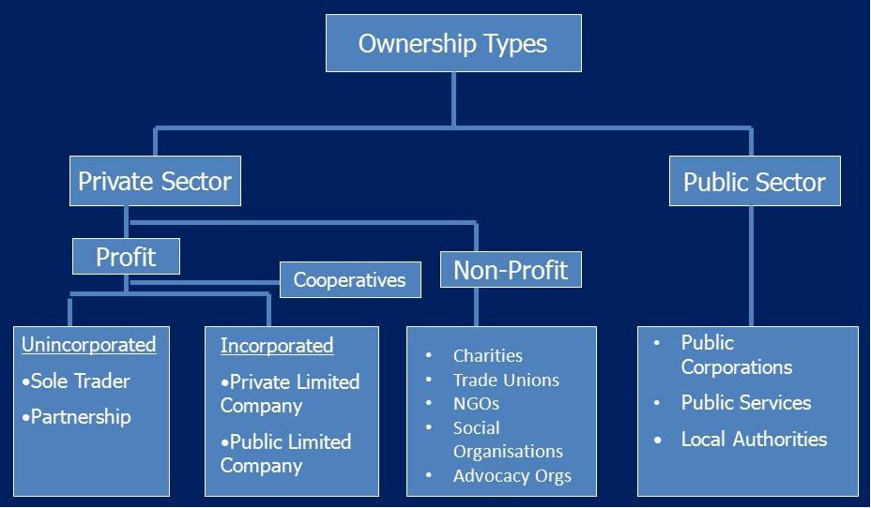
Types of organisations

Slide 14
Business organisations
Complete the worksheet 1.1 with your lecturer

Slide 15
Organisational environment
What is Business Environment?

Slide 16
Organisational environment
A business does not operate in a vacuum.
It has to act and react to what happens outside the factory and office walls (external factors or influences).
These will affect the main internal functions of the business and possibly the objectives of the business and its strategies
Anything that can impact on the activities of a Business .

Slide 17
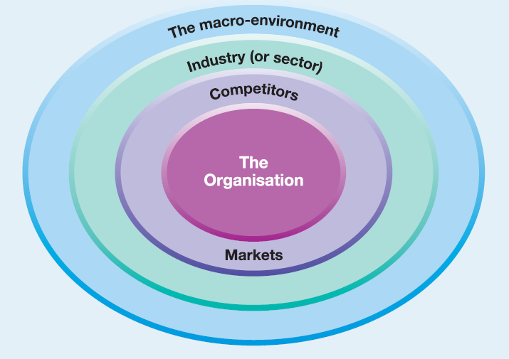
LAYERS OF BUSINESS ENVIRONMENT

Slide 18
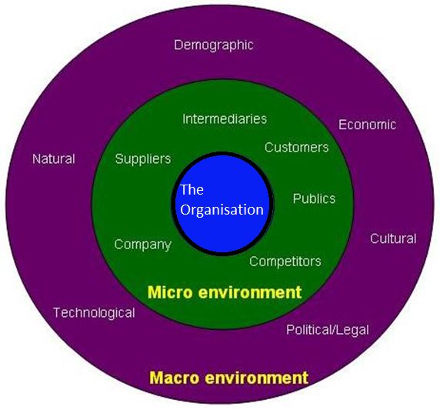
The elements of the Environment

Slide 19
Analysing the environment
SWOT
Environmental Analysis
Internal Environment
External Environment
Porter’s 5 forces

Slide 20
The PESTEL framework
The framework provides a comprehensive list of influences on the possible success or failure of strategies. PESTEL stands for Political, Economic, Social, Technological, Environmental and Legal.
POLITICS highlights the role of governments;
ECONOMICS refers to macro-economic factors such as exchange rates, business cycles and differential economic growth rates around the world;
SOCIAL influences include changing cultures and demographics, for example ageing populations in many Western societies;
TECHNOLOGICAL influences refer to innovations such as the Internet, nanotechnology or the rise of new composite materials;
ENVIRONMENTAL and Legal stands specifically for ‘green’ issues, such as pollution and waste; and Legal embraces legislative constraints or changes, such as health and safety legislation or restrictions on company mergers and acquisitions.

Slide 21
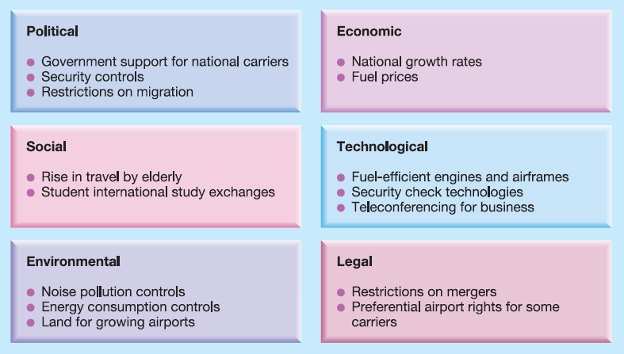
PESTEL ANALYSIS FOR THE AIRLINE INDUSTRY

Slide 22
Activity – Individual
What additional environmental influences would you add to this initial list for the airline industry?
From your more comprehensive list, which of these influences would you highlight as likely to be the ‘key drivers for change’ for airlines in the coming five years?

Slide 23
Group Activity - PESTEL
Conduct a PESTEL analysis for the UK real estate company using the information available in the report on Moodle and conducting further research if needed.
Complete worksheet 1.2 and present your findings to the class.

Slide 24


Summary
Can you explain;
What is an organisation?
What are the types of organisations?
The Elements of the business environment?

Slide 25

1. Select a company that you have worked for or know very well, or UWTSD
2. Discuss the characteristics of the business
3. Conduct a PESTEL analysis of the macro environment of the selected company.

Slide 26

Next session
The organisation and its environment – Part II

