Slide 1
EFFECTIVE TEAM WORKING AND COMMUNICATION
Assessment component 2
DENNIS CALERO
Lloyd Beharry
1810249

Slide 2
EFFECTIVE TEAM WORKING AND COMMUNICATION
Introduction
Both the team work and communication plays the vital role fro the development of the organization
With the proper delivery of communication, a particular team work succeed
Team work assist the organizational members to collaborate the allotted project in order to turn them effective for business profits

Slide 3
EFFECTIVE TEAM WORKING AND COMMUNICATION
Benefits of team working
I. Improves creativity level
As per the allotted work, the employees make use of several strategies for achieving the goal
In this way, the creativity prospects within the employees improves
II. Creates Trust
While working with team, different employees have different skills which are implemented within the project work
This is how, trust is being build among the organizational members.

Slide 4
EFFECTIVE TEAM WORKING AND COMMUNICATION
Benefits of team working
III. Develops the meaning of ownership
As per the allotted work, the employees contribute their skills in order to make the project successful
In this way, they understand the actual meaning of ownership
IV. Promotes risk taking
Without attempting risk not work gets successful.
Through this procedure, they adopt the techniques to take risks

Slide 5
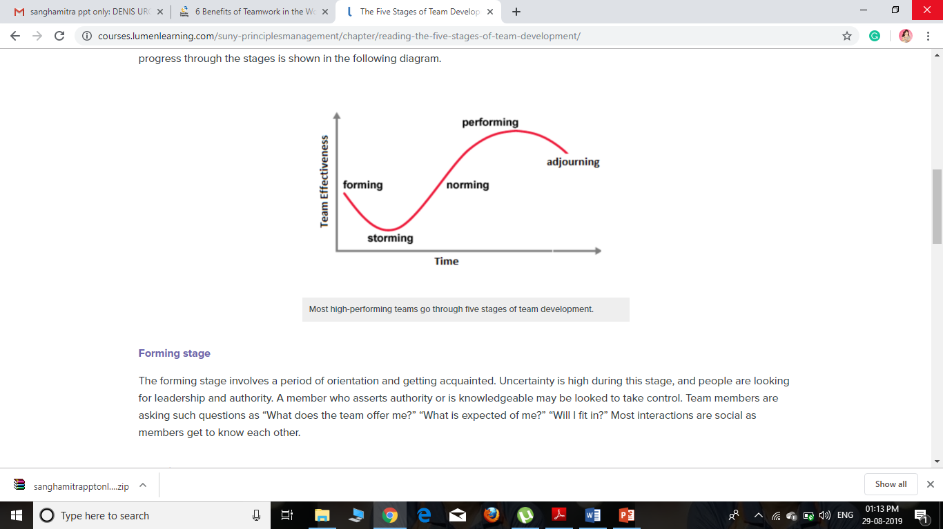
EFFECTIVE TEAM WORKING AND COMMUNICATION
Stages of developing team
Formation of the organizational team
Formation of the storming stage
Developing the norming stage
Initiates performing stage
Finally the Adjourning stage

Slide 6
EFFECTIVE TEAM WORKING AND COMMUNICATION
Stages of developing team
In the first stage, the aims and the objectives of the project are discussed. Time period are provided with adequate amount of ethical rules and regulations
In the second stage, the various conflicts and misunderstanding arises among the employees. This is the stage where the performance level of the employees decreases.
In the thirds stage, several strategies are used to prevent the arise conflicts and unity are initiated

Slide 7
EFFECTIVE TEAM WORKING AND COMMUNICATION
Stages of developing team
In the fourth stage, accurate cooperation arise within the group with the help of which they perform well as per thee provided project
In the last and the final stage, the aims and the allotted objectives are achieved in the most appropriate way and the teams get to warp up

Slide 8
EFFECTIVE TEAM WORKING AND COMMUNICATION
Various types of team roles
Action oriented role
Shaper: proper professional attitude, face challenges equally, overcome the negativities and motivates the other team members
Implementer: They are the one who implements several tasks to accomplish the targets
Finisher: they overlook the job task and solves the issues and errors for shaping the project perfect

Slide 9
EFFECTIVE TEAM WORKING AND COMMUNICATION
Various types of team roles
People oriented role
Coordinator: they basically guide the tem whenever necessary. They are much supportive and positive thinker as well
Team worker: They are the one who makes the team to work together. In fact they solves the conflicts as well.
Resource tester: they are the one who investigates properly on the delivered resources

Slide 10
EFFECTIVE TEAM WORKING AND COMMUNICATION
Various types of team roles
Thought oriented role
Monitor: they examine the project task in order to analyse if it is done accurately or not
Specialist: they are responsible for checking the work done. Specialist are basically a hierarchy member who have experience of the job tasks
Plants: they are the one who have innovate strategies and ideas with the help of which the project task are being improved

Slide 11
EFFECTIVE TEAM WORKING AND COMMUNICATION
Managing conflict
initiates appropriate training sessions for reducing the conflicts
Training the officials to develop positive work culture
Appropriate session of developing professional communication
To train the employees how to proceed with the project activities
Proper channel need to be develop in order to transfer information

Slide 12
EFFECTIVE TEAM WORKING AND COMMUNICATION
Managing conflict
Encouraging organizational environment
Leaders and the managers need to be trained for resolving organizational conflicts
The employees need to be clear about the job role and objectives
Equal treatment to all the organizational members irrespective of their gender, religion, caste and many more

Slide 13
EFFECTIVE TEAM WORKING AND COMMUNICATION
Successful team development
Proper policy need to be initiated which would include several rules, ethical legislations and policies as well
Accurate professional boundaries need to be developed
The issues and the errors need to be solved effectively
Before starting with the project work, it needs to be evaluated first

Slide 14
EFFECTIVE TEAM WORKING AND COMMUNICATION
Successful team development
Organizing a proper corporate and professional relationship in the work culture
The employees need to be permitted for delivering their skills and thoughts for the particular task
Development of accurate strategies for solving job related issues

Slide 15
EFFECTIVE TEAM WORKING AND COMMUNICATION
Conclusion
From this presentation it has been understood that accurate team work is necessary for the organizational growth and development
For this accurate communication style need to be opted by the organizational members
Thus, several benefits of team work, stages of team and there roles including the strategies to resolve conflicts are effectively demonstrated throughout this particular task

Slide 16
EFFECTIVE TEAM WORKING AND COMMUNICATION
References
Adler, R.B., Rodman, G.R. and Du Pré, A., 2016. Understanding human communication (Vol. 10). Oxford University Press.
Melewar, T.C., Foroudi, P., Gupta, S., Kitchen, P.J. and Foroudi, M.M., 2017. Integrating identity, strategy and communications for trust, loyalty and commitment. European Journal of Marketing, 51(3), pp.572-604.
Sapienza, Z.S., Iyer, N. and Veenstra, A.S., 2015. Reading Lasswell's model of communication backward: Three scholarly misconceptions. Mass Communication and Society, 18(5), pp.599-622.

Slide 17


