Slide 1
Electrical Principles
(ACMA4031)
Lecture - 3

Slide 2
Content
Series Circuit
Parallel Circuit
Voltage divider rule
Current divider Rule

Slide 3
Series circuits
When a number of resistors are connected end to end across a source of supply, there will be only one path for the current to flow. This circuit is called a series circuit.

Slide 4
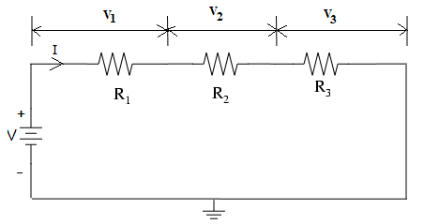
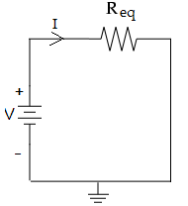

Series circuit
Series circuit
Series equivalent circuit
The total resistance or equivalent resistance across the series circuit is
$$R_{eq}=R_{1}\text{+}R_{2}\text{+}R_{3}$$
$R_{eq}=R_{1}\text{+}R_{2}\text{+}R_{3}$ +….+$R_{n}$

Slide 5
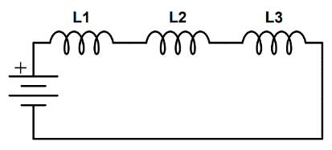

Series circuit
When inductors are connected in series the equivalent inductance can be obtained using the formula
$L_{eq}=L_{1}\text{+}L_{2}\text{+}L_{3}$ +….+$L_{n}$

Slide 6
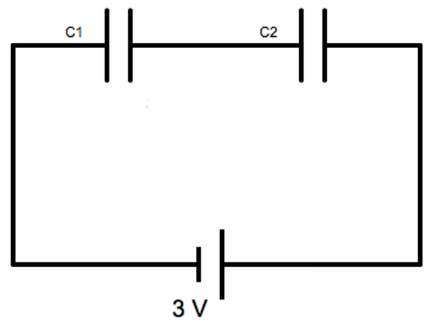

Series circuit
When capacitors are connected in series the equivalent capacitance can be obtained using the formula
$\frac{1}{C_{eq}}= \frac{1}{C_{1}}+\frac{1}{C_{2}} +\frac{1}{C_{3}}$ + …+ $\frac{1}{C_{n}}$

Slide 7
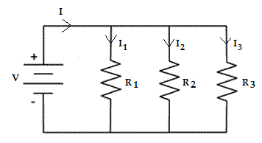
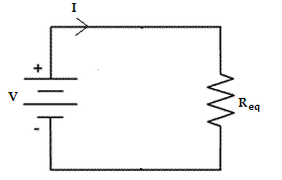
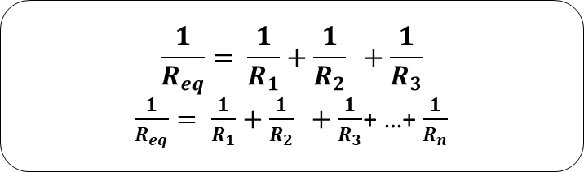
Parallel circuit
When the resistors are connected such that both ends of individual resistors are connected together, and two terminals of the resistors are connected to other part of the circuit, this configuration is called as parallel circuit.
Parallel circuit
Parallel equivalent circuit
The total resistance or equivalent resistance across the parallel circuit is
$$\frac{1}{R_{eq}}= \frac{1}{R_{1}}+\frac{1}{R_{2}} +\frac{1}{R_{3}}$$
$\frac{1}{R_{eq}}= \frac{1}{R_{1}}+\frac{1}{R_{2}} +\frac{1}{R_{3}}$+ …+ $\frac{1}{R_{n}}$

Slide 8
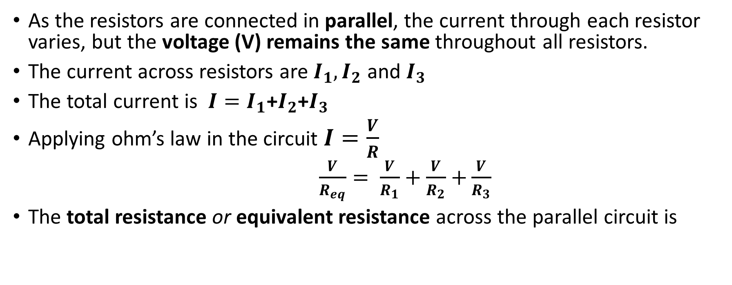

Parallel circuits
As the resistors are connected in parallel, the current through each resistor varies, but the voltage (V) remains the same throughout all resistors.
The current across resistors are $I_{1}, I_{2}$ and $I_{3}$
The total current is $I=I_{1}\text{+}I_{2}\text{+}I_{3}$
Applying ohm’s law in the circuit $I=\frac{V}{R}$
$\frac{V}{R_{eq}}= \frac{V}{R_{1}}+\frac{V}{R_{2}}$ $+\frac{V}{R_{3}}$
The total resistance or equivalent resistance across the parallel circuit is
$$\frac{1}{R_{eq}}= \frac{1}{R_{1}}+\frac{1}{R_{2}} +\frac{1}{R_{3}}$$
$\frac{1}{R_{eq}}= \frac{1}{R_{1}}+\frac{1}{R_{2}} +\frac{1}{R_{3}}$+ …+ $\frac{1}{R_{n}}$

Slide 9
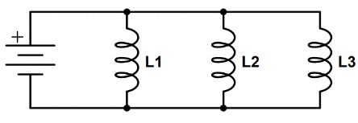

Parallel circuit
When inductors are connected in parallel the equivalent inductance can be obtained using the formula
$\frac{1}{L_{eq}}= \frac{1}{L_{1}}+\frac{1}{L_{2}} +\frac{1}{L_{3}}$ + …+ $\frac{1}{L_{n}}$

Slide 10
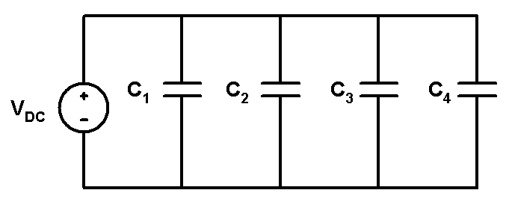

Parallel circuit
When capacitors are connected in parallel the equivalent capacitance can be obtained using the formula
$C_{eq}=C_{1}\text{+}C_{2}\text{+}C_{3}$ +….+$C_{n}$

Slide 11
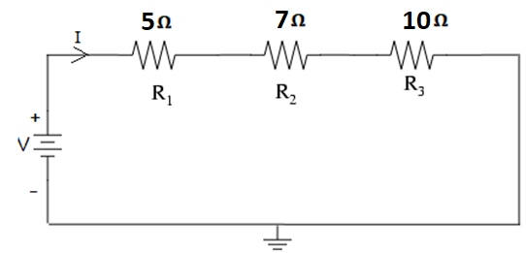
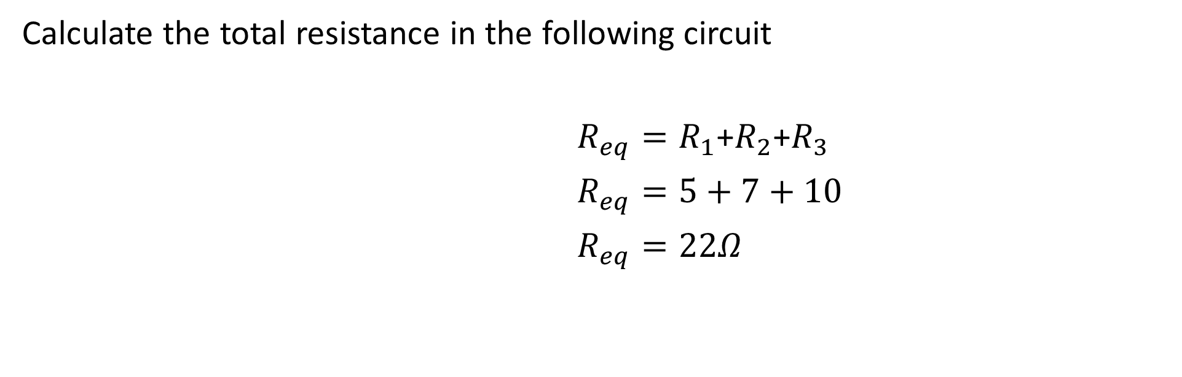
Series and Parallel circuits
Calculate the total resistance in the following circuit
$R_{eq}=R_{1}\text{+}R_{2}\text{+}R_{3}$
$R_{eq}=5+7+10$
$R_{eq}=22Ω$

Slide 12
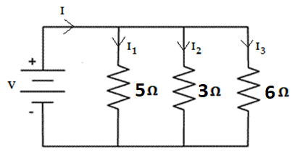
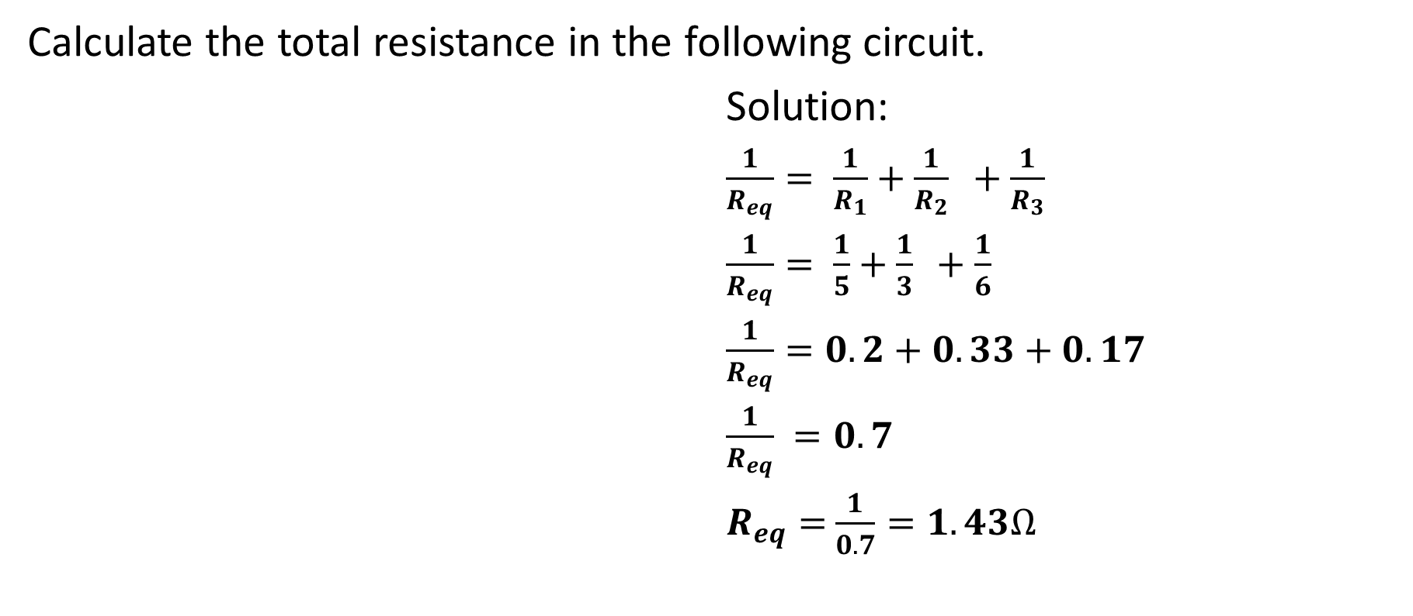
Series and Parallel circuits
Calculate the total resistance in the following circuit.
Solution:
$\frac{1}{R_{eq}}= \frac{1}{R_{1}}+\frac{1}{R_{2}} +\frac{1}{R_{3}}$
$\frac{1}{R_{eq}}= \frac{1}{5}+\frac{1}{3} +\frac{1}{6}$
$\frac{1}{R_{eq}}=0.2+0.33+0.17$
$\frac{1}{R_{eq}} =0.7$
$R_{eq}=$ $\frac{1}{0.7}=1.43Ω$

Slide 13
Voltage divider rule
Voltage divider rule
For easy calculation of voltage drop across each resistors in a series circuit, Voltage divider rule can be used. Consider the following circuit.

Slide 14
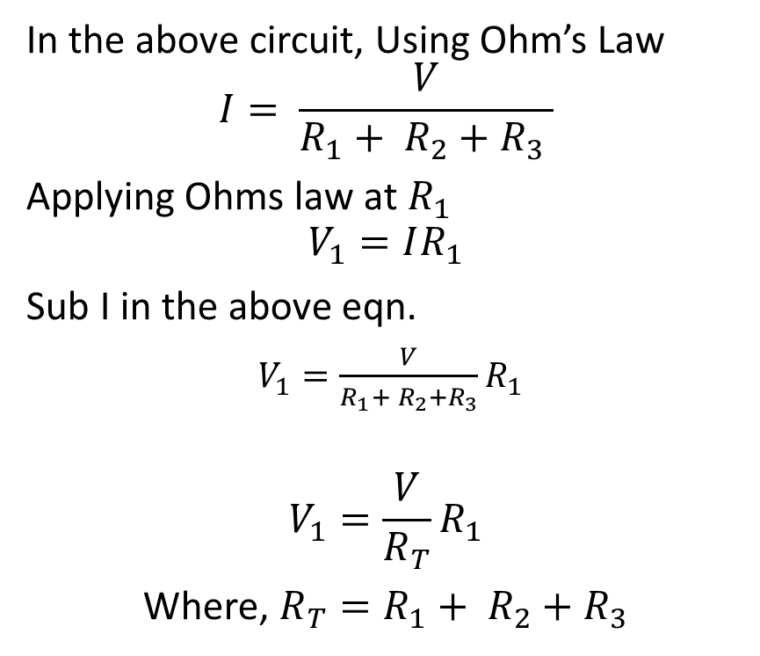
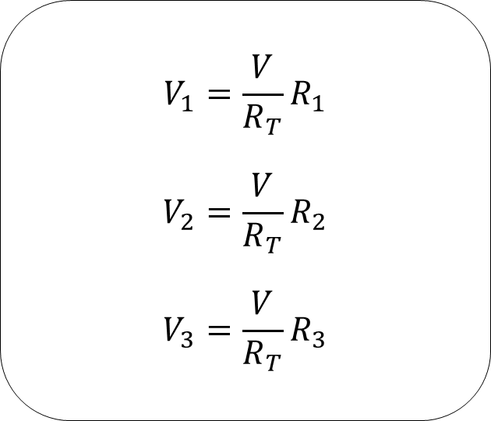
Voltage divider rule
In the above circuit, Using Ohm’s Law
$$I= \frac{V}{R_{1}+ R_{2}+R_{3} }$$
Applying Ohms law at $R_{1}$
$$V_{1}=IR_{1}$$
Sub I in the above eqn.
$V_{1}=\frac{V}{R_{1}+ R_{2}+R_{3}}R_{1}$
$$V_{1}=\frac{V}{R_{T}}R_{1}$$
Where, $R_{T}=R_{1}+ R_{2}+R_{3}$
$$V_{1}=\frac{V}{R_{T}}R_{1}$$
$$V_{2}=\frac{V}{R_{T}}R_{2}$$
$$V_{3}=\frac{V}{R_{T}}R_{3}$$
Lecture 3 / Electrical Principles

Slide 15
Voltage divider rule
The Voltage Divider Rule states that the voltage across any resistor in a series circuit equals the total applied voltage multiplied by the ratio of that resistor’s resistance to the total series resistance.
Lecture3 / Electrical Principles

Slide 16
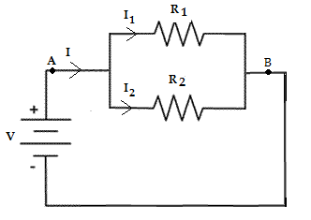
Current divider rule
Current divider rule:
Current divider rule is used in parallel circuits to find the branch currents, if the total current is known.

Slide 17
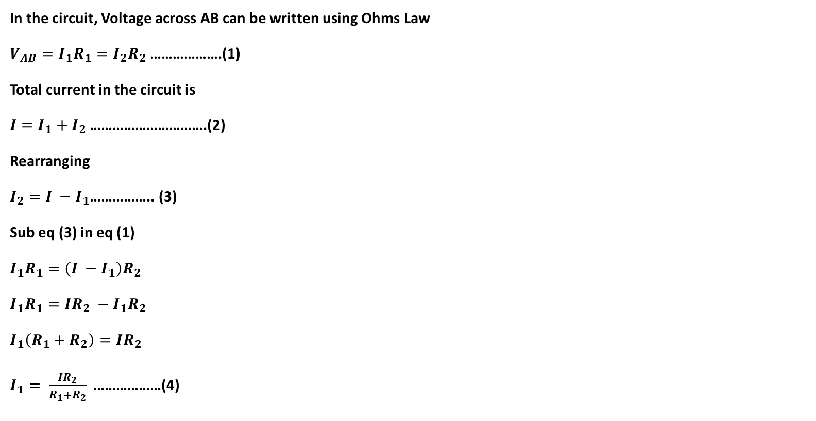
Current divider rule
In the circuit, Voltage across AB can be written using Ohms Law
$V_{AB}=I_{1}R_{1}=I_{2}R_{2}$ ……………….(1)
Total current in the circuit is
$I=I_{1}+I_{2}$ ………………………….(2)
Rearranging
$I_{2}=I −I_{1}$…………….. (3)
Sub eq (3) in eq (1)
$I_{1}R_{1}=\left(I −I_{1}\right)R_{2}$
$I_{1}R_{1}=IR_{2} −I_{1}R_{2}$
$I_{1}\left(R_{1}+R_{2}\right)=IR_{2}$
$I_{1}= \frac{IR_{2}}{R_{1}+R_{2}}$………………(4)

Slide 18
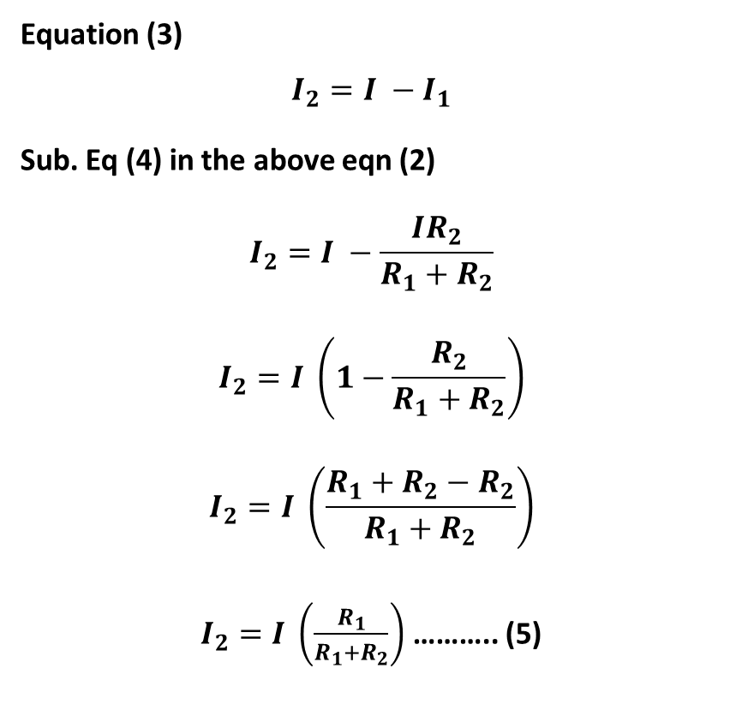
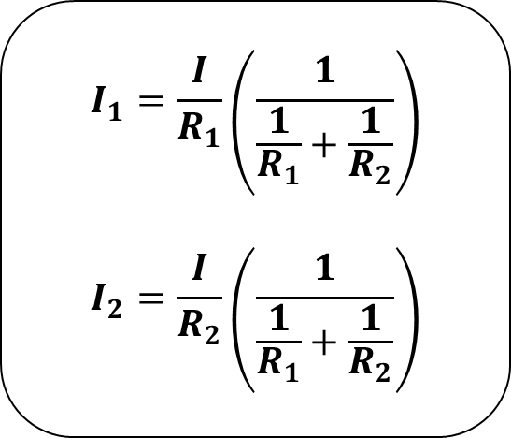
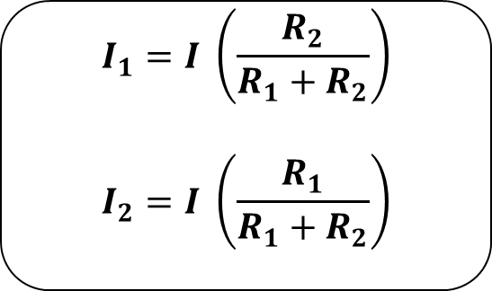
Current divider rule
Equation (3)
$$I_{2}=I −I_{1}$$
Sub. Eq (4) in the above eqn (2)
$$I_{2}=I −\frac{IR_{2}}{R_{1}+R_{2}}$$
$$I_{2}=I \left(1−\frac{R_{2}}{R_{1}+R_{2}}\right)$$
$$I_{2}=I \left(\frac{R_{1}+R_{2}−R_{2}}{R_{1}+R_{2}}\right)$$
$I_{2}=I \left(\frac{R_{1}}{R_{1}+R_{2}}\right)$ ……….. (5)
$$I_{1}=\frac{I}{R_{1}}\left(\frac{1}{\frac{1}{R_{1}}+\frac{1}{R_{2}}}\right)$$
$$I_{2}=\frac{I}{R_{2}}\left(\frac{1}{\frac{1}{R_{1}}+\frac{1}{R_{2}}}\right)$$
$$I_{1}=I \left(\frac{R_{2}}{R_{1}+R_{2}}\right)$$
$$I_{2}=I \left(\frac{R_{1}}{R_{1}+R_{2}}\right)$$
Lecture 3 / Electrical Principles

Slide 19
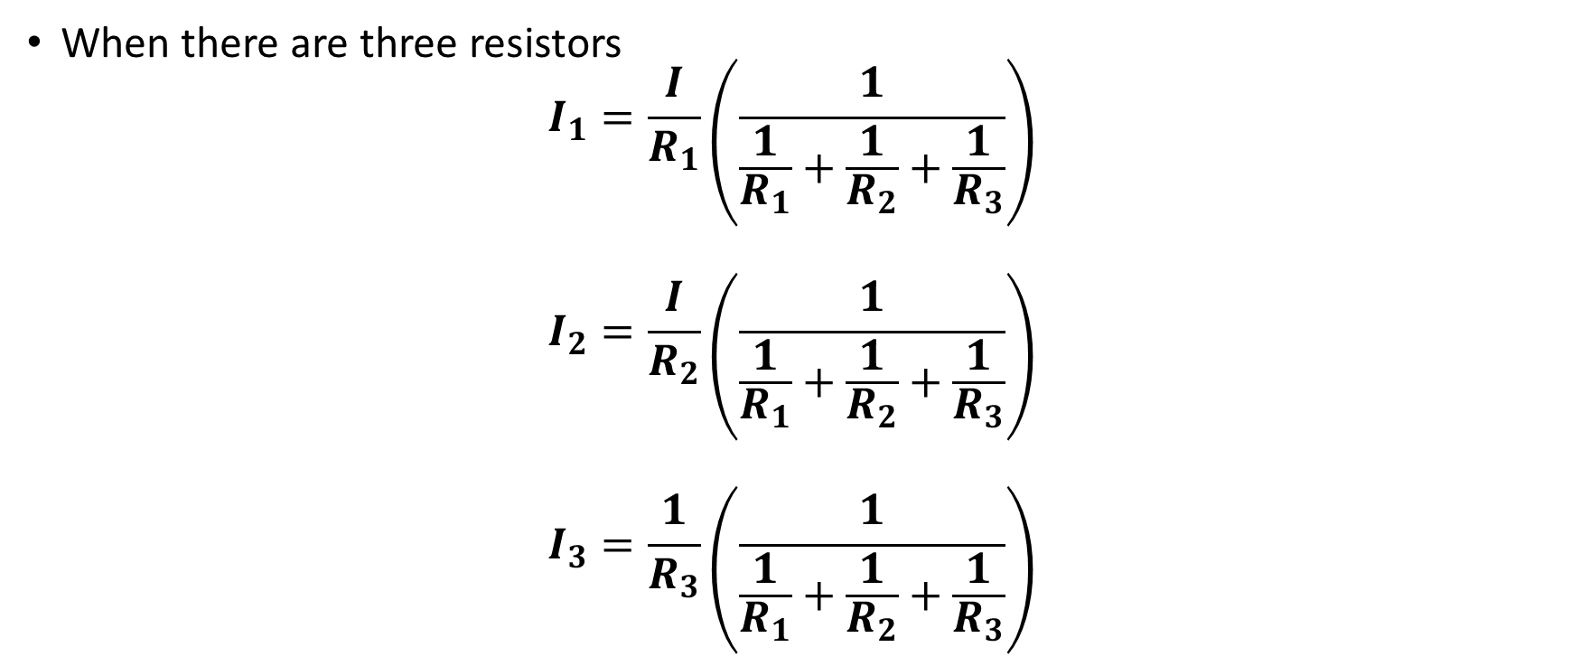
Current divider rule
When there are three resistors
$$I_{1}=\frac{I}{R_{1}}\left(\frac{1}{\frac{1}{R_{1}}+\frac{1}{R_{2}}+\frac{1}{R_{3}}}\right)$$
$$I_{2}=\frac{I}{R_{2}}\left(\frac{1}{\frac{1}{R_{1}}+\frac{1}{R_{2}}+\frac{1}{R_{3}}}\right)$$
$$I_{3}=\frac{1}{R_{3}}\left(\frac{1}{\frac{1}{R_{1}}+\frac{1}{R_{2}}+\frac{1}{R_{3}}}\right)$$
Lecture 3 / Electrical Principles

Slide 20
Current divider rule
The Current Divider Rule states that the current across any resistor in a parallel circuit equals the total current multiplied by the equivalent resistance, divided by the specific branch's resistance.
Lecture 3 / Electrical Principles

Slide 21
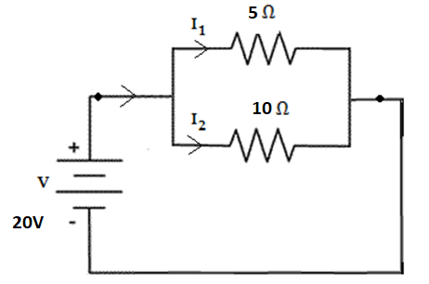
Exercise 1
Calculate the current flowing through the various resistors in the circuit.

Slide 22
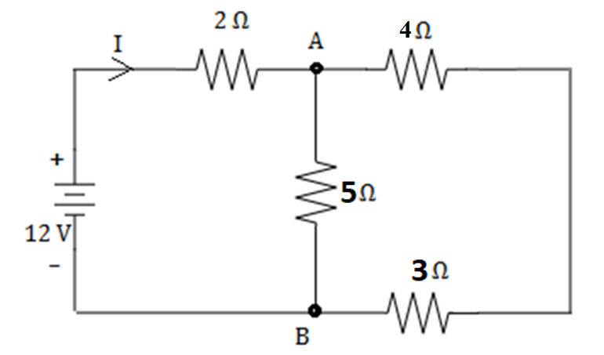
Exercise 2
Calculate the current flowing through the various resistors in the circuit.

Slide 23
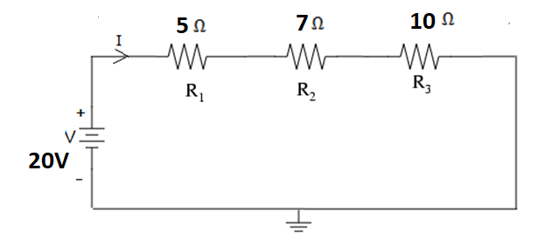
Exercise 3
Calculate the Voltage across various resistors in the circuit.

Slide 24
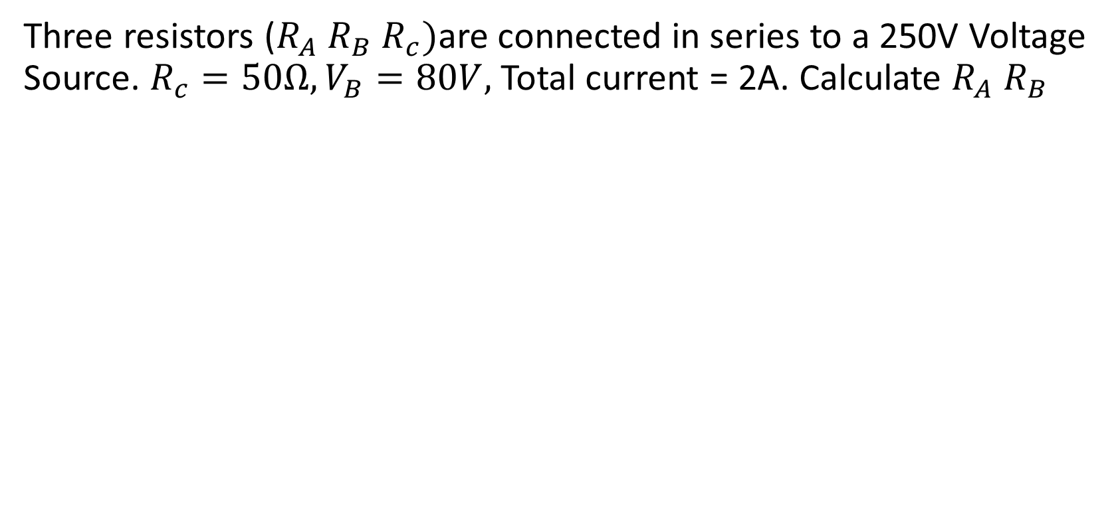
Exercise 4
Three resistors ($R_{A} R_{B} R_{c})$are connected in series to a 250V Voltage Source. $R_{c}=50Ω, V_{B}=80V,$ Total current = 2A. Calculate $R_{A} R_{B}$

Slide 25
Exercise 5
Three resistors 5Ω, 10Ω, and 15Ω are connected in parallel. If the Current in 10Ω resistor is 3A. Calculate the current in other resistors, total current and the voltage applied to the circuit.

Slide 26

Thank You

