Slide 1

Cardiovascular disease
Student name: Desislava Markova
Student number: 2512936
The module code and title: LCHS7003, Community Care and Management of Longer-term Conditions
Lecturer’s name: Dr Raheela Shaikh
Assessment title: Component 2 Individual Presentation

Slide 2
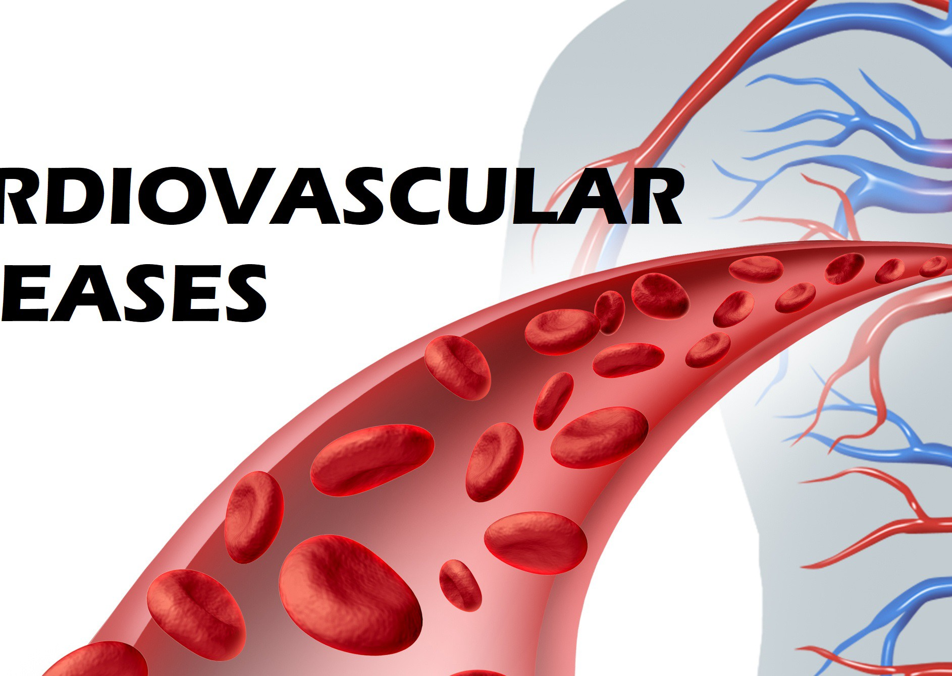
Defenition
A term which is used for a group of conditions which affect the blood vessels and the heart (NHS, 2026). Furthermore, diseases of the cardiac muscle and of the vascular systems that supply the brain, heart, and other vital organs (Gaziano et al., 2006). These refer to 4 entities:
1. Coronary artery (heart) disease is decreased myocardial perfusion resulting in angina due to ischemia (myocardial infarction and/or heart failure) (Lopez, Ballard and Jan, 2023);
2. Aortic atherosclerosis - arteries are narrowed, harder for blood to flow, risk of stroke and heart attack (NHS, 2023a);
3. Peripheral artery (vascular) disease - buildup of fatty deposits in the arteries that restricts blood supply to leg muscles (NHS, 2023b);
4. Cerebrovascular disease - bleeding or ischemia, a pathological process; disorders include carotid stenosis, intracranial stenosis and vertebral stenosis, vascular malformations, stroke and aneurysms (AANS, 2024).
(Awuku, 2020)

Slide 3
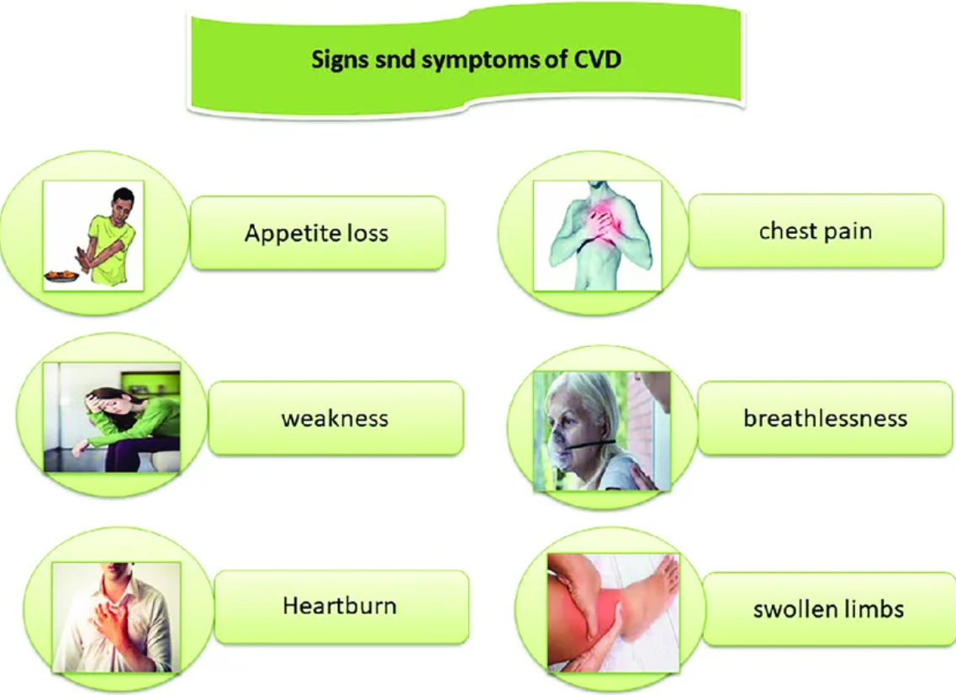
A stroke occurs when the constant blood flow is interrupted, leading to loss of neurological function. A blockage can cause this, leading to the common ischemic stroke, or it can be caused by bleeding in the brain, leading to a more dangerous hemorrhagic stroke (AANS, 2024). Symptomps include:
Disorientation, confusion or memory loss
Nausea, dizziness or vomiting
Loss of vision or difficulti seeing (AANS, 2024)
Face weakness – one side of the face can droop such as the mussels are not working any more and it will be hard to the individual to smile
Arm weakness – unablility to fully lift both arms and keep them up due to weakness in one of the arms
Speach difficulties such as slurred speech and sounding confused
Way to remember easily this main sypmtopmps is by using the abreviasion FAST which stands for Face, Arm, Speach and Time to phone 999 (NHS, 2024a).
(Niazi et. al 2023)

Slide 4
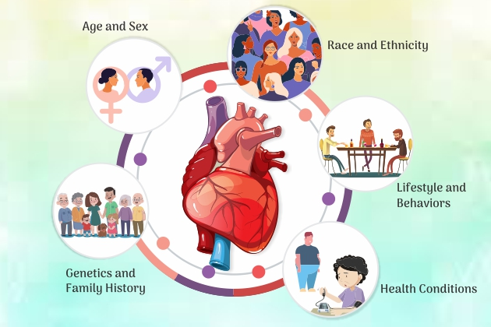
Risk factors/ causes
Cardiovascular disease (CVD) is often caused by a blood clot, which forms when a build-up of fat in the arteries impairs blood flow (NHS, 2026).
Factors which increase the chances of getting CVD include:
Lifestyle- smoking, drinking alcohol, obesity and inactivity
sex- men are more prone to having CVD than women
ethnicity - people from Black African, South Asian or African Caribbean origin
Having family members with CVD
Have conditions such as high blood pressure, diabetes and/or high cholesterol (NHS, 2026).
(Chiranjeevi, 2021)

Slide 5
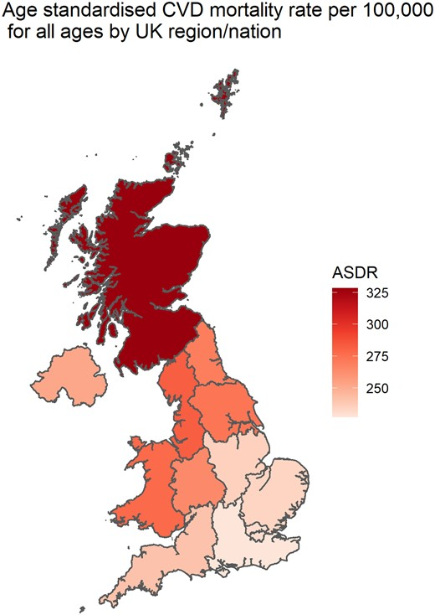
Prevalence of CVD in UK
CVD is the leading cause of death across the UK. In 2019, there were deaths 163 888 making it 27.1%. The Majority of these 73.6% are in older age people above 75 years of age. Nevertheless, over 43,000 people under 75 years of age have passed away, predominantly males than females (Cheema, et al., 2022).
Is fugure represent mortality rates per100 000 from all CVD all ages 2019 (Cheema, et al., 2022).
1.18 million hospital admissions in the UK in 2019/20, CVD conditions were recorded as the primary diagnosis; 57.2% of these patients were male (Cheema, et al., 2022).

Slide 6
CVDs Globaly
In 2022 32% of the glabal deaths were from CVDs and 85% of theses were due to stroke and heart attack (WHO, 2025). Furthermore, over three-quarters of the deaths have occurred in middle- and low-income countries (WHO,2025).
premature deaths (people under 70years of age) who have died due to noncommunicable diseases in 2021, in total 18 million, 38% were from CVDs (WHO, 2025)

Slide 7
Economic Burden
It can be predicted that when the mortality from CVD decreases, the number of people living with the condition will increase; thus, the burden in both economic and health terms needs to be considered.
In the UK, there is an enormous economic burden from CVD, with inpatient care direct costs highest reaching £6.732bn in comparison to long-term care, primary care, medications, outpatient care, medical devices and emergency care, as well as the highest indirect costs from informal care, £6.377 bn, in comparison to production losses to mortality and morbidity (Shih, et al., 2025).
In 179 countries, the total economic burden of heart failure was $284.17 billion in 2021 (Darvish,et al., 2023).

Slide 8
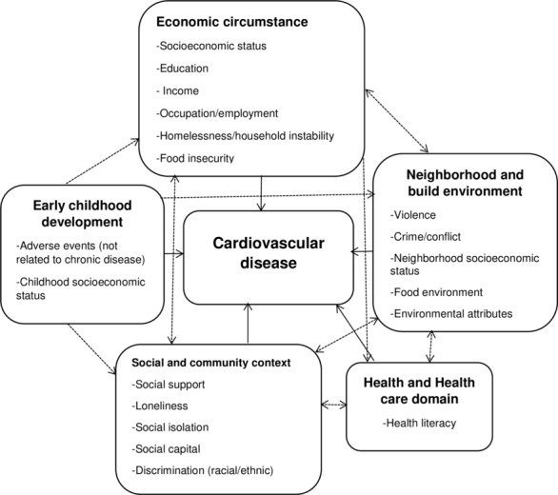
Social Burden
The social burden is concerned beyond indivdual behaviours it is connected to:
the educational access,
neighborhood;
enviromnet
income inequality (Powell-Wiley, et. al., 2020).
Firgure 1. the social determinants of health associated wth CVD
(Powell-Wiley, et. al., 2020).
(Powell-Wiley, et. al., 2020).

Slide 9

Key factors of Social burden from CVD
Heart failure and stroke can cause disability, cognitive impairment, mobility limitations, and chronic disability (Feigin, Norrving and Mensah, 2017);
Patients and caregivers can start experiencing mental health problems such as social isolation, anxiety and depression (Dhar and Barton, 2016 and Joynt, Whellan and O'Connor, 2003);
Health expenditures, which are taken from the patients' pockets, can push families into poverty (Powell-Wiley, et al., 2022);
Child welfare and education, when there is a parental death or illness, can disrupt children's future opportunities and education (Teshale, et al., 2023).
(Muler, no date)

Slide 10
Diagnosis and Initial Assessment
The initial assessment of CVD includes medical history, physical examination, and basic tests to identify symptoms and risk factors. If abnormalities are found, doctors may proceed to advanced tests such as echocardiography, stress testing, or angiography.
Initial assessment of cardiovascular disease involves evaluation of patient history, risk factors, and physical examination (World Health Organization, 2023).
Clinicians commonly assess symptoms such as chest pain, dyspnoea, palpitations, and fatigue when evaluating suspected cardiovascular disease (Mayo Clinic, 2024).
Measurement of blood pressure, heart rate, and auscultation of heart sounds are important components of the cardiovascular physical examination (NICE, 2023).
Basic diagnostic tests such as electrocardiography and blood tests are used during the early assessment to detect potential cardiac abnormalities (Braunwald, 2022).

Slide 11
Diagnosis earlier the better as can allows more effective treatment and lifestyle changes which will prevent complications it is based on clinical evaluation, blood tests and imaging tests.
Physical Examination- blood pressure, heart rate and rhythm, abnormal heart sounds or murmurs, swelling in the legs or feet (peripheral oedema), pulse in different arteries (Mayo Clinic, 2024; National Institute for Health and Care Excellence, 2023).
Laboratory Tests - blood tests - risk factors and signs of heart damage, cholesterol test (lipid profile), blood glucose test, cardiac biomarkers (troponin),kidney and thyroid function tests (World Health Organization, 2023; Braunwald, 2022).
Diagnostic Imaging and Heart Tests - Electrocardiogram (ECG/EKG), Echocardiogram, Chest Xray (Mayo Clinic, 2024), Coronary Angiography (Braunwald, 2022).
Advanced imaging techniques such as computed tomography (CT) scans and cardiac magnetic resonance imaging (MRI) provide detailed images of the heart structures, blood vessels, and surrounding tissues, assisting in the diagnosis of cardiovascular disease (World Health Organization, 2023).

Slide 12
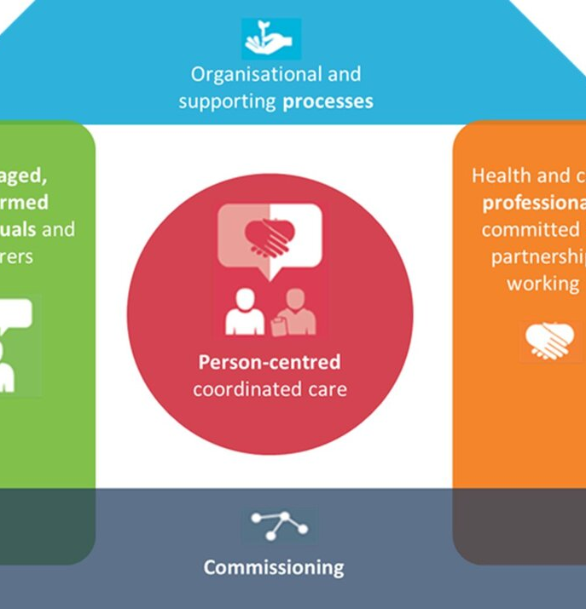
House of Care Model
Developed by the NHS to improve the management of long-term conditions in a person-centred care and collaboration between patients and healthcare professionals (Coulter, et al., 2016)
1. Engaged and Informed Patients (Left Wall) - actively participate in managing their health. They receive education about their condition, lifestyle changes, medications, and prevention strategies. For example, patients with CVD may receive support for smoking cessation, diet improvement, and physical activity (Coulter, Roberts and Dixon, 2013).
2. Health and Care Professionals (Right Wall) - doctors, nurses, pharmacists, and allied health professionals, work together to support patients. They use their clinical knowledge and communication skills to guide shared decision-making and personalised care planning (Coulter, Roberts and Dixon, 2013).
3. Organisational Systems (Foundation)- The base of the house represents healthcare systems andinfrastructure, such as electronic health records, appointment systems, and coordinated care pathways. These systems helpensure that care is efficient, continuous, and well-coordinated (Coulter, Roberts and Dixon, 2013).

Slide 13
House of Care Model continued
4. Commissioning (Roof) - The roof represents healthcare planning and funding.Commissioners ensure that the necessary services—such as cardiac rehabilitation programmes, community support, andspecialist care—are available to patients (Coulter, Roberts and Dixon, 2013).
5. Care Planning (Centre) - At the centre of the model is the care planning conversationbetween patients and healthcare professionals. This discussionhelps create a personalised care plan that supports long-termmanagement of conditions such as cardiovascular disease (Coulter, Roberts and Dixon, 2013).
Organisations such as the NHS and the National Institute for Health and Care Excellence promote person-centred and collaborative care models for chronic conditions through clinical guidelines and patient-centred care frameworks (NICE, 2023; NHS, 2024).
Key Benefit for Cardiovascular Disease Management
Using the House of Care Model helps:
Improve patient engagement and self-management
Support multidisciplinary care
Promote preventive lifestyle changes
Reduce hospital admissions and complications from CVD

Slide 14
Treatment Options for CVD in UK
1. Lifestyle & Behavioural Interventions
Lifestyle modification is the foundation of long-term CVD management:
Healthy diet, weight control, and physical activity to reduce risk factors such as high cholesterol and hypertension (NHS, 2024b).
Smoking cessation and reduction of alcohol intake (NHS, 2024b).
Cardiac rehabilitation after events such as heart attacks (NHS, 2024b)
2. Pharmacological (Medicines) Management
Medicines are prescribed lifelong or long-term to manage risk and prevent complications:
Lipid-lowering therapy (e.g., statins) to reduce cardiovascular events (NHS, 2024b; NICE, 2023).
Antiplatelet drugs (e.g., aspirin) to reduce clot risk after heart events (NICE, 2023).
Antihypertensives including ACE inhibitors, ARBs and beta-blockers to manage blood pressure (NHS, 2024b).
Combination therapies are common in long-term heart failure management (NHS, 2024b).

Slide 15
Treatment options continued
3. Procedures & Surgical Options
When medications or lifestyle changes are insufficient:
Percutaneous Coronary Intervention (PCI) / angioplasty to open narrowed arteries (NHS, 2024c; NHS Wales, 2024).
Coronary artery bypass graft (CABG) surgery for extensive blockage (Royal Papworth NHS, 2025).
Devices such as pacemakers or defibrillators for rhythm control in specific conditions (NHS, 2025).
4. Ongoing Monitoring and Risk Assessment
Long-term management includes regular monitoring and prevention strategies:
Regular GP follow-ups to monitor blood pressure, cholesterol, and medication effectiveness (NICE, 2023).
Use of risk assessment tools such as QRISK to guide treatment (NICE, 2023).
NHS Health Checks for eligible adults to detect and manage risk factors early (NHS, 2024)

Slide 16
Cardiovascular disease (CVD) often occurs alongside other long-term health conditions (comorbidities). These conditions can worsen cardiovascular outcomes and complicate treatment.
Common comorbidities associated with cardiovascular disease include:
Diabetes mellitus
Hypertension
Obesity
Chronic kidney disease
These conditions increase the severity, complications, and mortality risk of cardiovascular disease, making early detection and integrated management essential (NICE, 2023 and NICE CKS, 2025;).

Slide 17
Prevention - Identifying and Assessing Risk
Primary care teams use structured CVD risk assessment tools (e.g., QRISK3) to estimate a person’s 10-year risk and guide preventative action such as statin therapy and lifestyle support (NICE, 2023). Updated NICE guidance was published in December 2023 and reviewed in 2025, with new recommendations on lipid targets and ongoing risk assessment (NICE, 2023; NICE, 2025).
Blood Pressure and Diabetes Control
Controlling hypertension and diabetes — two of the strongest modifiable risk factors for CVD — can substantially reduce the likelihood of heart attacks and strokes.
Recent reports highlight that nearly 29 % of CVD deaths occur in individuals with diabetes, calling for strengthened diabetes care and prevention as part of CVD strategy (The Guardian, 2025).
Aspirin - Routine use of aspirin for primary CVD prevention is not recommended due to limited benefit outweighing bleeding risk (NICE, 2023).

Slide 18
Prevention
The recommendations from SIGN (2017) are that every 5 years, a CVD risk assessment is conducted for all individuals aged 40 and over, even if there is no history of CVD, chronic kidney disease, familial hypercholesterolaemia, or diabetes mellitus and people who do not receive treatment for lipids or high blood pressure. Furthermore, to assess the risk of people with a first-degree relative who has familial dyslipidaemia or premature atherosclerotic CVD without age consideration (SIGN, 2017).
Key prevention strategies for CVD: Healthy diet, regular physical activity, smoking cessation, maintaining a healthy weight, regular health screening and early risk detection. These reduce risk factors and prevent the development or progression of CVD (NHS, 2024 and NICE, 2023).
UK Public Health and Policy Actions
National programmes such as the NHS CVD Prevention Programme aim to improve detection, management and treatment of high-risk conditions like hypertension, atrial fibrillation and high cholesterol (NHS England, no date a).
Government targets include reducing premature deaths from heart disease and stroke by 25 % within a decade, although delivery and uptake of prevention services vary regionally (Lords Library, 2025).
Cardiovascular disease prevention recovery plans emphasise lifestyle change and early detection following reduced screening during COVID-19 and aim to improve uptake of prevention and secondary care measures (NHS, 2022).

Slide 19
Skills, values and behaviours for co-productive care (CVD)
communication skills – explan of the patient’s condition, treatment options, and lifestyle interventions while actively listening to patient concerns. Improves treatment adherence and patient satisfaction (Barry and Edgman-Levitan, 2012). However, communication alone does not guarantee co-production. Patients with limited health literacy or complex social circumstances may struggle to interpret medical information, suggesting that clinicians must adapt communication strategies to individual needs (Elwyn et al., 2012).
Professional values such as respect, empathy, and dignity are essential. Person-centred values encourage healthcare professionals to recognise patients as active partners rather than passive recipients of care. This is particularly relevant for individuals with CVD, where long-term lifestyle adjustments—such as dietary changes and increased physical activity—require sustained motivation. Nevertheless, critics argue that healthcare systems often promote person-centred values rhetorically while organisational pressures, including limited consultation time and high workload, restrict genuine patient involvement (Coulter, 2011).
Collaborative behaviours and shared decision-making also play a crucial role in co-productive care. Shared decision-making allows patients to weigh treatment benefits and risks according to their preferences, leading to more personalised care plans. Evidence suggests that collaborative decision-making improves engagement and health outcomes in chronic disease management (Elwyn et al., 2012). However, this approach can be challenging when patients feel overwhelmed by complex medical information or prefer clinicians to take a more directive role.
Supporting patient empowerment and self-management is critical for individuals with CVD. Education, cardiac rehabilitation programmes, and lifestyle counselling enable patients to take greater responsibility for managing their condition. While empowerment can improve long-term outcomes, it may unintentionally shift responsibility onto patients without addressing broader social determinants of health such as poverty or access to healthy food (Coulter, 2011).

Slide 20
The comprehensive model of personalised care
Encourages patients and healthcare professionals to collaborate; NHS England also promotes it to improve person-centred care.
The model includes six evidence-based components, which can be applied to improve the management of CVD (NHS England, no date b).
Shared decision-making involves patients working together with healthcare professionals to choose treatments and care plans that reflect their preferences and values. In CVD management, this could include discussing medication options, lifestyle changes, and cardiac rehabilitation programmes. This approach improves patient engagement and adherence to treatment because individuals feel more involved in their care (Elwyn et al., 2012).
Personalised Care and Support Planning - develops care plans that consider the patient’s health needs, goals, and circumstances. For individuals with CVD, this may include tailored plans for physical activity, diet modification, medication adherence, and risk factor management such as smoking cessation or blood pressure control (NICE, no date). Personalised planning ensures that treatment is realistic and relevant to the patient’s lifestyle (NHS England, no date c).

Slide 21
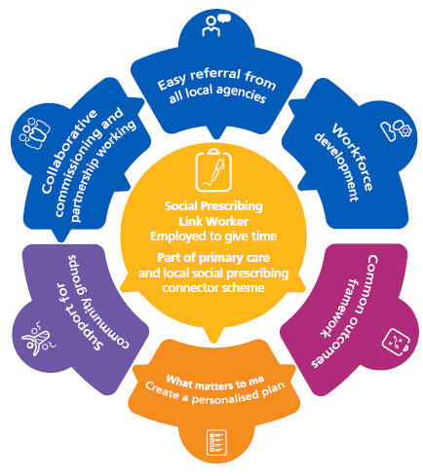
3. Social prescribing allows healthcare professionals to refer patients to community services that support health and wellbeing. For people with CVD, this might include referral to exercise groups, weight-management programmes, or community support groups. These services help address social and lifestyle factors that influence cardiovascular health (NHS England, no date d).
4. Supported self-management involves providing patients with education, tools, and confidence to manage their own health. For CVD, this includes monitoring blood pressure, maintaining healthy diets, exercising regularly, and adhering to prescribed medication. Evidence suggests that self-management support improves long-term outcomes and reduces hospital admissions for chronic conditions (Coulter, 2011).
(NHS England, no date d)

Slide 22
5.Personal health budgets allow individuals to have more control over how funding for their healthcare is used. For patients with CVD, this might support services such as rehabilitation programmes, home-based monitoring devices, or community wellbeing activities that improve cardiovascular health (NHS England, no date e).
6.Integrated personalised care ensures coordination between different healthcare professionals involved in CVD management, such as cardiologists, nurses, dietitians, and physiotherapists. This multidisciplinary approach helps deliver holistic care that addresses medical treatment, lifestyle factors, and psychological support (NICE, 2023).
Conclusion
Applying the six components of the personalised care model can significantly improve the management of CVD, as all of these components promote patient involvement and empowerment. Resulting in improved treatment adherence, enhance quality of life, and supporting better long-term outcomes for individuals living with CVD.

Slide 23
References:
AANS (2024) Cerebrovascular Disease.
Available at: https://www.aans.org/patients/conditions-treatments/cerebrovascular-disease/ (Accessed: 3 March 2026).
Awuku, P.L. (2020) What are Cardiovascular Diseases (CVD)? Available at: https://www.eathealthnutrition.com/what_is_a_cardiovasculardisease.html (Accessed: 14 March 2026).
Barry, M.J. and Edgman-Levitan, S. (2012) ‘Shared decision making — the pinnacle of patient-centered care’, New England Journal of Medicine, 366(9), pp. 780–781.
Braunwald, E. (2022) Braunwald’s Heart Disease: A Textbook of Cardiovascular Medicine. 12th edn. Philadelphia: Elsevier.
Cheema, K.M., Dicks, E., Pearson, J. and Samani, N.J. (2022) Long-term trends in the epidemiology of cardiovascular diseases in the UK: insights from the British Heart Foundation statistical compendium, Cardiovascular Research, 118(10), pp. 2267-2280. Available at: https://doi.org/10.1093/cvr/cvac053
Chiranjeevi (2021) Assessing the Risk Factors of Cardiovascular Diseases. Available at: https://blog.thyrocare.com/assessing-the-risk-factors-of-cardiovascular-diseases/ (Accessed: 13 March 2026)
Coulter, A. (2011) Engaging patients in healthcare. Maidenhead: Open University Press.
Coulter, A., Roberts, S. and Dixon, A. (2013) Delivering better services for people with long-term conditions: Building the House of Care. London: The King’s Fund, Available at: https://www.yearofcare.co.uk/wp-content/uploads/2024/06/delivering-better-services-for-people-with-long-term-conditions.pdf
Coulter, A., Kramer, G., Warren, T. and Salisbury, C. (2016) ‘Building the House of Care for people with long-term conditions: the foundation of the House of Care framework’, British Journal of General Practive, 66 (645), Available at: https://bjgp.org/content/66/645/e288

Slide 24
Darvish, M., Shakoor, A., Feyz, L., Schaap, J., Van Mieghem, N.M., De Boer, R.A., Brugts, J.J. and van der Boon, R.M.A. (2023) ‘Heart failure: assessment of the global economic burden’, European Heart Journal, 46(31), pp. 3069–3078. Available at: https://doi.org/10.1093/eurheartj/ehaf323
Dhar, A. K., & Barton, D. A. (2016) ‘Depression and the Link with Cardiovascular Disease’, Frontiers in psychiatry. 7, 33. Available at: https://doi.org/10.3389/fpsyt.2016.00033
Elwyn, G., Frosch, D., Thomson, R., Joseph-Williams, N., Lloyd, A., Kinnersley, P., Cording, E., Tomson, D., Dodd, C., Rollnick, S., Edwards, A. and Barry, M. (2012) ‘Shared decision making: a model for clinical practice’, Journal of General Internal Medicine, 27(10), pp. 1361–1367.
Feigin V.L., Norrving B. and Mensah, G.A. (2017) ‘Global Burden of Stroke’. Circulation Research, 120(3). Available at: https://doi.org/10.1161/CIRCRESAHA.116.308413
Gaziano, T., Reddy KS., Paccaud, F., (2006) “Cardiovascular disease”, in Jamison, D.T., Breman, J.G., Measham, A.R. (eds) Disease Control Priorities in Developing Countries. 2nd edn. Washington (DC): The International Bank for Reconstruction and Development / The World Bank, pp. 1-55. Available at: https://www.ncbi.nlm.nih.gov/books/NBK11767/?report=reader
Joynt, K.E., Whellan, D.J. and O’Connor, C.M. (2003) ‘Depression and cardiovascular disease: mechanisms of interaction', Biological Psychiatry, 54(3), pp. 248-261. Available at: https://www.sciencedirect.com/science/article/abs/pii/S0006322303005687
Lopez, E.O., Ballard, B.D. and Jan, A. (2023) ‘Cardiovascular Disease’, StatPearls. Available at: https://www.ncbi.nlm.nih.gov/books/NBK535419/ (Accessed: 14 March 2026).
Lords Library (2025) What is the government doing about cardiovascular disease? Available at: https://lordslibrary.parliament.uk/cardiovascular-disease-what-is-the-government-doing-about-englands-leading-cause-of-premature-death/ (Accessed: 13 March 2026).
Mayo Clinic (2024) Heart disease: Diagnosis and treatment. Available at: https://www.mayoclinic.org/diseases-conditions/heart-disease/symptoms-causes/syc-20353118 (Accessed: 14 March 2026).

Slide 25
Muler., M (no date) What is the Socioeconomic Burden of Cardiovascular Disease? Available at:
https://www.wifor.com/en/socioeconomic-burden-of-cardiovascular-disease/ (Accessed: 13 March 2026).
NHS (2022) CVD prevention recovery. Available at: https://www.england.nhs.uk/wp-content/uploads/2022/06/cvd-prevention-recovery-briefing-june-2022.pdf (Accessed: 13 March 2026).
NHS (2023a) Atherosclerosis. Available at: https://www.nhs.uk/conditions/atherosclerosis/ (Accessed: 3 March 2026).
NHS (2023b) Peripheral arterial disease (PAD). Available at: https://www.nhs.uk/conditions/peripheral-arterial-disease-pad/ (Accessed: 3 March 2026).
NHS (2024a) Symptoms of a stroke. Available at: https://www.nhs.uk/conditions/stroke/symptoms/ (Accessed: 3 March 2026).
NHS (2024b) Coronary heart disease – treatment. Available at: https://www.nhs.uk/conditions/coronary-heart-disease/treatment/ (Accessed: 11 March 2026).
NHS (2024c) Prevention of coronary heart disease. Available at: https://www.nhs.uk/conditions/coronary-heart-disease/prevention/ (Accessed: 13 March 2026).
NHS Wales (2024) Coronary heart disease – treatment. Available at: https://111.wales.nhs.uk/coronaryheartdisease/ (Accessed: 5 March 2026).
NHS (2025) Heart failure – treatment. Available at: https://www.nhs.uk/conditions/heart-failure/treatment/ (Accessed: 11 March 2026).

Slide 26
NHS (2026) Cardiovascular disease. Available at: https://www.nhs.uk/conditions/cardiovascular-disease/ (Accessed: 03 March 2026).
NHS England (no date a) Cardiovascular disease (CVD). Available at: https://www.england.nhs.uk/ourwork/clinical-policy/cvd/ (Accessed: 14 March 2026).
NHS England (no date b) Comprehensive model of personalised care. Available at: https://www.england.nhs.uk/personalisedcare/comprehensive-model-of-personalised-care/ (Accessed: 14 March 2026).
NHS England (no date c) Personalised care. Available at: https://www.england.nhs.uk/personalisedcare/ (Accessed: 13 March 2026).
NHS England (no date d) Social-prescribing. Available at: https://www.england.nhs.uk/personalisedcare/social-prescribing/ (Accessed: 11 March 2026)
NHS England (no date e) Personal Health Budgets. Available at: https://www.england.nhs.uk/personalisedcare/personal-health-budgets/ (Accessed: 11 March 2026).
Niazi, M.K., Saeed, Z., Imran, S. and Hassan, F. (2023) ‘Therapeutic Effect of Barley on Cardiovascular Diseases’, Frontiers in Clinical Trials. Available at: https://www.researchgate.net/figure/Sign-and-symptoms-of-CVD_fig1_373410871
NICE (2023) Cardiovascular disease: risk assessment and reduction, including lipid modification. Available at: https://www.nice.org.uk/guidance/ng238/resources/cardiovascular-disease-risk-assessment-and-reduction-including-lipid-modification-pdf-66143902851781 (Accessed: 10 March 2026).

Slide 27
NICE (no date) Cardiovascular disease risk assessment and prevention. Available at: https://bnf.nice.org.uk/treatment-summaries/cardiovascular-disease-risk-assessment-and-prevention/ (Accessed: 10 March 2026).
NICE (2025) Cardiovascular risk assessment and lipid modification. Available at: https://www.nice.org.uk/guidance/qs100 (Accessed: 10 March 2026).
NICE Clinical Knowledge Summary (CKS) (2025) Cardiovascular disease risk assessment and management: risk factors including comorbidities. Available at: https://cks.nice.org.uk/topics/cvd-risk-assessment-management/background-information/risk-factors-for-cvd/ (Accessed: 13 March 2026).
Powell-Wiley, T.M., Baumer, Y., Baah, F.O., Baez, A.,S., Farmer, N., Mahlobo, C.T., Pita, M.A., Potharaju, K.A., Tamura, K. and Wallen, G.R. (2022) Social Determinants of Cardiovascular Disease, Circulation Research, 130(5). Available at: https://doi.org/10.1161/CIRCRESAHA.121.319811
Reidy, C., Kennedy, A., Pope, C., Ballinger, C., Vassilev, I. and Rogers, A. (2016) ‘Commissioning of self-management support for people with long-term conditions: an exploration of commissioning aspirations and processes’, BMJ Open, 6(7), Available at: 10.1136/bmjopen-2015-010853

Slide 28
Royal Papworth NHS (2025) Coronary artery disease – treatment. Available at: https://royalpapworth.nhs.uk/our-services/cardiology-services/interventional-cardiology (Accessed: March 2026).
Scottish Intercollegiate Guidelines Network (SIGN) (2017) Risk estimation and the prevention of cardiovascular disease (SIGN publication no. 149). Edinburgh: SIGN. Available at: https://www.sign.ac.uk/assets/sign149.pdf (Accessed: 13 March 2026).
Shih, K., Herz, N., Sheikh, A., O’Neill, C., Carter, P. and Anderson, M. (2025) Economic burden of cardiovascular disease in the United Kingdom, European Heart Journal - Quality of Care and Clinical Outcomes, 11(5), pp. 678–690. Available at: https://doi.org/10.1093/ehjqcco/qcaf011
Teshale, A. B., Htun, H. L., Owen, A., Gasevic, D., Phyo, A. Z. Z., Fancourt, D., Ryan, J., Steptoe, A., & Freak-Poli, R (2023) ‘The Role of Social Determinants of Health in Cardiovascular Diseases: An Umbrella Review’, Journal of the American Heart Association, 12(13). Available at: https://doi.org/10.1161/JAHA.123.029765
World Health Organization (2025) Cardiovascular diseases (CVDs). Available at: https://www.who.int/news-room/fact-sheets/detail/cardiovascular-diseases-(cvds) (Accessed: 14 March 2026).

