Slide 1
Changemakers: Creativity and Value Creation
(BMHP5014)
Week 7
Unit 4: What’s the verdict?
Topic 1: It's all in the numbers
Topic 2: There's a theme here

Slide 2

Objectives of session…
Discuss and understand Unit 4 topics about:
Quantitative research
Quantitative data analysis
Qualitative research
Qualitative data analysis

Slide 3

What does quantitative research mean?

Slide 4
Quantitative research
Quantitative research is the process of collecting and analysing numerical data.
(Watson, 2015)

Slide 5

What statistics mean?

Slide 6

What statistics mean

Slide 7
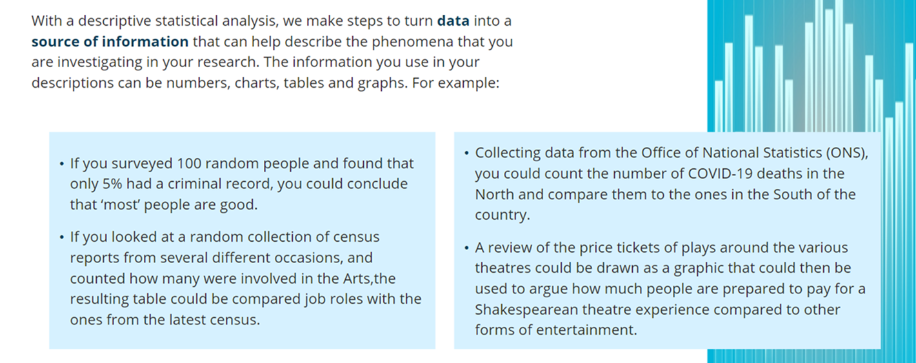
Descriptive statistical analysis

Slide 8
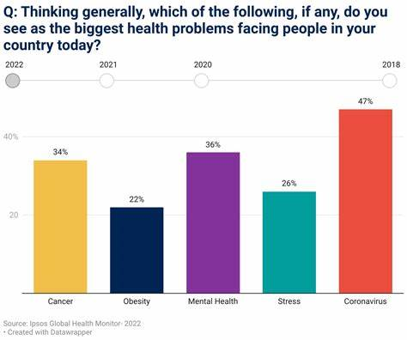
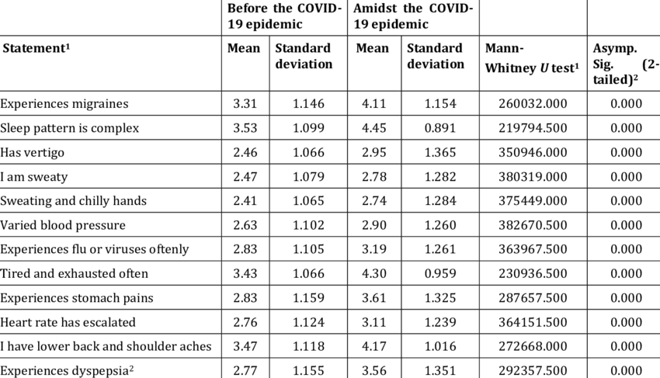
Types of statistic

Slide 9
Class discussion
Topic: Mental health in the UK.
Think of a research question about this topic, for which it would be required to use descriptive statistics.
Write on Moodle and Share with the class.

Slide 10
Research sample for quantitative study
Quantitative research is a way to learn about a particular group of people, known as a sample population.
Using scientific inquiry, quantitative research relies on data that are observed or measured to examine questions about the sample population.
(Delice, 2010)

Slide 11
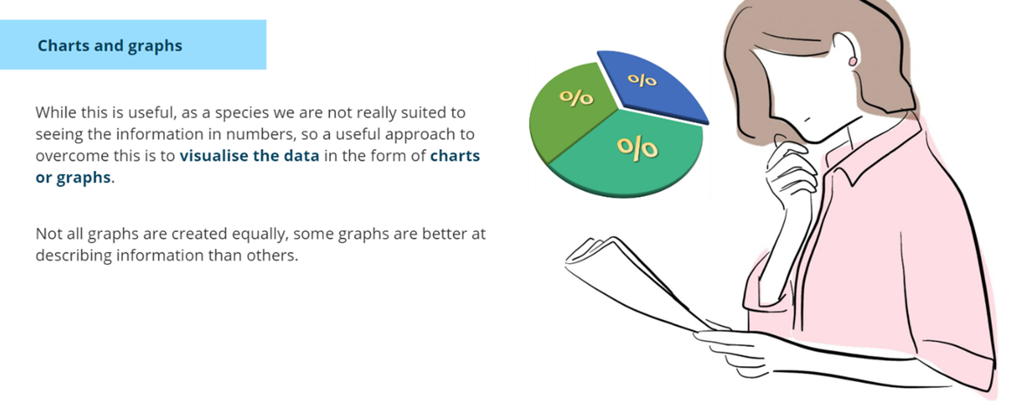
Analysing quantitative data

Slide 12
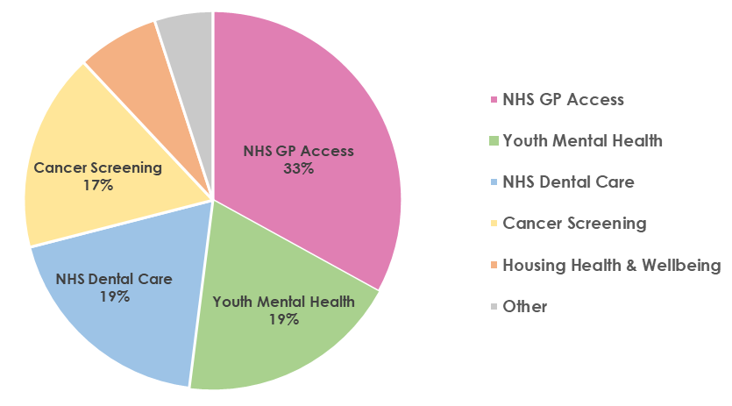
Chart presentation in understanding data
A chart is a graphical representation for data visualisation, in which "the data is represented by symbols, such as bars in a bar chart, lines in a line chart, or slices in a pie chart".
A chart can represent tabular numeric data, functions or some kinds of quality structure and provides different info.
Example: Top Health Priorities in Enfield
Source: Healthwatch Enfield Listening to Enfield: Community Priorities for 2024–2025 | Healthwatch Enfield

Slide 13
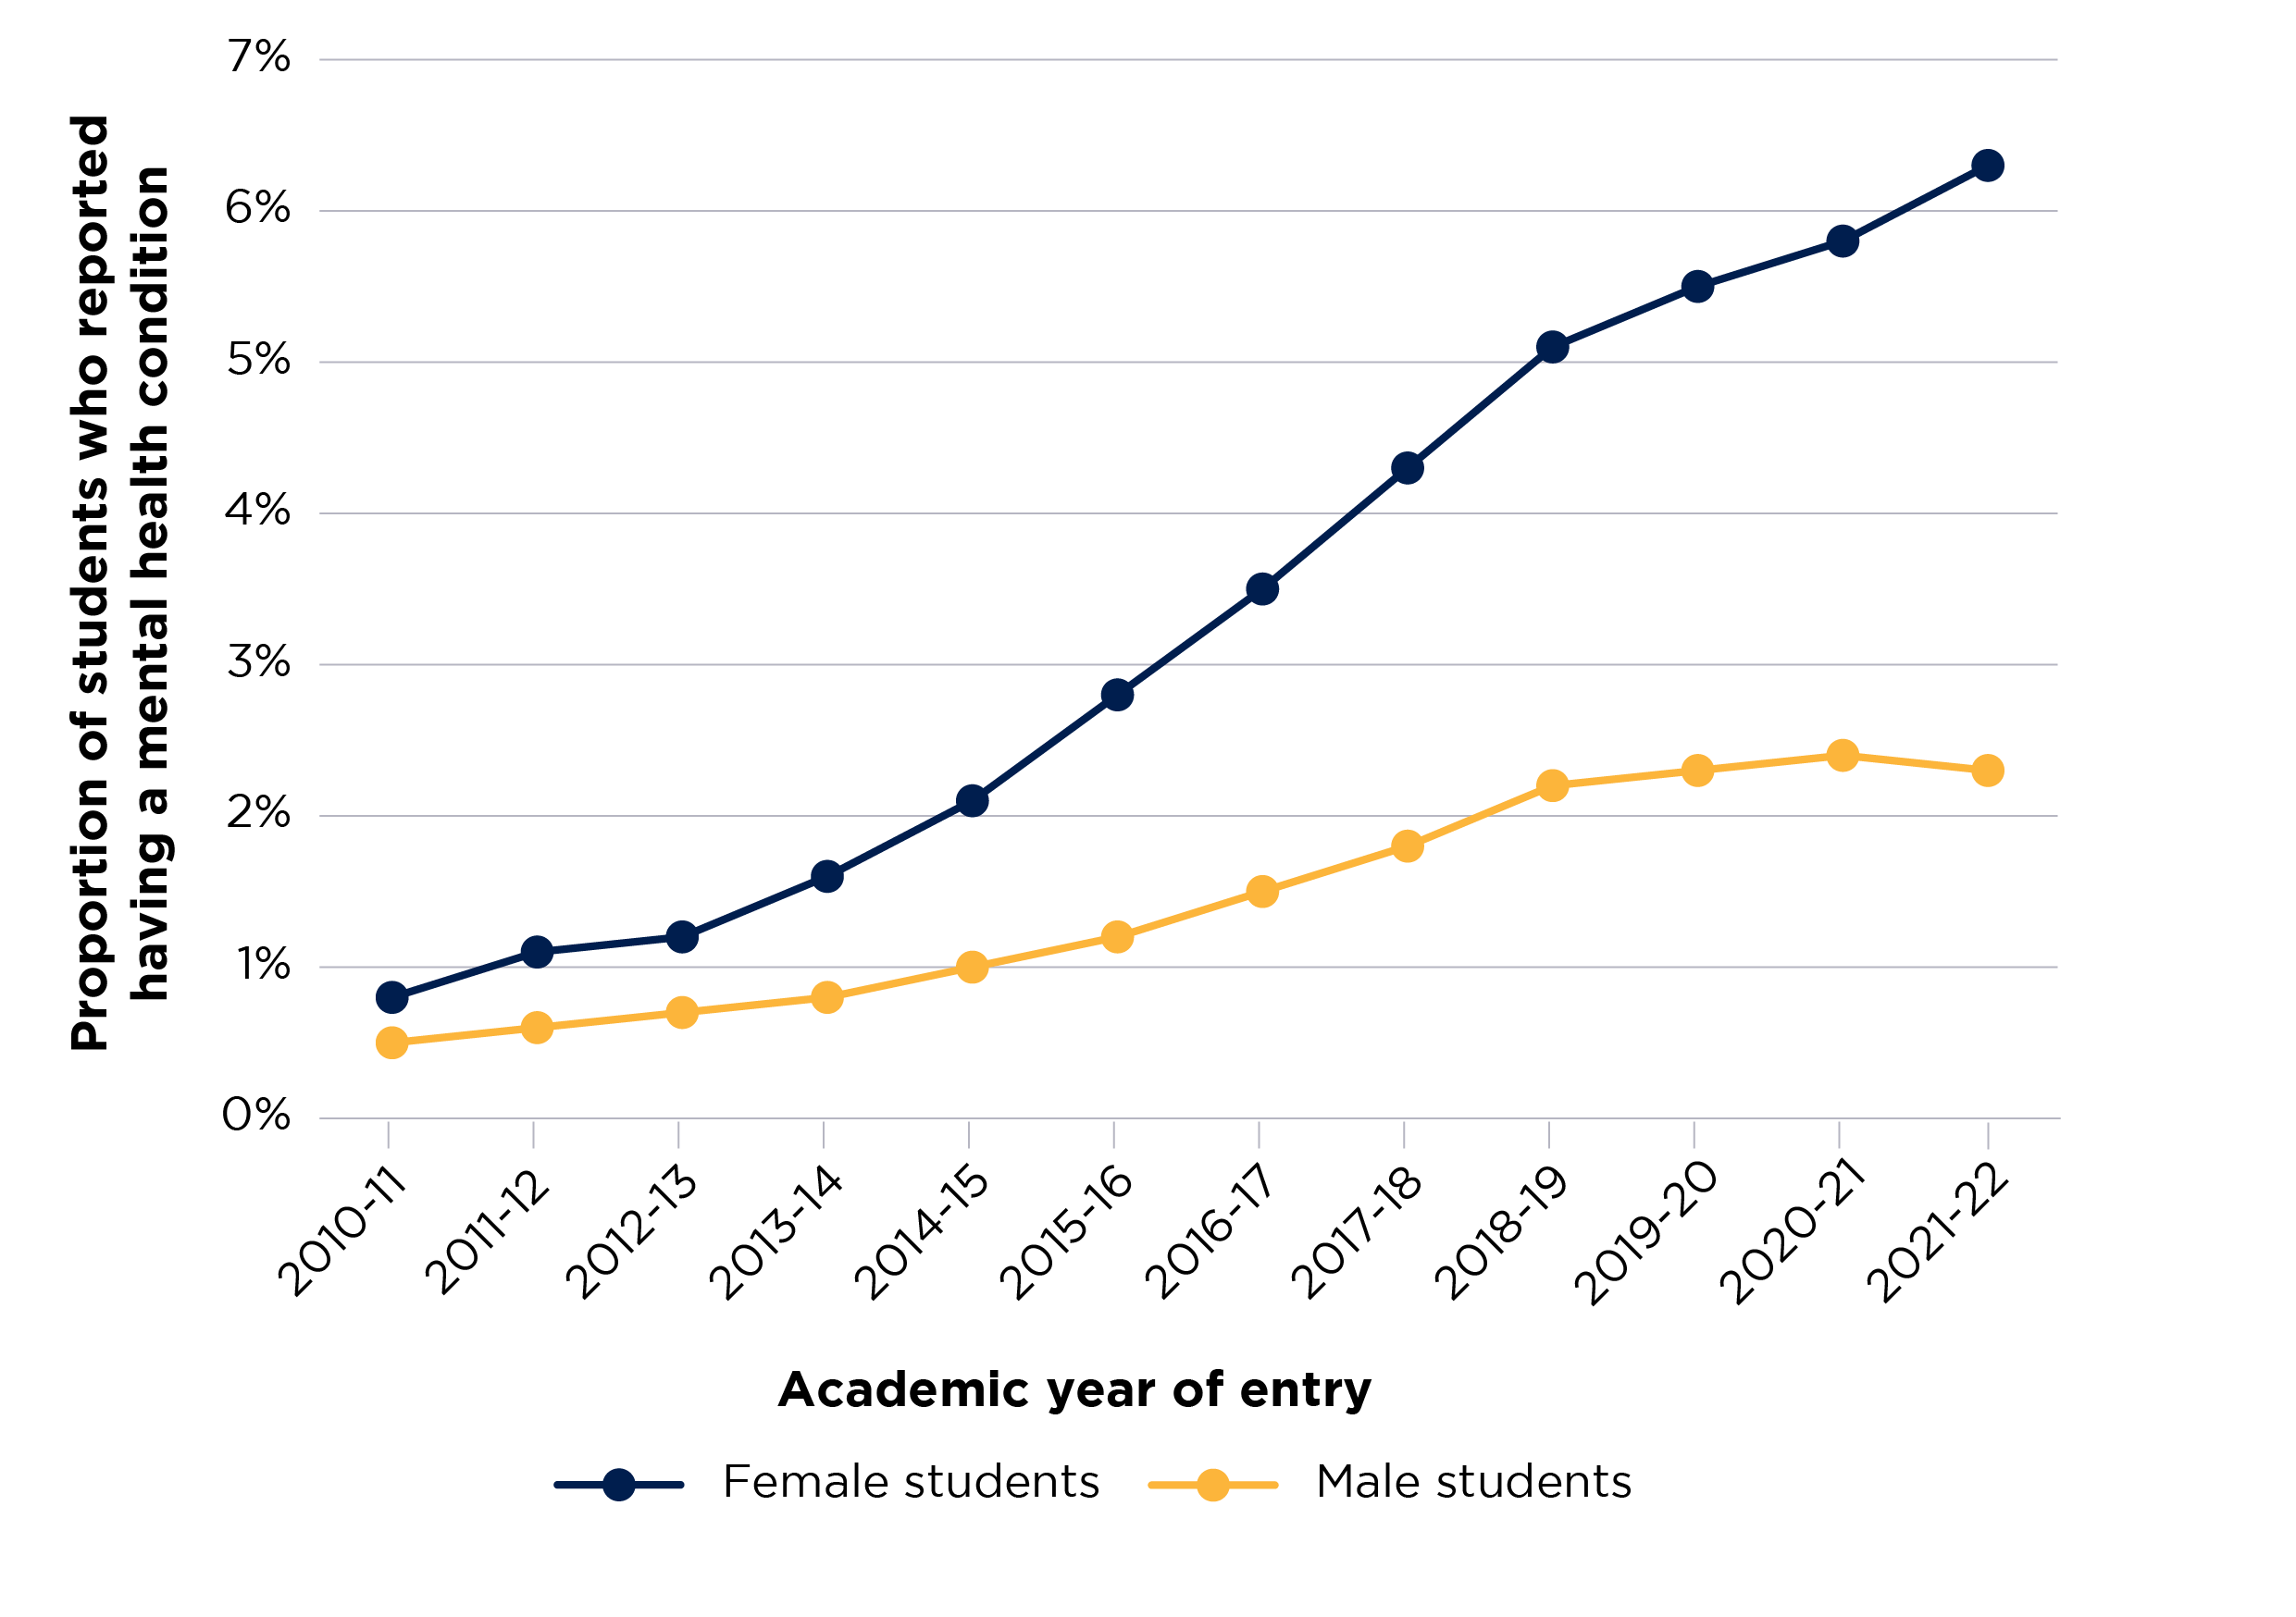
Example of a graph - Proportion of full-time students who reported having a mental health condition, by sex
Source: Meeting the mental health needs of students - Office for Students

Slide 14
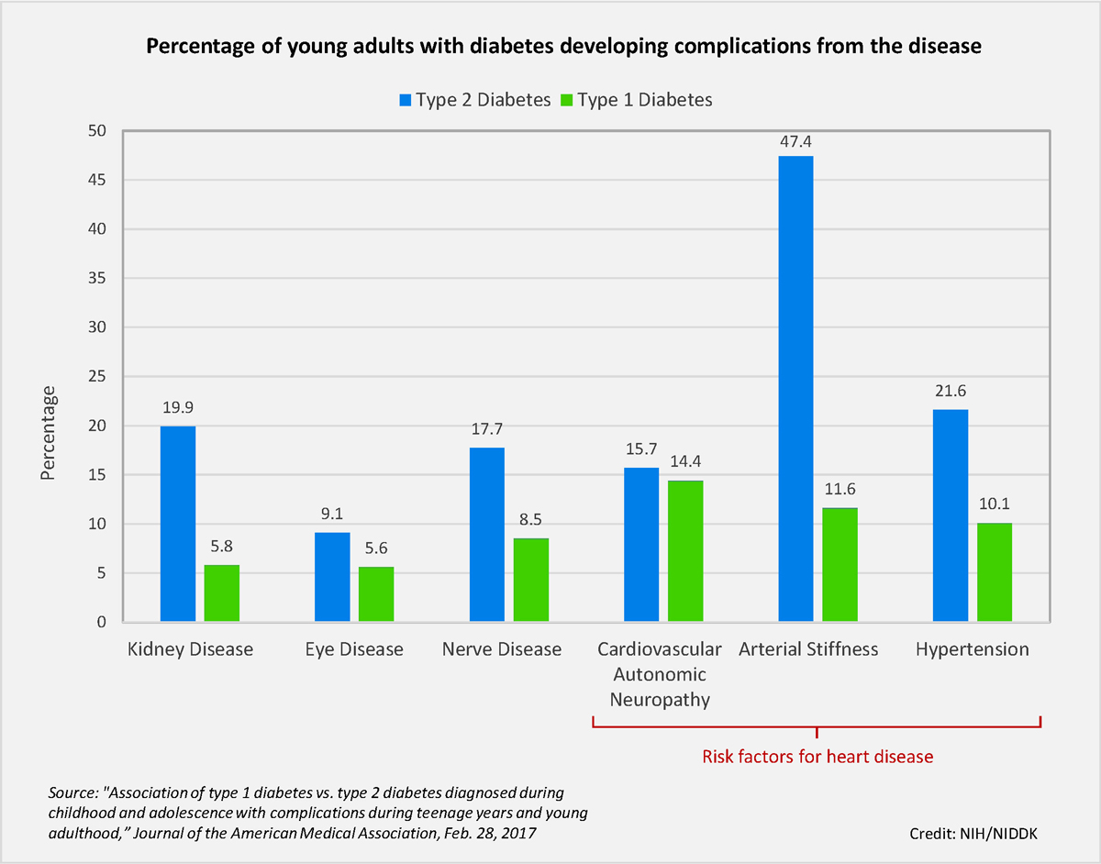
Group work: 10 mins
In your group, interpretate the graph and post your answers on this week’s Forum on Moodle.

Slide 15
What is a qualitative research?
Qualitative research methodology involves collecting and analysing non-numerical data (such as text, video, or audio) to understand concepts, opinions, or experiences.
(Tenny, Brannan, and Brannan, 2017)

Slide 16
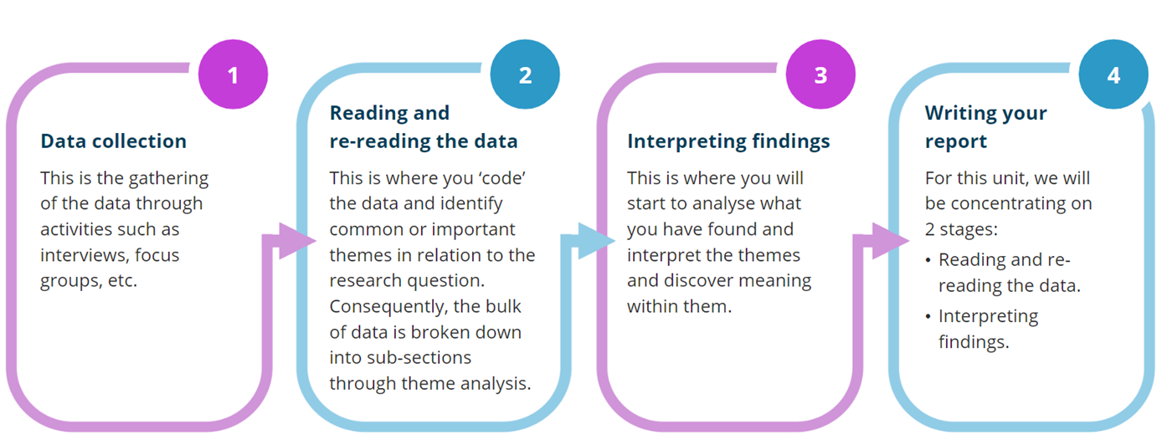
The four stages of qualitative research

Slide 17

Organising Qualitative data

Slide 18
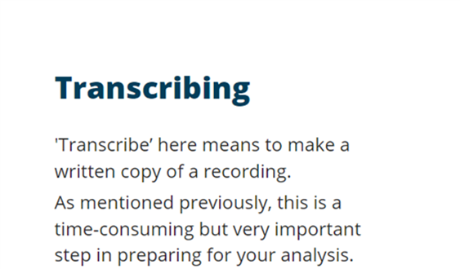

Transcribing qualitative research data

Slide 19
Thematic analysis in Qualitative research
Thematic analysis (TA) is a method for identifying, analysing, and interpreting patterns of meaning (‘themes’) within qualitative data.
(Castleberry and Nolen, 2018).

Slide 20
Group work: 30 mins
Read one of the research articles below and find out what was the methods they used, their sample size, and how data were analysed.
Write you answer on moodle
Dinos, S., Stevens, S., Serfaty, M., Weich, S. and King, M. (2004). Stigma: the feelings and experiences of 46 people with mental illness: qualitative study. The British Journal of Psychiatry, 184(2), pp.176-181.
Link to the article: Stigma: the feelings and experiences of 46 people with mental illness | The British Journal of Psychiatry | Cambridge Core
Anokye, R., Acheampong, E., Budu-Ainooson, A., Obeng, E.I. and Akwasi, A.G. (2018). Prevalence of postpartum depression and interventions utilized for its management. Annals of general psychiatry, 17, pp.1-8.
Link to the article: Prevalence of postpartum depression and interventions utilized for its management | Annals of General Psychiatry | Full Text (biomedcentral.com)

Slide 21
Conclusion
Quantitative research is the process of collecting and analysing numerical data.
Qualitative research methodology involves collecting and analysing non-numerical data (such as text, video, or audio) to understand concepts, opinions, and/or experiences.

Slide 22

Any Questions?

Slide 23
References
Castleberry, A. and Nolen, A. (2018). Thematic analysis of qualitative research data: Is it as easy as it sounds?. Currents in pharmacy teaching and learning, 10(6), pp.807-815.
Delice, A. ( 2010). The Sampling Issues in Quantitative Research. Educational Sciences: Theory and Practice, 10(4), pp.2001-2018.
Tenny, S., Brannan, J.M. and Brannan, G.D. (2017). Qualitative study.
Watson, R. (2015). Quantitative research. Nursing standard, 29(31)

