Slide 1

Erikson’s Psychosocial Development in Older Adulthood
A Lifespan Perspective Analysis
Name: Farzana
Date: July 2025
Course: LCHS4010

Slide 2
Introduction
Erikson’s theory, introduced in the 1950s, covers the entire human lifespan (Waterman, 1982).
Focuses on eight stages, each with a psychological conflict.
Understanding development across ages, especially older adulthood, is crucial.
Highlights social relationships’ role in shaping identity and well-being (Erikson, 1997).
Aims to explore how this theory applies to older adults’ development.
Provides insight into lifelong growth and adaptation.
Sets the stage for analyzing physical, cognitive, social, and emotional changes.

Slide 3
Lifespan Perspective in Psychology
Lifespan perspective views development from birth to death (Baltes, 1987).
Involves ongoing growth, change, and adaptation (Spencer, 2019).
Influenced by biological, psychological, and cognitive factors.
Helps individuals understand themselves and others better (Human Development, 2024).
Recognizes unique developmental paths for each person.
Emphasizes continuous learning and maturity across life stages.
Recent studies reinforce its relevance in aging research (Tavares et al., 2024).

Slide 4
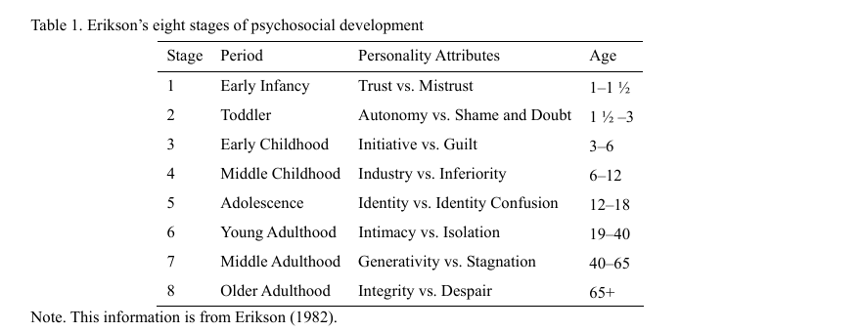
Eight stages of psychosocial development

Slide 5

Older Adulthood – Four Areas of Development
Physical: Decline in strength and health issues with age (Papalia et al., 2007).
Cognitive: Worsening mental abilities without treatment (Melici, 2016).
Social: Narrowing of social and emotional networks (Barker, 2016).
Emotional: Increased sensitivity due to brain changes.
Individual variations affect development patterns.
Physical skills may decline, but adaptability can persist.
Emotional growth linked to life reflection and acceptance.

Slide 6

Erikson’s Psychosocial Theory
Comprises eight stages, each with a psychosocial conflict (Waterman, 1982).
Stage 8 (Integrity vs. Despair) occurs in older adulthood.
Resolution through life reflection leads to wisdom (Erikson, 1997).
Emphasizes social influences on identity development.
Provides a framework for understanding late-life well-being.
Contrasts with Piaget’s focus on childhood cognition.
Widely recognized in psychological studies (Ministry of Health, 2024).

Slide 7

Application to Older Adulthood
Physical: Self-care increases despite health declines (Erikson, 1982).
Cognitive: Wisdom emerges from resolving integrity vs. despair (Barker, 2016).
Social: Shift to legacy and meaningful relationships (Meeus et al., 2010).
Emotional: Acceptance of mortality fosters growth or despair (Erikson, 1997).
Active role in care enhances autonomy.
Social networks adapt to life stage needs.
Example: Community programs support emotional resilience.

Slide 8

Critical Evaluation of Erikson’s Theory
Strengths: Comprehensive lifespan approach (Waterman, 1982).
Limitations: Western-centric, limited empirical support (textbook critique).
Varies across collectivist vs. individualist cultures.
Social focus may overlook biological factors (Melici, 2016).
Requires more cross-cultural validation.
Recent studies suggest refinements needed (Ignjatović et al., 2025).
Balances universal and context-specific insights.

Slide 9
How the Lifespan Perspective Helps
Enhances self-understanding through developmental continuity (Human Development, 2024).
Improves empathy for others’ aging experiences.
Supports tailored interventions in health care (Barker, 2016).
Links past experiences to current coping skills.
Encourages lifelong learning and adaptation.
Case study: Reflecting on life improves emotional health.
Applies to personal and professional growth.

Slide 10

Conclusion
Erikson’s theory explains older adulthood across four areas (Erikson, 1997).
Successful integrity vs. despair resolution leads to wisdom.
Earlier stages influence later life outcomes (Waterman, 1982).
Lifespan perspective deepens understanding of self and others.
Suggests need for cultural and empirical research.
Reinforces the importance of social relationships.
Encourages further exploration of aging processes.

Slide 11
References:
Baltes, P.B. (1987). Theoretical propositions of life-span developmental psychology. Developmental Psychology, 23(5), p.611.
Barker, S. (2016). Introduction to Psychological Theory. SAGE Publications Ltd.
Erikson, E.H. (1982). The Life Cycle Completed. Norton.
Erikson, E.H. (1997). The Life Cycle Completed (Extended Version). Norton.
Ignjatović, S., Pavlović, Z., & Todosijević, B. (2025). Outliving oneself through the next generations: (grand)parenthood and values in later life. Psychology and Aging. https://doi.org/10.1037/pag0000879
Meeus, W. et al. (2010). On the progression and stability of adolescent identity formation. Child Development, 81(5), pp.1565-1581.Melici, B. (2016). Ego integrity and resilience. The Chicago School of Professional Psychology.
Ministry of Health / Teaching Hospital Badulla / University of Colombo. (2024). © Uva Clinical Anaesthesia and Intensive Care ISSN 2827-7198.Papalia, D.E. et al. (2007). Human Development. McGraw-Hill.
Spencer, M.B. (2019). Lifespan Development. Academic Press.
Tavares, L., Xavier, A., Vagos, P., Castilho, P., Cunha, M., & Pinto-Gouveia, J. (2024). Lifespan perspective on self-compassion: Insights from age-groups and gender comparisons. Applied Developmental Science, 1–17. https://doi.org/10.1080/10888691.2024.2432864
Waterman, A.S. (1982). Identity development from adolescence to adulthood. Developmental Psychology, 18(3), p.341.

