Slide 1
All about me

Slide 2
Discussion….
Background
Inspirations
Achievements
Future aspirations

Slide 3
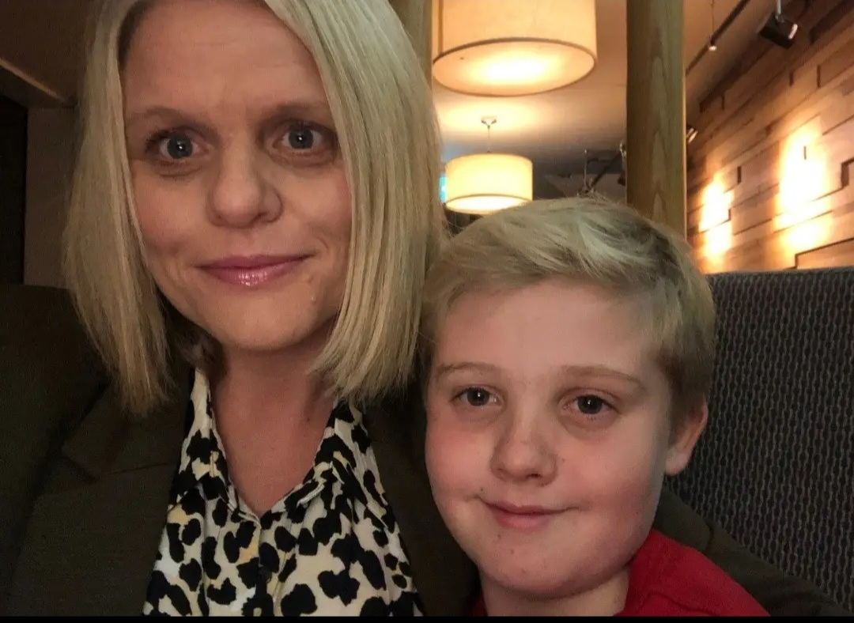
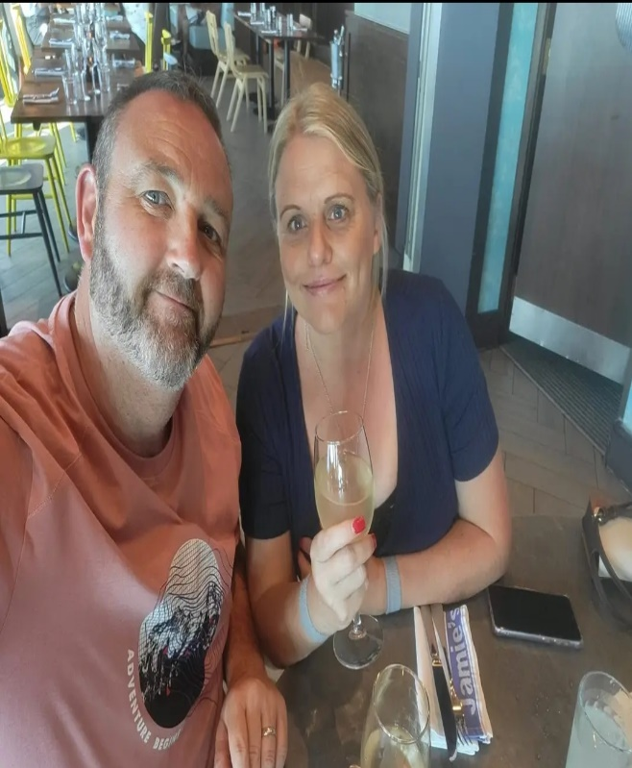
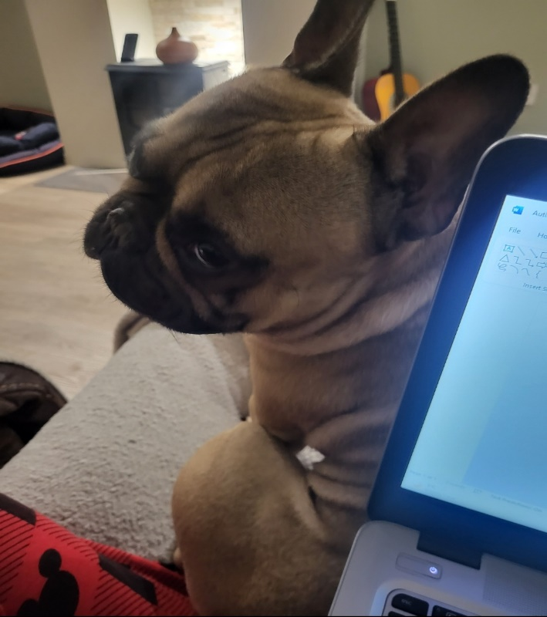
This is me
Mother
Wife
Dog owner

Slide 4
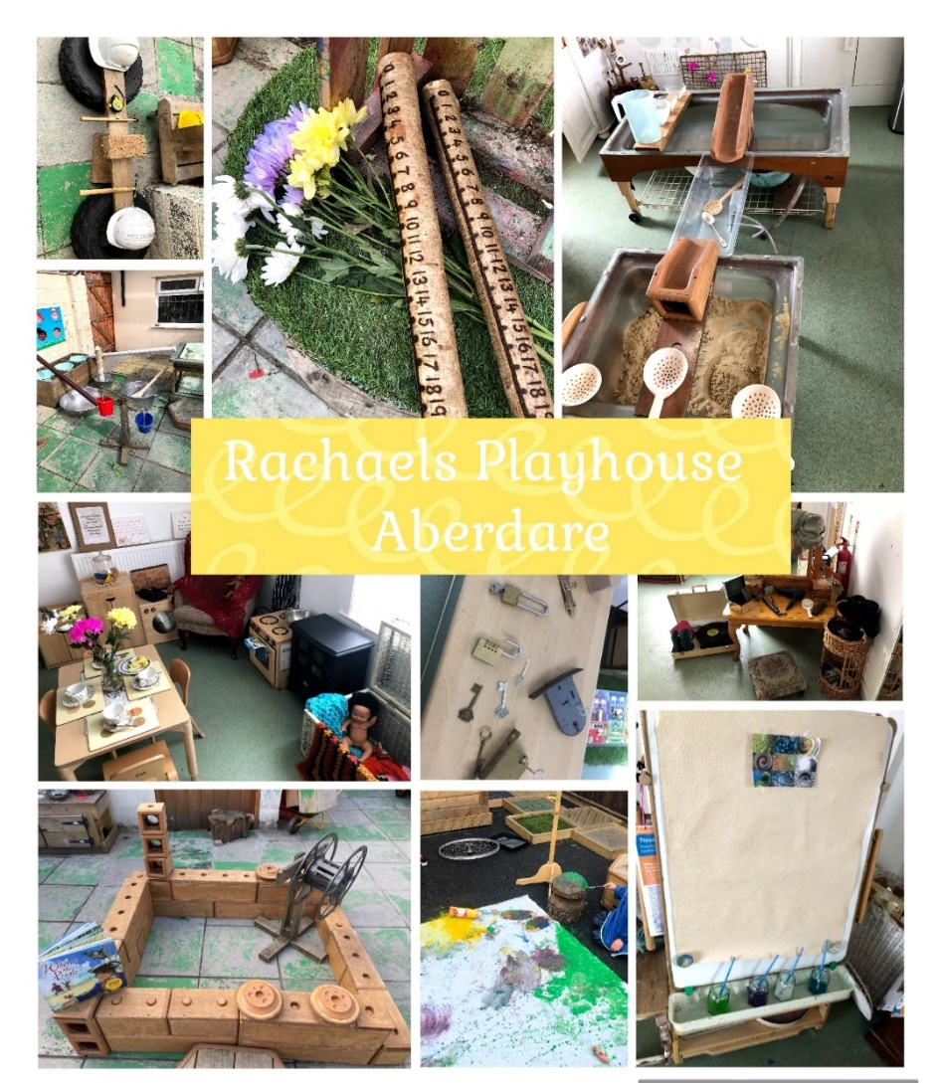
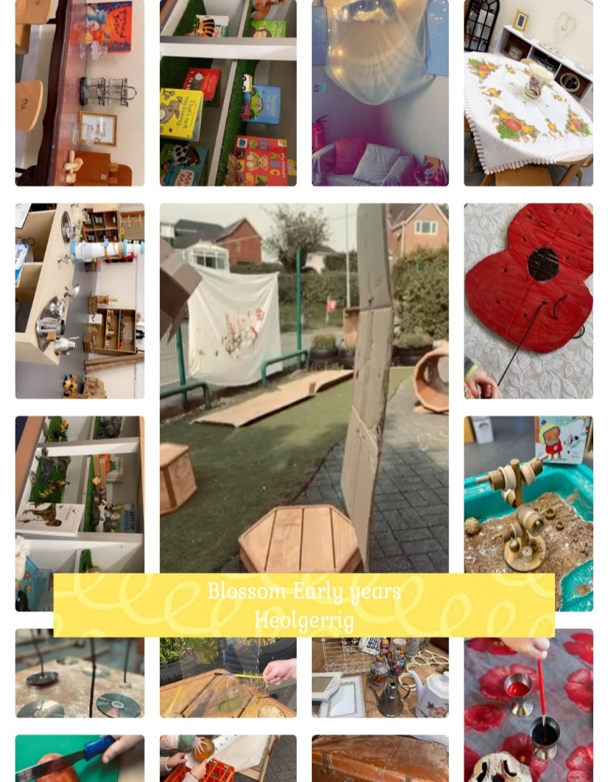
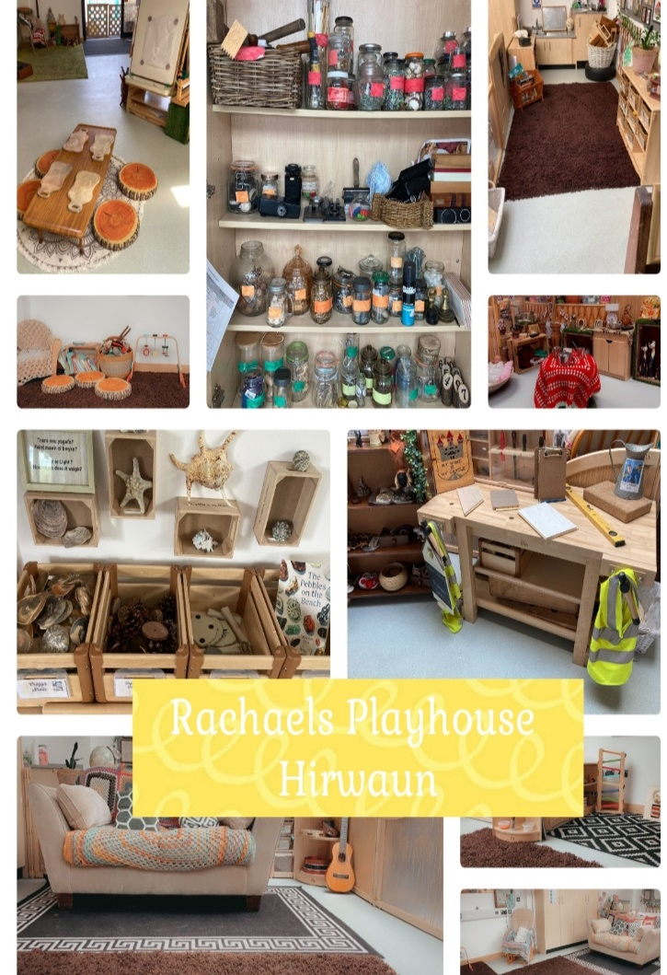
Our settings….
Rachael’s Playhouse Aberdare
Rachael’s Playhouse
Hirwaun
Blossom Early Years
Heolgerrig

Slide 5
As a mother
Factors that affect my parenting
Morin (2022) It is almost impossible to put yourself into one parenting category, although individuals may have one dominant style of parenting, there are going to be times where we are displaying traits of other parenting styles.
Benson and Haith (2009, p.282) State that authoritarian parents expect their children to accept their judgements values and goals without questioning.
These parents tend to take complete control over their children's lives, making decisions for them without allowing any input or discussion. This style of parenting can lead to children feeling suppressed and lacking autonomy, potentially hindering their ability to develop critical thinking skills and make independent choices.
Brooks (2023) This is because parenting is a dynamic and ever-changing process, influenced by various factors such as the child's age, temperament, and the specific situation at hand. Therefore, it is important for parents to remain flexible and adaptable in their approach to parenting, recognising that different styles may be needed in different circumstances

Slide 6
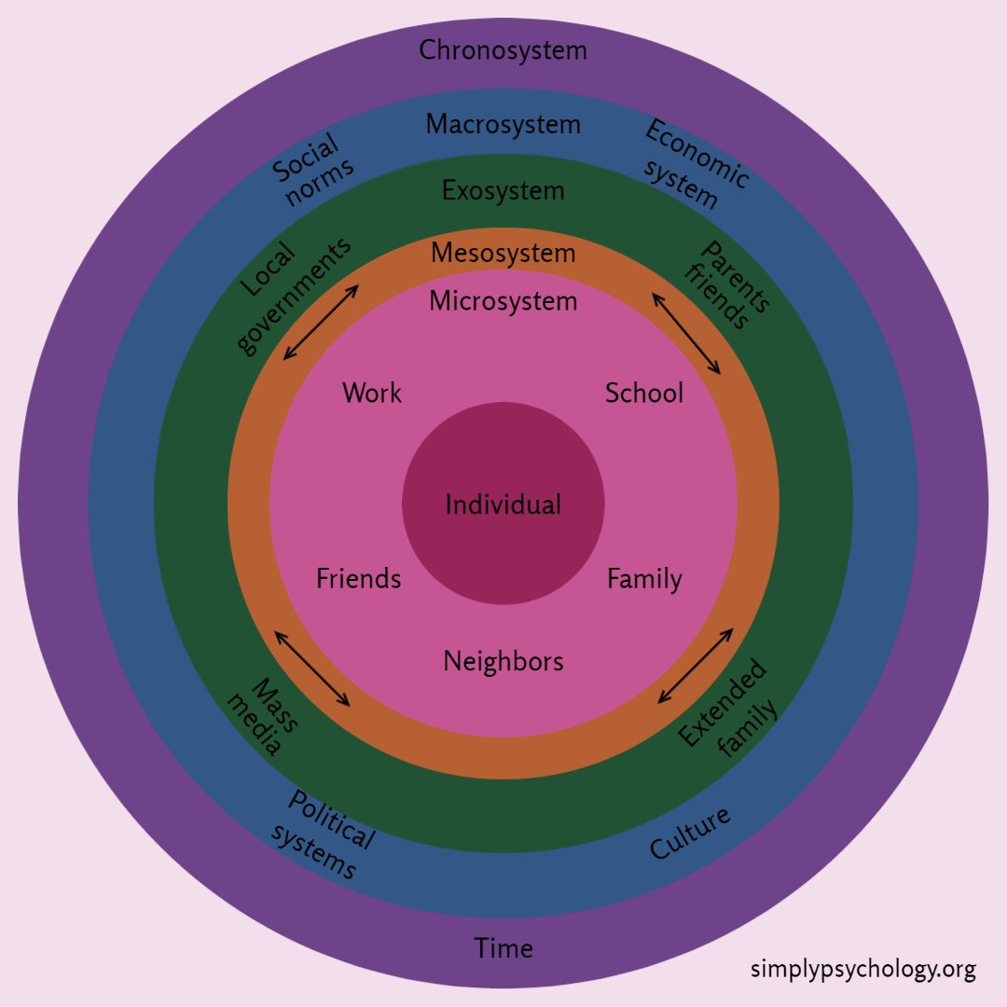
It takes a Community to raise a child
Bronfenbrenner (1977 )
(Guy-Evans, 2024)

Slide 7
It takes a Community to raise a child
Research conducted by Choudhury et al. (2012) Highlights the worrying perceptions on individuals living in the United Kingdom. When people within the communities were ask for their views on teenagers, comments such as moody, rowdy, impolite, criminal, aggressive, violent, and bothersome were mentioned. Out of the 203 words or phrases submitted, 194 were negative descriptions, indicating a significant representation.
When young people internalise culturally constructed stereotypes about adolescence, they can become self-fulfilling prophecies and mould their own expectations and standards, which in turn influence their thought processes, and behaviour (Lombaard, 2015).

Slide 8
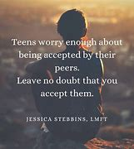
Source Google Images, 2024) [Image]

Slide 9
As a Wife
Smith (2006) defines Cognitive Empathy as “the ability to see the world from another person point of view”.
Different backgrounds
Different experiences
Previously caused conflict
Reacting
Different parenting approaches
Emotional Empathy -Decenter
Common grounding
Love of adventure
Love of travelling
Redmond ( 2018, p.107) Social Decentering refers to the ability to consider the perspectives and feelings of others in social interactions. By practicing Social Decentering, adults can develop empathy and understanding, which are crucial for fostering healthy and harmonious relationships. Additionally, this skill allows individuals to navigate conflicts more effectively and find mutually beneficial solutions, ultimately leading to successful and positive relationships.

Slide 10
As a Leader
Staff wellbeing
Safe spaces
Empowerment
Encourage and support ambition
High quality team members- Qualities and attributes
Reactor/ Responder ?

Slide 11
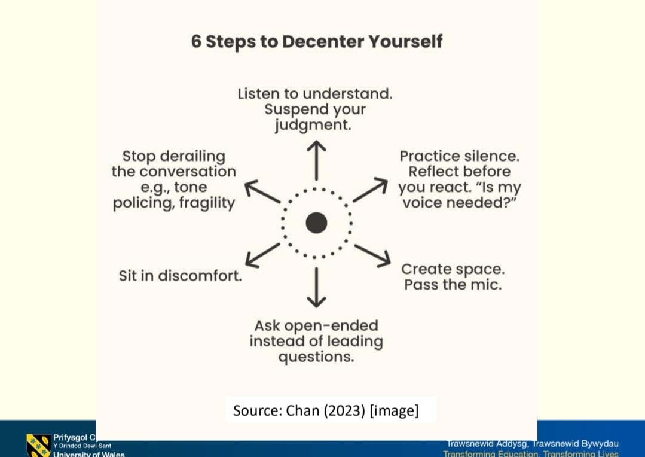
Reactor/ Responder
Nugent (2019, p.11) asserts that learning to decenter ourselves is not easy. It is an ongoing task and one that takes practice.

Slide 12
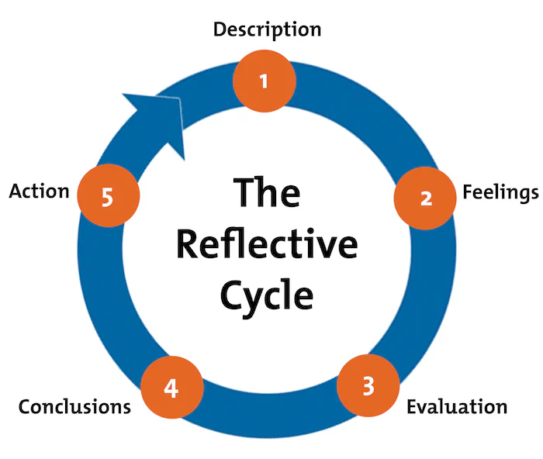
Reflection
Conscious Reflection
Source: Mindtools, 2024 [Image]

Slide 13
Who or What has Influenced Me?
Education
Shan Bowen
Travelling- Finland
Ceri Ward
My son and his experiences
More recent influences- UWTSD

Slide 14
My biggest accomplishments
My son
Getting married
Buying my own home as an independent woman
Becoming a business owner
Taking my son to my graduation

Slide 15
Professional achievements
Grown our business from 1 to 3 settings.
Participation in pilot programme for Funded Non-Maintained Curriculum and sharing our journey.
Estyn stake holders Forum
Social Care Wales Forum.
UWTSD conducted research on Sustained Shared Thinking in our setting.
Wrote an article for Natural Resources Wales on the benefits of Physical activity.
Joint inspection (case studies).
SSTEW inspection with local authority.
Have publicly spoken on a Westminster platform about the New Curriculum for Wales
Spoke at the Senedd on how we deliver a child centred approach to support children with Additional Learning Needs
Spoke about Leadership and Management for Social Care Wales

Slide 16
Future aspirations
Continue to grow our settings
Become part of the research
Develop a training company specialising in Early Years
Work with the Welsh Government to help inform change in the legislation and guidance for promoting positive behaviour, try to create a new regime of truth within our society

Slide 17
Thank you!
Questions?

Slide 18
References…
Benson and Haith (2009) Social and Emotional Development in Infancy and Early Childhood. Denver: Academic press
Brooks R (2023) The Power of Parenting. Handbook of resilience in Children.
Brooks, R.B. (2023). The Power of Parenting. Handbook of Resilience in Children. Switzerland: Springer [Online] Available at: https://doi.org/10.1007/978-3-031-14728-9_21 Accessed on 5 January 2024.
Choudhury S, McKinney K and Merten M (2012) Rebelling against the brain: Public engagement with the ‘neurological adolescent’ Social Science and Medicine. Vol 74 ( Issue 4) pp.565-573
Google Images (2024) Positive Teenage Affirmations. Available at: 26 Best Quotes About Parenting Teenagers - Raising Teens Today Accessed on 8 January 2024.
Guy-Evans O (2024). Bronfenbrenner’s Ecological Systems Theory: Simply Psychology. Available at: Bronfenbrenner's Ecological Systems Theory (simplypsychology.org) Accessed on 10 January 2024.
Morin A (2022) Very Well Family. Available at: 4 Parenting Styles: What Your Style Is and Why It Matters (verywellfamily.com) Accessed on 7 January 2024.
Nugent E (2019, p.11) The Necessity of Good Enough. New York: Simon and Schuster.
Redmond M ( 2018) Social Decentering: A Theory of Other-Orientation Encompassing Empathy and Perspective Taking. Boston: Walter de Gruyta.
Smith A (2006)’ COGNITIVE EMPATHY AND EMOTIONAL EMPATHY IN HUMAN BEHAVIOR AND EVOLUTION’ The Psychological Record. Vol 56, pp. 3-21 Available at: BF03395534.pdf Accessed on 10 January 2024.
Source: Mindtools, 2024 [Image] Available at: Gibbs' Reflective Cycle - Helping People Learn From Experience (mindtools.com) Accessed on 9 January 2024.

