Slide 1

Children, Young People, Families
Nisha Sharma
Sharifa Nandoo
Jazmin Dawes
Laura Callan
Neomi Dawes

Slide 2

Introduction
I'd like to introduce the class to our presentation from Group1. Throughout this presentation, we will highlight the key elements of children, young people, and family's wellbeing relating to Case Study Family A. Some of the areas we will be discussing will be:
Children, Young people and Families understanding of wellbeing.
Examine in detail one of the Key Domains of Children and Young people's wellbeing.
Investigate what Policies and Professional interventions are in place to measure and enhance the health and wellbeing of children, young people and families.
Discuss and evaluate current policy and professional interventions used by Multi-disciplinary services to meet the needs of children, young people, and families.
This Photo by Unknown author is licensed under CC BY-SA-NC.

Slide 3

Understanding Complex Needs
John was a child with complex needs, he suffered from cerebral palsy, epilepsy, and other complexities in his life.
Cerebral palsy (CP) is to move and maintain balance and posture. CP is the most common motor disability in childhood. Cerebral means to do with the brain. Palsy means weakness or problems with using the muscles. (Cerebral palsy, 2020)
What causes cerebral palsy:
Brain injury caused by a shortage of oxygen to the brain before, during, or immediately after childbirth is the most common cause of cerebral palsy. This brain damage can produce a variety of symptoms, including problems with fine motor skills, mobility, balance, muscle tone, and impaired cognitive development. (What is Cerebral Palsy? | CDC, 2021)
John’s passing was attributed to an unexpected death in infancy or childhood (SUDIC) a meeting was held by his health care professionals who found that John passed from Sudden Unexpected Death in Epilepsy (SUDEP) (SUDEP, 2017)
As there was no intervention in John's case from the Multi-disciplinary teams these complex needs were not managed.
(Does Experience Shape Our Understanding Of God?, 2022)

Slide 4

Children, Young People, Families Perception Of Well Being

Slide 5

Importance of wellbeing in young people
AFFECTS OF BAD WELLBEING
(Focusing On Child Development, 2022)
GOOD WELLBEING
Negative wellbeing can lead to bad relationships with people around you
Your physical heath may be poor because lack of sleep, food and water
Being unable to deal with stressful life events
May affect the focus of school life/work
Good wellbeing Can promote good relationships with others ,
Can Help you to cope with stress and change,
Can help you to build confidence and positive self-esteem,
Can help you to express and feel a different range of emotions

Slide 6

STATISTICS FOR CHILDRENS WELLBEING: “ Right now children's wellbeing is at a ten-year low, when things get too much, they are put on a waiting list. We want young people to be happy and feel good about themselves, to be able to fight and not give up. (Children's Society, 2022).
52% of 0 to 18years old's have experienced a deuteriation in mental health when facing health complications.
34% of those who do get referred into NHS services are not accepted into treatment.
1 in 6 children aged 5-16 likely to have a health problem ages 17-22 are the most at risk.
“The CHQ is a generic instrument designed to measure health status, wellbeing and health outcomes of children aged 0-18 years”
CHQ Collected data from caregivers of children aged 4-12 years old living with cerebral palsy
CHQ measures functional health and well-being.
CHQ determines only 62.9% of children with CP well-being needs are being met.
(Information To Support Young People | The Children's Society, 2022)

Slide 7
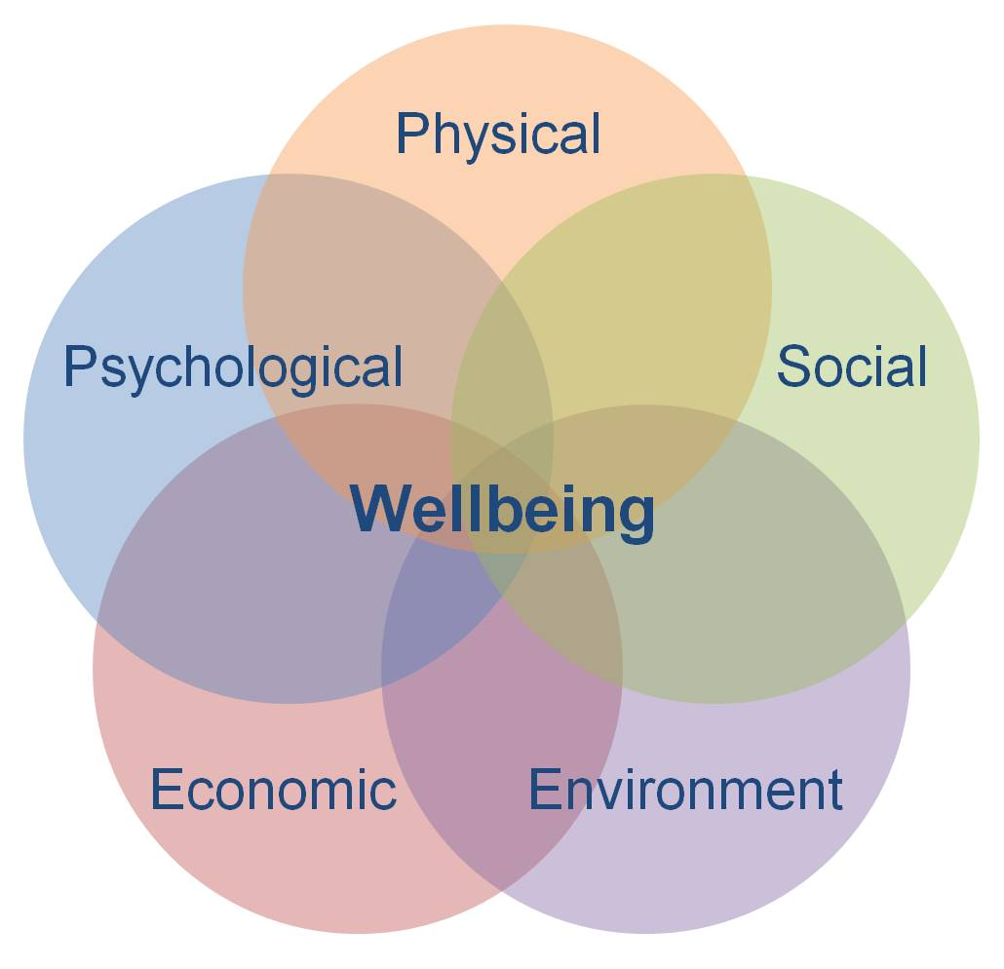
Analyse One Key Domain Of Childrens And Young People's Well being

Slide 8

Key Domains Of Well Being In Young People & Children
Physical Well Being
Relationships
Health
What We Do
Where We Live
Personal Finance
Education and Skills

Slide 9
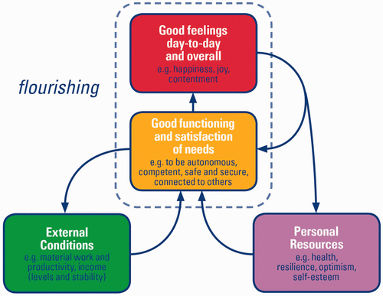
Measuring Well-Being
An article written by (Wood and Selwyn, 2017) researched a study. In this study they used subjective well being to measure happiness in children. This model was influenced by New Economic Foundation (NEF).
It was used to see how children function and flourish well in their day-to-day lives. Identifying how well children interact with their environment consequently result in positive emotions.
Aims to improve Local Authority Services putting aside economic circumstances and meet children's, young people and families emotional and social needs.
(Figure 1. (Wood and Selwyn, 2017)

Slide 10
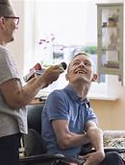
Analyze One Key Domain Of Well Being In Children & Young People
There's a plethora of research when looking into Key Domains, however One of the key domains we would like to analyze linking with Family A is Physical Well Being.
Physical Well Being is hugely influenced on how a child participates in everyday life situations. (Parkes, McCullough and Madden, 2010) conducted a survey on children with cerebral palsy with co-impairments and those without co-impairments. Findings indicated that higher parenting stress was strongly connected to lower child participation.
Leading us to question was there enough Professional Intervention support for Family A to address specific child and family social needs. Was mom supported in the right way to choose the right intervention for her son, which to date spikes a challenging process. l'd like to handover to Jazmin who will share some thoughts on this.

Slide 11

Analysis Of Policies & Professional Intervention In Place To Measure And Enhance Well Being

Slide 12

Policies and professional interventions to enhance the health and wellbeing of children, young people and families.
A report from (CQC), Care Quality Commission has discovered that the young children which have an illness or are physically disabled and depend on multiple therapies and medication and treatment are not receiving the support and guidance that they should be, and concluded we need to provide a systemic transformation that pulls together all of the resources that assist disabled children and parents (Care Quality Commission, 2014).
In reference to the case study and the report above from CQC, we believe that similar failings were seen by the health professionals under the care of John the appropriate interventions were not put in place to enhance his wellbeing to support him, and his mum and the professionals have not worked together to provide the best care.
(Vectors and Vectors, 2022)

Slide 13
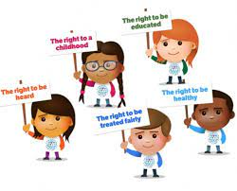
Policies and professional interventions to enhance the health and wellbeing of children, young people and families.
Children and Families Act 2014: Is a historic Act aimed at completely reforming services for vulnerable children by providing them with increased protection (with a special focus on those with special needs), as well as by assisting parents and families (UK Legislation - Children and Families Act 2014, 2022).
The policies in place to enhance health and wellbeing of children and families are:
The Children Act 1989
The Children Act of 1989 establishes a broad framework for the safeguarding of all vulnerable children in need (Department of health children's schools and family, 2009).
The Children Act of 2004. is a modified version of the 1989 Act by It declares that everyone who works with children has a duty of care to safeguard children and ensure their safety (Polnay, 2000).
(UN Convention on the Rights of the Child – Golftyn CP School, 2022)

Slide 14

Individual and family Support
In a child's life, intervention aims to lower potential risks while increasing protective elements. Parents can be offered specialized selection interventions based on broad background characteristics such as low income, or lone parent (Early Intervention Foundation. 2022)
Child In Need Plan
The section 17 of the children act 1989 states that a child placed under a child in need plan is defined as a child who seems to be unlikely to reach certain goals or milestones
or a child whose health or progression is likely to be considerably debilitated, or could gain further cognitive impairment, without any delivery of health care to him/her (Worcestershire county council. 2021).
(Parent Engagement – Oxhey First School | Biddulph | Staffordshire, 2022)
John was on a child in need plan and with the concerns that had been raised by the professionals, more interventions should have been put in place like reviewing the child in need plan to make amendments to improve his wellbeing, and to support the mother with parental programs to improve relationships, this would have been beneficial for John's wellbeing.

Slide 15
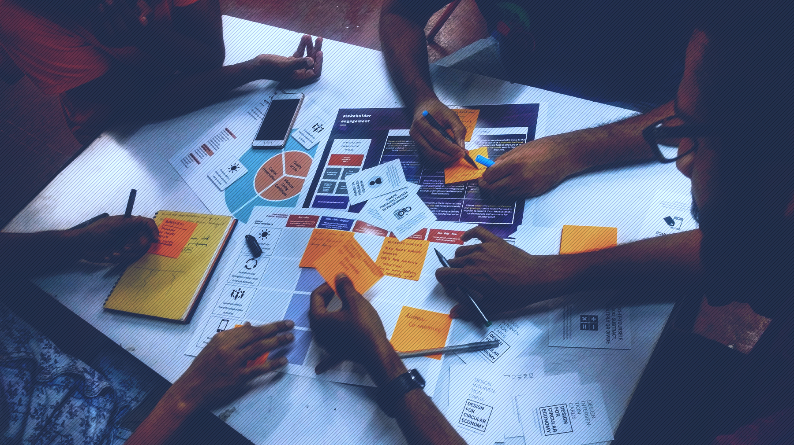
Discuss And Evaluate Policy And Professional Intervention Used By Multi-Disciplinary Services To Meet Diverse Needs.
Multidisciplinary teams (MDTs) are intended as a way for health and social care practitioners and other professionals to liaise and interact with one another effectively.
Multidisciplinary teams (MDTs) have been proved to be a excellent way to facilitate professional collaboration and, as a result, improve the quality of care delivered.
Efficient collaboration entails the identification of a manager or supervisor, regular joint discussions, and the sustainable exchange of electronic documents.(care and team, 2018)
Notes:
A review of MDTs in services found that all studies reported improved outcomes.
MDTs can encourage better care coordination and quality by fostering collaboration between professionals which wasn't the case with John.
Multidisciplinary teams (MDTs) are the mechanism for organising and coordinating health and care services to meet the needs of individuals with complex care needs. John may have had a longer life if these teams were involved.
The teams bring together the expertise and skills of different professionals to assess, plan and manage care jointly.
Multidisciplinary teams (MDTs) are presented as a way for healthcare staff and other professionals to interact effectively. MDTs tend to be effective in meeting the requirements of specific populations, according to research.
A manager or practice leader who supervises and facilitates all the teams with joint meetings to share ideas and concerns

Slide 16

MDT Development Working toward an effective multidisciplinary/multiagency team
Within NHS England there is a handbook that is reviewed regularly, this handbook covers all aspects of what an MDT is and the expectation.
This handbook is one of three service modules aimed to assist commissioners, GP practices, and community health practitioners in planning and delivering person-centered care and services to individuals with long-term illness or diseases.
A multidisciplinary strategy means gathering professionals from several fields to explore challenges beyond their usual scope and develop solutions based on new awareness of challenging circumstances(Stamp et al. 2022, p. 1-10)
Notes:
May 2013 saw the publication of ‘Integrated Care and Support: our shared commitment’ which launched a shared vision for integrated care and support to become the norm in the next five years
The NHS Five Year Forward View (FYFV) sets out in some detail a vision of what the future will look like in the context of new models of care and emphasises that over the next five years (and beyond) the NHS will need to dissolve the traditional boundaries that prevail between primary care, community services and hospitals, recognising that this traditional divide is increasingly a barrier to the personalised and coordinated health services people need.
Within the CASE STUDY THERE WAS NOT ANY PROFESSIONALS INVOLED IN HIS CARE PLAN APART FROM THE ….. THE PARENTS WOULD OF BENIFITED BY HAVING LIASION OFFICERS TO WORK ALONGSIDE TO EXPLAIN THE NEED FOR INTERVENTIONS JOHN WOULD OF BENIFITED FROM HAVING

Slide 17
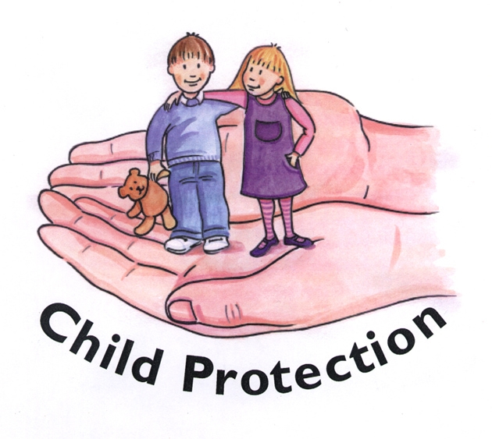
SAFEGUARDING & NICE
SAFEGUARDING;- safeguarding children against abuse or maltreatment.
assuring that children's health and development are not endangered.
ensuring that children are cared for in a safe and effective environment.
Taking the necessary steps to provide the best possible care for all children and young people.
This policy applies to all organisations and authorities with responsibilities to minors. This guidance is applicable to all authorities, care quality commissions, law enforcement, and other organisations and agencies. In the case study there is no evidence of safeguarding in place (Working together to safeguard children, 2018).
NICE GUIDELINES:- This guideline addresses the evaluation, assessment, and management of cerebral palsy in children and adolescents from birth to the age of 25. The aim is to ensure that they receive the appropriate care and treatment for the psychological and medical complications associated with cerebral palsy, enabling them to live a fruitful and independent life as possible.
The advice in this guideline reflects NICE's position, which is reached following a careful review of existing evidence. Authorities and professionals are expected to fully consider this guidance, and also the personal needs when applying their decision (Overview | Cerebral palsy in under 25s: assessment and management | Guidance | NICE, 2017).

Slide 18

Conclusion
To conclude what we have spoken about in this presentation we have discussed the complex needs of a child with cerebral palsy and the interventions that should have been in place to support John and his mother by multidisciplinary teams.
The effects wellbeing can have on children and families and discussed the positive outcomes. And shown the negatives that can result from poor wellbeing and how it can affect children and young families and the percentage of individuals with cerebral palsy not having their needs met.
We have shown the key domains of wellbeing in children and young people and what areas of life improved in an individual when their wellbeing is met like good health, educational skills , etc.
We Have analysed the failings of the professionals in not working together to provide the best wellbeing for john, and the policies that are in place to protect young people and families like: The Children Act 1989 ,The Children Act of 2004, Children and Families Act 2014. We have looked at the interventions that are in place to avoid this type of scenario from happening like implementing family support programs and reviewing current care plans that are in place regularly.
Finally, we have looked at the Multidisciplinary teams that should have been in place and worked together to manage John's care effectively and the procedures that should have been followed to protect John's wellbeing to prevent his death.

Slide 19
References
Bradshaw, J., 2011. The well-being of children in the UK. Bristol: Policy.
Care Quality Commission. (2014). Teenagers with disabilities and long term health needs lack appropriate support as they approach adulthood: system-wide change needed, warns CQC. [online] Available at: <https://www.cqc.org.uk/news/releases/teenagers-disabilities-long-term-health-needs-lack-appropriate-support-they-approach> [Accessed 25 February 2022].
care, I. and team, D., (2018). Delivering integrated care: the role of the multidisciplinary team. [online] Social Care Institute for Excellence (SCIE). Available at: <https://www.scie.org.uk/integrated-care/workforce/role-multidisciplinary-team> [Accessed 25 February
Centers for Disease Control and Prevention. (2021). What is Cerebral Palsy? | CDC. [online] Available at: <https://www.cdc.gov/ncbddd/cp/facts.html#:~:text=Cerebral%20palsy%20(CP)%20is%20a,problems%20with%20using%20the%20muscles.> [Accessed 2 March 2022].
Childrenssociety.org.uk. 2022. Information To Support Young People | The Children's Society. [online] Available at: <https://www.childrenssociety.org.uk/information> [Accessed 4 March 2022].
Department of health children schools and family's, (2009). Statutory Gov UK Guidance on Promoting the health and well-being of Looked After Children. Nottingham: Gov UK, p.10.
Early Intervention Foundation. (2022). What is early Intervention. [online] Available at: <https://www.eif.org.uk/why-it-matters/what-is-early-intervention> [Accessed 25 February 2022].
Epilepsy Foundation. (2017). SUDEP. [online] Available at: <https://www.epilepsy.com/learn/early-death-and-sudep/sudep> [Accessed 2 March 2022].
Figure 1. NEF Consulting, (2008). A dynamic model of well-being Foresight Mental Capital and Wellbeing Project, [image].
Focusing On Child Development. [image] Available at: <https://www.profellow.com/fellowships/12-fellowships-focusing-on-child-and-youth-development/> [Accessed 4 March 2022].
Glasby, J. and Dickinson, R., (2014). Building better health: joint working between health, housing and social care – introduction to the special edition. Journal of Integrated Care, 22(1).

Slide 20
References
Golftyncp.wales. (2022). UN Convention on the Rights of the Child – Golftyn CP School. [online] Available at: <http://golftyncp.wales/un-convention-on-the-rights-of-the-child/> [Accessed 28 February 2022].
GOV.UK. (2018). Working together to safeguard children. [online] Available at: <https://www.gov.uk/government/publications/working-together-to-safeguard-children--2> [Accessed 2 March 2022].
https://neweconomics.org/uploads/files/measuring-wellbeing.pdf, (2022). [image].
HuffPost. (2022). Does Experience Shape Our Understanding Of God?. [online] Available at: <https://www.huffpost.com/entry/does-experience-shape-our-understanding-of-god_b_3116735> [Accessed 2 March 2022].
NHS.uk. (2020). Cerebral palsy. [online] Available at: <https://www.nhs.uk/conditions/cerebral-palsy/> [Accessed 2 March 2022].
Nice.org.uk. (2017). Overview | Cerebral palsy in under 25s: assessment and management | Guidance | NICE. [online] Available at: <https://www.nice.org.uk/guidance/ng62> [Accessed 2 March 2022].
Northamptonshire.gov.uk. (2022). UK Legislation - Children and Families Act 2014. [online] Available at: <https://www.northamptonshire.gov.uk/councilservices/children-families-education/SEND/local-offer/advice-and-information/4067-uk-legislation-children-and-families-act-2014> [Accessed 26 February 2022].
[online] Available at: <https://www.mind.org.uk/> [Accessed 4 March 2022].
Oxhey.staffs.sch.uk. (2022). Parent Engagement – Oxhey First School | Biddulph | Staffordshire. [online] Available at: <http://oxhey.staffs.sch.uk/parent-engagement/> [Accessed 2 March 2022].

Slide 21
References
Parkes, J., McCullough, N. and Madden, A., (2010). To what extent do children with cerebral palsy participate in everyday life situations?. Health & Social Care in the Community,.
Polnay , L., (2000). Promoting the health of looked after children. BMJ, [online] 320(7236), pp.661-662. Available at: <https://assets.publishing.service.gov.uk/government/uploads/system/uploads/attachment_data/file/276500/promoting_health_of_looked_after_children.pdf>.
Stamp, J., (2022). 1-10. [online] England.nhs.uk. Available at: <https://www.england.nhs.uk/wp- content/uploads/2015/01/mdt-dev-guid-flat-fin.pdf> [Accessed 25 February 2022].
Vectors, R. and Vectors, S., (2022). Square grunge red failed stamp vector image on Vector Stock. [online] Vector Stock. Available at: <https://www.vectorstock.com/royalty-free-vector/square-grunge-red-failed-stamp-vector-16221102> [Accessed 2 March 2022].
Wood, M. and Selwyn, J., (2017). Looked after children and young people’s views on what matters to their subjective well-being. Adoption & Fostering, 41(1), pp.20-34.
Worcestershire county council. (2021). Children first. [online] Available at: <http://www.worcschildrenfirst.org.uk/> [Accessed 18 February 2022].

