Slide 1
Harrods Case Study
By Uanjuma Thompson

Slide 2
Human Resources
Human resouces can be seen as a strategic undertaking in regards to organisation functionality. This starts with the enhancement of people and the act of valueing the employees. Three aspects of the HRM are:
Recruitment alongside selection – Its all about bringing in the right talent
Performance – Encouraging workforce to perform at optimum levels as a result of a transparent organisational structure which provides opurtunity and development avenues
Development – Enabling the workforce to progress along there career path with Harrods using the identification of career advancement and acheivements

Slide 3
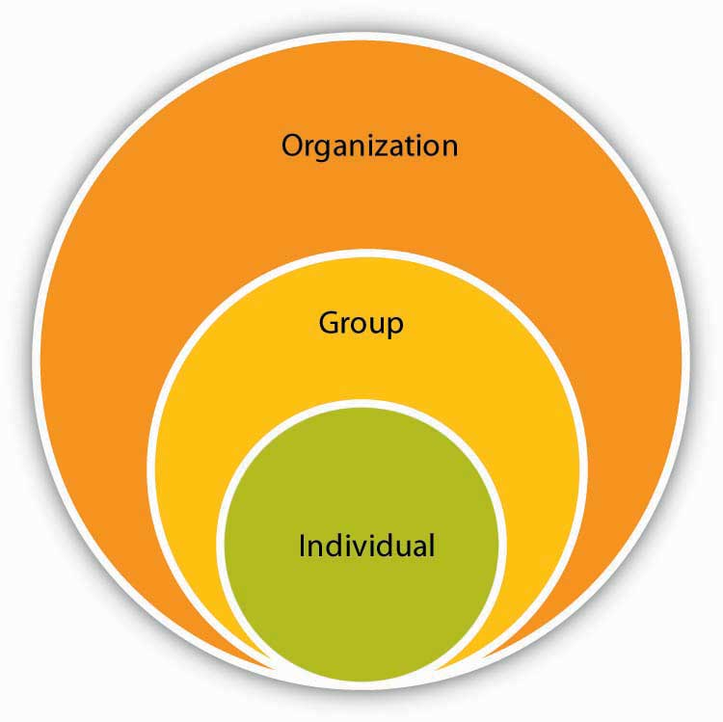
The MacLeod Report 2009
Engaging for Success
In 2009 a report was produced discussing the theory of "engaging for success". As reported this theory describes the concept of involving employees in the decision making results in better results within the workplace in regards employee engagement and performance.
This Photo by Unknown author is licensed under CC BY-SA-NC.

