Slide 1
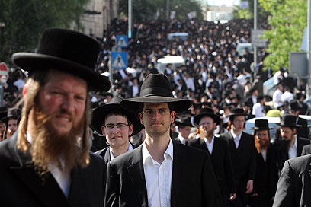
Haredi Judaism
By Daisy Wakefield/ 1500651
K. McCartan (2013), Clerical Whisper Ultra Orthodox Jews (Image), http://clericalwhispers.blogspot.co.uk/2013/05/no-sex-please-were-ultra-orthodox-jews.html (Date Accessed: 18th January 2017).

Slide 2
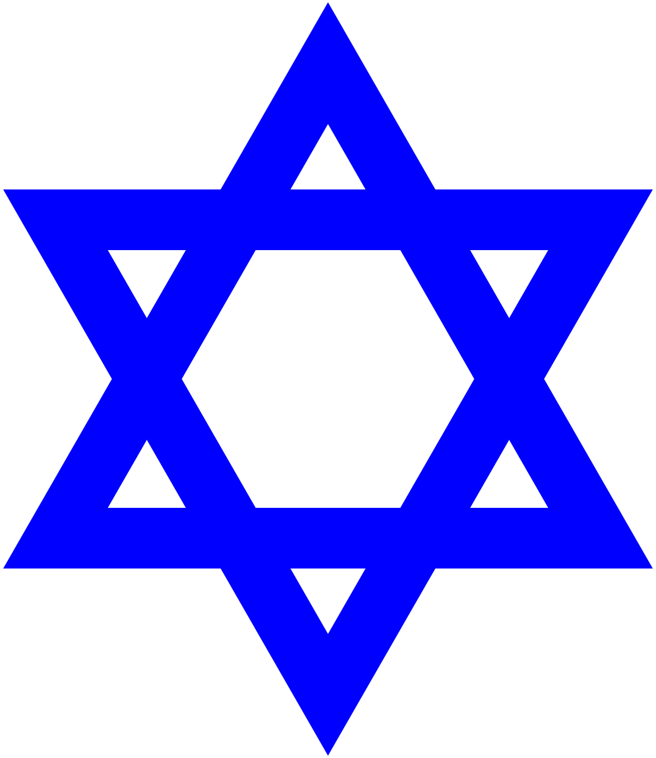
What will be discussed:
Origins.
Beliefs and emphases.
Influence on contemporary society.
Overview of Zionism.
Haredi attitudes towards Zionism.
Ellery, (2016), Mr. Trump’s Star of David (Image), http://awildduck.com/?p=4423 (Date Accessed: 18th January 2018).

Slide 3
Haredi
Ultra-Orthodox – smallest major Jewish denomination.
Book of Isiah 66:5 - “Hear the word of your Lord you who tremble [haredim] at his word”.
Haredi Jew referred to as a Yidn or Erlicher Yidn.
S. C. Heilman (2000),Defenders of the Faith: Inside Ultra-Orthodox Jewry, (Berkeley: University of California Press) p.12.
C. M. Pilkington (1995), World Faiths Judaism, (London: Teach Yourself Books)pp. 54-57.

Slide 4
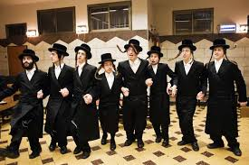
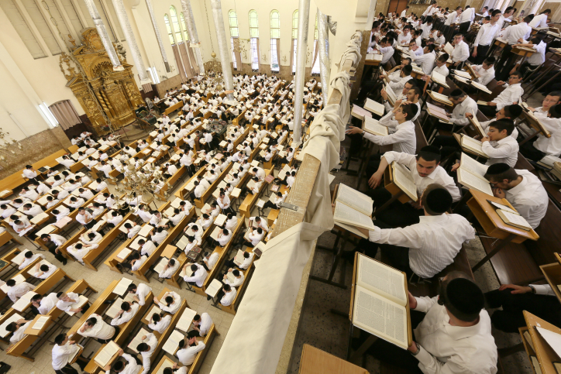
Beliefs
Spread of industrialisation and urbanization.
Society became free from community controls.
Rebbes – charismatic figures.
Absolute reverence to the Torah.
Halakhah – Jewish law, ‘the way’.
Emphasises traditionalism – new is never improved only corrupt.
Yeshivah – Jewish institution focus on study of traditional Jewish texts.
C. M. Pilkington (1995), World Faiths, pp.102-103.
S. C. Heilman (2000),Defenders of the Faith, pp.11-20.
Z. Zohar (2006), ‘Judaism: Orthodox Judaism’ in Worldmark Encyclopaedia of Religious Practices, Vol. 1, pp.462-468, Available from: Gale Virtual Reference Library, http://go.galegroup.com/ps/retrieve.do?tabID=T003&resultListType=RESULT_LIST&searchResultsType=Singl (Date Accessed: 18th January 2018).
S. C. Heilman and F. Skolnik (2007), ‘Haredim’ in Encyclopaedia Judaica, Vol. 8, 2, pp.348-352, Available from: Gale Virtual Reference Library, http://go.galegroup.com/ps/retrieve.do?tabID=T003&resultListType=RESULT_LIST&searchResultsType=SingleTab&searchType=BasicSe (Date Accessed: 14th December 2017).
Vos Iz Neias (2012), Israel, Tal Law Expired, Leaves Charedi Yeshivah Students out od Civil Service (Image), https://www.vosizneias.com/115655 (Date Accessed: 20th January 2018).

Slide 5
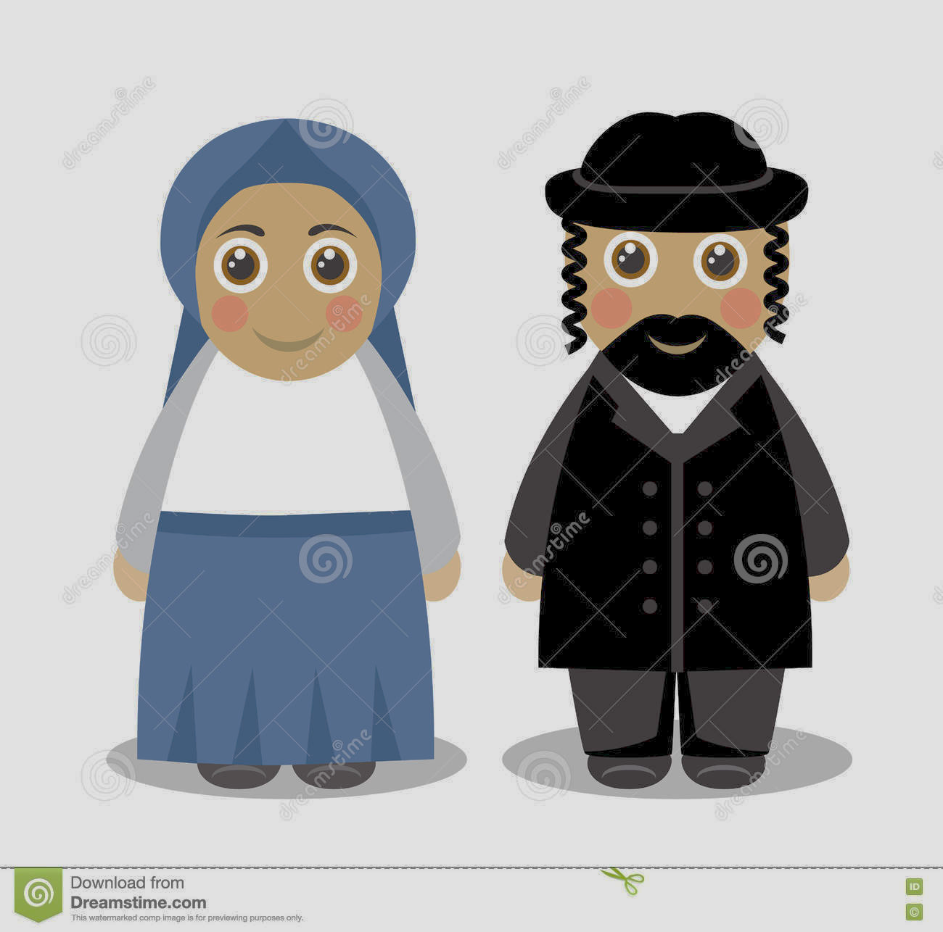
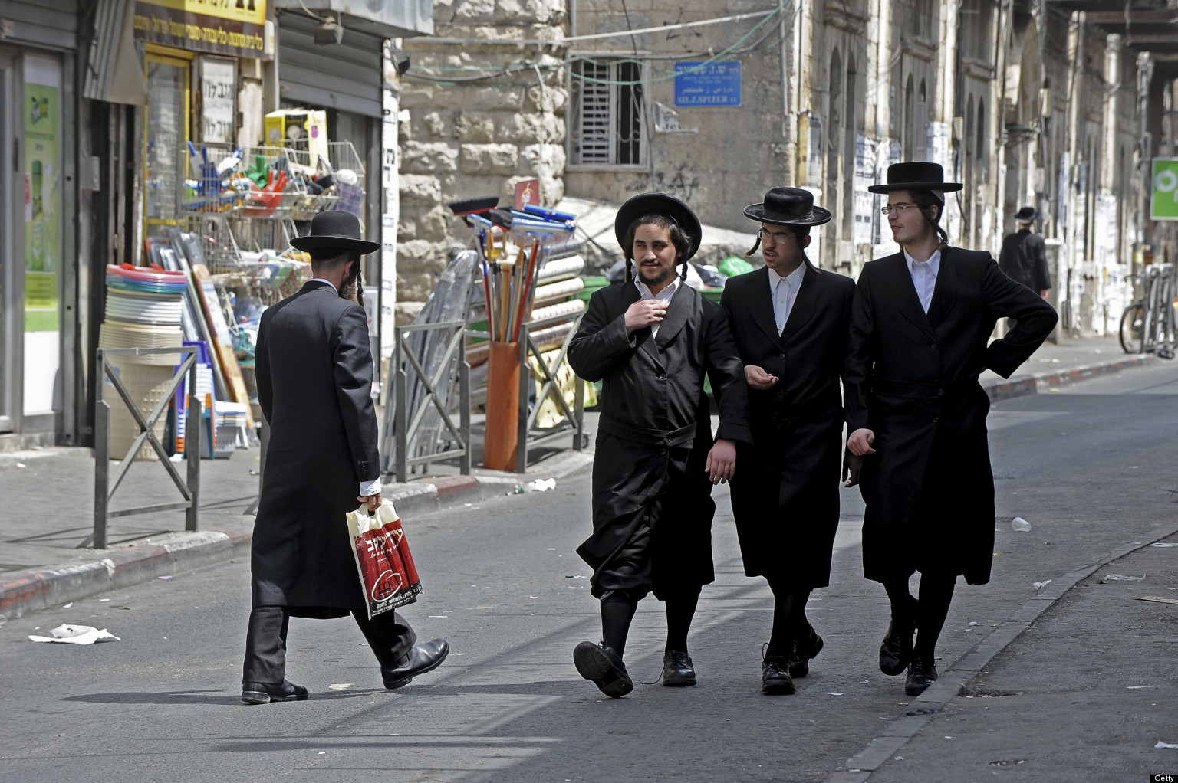
Customs
Live in segregated neighbourhood.
Distinctive dress for men and women.
Leviticus 19:27: “You shall not round off the hair on your temples or mar the edges of your beard.”
Rigorous laws of modesty.
Discourage dating and rely on arranged marriages.
Dreamstime (Unknown Date), Jewish Couple People (Image), https://www.dreamstime.com/stock-illustration-jewish-couple-people-cartoon-cute-husband-wife-jews-traditional-dress-white-background-image72250217 (Date Accessed: 18th January 2018).
C. M. Pilkington (1995), World Faiths, pp. 54-57.
S. C. Heilman and F. Skolnik (2007), ‘Haredim’ Vol. 8, 2, pp.348-350.
C. Balmer and M. Lubell (2013), Ultra-Orthodox Jews in Israel Face Form Drive as Haredim Resist Rapid Change (Image), https://www.huffingtonpost.com/2013/06/06/israel-ultra-orthodox-reform-_n_3394129.html (Date Accesssed: 20th January 2018).

Slide 6
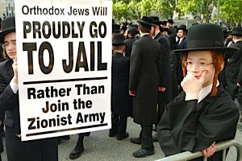
Influence in contemporary society
Military conscription created in 1948 “Has long caused resentment among Israel's secular minority leading to a demand for the ultra-Orthodox to share the so-called social burden”¹.
Israeli political leaders hoping to overcome this resentment.
Student Haredi claim they are playing a part in Israel's defence “the Torah holds the world together, and because of the Torah and Prayers, the IDF succeeds”².
Exposure by the press because of their ‘extreme views’.
Y. Brenner (2013), At Massive Anti-Draft Protest, Haredi Jews Came Together – But Not on Zionism (Image), https://forward.com/opinion/178334/at-massive-anti-draft-protest-haredi-jews-came-tog/ (Date Accessed: 14th December 2017).
1. Y. Knell (2014), Israeli ultra-Orthodox in mass rally over army draft, http://www.bbc.co.uk/news/world-middle-east-26412295 (Date Accessed: 18th January 2017).
2..B. Lynfield (2014), Ultra-Orthodox Jews are resisting new laws which force them to join the army, http://www.independent.co.uk/news/world/middle-east/ultra-orthodox-jews-are-resisting-new-laws-which-force-them-to-join-the-army-9249508.html (Date Accessed: 19th January 2017).

Slide 7
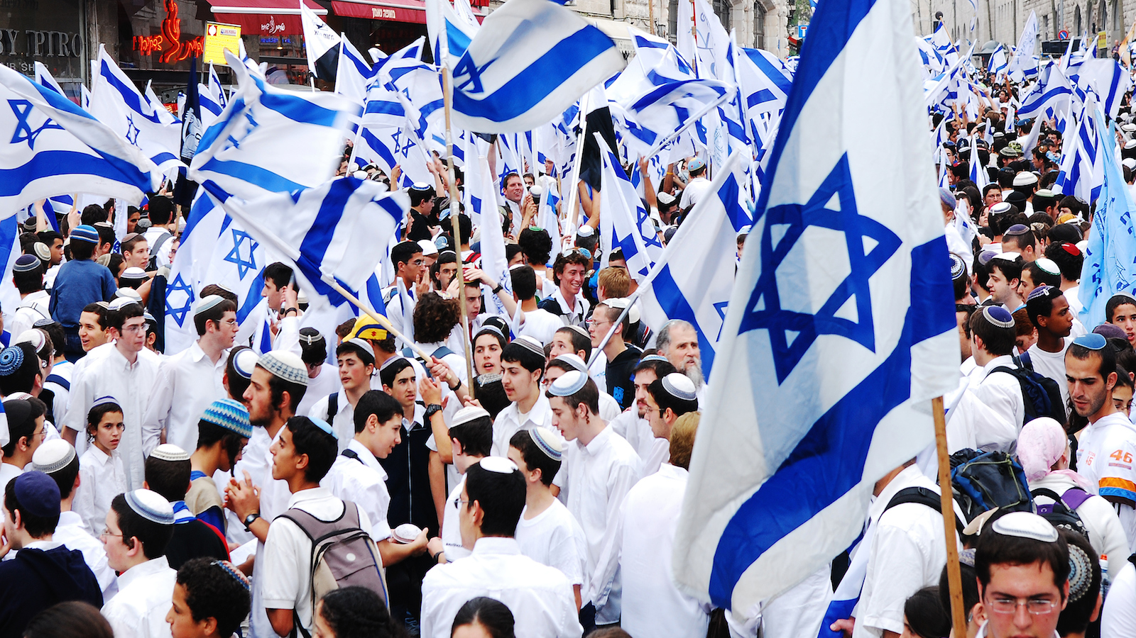
Zionism
Restoration of the Land of Israel.
Covenant made between Abraham and God (Gen 17: 7-8).
Political Zionism emerged from:
Reaction to ideas and challenges of enlightenment.
Response to persecution.
Lack of Jewish freedom in ghettos of Western Europe.
Theodor Herzl understood how anti-semitism was rooted in European society.
1947 Jews allowed to return to State of Israel.
E. Barnavi (Unknown Date), Zionism 101 (Image), https://www.myjewishlearning.com/article/zionism/ (Date Accessed: 18th January 2017).
G. Kouts, J.Jatz, S. Ettinger, A. Hertzberg, M. Medzini and C. Yahil (2007), ‘Zionism’ in Encyclopaedia Judaica, Vol. 21, 2, pp.539-577, Available from: Gale Virtual Reference Library, http://go.galegroup.com/ps/retrieve.do?tabID=T003&resultListType=RESULT_LIST&searchResultsType=SingleTa (Date Accessed: 21st January 2018).
W. Laqueur(2003), The History of Zionism, (London: Tauris Parke Paperbacks), pp. 84-136.

Slide 8
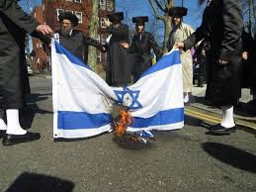
Haredi Jews view of Zionism
Most are opposed to the Zionism movement, why?
Only true salvation can come from the creator.
The Torah forbids the end of the exile.
Actions of Zionism are against the Torah.
Zionist state is constantly threatened by dangers of war.
Betrayal of traditional Judaism.
Neturei Karta (Unknown Date), Why Orthodox Jews are opposed to a Zionist Sate, http://www.nkusa.org/AboutUs/Zionism/opposition.cfm (Date Accessed: 19th January 2018).
G. Ben-Zvi (2014), Israel’s Ultra-Orthodox: Piety vs. Patriotism http://www.jpost.com/Experts/Israels-Ultra-Orthodox-Piety-vs-patriotism-351919 (Date Accessed: 19th January 2018).
Twitter (2016) Burning of Zionism Flag (Image), https://twitter.com/Satar_Gaza/status/720956338671656962 (Date Accessed: 19th January 2018).

Slide 9
Bibliography
Balmer, C. and Lubell, M. (2013), Ultra-Orthodox Jews in Israel Face Form Drive as Haredim Resist Rapid Change (Image), https://www.huffingtonpost.com/2013/06/06/israel-ultra-orthodox-reform-_n_3394129.html (Date Accesssed: 20th January 2018).
Barnavi, E. (Unknown Date), Zionism 101 (Image), https://www.myjewishlearning.com/article/zionism/ (Date Accessed: 18th January 2017).
Ben-Zvi, G. (2014), Israel’s Ultra-Orthodox: Piety vs. Patriotism http://www.jpost.com/Experts/Israels-Ultra-Orthodox-Piety-vs-patriotism-351919 (Date Accessed: 19th January 2018).
Brenner, Y. (2013), At Massive Anti-Draft Protest, Haredi Jews Came Together – But Not on Zionism (Image), https://forward.com/opinion/178334/at-massive-anti-draft-protest-haredi-jews-came-tog/ (Date Accessed: 14th December 2017).
McCartan, K. (2013), Clerical Whisper Ultra Orthodox Jews (Image), http://clericalwhispers.blogspot.co.uk/2013/05/no-sex-please-were-ultra-orthodox-jews.html (Date Accessed: 18th January 2017).
Emanuel, D. (2015), July Education series: The History of Haredi Judaism (Image), https://emanuel.org.au/civicrm/event/info?reset=1&id=135 (Date Accessed: 14th December 2017).
Ellery, (2016), Mr. Trump’s Star of David (Image), http://awildduck.com/?p=4423 (Date Accessed: 18th January 2018).
Heilman, S. C. (2000),Defenders of the Faith: Inside Ultra-Orthodox Jewry, (Berkeley: University of California Press).
Heilman, S. C. and Skolnik, F. (2007), ‘Haredim’ in Encyclopaedia Judaica, Vol. 8, 2, pp.348-352, Available from: Gale Virtual Reference Library, http://go.galegroup.com/ps/retrieve.do?tabID=T003&resultListType=RESULT_LIST&searchResultsType=SingleTab&searchType=BasicSearchForm&currentPosition=7&docId=GALE%7CCX2587508411&docType=Topic+overview&sort=RELEVANCE&contentSegment=&prodId=GVRL&contentSet=GALE%7CCX2587508411&searchId=R1&userGroupName=walamp&inPS=true (Date Accessed: 14th December 2017).
Jewish Virtual Library (Unknown Date), Orthodox Judaism: Hasidim and Mitnagdim, http://www.jewishvirtuallibrary.org/hasidim-and-mitnagdim (Date Accessed: 18th January 2017).
Knell, Y. (2014), Israeli ultra-Orthodox in mass rally over army draft, http://www.bbc.co.uk/news/world-middle-east-26412295 (Date Accessed: 18th January 2017).
Kouts, G. , Jatz, J. , Ettinger, S., Hertzberg, A. , Medzini, M. and Yahil, C (2007), ‘Zionism’ in Encyclopaedia Judaica, Vol. 21, 2, pp.539-627, Available from: Gale Virtual Reference Library, http://go.galegroup.com/ps/retrieve.do?tabID=T003&resultListType=RESULT_LIST&searchResultsType=SingleTab&searchType=BasicSearchForm&currentPosition=1&docId=GALE%7CCX2587521568&docType=Topic+overview&sort=RELEVANCE&contentSegment=&prodId=GVRL&contentSet=GALE%7CCX2587521568&searchId=R1&userGroupName=walamp&inPS=true (Date Accessed: 21st January 2018).
Laqueur, W. (2003), The History of Zionism, (London: Tauris Parke Paperbacks), p. 3-136.
Lynfield, B, (2014), Ultra-Orthodox Jews are resisting new laws which force them to join the army, http://www.independent.co.uk/news/world/middle-east/ultra-orthodox-jews-are-resisting-new-laws-which-force-them-to-join-the-army-9249508.html (Date Accessed: 19th January 2017).
Neturei Karta (Unknown Date), Why Orthodox Jews are opposed to a Zionist Sate, http://www.nkusa.org/AboutUs/Zionism/opposition.cfm (Date Accessed: 19th January 2017).
Pilkington, C. M. (1995), World Faiths Judaism, (London: Teach Yourself Books).
Vos Iz Neias (2012), Israel, Tal Law Expired, Leaves Charedi Yeshivah Students out od Civil Service (Image), https://www.vosizneias.com/115655 (Date Accessed: 20th January 2018).
Zohar, Z. (2006), ‘Judaism: Orthodox Judaism’ in Worldmark Encyclopaedia of Religious Practices, Vol. 1, pp.462-468, Available from: Gale Virtual Reference Library, http://go.galegroup.com/ps/retrieve.do?tabID=T003&resultListType=RESULT_LIST&searchResultsType=SingleTab&searchType=BasicSearchForm&currentPosition=1&docId=GALE%7CCX3437900051&docType=Topic+overview&sort=RELEVANCE&contentSegment=&prodId=GVRL&contentSet=GALE%7CCX3437900051&searchId=R1&userGroupName=walamp&inPS=true (Date Accessed: 18th January 2018).

