Slide 1
Reading at degree level
Academic Study Skills for Students: ECGE4001R

Slide 2
Aims:
Consider primary and secondary sources
Look at methods for searching for relevant texts and articles
Conducting a literature review
Introduction to journals and critical thinking / writing skills
Reading tips

Slide 3

Why do we need to research?
Carrying out a literature search is another key skill for psychology students.
Basically, a ‘literature search’ is a general or focused search of all (or selected) published material within a field in an attempt to find specific information on a topic, theory, author or debate.

Slide 4

Primary sources
Primary sources are original materials, created at the time of an event or soon after
Usually created (written) by those who saw an event, or collected data themselves

Slide 5
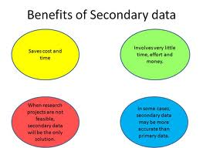
Secondary sources
Secondary sources describe, interpret, analyse, evaluate, explain, or comment on a primary source or event. Secondary sources are removed from and are often written after-the-fact, with hindsight.

Slide 6
Examples of primary resources
Conferences, meetings.
Data sets and statistics.
Original correspondence, including email.
Some Government documents.
Empirical studies (research based on scientific and experimental results – typically located in Journal Articles).
Technical reports.
Dissertations and theses (when based on original research).

Slide 7
Examples of secondary resources
Lectures
Textbooks
Edited Books (unless reporting on empirical research)
Critical Literature Reviews
Meta Analysis Journal Articles
Articles of opinion
Biographies

Slide 8
Which is stronger?
Research gains credibility and respect when it is founded on authentic evidence, empirical data, original documents, rather than on interpretations, explanations and opinions.
Interpretations (Secondary) can be bias and less accurate – although hindsight and a review can be a good thing.

Slide 9
References cited in lectures / modules
Modules will have a list of recommended reading - and they are recommended for a reason!
Lectures themselves will have references
  Look for / locate
At level four, we often use secondary sources. But by level five (and certainly at level six) we tend to divert you away from the use of secondary sources and encourage you to use far more primary sources
  Particularly in the form of journal articles

Slide 10

Searching for sources
1. Use the internet
  BUT – be very careful - AVOID generic or non-academic sites
Keywords are an important part of refining internet searches
Important skill to learn how to filter through many ‘hits’ in order to find pertinent information
Google Scholar is a good place to start
http://scholar.google.com

Slide 11
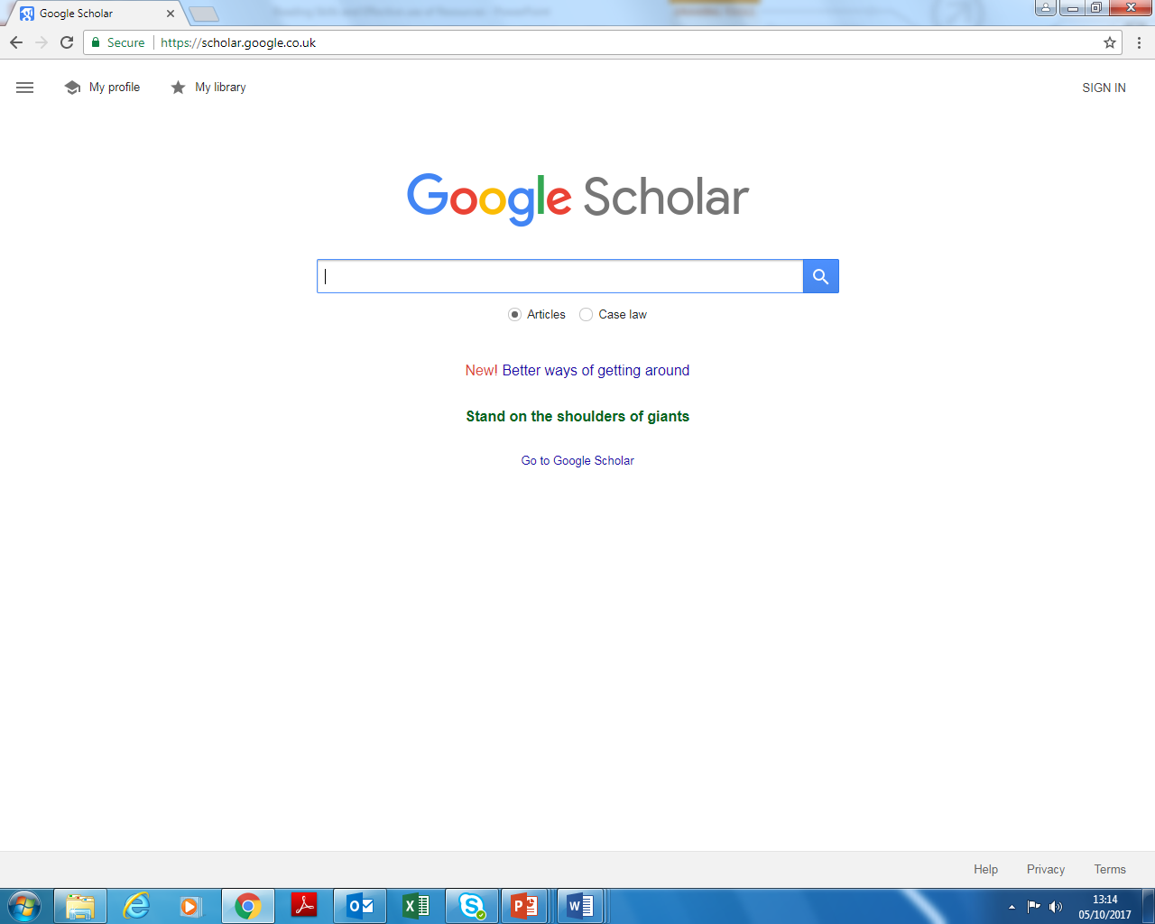

Slide 12
Searching for sources
2. Use the UWTSD library
When using the library catalogue, you have an option to search ALL available stock by title or keyword in the advanced search area
Title search = limits to words in the title
Keyword search = words relating to the topic you’re exploring, not necessarily in the title

Slide 13
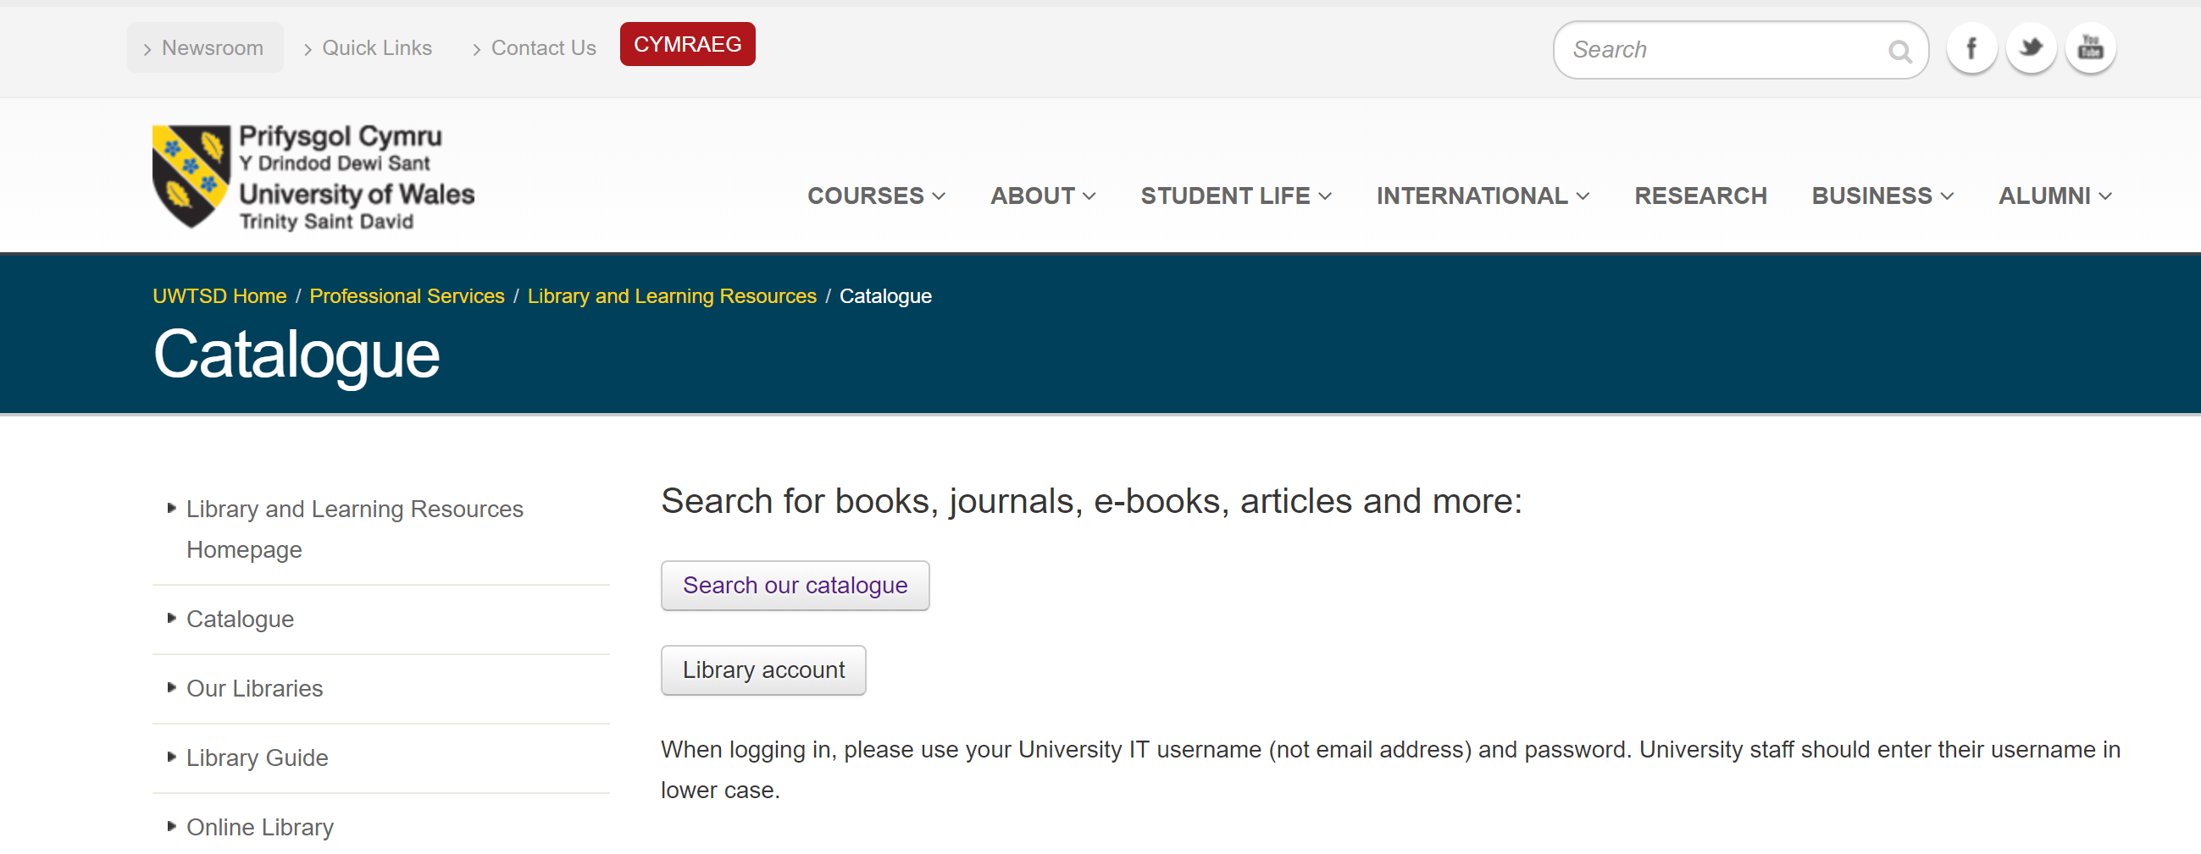
Library catalogue
http://www.uwtsd.ac.uk/library/catalogue

Slide 14


Using the online library

Slide 15
catalogue
Searches everything in the library database
  Books, journals, papers, etc
Useful to use keywords here, or the use of full title if you know it
Will show whether sources are available to view online

Slide 16
databases
The library subscribes to a large number of online databases which can give you access to thousands of full text journal articles in the field of Psychology.
Databases are useful because this can reduce the time it takes to search as it does code them into subject categories.
http://www.uwtsd.ac.uk/library/online-library/databases-by-subject/

Slide 17
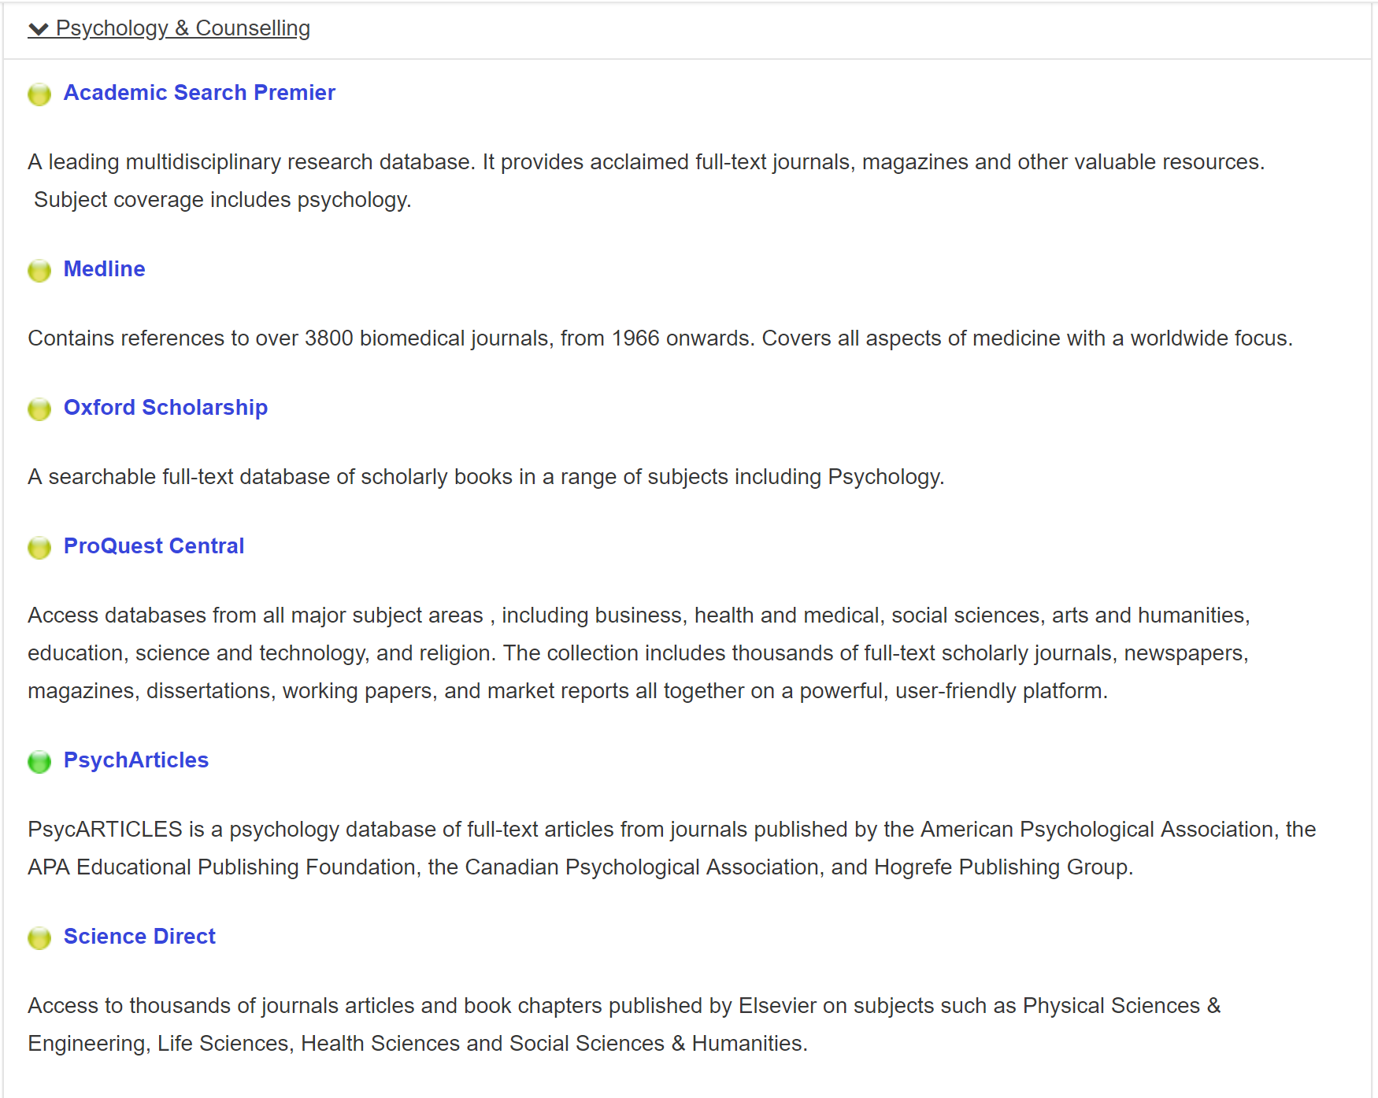

Slide 18
Other tips for researching
Look at reference sections of books and articles
E.g.,
  If you find a really good/specific article or book that precisely addresses the issues you’re interested in, look to see what the author has cited. From here, check the library or a database and see if you can locate the original sources.
Look at abstracts and/or summaries

Slide 19
Other tips for researching
If you have found a good article you can, in most web based databases, do a cited reference search. This means you can find out where this paper is cited - who else has referred to it in their work. This gives you another method of following the reference trail. You can also search to see who has cited a particular journal or author.

Slide 20
Critical thinking

Slide 21
What is Critical Thinking?
A process that evaluates ideas through the testing of statements (accuracy) and the soundness of reasoning behind them
    Not accepting everything you read at face value!
    Training your mind to think differently
Notes:
Officially, critical thinking can be described as ‘a process that evaluates ideas through the testing of statements (for accuracy) and the soundness of the reasoning behind them). Put simply, it just means not accepting everything you read at face value! If I tell you that the sky is blue, how do you know that the sky is blue and that I’m correct? If I told you that 60% of the females in the united kingdom prefer dogs to cats, what would you think? Would you challenge the idea? The point of critical thinking is to train your mind to think differently and to challenge what you read in terms of its robustness – where is the evidence?!

Slide 22
What else would we like to ask this magazine about this statement?
30%… is how much more likely you are to be depressed if you watch more than 3 hours of TV a day"
Zest Magazine,2012
How reliable is this
source??
Notes:
How reliable is this source likely to be?
What else would we want to ask this magazine about this statement?
How have you got this figure? 30% more depressed than who? Did you run a study to explore this? What sort of people have you presented this question to?

Slide 23
Critical thinking
Everyone can be critical!
  Involves questioning
  Children do this all the time
Be confident in your own interpretation, but also have the confidence to challenge yourself and your own opinions

Slide 24
Thinking Critically means...
Examining different viewpoints
Learning to think from different perspectives
Viewing those opinions that are different from yours
Avoiding automatic responses
Notes:
Thinking critically means examining different viewpoints, learning to think and see things from different perspectives, viewing other peoples opinions that may be different from yours, and avoiding automatic responses. Thinking critically means allowing yourself to take on the opinions of other people and incorporating them or adding them on to your existing opinions! (within reason)

Slide 25
So – what can you do?
Keep an open mind
Identify key issues and raise questions
Obtain relevant facts
Evaluate the findings and form judgements
Notes:
Ways in which you can develop critical thinking – keep an open mind. Don’t jump in with a response before you actually process what you have been told or have read. This is why we advise you to read an article or piece of text more than once!
Identify key issues that may have been made and raise questions about the issue (like the zest magazine example!) obtain relevant facts from academic sources about the topic, and provide an evaluation of the findings followed by (to some extent) your personal opinion and judgement.

Slide 26
What can we KNOW?
“I get frustrated with my Psychology classes. We study the ‘theory’ of this and the ‘principle’ of that. Aren’t there any laws? Why can’t psychologists make up their minds and stop acting like they don’t know anything for sure?”
Notes:
One of the questions that may already be bobbing around in your head is – Jesus, can’t psychology just decide on anything? Why are there so many different viewpoints that need to be examined?!
Yes we do teach you the theory of this and the principle of that. We also teach you the idea of X and the notion of Y – but we don’t state these as facts! There probably arent any laws in psychology that we follow (other than conventions for report writing and referencing!!!!) and it is our reading that informs us!
So this begs the question – what can we KNOW? Do I KNOW that males between the age of 18 and 25 are definitely more likely to be higher sensation seekers than females, and in turn are definitely more likely to develop a gambling addiction? No, not really. I know that as a consequence of the study I have created and the manipulations I have put in place that this is true, and I can infer some of this to a wider population – but there is no DEFINITE. Further reading around the topic will allow me to offer an informed conclusion and judgement.. And that is all we ask of YOU too.

Slide 27
Critical thinking is not just criticising
Critical thinking is a vital skill for a psychology student
It is NOT just ‘slating’ an article
  Highlight the negatives in a constructive and professional way
  BUT – highlight the positives too!

Slide 28
Critical view
    Imagine you’re reviewing papers for a journal – a paper has faults which you need to point out, but you also need to say how it could be better…
    You have to leave the author with the will to carry on!!
    Also remember that if the paper is published in a peer reviewed experts’ have agreed that the paper is good enough to be published. It doesn’t mean it’s perfect necessarily but does mean that it isn’t hopeless!!
    But also, some journals are better than others and more reputable ones have higher standards.

Slide 29
Journals and journal articles

Slide 30
Why are journals important?
Considered to be the ‘strongest’ sources for use in your assignments
  They are not all articles without criticism
Textbooks are not peer-reviewed
  But some edited books are..
Contain the most up-to-date information. Contain the latest research on any specific topic
  Without journals – psychology would be standing still

Slide 31
Peer reviewed?
Peer review is the evaluation of creative work or performance by other people in the same field in order to maintain or enhance the quality of the work or performance in that field.
  Typical 2 – 3 peers for each article.
Careful though – not all Journals are peer reviewed.
  Check the guidelines on the journals website.

Slide 32
Contents of a journal article
Title and author/s
  What the article is about
Abstract (summary)
  Very brief summary of the whole article
Introduction
  Introduces the topic of the article
  What the article contributes to existing knowledge on the topic
  Review of literature
  Hypothesis
Method
  Who, what, when, how
  Sample / participants
  Methods used / employed
  Type of analysis
  Procedure

Slide 33
Contents of a journal article
Results / Findings
  What were the findings?
  Tables and graphs
  Were findings significant?
  What does this mean?
Discussion
  What the results mean
  How do the findings contribute to knowledge?
  Are the hypotheses supported or rejected?
  Problems / limitations of the study
Conclusion (not always separate heading)
  Importance of research
  Future research
References
Appendices

Slide 34
Some final reading tips
Look for information that relates most exactly to your assignment (title)
Draw up a trial essay plan and see what information you will need
  What came up in the lecture/seminar?
Check the back cover of the book, contents list and index to see exactly what the book covers
Quickly scan the introduction and/or conclusion: these may even provide all the information you need
Browse through the headings to get a feel for the boook

Slide 35
Some final reading tips
Is the source a well-known one in the field, such as a recommended journal?
Is the source likely to be biased? If so, does the bias matter in this case?
Does the text have a good bibliography/reading list?
Is it clear where any evidence comes from?
Is the source from a publisher respected in your subject area? Information in newspapers or from friends is not usually considered reliable.
  Consider when sourcing information from the Web too!

