Slide 1
LCHS4001
Academic and Employability Skills
Paraphrasing

Slide 2
Aims of the session
To understand what paraphrasing is and why it is important for academic success.
To learn the main steps to effective paraphrasing.
To practice paraphrasing a range of sources.

Slide 3
In groups, discuss the following questions:
What is paraphrasing?
Why is paraphrasing important for academic success?
Is paraphrasing just changing a couple of words?
How can I paraphrase a text?

Slide 4
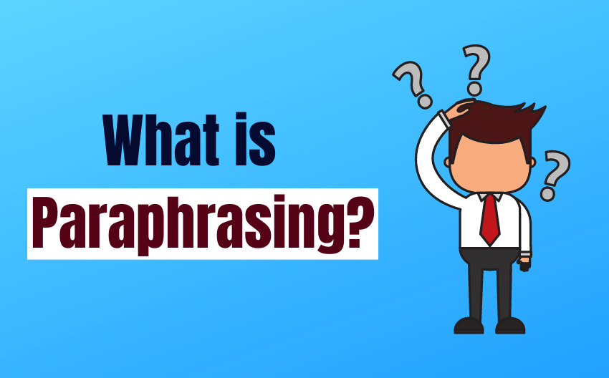
Paraphrasing

Slide 5
What is paraphrasing?
To write an assignment, you will have to read a range of sources (e.g., books, journal articles). This will allow you to understand a topic better.
There are three ways in which you can use ideas from external sources in your assignment:
Paraphrasing
Summarizing
Quoting
You should always remember to reference the source.

Slide 6
What is paraphrasing?
Paraphrasing is writing the ideas of another person in your own words. Paraphrasing is useful when you are using the work of others to support your own view.
When paraphrasing, you need to change the words and the structure but keep the meaning the same.
Please remember, though, that even when you paraphrase someone's work, you must acknowledge it by providing a reference.

Slide 7
Example 1
Source
It has long been known that Tokyo is the most populous city on earth, but no-one knew exactly how populous it was until last month.
Paraphrase
Although Tokyo has been the world's most heavily populated city for many years, the precise population was not known until four weeks ago.

Slide 8
Example 2
Direct quote: Brown (2004, p.72) argues that “ascertaining learning styles is essential to facilitate learning”.
Paraphrase:
  Brown (2004) is a keen advocate of learning styles.
  Learning styles are critical to reaching learners (Brown, 2004).
Note that the brackets depend upon whether the emphasis is on the author (a) or the information (b)
Note that in (b) the full stop comes after the citation – the citation is always part of the sentence. No page number is needed with a paraphrase.

Slide 9
Why should you paraphrase ?
Paraphrasing provides support for your claims and adds credibility to your writing.
It is a way of showing your understanding of the information you have read in a source.
To avoid plagiarism.
Please remember that in your assignments you cannot simply provide a list of quotations (copy of the exact words). Instead, you should explain ideas in your own words (paraphrasing).

Slide 10
Paraphrasing Techniques
What are the techniques used to present the same meaning differently?
  using synonyms
  changing word class (and making any other necessary changes)
  changing word order (and making any other necessary changes)
  Using Active and Passive voice

Slide 11
The use of synonyms
The most common technique is the use of synonyms.
Students highlight important nouns, verbs or adjectives and provide a synonym.
The use of thesaurus can help you find synonyms:
Synonyms and Antonyms of Words | Thesaurus.com
Please remember that you cannot simply use synonyms when paraphrasing. You should also change the structure of the original text.

Slide 12
Example - Synonyms
Source
Many well-known multinational companies are located in London.
Suggested Paraphrase
Many famous multinational companies are situated in London.

Slide 13
Another example
Source
“One major problem confronting coursebook writers, is the enormous number of phrasal verbs in the language” (Koprowski, 2005, p.322).
Paraphrased Example
According to Koprowski (2005) a significant problem confronting textbook writers, is the great number of phrasal verbs in the language.

Slide 14
Changing word class
Source
You are required to complete your coursework before the end of the term.
Paraphrased Example
The completion of your coursework is required before the end of the term.

Slide 15
Another Example
Source
Approximately 80% of low-income families will be assisted by the proposed ‘free lunch’ program. (Health Canada, 2015)
Paraphrased Example
According to Health Canada (2015), the suggested ‘free lunch’ campaign will provide assistance to roughly 80% of poor families.

Slide 16
Active and Passive voice
Source
A lot of people do not know the effect of antibiotics.
Paraphrased Example
The effect of antibiotics is not known by a lot of people.

Slide 17
Active / Passive voice
Source
Approximately 80% of low-income families will be assisted by the proposed ‘free lunch’ program (Health Canada, 2015).
Paraphrased Example
According to Health Canada (2015), the suggested ‘free lunch’ campaign will assist / help roughly 80% of poor families.

Slide 18
Paraphrasing
Whichever technique you use, remember that your sentences must:
  retain the meaning of the original
  have a different structure
  be grammatically correct
  have correct spelling
  Include a reference

Slide 19
Steps to paraphrasing
Read and understand the text.
Make a list of the main ideas.
  Find the important ideas - the important words/phrases. In some way mark them - write them down, underline or highlight them.
  Find alternative words/synonyms for these words/phrases - do not change specialised vocabulary and common words.

Slide 20
Steps to paraphrasing
Change the structure of the text.
  Identify the meaning relationships between the words/ideas - e.g. cause/effect, generalisation, contrast.
  Express these relationships in a different way.
  Change the grammar of the text: change nouns to verbs, adjectives to adverbs, etc., break up long sentences, combine short sentences.

Slide 21
Steps to paraphrasing
Rewrite the main ideas in complete sentences. Combine your notes into a piece of continuous writing.
Check your work.
  Make sure the meaning is the same.
  Make sure the length is the same.
  Make sure the style is your own.
  Remember to acknowledge other people's work.

Slide 22
What not to do when paraphrasing
Use the same sentence structure as the original source: for example, only changing a few words.
Use parts of the original sentence(s) without referencing these appropriately following Harvard Guidelines.
Changing the meaning of the original text.

Slide 23
Paraphrasing Practice
Now try paraphrasing the following:
Smith et al., (2010, p.20) state that ‘human activities can also change the climate.’

Slide 24
Paraphrasing Practice
Suggested paraphrase:
According to Smith et al., (2010) climate change is influenced by human activity.

Slide 25
Paraphrasing Practice
Although poor training and inadequate resources have caused many plagiarism problems, the Internet has added to the challenges. At University of Toronto, plagiarism related to the Internet increased from 50% to 99% of cases between 2000-2001 and 2001-2002.
Notes:
Source: Locker, K. and Findlay, I. (2009) Business Communication Now. Toronto: McGraw-Hill,

Slide 26
Paraphrasing Practice
Suggested paraphrase:
The main causes of plagiarism arise from lack of training/preparation and insufficient resources, as well as the Internet. At University of Toronto, in the years between 2000-2002 web-related plagiarism cases doubled / increased by almost 100%.

Slide 27


Slide 28
References
British Council (2022) Top five paraphrasing techniques. Available at: Top Five Paraphrasing Techniques (video included) | British Council (accessed 2nd November 2022)
Strongman, L. (2013) Academic writing. Cambridge: Cambridge scholars publishing.
UEfAP (2019). ‘Academic Writing: Reporting - paraphrase, summary & synthesis’. Online. http://www.uefap.net/writing/writing-reporting/writing-reporting-paraphrase (accessed 2nd November 2022)

Slide 29
Further Reading
UCL (2021) ‘Paraphrasing for Beginners.’ Online. https://www.ucl.ac.uk/ioe-writing-centre/reference-effectively-avoid-plagiarism/paraphrasing (accessed 2nd of November 2022)
University of Bristol (2015). ‘Paraphrasing.’ Online. https://www.bristol.ac.uk/arts/exercises/referencing/page_05.htm (accessed 05.03.2021)
Future Learn (n.d.) ‘Techniques for paraphrasing.’ Online. https://www.futurelearn.com/info/courses/english-for-study-intermediate/0/steps/35241 (accessed 2nd November 2022)

