Slide 1
Angular Kinetics:
Explaining the Causes of Angular Motion
Chapter 7

Slide 2
Objectives
Define moment of inertia
Explain how the human body’s moment of inertia may be manipulated
Explain Newton’s first law of motion as it applies to angular motion
Explain Newton’s second law of motion as it applies to angular motion
(continued)

Slide 3
Objectives (continued)
Explain Newton’s third law of motion as it applies to angular motion
Define angular impulse
Define angular momentum
Explain the relationship between angular impulse and angular momentum

Slide 4
Angular Inertia
Many concepts similar to linear kinetics
Inertia: resistance of a body to changing motion
Angular inertia: property of an object to resist changes in its angular motion
Unlike linear inertia, not just dependent on mass

Slide 5
Moment of Inertia
Quantifies how an object’s mass is distributed relative to a specific axis of rotation
  Mass farther from the axis creates more angular resistance
  Mass closer to the axis creates less angular resistance
  (continued)

Slide 6
Moment of Inertia (continued)
Considers each individual mass particle
Mathematically, I_{a} = Σm_{i}r_{i}²
Where
  I_{a} = moment of inertia about axis a through center of gravity (cg)
  m = mass of particle i (kg)
  r_{i} = radius from particle i to axis of rotation a (m)
  (continued)

Slide 7
Moment of Inertia (continued)
Radius of gyration
Simpler approach to consider mass distribution
Describes how far from an axis of rotation all the object’s mass must be concentrated to create the same resistance to change in angular motion as the object had in its original shape
(continued)

Slide 8
Moment of Inertia (continued)
Radius of gyration: makes it easier to calculate I
Mathematically, I_{a} = mk_{a}²
Where
  I_{a} = moment of inertia about axis a through the cg
  m = mass of the object (kg)
  k_{a} = radius of gyration about axis a through the cg (m)
  (continued)

Slide 9
Moment of Inertia (continued)
Moment of inertia (I) depends on
  Mass
  Distribution of the mass
  Distribution has a greater effect, as seen by I_{a} = mk_{a}²
Double the mass = 2 × I (double)
Double the radius of gyration = 4 × I (quadruple)

Slide 10
Moment of Inertia About Eccentric Axes
Not all rotation occurs around the cg
  Eccentric axis: Implement axis not passing through cg
Performer holds “grip” or “end” of implement, not cg
  Bat, hammer, stick, racket
New axis is called a parallel axis
Mass farther from axis of rotation means I is greater
(continued)

Slide 11
Moment of Inertia
About Eccentric Axes (continued)
Mathematically: I_{b} = I_{cg} + mr²
  Where
    I_{b} = moment of inertia about axis b
    I_{cg} = moment of inertia about axis through the object’s center of gravity and parallel to axis b
    m = mass of object
    r = radius = distance from axis b to parallel axis through the center of gravity

Slide 12
Moments of Inertia in the Human Body
Three principal axes in the human body
  Anteroposterior (cartwheel)
  Transverse (somersault)
  Longitudinal (twist)
The moment of inertia around each axis depends on the position or orientation of the limbs relative to the axis

Slide 13
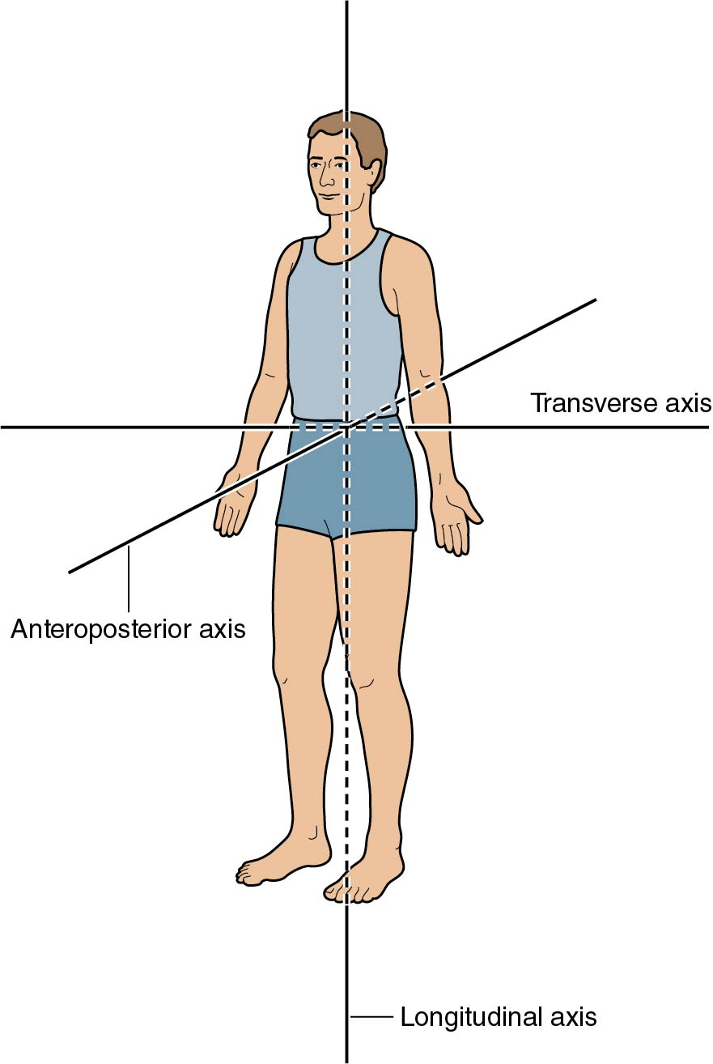
Three Principal Axes of Rotation for the Human Body

Slide 14
Manipulating the Moments of Inertia of the Human Body
Altering the relative angle at a joint or joints changes I by changing the mass distribution around a joint axis
  Sprinter’s leg during recovery phase
  Swinging a tool
  (continued)

Slide 15
Manipulating the Moments of Inertia of the Human Body (continued)
Altering the relative angle at many joints changes the I_{cg} by changing the mass distribution around the cg
  Arm use by figure skaters when spinning
  Tuck versus layout position of divers and gymnasts in somersaults

Slide 16
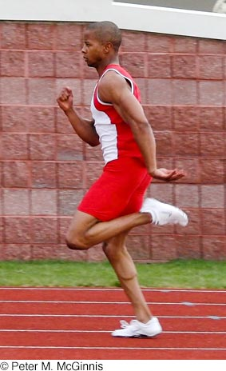
Knee and Hip Flexion of the Recovery Leg

Slide 17
Moments of Inertia and Linear Velocity
Tangential velocity (v_{T}) greater with longer radius
Moment of inertia (I) greater with longer radius
Trade-off when choosing length of swinging implement
  Ease of swing versus effectiveness of velocity achieved
    Bat, stick, racket, hammer
Equipment design changes (length, mass, distribution)
Technique changes (choking up)

Slide 18
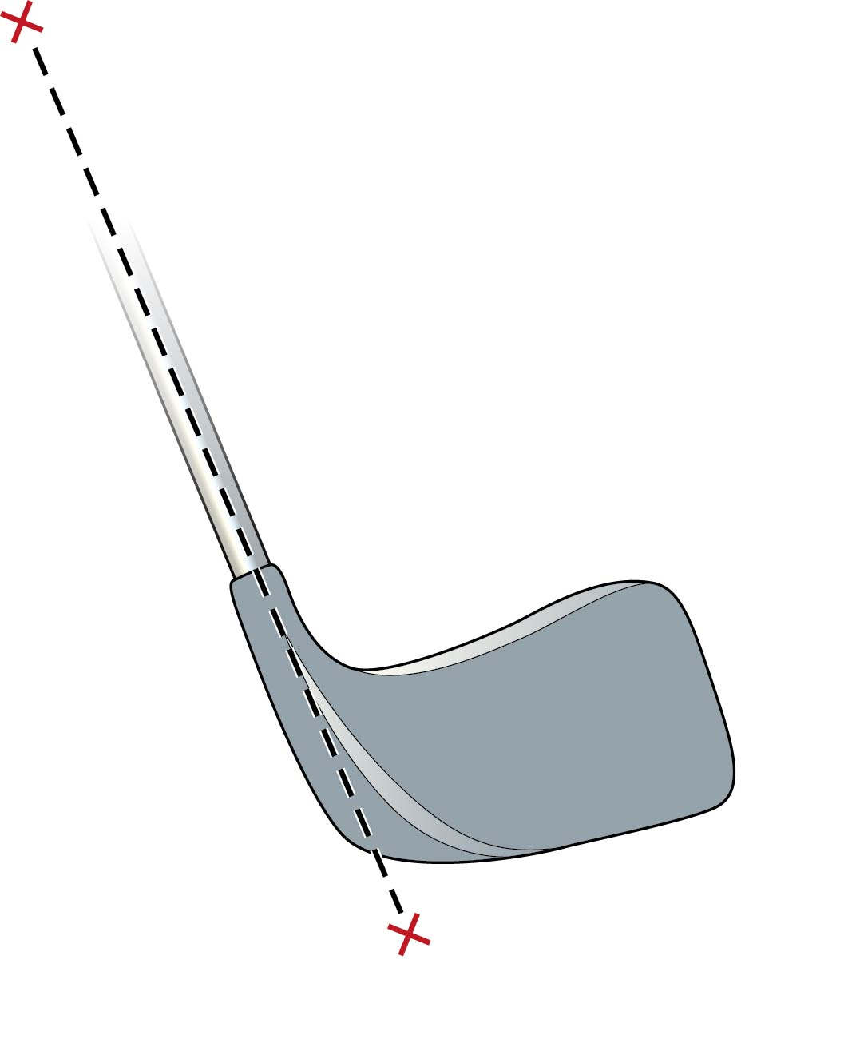
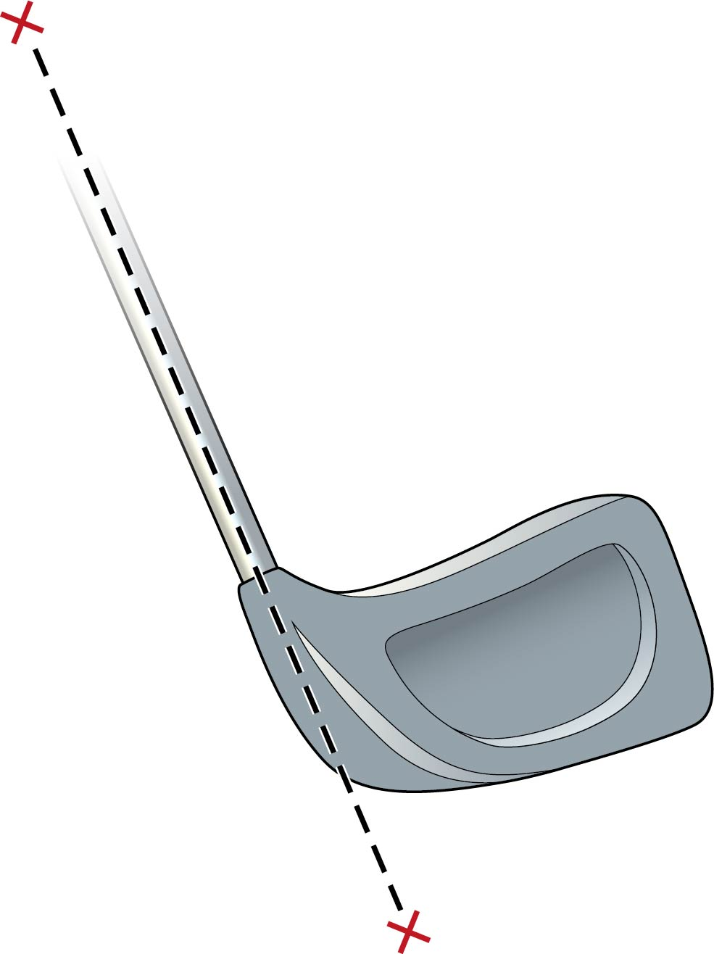
Golf Club Head Designs

Slide 19
Angular Momentum
Quantifies the angular motion of an object, describing both
  Current state of motion
  Resistance to changing motion
H_{a} = I_{a}ω_{a}
Where
  H_{a} = Angular momentum about axis a (kg∙m²/s)
  I_{a} = moment of inertia about axis a (kg∙m²/s)
  ω_{a} = angular velocity about axis a (must be in rad/s)
  (continued)

Slide 20
Angular Momentum (continued)
Vector quantity: magnitude and direction
  Magnitude: Iω (units: kg∙m²/s)
  Direction: same as direction of ω
    Follows right-hand rule conventions
Note
  H_{a} will change because of changes in either or both of I and ω
    Unlike linear momentum where v varies, m constant in human movement

Slide 21
Angular Momentum of the Human Body
Frequently, many limbs rotating at different ωs
  H_{a} of body is the sum of angular momenta of individual segments
Mathematically H_{a} ≈ Ʃ(I_{i/cg} ω_{i})
Where
  H_{a} = angular momentum about axis a through the cg
  I_{i/cg} = moment of inertia of segment i about the entire body cg
  ω_{i} = angular velocity of segment i

Slide 22
Newton’s First Law: Angular Interpretation
Angular momentum of an object remains constant unless a net external torque acts on it
  If Is are constant, ω is constant
(continued)

Slide 23
Newton’s First Law: Angular Interpretation (continued)
For a rigid projectile, gravity is the only external force
  Weight acts through the cg
    Weight has no moment arm around the cg
      No external force on body
  Weight creates no external torque on a projectile
(continued)

Slide 24
Newton’s First Law: Angular Interpretation (continued)
H (product of I and ω) remains constant unless a net external torque acts on the rotating body
Mathematically: H_{i} = I_{i}ω_{i} = I_{f}ω_{f} = H_{f}
  Where
    H_{i} = initial angular momentum
    H_{f} = final angular momentum
    I_{i} = initial moment of inertia
    I_{f} = final moment of inertia
    ω_{i} = initial angular velocity
    ω_{f} = final angular velocity
    (continued)

Slide 25
Newton’s First Law: Angular Interpretation (continued)
Human body is a system of rigid links with modifiable I
With H constant (no external torque applied)
  Increase in I, there must be a proportional decrease in ω
  Decrease in I, there must be a proportional increase in ω
For faster spin, reduce I (tuck, arms in)
For slower spin, increase I (layout, arms out)

Slide 26
Control ω of Limbs or Trunk
H_{cg} remains constant while a projectile
  Individual segments have H_{i/cg} from I and ω
Repositioning one or more segments of body must be countered by repositioning one or more segments in the opposite direction to maintain constant H_{cg}
  Repositioning means changing ω

Slide 27
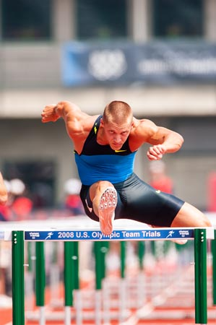
Angular Momentum of Hurdler’s Trailing Leg

Slide 28
Newton’s Second Law: Angular Interpretation
If a net external torque acts on a body, the body will angularly accelerate in the direction of the net external torque; its acceleration will be directly proportional to the torque and inversely proportional to its moment of inertia
Similar to Newton’s second law for linear motion
    (continued)

Slide 29
Newton’s Second Law: Angular Interpretation (continued)
Mathematically, ƩT_{a} = I_{a}α_{a}
  Where
    ƩT_{a} = net external torque about axis a
    I_{a} = moment of inertia of the object about axis a
    α_{a} = angular acceleration of the object about axis a
    Remember that both I and α can change or be changed!
    (continued)

Slide 30
Newton’s Second Law: Angular Interpretation (continued)
Angularly accelerate = change in angular momentum
The change in angular momentum of an object is proportional to the net external torque exerted on it, and the change is in the direction of the net external torque
  Torque_{a} and ω_{a} have same sign: H_{a} increases
  Torque_{a} and ω_{a} have opposite sign: H_{a} decreases
If I changes when T applied, change in ω is greater

Slide 31
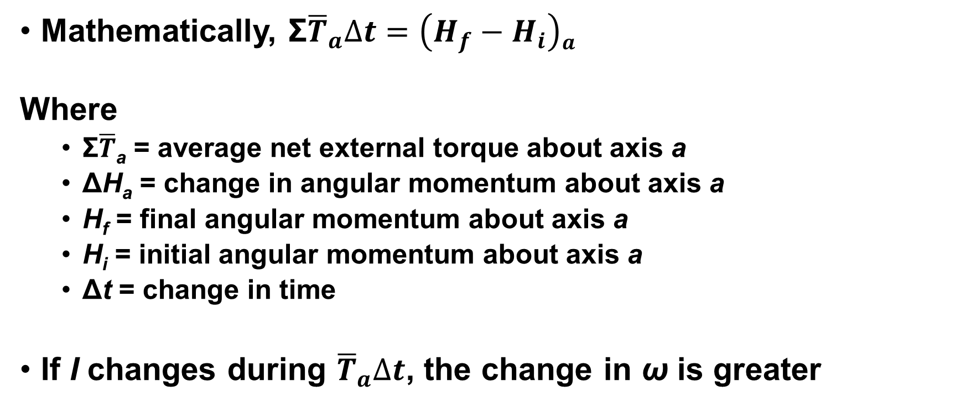
Impulse–Momentum: Angular Version
Mathematically, ${\text{Ʃ}\overline{T}}_{a}∆t=\left(H_{f}−H_{i}\right)a$
Where
  Ʃ$\overline{T}$_{a} = average net external torque about axis a
  ΔH_{a} = change in angular momentum about axis a
  H_{f} = final angular momentum about axis a
  H_{i} = initial angular momentum about axis a
  Δt = change in time
If I changes during ${\overline{T}}_{a}∆t$, the change in ω is greater

Slide 32
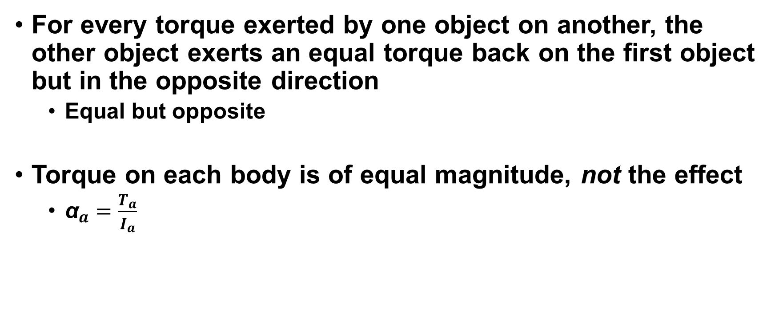
Newton’s Third Law: Angular Interpretation
For every torque exerted by one object on another, the other object exerts an equal torque back on the first object but in the opposite direction
  Equal but opposite
Torque on each body is of equal magnitude, not the effect
  ${\text{α}}_{a}=\frac{T_{a}}{I_{a}}$

