Slide 1
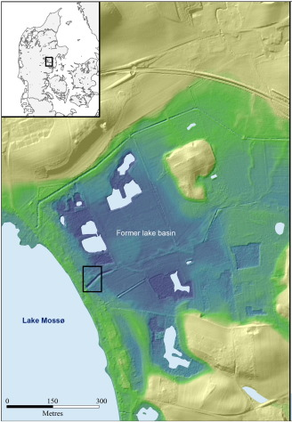

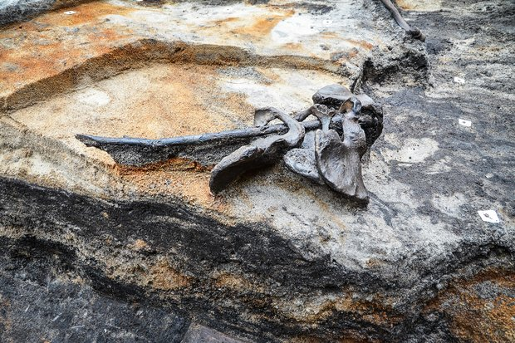
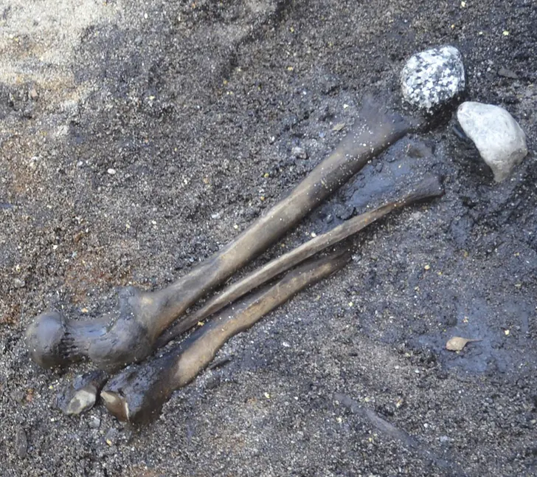
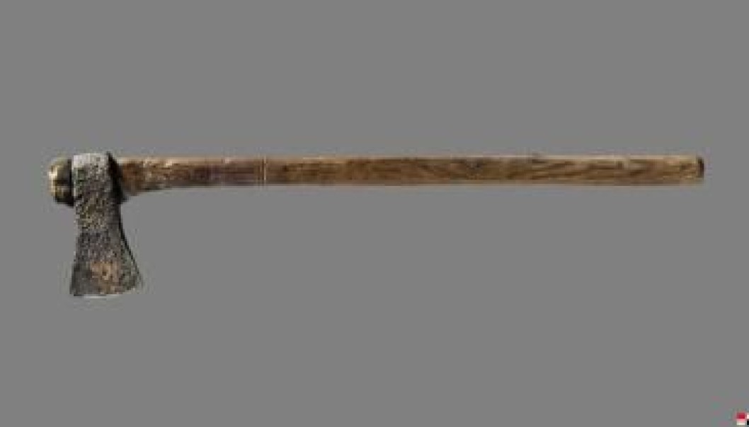
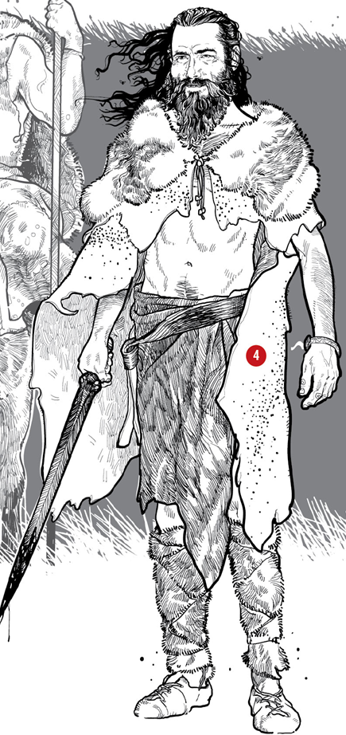
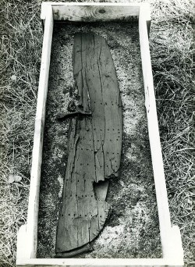
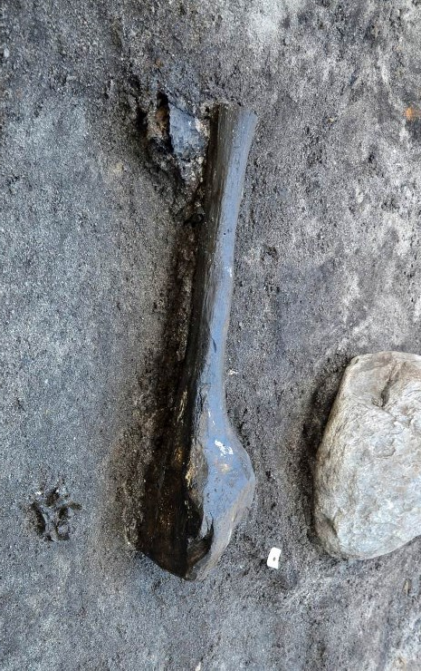
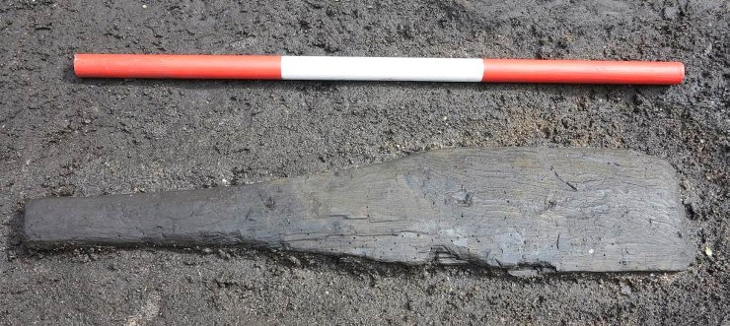
Alken Enge Battle Timeline
Alken Enge
A Story of Communities at War and Post Battle Violence Emerges from the Marsh
Excavation Site Map
Alken Enge, Skanderborg, Denmark
The Battle at Alken Enge c.1ST Century AD
Bodies left for scavengers 6months – 1 year
Desecration of bodies for rituals up to 1 year after the battle
Estimate 300+ Warriors clash in the Danish wetlands of Alken Enge
Fighting was fierce and bodies were left for scavengers
Survivors return up to 6 months to a year later to ritually desecrate the skeletonised remains
Excavations began in
1957 led by archaeologist Harald Andersen.
The mass burial ground contained the skeleton remains of several hundred Iron Age fighters.
Archaeologists believe that the discoveries are from an internal conflict which was forced by Roman powers extending their boundaries.
Post-battle Violence
Former Lake Basin
Four pelvic bones threaded onto a stick. Bundles of leg bones from separate bodies thrown into the lake with non-local stones. These provide clear evidence of post-battle violence and unrecognised rituals.
Excavation Site
Lake Mossø
The bones have a high number of unhealed trauma from sharp-edged tools and weapons.
Taphonomy results show animal gnawing on many of the bones for a period of between 6months to 1year evidence that the bones were left exposed to scavengers.
Adult leg bones recovered show scraping marks occurred after the exposure period to scavengers. This gives further evidence and demonstration of post-battle violence and practices.
Combatants were armed with improvised weapons
Well preserved iron axe
Conclusion
Changes the known narrative about the size of Barbarian armies from around 80 to several hundred.
The find has raised questions about post-battle violence.
Evidence on the bones show the combatants revealed not to be professional soldiers but villagers.
The site is evidence of considerable intercommunity animosity that may be related to Roman expansion in the region.
94 cm long shield
Age of Remains
Wooden spade used as a club.
Children as young as 13 and even some women may have been among the fighters.
Heavy club approximately 65 cm length in oak

Slide 2
Bibliography
Primary Sources
Andersen, C., 2016. Location of the Alken Enge site. https://www.sciencedirect.com/science/article/pii/S2352409X16302723.
Andersen, H., n.d. The 94 cm long shield. https://www.museumskanderborg.dk/alken-enge-english-version.
Deposit Photos, n.d. Old viking shield with sword, axe and parchment scroll on wooden floor. https://depositphotos.com/stock-photos/viking-battle-axe.html?qview=98857348.
Jensen, P., 2014. Four pelvic bones on a stick. https://cas.au.dk/en/currently/news/singlenews/artikel/translate-to-english-in-alken-enge/.
Jensen, P., 2012. Heavy club of approx. 65 cm length in oak. https://www.museumskanderborg.dk/status-2012.
Larsson, R., 2012. approx. 75 cm long and very well preserved iron ax with shaft. https://www.museumskanderborg.dk/status-2012.
Museum Skanderborg, 2014. Thighbones from the dead warriors (Alken Enge).
Museum Skanderborg, 2014. Wooden spade reshaped as a club. https://www.museumskanderborg.dk/status-2013-1.
P.J, P., 2018. Femur, fibula, tibia, and two white stones. https://www.ancient-origins.net/ancient-places-europe/alken-enge-and-buried-army-002120.
Secondary Sources
Aarhus University, 2012. An entire army, sacrificed in a bog. HeritageDaily - Archaeology News. URL https://www.heritagedaily.com/2012/07/an-entire-army-scarificed-in-a-bog/46597 (accessed 3.13.20).
Aarhus University, Jensen, P., 2017. Where are we? Reviewing the Integration of Complex Spatial Data in Current Field Archaeology.
Ancient-Origins, 2017. Ancient Remains: Iron Age Necromancy on the Bones of the Dead? | Ancient Origin. Ancient Origins - Reconstructing the Story of Humanity’s Past. URL https://www.ancient-origins.net/ancient-places-europe/ancient-remains-iron-age-necromancy-bones-dead-008223 (accessed 3.13.20).
Curry, A., 2016. Slaughter at the bridge: uncovering a colossal Bronze Age battle [WWW Document]. Science | AAAS. URL https://www.sciencemag.org/news/2016/03/slaughter-bridge-uncovering-colossal-bronze-age-battle (accessed 3.9.20).
Holst, M.K., Heinemeier, J., Hertz, E., Jensen, P., Løvschal, M., Mollerup, L., Odgaard, B.V., Olsen, J., Søe, N.E., Kristiansen, S.M., 2018. Direct evidence of a large Northern European Roman period martial event and postbattle corpse manipulation. Proc Natl Acad Sci USA 115, 5920–5925. https://doi.org/10.1073/pnas.1721372115
Johnson, R., 2016. Bronze Age battle gear. https://www.sciencemag.org/news/2016/03/slaughter-bridge-uncovering-colossal-bronze-age-battle.
Mollerup, L., Tjellden, A.K.E., Hertz, E., Holst, M.K., 2016. The postmortem exposure interval of an Iron Age human bone assemblage from Alken Enge, Denmark. Journal of Archaeological Science: Reports 10, 819–827.
Museum Skanderborg, 2005. History of Alken Enge. Museum Skanderborg. URL http://www.museumskanderborg.dk/Default.aspx?ID=1071 (accessed 3.13.20).
Petersen, I.B., 2012. An entire army sacrificed in a bog. Science Nordic. URL https://sciencenordic.com/anthropology-archaeology-denmark/an-entire-army-sacrificed-in-a-bog/1375773 (accessed 3.13.20).
Prieto‐MartÍnez, M.P., 2008. Bell Beaker Communities in Thy: The First Bronze Age Society in Denmark. Norwegian Archaeological Review 41, 115–158.
Rasmussen, N., 2014. Axe, Clubs & Shield from Alken Enge, Lake Mossø, Denmark. myArmoury.com. URL http://myarmoury.com/talk/viewtopic.30810.html (accessed 3.13.20).
Romey, K., 2018. Thousands of Human Bones Reveal “Barbarian” Battle Rituals. National Geographic. URL https://www.nationalgeographic.com.au/history/thousands-of-human-bones-reveal-barbarian-battle-rituals.aspx (accessed 3.10.20).
The scavenger hunt for survival, 2020. https://www.ontarioparks.com/parksblog/scavenger-hunt-survival/.
Weston, P., 2018. Researchers find evidence of battles during the Roman Empire. Mail Online. URL http://www.dailymail.co.uk/sciencetech/article-5753953/Remains-380-bodies-provide-evidence-ferocious-battles-Roman-Empire.html (accessed 3.9.20).

