Slide 1
Student Name: Rahel Yohannes Tsegaye
Student ID: 2523394
Lecturer’s Name: Deji Olagboye
Module Code: LCLM 4004
Module Name: Problem Solving and Decision-Making
Component 1: Basil’s Bakery

Slide 2
Good afternoon. My name Is Rahel Yohannes Tsegaye
In my presentation I will:
Provide an overview of Basil’s Bakery and the nature and scope of the problems they are encountering.
Provide a critique and application of the PESTEL framework.
Provide a critique and application of the Cause-and-Effect model.
And, finally, provide a summary of the key findings.

Slide 3
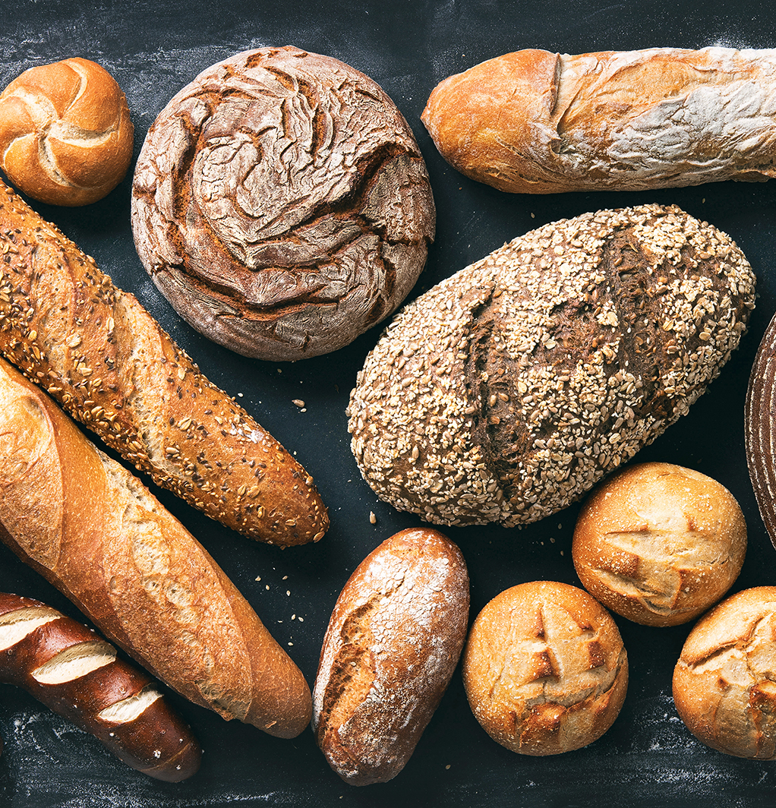
Overview of Basil’s Bakery.
Basil’s Bakery is a small, independent business located in a shopping retail park in Coventry, UK. Basil is an accomplished artisan baker and prides himself on sourcing high quality organic ingredients for his contemporary styled cakes, pastries and breads. The local shoppers and retail workers, value the tasty options available, along with the convenience the bakery location provides. In addition, office workers and warehouse workers from the adjacent industrial site often frequent the bakery, too
The business was opened in 2015. During the following few years, the annual sales figure increased year-on-year. However, in 2020, the footfall and sales significantly decreased – this was understandable given the restrictions imposed during ‘lockdown’. Basil was not unduly concerned as he expected these figures to rise once the restrictions were lifted. However, although footfall and sales did rise, they never returned to the levels pre-2020. Indeed, since 2023 - 2025, the sales figure has stagnated at an average of 25% below the 2019 figures.
Basil believes that the shopping centre is much quieter now than in 2019 – quite simply, there are less people visiting the retail park. He has also noticed that every couple of months, one of the shops in the retail park closes, leaving the unit empty as no new retail outlet moves in. Sadly, some of Basil’s most loyal customers, who worked in the local shops, have been made redundant. In addition, Basil has noticed that many of the office workers now ‘work from home’ a couple of days a week and, therefore, do not need to come in to buy their lunch every day
Some of Basil’s loyal customers (for example, those who no longer work in the retail park or who work from home), have enquired about a ‘delivery service’. Alas, Basil does not provide this service as he is needed onsite to bake the products.
Other customers have asked if they could ‘pre-order’ as, on many occasions during busy periods, there is an unsatisfactory waiting time. Basil has tried to provide this service; although, he is not always able to answer the phone
At the same time as the number of his customers are decreasing, Basil has also had to contend with his overheads increasing. His utility bills; rent; business rates and insurance are considerably higher than they were in 2019. Furthermore, given that he only wants to source organically grown produce (which are more vulnerable to crop failure), the cost of his stock is unpredictable and difficult to budget for
Basil is increasingly concerned that the prospects for continuing his business, in its present format, is not viable. However, before making any changes he wants to gain a more thorough understanding of the

Slide 4

The root problem
The root problem facing basil’s bakery is that its current business model is longer aligned with post pandemic customer behaviour and the changing economic environment.
The bakery was originally dependent on;
High football within the retail park,
Daily commuting works,
And in person purchases
However, since 2020, customer habits, local economic, conditions and operation costs have changed significantly, while the bakery has not substantially adapted its operating or service model.
As a result, sales have stagnated at around 25% below pre-pandemic levels.
Reference: Duffy,D.L,2003. internal and external factors which affect customer loyalty. Internal and external factors which affect customer loyalty | Journal of Consumer Marketing | Emerald Publishing

Slide 5
contributing issues behind the sales stagnation s behind the sales stagnation Contributing issues behind the sales stagnation
1. Declining retail park football
one of the biggest contributing factors is the reduction in visitors to the retail park Fewer shoppers visit the area then in 2019.
Evidence
Shop are regularly closing and remaining vacant.
Redundant retail works no longer purchase from the bakery.
This is largely external environment issue that basil can not directly control.
2. Changing in working patterns (remote & hybrid working)
Office workers who once visited daily are now working from home several days per week
3. Overdependence on physical/in-person sales
The bakery relies heavily on costumers physically visiting the premises.
Problems:
No online ordering system, No delivery service, Limited remote accessibility for former customer
4. Lack of delivery capability: Customer have actively request delivery service
Problems: Basils cannot deliver because: He bakes onsite him self, The business appears understaffed, The business appears understaffed, Operation rely too heavily on basil’s
Impact: Lost sales opportunity, Reduce customer retention

Slide 6
5. Inefficient pre-ordering system
Customer also requested pre-ordering to avoid wating times.
Current issues:
Order rely phone calls
Basil often cannot answer while baking
Impact:
Customer frustration
Missed sales
Longer queues discourage purchases during busy periods.
This indicates poor service efficiency and outdated ordering processes.
6.Rising operating costs:
The bakery’s overheads have increase substantially since 2019.
Increase costs : Utilities, Rent, business rates, influence.
Impacts:
Even if sales remain stable profitability declines because expenses consume a larger proports this creates financial pressure and reduces resilience.
Reference:
Johnson, Eugene M. and Donald C. Norris. 1976. The decline of horse racing in New England: A product life cycle analysis. The New England Journal of Business and economics available at Lotto Sales Stagnation: Product Maturity or Small Jackpots? - DeBOER - 1990 - Growth and Change - Wiley Online Library

Slide 7
Internal and external problems affecting basils bakery
External problems declining retail park football Closure of neighbouring shops Redundancies among retail Hybrid/remote working trends Post-pandemic consumer behaviour changes Rising overhead costs Unpredictable organic ingredient costa Wider economic uncertainty | Internal problems No delivery service Poor pre-order system Long wating times during busy periods Heavy dependence on basil personally Lack of digital systems Limited operational capacity Overreliance on physical football Limited adaptability
Reference: Duffy,D.L,2003. internal and external factors which affect customer loyalty. Internal and external factors which affect customer loyalty | Journal of Consumer Marketing | Emerald Publishing

Slide 8
What is pestle analysis
PESTEL
political
Technological
Environmental
legal
Economical
social
Pestel analysis is framework that can help marketers assess whether macro-economic factors are affecting an organization.
This is critical step that helps organization identify potential threats and weaknesses that can be used in other farmwork such as SWOT or to gene a border and better understanding of the overall marketing environment
Cuofano, G,(2024).what is PESTEL analysis. Available at What Is A PESTEL Analysis And Why It Matters — Complete Guide 2026 – FourWeekMBA(updated: Apr 2026)

Slide 9
What is pestle analysis and why is matters
POLITICAL
Government policy regulation, trade barriers, tax policy, political stability.
ECONOMIC
GDP growth, interest rates, inflation, exchange rates unemployment.
SOCIAL
Demographics, cultural trends, lifestyle changes, education, health consciousness.
TECHNOLOGICAL
Innovation rate, automation, R&D, tech disruption, digital infrastructure.
LEGAL
Employment law, consumer protection, IP law, data privacy(GDPR).
ENVIRONMENTAL
Climate change, sustainability, carbon regulations waste management.
Cuofano, G,(2024).what is PESTEL analysis. Available at What Is A PESTEL Analysis And Why It Matters — Complete Guide 2026 – FourWeekMBA(updated: Apr 2026)

Slide 10
The benefits of pestle analysis
PESTLE analysis is an efficient technology in businesses.
They are as follows :
Identifies opportunities:
By analysing political, economic, social, technological, environmental, and legal factors, business and uncover new opportunities for growth, market expansion, and innovation. For example, understanding emerging technologies evolving consumer preferences can help companies capitalize on new trends.
Helps with risk of management:
PESTEL analysis highlights potential external threats such as changes in government policies, economic, downturns, or new environmental regulations identifying these risk early allows business to prepare strategies to mitigate them and avoid negative impacts.
Enhances strategic planning:
With a clear understanding of external factors, business can make more informed decisions and align their strategies with the broader macro-environment. This leads to more effective business plans, marketing strategies, and resource allocation.
Improves decision making:
The comprehensive view provided by PESTLE helps business consider all relevant external factors before making Mager decisions, from entering new markets to launching new products.
Supports competitive advantages:
By continually monitoring external trends and adapting to changs in the macro-environment, business can stay ahead of competitors who might be slower to recognize these shift. This proactive approach helps in gaining a competitive edge.
Dutta, A.(2023). What are the benefits of PESTEL analysis in business. Available at What are the Benefits of PESTEL Analysis in a Business? (updated: 11 Apr. 2025).

Slide 11
PESTEL Framework
Political Factors | Economic Factors | Social Factors | Technological Factors | Legal Factors | Environmental Factors
COVID-19 lockdown restrictions in 2020. | Rising utility bills, rent, business rates, insurance, organic ingredient costs. Shop closures. And redundancies in the retail park. | More people working from home. Customer want delivery and ore-order services Fewer shoppers visiting the retail park. | no delivery service. Difficulty answering phone calls for pre-orders. limited use of digital ordering systems. | Business rates and regulation affecting operating costs. COVID restriction previously limited trading activity. | Customer want delivery and pre- order options. Employees nearby shops have lost jobs Retail park business are closing. Basil is concerned about viability.
Dutta, A.(2023). What are the benefits of PESTEL analysis in business. Available at What are the Benefits of PESTEL Analysis in a Business? (updated: 11 Apr. 2025).

Slide 12
Cause and effect
Cause and effect is a tool helps identify, sort, and display possible cause of specific problem or quality characteristic.
The cause: the opening action or reason behind an event (why?)
The effect: the outcome or consequence generated by the cause (what?)
Example: it rains heavily (cause) _the streets become slippery and car accidents increase (effect)
Why it is used:
solve problems
Predict outcomes
Make better decisions
Improve understanding
Why is important:
Allowing us to solve core problems rather then just treating symptoms
Root cause resolution
Logical decision making
Enhanced problem solving
Allows exploration of possible causes
Fishbones: a way of analysing problems, also called cause effect diagram are simple visual technique for analysing problems where many possible causes may need to be considered.
The figure below is fishbone diagram showing the six main group of possible causes for basil bakery
Reference: Institute of leadership & management.(2013). Solving problem and making decisions. Routledg available at EpubReader

Slide 13
Cause-and-Effect diagram
customer
Location
Products/supplier’s
Fewer shoppers visit retail park
Reduced lunch demand
Office workers work from home
long wating times
Limited staff capacity
Basil needed for baking
Cannot always answer phone
Reduce retail park football
More online shopping
Fewer local job
Empty shop units reduce attraction
Organic ingredients only
Higher ingredient costs
Crop failures affect supply
Difficult budgeting
Customer may choose easier ordering options
Lost sales opportunities because basil dose not provide delivery
Customer dissatisfaction
  Stagnation
Higher rent cost
Higher unit bills
Increased business rates
Higher insurance
Organic storage cost volatile
processes
costs
Environment
Reference: Institute of leadership & management.(2013). Solving problem and making decisions. Routledg available at EpubReader

Slide 14
summary of your Key Findings
benefits of understanding internal and external factors helps identify and manage risks and opportunities aligns the management system with the organisation strategic decision.
Enables informed decisions based on current realities and future challenges. regular reviews of internal and external factors helps organisations adapt and grow.
PESTLE analysis helps organizations identify external opportunities and threats, improve strategies planning, support decision making, and prepare for changs in the political, economic, social, technological, legal, and environments
A cause-and-effect diagram helps identify the root causes of a problem, organize potential causes visually, improve teamwork and decision making, and support effective problem solving and quality improvement.

Slide 15
Reference List:
Duffy,D.L,2003. internal and external factors which affect customer loyalty. Internal and external factors which affect customer loyalty | Journal of Consumer Marketing | Emerald Publishing
Johnson, Eugene M. and Donald C. Norris. 1976. The decline of horse racing in New England: A product life cycle analysis. The New England Journal of Business and economics available at Lotto Sales Stagnation: Product Maturity or Small Jackpots? - DeBOER - 1990 - Growth and Change - Wiley Online Library
Cuofano, G,(2024).what is PESTEL analysis. Available at What Is A PESTEL Analysis And Why It Matters — Complete Guide 2026 – FourWeekMBA(updated: Apr 2026)
Institute of leadership & management.(2013). Solving problem and making decisions. Routledg available at EpubReader
Dutta, A.(2023). What are the benefits of PESTEL analysis in business. Available at What are the Benefits of PESTEL Analysis in a Business? (updated: 11 Apr. 2025).

Slide 16
Thank you for listening

Slide 17


