Slide 1

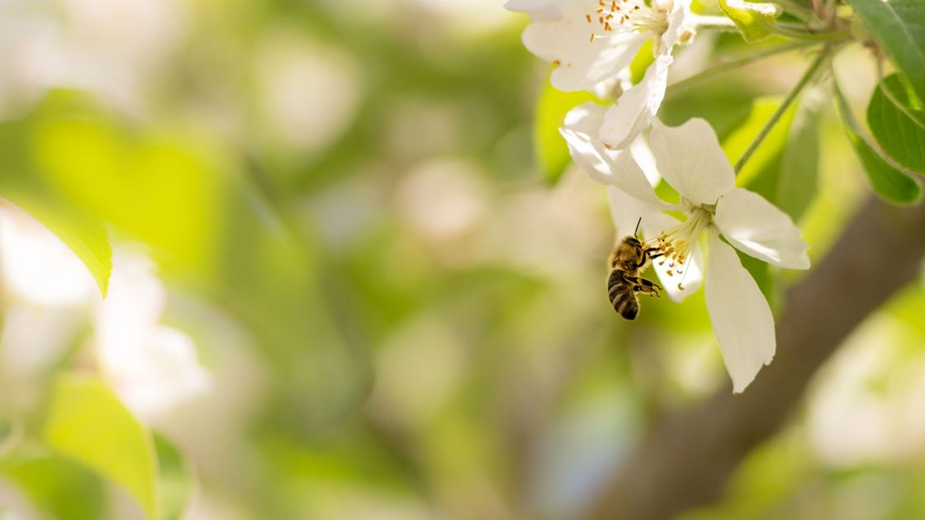
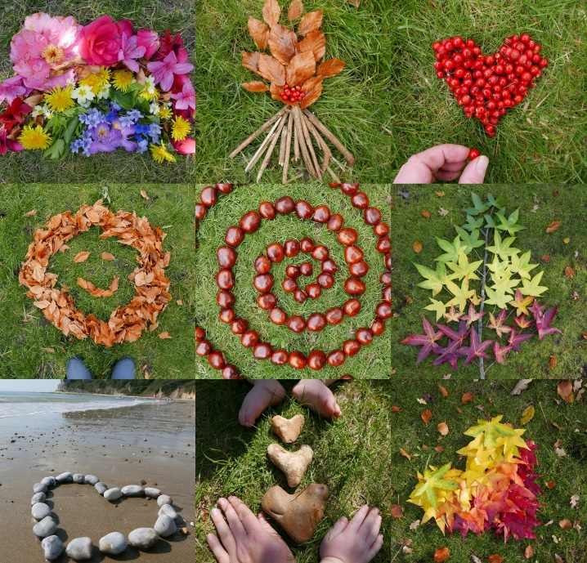
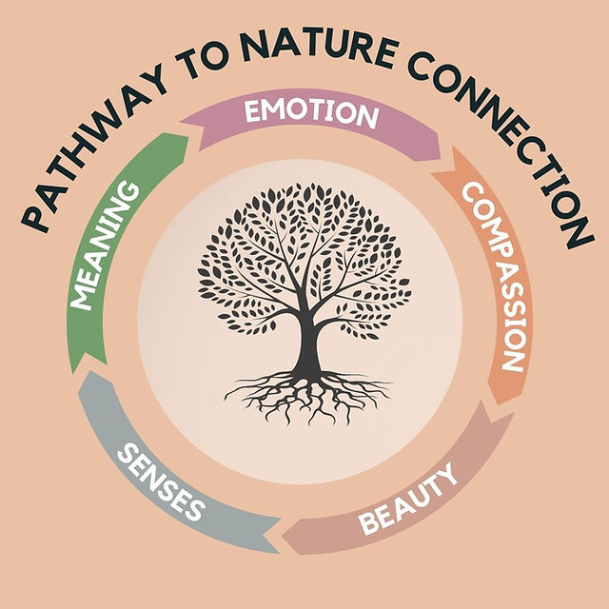
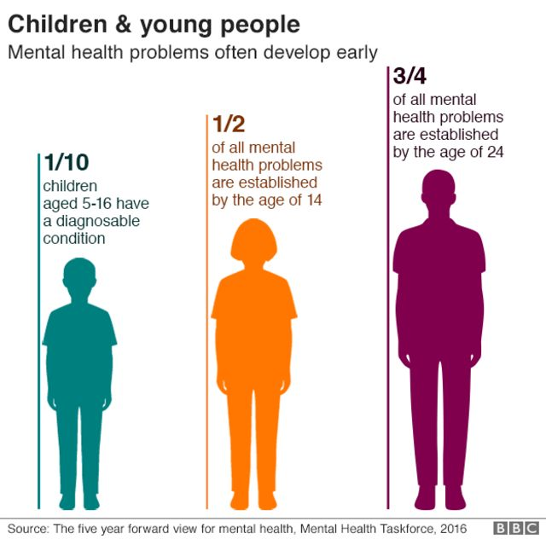
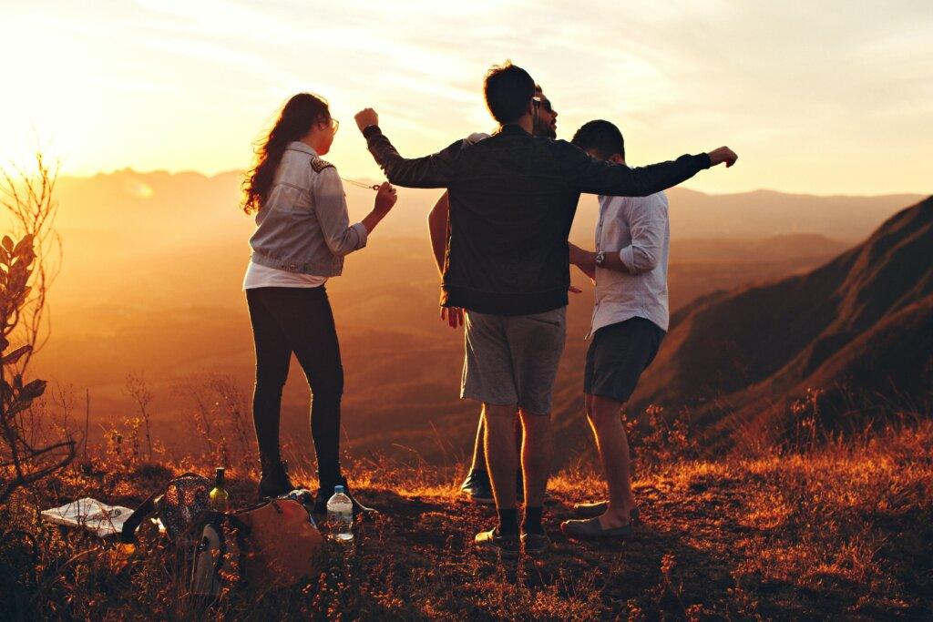
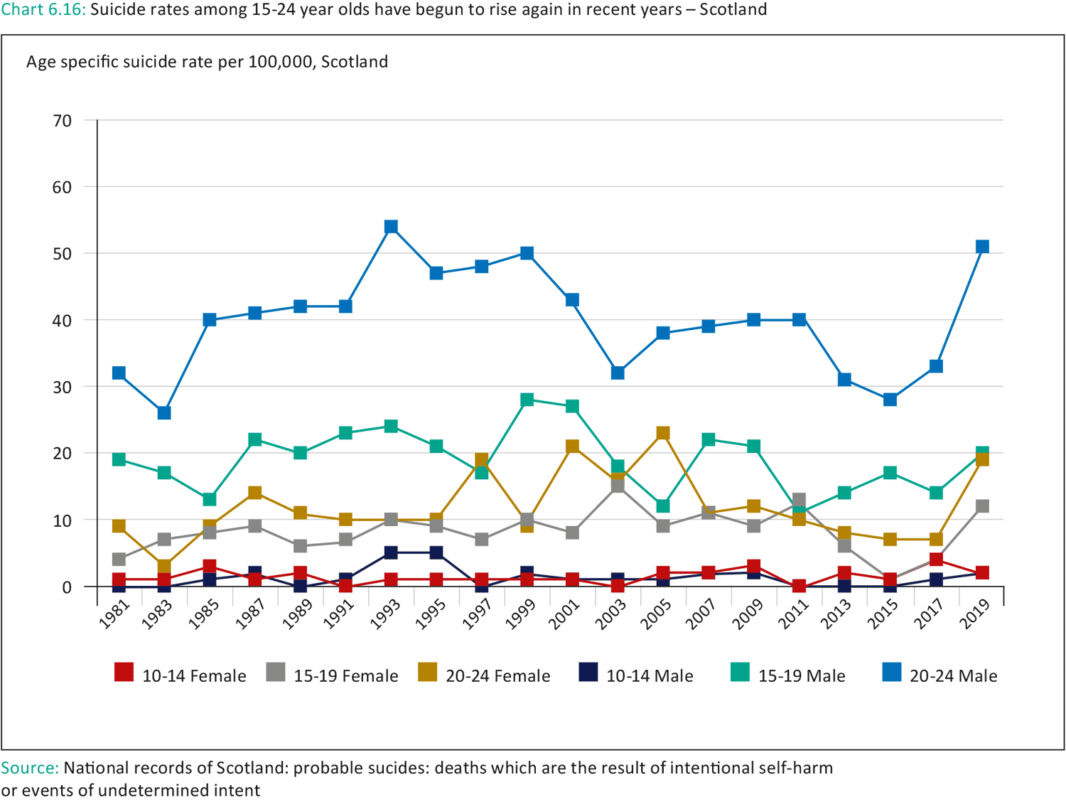
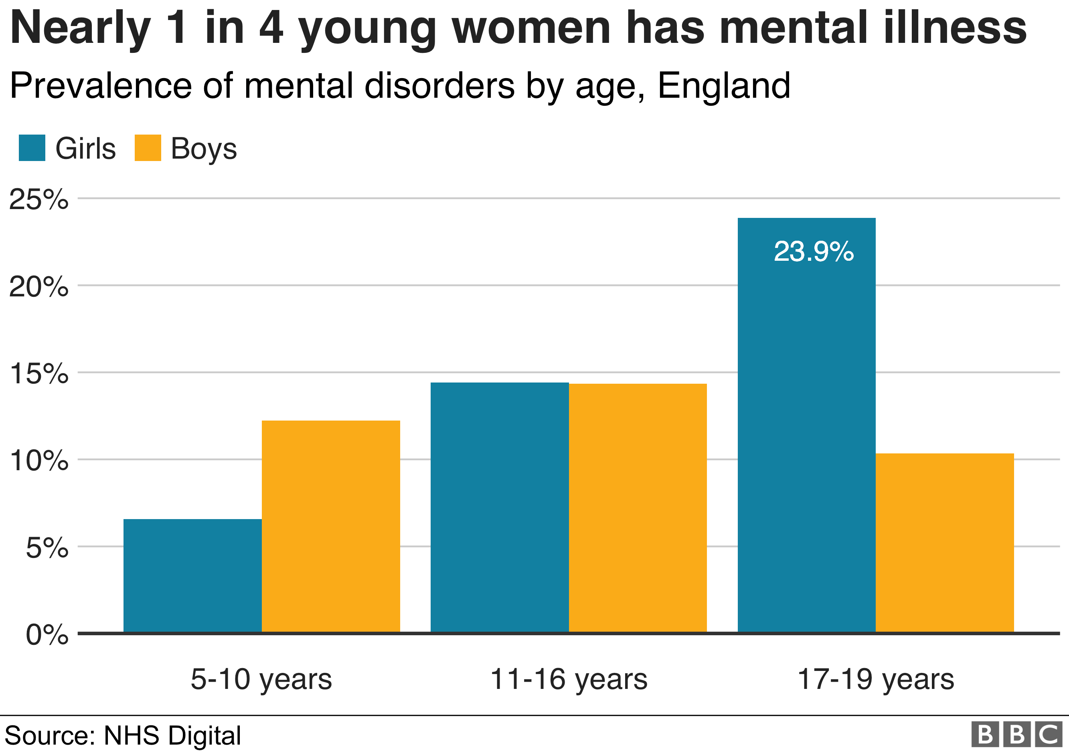
The Benefits of Nature Connectedness for Adolescents’ Mental Health and Well-being
Introduction
Nature Connection
Nature connectedness describes the human-nature relationship felt with the natural environment, it is more than merely being in nature, but the beliefs of how you identify with the natural world and the emotional connection that is felt (Richardson et al., 2020, Capaldi et al., 2014; Price et al., 2022). Nature connectedness has been suggested to improve mood, cognition, fitness, health and wellbeing, life satisfaction and happiness (Chen et al., 2023; Capaldi, 2014), however much of the research has been carried out in the adult population. With ways of modern living creating a disconnect from nature and natural environments through urbanisation and increased time spent indoors (Louv, 2010; Price et al., 2022), the benefits of nature connectedness is an important area for psychology research, policy development and intervention development.
Many recent studies have found links between nature exposure and nature connection for improved mental health outcomes, however much of the research is in the adult population (Capaldi et al., 2014). A dip in nature connection is seen between age 11-15 so it would be beneficial for adolescents to reduce the disconnection from nature and increase the exposure to the natural environment (Richardson et al, 2020; Price et al. 2022). Research shows that there is a difference in accessible green outdoor spaces found between urban and rural populations a survey by Public health Wales 2022 found higher rates of poor mental health in urban populations. One framework that has been put forward to develop nature connectedness is called the 5 Pathways to nature connection.
British Association of Counselling and Psychotherapy (2021)
Physical Health
Psychological and Cognitive Benefits
More exposure and connectedness to nature is linked with higher rates of physical activity and physical fitness leading to improved physical health (Baceviciene et al., 2021;Piccinnini et al., 2018; Richardson et al 2020). A study by Piccinnini et al. 2020 found that adolescents who spent 0.5 hours per week in a natural environment had lower mental health illness and improved wellbeing, and significantly higher rates of improvement found for females. Levels of obesity and inactivity in adolescence are increasing causing harmful effects on physical and psychological health. Exercise is well known to have a positive effect on mood and wellbeing, coupled with activity in an outdoor environment or greenspace is found to have an increased benefit.
Adolescent Mental Health
Nature connectedness has been found to significantly increase levels of happiness, vitality and positive emotions(Capaldi et al., 2014). Cognitive function is seen to improve with increased attention and concentration levels through nature connection. Public Health England (2023) reports reduced symptoms of ADHD through nature connection and greenspace engagement.
Adolescent mental health and well-being is an area of great concern for public health and development. Today, mental health illness is the leading cause of disability in (Public Health England, 2016) and, as a result, is the focus of attention for much research. It is believed that the period of adolescence is a vulnerable time for developing mental health issues and sensitivities (McGorry et al., 2013) which is why it is critical that identifying both the risk factors and protective factors is a top priority for professionals. According to NHS England (2023) 1 in 5 young people aged 8-25 are thought to have a probable mental disorder with just 25% who suffer able to access children’s mental health services. This means that there are many adolescents and their families unable to access the help they require from medical professionals. However, due to the lack of available quality healthcare for young people, multi-agency approaches to tackling mental health issues for adolescents are looking at the many ways that may help alleviate, reduce, or prevent symptoms of poor mental health through facilitating educational programmes, curriculum policy and social service interventions.
Decreases in psychological symptoms for both male and female adolescents who engage in nature and play in natural environments for 30 minutes per week or more. (Piccinnini et al., 2018)
5 Pathways to Nature Connection
Higher levels of self-esteem and positive body image were seen in women with more nature connectedness (Swami et al., 2016), Baceviciene et al., (2021) added that increases in positive body image and self-esteem increased wellbeing and resilience through reduced stress and enhanced sleep and a better immune system.
Nature engagement is known to aid cognitive function, academic performance and creativity (Richardson et al., 2020).
Research suggests that adolescence is a particularly sensitive time for psychological development with 50% of all mental health disorders emerging before the age of 14 and 75% of all mental health disorders established before 24 (Public Health England, 2016; NHS England, 2023).
Social Connection
Nature connection helps to facilitate meaningful connections with peers and strengthen social connections which are vital for the developing adolescent. Chen et al. (2023) found that nature connection helped reduce anxiety, distress and withdrawal behaviours that were a result of social exclusion in adolescents. The benefits of nature exposure and connection and even through nature pictures were able to promote a sense of belonging and positive emotions.
5 pathways to nature connectedness is a framework through which to explore nature connection and build the human-nature relationship (Richardson et al., 2020). It is now in use by several outdoor and environmental organisations including The National Trust and The Scout Group
  Age is one potential risk factor of poorer mental health and wellbeing - statistics show that increases in mental health disorders are seen through childhood and early adolescence with a peak between ages 17-19 years (23.3%).
  Children living in lower income families who may be at risk of financial and food insecurity are more likely to be diagnosed with a mental health disorder (NHS England, 2023; Jackson et al., 2021; Piccinnini et al., 2018) and more likely to be unable to afford activities outside of school or college.
  The rates of mental health disorder is similar for boys and girls age 8-16 but the rates for women age 17-25 are twice as high compared to men.
  Anxiety, depression and self-harm is higher in women than men (Public health England, 2016; ).
  Higher rates of mortality for men than women due to suicide (Youth health data, 2021)
  Increases in mental health crisis are seen in urban areas compared to rural areas (Public Health Wales, 2022).
Sensory – Explore nature through all 5 senses, such as listen to the birds, feel the bark of the trees
Beauty – appreciate the wonder and aesthetic beauty found in nature
Meaning – find meaning in the natural environment, look at the signs of nature you recognise, such as the changing seasons
Emotion – explore an emotional bond and love for nature, reflect on your feelings
Compassion – develop an understanding and concern for environmental and wildlife conservation through ethical and moral issues. Look at the impact we have on the world around us.
Global Compassion Coalition, 2023)
Creating Healthy Habits
Encouraging healthy lifestyles during adolescents has shown to increase rates of lifelong adult engagement and habit formation. This is seen in nature connection, physical activity and other health behaviours. Therefore, promoting nature connection and developing positive childhood experiences in nature would be beneficial to individuals during their adolescent years to help establish lifelong healthy lifestyles (Price et al., 2022; Louv, 2017).
Conclusion
The potential for increased wellbeing and reduced mental health illness in adolescence through nature connectedness is desirable for many reasons. To alleviate the cost and resource pressures on the NHS, to foster healthy lifestyle habits in adolescence, to increase physical activity in adolescents and to encourage pro-social and pro-environmental behaviours. It is necessary to consider whether exposure to nature and green spaces are available and accessible to all due to location, transport, income and government policy if targeted interventions for adolescence are going to work effectively as a protective factor to improve the wellbeing and mental health of adolescents in todays society.

Slide 2
References
Arola, T., Aulake, M., Ott, A., Lindholm, M., Kouvonen, P., Virtanen, P., & Paloniemi, R. (2023). The impacts of nature connectedness on children's well-being: Systematic literature review. Journal of Environmental Psychology, 85, 101913. https://doi.org/10.1016/j.jenvp.2022.101913
Baceviciene, M., Jankauskiene, R., & Swami, V. (2021). Nature exposure and positive body image: a cross–sectional study examining the mediating roles of physical activity, autonomous motivation, connectedness to nature, and perceived restorativeness. International journal of environmental research and public health, 18(22), 12246. https://doi.org/10.3390/ijerph182212246
British Association of Counselling and Psychotherapy (BACP). (2021). Natalie Rossiter The importance of nature connection. https://www.bacp.co.uk/news/news-from-bacp/blogs/2021/14-may-the-importance-of-nature-connection/
Chen, L., Zeng, S., & Su, Y. (2023). The influence of social exclusion on adolescents' social withdrawal behavior: The moderating role of connectedness to nature. Journal of Environmental Psychology, 87, 101951. https://doi.org/10.1016/j.jenvp.2022.101951
Global Compassion Coalition (2023). The benefits of connecton. https://www.globalcompassioncoalition.org/the-benefits-of-connection/
Jackson, S. B., Stevenson, K. T., Larson, L. R., Peterson, M. N., & Seekamp, E. (2021). Outdoor activity participation improves adolescents’ mental health and well-being during the COVID-19 pandemic. International Journal of Environmental Research and Public Health, 18(5), 2506. https://doi.org/10.3390/ijerph18052506
Louv, R. (2010) Last child in the woods, saving our children from nature-deficit-disorder. Atlantic Books.
Louv, R. (2017). Vitamin N The essential guide to a nature-rich life. Atlantic Books.
McGorry, P., Bates, T., & Birchwood, M. (2013). Designing youth mental health services for the 21st century: Examples from Australia, Ireland and the UK. British Journal of Psychiatry, 202(S54), S30-S35. doi:10.1192/bjp.bp.112.119214
NHS England (2023) Mental health of children and young people in England, 2023 – wave 4 follow up to the 2017 survey. Mental health of children and young people surveys. https://digital.nhs.uk/data-and-information/publications/statistical/mental-health-of-children-and-young-people-in-england/2023-wave-4-follow-up#
Piccininni, C., Michaelson, V., Janssen, I., & Pickett, W. (2018). Outdoor play and nature connectedness as potential correlates of internalized mental health symptoms among Canadian adolescents. Preventive Medicine, 112, 168-175. https://doi.org/10.1016/j.ypmed.2018.04.020
Price, E., Maguire, S., Firth, C., Lumber, R., Richardson, M., & Young, R. (2022). Factors associated with nature connectedness in school-aged children. Current Research in Ecological and Social Psychology, 3, 100037. https://doi.org/10.1016/j.cresp.2022.100037
Public Health England. (2016). The mental health of children and young people in England.
Public Health Wales (2022) Children and Young People’s Mental Health Exploring presentation in mental health crisis through linked routine health care data in Wales, NDL Wales Team. https://phw.nhs.wales/publications/publications1/children-and-young-peoples-mental-health/
Richardson, M., & McEwan, K. (2018). 30 days wild and the relationships between engagement with nature’s beauty, nature connectedness and well-being. Frontiers in Psychology, 9, 1500. https://doi.org/10.3389/fpsyg.2018.01500
Swami, V., von Nordheim, L., & Barron, D. (2016). Self-esteem mediates the relationship between connectedness to nature and body appreciation in women, but not men. Body image, 16, 41-44. https://doi.org/10.1016/j.bodyim.2015.11.001
Youth health Data (2021). https://ayph-youthhealthdata.org.uk/key-data/mental-health/suicide/

