Slide 1
Certificate of Higher Education in Employability Skills
Level 4
Digital Skills for Personal and Professional Growth
(BMSW4008)
Sergiu Vranceanu
(2435824)
2025 - 2026

Slide 2
Contents page:
1- Cover page
2- Contents page
3- Title Page
4- Business Idea
5- Questionnaire Design
6- Key Research Findings
7- Marketing Materials/Website Design
8- Video Advertisement
9- Conclusion
10-Reference List
11- AI Statement

Slide 3

Market Research and Website Development Project

Slide 4
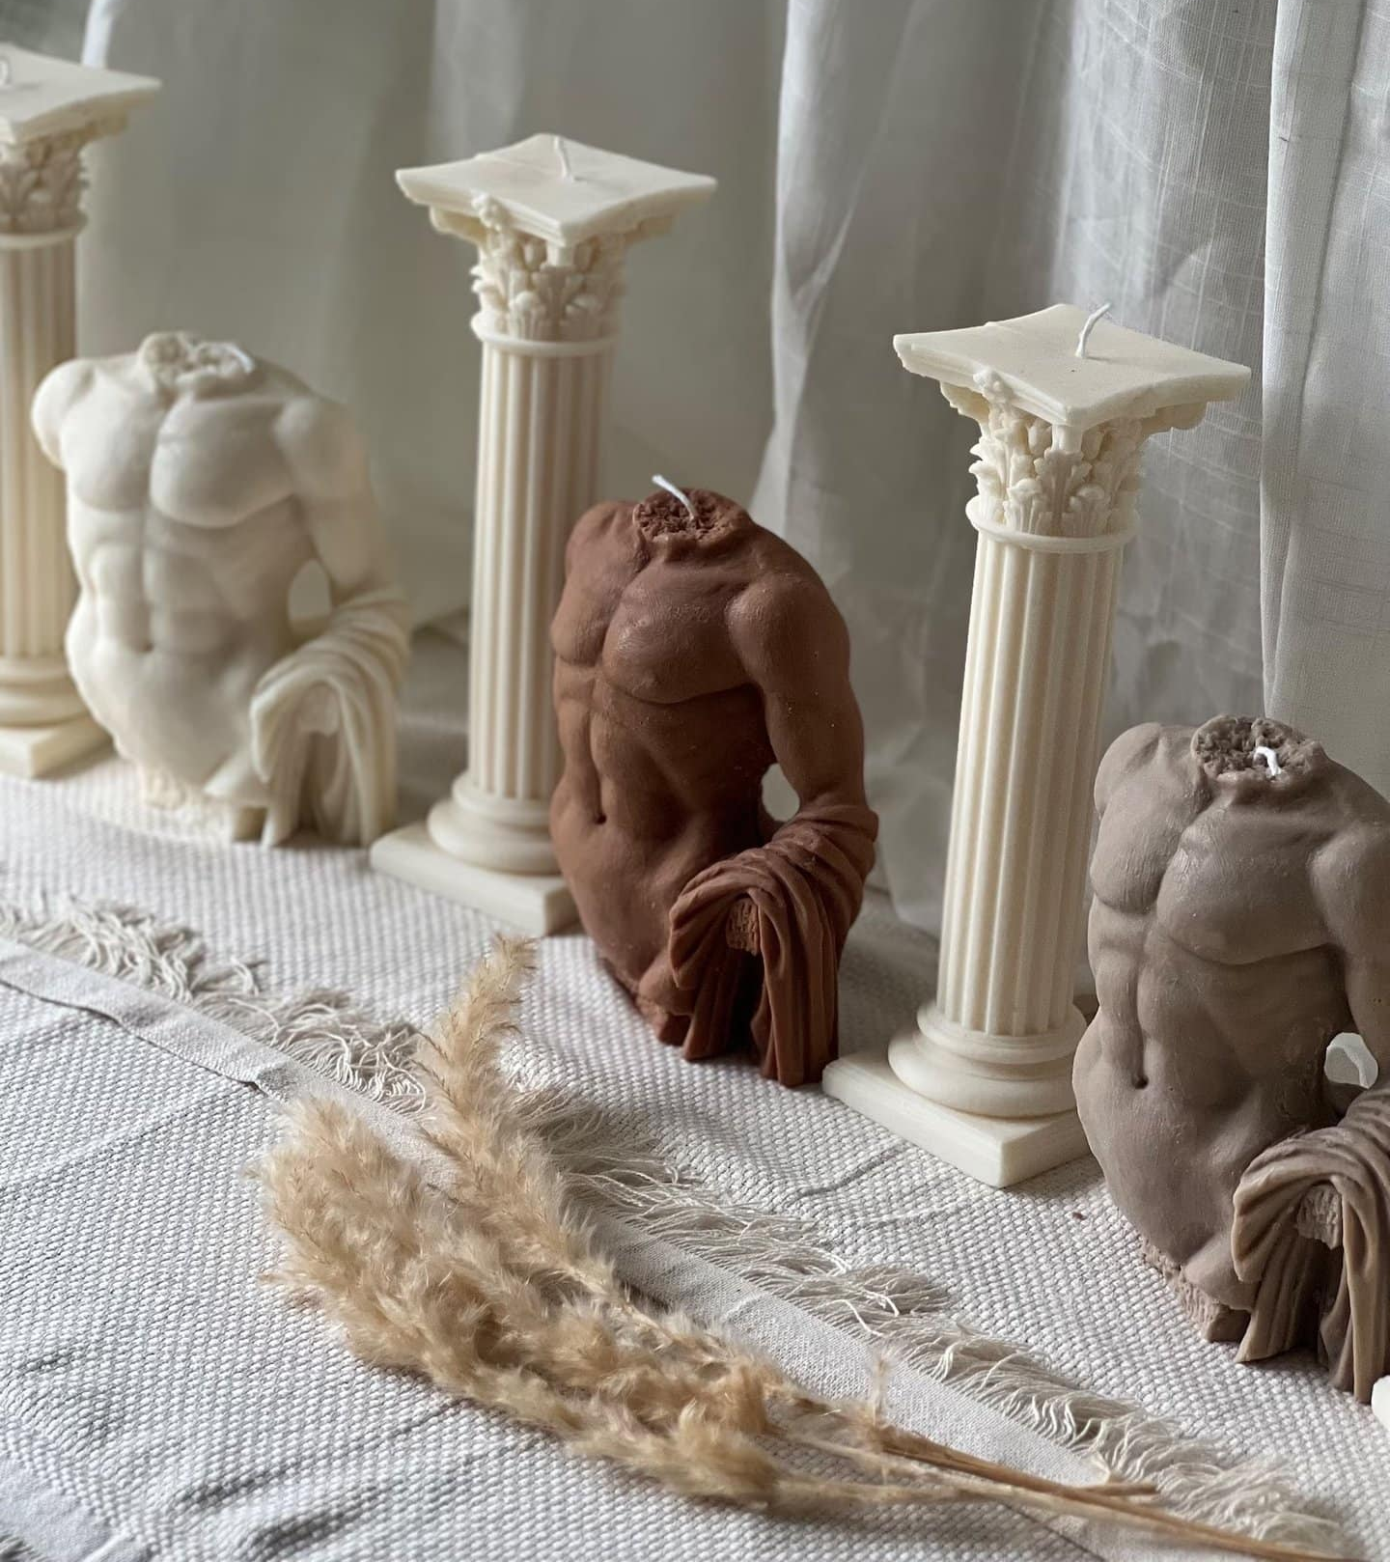
Business Idea
Form and Flame. Com
Premium sculptural candles combining modern art, interior design and sustainable home fragrance.
Mission Statement;
To transform everyday spaces through design-led, eco-friendly candles that are as beautiful unlit as when they are burning.

Slide 5
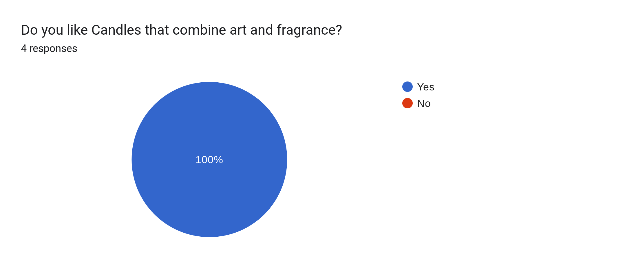
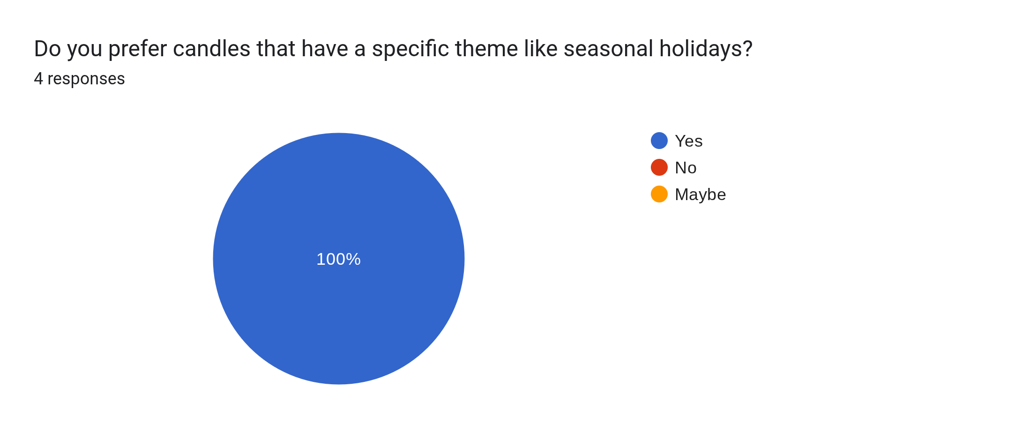
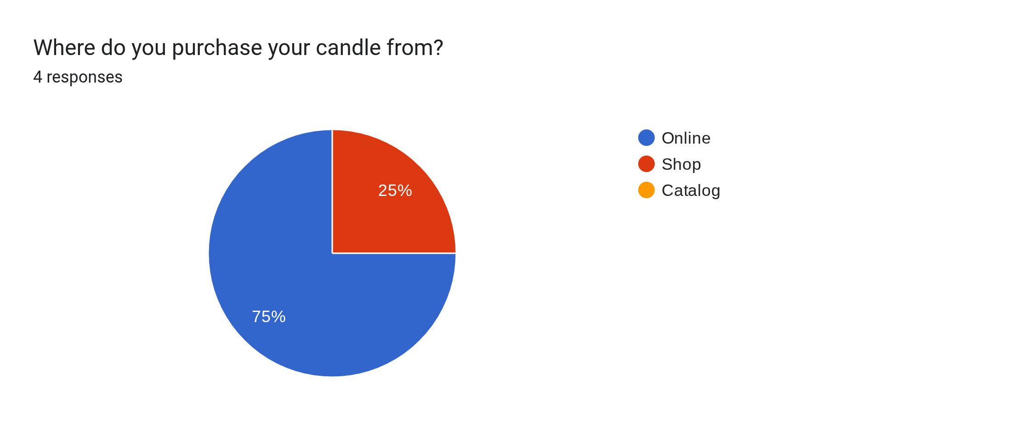
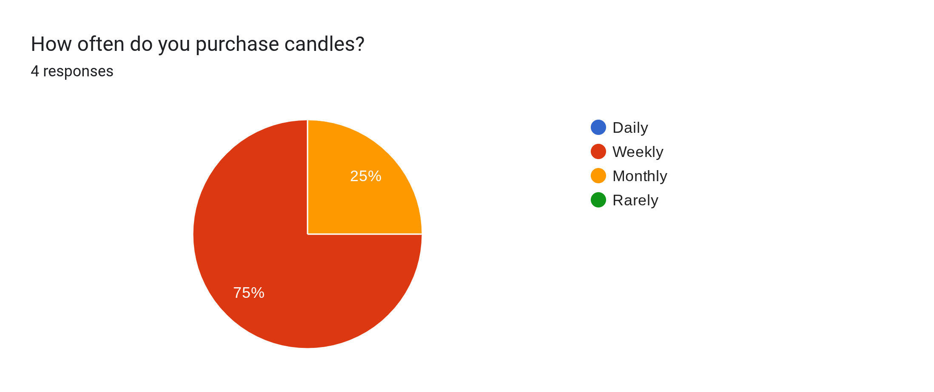
Questionnaire Design
The Questionnaire was created with Google Forms to collect data from participants and explore purchasing behavior
The analysis focuses on four key questions from the questionnaire:
How often customers purchase candles
Interest in candles that combine art and fragrance
Preference for themed or seasonal candles
Where customers prefer to purchase candles

Slide 6
Key Research Findings
The First question asked respondents how often they purchase candles, the result showed:
75% purchase candles weekly
25% purchase candles monthly
0% daily or rarely
The Second one asked whether consumers like candles that combine art with fragrance, the results showed:
100% of Respondents answered Yes
The Third question asked whether costumers prefer candles with a specific theme, such as a holiday, the results show :
100% of Respondents said yes
The Fourth question asked where respondents prefer to purchase candles, The Results showed:
75% online
25% Physical location
0% from cataloque

Slide 7
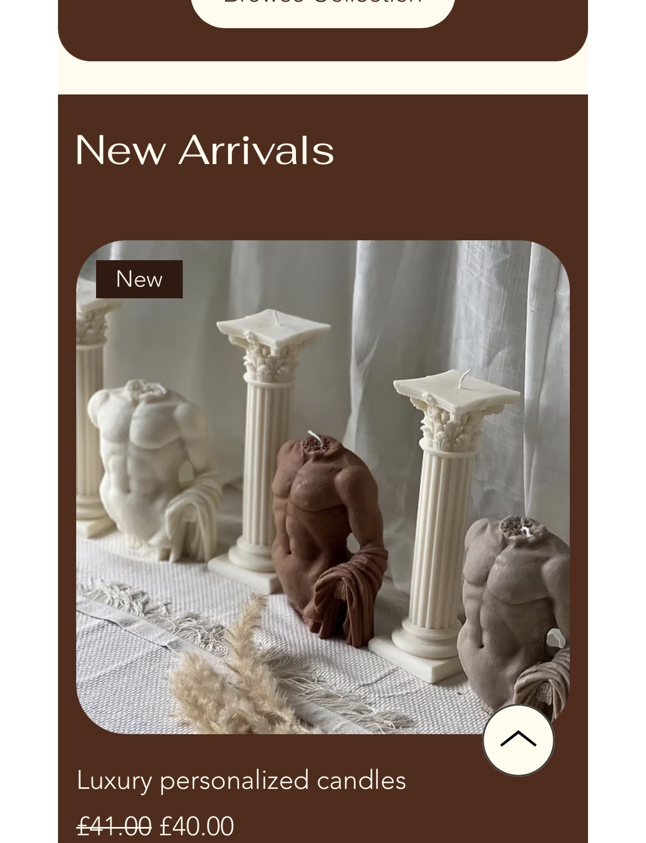
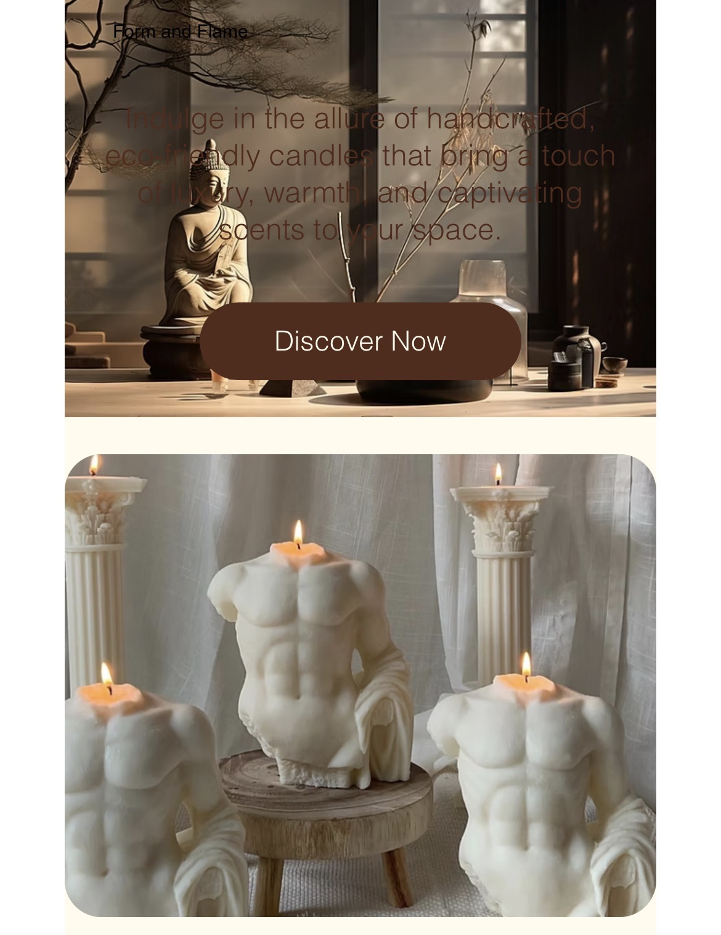
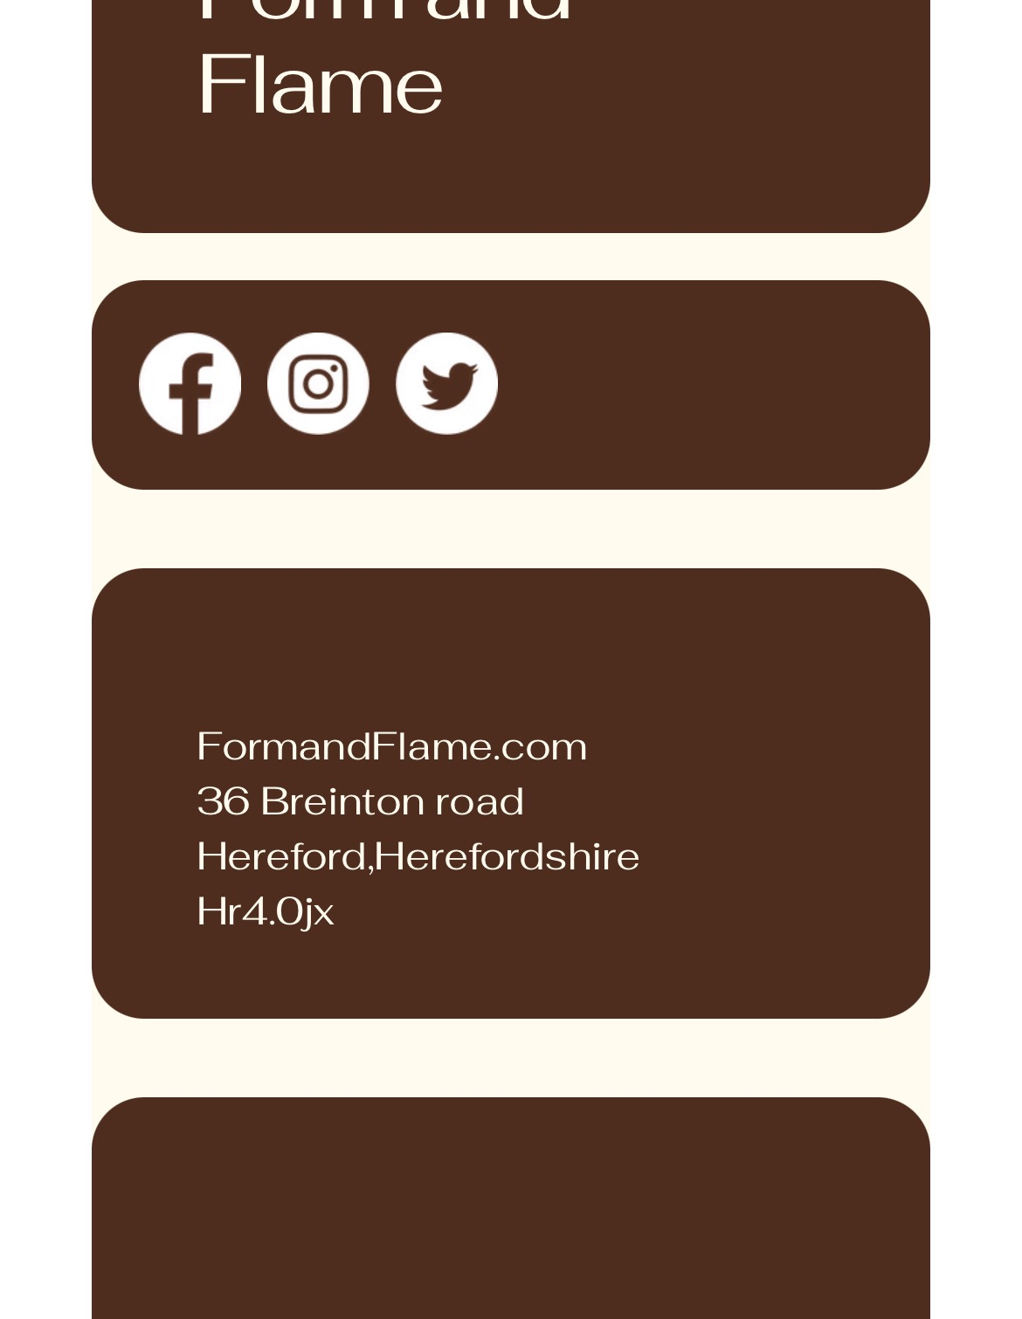
Marketing Materials

Slide 8
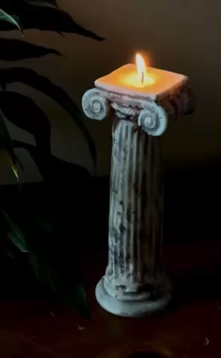
Video Advertisement
The video advertisement Shows how the candles we make can be used both as décor and as a candle, creating a comfortable atmosphere and visually appealing background.

Slide 9
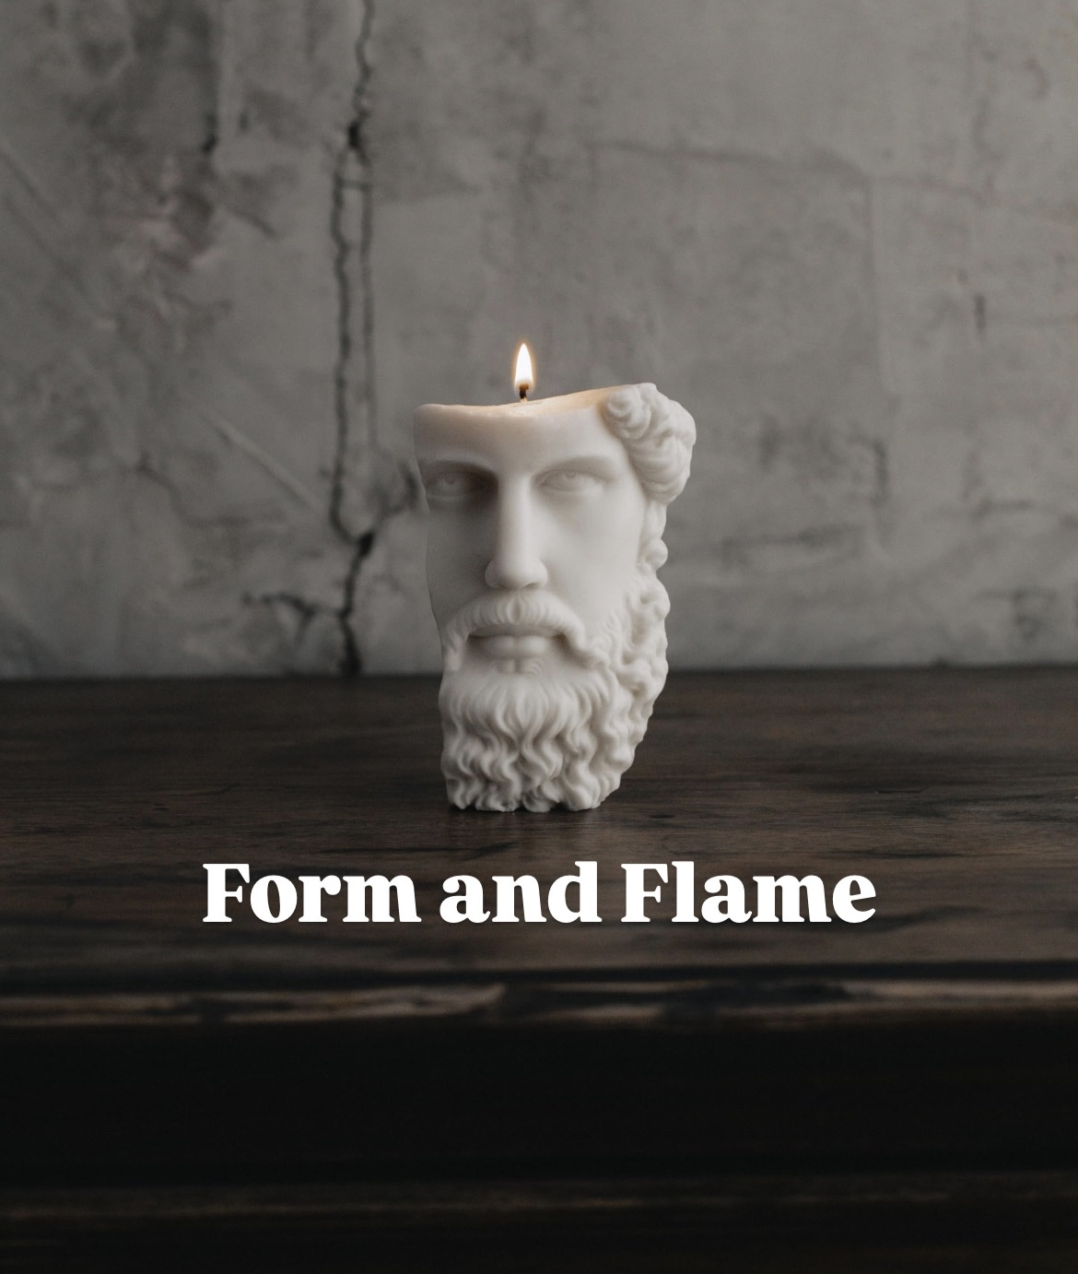
Conclusion
Overall the questionnaire results strongly support the proposed art inspired candle business concept.
Key insights include:
High Purchasing frequency indicates strong demand
Consumers strongly prefer candles that combine art and fragrance
Seasonal themed candles are highly attractive to customers
Most customers prefer buying candles online
This finding influenced several aspects of the business strategy, including product design, website development, marketing campaign, audience segmentation and SEO planning.

Slide 10
Reference List
Chaffey, D., & Ellis-Chadwick, F. (2019). Digital Marketing. Pearson.
Solomon, M. (2020). Consumer Behavior: Buying, Having, and Being. Pearson.
Krug, S. (2014). Don’t Make Me Think: A Commonsense Approach to Web Usability. New Riders.
Ryan, D. (2016). Understanding Digital Marketing. Kogan Page.

Slide 11
AI Statement
I confirm that I have not presented any AI generated text as my own work, I confirm I have copies of my drafts, notes, and other resources I used.

