Slide 1

BMSK5002
Developing relationships and workplace achievement
Workshop

Slide 2

Developing Relationships
& Workplace Achievement
What do you think this means?
  What relationship?
  Why develop them?
  How could they affect workplace achievement?
10 mins to discuss and record your thoughts

Slide 3
Aim & Learning Outcomes
AIM(S)
  To develop strategies for the personal and career development of individuals
LEARNING OUTCOMES
Upon the successful completion of this module, the student should be able to demonstrate the ability to:
Critically assess the potential benefits to the organisation of developing individuals in the workplace
Manage the individual's expectations in respect of personal development
Critically evaluate development vehicles available to an organisation appropriate to the development needs of the individual
Generate a detailed plan to meet the development needs of the individual in the workplace

Slide 4
INDICATIVE CONTENT
Examining the expectations and requirements of people
Administering people in accordance with guidelines and career pathways
Managing career development of people
Career development strategies
Promotion of work/life balance
Promotion of a healthy life-style
Diversity in the workplace
Understanding the causes of conflict in the organisation
Being aware of/ understanding company policies (diversity, alcohol abuse etc)
Techniques for managing interpersonal conflict
Understanding the variety of documentation required to manage people
Techniques for supervision and formal appraisal
Methods of ensuring fair and objective assessment/appraisal
Methods to monitor, evaluate and record individual feedback
Reporting performance appraisal including the importance of confidentiality
Learning styles and the range of training/development opportunities available
Mechanisms to provide appropriate feedback to individuals
Appropriate recording systems
Determining groups and individuals for whom the manager has responsibility
Support structures within the organisation

Slide 5
BMSK5002
Critically assess the potential benefits to the organisation and the individual of personally developing individuals in the workplace (30%)

Slide 6
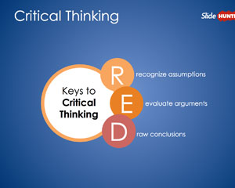
BMSK5002
What is Critically Assess?
Who are the individuals in the Workplace?
What is Personal Development? Reference?
What are the potential benefits? Who Said?
How would the Organisation Benefit? Case studies?
How would the Individual Benefit? Case studies?

Slide 7
BMSK5002
Critically evaluate development vehicles available to an organisation appropriate to the development needs of the individual.
(30%)

Slide 8
BMSK5002
What is Critical Evaluation?
What is a development vehicle?
What sorts of development vehicles do companies use?
How do you determine the appropriate vehicle?
What does your organisation use?

Slide 9
BMSK5002
Develop a plan to meet the identified development needs and expectations of an individual.
(20%)

Slide 10
BMSK5002
How do you identify the needs?
What information do you need?
How is it Captured?
How is the plan presented?
How is the plan implemented and monitored?
How is the effectiveness evaluated?

Slide 11
BMSK5002
Evidence of wide reading and research, encompassing application of relevant academic theories and models.
(10%)

Slide 12

BMSK5002
Evidence in depth
High quality research has been demonstrated throughout the assignment
Using relevant theorists
Using a variety of quality resources (web, book, article, newspaper, TV, etc)

Slide 13
BMSK5002
Citation/ referencing, report structure, syntax, grammar and punctuation.
(10%)

Slide 14

BMSK5002
Correct citation in the text
Good quality Bibliography
Laid out well, including a front page
Runs logically throughout
Spelling, grammar and punctuation correct

Slide 15
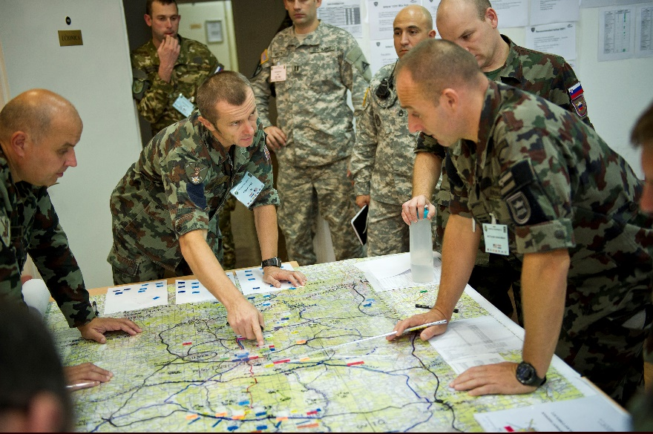
Assignment Strategy
What are the key components to address?
How can you do it?
What are the steps you need to take?
What’s your plan?
Check Submission Date?
4,000 words

Slide 16
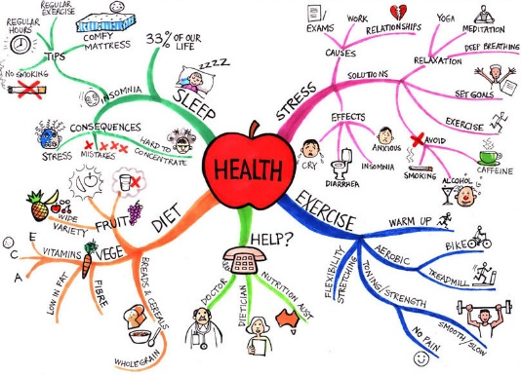
The Assignment – Mind Map
In your pairs, please begin creating a Mind Map to help you identify: -
What you already know about this topic
The key areas you will need to address to complete the assignment to a high standard………>72%

Slide 17
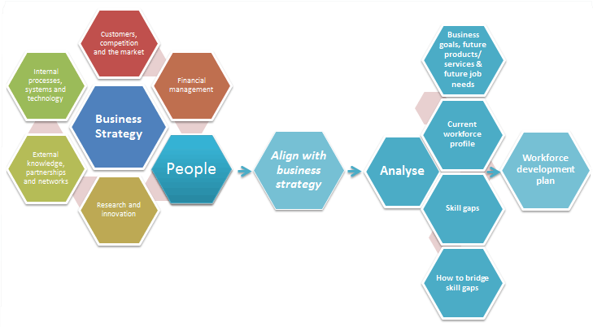
Aligning people development with business strategy

Slide 18
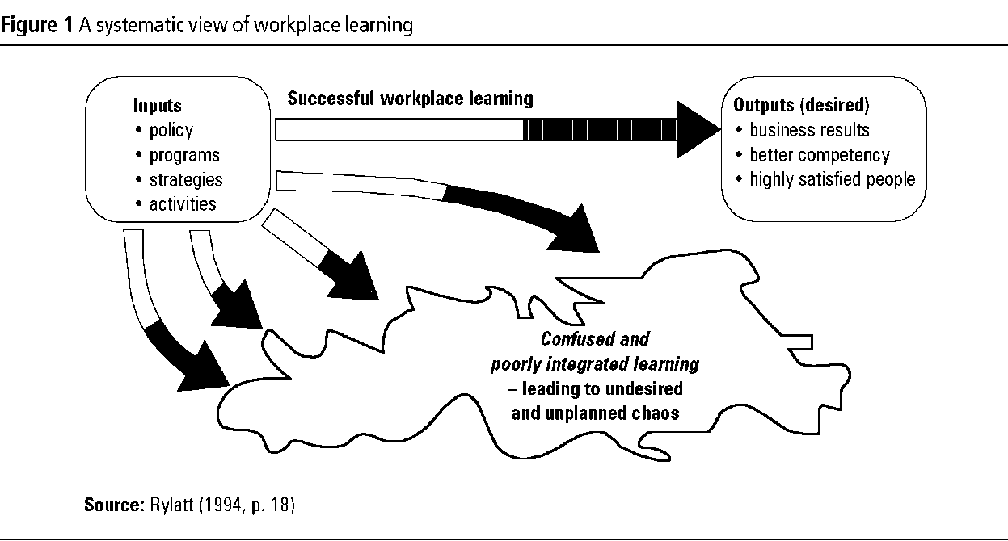

Slide 19
The Value of
Management and Leadership
Qualifications
Bradley, M. Woodman, P. & Hutchings, P. (2012)

Slide 20
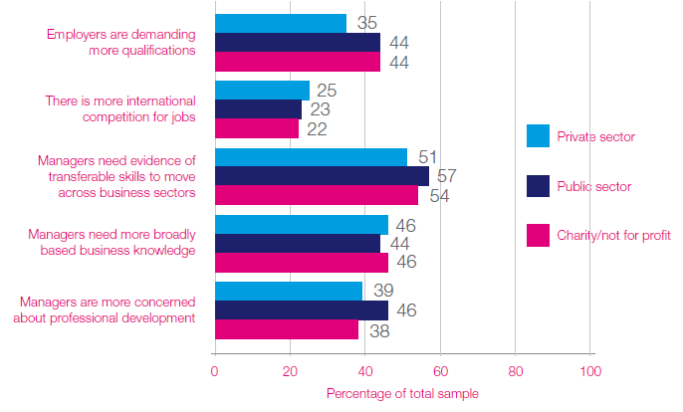
Why qualifications have become more important, by sector
Source: Bradley, Woodman and Hutchings 2012
Notes:
Source: Bradley, Woodman and Hutchings 2012

Slide 21
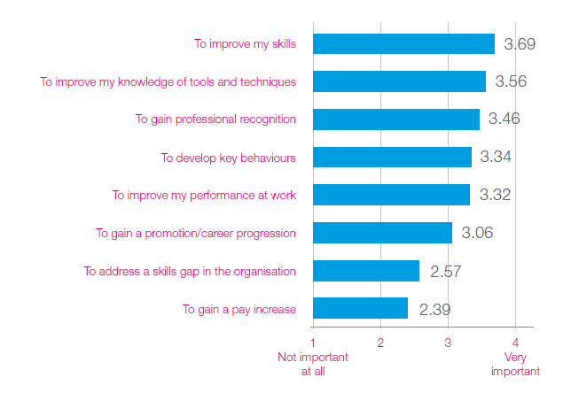
Learners reasons for study

Slide 22

Value of qualifications from an employer perspective

Slide 23
Impact of management qualifications on work based skills, knowledge & behaviours
Increased confidence
Increased self-awareness
Increased strategic awareness
Enhanced people management skills
Managing change more effectively
Improved networks
Notes:
Increasing confidence - is a very important concept in organisational psychology as it is closely linked to “self-efficacy” ,a person’s belief in their ability to succeed in specific situations. People with a high level of self-efficacy will readily undertake challenging activities and will be more motivated to
persist in these activities (Wood and Bandura 1989).
Increased self awareness -MLQs had provided the opportunity to reflect on their behaviour in relation to theory and best practice, and how they may be perceived by others. This was especially pertinent in relation to people management
Increased strategic awareness - Numerous participants described how their qualification had helped them to develop a broader outlook on their business, beyond the immediate concerns of their department. This helped them understand their role in the wider organisational context and gave them strategic awareness of the organisation’s aims, hence enhancing their effectiveness.
Enhanced people management skills - These enhanced people management skills are evidence of an engaging transformational style of leadership, which is known to not only increase employee engagement and motivation, but has also been shown to enhance team performance (Alimo-Metcalfe at al.
2008; Alimo-Metcalfe and Alban-Metcalfe 2011).
Managing change more effectively - MLQ had equipped them to manage change better, a particularly relevant benefit given the prevailing economic conditions. This increased effectiveness was largely attributed to enhanced people management skills, which enabled them to communicate change more positively and in a way that engaged staff rather than de-motivated them
Improved networks - Undertaking courses gave participants the opportunity to meet people within the organisation that they would otherwise not have met; they valued the opportunity to build relationships with their colleagues and have a wider network of “friends” internally to call on when needed.

Slide 24
Skills for the Workplace Modules for Qualifications
Year 1 | Year 2 | Year 3
Module Titles
Professional Career Development | Developing relationships for workplace achievement | Developing innovation & creativity skills in the workplace
Effective Teamworking and Communication | Workplace culture & organisational efficiency | Strategic business planning skills for SME’s & SBU’s
Problem Solving & Decision Making | Developing workplace critical thinking | Emergent leadership skills for the workplace
Managing Enterprise in the 21st Century | Understanding & engaging in the customer experience | Skills for leading & implementing workplace change
Academic and Employability Skills | Knowledge & information management skills for the workplace | Coaching & mentoring skills for the workplace
Digital Skills and Research methods | Managing projects in the organisation | Equality & diversity
 |  | Developing workplace skills for ebusiness
Notes:
Working module title are provided for the 2nd and 3rd year

