Slide 1
MBA
Financial Management
Week 7
Time Value of Money

Slide 2
Week Outline
Compound Interest, Future, and Present Value
Annuities

Slide 3
Compound Interest, Future, and Present Value

Slide 4
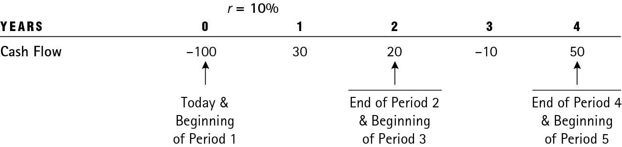
Using Timelines to Visualize Cash Flows
Timeline of cash flows

Slide 5
Compound Interest (1 of 2)
Compounding is when interest paid on an investment during the first period is added to the principal; then, during the second period, interest is earned on the new sum (that includes the principal and interest earned so far).
Compounding is the process where your money earns returns not just on the initial amount, but also on the returns it generates over time. Think of it as "growth on growth."

Slide 6
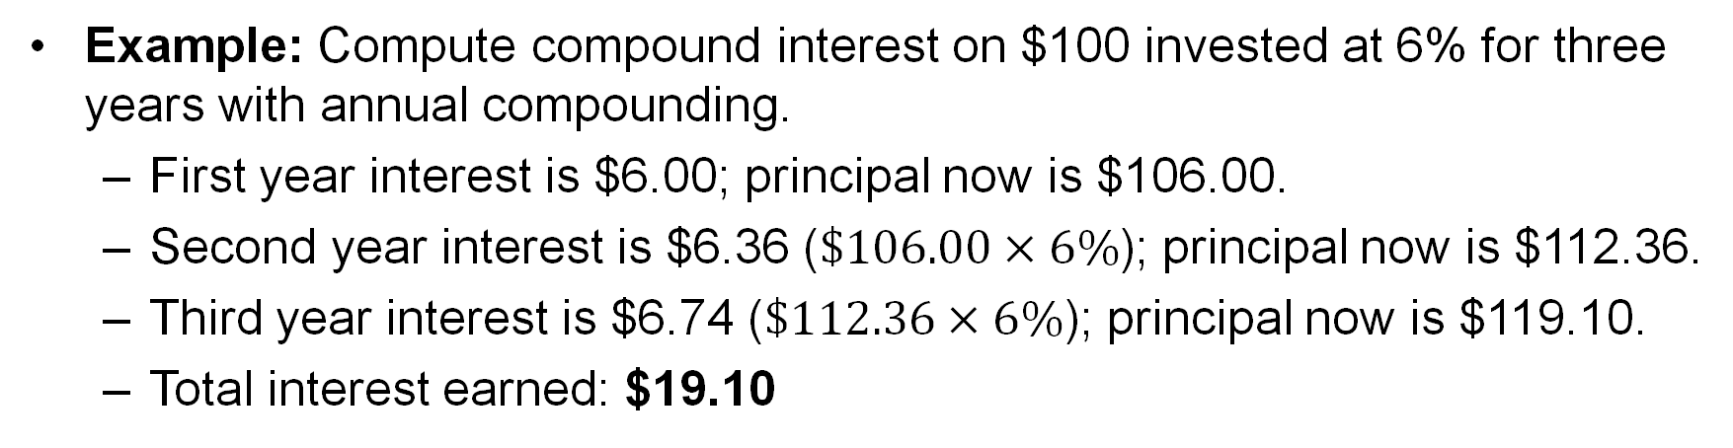
Compound Interest (2 of 2)
Example: Compute compound interest on $100 invested at 6% for three years with annual compounding.
  First year interest is $6.00; principal now is $106.00.
  Second year interest is $6.36 ($\$106.00×6\%$); principal now is $112.36.
  Third year interest is $6.74 ($\$112.36×6\%$); principal now is $119.10.
  Total interest earned: $19.10

Slide 7
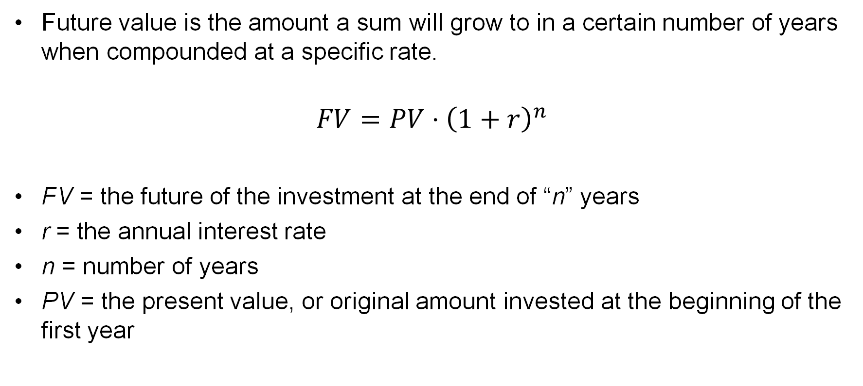
Future Value
Future value is the amount a sum will grow to in a certain number of years when compounded at a specific rate.
$$FV=PV⋅{\left(1+r\right)}^{n}$$
FV = the future of the investment at the end of “n” years
r = the annual interest rate
n = number of years
PV = the present value, or original amount invested at the beginning of the first year

Slide 8
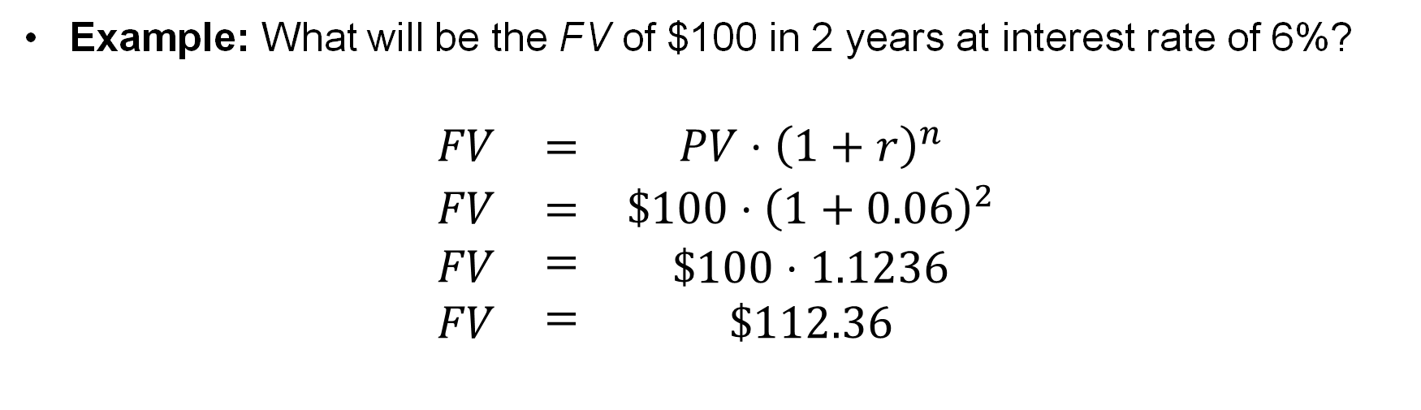
Future Value Example
Example: What will be the FV of $100 in 2 years at interest rate of 6%?
$$\begin{matrix}FV & = & PV⋅{\left(1+r\right)}^{n} \\ FV & = & \$100⋅{\left(1+0.06\right)}^{2} \\ \begin{matrix}FV \\ FV\end{matrix} & \begin{matrix}= \\ =\end{matrix} & \begin{matrix}\$100⋅1.1236 \\ \$112.36\end{matrix}\end{matrix}$$

Slide 9
How to Increase the Future Value?
Future value can be increased by
  Increasing number of years of compounding (n)
  Increasing the interest or discount rate (r)
  Increasing the original investment (PV)
See example on next slide.

Slide 10
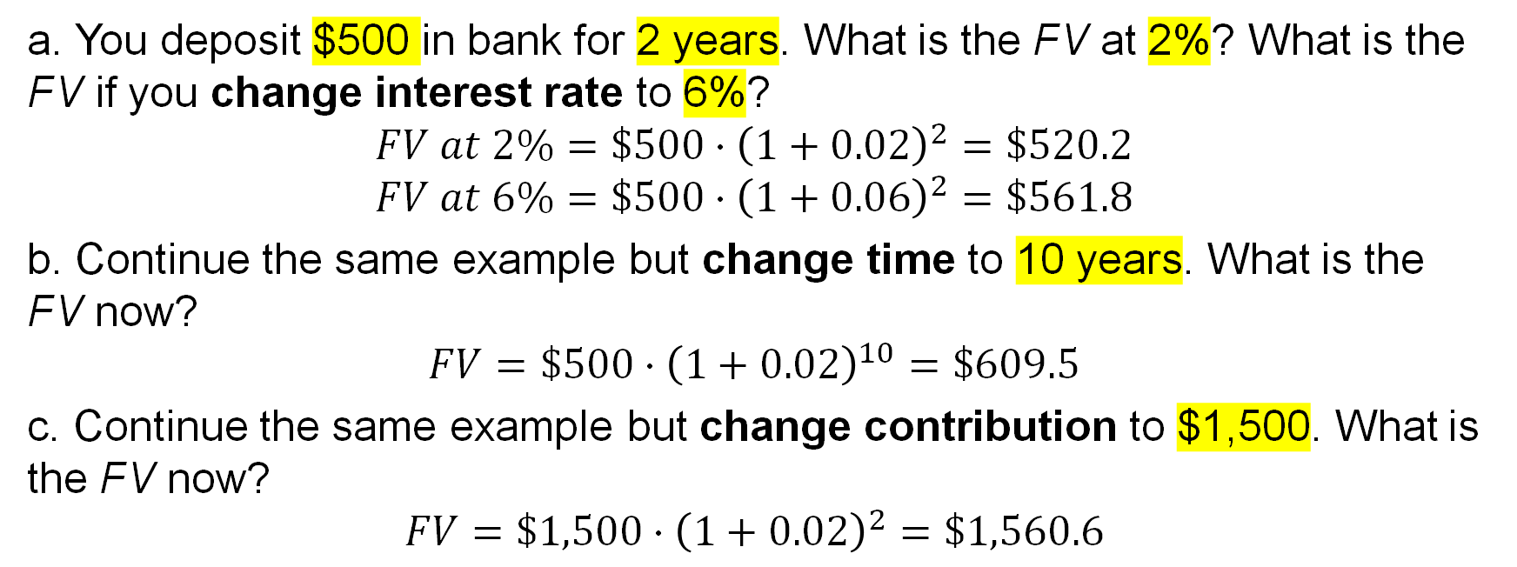
Changing R, N, and PV
a. You deposit $500 in bank for 2 years. What is the FV at 2%? What is the FV if you change interest rate to 6%?
$$FV at 2\%=\$500⋅{\left(1+0.02\right)}^{2}=\$520.2$$
$$FV at 6\%=\$500⋅{\left(1+0.06\right)}^{2}=\$561.8$$
b. Continue the same example but change time to 10 years. What is the FV now?
$$FV=\$500⋅{\left(1+0.02\right)}^{10}=\$609.5$$
c. Continue the same example but change contribution to $1,500. What is the FV now?
$$FV=\$1,500⋅{\left(1+0.02\right)}^{2}=\$1,560.6$$

Slide 11
Group Activity 1
Use Excel to solve the following questions:
1. You plan to invest £10,000 in the shares of a company.
  (a) If the value of the shares increases by 5 per cent a year, what will be the value of the shares in 20 years?
  (b) If the value of the shares increases by 15 per cent a year, what will be the value of the shares in 20 years?
2. How long will it take you to double your money if you invest it at:
  (a) 5 percent?
  (b) 15 per cent?

Slide 12
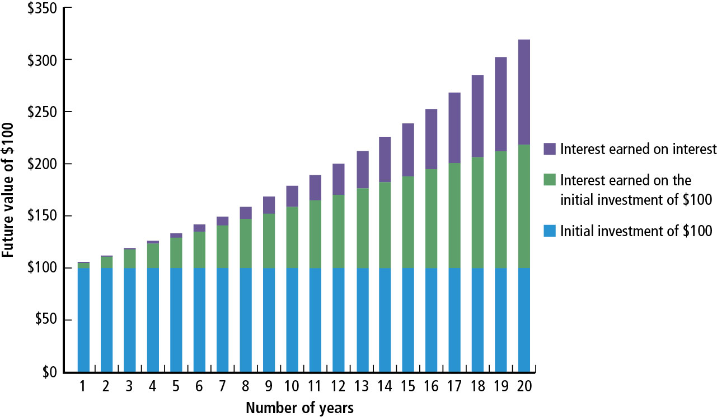
Figure 5.1 $100 Compounded at 6 Percent over 20 Years

Slide 13
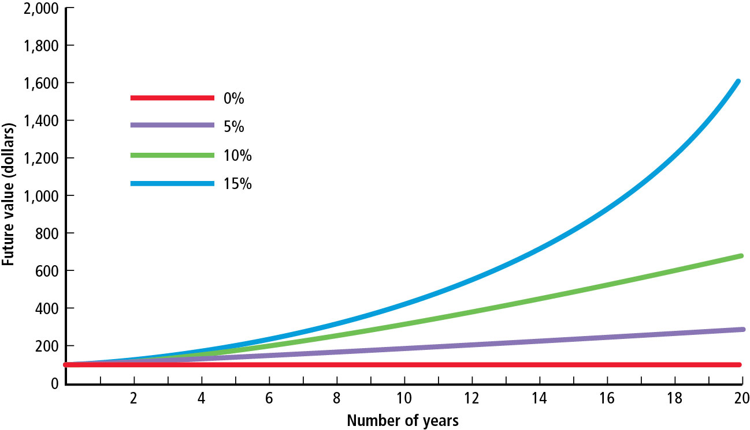
Figure 5.2 The Future of $100 Initially Deposited and Compounded at 0, 5, 10, and 15 Percent (1 of 2)

Slide 14
Figure 5.2 The Future of $100 Initially Deposited and Compounded at 0, 5, 10, and 15 Percent (2 of 2)
Figure 5.2 illustrates that we can increase the FV by
  Increasing the number of years for which money is invested
  Investing at a higher interest rate

Slide 15
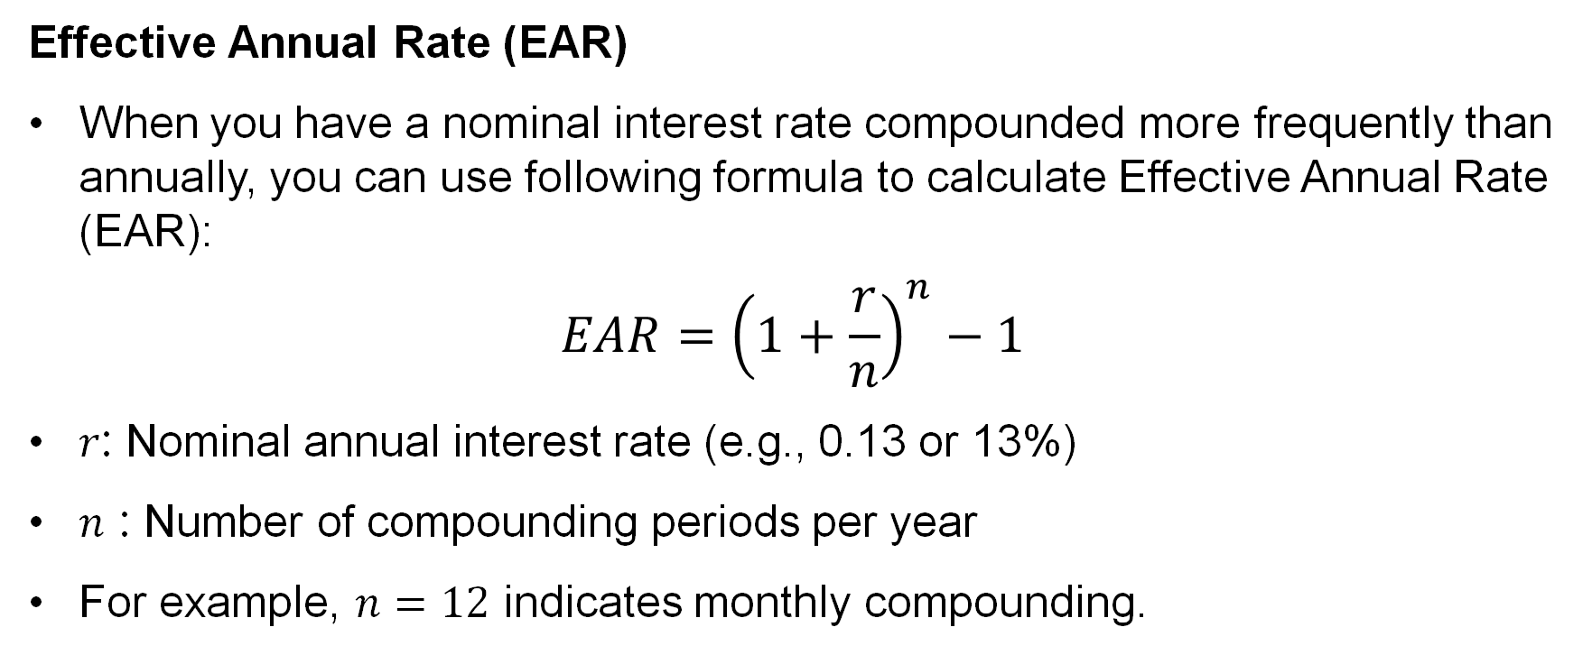
Real-Life Example: EAR v.s. APR
Effective Annual Rate (EAR)
When you have a nominal interest rate compounded more frequently than annually, you can use following formula to calculate Effective Annual Rate (EAR):
$$EAR={\left(1+\frac{r}{n}\right)}^{n}−1$$
$r$: Nominal annual interest rate (e.g., 0.13 or 13%)
$n$ : Number of compounding periods per year
For example, $n=12$ indicates monthly compounding.

Slide 16
Real-Life Example: EAR v.s. APR
How does EAR make things different?
Think about you borrow £10,000 with nominal annual rate of 10% and repay it in 5 years. Here are different compounding rules:
Loan Principal | Nominal Annual Interest Rate | Compounding Frequency | Compounding Times Each Year | EAR | Years | Repayment
10000 | 10% | Yearly | 1 | 10.00% | 5 | 16105.10
10000 | 10% | Quarterly | 4 | 10.38% | 5 | 16386.16
10000 | 10% | Monthly | 12 | 10.47% | 5 | 16453.09
10000 | 10% | Weekly | 52 | 10.51% | 5 | 16479.30
10000 | 10% | Daily | 365 | 10.52% | 5 | 16486.08

Slide 17
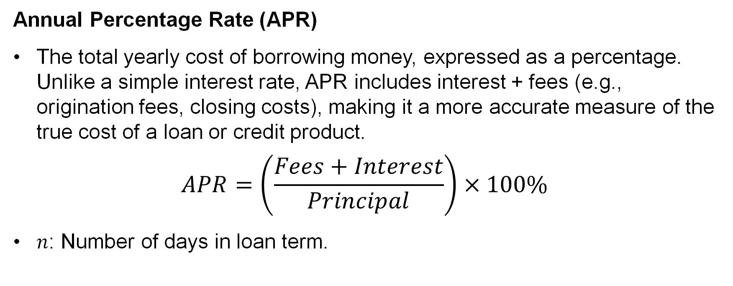
Real-Life Example: EAR v.s. APR
Annual Percentage Rate (APR)
The total yearly cost of borrowing money, expressed as a percentage. Unlike a simple interest rate, APR includes interest + fees (e.g., origination fees, closing costs), making it a more accurate measure of the true cost of a loan or credit product.
$$APR=\left(\frac{Fees+Interest}{Principal}\right)×100\%$$
$n$: Number of days in loan term.

Slide 18
Real-Life Example: EAR v.s. APR
Why APR matters?
Let borrowers compare loan/credit card.
Disclosed by law to prevent hidden fees.
APR assumes no compounding within the year (unlike EAR).

Slide 19
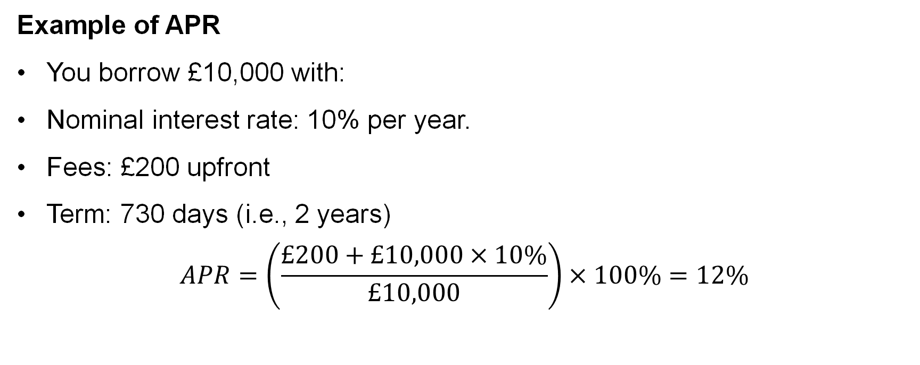
Real-Life Example: EAR v.s. APR
Example of APR
You borrow £10,000 with:
Nominal interest rate: 10% per year.
Fees: £200 upfront
Term: 730 days (i.e., 2 years)
$$APR=\left(\frac{£200+£10,000×10\%}{£10,000}\right)×100\%=12\%$$

Slide 20
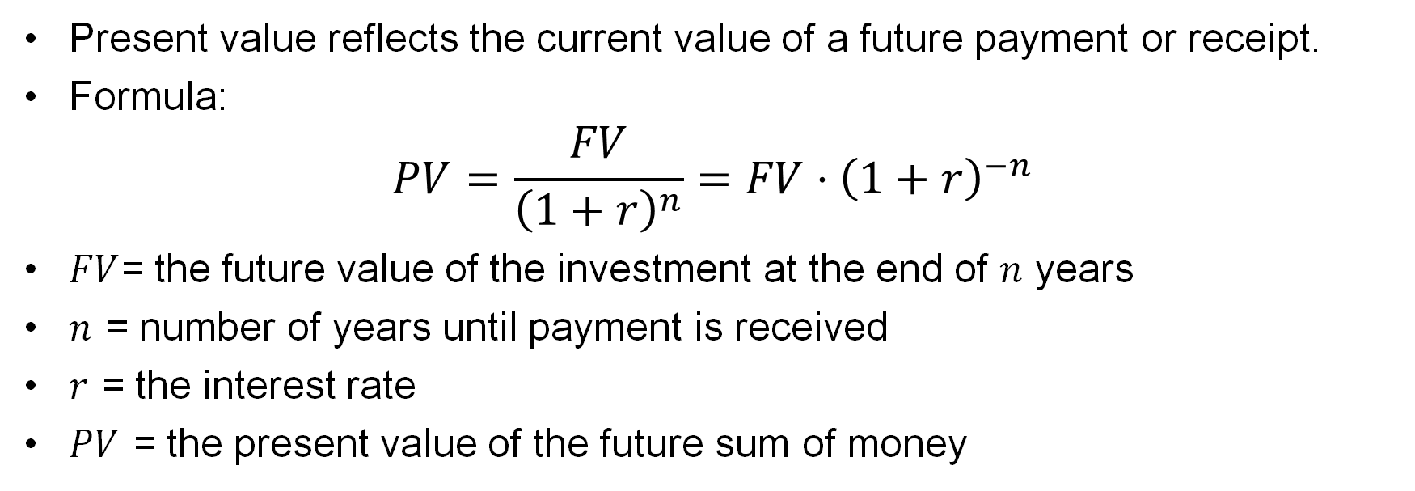
Present Value
Present value reflects the current value of a future payment or receipt.
Formula:
$$PV=\frac{FV}{{\left(1+r\right)}^{n}}=FV⋅{\left(1+r\right)}^{−n}$$
$FV$= the future value of the investment at the end of $n$ years
$n$ = number of years until payment is received
$r$ = the interest rate
$PV$ = the present value of the future sum of money

Slide 21
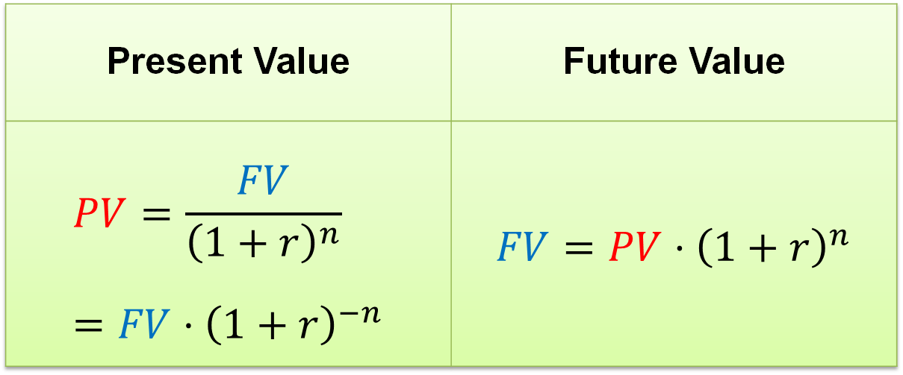
Present Value
Difference between Present Value and Future Value
Present Value | Future Value
$$PV=\frac{FV}{{\left(1+r\right)}^{n}}=FV⋅{\left(1+r\right)}^{−n}$$ | $$FV=PV⋅{\left(1+r\right)}^{n}$$

Slide 22
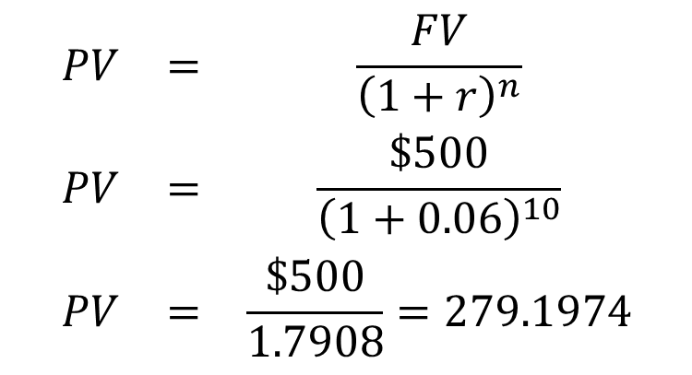
Present Value Example
What will be the future value of $500 to be received 10 years from today if the discount rate is 6%?
$$\begin{matrix}PV & = & \frac{FV}{{\left(1+r\right)}^{n}} \\ PV & = & \frac{\$500}{{\left(1+0.06\right)}^{10}} \\ PV & = & \frac{\$500}{1.7908}=279.1974\end{matrix}$$

Slide 23
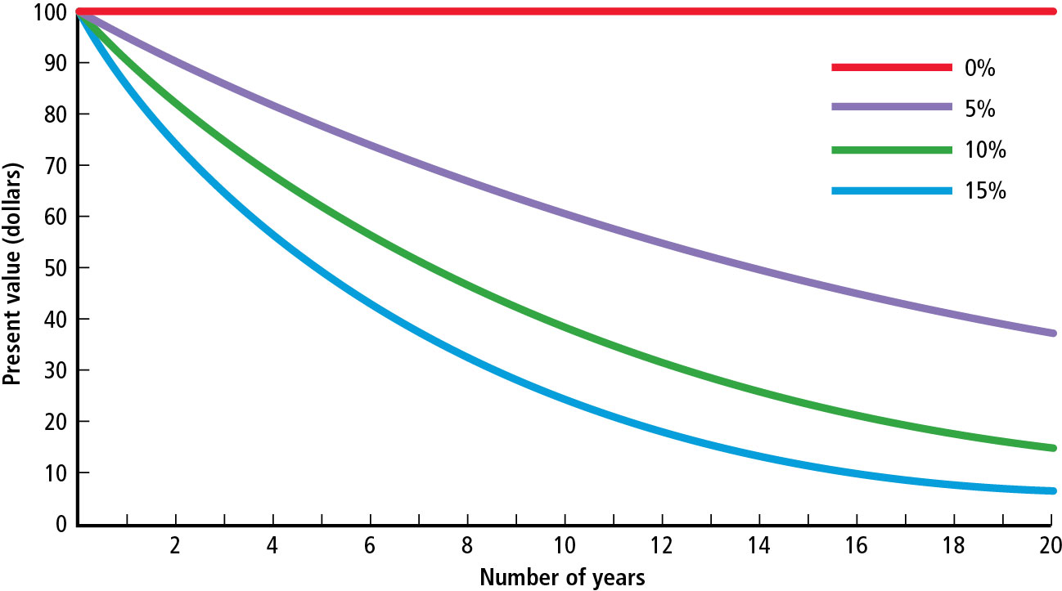
Figure 5.3 The Present Value of $100 to Be Received at a Future Date and Discounted Back to the Present at 0, 5, 10, and 15 Percent (1 of 2)

Slide 24
Figure 5.3 The Present Value of $100 to Be Received at a Future Date and Discounted Back to the Present at 0, 5, 10, and 15 Percent (2 of 2)
Figure 5.3 illustrates that given the same PV, we can lower the FV by
  Increasing the number of years for which money is invested
  Investing at a higher interest rate

Slide 25
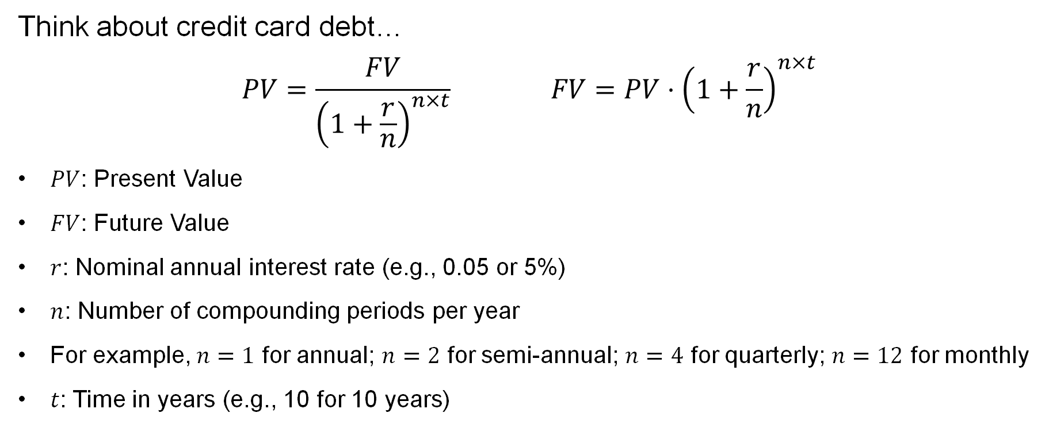
Multiple Compounding Per Year
Think about credit card debt…
$$PV=\frac{FV}{{\left(1+\frac{r}{n}\right)}^{n×t}} FV=PV⋅{\left(1+\frac{r}{n}\right)}^{n×t}$$
$PV$: Present Value
$FV$: Future Value
$r$: Nominal annual interest rate (e.g., 0.05 or 5%)
$n$: Number of compounding periods per year
For example, $n=1$ for annual; $n=2$ for semi-annual; $n=4$ for quarterly; $n=12$ for monthly
$t$: Time in years (e.g., 10 for 10 years)

Slide 26
Group Activity 2
Use Excel to solve the following questions:
1. How much must be invested now to provide an amount of £10,000 in six years (at the end of Year Six) assuming a nominal annual interest of 8 per cent is compounded:
  1) annually?
  2) quarterly?

Slide 27
Annuities

Slide 28
Annuities
An annuity is a series of equal dollar payments for a specified number of years.
Ordinary annuity payments occur at the end of each period.

Slide 29
FV of Annuity
Compound Annuity
Depositing or investing an equal sum of money at the end of each year for a certain number of years and allowing it to grow
For example, you start to deposit a part of your annual salary (say, £500) into pension fund at the end of the 1st year and stop at the end of the 5th year (because you leave your employer).

Slide 30
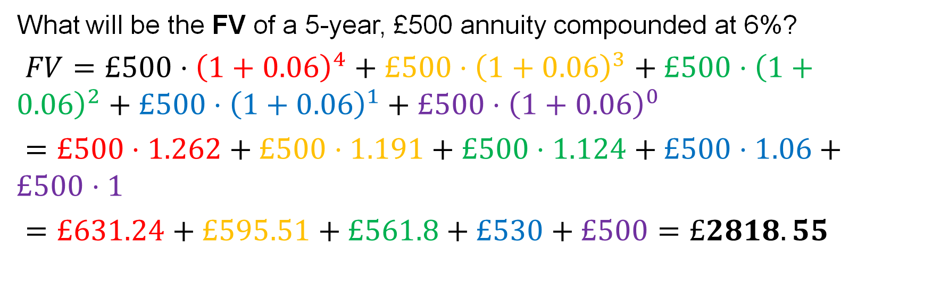
FV Annuity Example
What will be the FV of a 5-year, £500 annuity compounded at 6%?
$FV=£500⋅{\left(1+0.06\right)}^{4}+£500⋅{\left(1+0.06\right)}^{3}+£500⋅{\left(1+0.06\right)}^{2}+£500⋅{\left(1+0.06\right)}^{1}+£500⋅{\left(1+0.06\right)}^{0}$
$=£500⋅1.262+£500⋅1.191+£500⋅1.124+£500⋅1.06+£500⋅1$
$=£631.24+£595.51+£561.8+£530+£500=£2818.55$

Slide 31
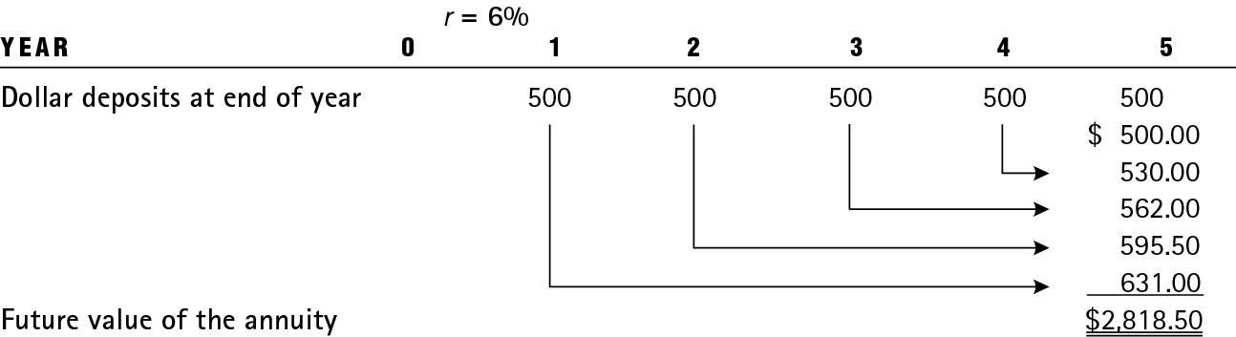
Table 5.1 Growth of a 5-Year, $500 Annuity Compounded at 6 Percent

Slide 32
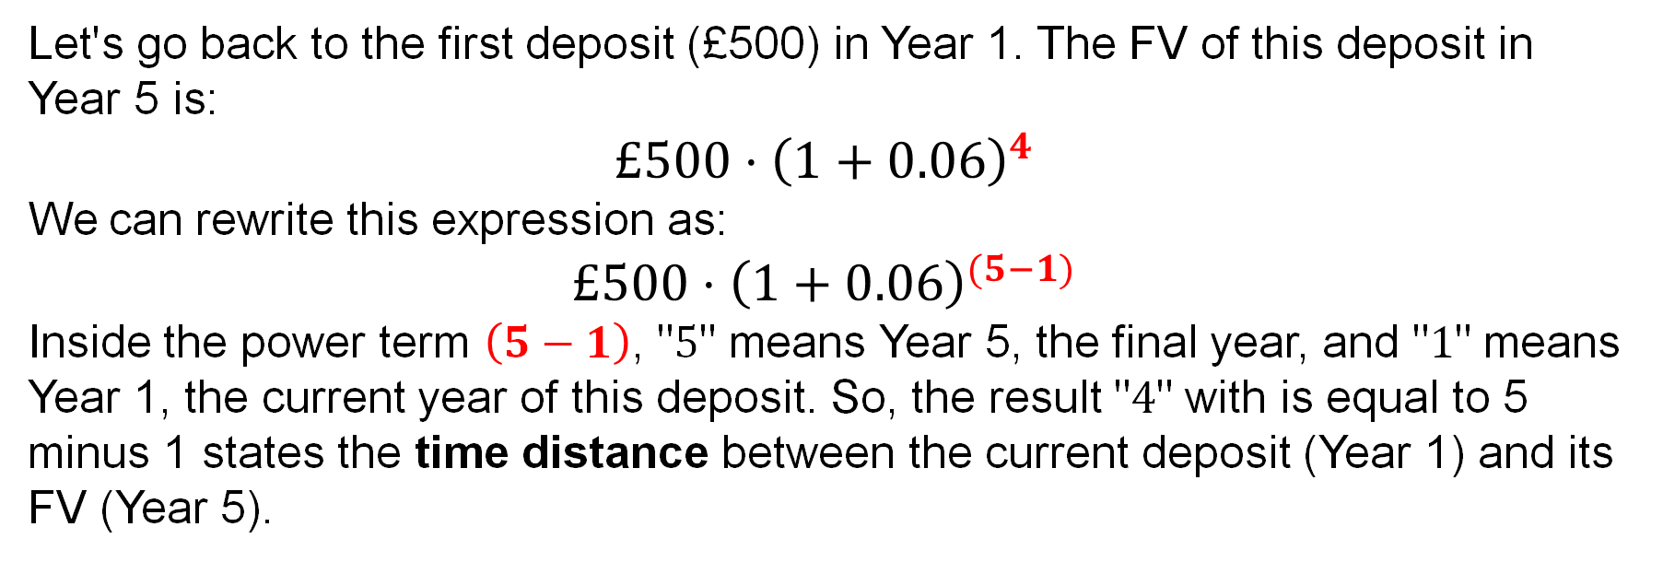
FV Annuity Formula
Let's go back to the first deposit (£500) in Year 1. The FV of this deposit in Year 5 is:
$$£500⋅{\left(1+0.06\right)}^{4}$$
We can rewrite this expression as:
$$£500⋅{\left(1+0.06\right)}^{(5−1)}$$
Inside the power term $\left(5−1\right)$, "$5$" means Year 5, the final year, and "$1$" means Year 1, the current year of this deposit. So, the result "$4$" with is equal to 5 minus 1 states the time distance between the current deposit (Year 1) and its FV (Year 5).

Slide 33
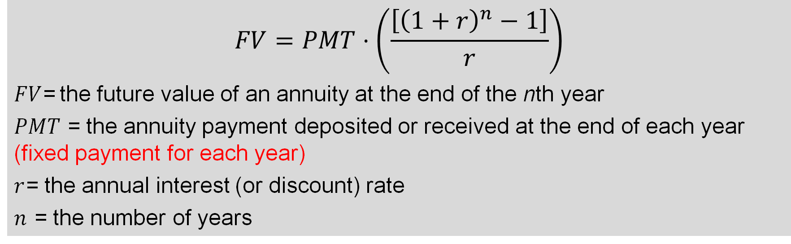
FV of an Annuity – Using the Mathematical Formulas (1 of 2)
$$FV=PMT⋅\left(\frac{\left[{\left(1+r\right)}^{n}−1\right]}{r}\right)$$
$FV$= the future value of an annuity at the end of the nth year
$PMT$ = the annuity payment deposited or received at the end of each year (fixed payment for each year)
$r$= the annual interest (or discount) rate
$n$ = the number of years

Slide 34
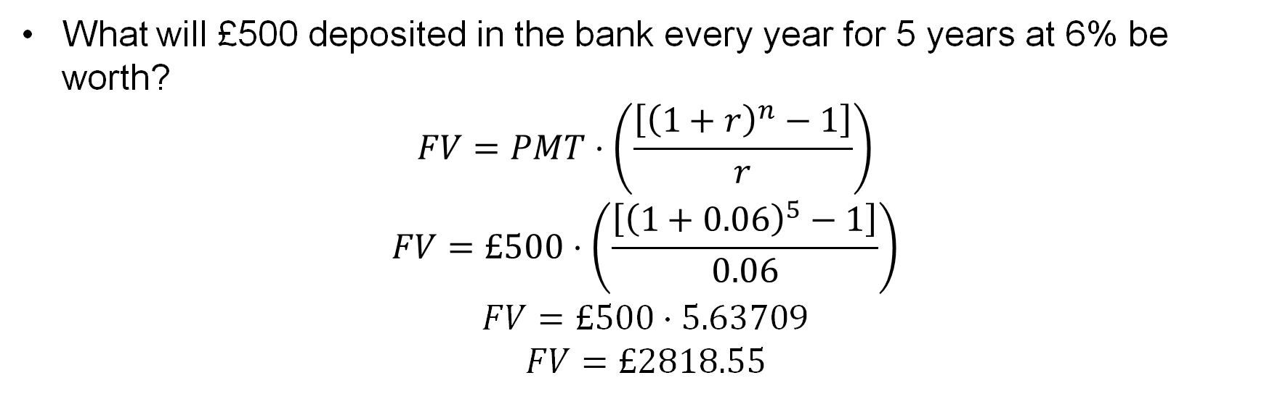
FV of an Annuity – Using the Mathematical Formulas (2 of 2)
What will £500 deposited in the bank every year for 5 years at 6% be worth?
$$FV=PMT⋅\left(\frac{\left[{\left(1+r\right)}^{n}−1\right]}{r}\right)$$
$$FV=£500⋅\left(\frac{\left[{\left(1+0.06\right)}^{5}−1\right]}{0.06}\right)$$
$$FV=£500⋅5.63709$$
$$FV=£2818.55$$

Slide 35
FV of Annuity: Changing PMT, N, and r (1 of 3)
What will $5,000 deposited annually for 50 years be worth at 7%?
  FV = $2,032,645
  Contribution = $250,000 (= 5000×50)
Change PMT = $6,000 for 50 years at 7%
  FV = $2,439,174
  Contribution = $300,000 (= 6000×50)

Slide 36
FV of Annuity: Changing PMT, N, and r (2 of 3)
3. Change N = 60 years, $5,000 at 7%
  FV = $4,067,602
  Contribution = $300,000 (= 5000×60)
4. Change r = 9%, 50 years, $5,000
  FV = $4,075,418
  Contribution = $250,000 (= 5000×50)

Slide 37
Present Value of an Annuity
Pensions, insurance obligations, and interest owed on bonds are all annuities. To compare these three types of investments we need to know the present value (PV) of each.

Slide 38
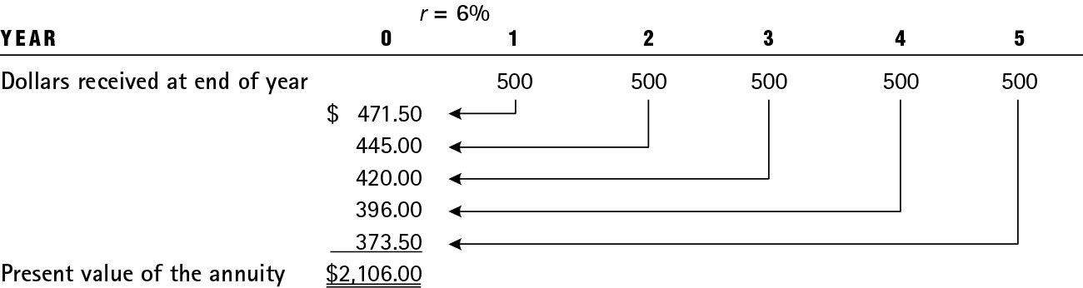
Table 5.2 Illustration of a 5-Year, $500 Annuity Discounted to the Present at 6 Percent

Slide 39
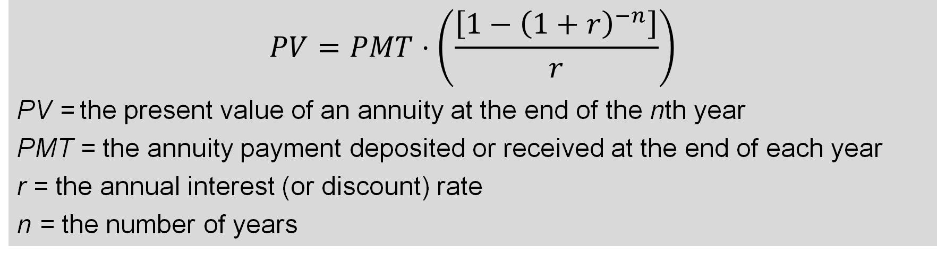
PV of an Annuity – Using the Mathematical Formulas (1 of 2)
$$PV=PMT⋅\left(\frac{\left[1−{\left(1+r\right)}^{−n}\right]}{r}\right)$$
PV = the present value of an annuity at the end of the nth year
PMT = the annuity payment deposited or received at the end of each year
r = the annual interest (or discount) rate
n = the number of years

Slide 40
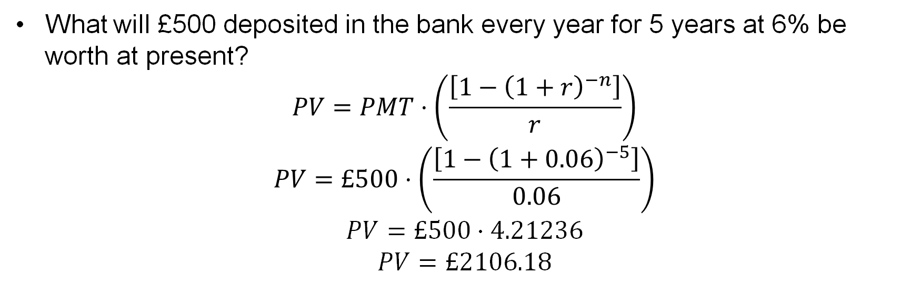
PV of Annuity – Using the Mathematical Formulas (2 of 2)
What will £500 deposited in the bank every year for 5 years at 6% be worth at present?
$$PV=PMT⋅\left(\frac{\left[1−{\left(1+r\right)}^{−n}\right]}{r}\right)$$
$$PV=£500⋅\left(\frac{\left[{1−\left(1+0.06\right)}^{−5}\right]}{0.06}\right)$$
$$PV=£500⋅4.21236$$
$$PV=£2106.18$$

Slide 41
Annuities Due (1 of 2)
Annuity Due is a series of equal payments made at the beginning of each period (e.g., monthly, quarterly), as opposed to an ordinary annuity, where payments occur at the end of each period.
Example: Rent payments (paid at the start of the month), insurance premium, or any scenario requiring upfront payments.

Slide 42
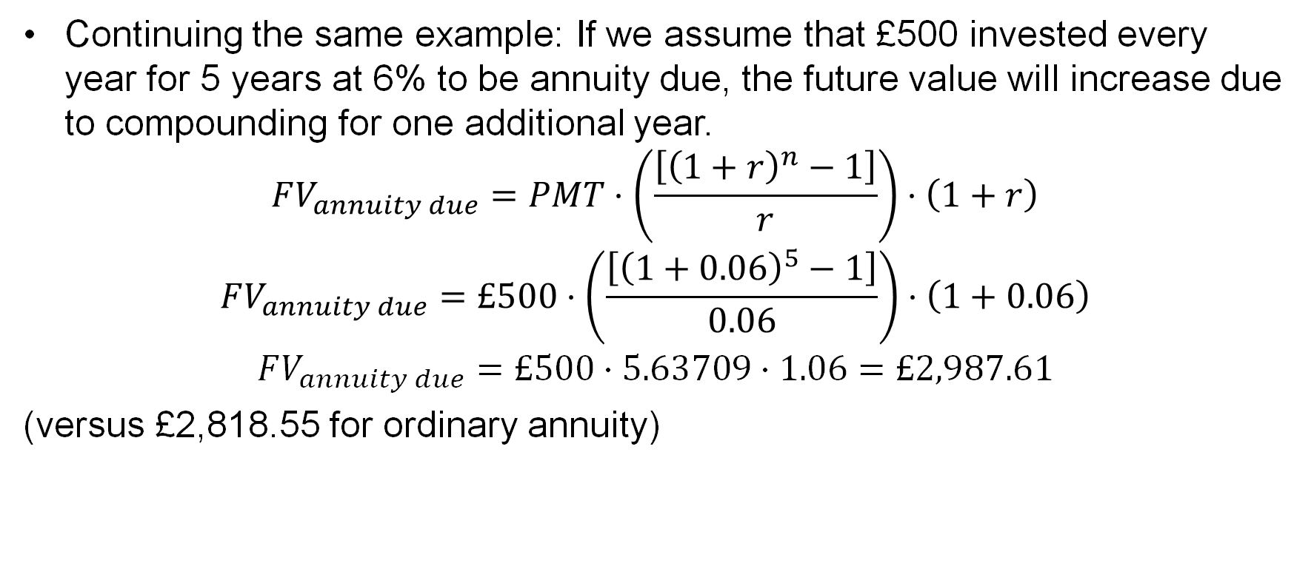
Annuities Due (2 of 2)
Continuing the same example: If we assume that £500 invested every year for 5 years at 6% to be annuity due, the future value will increase due to compounding for one additional year.
$$FV_{annuity due}=PMT⋅\left(\frac{\left[{\left(1+r\right)}^{n}−1\right]}{r}\right)⋅\left(1+r\right)$$
$$FV_{annuity due}=£500⋅\left(\frac{\left[{\left(1+0.06\right)}^{5}−1\right]}{0.06}\right)⋅\left(1+0.06\right)$$
$$FV_{annuity due}=£500⋅5.63709⋅1.06=£2,987.61$$
(versus £2,818.55 for ordinary annuity)

Slide 43
Amortized Loans (1 of 2)
Loans paid off in equal installments over time are called amortized loans.
Examples: Home mortgages, auto loans
Reducing the balance of a loan via annuity payments is called amortizing (or amortization).

Slide 44
Amortized Loans (2 of 2)
The periodic payment is fixed. However, different amounts of each payment are applied toward the principal and interest. With each payment, you owe less toward principal. As a result, the amount that goes toward interest declines with every payment (as seen in Figure 5.4).

Slide 45
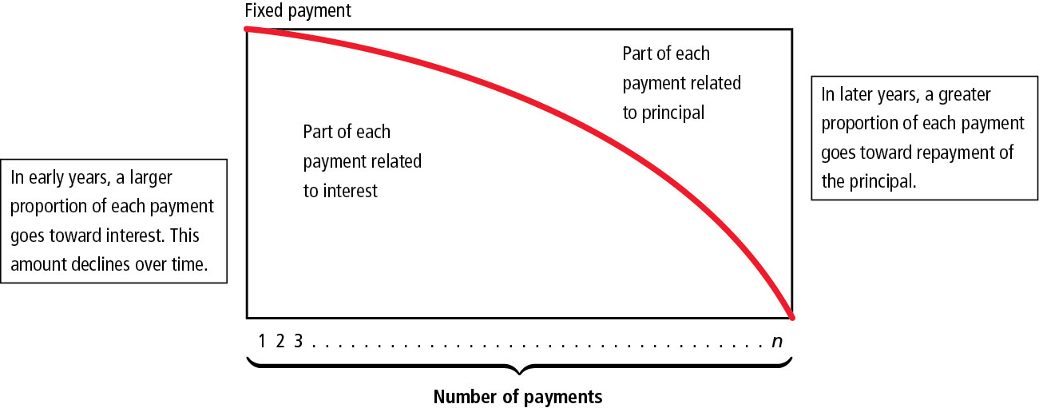
Figure 5.4 The Amortization Process

Slide 46
Amortization Example
Example: If you want to finance a new machinery with a purchase price of £6,000 at an interest rate of 15% over 4 years, what will your annual payments be?

Slide 47
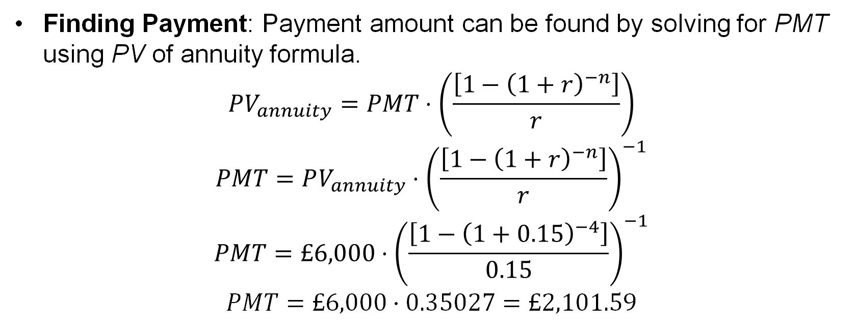
Finding PMT – Using the Mathematical Formulas
Finding Payment: Payment amount can be found by solving for PMT using PV of annuity formula.
$$PV_{annuity}=PMT⋅\left(\frac{\left[1−{\left(1+r\right)}^{−n}\right]}{r}\right)$$
$$PMT=PV_{annuity}⋅{\left(\frac{\left[1−{\left(1+r\right)}^{−n}\right]}{r}\right)}^{−1}$$
$$PMT=£6,000⋅{\left(\frac{\left[1−{\left(1+0.15\right)}^{−4}\right]}{0.15}\right)}^{−1}$$
$$PMT=£6,000⋅0.35027=£2,101.59$$

Slide 48
Loan Amortization Schedule
Year | Annuity | Interest portion of the Annuityª | Repayment of the principal portion of the Annuity^{b} | Outstanding loan Balance After the Annuity Payment
0 | 0 | 0 | 0 | $6,000.00
1 | $2,101.59 | $900.00 | $1,201.59 | 4,798.41
2 | 2,101.59 | 719.76 | 1,381.83 | 3,416.58
3 | 2,101.59 | 512.49 | 1,589.10 | 1,827.48
4 | 2,101.59 | 274.12 | 1,827.48 | Blank
ªThe interest portion of the annuity is calculated by multiplying the outstanding loan balance at the beginning of the year by the interest rate of 15%. Thus, for year 1 it was $6,000 × 0.15 = $900.00; for year 2 it was $4,798.41 × 0.15 = $719.76; and so on.
^{b}Repayment of the principal portion of the annuity was calculated by subtracting the interest portion of the annuity (column 2) from the annuity (column 1).

Slide 49
Amortization Example: Mortgage
Scenario
3B2B House Price: £500,000
Down Payment: 10% (£50,000)
Loan Principal: £450,000
Annual Interest Rate: 5%
Payment Method: Monthly (12 times per year)
Loan Term: 30 years (360 months) v.s. 20 years (240 months)

Slide 50
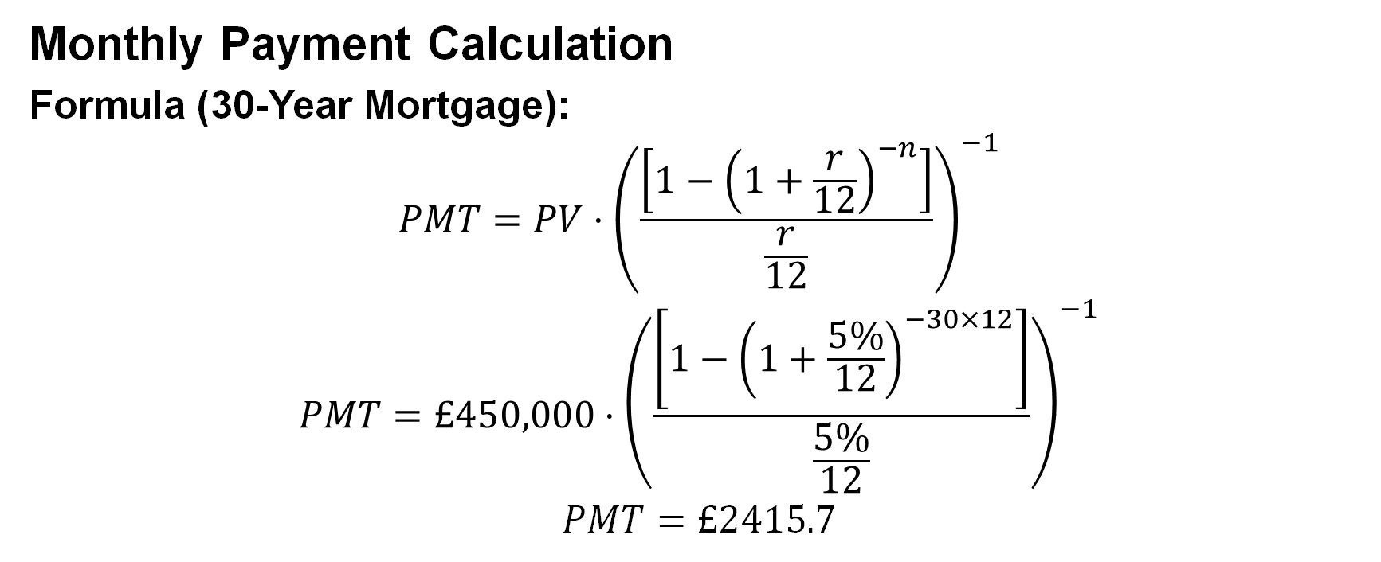
Amortization Example: Mortgage
Monthly Payment Calculation
Formula (30-Year Mortgage):
$$PMT=PV⋅{\left(\frac{\left[1−{\left(1+\frac{r}{12}\right)}^{−n}\right]}{\frac{r}{12}}\right)}^{−1}$$
$$PMT=£450,000⋅{\left(\frac{\left[1−{\left(1+\frac{5\%}{12}\right)}^{−30×12}\right]}{\frac{5\%}{12}}\right)}^{−1}$$
$$PMT=£2415.7$$

Slide 51
Key Terms
Amortized loan
Annuity
Annuity due
Compound interest
Future value
Ordinary annuity
Nominal or stated interest rate
Present value
Simple interest

Slide 52
Independent Study

Slide 53
Task 1
Calculate the cash conversion cycle (CCC) for each of the 5 years: Days Inventory Outstanding (DIO) + Days Sales Outstanding (DSO) – Days Payables Outstanding (DPO). Show your workings. Explain any significant changes year‑on‑year. Add this data to the same Excel file.
Submit to Tile: Week 7 - Independent Study | Financial Management (LCMB7002_LON) | Home: Updated Excel file with a new worksheet named “CCC_5yr”. A written explanation (max 150 words) of CCC in Word file.
Online text: Write a note of AI usage.

Slide 54
References and Reading List
Berk, J. and DeMarzo, P. (2020). Corporate Finance (5th Global Edition). Pearson Education. ISBN: 9781292304151. ​
Keown, A.J., Martin, J.D., and Petty, J.W. (2024). Foundations of Finance (10th Global Edition). Pearson Education. ISBN: 9781292742168.

