Slide 1

Name: Nazmin Malik
Student no: 2242813
Module Code: LCHS7003
Module: Community Care and Management of Longer-term Conditions
Assignment Title: Component 2 Individual Presentation
Lecturer: Dr Aishat Bakre

Slide 2


A Critical Review of Type 2 Diabetes Mellitus: Diagnosis, Assessment, Management and Prevention in UK Community Nursing Practice
Target Audience
This presentation is aimed at community nurses, who play a pivotal role in the prevention, early identification, ongoing management and person-centred care of individuals living with Type 2 Diabetes Mellitus (T2DM).

Slide 3

Type 2 Diabetes
Common Problems
Polyuria
Polydipsia
Fatigue
Blurred vision
Delayed wound healing
Recurrent infection
Unintentional weight loss (NICE, 2024)
Aetiology
Genetic predisposition
Obesity
Sedentary lifestyle
Poor nutrition
Ageing
Ethnicity
Social deprivation (Public Health England, 2023)
Overview of Type 2 Diabetes
Type 2 Diabetes Mellitus (T2DM) is a chronic metabolic disorder characterised by persistent hyperglycaemia due to insulin resistance and progressive β-cell dysfunction (NICE, 2024).
It accounts for around 90% of all diabetes cases worldwide (WHO, 2024).
T2DM is strongly linked to obesity, inactivity and socioeconomic deprivation (Diabetes UK, 2024).
It represents a major public health challenge because of its preventable complications and increasing prevalence (WHO, 2024).

Slide 4
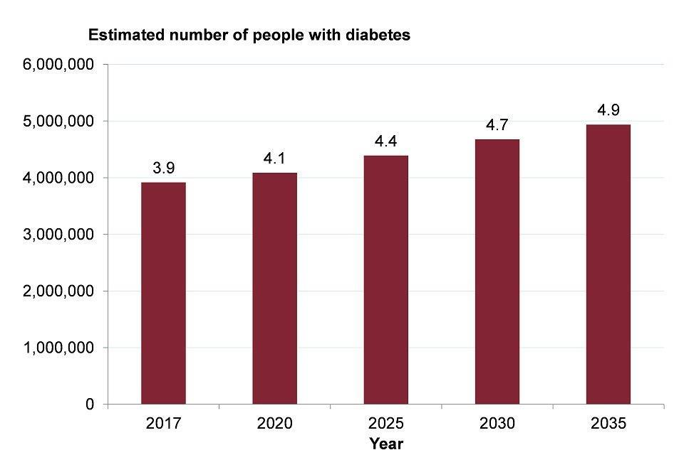
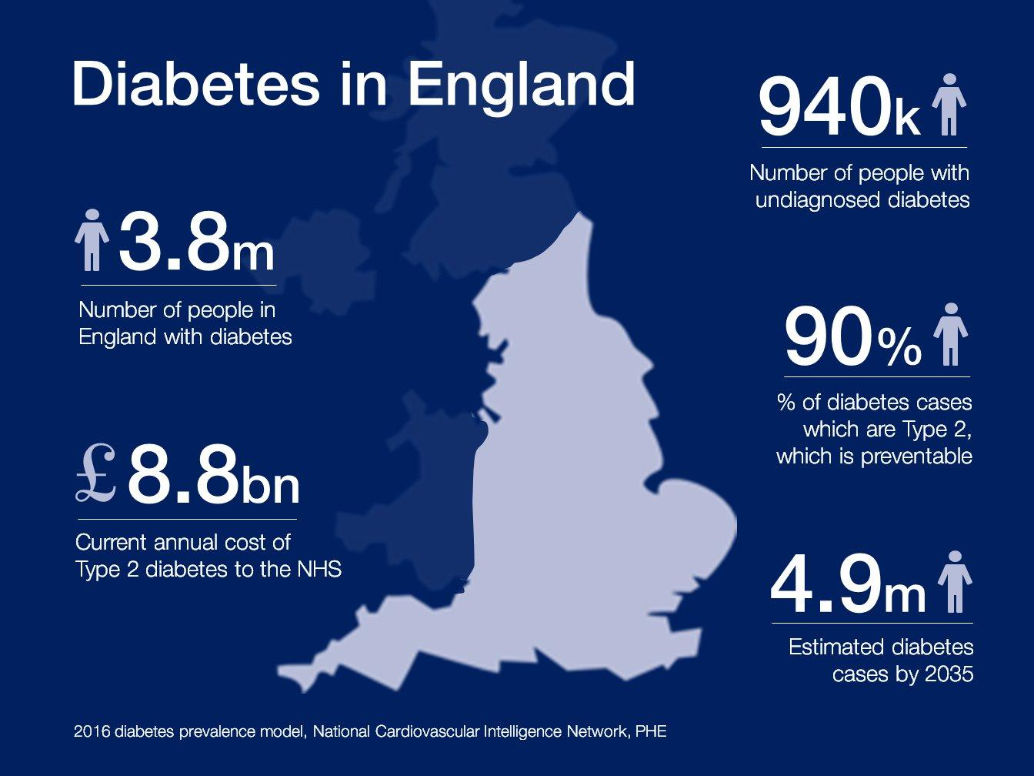
Prevalence of Type 2 Diabetes in the UK and Worldwide
Epidemiology and relevance to community nursing
Approximately 5.8 million people in the UK live with diabetes; around 90% have Type 2 Diabetes (Diabetes UK, 2025).
Over 1.3 million people in England may remain undiagnosed (NHS England, 2024).
Globally, over 830 million adults are affected (WHO, 2024).
Prevalence is highest in deprived communities and among South Asian and Black ethnic groups (Diabetes UK, 2025).
Community nurses are central to early detection, screening, patient education and long-term monitoring in community settings.
Key trend
Significant rise in earlier-onset Type 2 Diabetes among younger adults.
Growing health inequality burden.
Increasing demand on primary and community healthcare services.

Slide 5
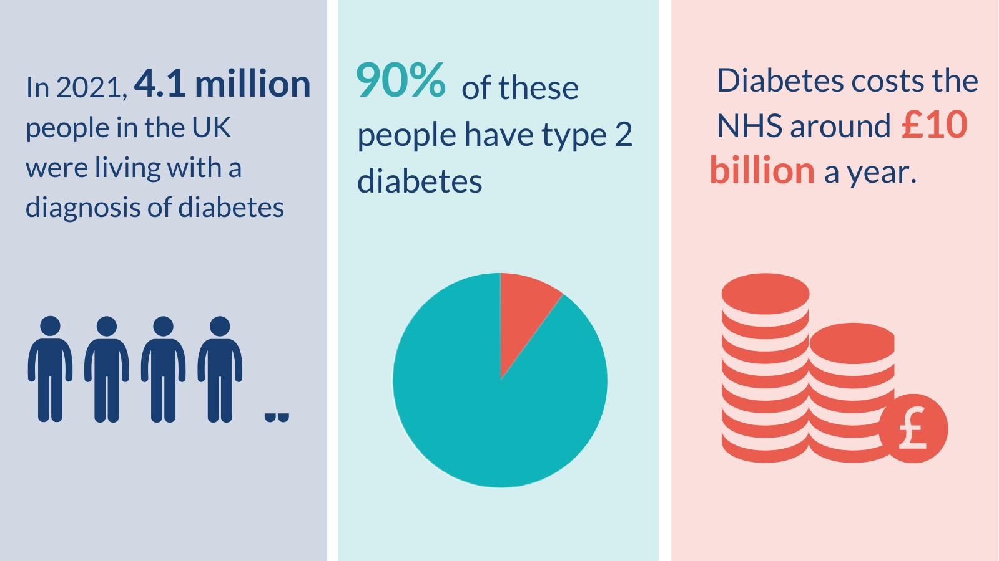
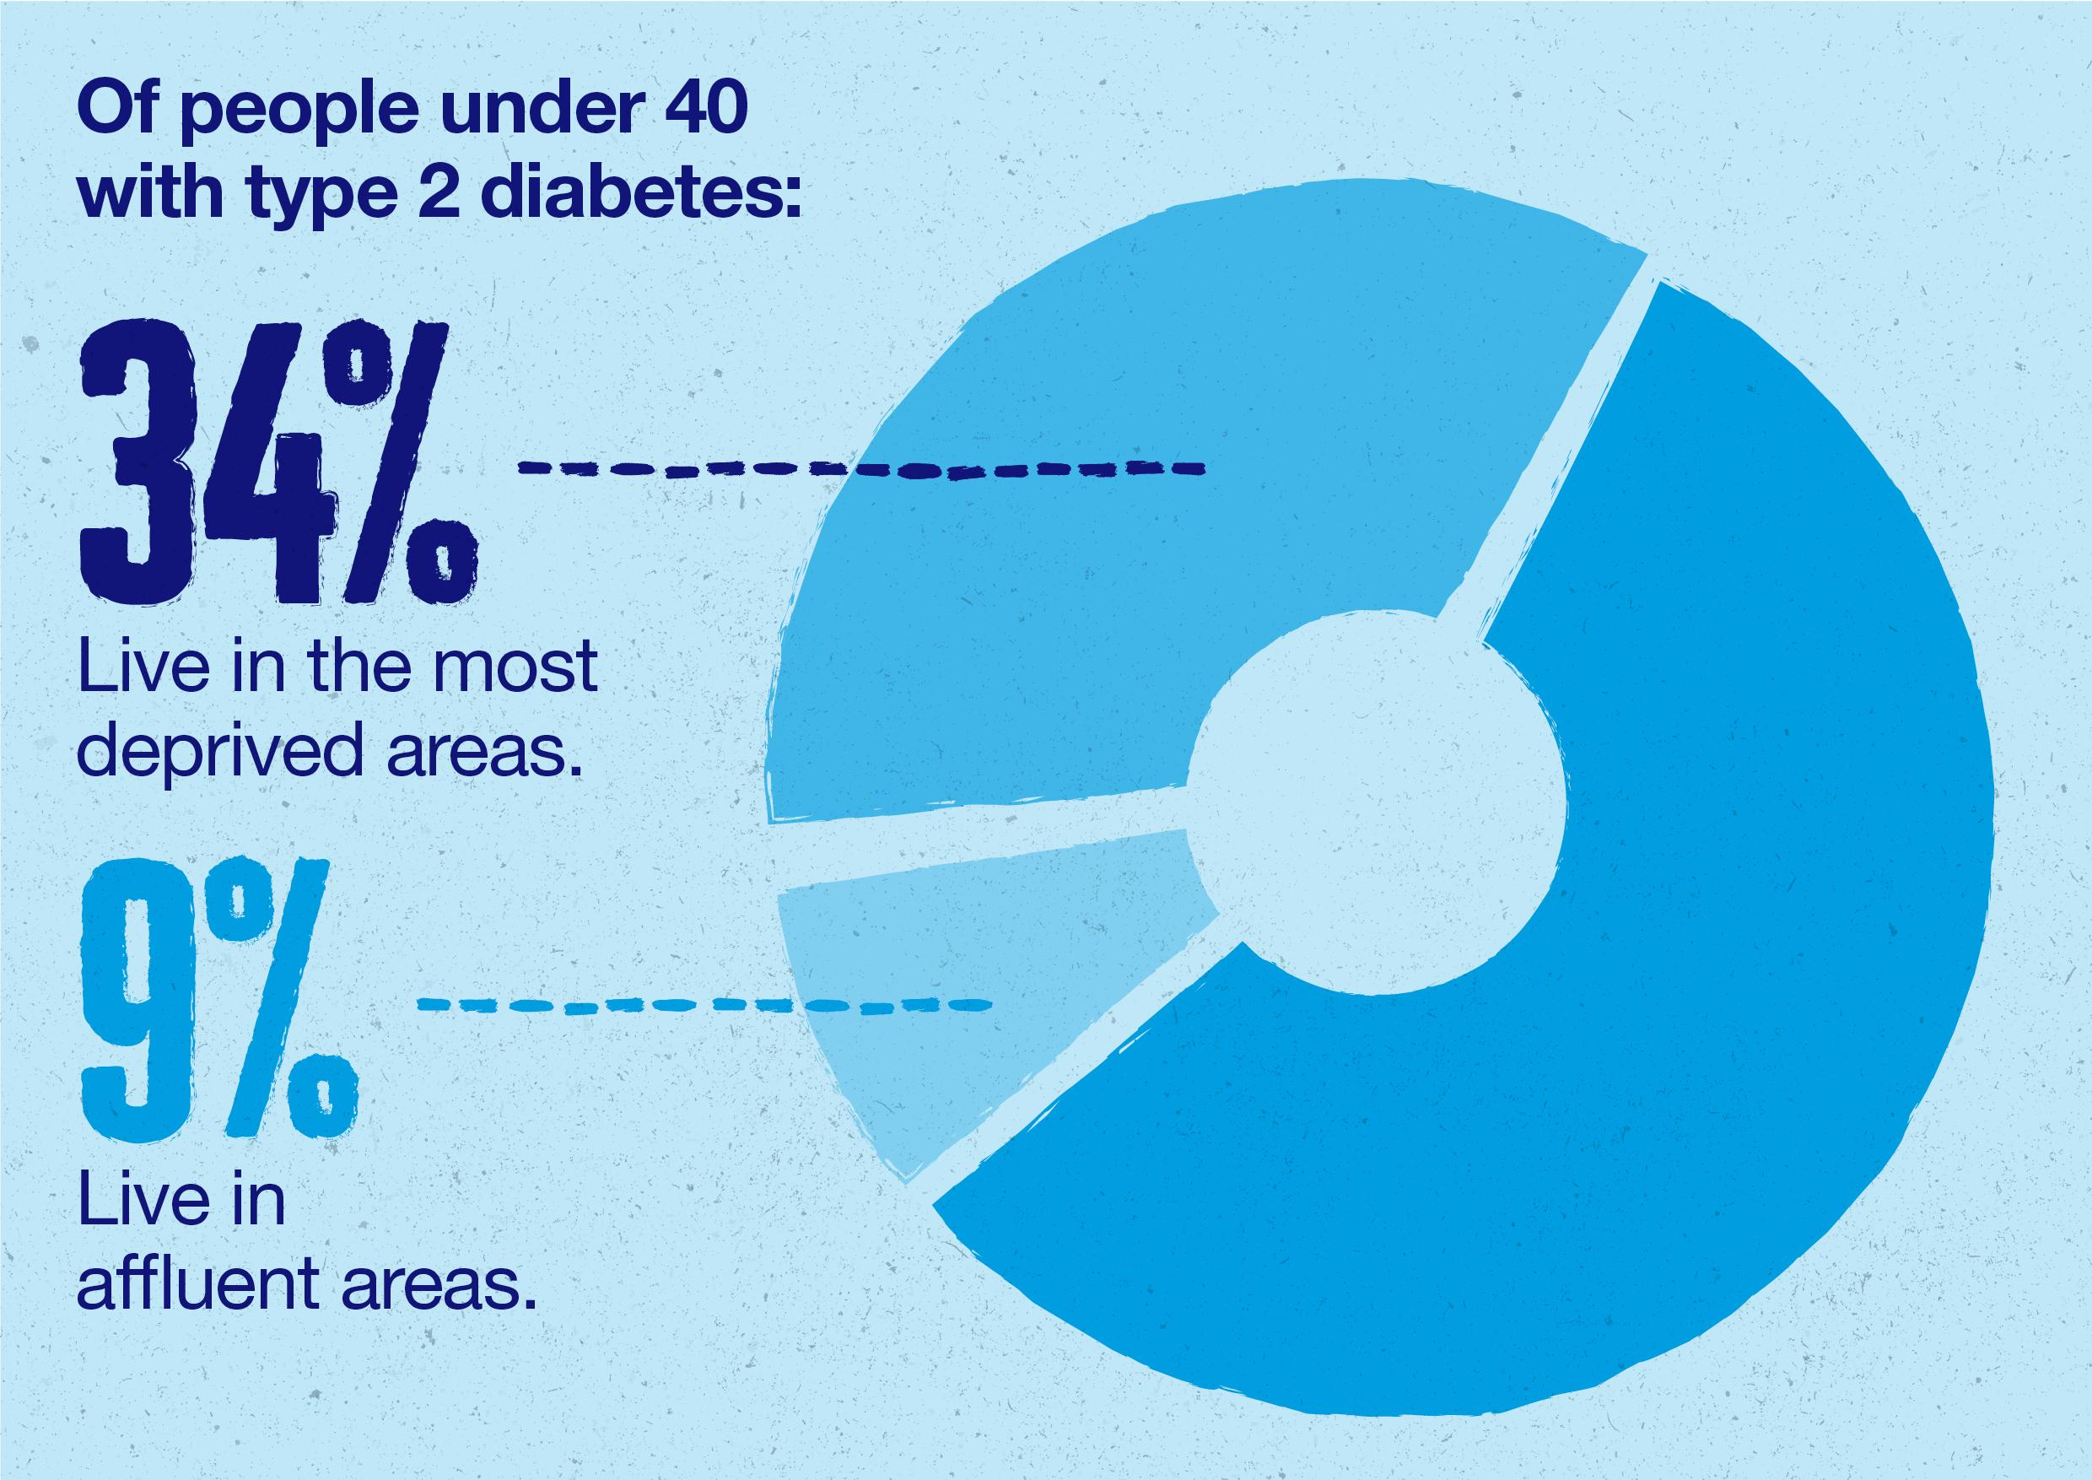
Economic and Social Burden of Type 2 Diabetes
Social burden
Reduced quality of life due to fatigue, pain, visual impairment and mobility limitations (NICE, 2024).
Increased risk of unemployment, social isolation and psychological distress (WHO, 2024).
Disproportionate burden in deprived communities, widening health inequalities (Marmot, 2020).
Community nurses play a key role in reducing avoidable deterioration through preventative and supportive interventions.
Economic burden
NHS England spends approximately £10 billion annually on diabetes care; around 80% is linked to preventable complications (Diabetes UK, 2025).
Costs arise from hospital admissions, medication, wound care, renal replacement therapy and cardiovascular complications (Hex et al., 2012).
Rising prevalence places increasing pressure on community nursing caseloads and primary care resources.

Slide 6
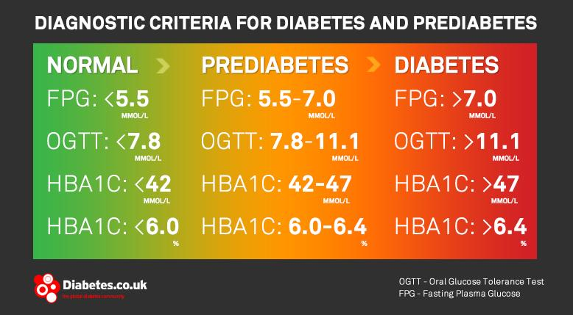

Diagnosis and Initial Assessment of Type 2 Diabetes
Diagnosis
Diagnosis is confirmed through:
HbA1c ≥ 48 mmol/mol (6.5%) (NICE, 2024)
Fasting plasma glucose ≥ 7.0 mmol/L (WHO, 2024)
Oral glucose tolerance test where indicated
Repeat testing may be required if asymptomatic (NICE, 2024)
Initial assessment
Full medical history
Cardiovascular risk assessment
BMI and waist circumference
Blood pressure
Renal function
Foot assessment
Retinal screening referral
Lifestyle assessment
Psychosocial assessment
Community nursing relevance
Early recognition
Opportunistic screening
Home-based assessment
Health education
Care coordination

Slide 7
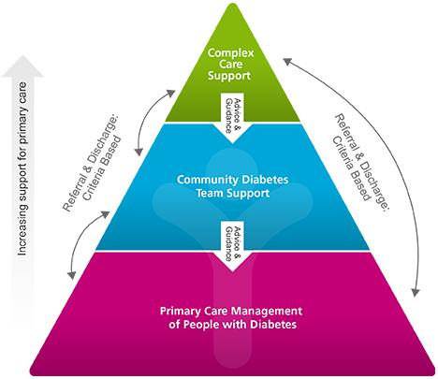
Management of Type 2 Diabetes Following UK Guidance
Management of Type 2 Diabetes in the United Kingdom is guided primarily by National Institute for Health and Care Excellence NG28, which recommends a holistic approach combining glycaemic control, cardiovascular risk reduction, structured education and long-term complication prevention (NICE, 2024)
NHS England (2024) emphasises personalised care and supported self-management as core components of long-term condition management. This reflects a move away from acute episodic treatment towards collaborative, person-centred care.
Community nurses play a central role in monitoring physical health, promoting behavioural change, supporting treatment adherence and coordinating multidisciplinary interventions within primary and community settings. Their continuity of contact enables early intervention and sustained self-management support (NHS England, 2024).
Key components of management
Glycaemic control.
Blood pressure management.
Cholesterol management.
Structured education (DESMOND).
Lifestyle interventions.
Self-management support.
Annual diabetes review.

Slide 8
Treatment Options Available in the UK
Individualised Treatment Approach
Management should be tailored according to glycaemic control, comorbidities, cardiovascular risk and patient preferences (NICE, 2024).
Lifestyle Modification
Weight reduction and increased physical activity remain the cornerstone of treatment; however, sustaining behavioural change is often influenced by wider social determinants of health (Marmot, 2020).
Pharmacological Management
Metformin remains first-line therapy, while SGLT2 inhibitors and GLP-1 receptor agonists are increasingly recommended because of their cardiovascular and renal benefits (NICE, 2024).
Prevention of Complications
Regular retinal screening, foot examinations and kidney monitoring are essential because most diabetes-related expenditure is associated with preventable complications (Diabetes UK, 2025).
Implications for Community Nursing Practice
Effective treatment extends beyond medication management and requires education, self-management support and early intervention to improve long-term outcomes.

Slide 9

Comorbidities Associated with Type 2 Diabetes
Cardio metabolic Conditions
Hypertension, obesity and dyslipidaemia commonly coexist with Type 2 Diabetes and substantially increase cardiovascular risk (NICE, 2024).
Cardiovascular Disease
People with Type 2 Diabetes are at significantly greater risk of coronary heart disease, stroke and heart failure (Diabetes UK, 2025).
Microvascular Complications
Chronic hyperglycaemia contributes to diabetic nephropathy, retinopathy and peripheral neuropathy, which are major causes of disability (WHO, 2024).
Psychological Comorbidities
Diabetes distress, depression and anxiety are more prevalent among people living with Type 2 Diabetes and can adversely affect self-management and treatment adherence (Diabetes UK, 2024).
Implications for Community Nursing Practice
Multimorbidity increases the complexity of care and requires holistic assessment, multidisciplinary working and personalised care planning.

Slide 10
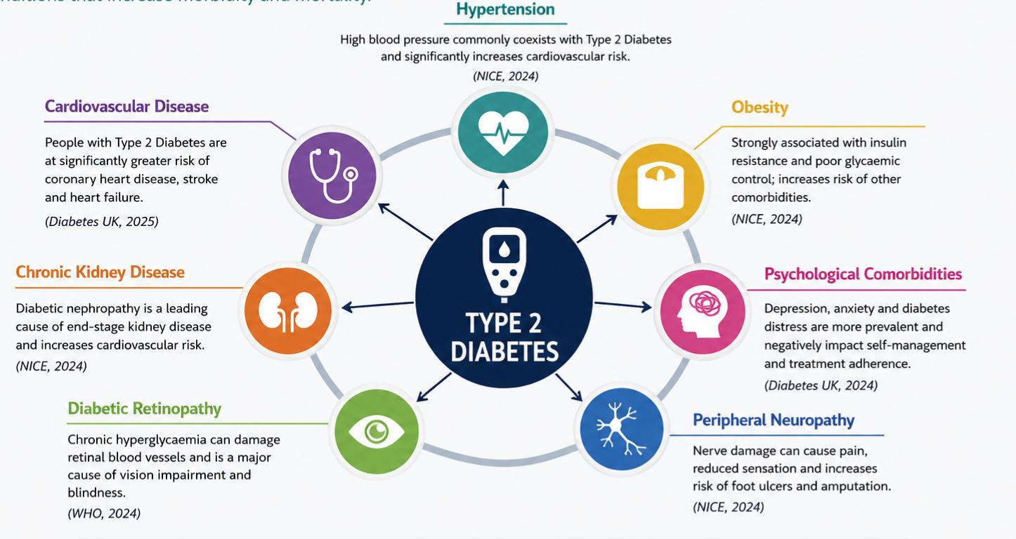
Comorbidities Associated with Type 2 Diabetes

Slide 11
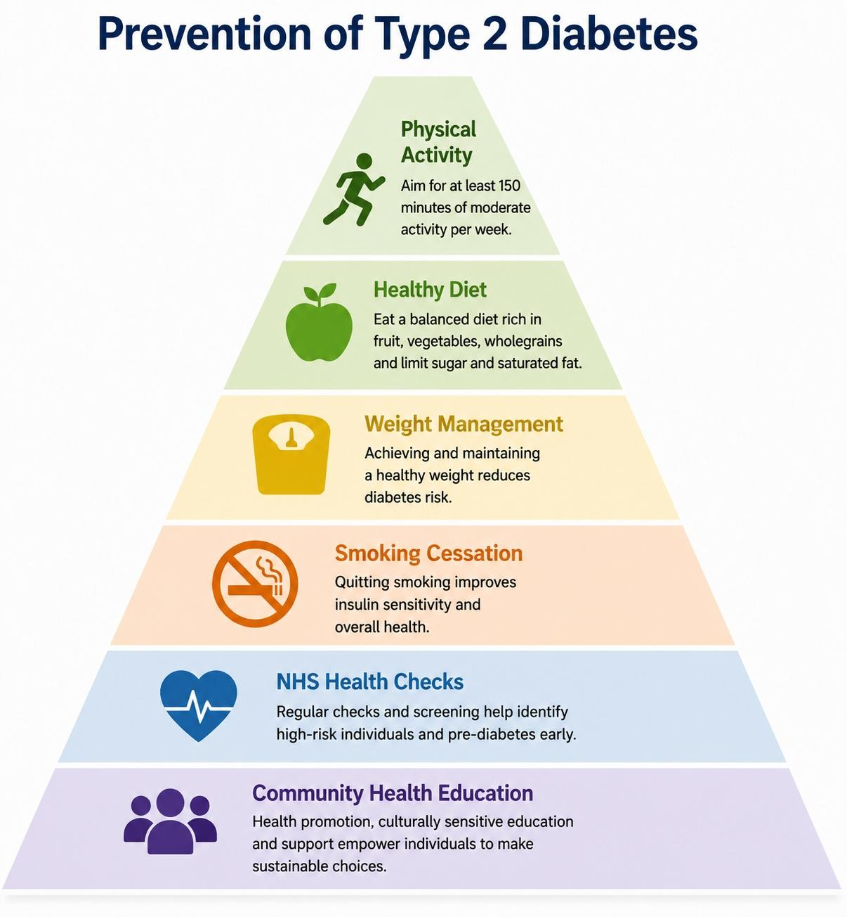
Prevention of Type 2 Diabetes
Primary Prevention
Healthy eating, weight management and regular physical activity can significantly reduce the risk of developing Type 2 Diabetes.
Early Identification and Risk Reduction
NHS Health Checks and screening of high-risk individuals enable earlier intervention and identification of pre-diabetes.
Implications for Community Nursing Practice
Community nurses play a key role in health promotion, opportunistic screening and supporting sustainable behaviour change.
NHS Diabetes Prevention Programme
Evidence demonstrates that structured lifestyle interventions can reduce progression from pre-diabetes to Type 2 Diabetes.
Addressing Health Inequalities
The risk of Type 2 Diabetes is disproportionately higher among deprived and some ethnic minority populations, highlighting the importance of targeted prevention strategies (Marmot, 2020).

Slide 12
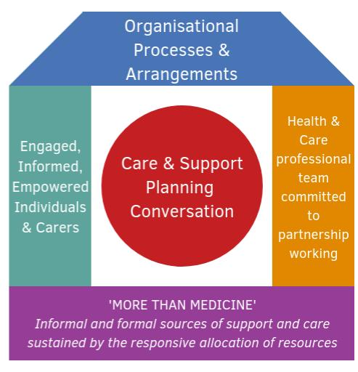
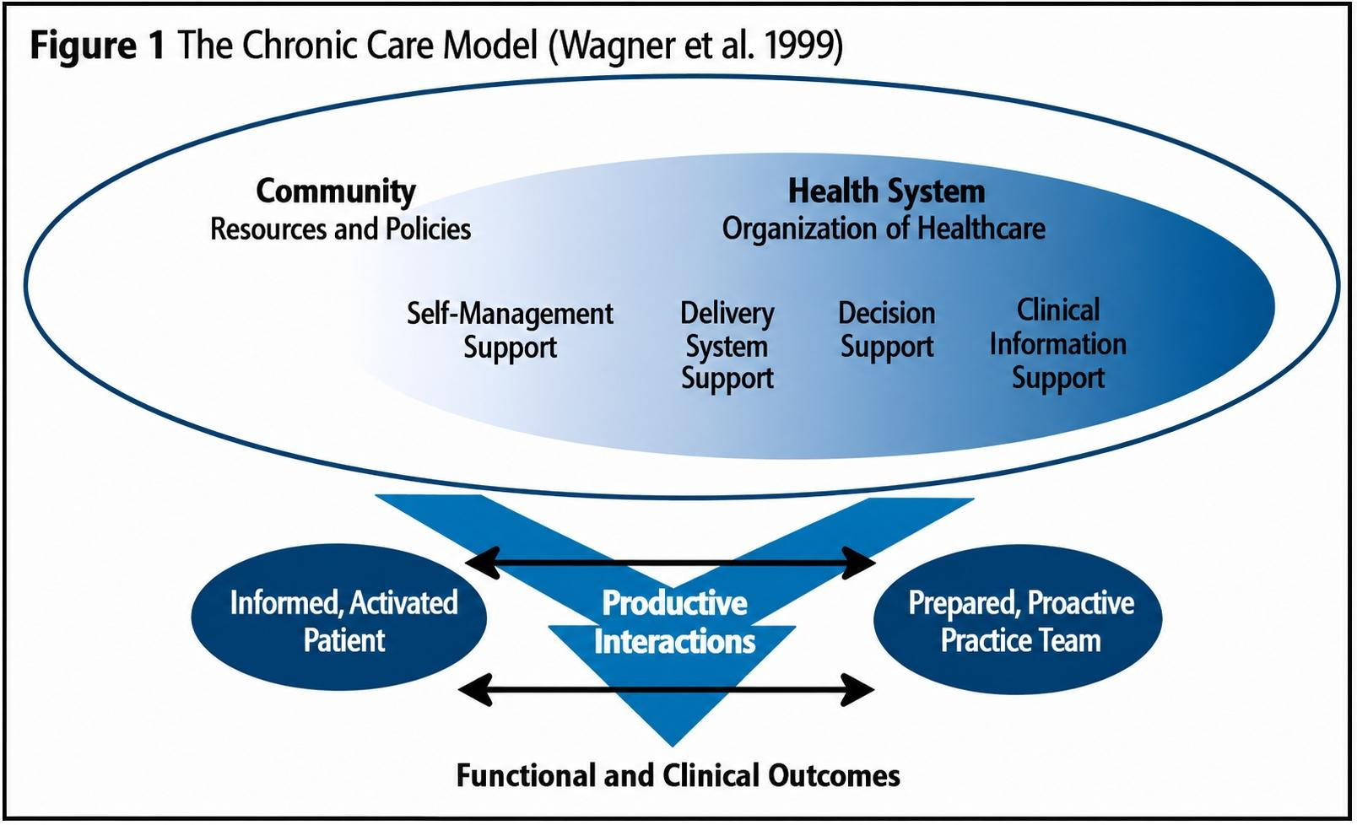
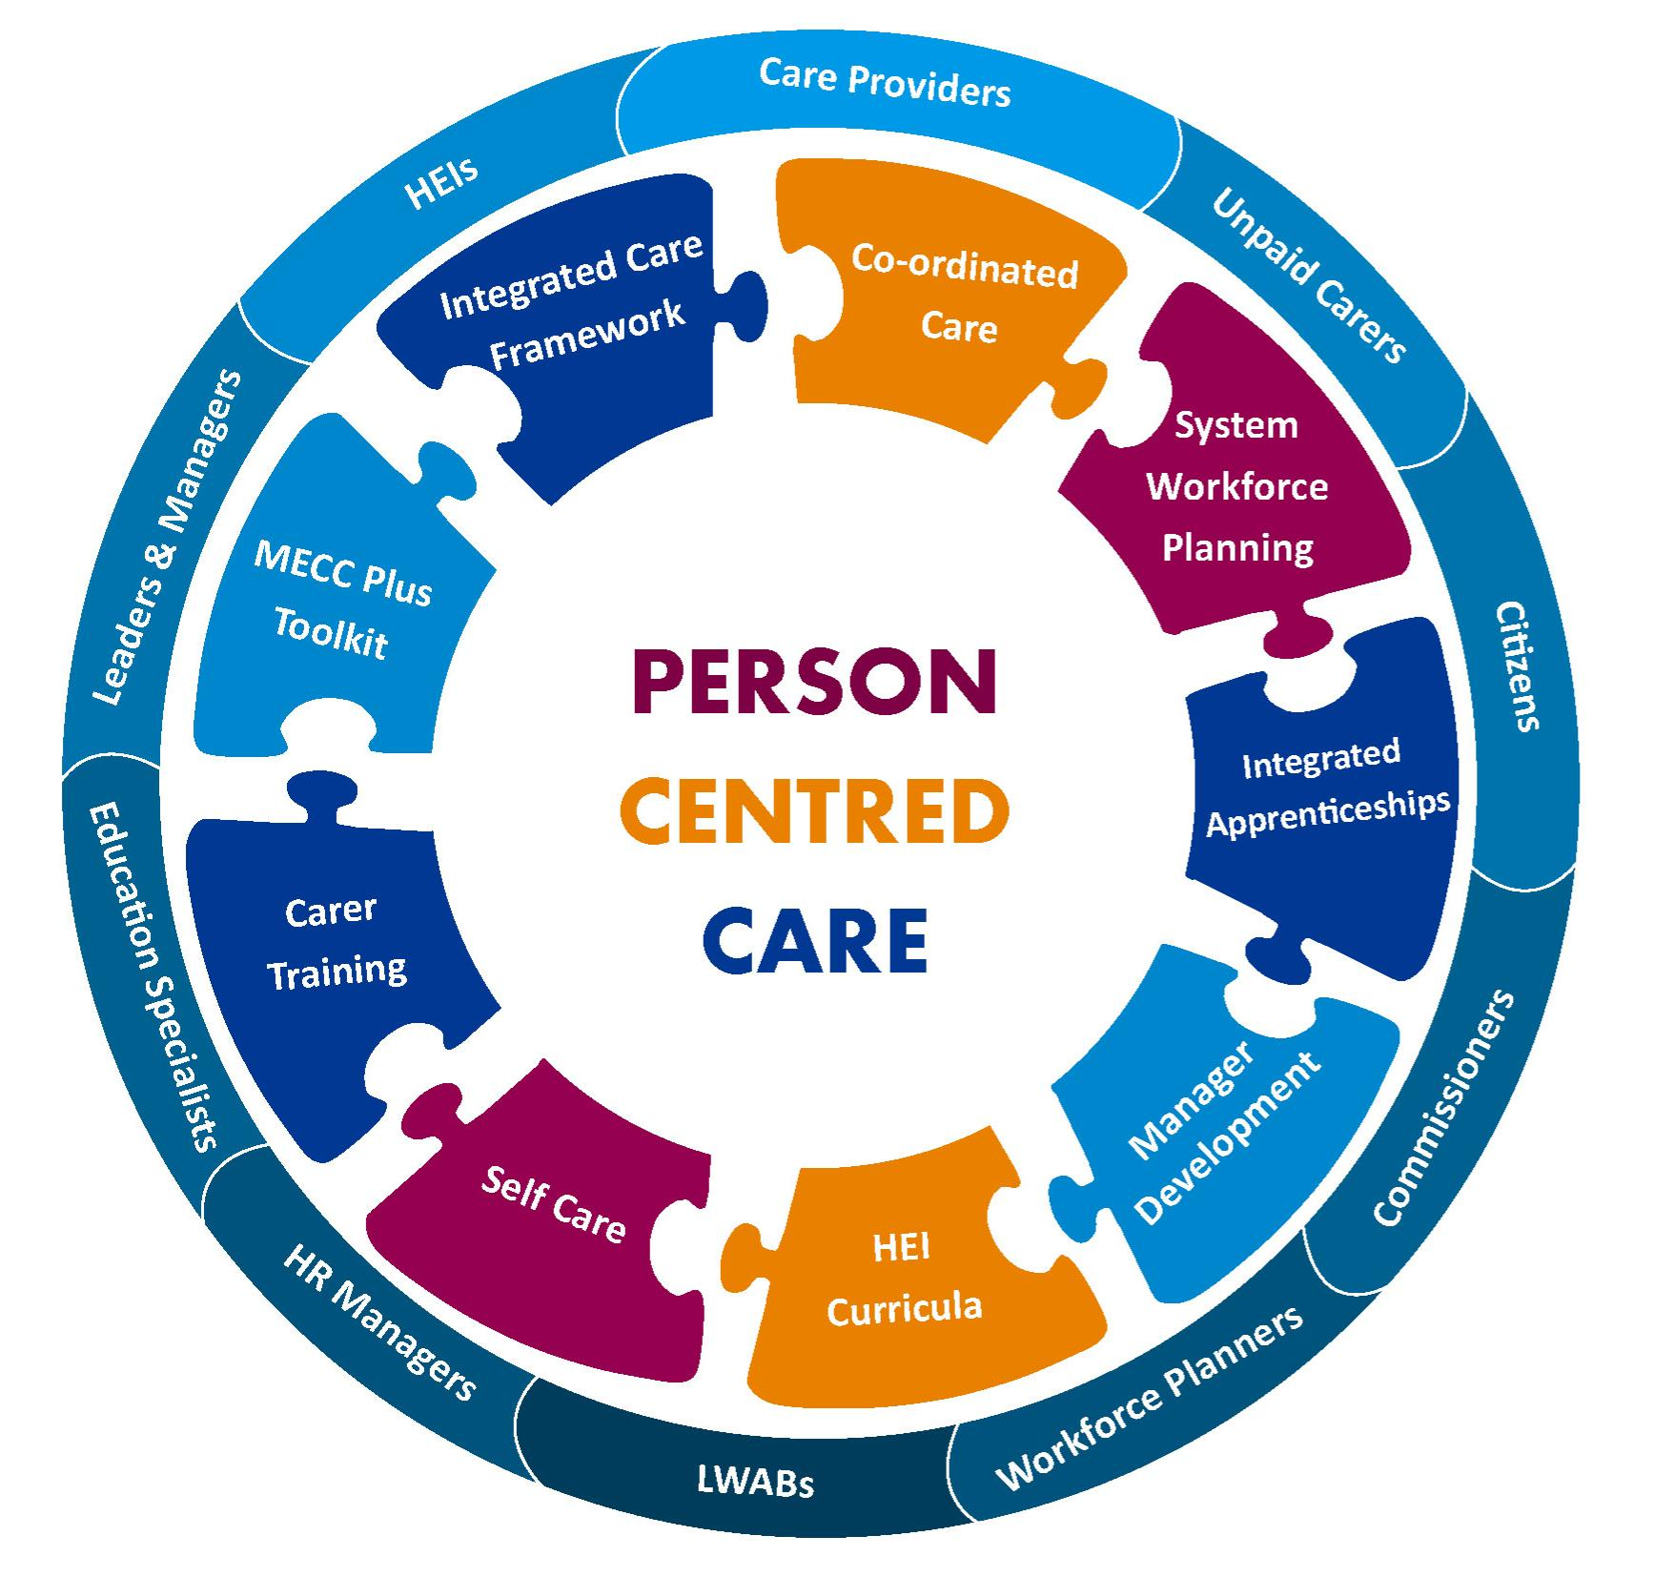
Models and Frameworks to Improve Outcomes
House of Care
↓
Empowered patient & collaborative care planning
House of Care Model
Promotes collaborative care planning by placing an informed and activated patient at the centre of care (NHS England, 2016).
Chronic Care Model
Emphasises self-management support, multidisciplinary working and proactive care to improve long-term outcomes (Wagner et al., 2001).
Chronic Care Model
↓
Proactive multidisciplinary management
Comprehensive Model of Personalised Care
Advocates shared decision-making and personalised support planning to improve patient activation and self-management (NHS England, 2019).
Critical Perspective
No single model is sufficient in isolation; effective diabetes management requires integration of personalised care, behavioural support and multidisciplinary collaboration.
Implications for Community Nursing Practice
Community nurses are well positioned to operationalise these frameworks through continuity of care, health coaching and care coordination.
Personalised Care Model
↓
Shared decision-making & self-management
"Integrated implementation of these models may improve patient activation, treatment adherence and long-term outcomes."
(NHS England, 2019; Wagner et al., 2001).

Slide 13
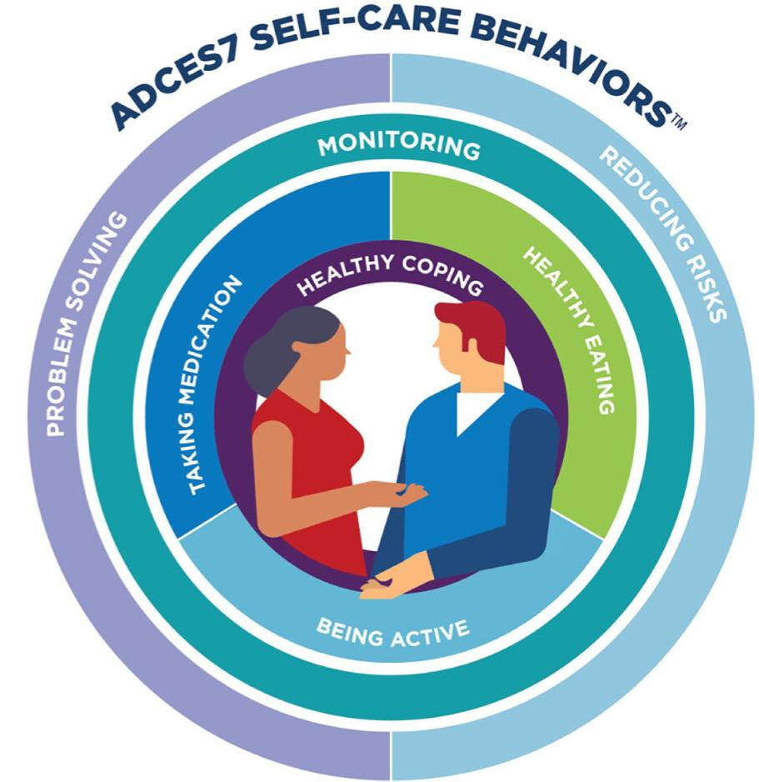
Skills, Values and Behaviours Required for Co-productive Care
Co-productive Care in Type 2 Diabetes
Essential Skills
Effective communication and active listening
Motivational interviewing and health coaching
Shared decision-making
Clinical assessment and critical thinking
Professional Values
Compassion, empathy and respect
Cultural competence and inclusivity
Person-centred practice
Professional Behaviours
Partnership working
Advocacy
Reflective practice
Collaborative multidisciplinary working
Critical Evaluation
Traditional clinician-led care can reduce patient engagement. Co-production empowers individuals to become equal partners in decision-making, improving self-management, adherence and long-term outcomes (NHS England, 2019).

Slide 14
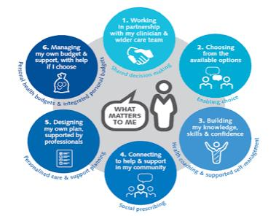
Applying the Comprehensive Model of Personalised Care in Type 2 Diabetes
Recommendation for Community Nursing
Integrating all six components into routine community nursing practice may improve patient activation, reduce avoidable complications and support equitable, person-centred care.
(NHS England, 2019)
Shared Decision-Making
Treatment decisions should be made collaboratively to improve engagement and adherence.
Personalised Care and Support Planning
Care plans should reflect individual goals, comorbidities, cultural needs and lifestyle circumstances.
Supported Self-Management
Education, health coaching and digital technologies empower individuals to confidently manage their condition.
Social Prescribing
Connecting people with community resources can address wider determinants of health, including social isolation, financial hardship and physical inactivity.
Personal Health Budgets and Choice
Where appropriate, greater choice and personalised support can improve autonomy and patient experience.

Slide 15
Key Take-Home Messages
Overall, the evidence presented throughout this review suggests that effective Type 2 Diabetes management requires more than intensifying pharmacological treatment. Instead, integrating personalised care, preventative strategies and co-productive approaches may improve self-management, reduce health inequalities and optimise long-term outcomes (NICE, 2024).
Type 2 Diabetes is a growing public health challenge
The increasing prevalence of Type 2 Diabetes continues to place significant clinical and financial pressure on NHS services, particularly within primary and community care (Diabetes UK, 2025).
Early intervention improves outcomes
Early diagnosis, evidence-based treatment and proactive management can delay disease progression and reduce preventable complications (NICE, 2024).
Community nurses are central to long-term diabetes management
Community nurses play a pivotal role in health promotion, care coordination, patient education and supporting self-management across the disease trajectory (NHS England, 2024).
Person-centred and co-productive care should underpin practice
Integrating personalised care, shared decision-making and multidisciplinary collaboration is fundamental to improving patient activation, reducing health inequalities and achieving sustainable long-term outcomes (NHS England, 2019).
Within community nursing practice, this places nurses at the centre of delivering holistic, evidence-based and person-centred care that empowers individuals to become active partners in managing their long-term condition.

Slide 16
References
Barlow, J., Wright, C., Sheasby, J., Turner, A. and Hainsworth, J. (2002) 'Self-management approaches for people with chronic conditions: a review', Patient Education and Counseling, 48(2), pp. 177–187.
Coulter, A. and Oldham, J. (2016) 'Person-centred care: what is it and how do we get there?', Future Hospital Journal, 3(2), pp. 114–116.
Diabetes UK (2025) Diabetes statistics in the UK. Available at: https://www.diabetes.org.uk/about-us/about-the-charity/our-strategy/statistics (Accessed: 03 July 2026).
Diabetes UK (2025) The cost of diabetes. Available at: https://www.diabetes.org.uk/about_us/news_landing_page/diabetes-costs-the-nhs (Accessed: 04 July 2026).
Elwyn, G., Frosch, D., Thomson, R., Joseph-Williams, N., Lloyd, A., Kinnersley, P., Cording, E., Tomson, D., Dodd, C., Rollnick, S., Edwards, A. and Barry, M. (2012) 'Shared decision making: a model for clinical practice', Journal of General Internal Medicine, 27(10), pp. 1361–1367.
Hex, N., Bartlett, C., Wright, D., Taylor, M., Varley, D. and Bloor, K. (2012) 'Estimating the current and future costs of Type 1 and Type 2 diabetes in the UK, including direct health costs and indirect societal and productivity costs', Diabetic Medicine, 29(7), pp. 855–862.
Holman, R.R., Paul, S.K., Bethel, M.A., Matthews, D.R. and Neil, H.A.W. (2008) '10-year follow-up of intensive glucose control in Type 2 diabetes', The New England Journal of Medicine, 359(15), pp. 1577–1589.
International Diabetes Federation (2025) IDF Diabetes Atlas. 11th edn. Brussels: International Diabetes Federation. Available at: https://diabetesatlas.org (Accessed: 02 July 2026).
Lean, M.E.J., Leslie, W.S., Barnes, A.C., et al. (2018) 'Primary care-led weight management for remission of Type 2 diabetes (DiRECT): an open-label, cluster-randomised trial', The Lancet, 391(10120), pp. 541–551.
Marmot, M., Allen, J., Boyce, T., Goldblatt, P. and Morrison, J. (2020) Health Equity in England: The Marmot Review 10 Years On. London: Institute of Health Equity. Available at: https://www.instituteofhealthequity.org/resources-reports/marmot-review-10-years-on (Accessed: 28 June 2026).

Slide 17
Michie, S., Atkins, L. and West, R. (2014) The Behaviour Change Wheel: A Guide to Designing Interventions. London: Silverback Publishing.
National Institute for Health and Care Excellence (2024) Type 2 diabetes in adults: management (NG28). Available at: https://www.nice.org.uk/guidance/ng28 (Accessed: 01 July 2026).
NHS England (2016) The House of Care Framework. Available at: https://www.england.nhs.uk/ourwork/clinical-policy/house-of-care/ (Accessed: 27 June 2026).
NHS England (2019) The Comprehensive Model of Personalised Care. Available at: https://www.england.nhs.uk/personalisedcare/comprehensive-model-of-personalised-care/ (Accessed: 28 June 2026).
NHS England (2024) NHS Diabetes Prevention Programme. Available at: https://www.england.nhs.uk/diabetes/treatment-care/diabetes-prevention/ (Accessed: 8 July 2026).
NHS England (2024) Personalised care and supported self-management. Available at: https://www.england.nhs.uk/personalisedcare/ (Accessed: 02 July 2026).
Nursing and Midwifery Council (2018) The Code: Professional Standards of Practice and Behaviour for Nurses, Midwives and Nursing Associates. London: NMC. Available at: https://www.nmc.org.uk/standards/code/ (Accessed: 8 July 2026).
Powers, M.A., Bardsley, J., Cypress, M., et al. (2020) 'Diabetes self-management education and support in adults with Type 2 diabetes: a consensus report', Diabetes Care, 43(7), pp. 1636–1649.
Wagner, E.H., Austin, B.T., Davis, C., Hindmarsh, M., Schaefer, J. and Bonomi, A. (2001) 'Improving chronic illness care: translating evidence into action', Health Affairs, 20(6), pp. 64–78.
World Health Organization (2024) Diabetes. Available at: https://www.who.int/news-room/fact-sheets/detail/diabetes (Accessed: 01 July 2026).

