Slide 1

LCHS-4007: Digital Skills & Research Methods
Group Members :
Mohammed Basharat (2604365)
Mahek Haroon (2605099)
Subhan Slehry (2604233)
Lecturer : Ihsan Ul Haq
Staff scheduling/rotas and visits​: Excel

Slide 2

Outline
In this presentation we have decided to choose staff scheduling/Rota as a workplace task, and our chosen tool will be Microsoft excel.
Chosen workplace task involves
Which Microsoft 365 tool we selected
Presented by Mohammed Basharaat
Why this tool is suitable for the task
How it improves efficiency or communication
Presented by Mahek Haroon.
Advantages and limitations of using the chosen tool.
Recommend how Ashford can implement these changes.
Presented by Subhan Slehry.

Slide 3

What their chosen workplace task involves
Below is a list of what staff scheduling and rotas entail:
Balancing staff,
Staff availability,
Shift's spread out equally,
Staff on holiday,
Staff off sick,
Staff payroll,
7.Not over staffed on any one shift,
8. Staff breaks, Rest, Days off.

Slide 4
Which Microsoft 365 tool they selected
We have chosen Microsoft Excel for this task. There are number of benefits of using this tool. Below are some of the bullet points of why we have chosen Excel.
It can handle data.
Excel is a good tool because you can write and do diagrams.
You can add, delete & change on a day-to-day basis.
With excel you can make visiting time slots.

Slide 5
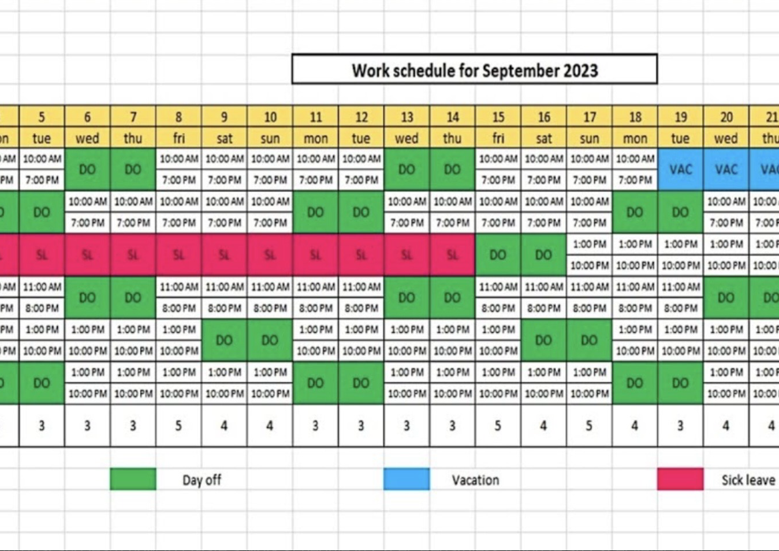
Why Microsoft excel is suitable.
Excel allows staff rotas to be organised in clear table.
Staff names ,dates , times, and visits can be added easily.
Managers can quickly update the rota changes happen.
Different shifts and visits can be organised in one place.
The rota can be shared with authorised staff.
This helps staff know their working times and scheduled visits.

Slide 6

How excel improves efficiency and communication.
Excel saves time by keeping staff schedules in one place.
It helps staff see their shifts and visits clearly.
It makes it easier to share information with other staff.
Staff can quickly see when changes are made.
It helps reduce mistakes and confusion.
It improves communication between staff and managers.

Slide 7
Advantages and limitations of using the chosen tool
There are many pros and cons of using excel. In this slide we will explore the advantages and limitations of using Microsoft Excel. Below is a table of the advantages and limitations of using Microsoft Excel.
Advantages
Limitations
Easy data organisation
Data visualisation
Collaboration and integration
Universal relevance
No prior training
Easy tutorials and help page
Web limitations
Inttergration issues
Performance limits
Steep learning curve

Slide 8

Advantages of Microsoft Excel
Microsoft excel is crucial for businesses to keep track of data. It is a tool designed to help people to analyse data and to do calculations in there business. We have chosen Excel because with the data of staff scheduling it can give a business an analytical point of view.
Any person can also use Excel, which is why it is a great tool to have. According to Kaplan article it state that ' Excel is used across industries because of its flexibility and practicality It supports a wide range of use cases, making it valuable for both specialist and non-specialist roles. Kaplan (2019) This suggests, that it is easy access to everyone and anyone.

Slide 9
Ashford community care service
Ashford community care service can use Excel to support the management and administrative team. The case study suggests that they would like to improve communication, they can do this with Excel as they can share and collaborate with other team members to make changes to the spreadsheet. As a result of this, this would mean team members and leaders can all have the same spreadsheet to look at.
They can use this microsoft tool to improve the effectiveness of staff rotas, they can plan days off, and holiday entitlements, because the tool also has the ability to do sums. Which makes it effective with time management, and teams don’t have to do any calculations.
Ashford can also implement this by having certain teams assigned to different spreadsheets, as the case study it states that there is a team of support workers, nurses, care coordinators and other health and social care professionals.

Slide 10
References
Employment Hero (2025) Work rotas: UK shift management laws and best practices. Available at: https://employmenthero.com/uk/resources/work-rotas-best-practices/ (Accessed: 05 October 2026).
Samel, M. (2025) ‘Work rotas law UK: Shift pattern notice & other laws (2025 update)’. PARiM. Available at: https://www.parim.co/blog/work-rotas-law-uk (Accessed: 05 October 2026).
The Access Group (n.d.) Working time regulations and rota compliance in UK hospitality. Available at: https://www.theaccessgroup.com/en-gb/blog/hos-working-time-regulations-and-rota-compliance-in-uk-hospitality/ (Accessed: 05 October 2026).
Acas (n.d.) Working time and rest. Available at: https://www.acas.org.uk/working-time-and-rest (Accessed: 11 October 2026).
Corporate Vision News (n.d.) An easy guide to work rota laws. Available at: https://www.corporatevision-news.com/an-easy-guide-to-work-rota-laws (Accessed: 07 October 2026).

Slide 11
References
Kaplan (2019) Is Microsoft Excel still relevant? Available at: https://kaplan.co.uk/blog/digital-skills/is-microsoft-excel-still-relevant (Accessed: 07 October 2026).

