Slide 1
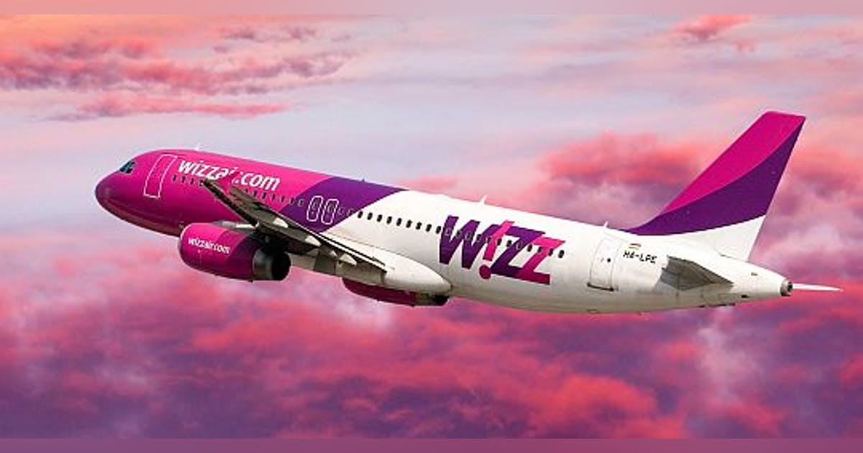
Wizz Air company before and during Covid 19 pandemic
Module: Academic skills - LCBB401
Group 2 : Carmen-Ioana Hodoroaba
Vasilica Curea
Alexandra Maria Cristea
Florin Daniel Baleanu

Slide 2
Wizz-Air airline background
The name of Wizz Air Company is Wizz Air Hungary Ltd.
It is developed as well as stylized as Wizz Air.
The main office of Wizz Air is in Budapest, Hungary.
It is one of the most affordable and low cost airline

Slide 3
Wizz airline was established on September 2003.
The major role of its development is done by American private equity organization named Indigo Partners.
The first ever flight of Wizz airline was made from Katowice International airport in 2004.
The current CEO of WIZZ airline is named József Váradi.
József Váradi played major role for the development of Wizz airline and he took this airline on the path of success (Suchodolska, 2020).

Slide 4
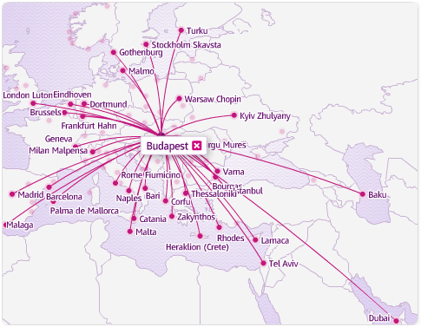
Wizz-Air destinations
Notes:
Wizz Airline has a network of flights in many cities across Europe.
Wizz Airline also offers its services to Middle East and North Africa.
The current approach of Wizz Airline and its services are in 44 countries.
The largest base of Wizz Airline is in Budapest.
The airplanes of Wizz Airline flies to about 164 airports (TUCKI, PANTYLEY, DĘBICKI, & VIEGA, 2019).

Slide 5
Pre-Covid 19 period of Wizz-Air company
Flight delays and change in timing etc.
In 2019, there was a movement “flight shame”
Wizz air condemned this movement and ensure its passengers regarding timely flights (Albers, & Rundshagen, 2020).
Notes:
Before the covid-19 came, Wizz airlines were facing minor issues such as flight delays and change in timing etc. however, in 2019, there was a movement ran against Wizz airlines named “flight shame”. The purpose of the movement was to defame the organization. Wizz air condemned this movement and ensure its passengers regarding timely flights.

Slide 6
The situation before COVID-19 was considered as very smooth going for Wizz-Air as they achieved many milestones.
Wizz Airlines also partner up with other airlines for their mutual benefits
In November 2020, Wizz Air showed the lowest CO₂ emission per passenger.
Wizz Airlines were efficient enough for fuel-saving fligts as they were using advanced technologies (Madar, 2018).

Slide 7
In March 2019, Wizz airlines fleet to 112 aero planes and took delivery of first two A321neo aircrafts, which represents about 41 percent total capacity of organization`s seats.
A321neo aircraft is 50 percent more environment friendly and it provides environmental benefits (Shkurat, & Zavydovska, 2020).
The focus of cleaning the environment was more than ever by Wizz airlines in 2019.

Slide 8
Wizz-Air airline during Covid 19 and it's effects
In early 2020, the Wizz airline take a sudden blow by COVID-19 as they have to shut their operations.
Wizz Air have to gradually force their aircrafts to stop flying as well as sudden landing occurs between flights.
The sponsors and business partners also faced severe loss in the pandemic situations (Pilat, et al., 2018, August).
Wizz airline decrease their prices but they could not prevent the disastrous situation caused by Covid-19 (Popa, 2019)
The sales of tickets stopped in 13 June 2021 (Suchodolska, 2020).

Slide 9
Wizz-Air took delivery of A330-200F freight aircraft in October 2020 which supposed to be operated on behalf of Hungarian government.
Notes:
After the third wave of COVID-19, the CEO of Wizz airlines expected that the situation may be restored by 2024-2025.
The CEO of Wizz Airline was hopefull regarding the loss recovery of the organization.
The Wizz airlines carries highest liquidity in entire airline industry which can help it getting back on track.

Slide 10
Wizz-Air in 2021
Wizz air provides focus and attention towards airport construction and development in 2021
On 3 February 2021, Wizz airline opens its second airbase in Herzegovina and Bosnia.
Wizz airlines announced nine new locations from where flight departures will start.
In April 2021, Wizz airlines started their services at Abu Dhabi (TUCKI, PANTYLEY, DĘBICKI, & VIEGA, 2019).

Slide 11
General overview of Wizz Airline
The current office of Wizz airlines are in Budapest
The airline employed the space of over 2,000 square metres (22,000 sq ft)
In the main office, Wizz airline have over 150 employees.
There is proper monitoring system within the main office (Tłoczyński, 2019)

Slide 12
Wizz airlines focuses on providing better facilities to its passengers
Always remained cost effective.
The company gives value for money services
They serve quality meals in the flights (Proszowska, 2017).
Notes:
Taking more about wiz airlines, I will say Wizz airlines focuses on providing better facilities to its passengers. They also remained cost effective. Wizz airlines gives value for money services. They serve quality meals in the flights.

Slide 13
Wizz airline uses secondary airports for their flights in Europe
Wizz prefers landing on smaller airports
There is a shopping centre in Wizz called Wizz boutique.
The rate of calling customer care of Wizz is 0.95 EUR (Sebrek, & Váradi, 2019).
Notes:
Continuing the presentation, I will talk more about wiz airline. Wiz airline uses secondary airports for their flights in Europe. Wiz prefers landing on smaller airports. There is a shopping centre in wiz called wiz boutique. The rate of calling customer care of Wiz is 0.95 EUR.

Slide 14
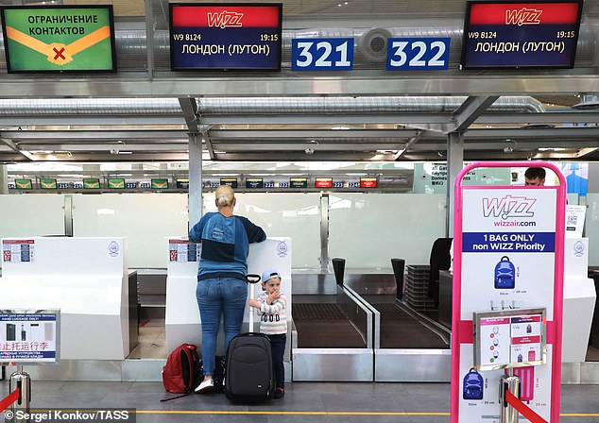
Wizz-Air check-in
Notes:
There is discount for check-in at Wizz airlines
Customers can pre-book their flight online through Wizz-Air website or partner’s agencies
The booking costs varies from 10 EUR to 30 EUR.
The option of flight cancel is also available for passengers (Tobisová, & Vajdová, 2018).

Slide 15
Conclusion
Wizz Air is one of the most affordable and low cost airline
During Covid 19 there were flight delays and change in timing
They provide focus and attention towards airport construction and development in 2021
Always remained cost effective.

Slide 16
References
Tobisová, S. M. S. S. A., & Vajdová, M. P. Ľ. S. I. (2018). WIZZ AIR CABIN CREW TRAINING. CER Comparative European Research 2018.
Sebrek, S. S., & Váradi, A. (2019). Letettük a névjegyünket! Dinamikus képesség a vállalati növekedés szolgálatában–a Wizz Air esete. Vezetéstudomány-Budapest Management Review, 50(6), 48-62.
Szabo, S., Pilat, M., Mako, S., Hanak, P., & Tobisova, A. Wizz Air Operation Analysis at Kosice International Airport.
Proszowska, S. (2017). Rozpoznawalność wizerunku firmy na przykładzie linii lotniczej Wizz Air.
Tłoczyński, D. (2019). The competitive position of the low cost carrier Wizz Air on the Polish market of air transport services. Transport Economics and Logistics, 76, 65-76.
Pilat, M., Mako, S., Szabo, S., Tobisová, A., Hanák, P., Socha, L., & Rozenberg, R. (2018, August). Wizz Air cancels the base in Košice despite a minimum of 80% occupancy of flights to four destinations. In 2018 XIII International scientific conference-new trends in aviation development (NTAD) (pp. 100-104). IEEE.
Pilát, M., SZABO, S., MAKO, S., & FERENCOVA, M. Market segmentation in air transportation in Slovak republic. Acta Avionica, 32-36.
Suchodolska, E. (2020). Działania na rzecz zrównoważonego rozwoju, jako metoda uzyskania przewagi konkurencyjnej w sektorze lotniczym. Analiza na podstawie działalności Ryanair i Wizz Air w latach 2017-2019.
Popa, I. C. (2019). Competition in Air Transport Services in the Liberalized Market in Romania. Ovidius University Annals, Economic Sciences Series, 19(2), 567-571.
Рублев, В. В. ПЕРСПЕКТИВЫ РАЗВИТИЯ ВЕНГЕРСКОЙ БЮДЖЕТНОЙ АВИАКОМПАНИИ «WIZZ AIR» В УСЛОВИЯХ МАКРОЭКОНОМИЧЕСКОЙ НЕСТАБИЛЬНОСТИ. Вестник Алтайской академии экономики и права, 201.

Slide 17
References
Albers, S., & Rundshagen, V. (2020). European airlines′ strategic responses to the COVID-19 pandemic (January-May, 2020). Journal of air transport management, 87, 101863.
Madar, A. (2018). RYANAIR IS LOOKING FOR NEW SOLUTIONS TO COPE WITH THE COMPETITION. Bulletin of the Transilvania University of Brasov. Economic Sciences. Series V, 11(2), 95-102.
Zaušková, M. V. M. K. A. THE AIRLINES COMMUNICATING THROUGH SOLOMO PLATFORMS DURING THE COVID-19 PANDEMIC.
Gúčik, M., Vetráková, M., & Marciš, M. (2018). The Role of Slovak Airports in Tourism Development. In MATEC Web of Conferences (Vol. 236, p. 02008). EDP Sciences.
Endrizalova, E., Novak, M., Nemec, V., Hyrslova, J., & Mrazek, P. (2018). Operating Lease As a Specific Form of Airlines Outsourcing. Business Logistics in Modern Management.
Ionuț-Claudiu, P. O. P. A. (2019). THE INFLUENCE OF THE PERSONNEL MANAGEMENT IN THE AIRLINE COMPANIES ON THEIR FINANCIAL COORDINATES. Defense Resources Management in the 21st Century, 14(14), 210-216.
Shkurat, M., & Zavydovska, A. (2020). THE INFLUENCE OF THE ACTIVITIES OF INTERNATIONAL LUCOST AIRLINES ON THE DEVELOPMENT OF THE AIR MARKET OF UKRAINE. Друкується за рішенням Вченої Ради ДонНУ імені Василя Стуса (протокол № 6 від 11.12. 2020 р.), 168.
TUCKI, A., PANTYLEY, V., DĘBICKI, R., & VIEGA, A. (2019). Problems and Perspectives of LCC in Europe. Case Study: Poland and Portugal. Annales UMCS, Geographia, Geologia, Mineralogia et Petrographia, 74.
Bernáthová, S., Čekan, P., Džunda, M., Szabo, S., Makó, S., & Horvath, A. (2020, September). Impact of global pandemic COVID-19 on Air Transport in Slovakia in the Period from March to June 2020. In 2020 New Trends in Aviation Development (NTAD) (pp. 24-27). IEEE.
Mgoec, D. R., & Droec, R. Š. (2019). ASSESSMENT OF JSC AIR BALTIC CORPORATION COMPETITIVENESS IN THE BALTIC STATES. Acta Prosperitatis, (10), 87-158.

