Slide 1

Expressive Arts: Statements of what matter; Expressive Arts: Introduction - Hwb (gov.wales)

Slide 2
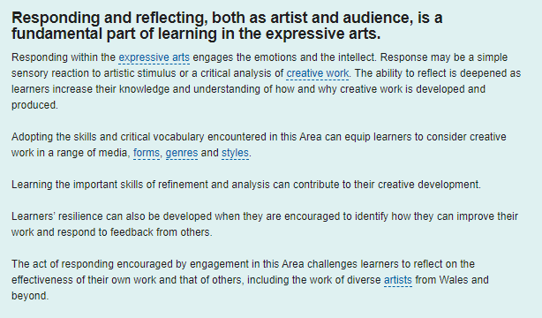

Slide 3
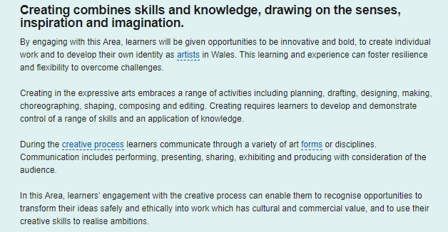

Slide 5
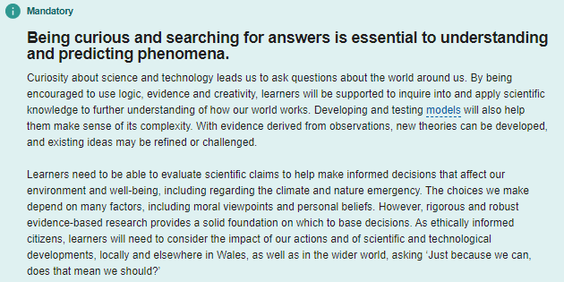
Science and Technology: Statements of what matters; Science and Technology: Statements of what matters - Hwb (gov.wales)

Slide 6

Science and Technology: Statements of what matters; Science and Technology: Statements of what matters - Hwb (gov.wales)

Slide 7
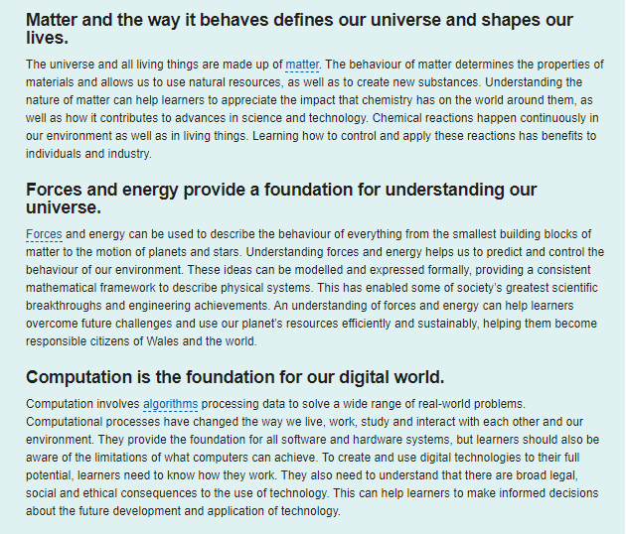
Science and Technology: Statements of what matters; Science and Technology: Introduction - Hwb (gov.wales)

