Slide 1

The Modern World
ACaa4005
Lara Hopkinson

Slide 2
Outline
Types of knowledge
Writing in your own voice
How to evaluate sources of information

Slide 3

Types of knowledge?

Slide 4
Types of knowledge
Common knowledge
  Widely known within a specific discipline
  Found within a range of texts, unreferenced
  Attributed to a number of differing authors
  May therefore also be subject-specific
  Required academic judgment
Subject specific knowledge
  Relates to a specific subject
  Requires referencing

Slide 5
Which are common knowledge?
The capital of France is Paris
When walking along the road, you should keep to the pavement
The population of England and Wales in 1700 was around 5.5 million
King Henry VIII ruled from 1509 - 1547

Slide 6

Further guidance on common knowledge
Open University, 2022

Slide 7
Writing in your own words?

Slide 8
Writing in your own voice
Open University, 2022

Slide 9
Quiz – writing in your own words (1)
Why is writing in your own words an important academic skill to develop? (Select all options that apply.)
Select one or more:
  a. It allows you to demonstrate to your tutor what you have learned about the topic being assessed.
  b. You can make sure your answer matches what the question is asking for, whereas copied text is likely to stray off the point.
  c. It enables you to show that you understand the topic being assessed, as you are presenting your own interpretations of a particular subject.
  d. You’ve been told to do this in the assignment booklet.

Slide 10
Quiz – writing in your own voice (2)
Read the following statement and decide whether it is true or false.
Statement: If you construct a summary (written in your own words) of the ideas, concepts and results presented in some source material, you are producing a new piece of work that belongs to you. If you then use this summary to write up your answers, you do not need to include a reference, because you are referring to your own work.
Select one: True or False

Slide 11
Quiz – writing in your own voice (3)
Read the following statement and decide whether it is true or false.
Statement: Writing in your own words means that every single word in your answer needs to be different to those in the source materials you have referred to.
Select one: True or False

Slide 12
Quiz – writing in your own voice (4)
Read the following statement and decide whether it is true or false.
Statement: You do not need to reference an idea or argument that you have read or encountered in some source material, as long as you write it in your own words.
Select one: True or False

Slide 13
Identifying good sources of information
Where do you currently look for information?
How could you improve your practice?
Some points to note:
  The web is not ALL BAD!
  Check the origin of your source
  Use PRIMARY sources where possible
  If not, SECONDARY sources are also acceptable
  Utilise UWTSD facilities…

Slide 14
Evaluation of sources
Theme | Questions
Relevance | Does this information match my needs?
Provenance | Where does the info come from? Who are the authors / organisations? Publication method? Any peer review?
Objectivity | What is the author’s position? Any conflict of interest? Vested interests?
Timeliness | Clarity on when produced? Does this date meet my requirements?
Presentation | Clearly communicated?
Method | Research methods used, how reported? How significant are the results?

Slide 15
Academic sources
Source | Advantages | Disadvantages
Text books | Focused view of key issue, OR Broad view of subject, OR Outcome focused | Present a particular view Sometimes too broad Issues with timeliness
Academic journals | Current and credible Theoretical or empirical Argue and critique | Can be inaccessible Issues with timeliness
Professional journals | Represent a ‘profession’ Uphold professional standards Accessible and contemporary | Language can be difficult Particular school of thought May not publish challenges
Government literature | Reliable data, well analysed Longitudinal studies | Data gathered for specific purpose, confidentiality
Organisational literature | Aids decision-making or stakeholder engagement | Structured in a particular way Confidentiality?

Slide 16
“Grey” literature
“literature that is not formally published in sources such as books or journal articles” (Cochrane Handbook, 2019)
Includes:
  Technical or research reports from government agencies
  Reports from scientific research groups
  Working papers from research groups or committees
  Doctoral (PhD) dissertations
  Some conference proceedings and official publications
  Preprints (journal articles not yet peer-reviewed and/or published)

Slide 17
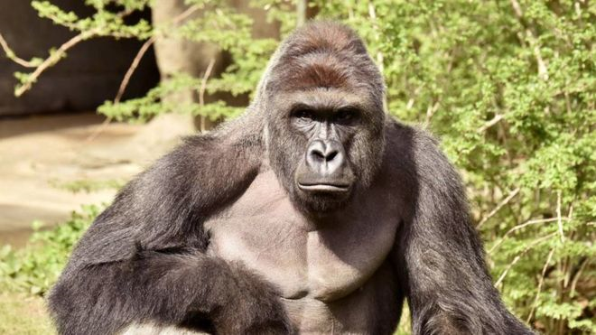
News and ‘not news’
News or ‘fake news’?
Is it easy to tell the difference?
Source: BBC, Sept 2016

Slide 18
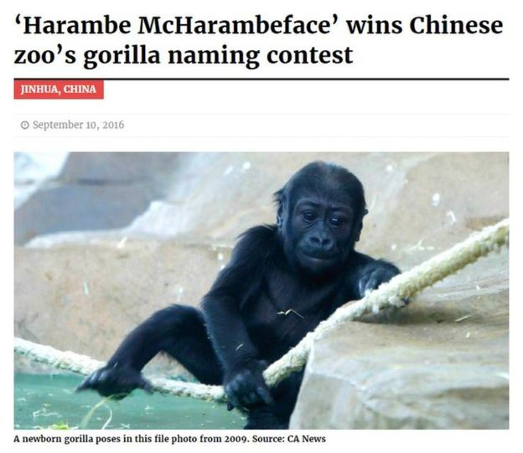
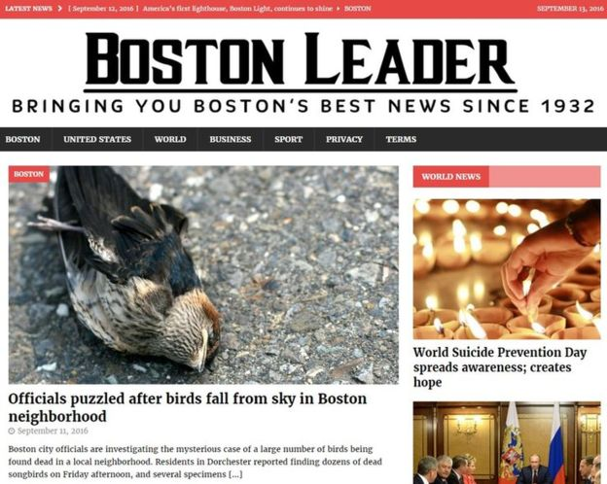

Slide 19

Source: Cosmos Magazine

Slide 20
Some things to think about…
Have I heard of the publisher before?
Is this the source I think it is, or does it sound a bit like them?
Can I point to where this happened on a map?
Has this been reported anywhere else?
Is there more than one piece of evidence for this claim?
Could this be something else?

Slide 21
Useful information
Open University (2022) Developing good academic practice Developing good academic practice: 4.2.4 Science - OpenLearn - Open University
Open University (2021) Finding appropriate academic material (http://www2.open.ac.uk/students/skillsforstudy/finding-appropriate-academic-material.php)
Open University (2021) Comparing academic sources (http://www2.open.ac.uk/students/skillsforstudy/comparing-academic-sources.php)
BBC News (2016)
Higgins JPT, Thomas J, Chandler J, Cumpston M, Li T, Page MJ, Welch VA (editors). Cochrane Handbook for Systematic Reviews of Interventions version 6.0 (updated July 2019). Cochrane, 2019. Available from www.training.cochrane.org/handbook
Ian Hislop’s fake News: A true story (https://learningonscreen.ac.uk/ondemand/index.php/prog/3BF294CC?bcast=138969512)

