Slide 1

Week 1
What is my position as a doctoral practitioner?
Session 1:
From Practitioner to Practitioner-Researcher

Slide 2
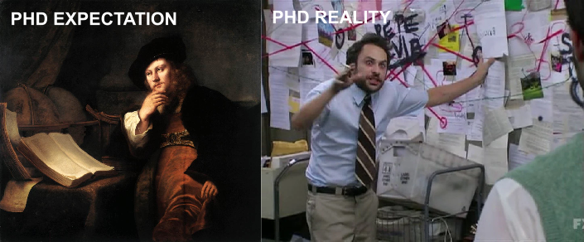
The modules throughout the year are design so that you can focus on the development of your research design, with each module contributing to different aspect of the project's development.
This approach allows you to explore new ideas and evolve your thinking .
However, it’s important to note that you cannot hand in the same work for multiple modules. Each submission must be new, building on, or developing from, a single research idea, showing progression over time. In the aim to develop a fully fledged research plan for part 2.

Slide 3
Today’s question
What makes doctoral research different from simply being a creative practitioner?
What does it mean to become a practitioner-researcher?
How can your professional and creative practice become a site of research?

Slide 4
Start here: What do you do?
Write down three things you currently do as a creative or professional practitioner.
For example: I make things, I design things, I teach, I build things, I perform, I code, curate, manage, communicate, experiment, I solve problems.
Now ask: Which of these activities involve asking questions?
Which involve producing knowledge, even if you do not normally call it 'research'?

Slide 5
Many practitioners would say they do ‘research’ as part of their everyday practice. For example, searching for new understandings, seeking out techniques for realising ideas, and identifying relevant influences. However, this type of research, for the most part does not seek to add to shared knowledge or add to operational significance in a professional field. As a professional doctorate student your practice and process must transition from that of the typical art and design practitioner into a structured process of research governed by academic expectations.

Slide 6
Practice is not automatically research
Making something can be practice without being research.
Research requires a question, a purpose and a reason for investigating.
It involves engaging with existing knowledge and making sense of what you discover.
It should produce or develop knowledge, understanding or insight that can be communicated and examined.

Slide 7
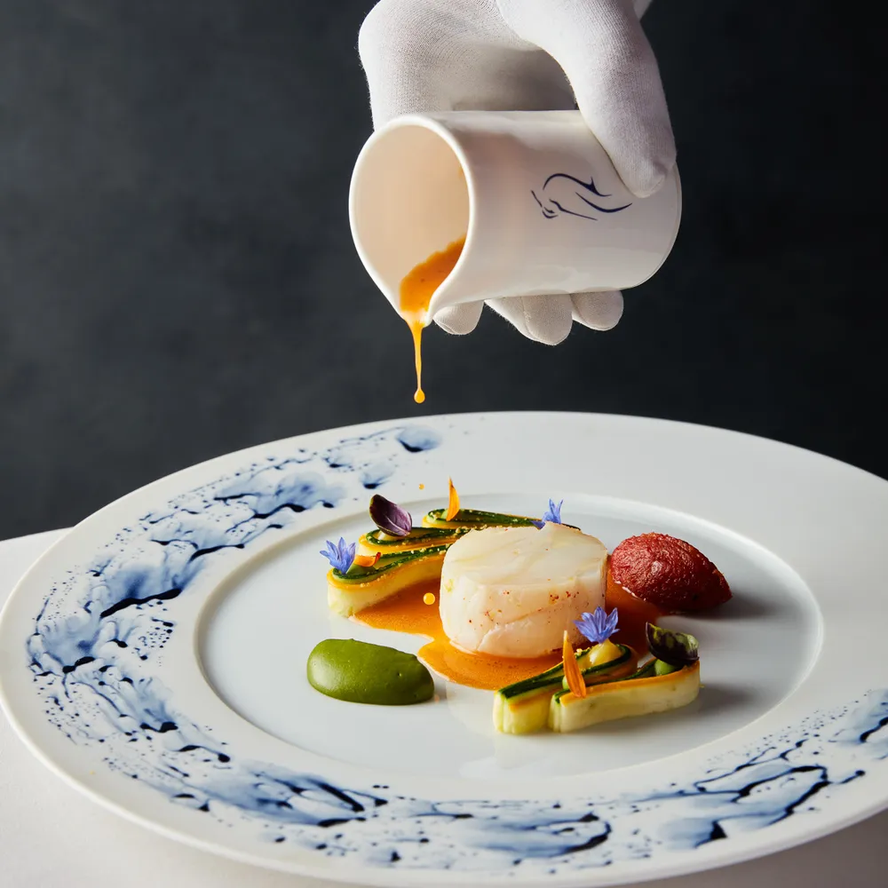

Discussion
A chef tries a new recipe because they are curious. What would that chef have to do to turn that recipe into a doctoral-level project?
The chef must move beyond personal curiosity. They would need to: Set specific research questions.
Explain the context (what other chefs and professionals have tried).
Use a clear method and document the process.
Share the results with the wider community through a structured process.

Slide 8
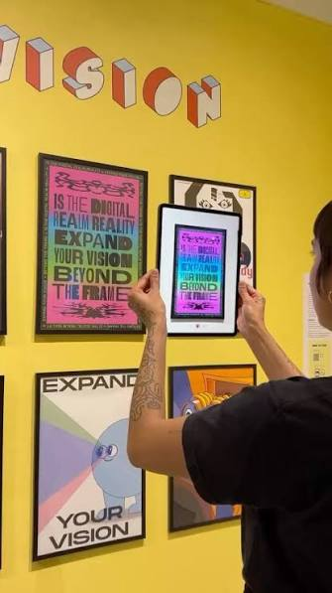
A simple example
PRACTICE: A designer creates five poster designs.
RESEARCH: A designer investigates how different visual structures affect how audiences interpret information.
The difference is not simply the activity.
The difference is the question, purpose, process, critical thinking and knowledge generated.

Slide 9

Research Methodology
Sampling strategy
Research Methodology
Data Collection Methods
Research Methodology
Data Analysis Methods
Ethical considerations
Research
Question
Research Aims and Objectives
Research gap
Theoretical
Framework / interpretations

Slide 10
Activity: Practice or research?
In pairs, discuss each example.
1. An artist makes a series of paintings exploring grief.
2. A fashion designer develops three sustainable materials.
3. An architect interviews residents about a housing project.
4. A photographer experiments with analogue processes to explore memory.
5. A graphic designer redesigns a logo for a client.
Decide: Mainly Practice / Mainly Research / Could be both · Be prepared to explain why

Slide 11
There is not always a clear boundary
Creative practice can become a way of investigating a question.
Research can also inform and change creative practice.
The relationship between practice and research depends on how the practitioner frames, documents, analyses and communicates what they are doing.
Ask yourself: What is the question? Why are you doing it? How are you investigating it? What knowledge or understanding might be produced? How will you critically reflect on and communicate what you have learned? | Practice I am making/designing/doing something. Research I am investigating a question in order to develop knowledge or understanding. Practice + Research I am using my creative practice to investigate a question and develop knowledge or understanding.

Slide 12
PhD and Professional Doctorate
Both are doctoral-level research qualifications.
Both require critical engagement with existing knowledge and an original contribution.
A PhD is often assessed on original contribution to knowledge.
A Professional Doctorate is also assessed on original contribution to knowledge, but it also considers professional practice. A Professional Doctorate is therefore closely connected to professional practice, and contribution of knowledge is made from inside a field, by someone who holds a position in it.
The distinction is not 'academic' versus 'practical'. A Professional Doctorate still requires rigorous research.
Your standing as a practitioner is not incidental to the research. It is part of what gives the research warrant.

Slide 13
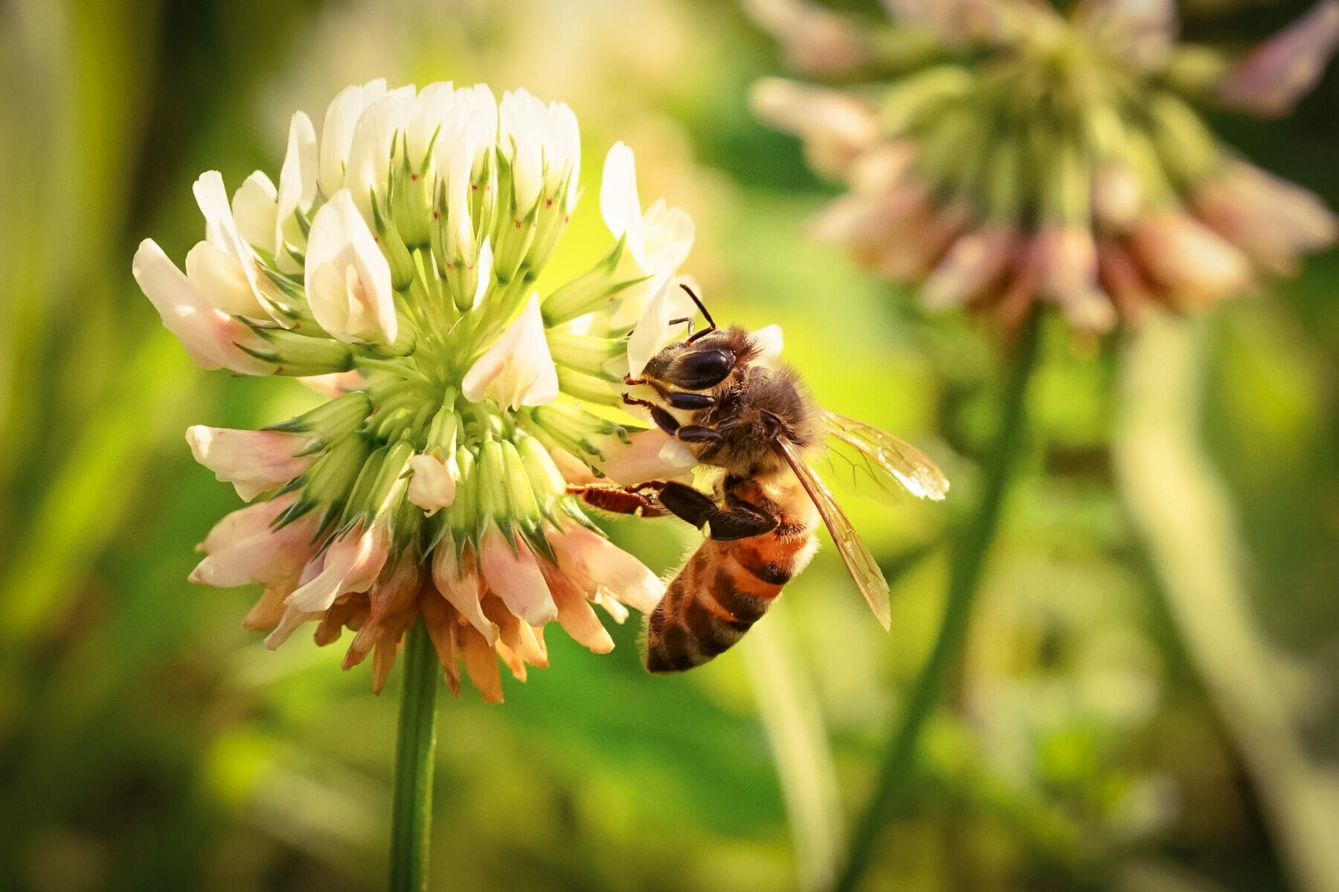
So what is a practitioner-researcher?
A practitioner-researcher works between professional/creative practice and research.
You bring knowledge from your practice into the research.
Your practice may generate questions, provide a context for investigation, or become part of the research process.
You also bring research thinking back into your practice.
The relationship should be critical rather than simply descriptive.

Slide 14

"Judge a man by his questions rather than his answers.” Voltaire
"He who asks a question is a fool for five minutes; he who does not ask a question remains a fool forever.” Chinese Proverb
A well-defined research question is crucial in order to guide and focus an entire project. A well-developed question can…
narrows the scope of your research.
Help you address or identify specific issues or gaps in knowledge.
Streamline your data collection, analysis, and interpretation.

Slide 15


Slide 16
Think about your own practice
What questions repeatedly emerge from your professional work?
What problems, tensions or gaps have you noticed?
What do you do that others in your field might learn from?
What do you want to understand differently?

Slide 17
From practice to research
Start
Start with something you already know.
Notice
Notice something that interests, troubles or challenges you.
Turn
Turn that into a question.
Investigate
Investigate the question critically.
Connect
Connect your thinking to existing knowledge.
Develop
Develop new understanding, insight or knowledge.

Slide 18
Activity: Turn practice into a question
Choose one aspect of your practice that interests you.
1. Complete: 'I have noticed that…'
2. Then: 'This makes me wonder…'
3. Then: 'I would like to understand/investigate…'
4. Finally: 'A possible research question is…'

Slide 19
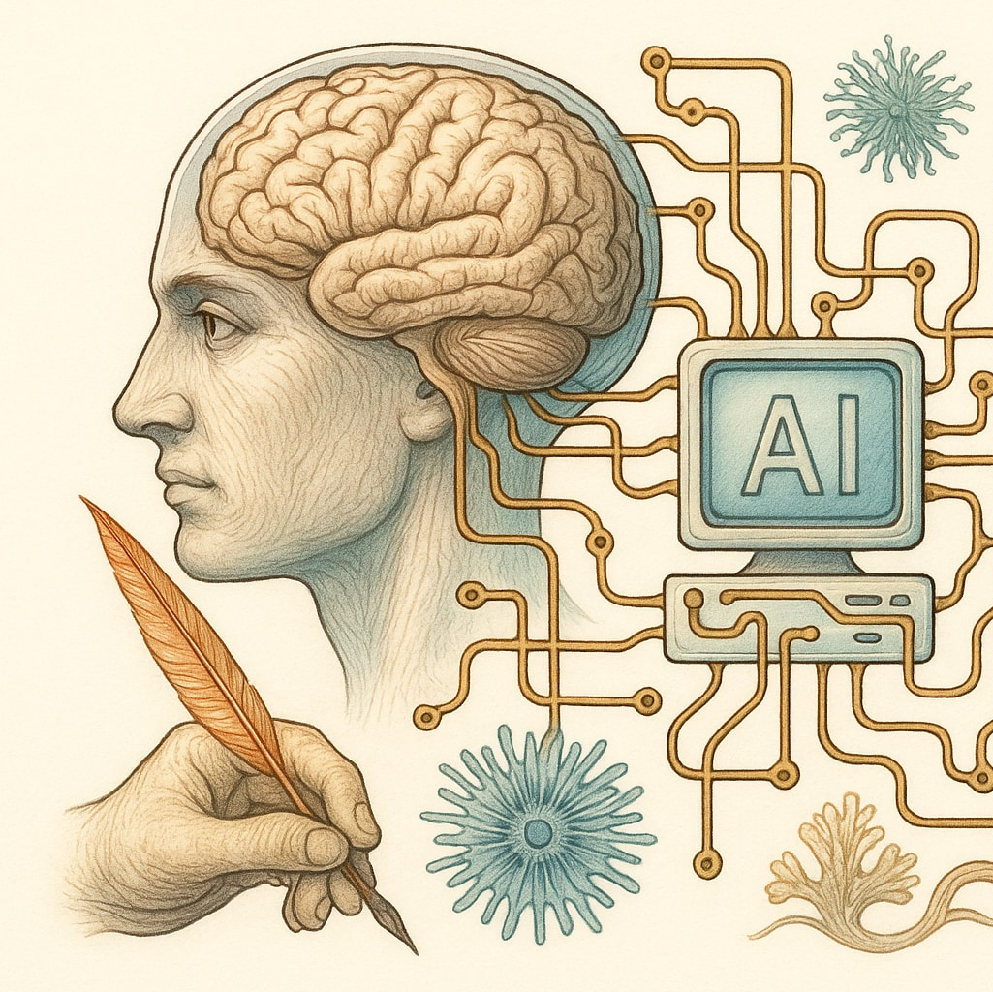
Example
Practice
I work with digital illustration.
Observation
I have noticed that generative AI is changing how clients develop and judge visual ideas.
Question
I wonder how this is changing the role of the professional illustrator.
Possible research question
How is generative AI changing the role and practice of professional illustrators?
How are professional illustrators adapting their creative practices in response to generative AI?
How might human–AI collaboration reshape creative decision-making and professional identity within illustration practice?

Slide 20
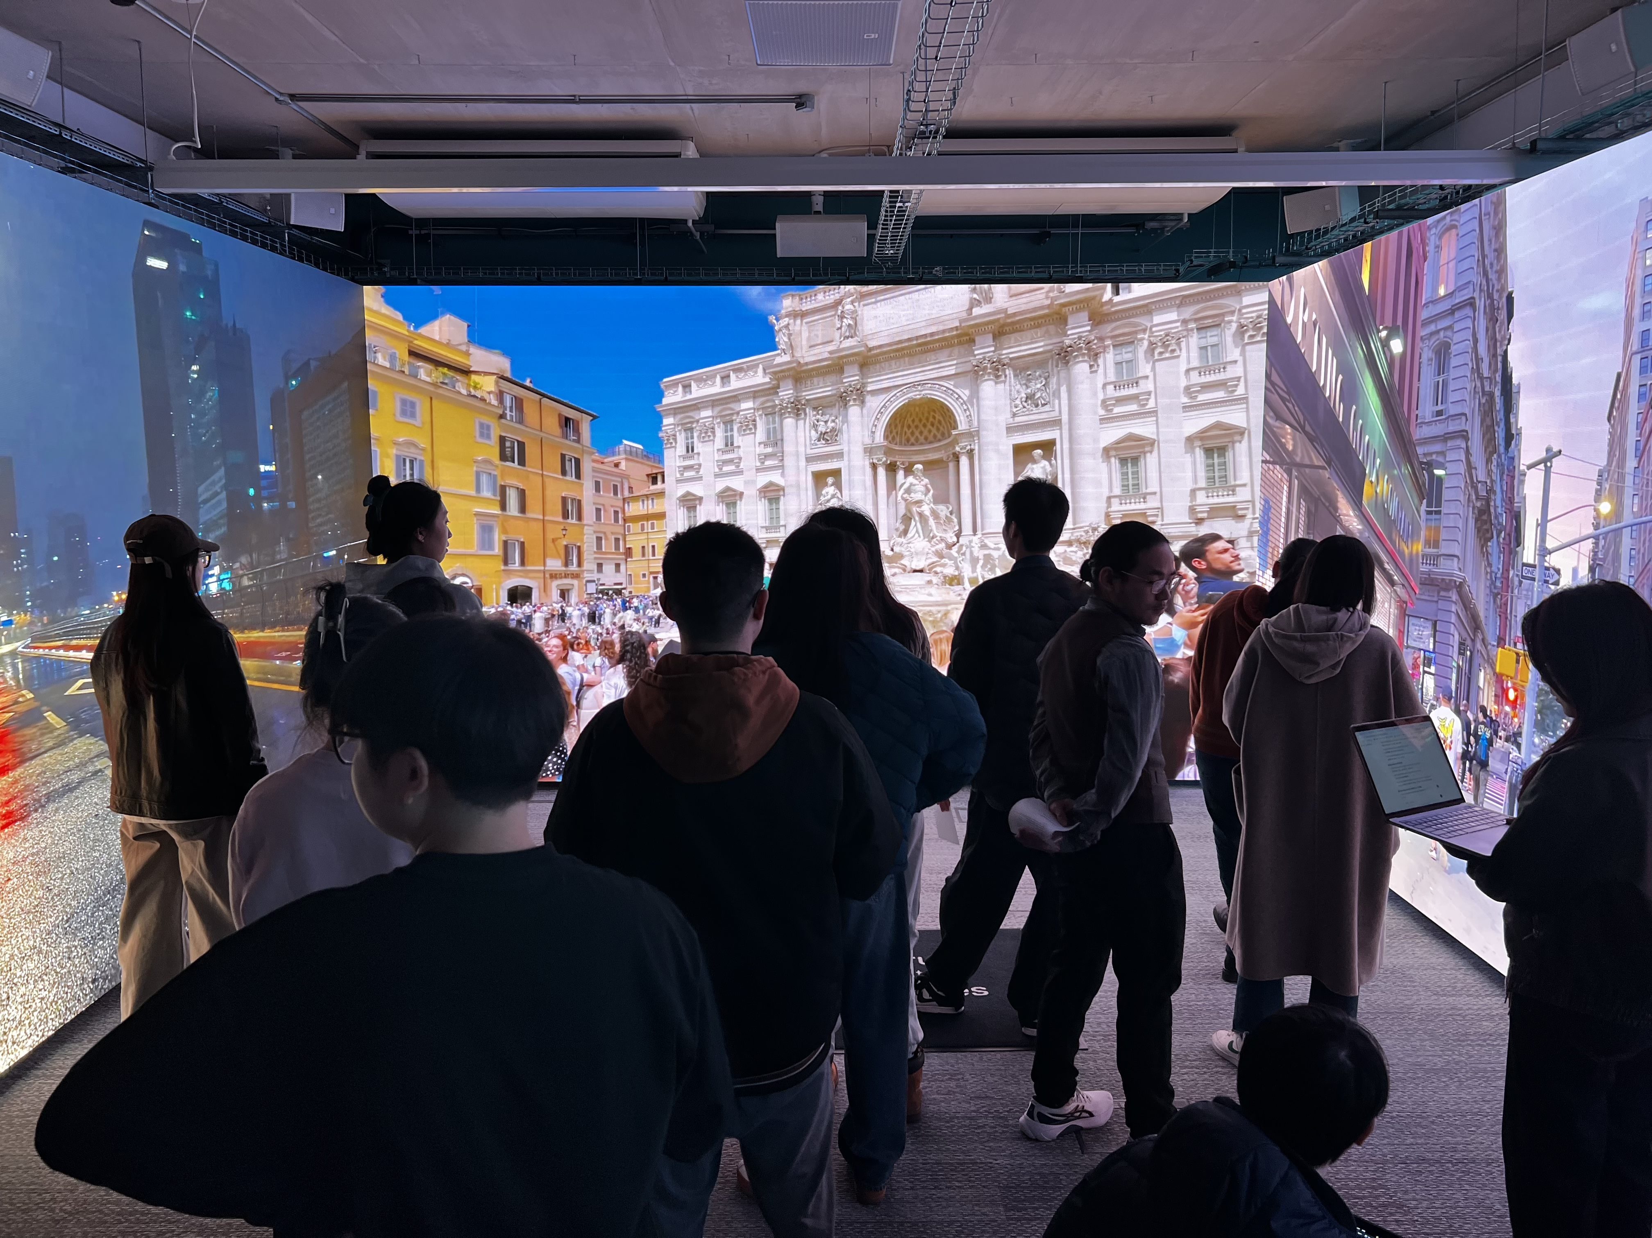
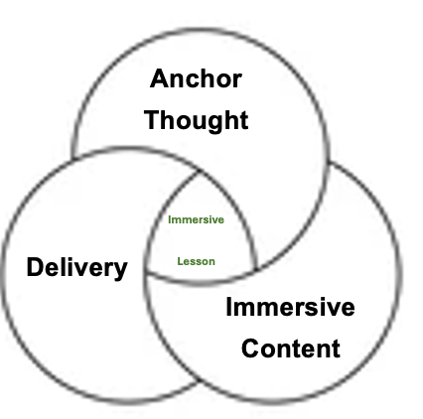
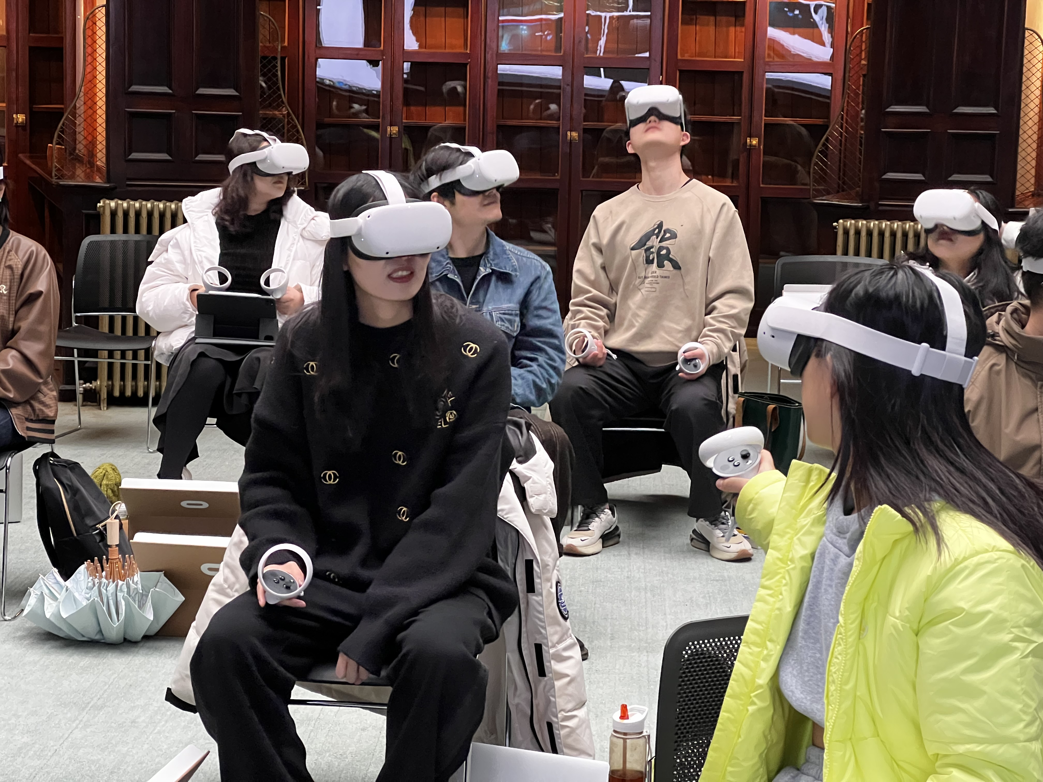
What counts as a contribution to knowledge?
A doctoral contribution does not necessarily mean discovering something completely new to humanity.
It may develop a new understanding, interpretation, framework, method, application or insight.
For a practitioner-researcher, the contribution may emerge from a problem or possibility within professional practice.
Your task is to identify what your research might contribute, this will develop throughout the doctorate.

Slide 21
Please read…
Professional Doctorates-A Better Route for Researching Professionals? By Fenge, L.-A. (2009)
Becoming a Researcher in Art Education: Forming Research Questions By Freedman, K. (2004)
CAN BE FOUND ON MOODLE

Slide 22
Discussion: Professional Doctorates-A Better Route for Researching Professionals? By Fenge, L.-A. (2009)
From Fenge’s discussion, what do you see as the main difference between a PhD and a Professional Doctorate?
What is the Professional Doctorate trying to develop that may be different from a traditional academic research degree?
What does Fenge mean by the idea of the ‘enterprising self’?
Why might this idea be important to someone undertaking a Professional Doctorate?
Think about your own professional experience.
  How might your professional experience shape the research you undertake?
  What can you investigate because of your position within your profession that someone outside that profession might not see?

Slide 23
Discussion: Becoming a Researcher in Art Education: Forming Research Questions By Freedman, K. (2004)
From Freedman's discussion:
What do you think a research question needs to do?
What makes a question suitable for doctoral research rather than simply an interesting question?

Slide 24
Your first research position Complete these statements:
My practice is…
My professional context is…
I am interested in…
I have noticed…
I want to understand…
A possible research question is…
This could matter because…

Slide 25

Looking ahead
Today we have considered what it means to move from practitioner to practitioner-researcher.
Next, we will begin examining the assumptions underneath your research.
We will ask: What do you believe is real, existing or meaningful within your practice?
This is the starting point for thinking about ontology.

Slide 26
Exit question
In one sentence:
What is the difference between being a creative practitioner and being a practitioner-researcher?

