Slide 1

Education for Sustainable Development &
Global Youth Work:
A Lesson Plan
By Kayleigh Cowdery
2218436
Notes:
Hello everyone, and welcome to my presentation on Education for Sustainable Development and Global Citizenship (ESDGC). My name is Kayleigh Cowdery, and I am a youth worker, currently studying for a youth work degree at the University of Wales, Trinity Saint David. Today, we will explore the rationale behind a lesson plan, developed to empower young people towards a sustainable future as global citizens.

Slide 2

Aims of Presentation
Provide a clear understanding of ESDGC and its significance in youth work.
Introduce Peace Mala.
Provide a Lesson plan.
Bracelet-making activity
Evaluation of a related activity.
Notes:
The aim of this presentation is to provide a comprehensive understanding of ESDGC, highlighting its key themes and concepts in youth work, emphasising their interrelated nature and importance in addressing global challenges. I will introduce a lesson plan on the Peace Mala initiative and showcase its role in fostering peace, tolerance, and global understanding among young people. Additionally, I will discuss a lesson plan and facilitate a 10-minute interactive activity on Peace Mala. Finally, I will evaluate a related activity, demonstrating its alignment with the principles of ESDGC and youth work. I hope you find this presentation informative and engaging.

Slide 3

Rationale
A changing world
Global interdependence
Role of youth work
Importance of ESDGC
Call to action
Notes:
Young people today are facing a world transformed by new technology and globalization (CWVYS, 2014). According to the World Economic Forum (2024) the top global issues include misinformation and disinformation, extreme weather events, and societal polarization. There are also issues for young people to navigate, such as poverty, unemployment, and terrorism, problems often unfamiliar to those from previous generations (CWVYS, 2014).
Our interconnected lifestyles mean that local actions have global impacts and as global citizens, we have rights and responsibilities to our neighbours and the planet (CWVYS, 2014).
It is essential that we as youth workers recognise the importance of ESDGC in equipping young people with the knowledge and skills they need to play their part as local, national, and global citizens (Youth Work in Wales Group, 2022). Adopting ESDGC in everything we do as youth workers will contribute to a more just, and sustainable world (CWVYS, 2014).

Slide 4

Peace Mala
Award-winning initiative.
Introduced in response to the events of 9/11.
Creation of symbolic bracelets.
Golden Rule 'Treat others as you wish to be Treated'.
Represents 14 spiritual traditions.
Engaging in this activity.
Notes:
Peace Mala is an award-winning educational programme, introduced by a Welsh school teacher in 2001, in response to the fear and confusion following the events of September 11 (Peace Mala, no date). Concerned about a rise in bullying towards minority and Asian students at her school, the teacher created Peace Mala to help combat racism, religious intolerance, ignorance, and the lack of respect among young people in her school, and the wider community (Peace Mala, no date).
An introductory feature of the programme involves the creation of a symbolic bracelet with messages promoting the golden rule; ‘treat others as you wish to be treated’ (Peace Mala, no date). This simple, but effective educational tool aims to address prejudice, confront bullying, support human rights, and celebrate diversity (Peace Mala, no date). The bracelet represents fourteen spiritual traditions and their version of the golden rule (Peace Mala, no date). Later, in this presentation, we will be making these bracelets together.

Slide 5

ESDGC Themes and Concepts
Identity and Culture.
Interdependence, citizenship and stewardship, needs and rights, and diversity.
Links to youth work and Articles 2, 12, 24, and 30 of the UNCRC.
Notes:
Today’s activity is deeply rooted in the ESDGC theme of identity and culture, but it is important to note its connection to other themes such as choices and decisions, or how culture and identity can influence health, and well-being. Moreover, this theme also could extend to the exploration of ESG concepts such as interdependence, citizenship, stewardship, needs and rights, and diversity, among others.
These themes and concepts are integral aspects of youth work, and form the foundation that supports young people's holistic development (CLD Standards Council Scotland, 2019). As youth workers, we have a commitment to promoting inclusion, equity, and diversity, as well as young people's interests, health and well-being (CLD Standards Council Scotland, 2019, p. 6). These themes and concepts link closely to Articles 2, 12, 24, and 30 of the UN Convention on the Rights of the Child (UNICEF, no date).

Slide 6
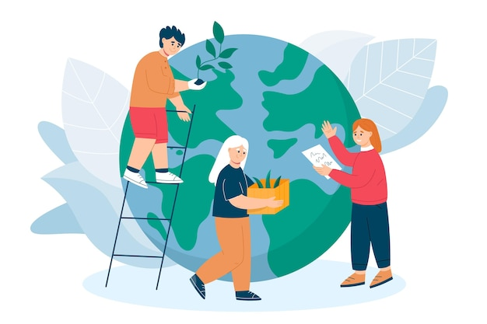
Pillars of ESD
Cultural Sustainability: relates to cultural identity, diversity, heritage, and spirituality (Council of Europe, 2018).
Notes:
My activity relates directly to the ESD pillars of social inclusion and its fourth dimension, cultural sustainability (Council of Europe, 2018). However, it is important to highlight that my activity could also have an indirect influence on both economic growth and environmental protection. For instance, more inclusive communities could lead to economic growth in society.

Slide 7

UN Global Goals
Goal 4: Quality Education
Goal 16: Peace, Justice, and Strong Institutions
Notes:
The activity aligns with several goals outlined in the Well-being of Future Generations (Wales) Act (Welsh Government 2015). Firstly, A Globally responsible Wales, as this activity fosters global citizenship and sustainable practices (Welsh Government 2015). Secondly, a More Equal Wales, encouraging inclusivity and respect for diversity and a Wales of Cohesive Communities, promoting social cohesion through shared activities and mutual understanding (Welsh Government 2015).

Slide 8
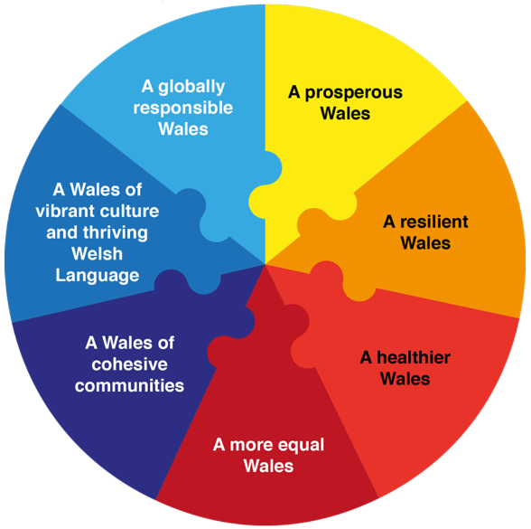
Well-being of Future Generations (Wales) Act (2015)
A Globally Responsible Wales
A More Equal Wales
A Wales of Cohesive Communities
Notes:
The activity aligns with several goals outlined in the Well-being of Future Generations (Wales) Act (Welsh Government 2015). Firstly, A Globally responsible Wales, as this activity fosters global citizenship and sustainable practices (Welsh Government 2015). Secondly, a More Equal Wales because it encourages inclusivity and respect for diversity (Welsh Government 2015). Thirdly, A Wales of Cohesive Communities because it promotes social cohesion through shared activities and mutual understanding (Welsh Government 2015).

Slide 9

Role of a Youth Worker
Transformational Education
Critical thinking skills
Active Participation
Exploration of values and cultural perspectives
Five Pillars
Notes:
As a youth worker it is crucial to consider how we facilitate young people’s shift towards transformative education, moving away from traditional transmissive methods (Council of Europe, 2018). For this activity, I aim to facilitate the development of young people’s critical thinking skills, active participation, and exploration of values and cultural perspectives (Council of Europe, 2018). This approach aligns with the five pillars of youth work which include, inclusivity, empowerment, participation, education, and self-expression (Youth Work in Wales Review Group, 2022).

Slide 10

Experiential Learning
Enhance transformative approach.
Inspire ongoing engagement and motivation.
Aligns with participative nature of youth work.
Notes:
To enhance this transformative approach, I will facilitate experiential learning to inspire young people’s ongoing engagement and motivation to address any issues that they feel are important beyond the workshop (Council of Europe, 2018). This aligns with the participative nature of youth work, which encourages young people to become partners in, and take responsibility for the opportunities and decision-making structures that affect their own and other people’s lives and environments (Youth Work in Wales Review Group, 2022).

Slide 11

Lesson Plan: NAOMIE Planning Model
Needs:
To identify young people’s cultural backgrounds, religious knowledge, and interests, and determine their level of understanding of interfaith dialogue and global issues.
Notes:
I have created a lesson plan for the Peace Mala activity by utlising the NAOMIE needs assessment framework. The needs of the lesson plan are:
To identify young people’s cultural backgrounds, religious knowledge, and interests, and determine their level of understanding of interfaith dialogue and global issues.

Slide 12

Aims of Lesson Plan
To promote interfaith knowledge, understanding, and dialogue among young people.
Notes:
The aims of the lesson plan are to promote interfaith knowledge, understanding, and dialogue among young people.

Slide 13

Objectives of Lesson Plan
To educate young people about various faiths.
To foster respect and appreciation for cultural diversity.
To encourage teamwork and dialogue among young people from different backgrounds.
Notes:
The objectives of the lesson plan are to:
To educate young people about various faiths.
To foster respect and appreciation for cultural diversity.
To encourage teamwork and dialogue among young people from different backgrounds.

Slide 14
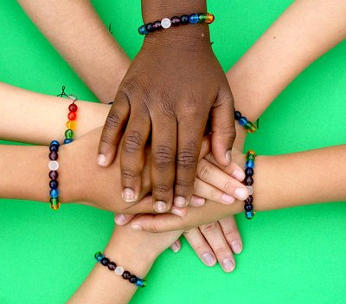
Implementation
Deliver a bracelet-making workshop which incorporates different coloured beads that represent different faiths.
Provide a leaflet explaining the significance of each bead, and its relevance to each faith.
Facilitate discussions that encourage participation and collaboration among young people.
Notes:
Deliver a bracelet-making workshop which incorporates different coloured beads that represent different faiths.
Provide a leaflet explaining the significance of each bead, and its relevance to each faith.
Facilitate discussions that encourage participation and collaboration among young people.

Slide 15

Evaluation of Activity
Assess the impact of the activity on young people’s knowledge and attitudes towards interfaith dialogue and global citizenship.
Gather feedback from young people to identify strengths and areas for improvement.
Reflect on the overall effectiveness of the activity in meeting its aims and objectives.
Notes:
Assess the impact of the activity on young people’s knowledge and attitudes towards interfaith dialogue and global citizenship.
Gather feedback from young people to identify strengths and areas for improvement.
Reflect on the overall effectiveness of the activity in meeting its aims and objectives.

Slide 16

Activity

Slide 17
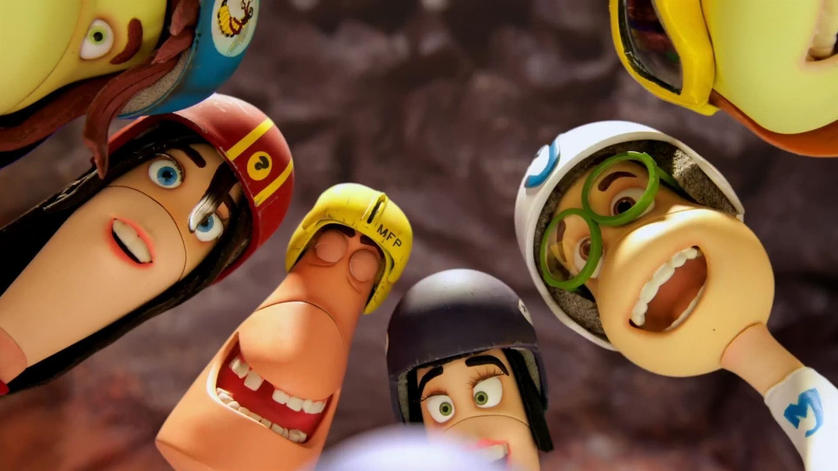
Evaluation of an Activity
Activities at Swansea Community Farm.
Exploration of the wormery, herb garden, and planting potatoes in the allotments.
Notes:
I will now evaluate a session I observed at Swansea Community Farm, where a local school visited and participated in activities. They explored the wormery, learning about the importance of worms for our planet and how worms help recycle food waste. Additionally, the pupils explored their senses in the herb garden and planted potatoes in the allotments.

Slide 18

Lesson Plan Rationale
Sustainable agriculture and local food production.
Aligned with ESDGC themes
Five ways to well-being
Notes:
The rationale behind the activity was clear and focused on educating young people about sustainable agriculture, and the importance of local food production. These activities aligned with the ESDGC themes of choices and decisions, health and well-being, the natural environment, wealth and poverty, climate change, and consumption of waste (CWYVYS, no date). These activities also align with the five ways to wellbeing which include being more active, connected, taking notice of nature, continuous learning, and giving to others (Swansea Community Farm, no date).

Slide 19
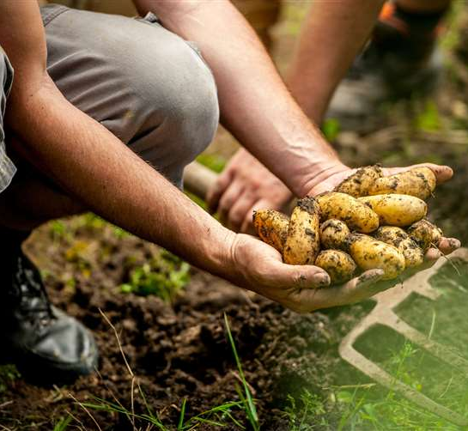
Activity Suitability
Age-appropriate
Interactive
Sustainability
Five Pillars of Youth Work
Notes:
The activity was age-appropriate and combined interactive learning with important lessons on sustainability. The activity aligned well with the five pillars of youth work (Youth Work in Wales Review Group, 2022) and was physical, collaborative, and interactive, keeping the young people engaged throughout.

Slide 20

Engagement
Engaged well
Enthusiastic
Interactive
Clear instructions
Maintained high levels of interest and participation
Notes:
The young people engaged well with the activity and appeared enthusiastic when exploring the wormery and planting potatoes. The interactive nature of the tasks, along with clear instructions, and the visible results of their work, helped to maintain high levels of interest and participation.

Slide 21

Areas for Improvement
Structured Reflection time
Notes:
The youth worker could have incorporated more structured reflection time immediately after the activity to discuss what was learned and how it applies to broader sustainability issues. This could have made the activity more impactful.

Slide 22

Future Use
Practical
Important educational outcomes
Aligned with ESD Principles
Young people enjoyed and felt accomplished
Notes:
Going forward, I will definitely use this activity again as it effectively combines practical skills with important educational outcomes. It aligned with youth work and ESD principles, and the young people enjoyed and felt accomplished.

Slide 23
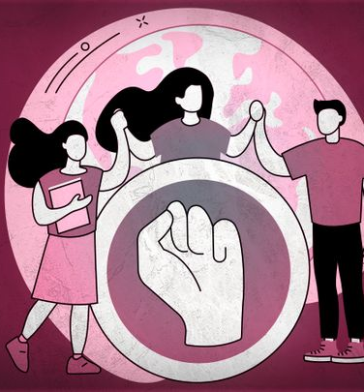
Conclusion
Provided an understanding of ESDGC.
Crucial role within youth work.
Should be underpinned in youth work standards.
Youth Workers should adopt ESDGC in daily practice.
Empower young people to contribute to a sustainable world.
Notes:
To conclude this presentation has provided an understanding of ESDGC, highlighting its crucial role within youth work. Unfortunately, ESDGC is not yet underpinned within the National Occupational Standards of Youth Work (CLD Standards Council Scotland, 2019), however, youth workers can adopt ESDGC into their daily practice to empower young people to make meaningful contributions to a better and more sustainable world.

Slide 24

Thank you for listening
Notes:
Thank you for listening and engaging in todays activity. Does anyone have any questions?

Slide 25
References
CLD Standards Council Scotland (2019) Youth Work National Occupational Standards. Glasgow: CLD Standards Council Scotland.
(CWVYS, 2014) Working Together for the Good of Each Other The Education for Sustainable Development and Global Citizenship. Available at: https://www.cwvys.org.uk/wp-content/uploads/2014/06/HB-Sustinable-Development-Global-Citizenship.pdf (Accessed: 23 May 2024).
Peace Mala (no date) History, Concept, and Design. Available at https://www.peacemala.org.uk/history.php (Accessed: 23 May 2024).

Slide 26
Swansea Community Farm (no date) About Us. Available at: https://www.swanseacommunityfarm.org.uk/about-us (Accessed: 23 May 2024).
The Council of Europe (2018) T-Kit 4 intercultural learning. Available at: https://pjp-eu.coe.int/documents/42128013/47262514/PREMS+042218+T-kit4+WEB.pdf/37396481-d543-88c6-dccc-d81719537b32?t=1522062157000 (Accessed: 23 May 2024).
UNICEF (no date) A Summary of the UN Convention on the Rights of the Child. Available at: https://www.unicef.org.uk/wp-content/uploads/2019/10/UNCRC_summary-1_1.pdf (Accessed: 23 May 2024).
United Nations (no date) The 17 Goals. Available at: https://sdgs.un.org/goals (Accessed: 23 May 2024).

Slide 27
Welsh Government (2012) Education for Sustainable Development and Global Citizenship. Available at: https://www.gov.wales/sites/default/files/publications/2018-02/education-for-sustainable-development-and-global-citizenship-a-common-understanding-for-the-adult-and-community-learning-sector.pdf (Accessed: 23 May 2024).
Welsh Government (2015) Well-being of Future Generations (Wales) Act 2015: the essentials. Available at: https://www.gov.wales/well-being-future-generations-act-essentials-html (Accessed: 23 May 2024).
World Economic Forum (2024) The Global Risks Report 2024 19th Edition. Available at: https://www3.weforum.org/docs/WEF_The_Global_Risks_Report_2024.pdf (Accessed: 23 May 2024).
Youth Work in Wales Review Group (2022) Youth Work in Wales: Principles and Purposes. Available at: https://www.cwvys.org.uk/youth-work-in-wales-principles-and-purposes-2/ (Accessed: 23 May 2024).

