Slide 1
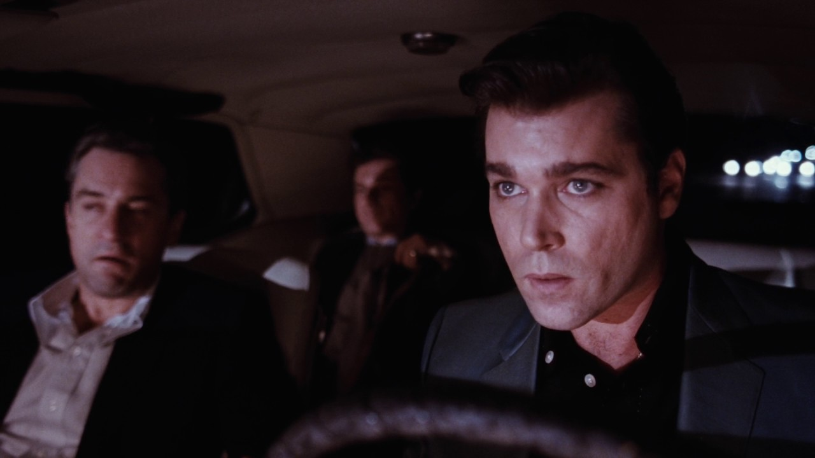
Adaptation Goodfellas
https://www.youtube.com/watch?v=2tzKAlLb4iM
https://www.youtube.com/watch?v=tkNIOuZPXSc

Slide 2
A dialogue between two mediums
“To consider a film and its parental work of fiction together is to imagine a dialogue going on between two mediums. We ask how the text informs the film and vice-versa.”
Rick Wallach, No Country for Old Men: From Novel to Film, eds. Lynnea Chapman King, Rick Wallach and Jim Welsh (Plymouth: The Scarecrow Press, 2009)

Slide 3
Adaptation theory: overview
The adaptation process involves ‘a “hybrid” construction mingling different media and discourses and collaborations’.
Director and other production staff
Author of source text
Genre
Studio
Stars
Censorship
The ‘mingling of different media’ involves, in the main, the relationship between the film and the source text.
Robert Stam, Literature and Film, p.9

Slide 4
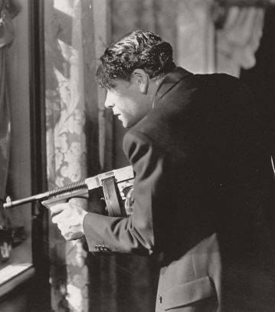
The Hollywood Gangster cycle (1920s-30s)
The quality of irrational brutality and rational enterprise become one. Since we do not see the rational and routine aspects of the gangster’s behaviour, the practice of brutality becomes the totality of his career. At the same time, we are always conscious that the whole meaning of this career is a drive for success: the typical gangster film presents a steady upward progress followed by a very precipitate fall.
Robert Warshow, ‘The Gangster as Tragic Hero’, in The Gangster Film Reader

Slide 5
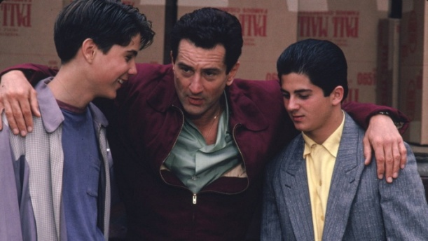
The Gangster and ‘realism’ in Pileggi & Scorsese
As in Pileggi’s Wiseguy, Goodfellas sets out to present a realistic portrayal of organized crime and how it operates by approaching the social milieu and attitudes of the Mafia not from the top, but by taking up its position at the bottom, alongside the rank and file – “the Mafia foot soldiers” – who have to work within the conventions and power relations of the system.
Constantine Verevis, ‘Way of Life: Goodfellas and Casino’, in The Gangster Film Reader

Slide 6
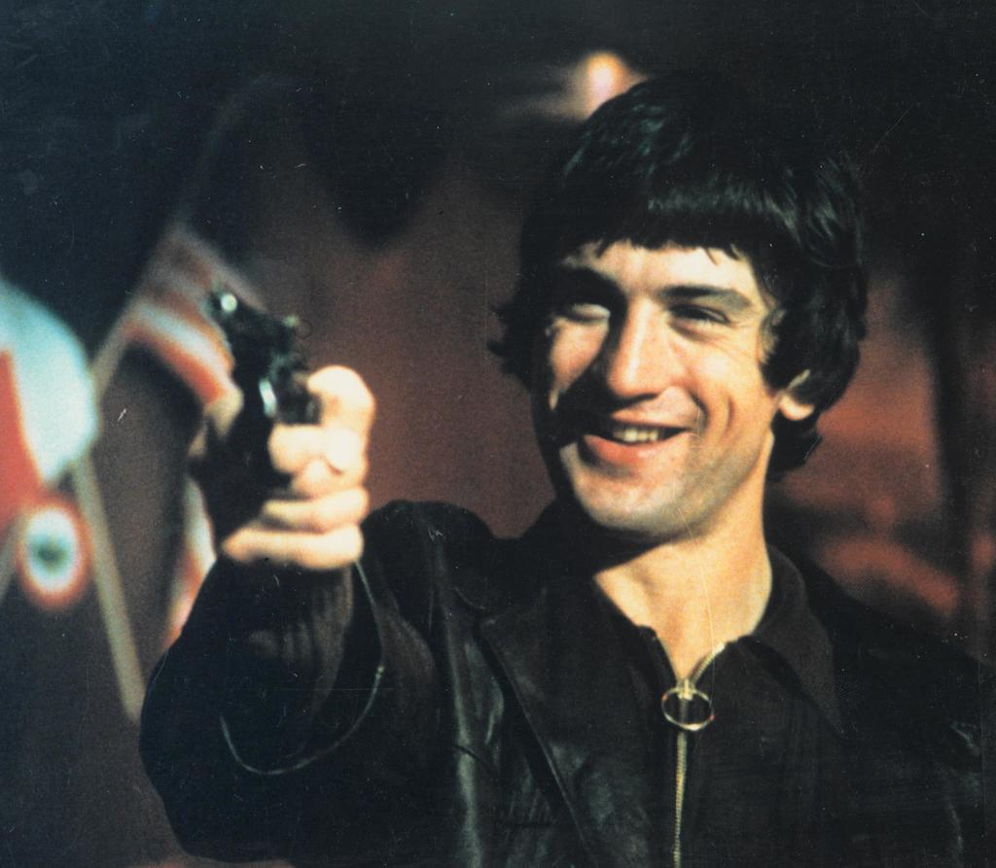
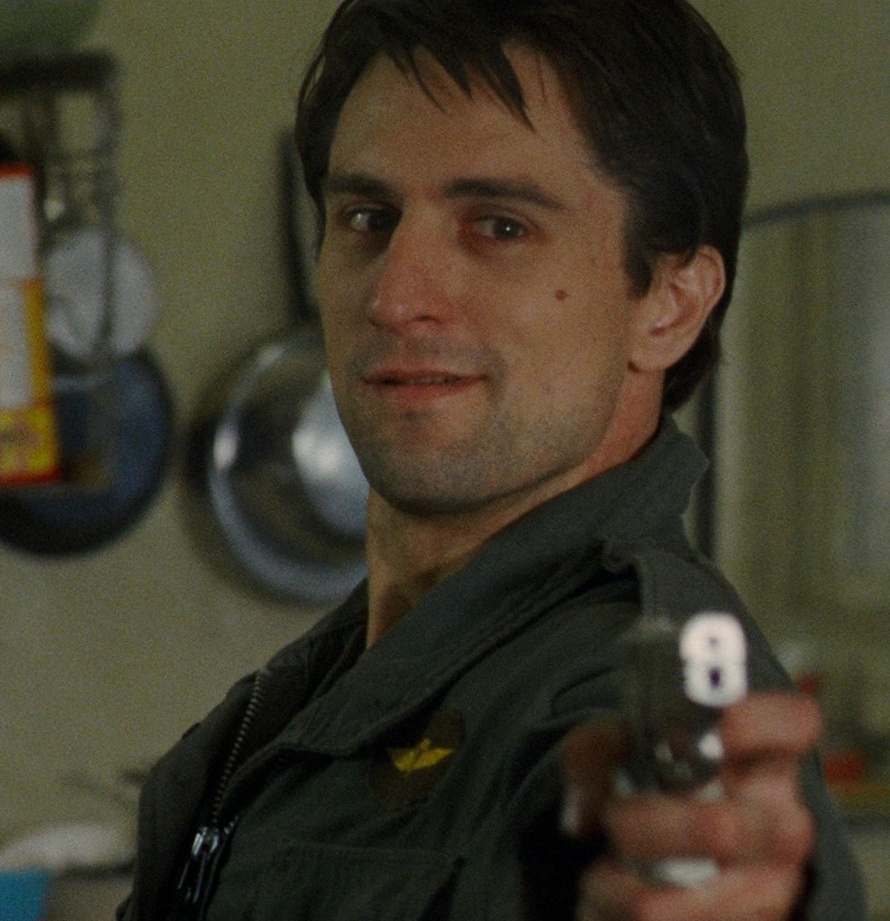
Martin Scorsese (1)
Mean Streets 1973
Taxi Driver 1976

Slide 7
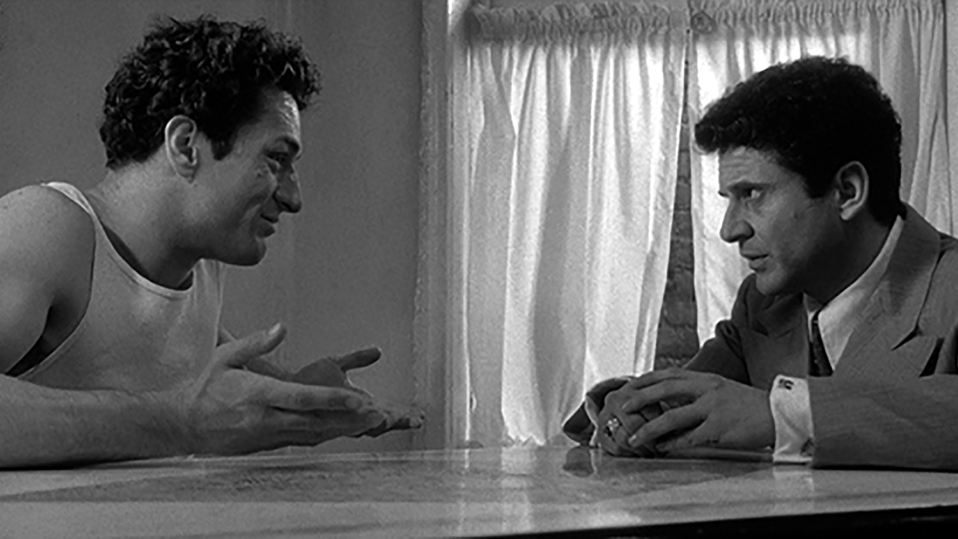
Martin Scorsese (2)
Raging Bull 1980

Slide 8

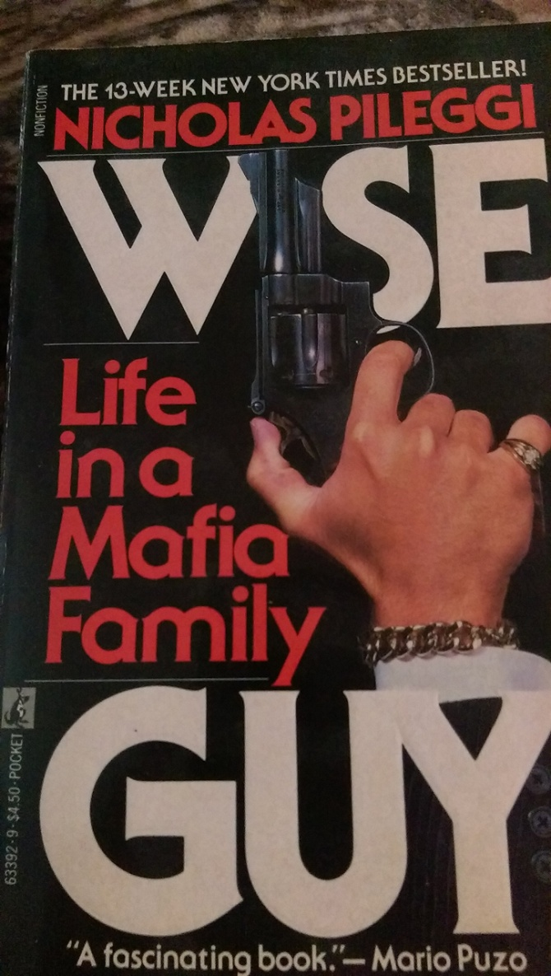
Pileggi: The Mob Exposé
Wiseguy 1985
Casino 1995

Slide 9
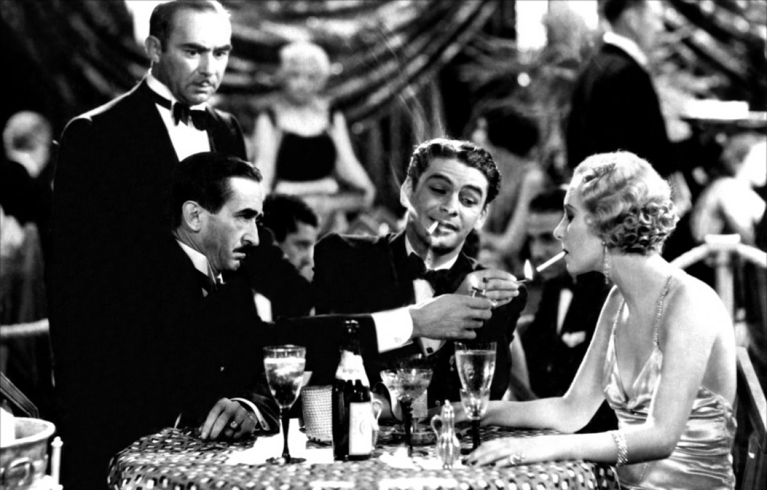
Gangster texts (1)
Scarface (Howard Hawks, 1932)

Slide 10
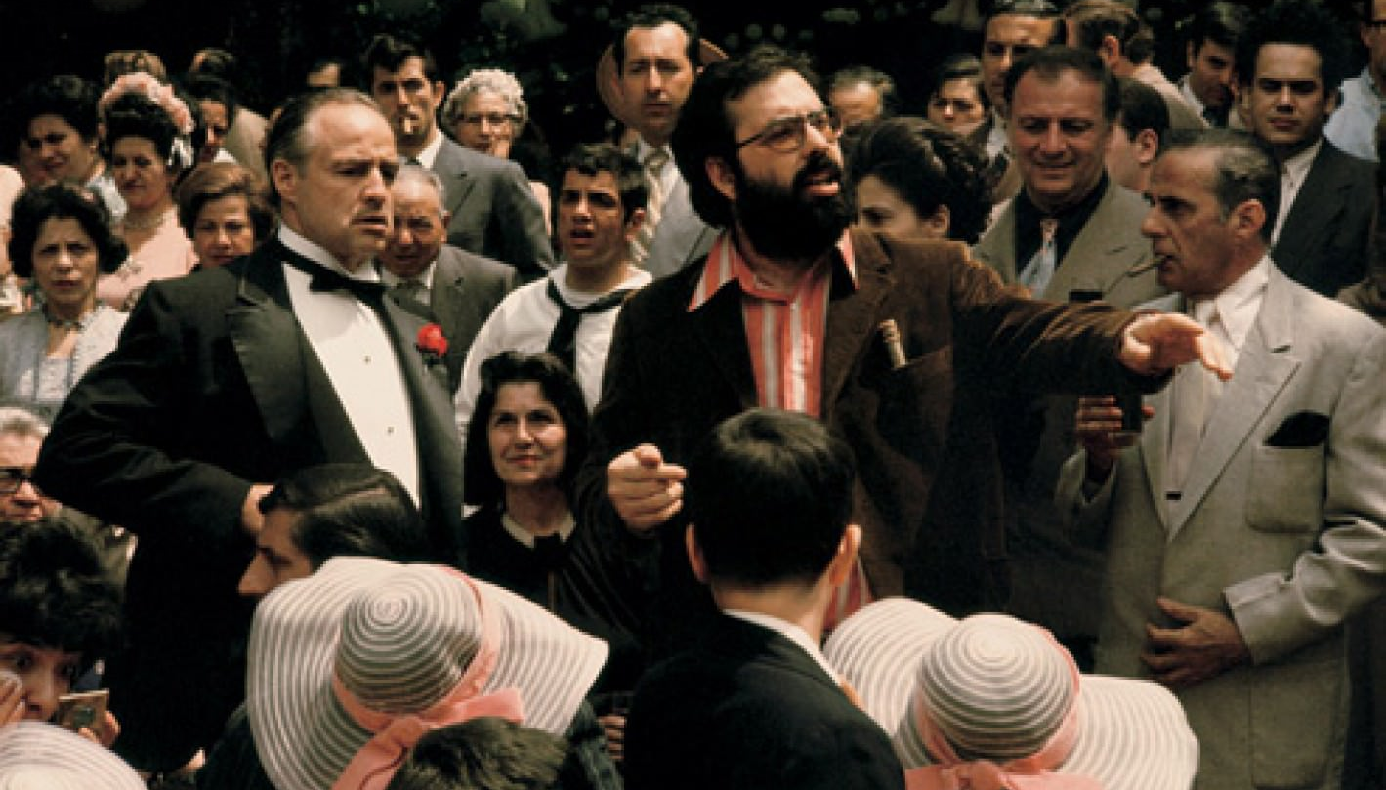
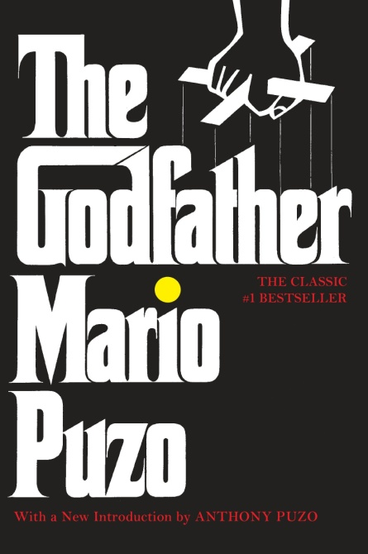
Gangster texts (2)
The Godfather (Francis Ford Coppola, 1972); inset: Mario Puzo’s 1969 novel

Slide 11

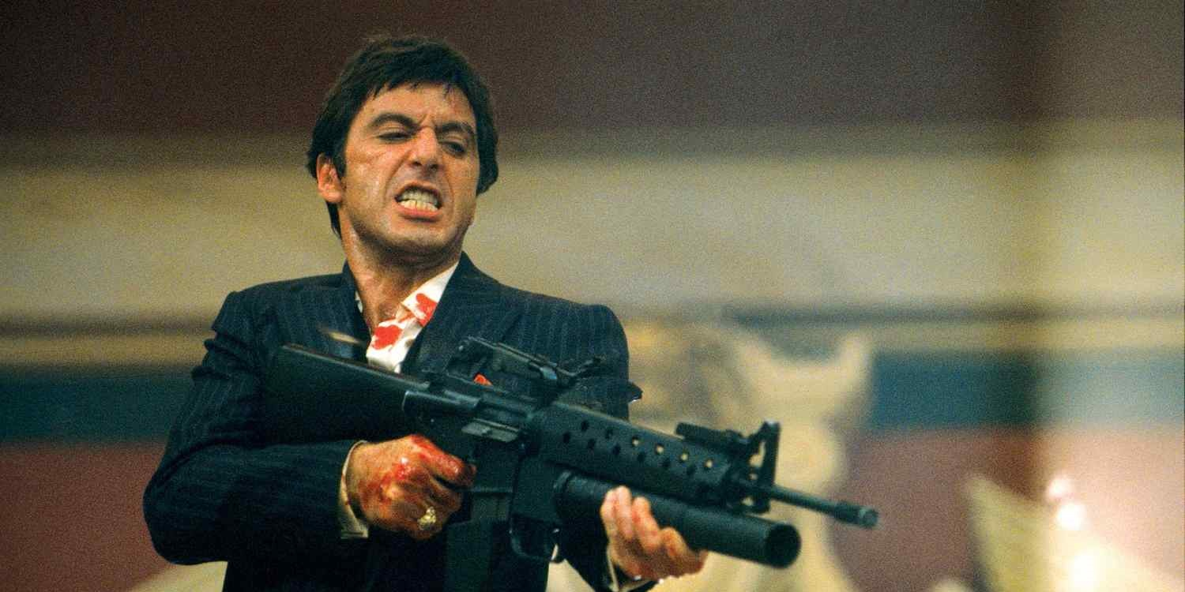
Gangster texts (3) : Weapons & Violence
Scarface (De Palma, 1983); inset: the Hawks 1932 original

Slide 12
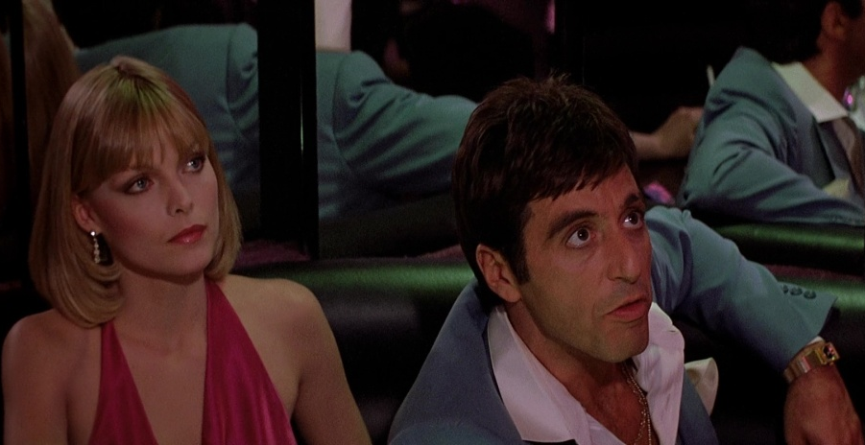
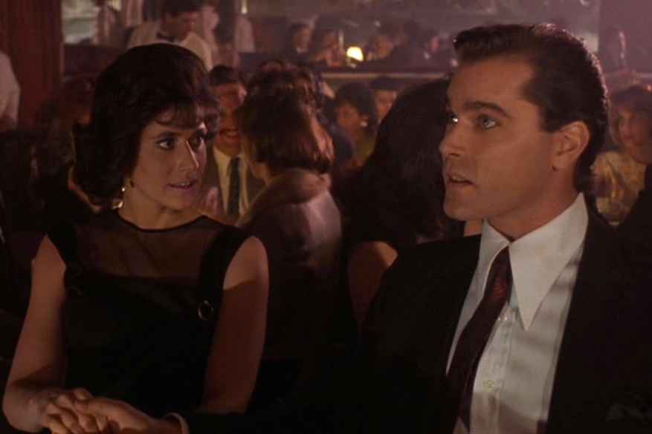
Gangster texts (4) : ‘The Moll’
Tony and Elvira
Tony and Poppy
Henry and Karen
Scarface (Hawks, 1932); inset: Scarface (De Palma, 1983); Goodfellas

Slide 13
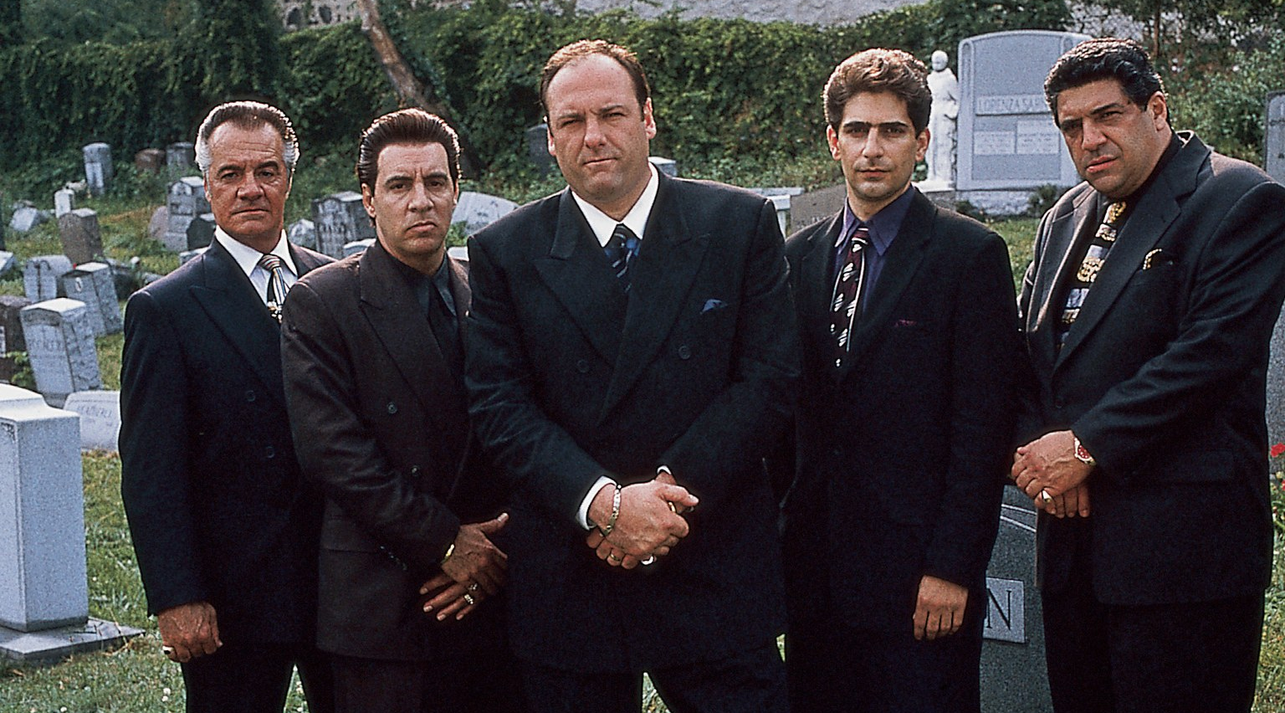

Gangster texts (5): ‘The Family’
The Sopranos (TV Series 1999-2007); inset: the surrogate family in Goodfellas

Slide 14
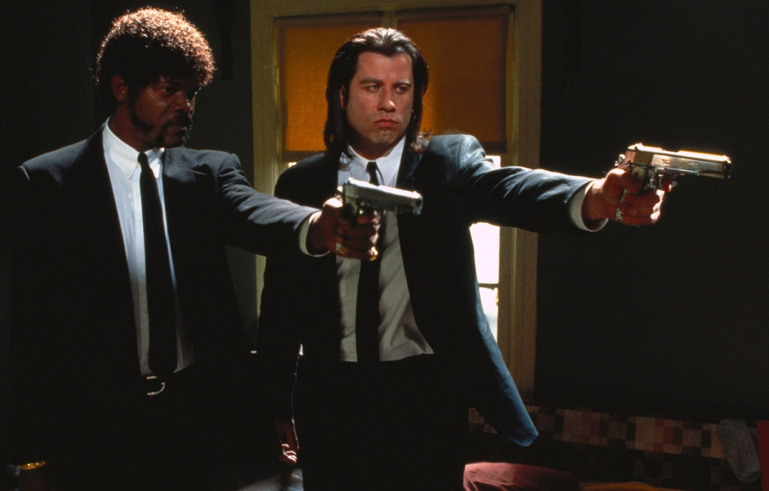

Gangster texts (6): The Legacy
Pulp Fiction (Tarantino, 1994)
Grand Theft Auto (Rockstar Games)

