Slide 1
BMTP5023
Sustainable Global Tourism
Week 3

Slide 2
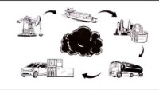
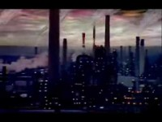
What is carbon footprint?

Slide 3
In case you forgot to look into this:
What Is Doxey's Irritation Index And How Does It Work? - Tourism Teacher
Butler's Tourism Area Life Cycle Model: A Simple Explanation - Tourism Teacher
Notes:
Take time now to review,

Slide 4
Tourism Development
Tourism has become an increasingly important factor in the economic and social development of a destination
Tourism development can boost the economic growth, expand employment opportunities, and improve income for both the government and the residents (Gursoy and Rutherford, 2004; Seetanah, 2011; Tao and Wall, 2009).
The development of tourism may also preserve peace and order (Pratt and Liu, 2016)
Positive host attitudes toward tourism development can improve the service quality and intangible infrastructure provided at the destination, which, in turn, enhance destination image and attract more tourists (Sharpley, 2014).
minimize the perceived cultural distance between the tourists and the hosts (Fan et al., 2017).

Slide 5
Tourism Development
Tourism development in an area or region may also lead to various social and environmental issues, such as traffic congestion and pollution (Choi and Murray, 2010; Zhang et al., 2017).
Such problems often lead to a negative host attitude toward tourism and restrain the destination to establish a sustainable tourism development.
As argued by Sharpley (2014), the success of tourism development depends on the balance of the relationship between the tourists and the hosts.
Negative host attitudes may damage the destination image or even cause conflicts between hosts and tourists—a phenomenon that deviates from the initial motivation of tourism development. Although all destinations aim to benefit the hosts through the development of the tourism industry, the ‘ irritated voice’ has already been heard from a few destinations like Barcelona (Gordon, 2014), and Amsterdam (Haines, 2016).

Slide 6
Butler Talc Model & Doxey Irridex
The tourism area life cycle (TALC) model (Butler, 1980) is introduced to explain the tourism development process in a destination.
This is followed by introducing of various factors which influence host attitudes toward tourism development from a sustainable viewpoint.
Then, two theories related to the change of host attitudes, Doxey’s (1975) Irridex model and social exchange theory, are reviewed.
The research gaps are identified and feasible solutions are suggested to bridge those gaps.

Slide 7
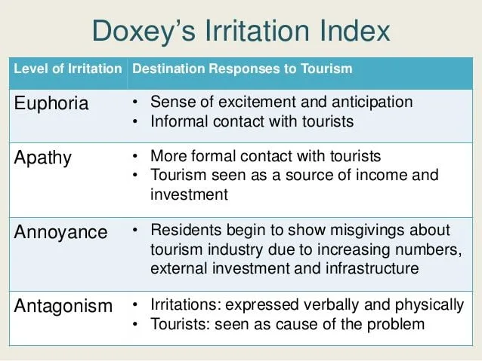
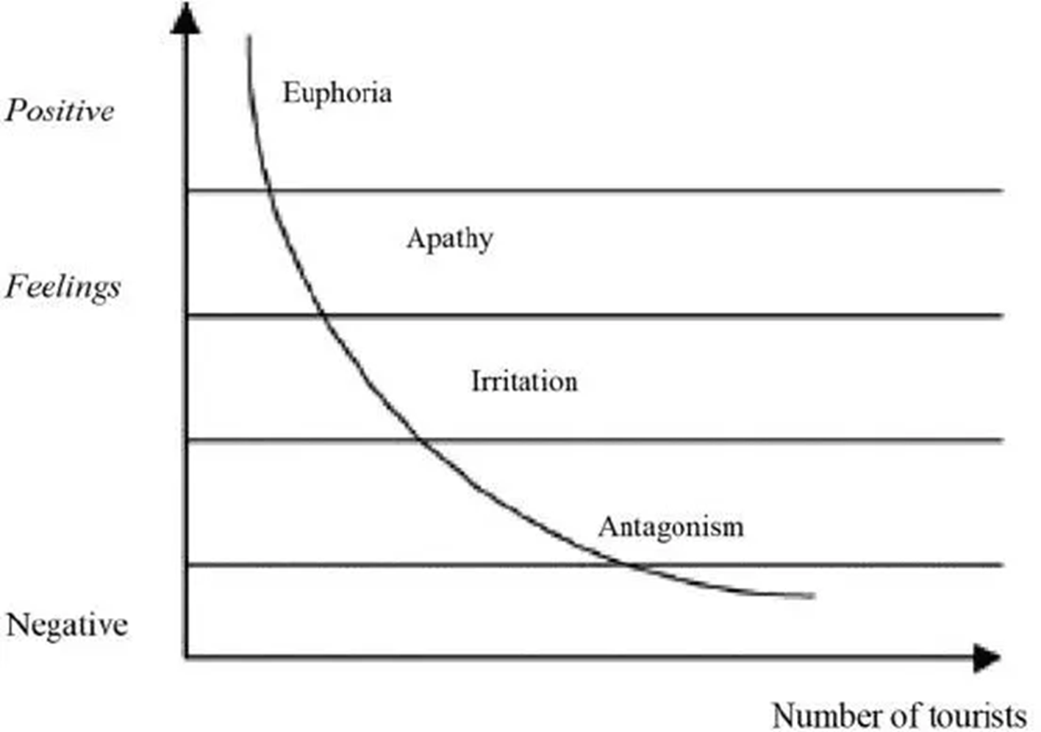

Slide 8
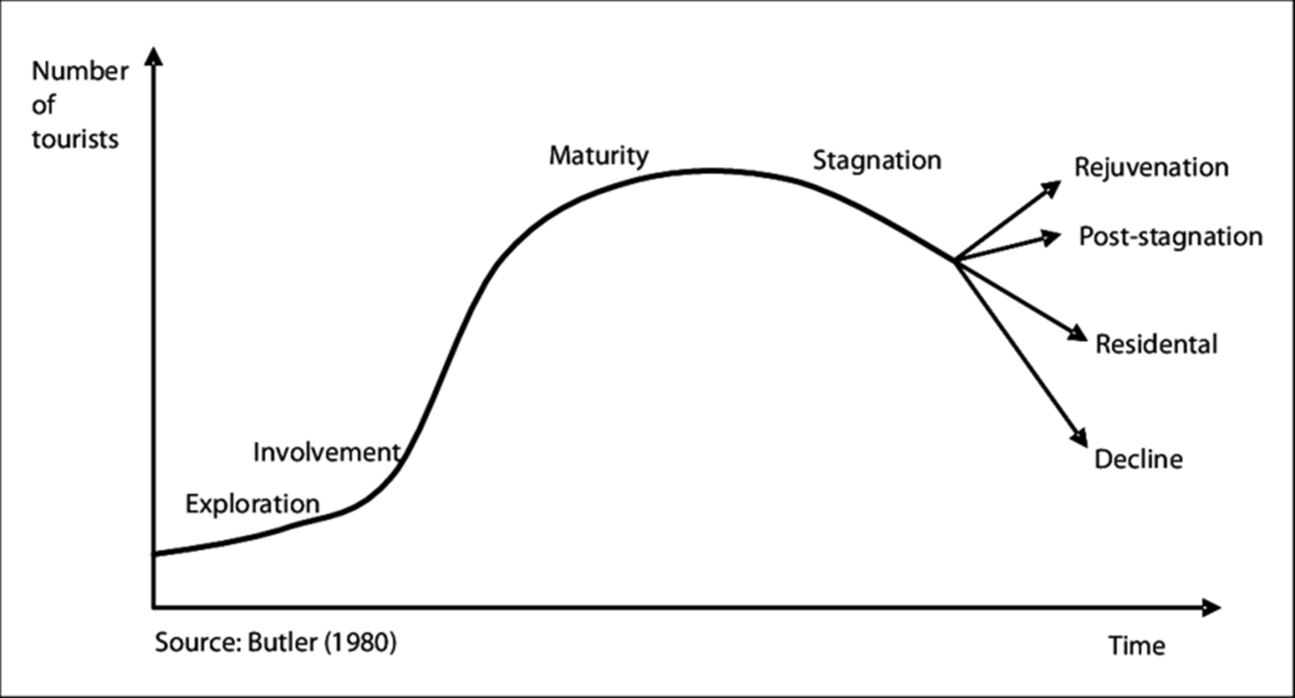
Butler Model
The TALC model (Butler, 1980), one of the most renowned and widely used models to explain the tourism development in an area uses a series of stages that characterize the life cycle of a destination.
According to the model, the development of a tourism area typically experiences six stages, namely, the exploration, involvement, development, consolidation, stagnation, and post-stagnation stages.
Host attitudes toward tourism development may vary at different stages.

Slide 9
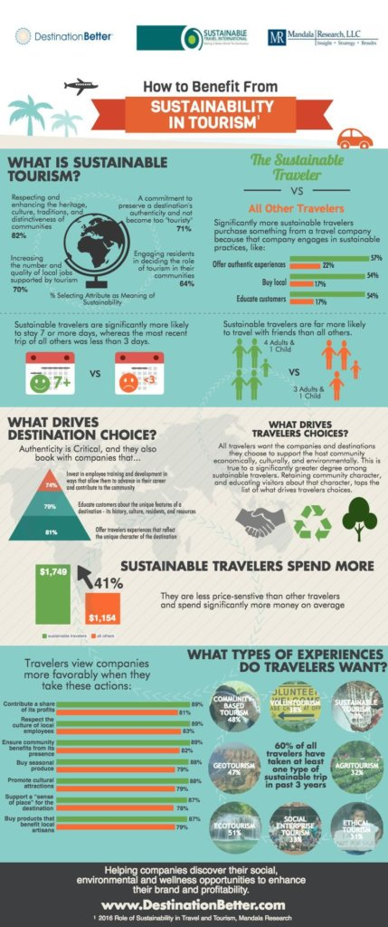
The final stage of Butler’s Tourism Area Life Cycle Model represents a range of possible outcomes for the destinations along the spectrum between rejuvenation and decline.
Complete rejuvenation can occur through major redevelopments. Perhaps new attractions are added, sustainable tourism approaches are adopted or there is a change in the target market.
Sustainable tourism, therefore, relies on the premise of taking care of the environment, society and the economy. Sustainable tourism principles intend to minimise the negative impacts of tourism, whilst maximising the positive impacts.

Slide 10

In recent decades, consumer awareness of social and environmental issues has increased markedly. Companies are progressively integrating sustainable development into their growth strategies for both ethical and profitable reasons, especially if they are to continue attracting the younger, socially active customer.
Many companies base their targets around the UN Sustainable Development Goals.
Notes:
In recent decades, consumer awareness of social and environmental issues has increased markedly. Companies are progressively integrating sustainable development into their growth strategies for both ethical and profitable reasons, especially if they are to continue attracting the younger, socially active customer.
Many companies base their targets around the UN Sustainable Development Goals. Quick test - How many are there?!

Slide 11
A tide of green…
A study by Harvard Business Review (2019) found that for sales in 90% of the observed Consumer Packaged Goods categories, brands that were marketed as sustainable were growing faster than traditional competitors.
Truly impactful changes to the ways in which businesses operate tend to be rewarded by the public through a rise in popularity and consequently, sales.
40% of millennial respondents had chosen an employer because of their sustainability performance. 70% of millennials answered that they are more likely to stay with a company with a strong environmental reputation and policy (Governance & Accountability Institute, 2019).
Hospitality as well as food and beverage companies also often focus their public messaging around these topics, promoting achievements in saving water, electricity or reducing greenhouse gas emissions either directly or along their supply chain. Truly impactful changes to the ways in which businesses operate tend to be rewarded by the public through a rise in popularity and consequently, sales.
Notes:
A 2019 study by Harvard Business Review found that for sales in 90% of the observed Consumer Packaged Goods categories, brands that were marketed as sustainable were growing faster than traditional competitors. This rise in customers’ attention to environmental issues has been picked up on by large companies in virtually any industry. As a consequence, the use of buzzwords such as “sustainable”, “eco-friendly” and “green” has skyrocketed in recent years, as brands are trying to highlight the ecological advantages of their products or services.
Adidas’ recent pledge to use only recyclable polyester in their sneaker and clothing production by 2024, or forty-two major consumer goods brands (e.g. Häagen-Dasz, Tide & Gilette) coming together in the Loop TerraCycle project to provide households with zero-waste containers that are refilled only when needed are merely two examples of these “green” initiatives.
Hospitality as well as food and beverage companies also often focus their public messaging around these topics, promoting achievements in saving water, electricity or reducing greenhouse gas emissions either directly or along their supply chain. Truly impactful changes to the ways in which businesses operate tend to be rewarded by the public through a rise in popularity and consequently, sales.
A study by Just Capital, an outlet that ranks American companies on issues such as fair pay, equal treatment and ecological impact, found that companies that lead their competitors in terms of environmental performance also tend to enjoy a median Return-on-Equity that is 3% higher than that of their counterparts.
Furthermore, running an ethical and sustainable business is gaining importance in the fight for scarce talent. A survey by the Governance and Accountability Institute published this year found that 40% of millennial respondents had chosen an employer because of their sustainability performance. On retention, the responses were even clearer. Here, 70% of millennials answered that they are more likely to stay with a company with a strong environmental reputation and policy.

Slide 12
What does this mean for tourism?

Slide 13
What is Corporate Social Responsibility?
Corporate Social Responsibility is a management concept whereby companies integrate social and environmental concerns in their business operations and interactions with their stakeholders.
CSR is generally understood as being the way through which a company achieves a balance of economic, environmental and social imperatives (“Triple-Bottom-Line- Approach”), while at the same time addressing the expectations of shareholders and stakeholders.
Notes:
Discuss directed learning form last week and apply Doxey to this.
Corporate Social Responsibility is a management concept whereby companies integrate social and environmental concerns in their business operations and interactions with their stakeholders...
...CSR is generally understood as being the way through which a company achieves a balance of economic, environmental and social imperatives (“Triple-Bottom-Line- Approach”), while at the same time addressing the expectations of shareholders and stakeholders.
What is CSR? | UNIDO
We should care about the community because our customers want us to. A decade ago any kind of corporate social responsibility was driven by the loud eco-voice of a small minority. As they did not want to lose that share of wallet revenue however small, large companies hastily put into place a CSR (corporate social responsibility). These were statements or practises that accentuated any green element of the company that could be found from already established practices. Exaggerations were rife. The general feeling at the time was that sustainability demands would be soon outdated and not worth any major policy or production changes – hence the notes left in Hotels about not wanting to wash your towels to ‘save the environment’. In short, industry thought that any demand for sustainable accountability would not last.
But the demands for sustainable accountability did not go away. In fact, they increased.

Slide 14
CSR defined and debated
CSR encompasses the economic, legal, ethical and philanthropic expectations that society has of organisations at a given point in time. (Carrol, 1979)
CSR is a view of the corporation and its role in society that assumes a responsibility among firms to pursue goals in addition to profit maximisation and a responsibility of the stakeholders to hold the firm responsible for its actions. (Freeman, 1984)
Business decision making linked to ethical values, compliance with legal requirements, and respect for people, communities, and the environment around the world (Aaronson, 2003)
Strategic CSR as ‘the incorporation of a holistic CSR perspective within a firm’s strategic planning and core operations so that the firm is managed in the interest of a broad set of stakeholders to achieve maximum economic and social value over the medium to long term’ (Chandler, 2017)
Notes:
Some additional points

Slide 15
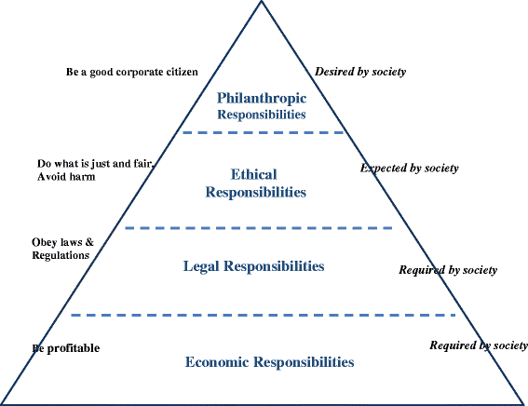
Carroll’s pyramid of CSR
Corporate social responsibility (CSR) in its modern formulation has been an important and progressing topic since the 1950s. To be sure, evidences of businesses seeking to improve society, the community, or stakeholder groups may be traced back hundreds of years (Carroll et al. 2012).
(Carroll, 2016)
Notes:
Figure 1 | Carroll’s pyramid of CSR: taking another look | International Journal of Corporate Social Responsibility (springer.com)
Corporate social responsibility (CSR) in its modern formulation has been an important and progressing topic since the 1950s. To be sure, evidences of businesses seeking to improve society, the community, or particular stakeholder groups may be traced back hundreds of years (Carroll et al. 2012).
it must be acknowledged that some writers early on have been critical of the CSR concept. In an important Harvard Business Review article in 1958, for example, Theodore Levitt spoke of “The Dangers of Social Responsibility.” His position was best summarized when he stated that business has only two responsibilities – (1) to engage in face-to-face civility such as honesty and good faith and (2) to seek material gain. Levitt argued that long-run profit maximization is the one dominant objective of business, in practice as well as theory (Levitt 1958, p. 49). The most well-known adversary of social responsibility, however, is economist Milton Friedman who argued that social issues are not the concern of businesspeople and that these problems should be resolved by the unfettered workings of the free market system (Friedman 1962).
Introduction

Slide 16
CSR - positive/negative
Clear policies
Commitment and agreement on objectives
Resources made available
No conflicts with other policies
Coordination of efforts and communication by a committee or problem-solving group
Rising costs of operations
Locking horns with stakeholders
Public Image/Risk to reputation
Increased Accountability
Losing sight of what matters
(Legrand, Sloan, Chen, 2017)
Harrapa (2017)
Notes:
Essentially, CSR is sustainable business management with improved financial performance reduced operating costs, enhanced brand image, increased sales and customer loyalty, increased productivity and ability to attract and retain employees.
One of the most significant disadvantages of CSR in business is the impact on public image. Once you're in the public eye, you're more likely to be scrutinized for everything you do. As an organization that upholds its credibility with its actions, you may be subject to criticism over the smallest acts.
For Organizations, The Primary Aim Is To Generate Revenue And Turn Profits. So, How Does Corporate Social Responsibility, Which Is About Giving And Not Taking, Factor Into The Balance Sheet?
An Organization’s Social Responsibility Toward Its Community, Employees And Other Stakeholders Is Significant And Concrete. The Sphere In Which An Organization Operates Needs To Be Sustained Not Just For The Organization’s Sake But For Others Involved. Having Said That, There Are Some Disadvantages Of Social Responsibility That May Put Organizations In A Dilemma.
Let’s Explore The Flip Side Of Social Responsibility And What It Means For A Business. Learn About The Importance Of Building Trust Among Stakeholders.
What Are The Disadvantages Of Social Responsibility?
A Corporate’s Social Responsibility Sets It Apart By Lending It A Competitive Advantage. Philanthropic Efforts Go A Long Way In Building Rapport, Goodwill And Loyalty Among Members In And Outside The Organization. But Once Organizations Engage In CSR, They’re Also Subject To Inspection, Criticism And Public Opinion.
Here Are Some Disadvantages Of Corporate Social Responsibility:
Rising Costs Of Operations
Investing In CSR, At Any Scale, Can Lead To High Costs And Expenses. Organizations May Have To Reorganize Their Finances To Accommodate This Budgetary Change. They Need Investment To Train Employees, Launch Campaigns And Collaborate With External Agencies To Roll Out Programs. It Largely Depends On The Type Of CSR Initiative, But Most Call For An Effort To Ensure Things Go To Plan.
Locking Horns With Stakeholders
Shareholders, Clients Or Customers May Experience The Financial Burden Of An Organization’s CSR Activities. In Terms Of Investors, They’ll Be Keen To Learn Where And How Their Money Is Being Spent. Clients Would Want To Know About Your Initiatives, Whether They Align With Their Organization’s Missions And If There Are Conflicts Of Interest. Customers Pay Greater Attention To Organizations That Make Visible CSR Efforts. This Can Impact Your Marketing And Sales Initiatives.
Public Image
One Of The Most Significant Disadvantages Of CSR In Business Is The Impact On Public Image. Once You’re In The Public Eye, You’re More Likely To Be Scrutinized For Everything You Do. As An Organization That Upholds Its Credibility With Its Actions, You May Be Subject To Criticism Over The Smallest Acts. This Can Put You At A Disadvantage As It May Affect Your Customer Base. Organizations Have To Invest Substantially To Maintain Their Public Image And Sustain Their Brand.
Increased Accountability
Organizations That Invest In CSR Agree To Be More Accountable And Responsible For Their Actions. If Your Business Operations Negatively Impact The Environment, For Instance, You Have To Do Damage Control And Set Things Right. If Your Products Aren’t Sustainable Or Eco-Friendly On One Hand And Your CSR Arm Is Protesting Against Climate Change And Other Environmental Detriments, You Can Be Put In The Spotlight. You Have To Assess Your Operations Before You Invest In Appropriate CSR Measures.
Losing Sight Of What Matters
Sometimes When You’re Fully Invested In External Activities That Take You Away From Your Work, You May Lose Sight Of What Matters. You May Start Doing CSR Just Because You Get Traction And Attention. Some May Resort To Attracting Numbers Of People With Empty Promises And Hollow Campaigns. It’s Important To Be True To Yourself, Trust The Process And Give Your Best Shot When You’re Trying To Do Something Good For Others.
The Advantages Greatly Offset The Disadvantages Of CSR. You May Be At Risk Of Losing Your Public Image In Case Of Any Missteps, But With Concerted Effort, You Can Surely Build Trust Within Your Community. If You’re Doing It Right, You Have Nothing To Fear.
A Helpful Trick Is To Learn All About Building Trust-Based Relationships That Add Value To Your Business. Harappa’s Establishing Trust Course Incorporates Key Concepts And Frameworks Such As The Trust Toolkit And The Dominant Factor To Understand How You Can Build Credibility. Learn To Honor Your Commitments, How To Be Open And Empathetic And Prioritize Others Before You. Create Something You’re Proud Of And Focus On What You Can Do To Change The Game. Overcome Barriers To Social Responsibility And Give Back To Your Community.

Slide 17


Slide 18
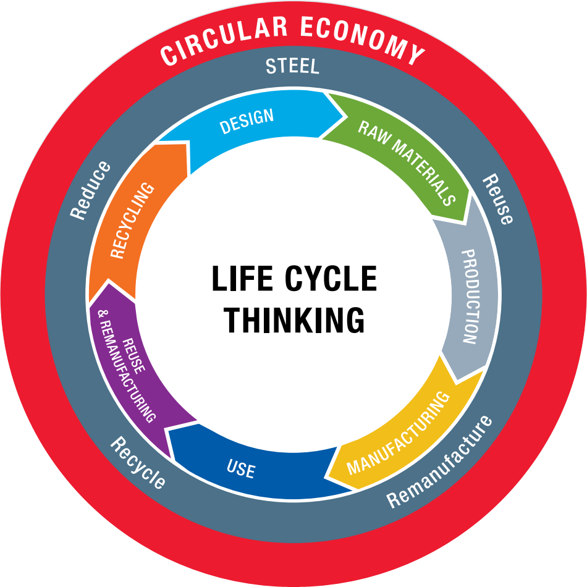
What is the Circular Economy?
The term ‘circular economy’ was brought to
prominence by the Ellen MacArthur Foundation
when it launched in 2010.
The circular economy is defined as a ‘regenerative system in which resource input and waste, emission, and energy leakage are minimised by slowing, closing and narrowing material and energy loops. This can be achieved through long-lasting design, maintenance, repair, reuse, remanufacturing, refurbishing and recycling’ (Geissdoerfer et al., 2017:764).
Notes:
The term ‘circular economy’ was brought to
prominence by the Ellen MacArthur Foundation
when it launched in 2010.

Slide 19
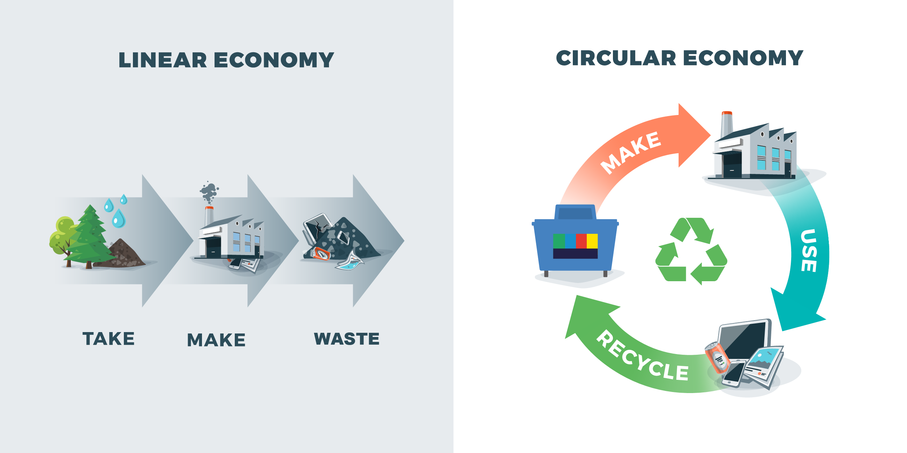
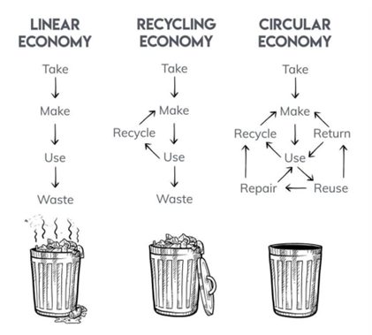
Notes:
So is it achievable?
Cradle to grave

Slide 20
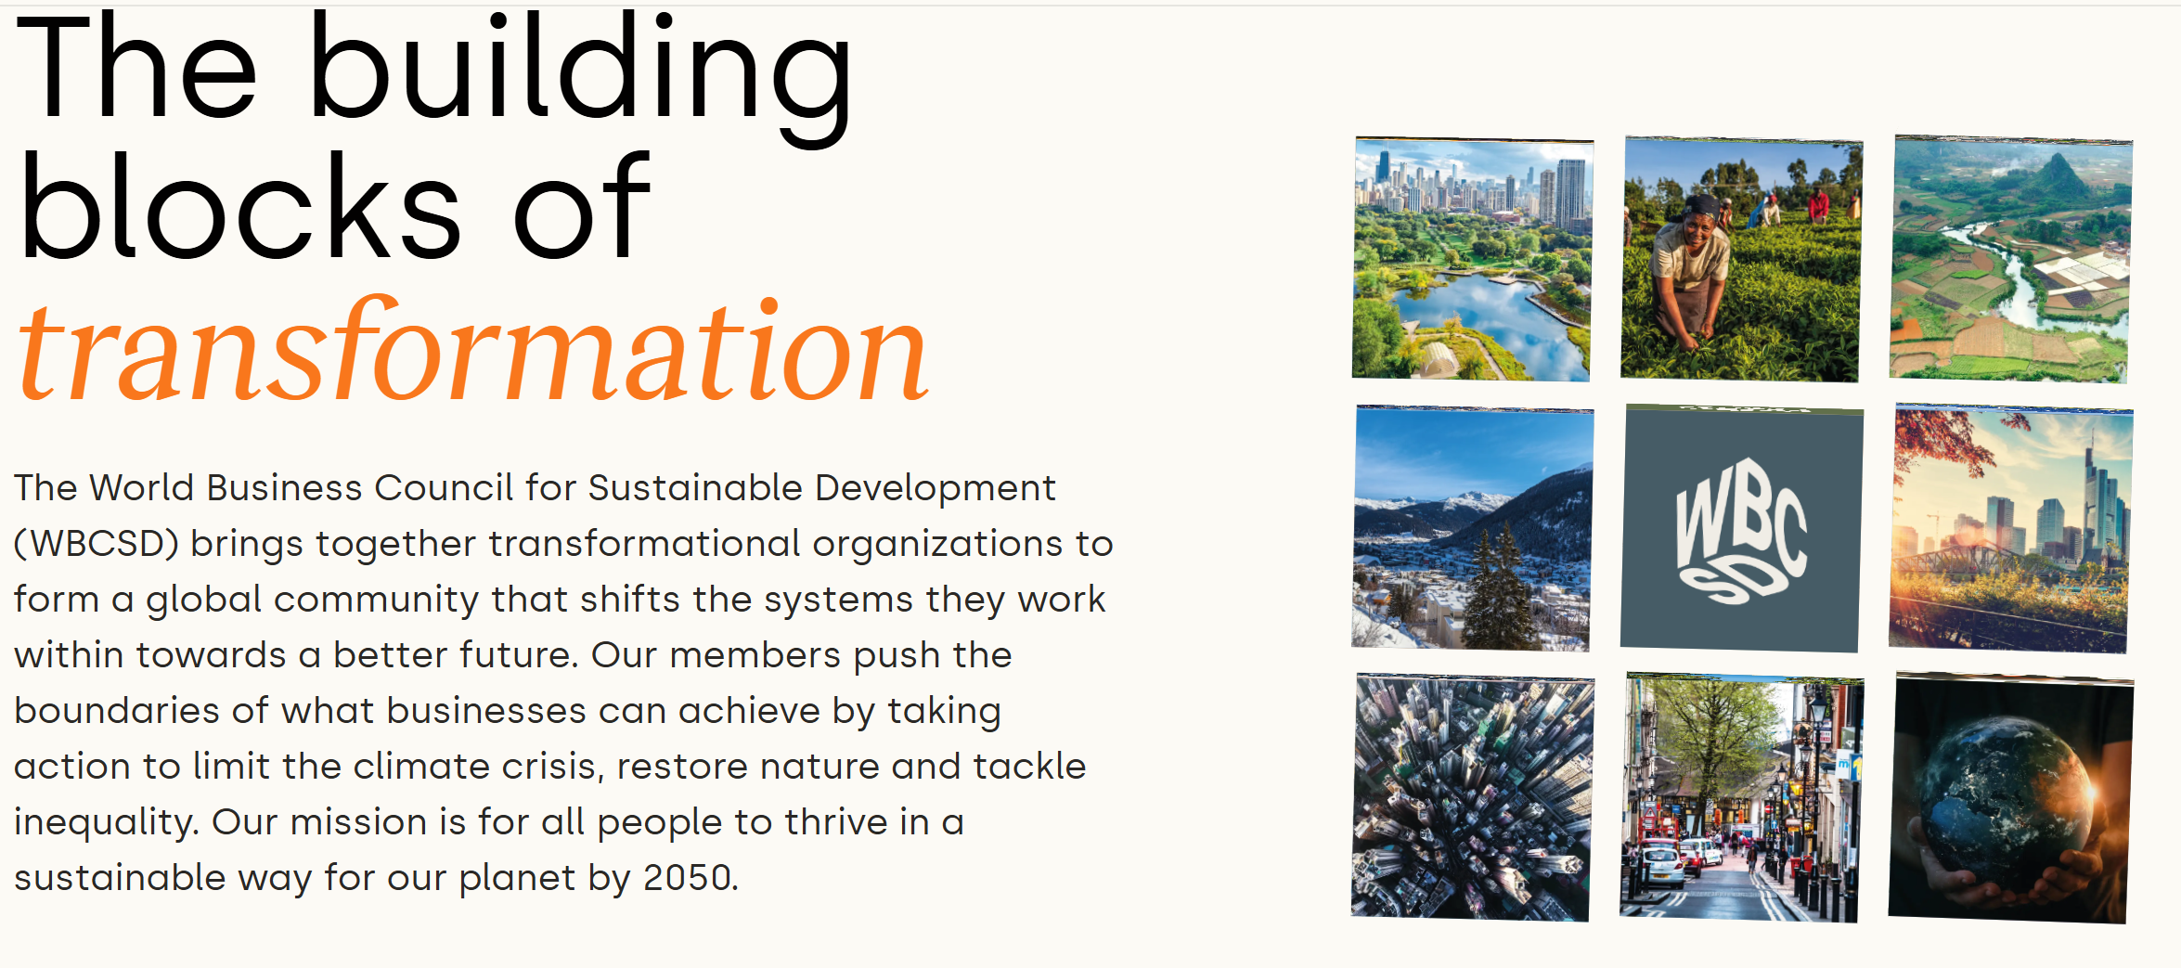
The Benefits
In a survey by the World Business Council For Sustainable Development (WBCSD): (www.wbcsd.org)
  40% of companies implementing the circular economy referenced growth and competitiveness as key business cases.
  In all, eight business cases for going circular are identified.
Over 200 leading businesses are members of the WBCSD. It’s their valuable work and dedication that allows us to create real change across global value chains. Benefitting the world around us and everyone who calls it home
Notes:
The World Business Council for Sustainable Development (WBCSD) brings together transformational organizations to form a global community that shifts the systems they work within towards a better future. Our members push the boundaries of what businesses can achieve by taking action to limit the climate crisis, restore nature and tackle inequality. So that all people can thrive in a way that’s sustainable for our planet – by 2050.
Over 200 leading businesses are members of the WBCSD. It’s their valuable work and dedication that allows us to create real change across global value chains. Benefitting the world around us and everyone who calls it home.
Actually these 8 materials cover most of human activity!

Slide 21

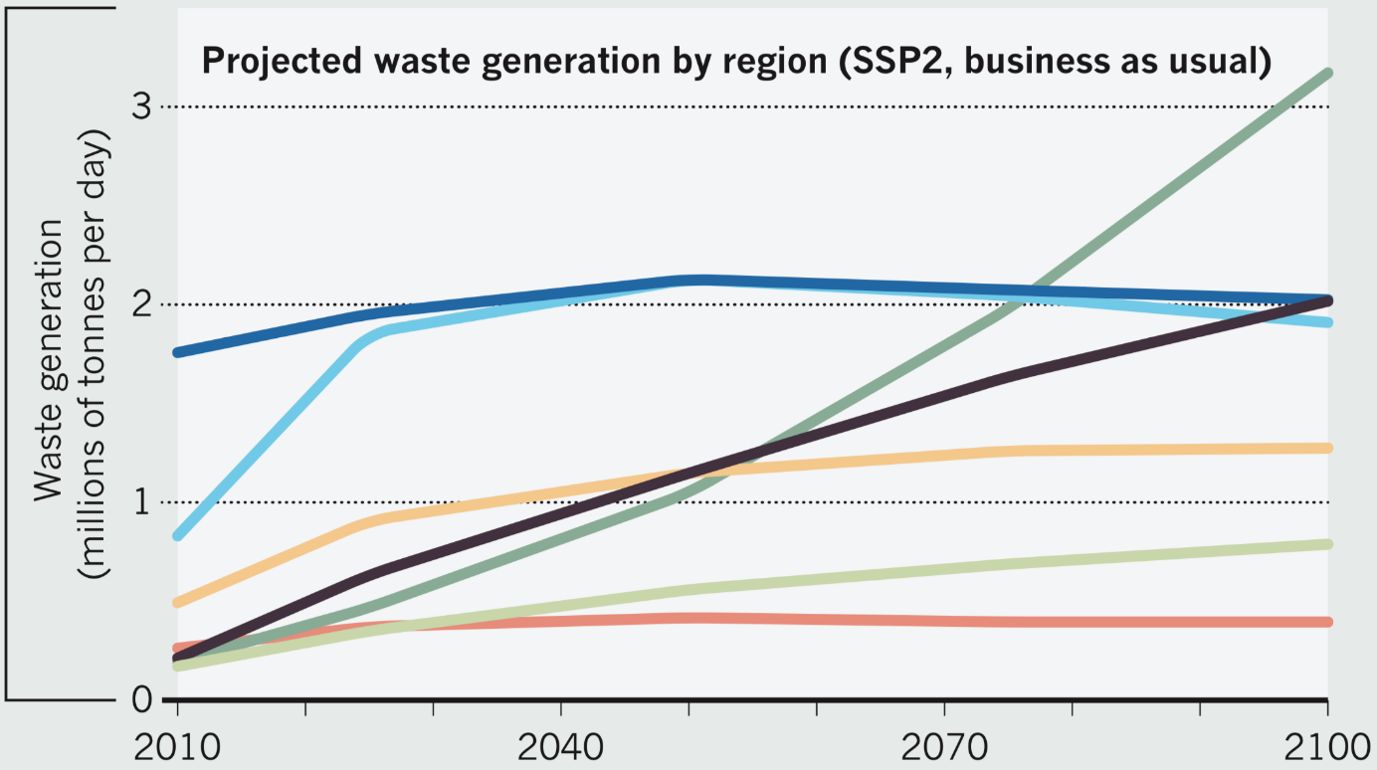
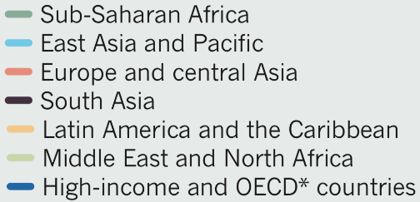
The Blunt Fact!
In a truly Circular Economy, the concept of waste simply doesn’t exist.
Hoornweg, D., Bhada-Tata, P. and Kennedy, C. (2013). Environment: Waste production must peak this century. Nature, 502(7473), pp.615-617.
Notes:
Many are flat or falling, apart from south asia and sub Saharan Africa – large projected increases

Slide 22
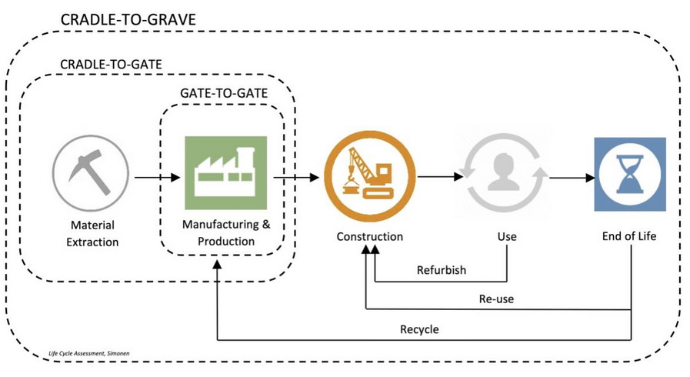
Notes:
Cradle to grave
It’s about elimintating this mindset of cradle to grave.
Ask students what they think the meaning is?

Slide 23

Notes:
(20) The Struggle of a Zero-Waste Restaurant – YouTube – For them to watch in their own time, deeper understanding of the challenges.

Slide 24
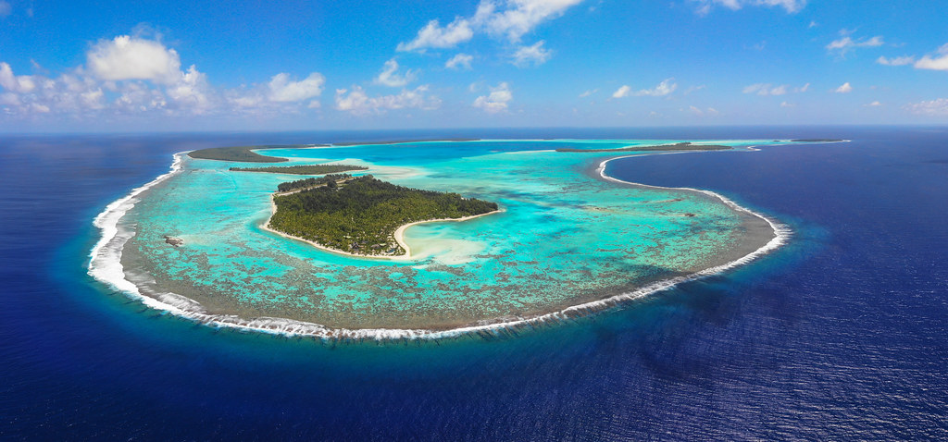

One of the world's top luxury resorts is also self sustainable and an inspirational role model to communities everywhere, showing even the best lifestyles can be lived in harmony with nature, without any negative impact. https://www.youtube.com/watch?v=k7j7CpjSj1o
Marlon Brando's Island Eco Resort in Tahiti
Exclusive eco-conscious hotel
Everything is recycled
Special machines for composting all food waste
All water is taken from the ocean and used to power air conditioning and is used for drinking water.
No boats are allowed inside the lagoon. Everything is dropped off in the ocean outside, so as not to damage the coral reef.
Explore
This is how it’s done!
Notes:
Youtube link is a 40min documentary for Students to explore in their own time, should they wish to find out more.
This slide is for students to discover more. The things they do are incredible!
With its white sand beaches, swaying coconut palms, colorful birds, and sparkling lagoon, Tetiaroa is a dream paradise.
Beyond its breathtaking beauty, it is a place of rare biodiversity and a natural sanctuary for birds and marine life. Preserving and protecting this rare habitat and its plant and animal life is critical to The Brando. 35 low rise luxury villas were built here with local materials and they blend perfectly into the landscape. Sea water is used as air conditioning, for hot water, solar panels and for power a coconut oil power station. Food is grown for their kitchens in their very own organic garden and their team is trained in sustainability and imparting that knowledge with the guests.

Slide 25
B – corp
Our most challenging global problems cannot be solved by governments and non-profits alone. By harnessing the power of their business, B Corps commit to positively impact all stakeholders – workers, communities, customers, and our planet.
Definition: A B Corp is a business that meets high standards of social and environmental impact, balancing profit with purpose.
Sustainability Focus: Emphasizes eco-friendly event practices, such as waste reduction, carbon offsetting, and responsible sourcing.
Social Responsibility: Ensures fair treatment of workers, ethical supplier partnerships, and community engagement.
Stakeholder-Centric Approach: Considers the impact on employees, consumers, and local communities, not just shareholders.
Transparency & Accountability: Requires annual impact reports to track and showcase ethical business practices.
Brand Reputation: Events associated with B Corps attract socially conscious attendees, partners, and sponsors.
Long-Term Legacy: Encourages event planners to create sustainable and meaningful experiences with lasting benefits.

Slide 26

Notes:
B – corp
Our most challenging global problems cannot be solved by governments and non-profits alone. By harnessing the power of their business, B Corps commit to positively impact all stakeholders – workers, communities, customers, and our planet.

Slide 27
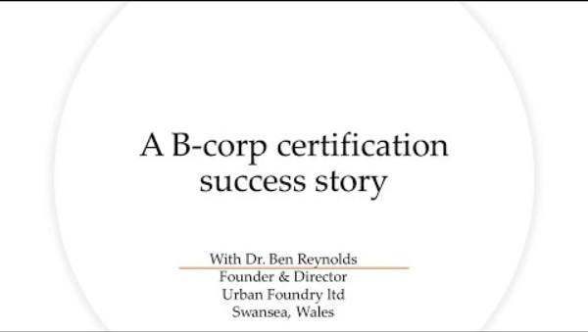
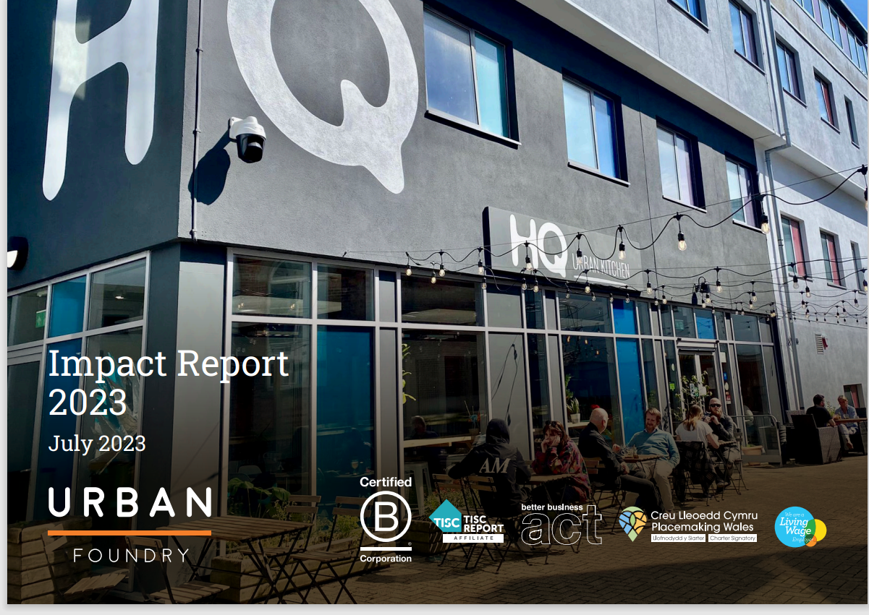
https://www.bcorporation.net/en-us/certification/
Notes:
“Urban Foundry is a pioneering organisation – amongst the first in Wales to achieve BCorp certification, leading work on meanwhile and popup spaces in Wales, working to mainstream green infrastructure urban regeneration projects with Welsh Government and Natural Resources Wales, creating the wonderful Swansea Bay Street Markets social enterprise to support local producers and bring life to places, and great ambassadors for paying a Real Living Wage
We have worked with Natural Resources Wales and Welsh Government to establish a Green Infrastructure funding stream and to introduce the concept and best practice to local authorities
• We have worked with Swansea Council to establish two rain gardens in the courtyard at our new venue to act as demonstrator projects.
• We partnered with Swansea Council and Natural Resources Wales to secure Community Renewal Fund (CRF) funding to pilot a supply chain development project to deliver Green Infrastructure projects for our local area to support the development of the local green economy.
• We established a Library of Things in our local area and joined the Wales-wide movement through Benthyg Cymru.
• We hosted a Repair Café as a PopUp event in the local shopping mall.
• We have moved all PopUp (or ‘Meanwhile’) spaces that we have taken over to renewable energy and accredited B Corp supplier Octopus.
• Our Uplands Market project was recognised by the Design Commission for Wales as an exemplary initiative for temporary placemaking initiatives in the built environment and features as a case study in their Placemaking Guide.
• We signed up to the Welsh Government and Design Commission for Wales’ Placemaking Wales Charter.
• We have given several talks on the concept of the 15-minute city, linking it back to our long-standing work on creating sustainable urban environments, which itself draws on the seminal work of Jane Jacobs.
• We have updated our written environmental policy and tied that into our written finance policy for procurement – both form part of our staff handbooks, some of the key aspects are listed opposite.
• Our new HQ Urban Kitchen venue uses local suppliers wherever possible and aims to be fairtrade – it sources its tea and coffee from ethical sources via certified B Corps.
• We have worked hard to create a strong vegan menu in our venue, which has a lower carbon footprint than non-vegan foods.
• We have supported the Swansea Food Partnership with free staff time to further its work.
• We supported the Swansea Green Economy conference, promoting Green Infrastructure alongside Natural Resources Wales and Swansea Council

Slide 28
Main Activity in Groups
Our Story – Coaltown Coffee
Seastainability® - Royal Caribbean Group
Sustainability: Our Philosophy | Aspen Skiing Company (aspensnowmass.com)
HOME - 4theRegion
Create a small presentation about what these companies CSR policies are
Notes:
Create a small presentation about what these companies do. Why are they sustainable? How does it link to the circular economy? What is their CSR?

Slide 29
Conclusion
The economy was pictured until recently as linear, with a strong tendency to satisfy the consumers’ needs with brand new products, somehow to give them a feeling of exclusivity.
However, a full range of environmental, socio-demographic and economic indicators, mostly alarming, created the need to change our consumption and production habits.
One of the main and current issues discussed in the media is climate change, of which a principal source is, according to studies, households’ consumption, thus including consumption of tourism.
To tackle this problem, new ways of thinking appeared over the course of a few years, in particular in developed countries, and the circular economy embodies most of them.

Slide 30


Slide 31
References
Carroll, A.B. (2016) Carroll’s pyramid of CSR: taking another look. Int J Corporate Soc Responsibility 1, 3 . https://doi.org/10.1186/s40991-016-0004-6
Sloan, P., Legrand, W. and Chen, J.S. (2017) Sustainability in the hospitality industry : principles of sustainable operations. 3rd edn. London: Butterworth-Heinemann.
Harappa (2023) Disadvabtages of Social Responsibility. Available at:Disadvantages Of Corporate Social Responsibility - Harappa‌ ‌(accessed: 06 October 2023).

Slide 32
Geissdoerfer, M., Savaget, P., Bocken, N. and Hultink, E. (2017). The Circular Economy – A new sustainability paradigm? Journal of Cleaner Production, 143, pp.757-768.
https://ellenmacarthurfoundation.org/
Hoornweg, D., Bhada-Tata, P. and Kennedy, C. (2013). Environment: Waste production must peak this century. Nature, 502(7473), pp.615-617
https://www.wbcsd.org/
https://wrap.org.uk
https://www.whitbread.co.uk/sustainability/
www.qo-Amsterdam.com/about
https://www3.weforum.org/docs/WEF_ENV_CircularEconomy_MainStream_ProjectOutline_2014.pdf
https://group.accor.com/en/brands/economy/greet

