Slide 1
Classics Project
Choosing a topic
and title

Slide 2
From Idea to Project
You’ve decided on your rough subject area – you have an idea of what you want to do?
Then what are the considerations that you need to take into account in order to make your research project a success?

Slide 3
Considerations: The Material
What ANCIENT sources are there relating to your subject area?
  How do you find out?
  Are there enough of them? (And what is enough, anyway?)
  Can you access them?
    Availability in library? online resources?
    Language skills – not only ancient, but modern languages too!

Slide 4
Considerations: Materials
What MODERN SCHOLARSHIP relates to your area of study?
  How do you find out?
  How do you avoid getting bogged down by scholarship?
    Why reading too much can be bad
  …and what can that tell you?
  Can you access the necessary secondary literature on your subject area?
    Availability in the Library/LRC, online resources,…
    Language skills

Slide 5
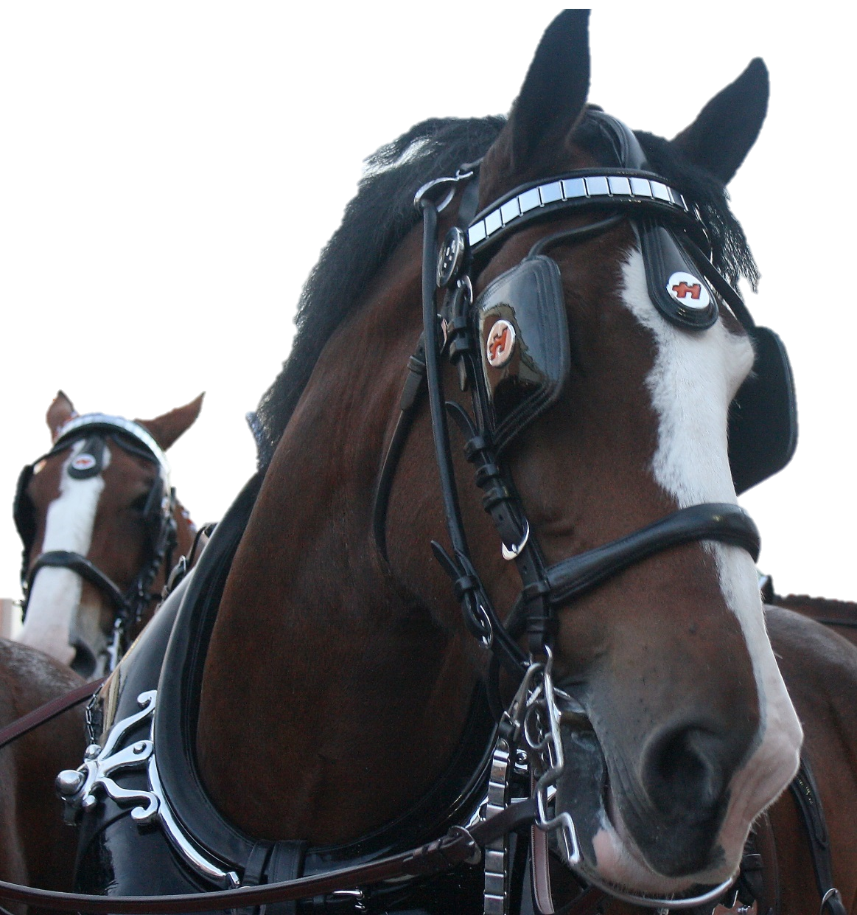
Considerations: About you
Do you have pre-conceptions about your area?
  Have you studied it before? Have you not studied it before?
Can you let go of those preconceptions?
Or else:
  You will read ANCIENT and MODERN evidence with BLINKERS on
  Your readings will be vulnerable to criticism

Slide 6
To think about
Consider the following issues:
  Have you missed anything you need to consider for a successful project?
  How do you locate the material you will need?
  What are the main ANCIENT sources you expect to use?
  What are the main MODERN WORKS you expect to use?
  How do you work with them (ancient & modern)?
  What do you expect to be the main problems you will have to face?

Slide 7
You have chosen your subject area…
Now what?

Slide 8
Narrowing your ideas own (1)
Historical
Exploration
Fantasy
Abstract

Slide 9
Narrowing your ideas own (2)
By Land
Accidental
By Sea
Historical Exploration
Deliberate

Slide 10
Narrowing your ideas own (3)
Archaic and Classical
Greek
Historical Exploration by Sea
Hellenistic
Roman
Roman Era

Slide 11
Narrowing your ideas own (4)
Historical Exploration by Sea – focus on the Greeks – Archaic and Classical Period
India
Ethiopia
Northern Europe
West Africa

Slide 12
Problems!
There is a archaic period Greek explorer who travels down the Indus, via the Indian Ocean to the Red Sea – Scylax of Caryanda.
However this is deliberative rather than accidental.
More importantly there is a snag – very limited historical evidence for him and his voyage survives – mostly fragmentary – possible, but more challenging than I want for the Project.

Slide 13
What do I do?
A this point I may need to alter my parameters:
  I want to keep the same period but am flexible culturally and geographically:
    May the voyage of Hanno – still Archaic – but a Carthaginian explorer who travelled down the western coast of Africa.
  I want to stick with the Greek and roughly to the Archaic or Classical period, but am flexible otherwise:
    Maybe Ctesias of Cnidus’ Indica – travelled to Persian court but did not directly go to India – nevertheless a good amount of fragments survive.
  I am willing to change the period, but want to stick with the Greeks and with the geographic focus:
    Eudoxus of Cyzicus – voyages to India, but in the late second century BC.
I am flexible in all elements, but I feel more comfortable with more substantial textual material and a good range of scholarship:
  Philostratus’ Life of Apollonius of Tyana books 2 and 3.

Slide 14
Now What? – Part 2

Slide 15
Step 1: Narrowing it down
Home
Women
Work

Slide 16
Step 1: Narrowing it down
Home
Greek?
Roman
Women
Free
Slaves
Work
Unpaid work
Paid work
Ages?
Wool work

Slide 17
Step 1: Narrowing it down
home
women
in Rome
wool
as part of upbringing
mainly unpaid?
=> good wives?
work
free women

Slide 18
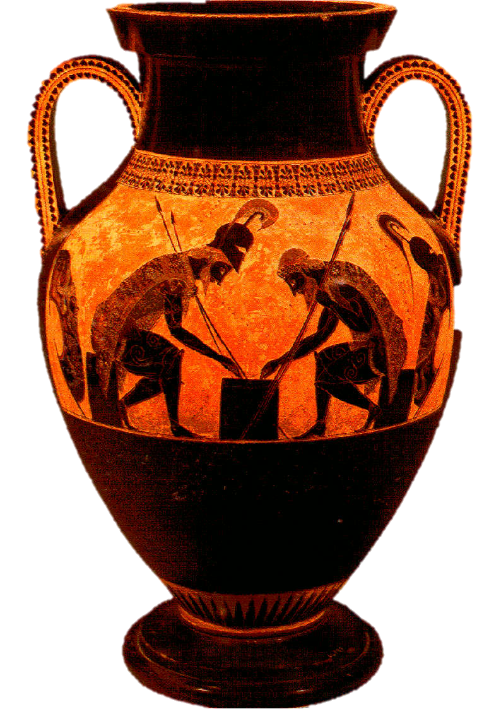
Step 2: Focusing your reading
What is available?
What ANCIENT evidence is available and can you access it?
What MODERN scholarship is available and can you access it?

Slide 19
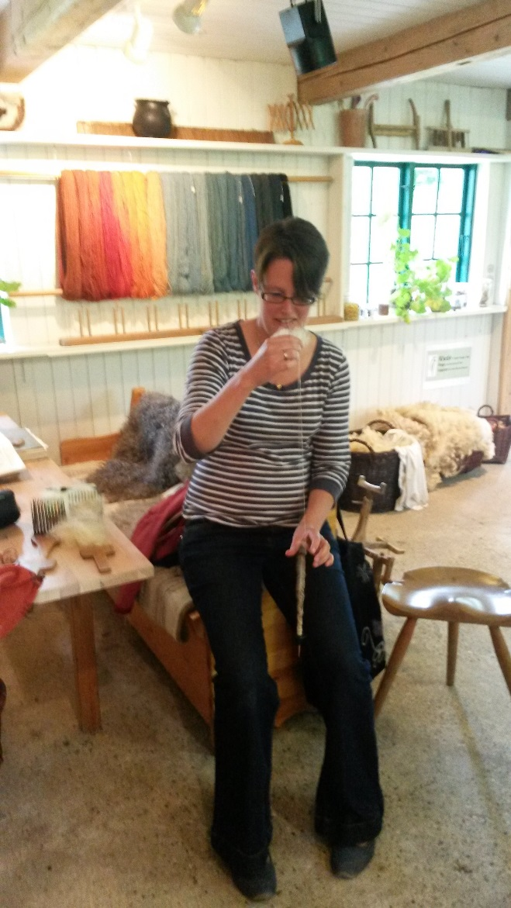
Step 3: Tweaking the topic
A lot more material to do with adult women, less clear on children.
  There are quite a few Augustan poems mentioning women spinners
There is some scholarship on paid spinning in the empire
  but it doesn’t relate to young women especially
So, not young women/girl children
Plenty of papyriological evidence… …but I can’t access it…
…so, NOT Roman Egypt…
…and I have little previous knowledge about life in the provinces, so…
…either: I’ll stick with spinning women in Augustan literature and the historical context
…or: I’ll use this module as a stepping stone to get to grips with a completely new area: I do have time to do research here!

Slide 20
Step 4: Write a working title
A working title needs to tell you and the reader what the topic is about.
It needs to have the possibility of an answer
It needs to create the need for an argument or discussion rather than merely be descriptive
For example:
Do the descriptions of female wool work in Augustan poetry support the idea that women could support themselves by wool-work in the 1st C BC?

Slide 21

Working titles and the Eye-catcher
A working title (or subtitle) is there to tell the reader specifically what your work is about.
The “eye-catcher” is there to seduce the reader into picking up your work with interest.
The “eye-catcher” is best written when you are nearing the completion of your work.

Slide 22
Preparation before the deadline
Work on your title.
Consult with other members of your group
or with us.
You will need to have a working title Friday.
Publish your working title on the Moodle forum by 3 pm on Friday, 29 January 2016.
Check the forum regularly over the next few days as you will be receiving approval and/or feedback on your working title.

