Slide 1

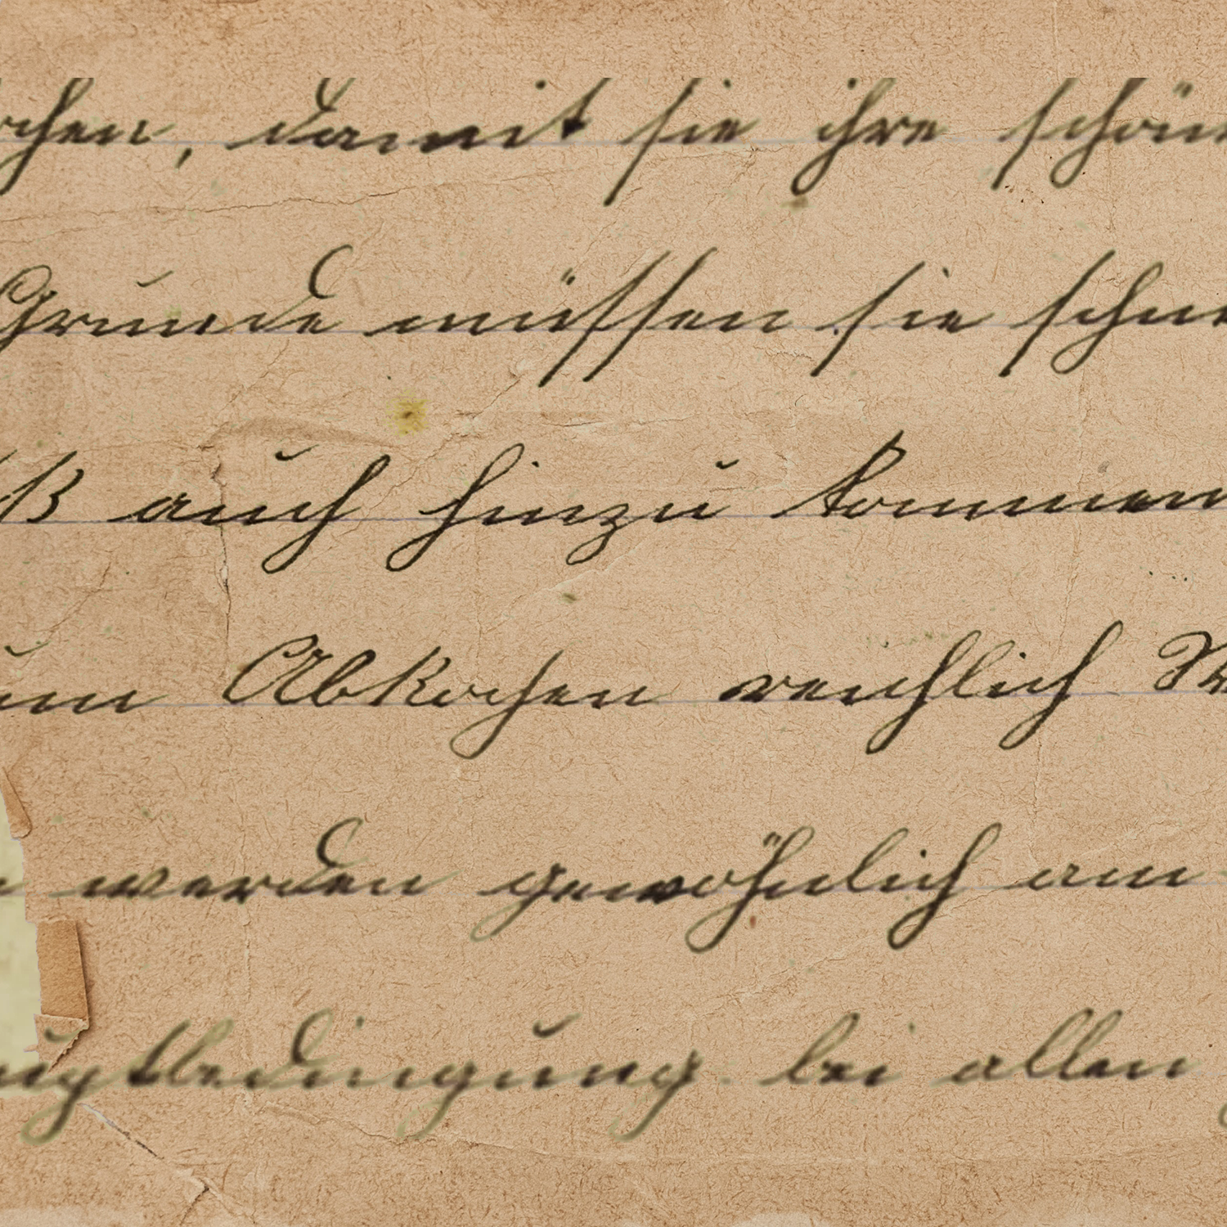







By Zita Draper
Assignment Guidance

Slide 2


Content
01.
02.
03.
04.
05.
Question
Guidance
Breaking it down
FAQ’s
Summary

Slide 3





01
Questions
1.Is there a general duty to act in criminal law?
2.What are the requirements for a crime to be committed by omission?
3.When might a statutory duty to act be present?
4.When might a contractual/ duty based on office be present?
5.When might a duty to act arise from assumed responsibility?
6. Do you consider that there should be a general duty to act within the criminal law of England and Wales. What arguments are put forward for and against this and by whom? Which arguments are you persuaded by and why? [750 Words] [50 Marks]

Slide 4

02
Guidance
Please note the individual word count for each question; Questions 1-5 have an individual word count of 150 words each and are worth 10 marks each. Question 6 is worth 50 marks and has a word count of 750 words.
Within your answers you are to utilise the following sources, alongside 5 further independently retrieved sources ; Your work should be supported with credible sources, such as relevant case law, journal articles, Law Commission reports, Parliamentary papers and textbooks (to name a few). You are reminded to reference in accordance with the Harvard Referencing System throughout your work and should include a reference list to demonstrate your engagement with literature;

Slide 5
02
Guidance
- Finch, E. and Fafinski, S. (2021) Criminal law. 8th edition. Harlow, England: Pearson.
- Herring, J. (2022) Criminal law : text, cases, and materials. Tenth edition. Oxford: Oxford University Press.
- Macdonald, S.K. (2018) Text, cases, and materials on criminal law. Second edition. Harlow, England: Pearson Education Limited.
- Taylor, L. (2018) Elliott and Quinn’s criminal law. Twelfth edition. Harlow, England ; Pearson Education Limited.

Slide 6
02
Guidance
- Deadline is the 7th November 2025 at 23:59pm
  - Up to a week late - capped at 40
  - Over a week late 0
  - Remember the extenuating circumstances process is there and can be accessed by the data and forms section on mytsd. Evidence will need to be provided.

Slide 7
03
Breaking it down
Question 1
Question 1
Must be written in 3rd person. No need for an introduction or conclusion. You do need to provide a full answer.
I cannot give you an answer to the question.
But I can guide you in how you answer.
Yes/No there is not/is a general duty to act in criminal law. Smith (2020) expresses this duty arises where .........

Slide 8
03
Breaking it down
Question 2
Question 3
  Look at the legislation (Law)
  What does a statutory duty mean?
  Need to include case law examples
  Contractual duty / Office
  Police officers
  Define contractual duty/ office
  Support your answer with case law.

Slide 9
03
Breaking it down
Question 4
Question 5
  Define what is meant by the term ‘’assumed responsibility’’
  Answer the question using your research
  Support with case law
Follows the same pattern.

Slide 10
Breaking it down
03
QUESTION 6 –
Part 1 of the question - written in first person!
Part 2 - Written in third person, you are expected to analyse.
Utilise point, evidence, explain and link.
This part should take up quite a bit of your word count.
Part 3 - Written in first person.

Slide 11


04
FAQ’S
How many marks do I need to pass?
What if I fail?
Can Zita give me an extension?
You need to get 40 marks overall in the module, so you could get 20 in the first assignment and 60 in the second and still pass.
NO
40 marks out of 100

Slide 12

05
Summary
  Assignment Question
  Guidance
  Breaking down the question
  Frequently asked questions
You get out, what you put in!

Slide 13

Any Questions?
Thank
you

