Slide 1
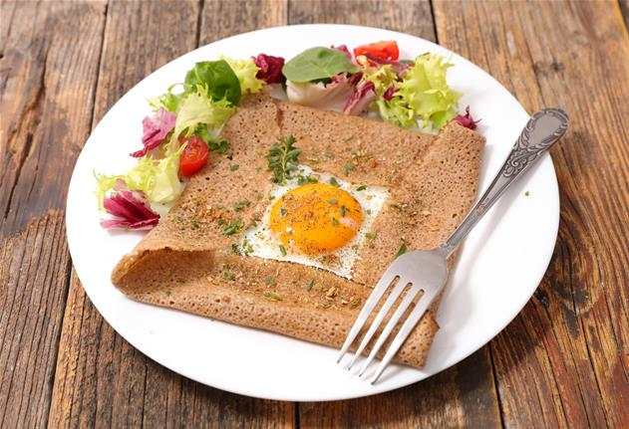
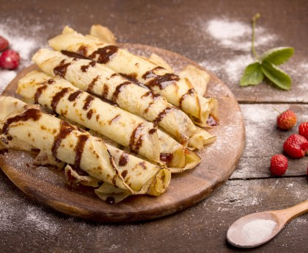
Business Model Canvas :
Fictional French Crêperie
Maëlis Peretjatko, Etienne Bosser, James Sabatier, Chloé Jugan

Slide 2
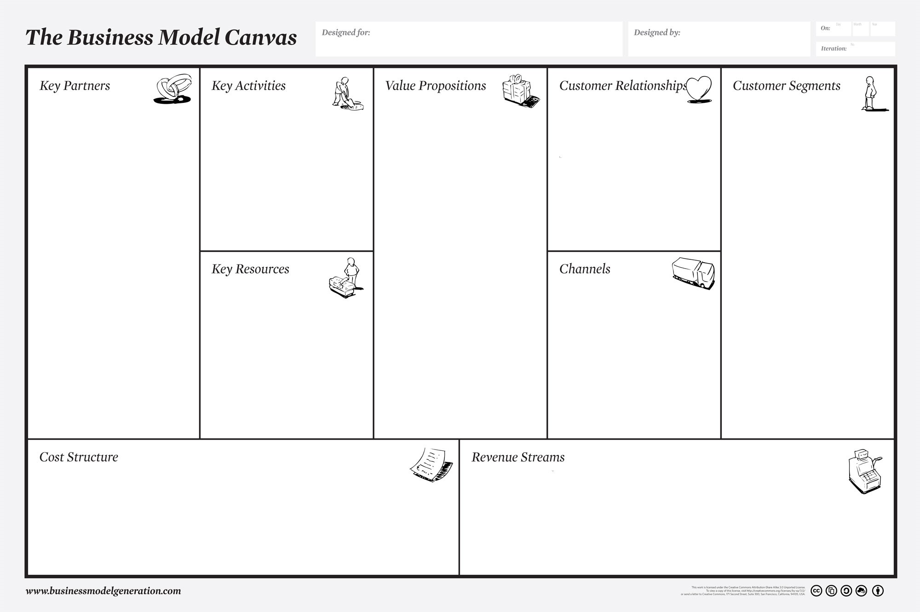
French Crêperie
A welcoming atmosphere
Unique restaurant
Conviviality
Originality
Key suppliers : local farmers, wholesalers
French local products
Partnership : Delivroo
Crêpes selling take away and eat in
Traditional cooking lessons, morning and afternoon
Typical and original French crêperie
Knowledge, classes of west speciality
Satisfying curiosity and improving cooking skills
Meeting place for Frenchie
People who likes crêpes and Britany
People who are food curious
Breton who live in Swansea
Most important customer : families and expatriate people
Leasing / Rental
Kitchen, utensil, equipment
Breton chef, waitress
Classic store channel, B to C
Instagram influencing
Leaflet / Prospectus on the street and letterbox
Local renting furniture / tools / utensils…
Energy consumption
Licence norms to be allow to teach and sell food / alcohol
Principal activity : restaurant
Secondary revenue : Cooking lessons

