Slide 1
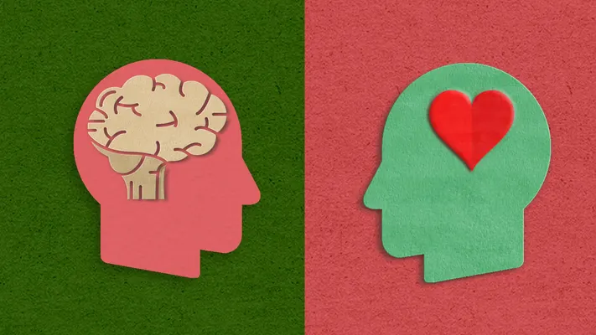
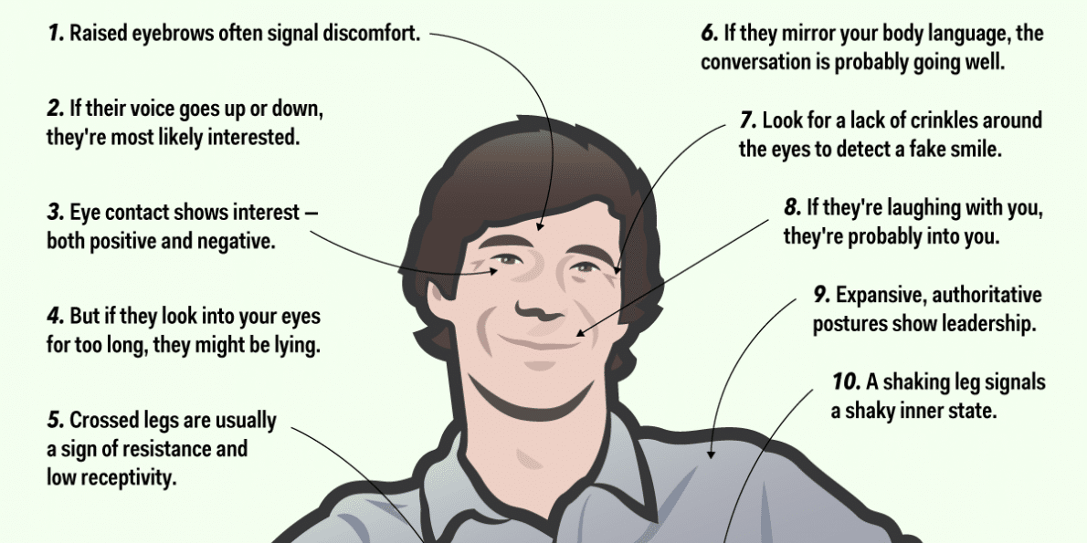
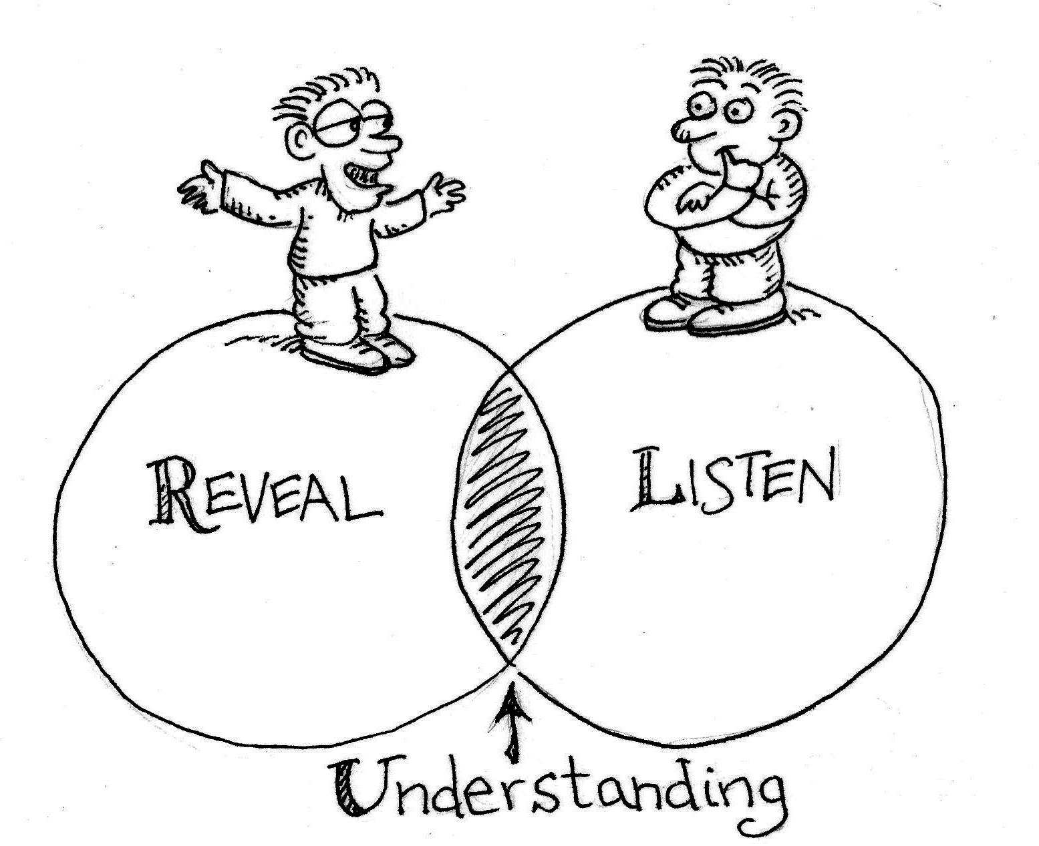
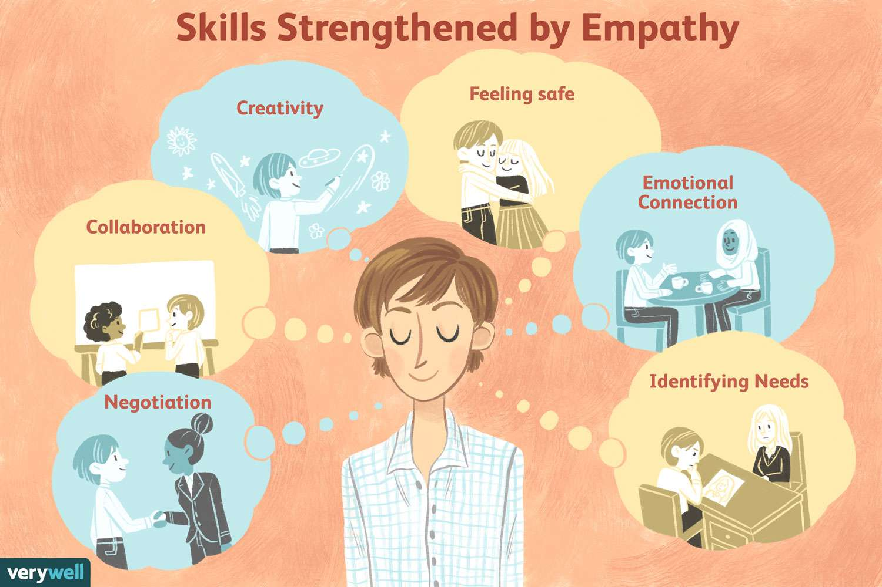
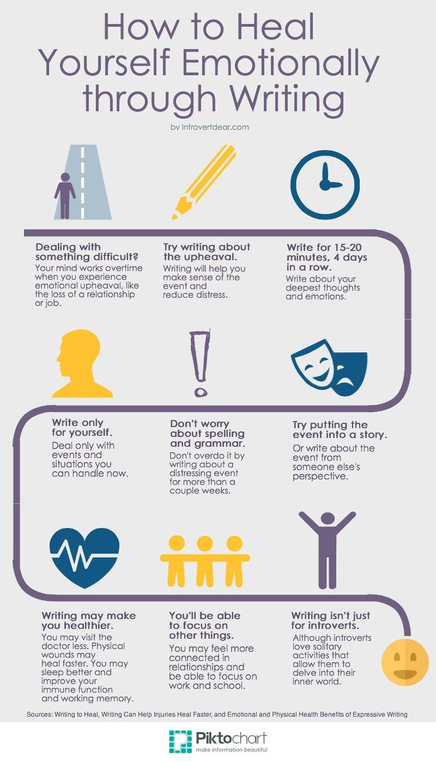
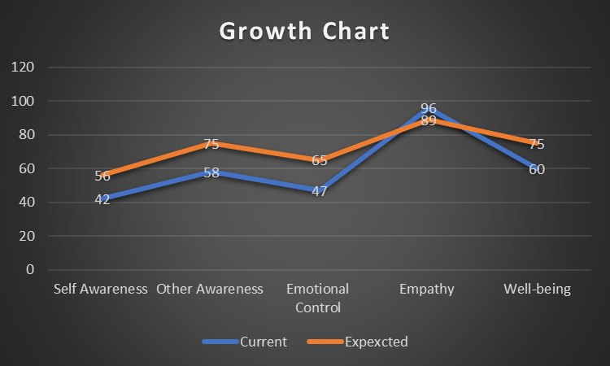
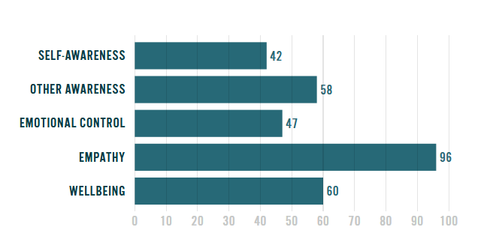
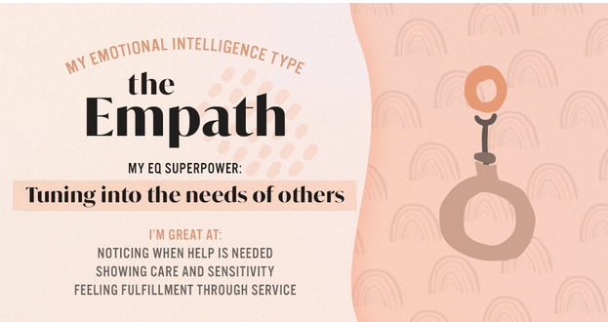
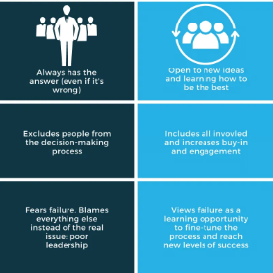
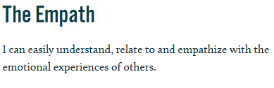
Harnessing emotional intelligence for success in workplace and personal life
“In a very real sense we have two minds, one that thinks and one that feels”
The benefits of emotional intelligence include communication, decision-making skills
It promotes mental health stability based on reduced stress within an individual (Medium, 2023).
It also helps in maintaining open communication in the workplace so that I can connect to the needs of the members within the organisation
Based on the personal emotional intelligence test that has been conducted it is empathetic
The issues highlighted lack of problem-solving and self-management.
The connected issues that can be faced is issues regarding the management of emotions at the time of decision-making
Improvement in communication can help in resolving problems within the members of the team.
The first improvement that I need to make so that I can improve the drawbacks is “feeling certain and confident”
This will help me address issues of self-management as this will help in understanding individual emotions
The second initiative that can be taken to reduce issues is ‘writing down’.
In this case, writing down will help me in tracing the emotional progress based on the triggers that will be identified
This will provide me with a written account of my thoughts and emotions
This will help in developing self-awareness within me so that I can keep control of my emotions
The third change that can be implemented is to “acknowledge the situation”
This will help me to recognise and understand the dynamics of other individuals in particular situations.
The first skill that I have put into action was being empathetic towards others in the organisation.
This helps me understand the emotions of other members so that their issues and challenges while working in the organisation can be identified.
This helped me in the identification of the emotions of others based on facial expressions and body language.
The second skill that I have implemented is listening to others,
Developing active listening skills while remaining empathetic towards other members
The third skill that I have used while working in the workplace is understanding and considering others' perspectives.
This has allowed me to avoid any kind of business at the time of decision-making.
. Medium (2023) Emotional Intelligence 101: Identifying, Understanding, and Managing Emotions Available at: https://medium.com/psych-pstuff/emotional-intelligence-101-identifying-understanding-and-managing-emotions-b836a6b90a54#:~:text=Salovey%20and%20Mayer%20(1990)%20proposed,of%20emotional%20dynamics%2C%20and%20effectively (Accessed: 20 February 2025)
Developing the skills will help me keep track of my thoughts and emotions
This will help in developing my emotional intelligence skill set
Notes:
Section 1: Self-Reflection
Emotional intelligence within an individual can be referred to as the ability in an individual for recognising, managing and understanding the emotions of an individual so that they can perceive and respond appropriately to the emotions of others. The potential benefits of emotional intelligence that has been identified include communication, problem-solving, decision-making, relationship management and mental health well-being. Based on the benefits it can be said that developing these skills will helps in attaining better problem-solving so that strategic decision of the organisation can be attended. Based on the emotional intelligence test that has been taken it has been identified that as an individual I am empathetic in nature. This highlights that as an individual I possess the ability in understanding the needs of an individual based on their expressions or nonverbal cues. On the other hand, the test has highlighted that as an individual I am sensitive and emotionally driven in various situations. This suggests certain negative aspects in my skill set which include poor communication, problem-solving and self-management so that I can serve the organisational goals without being affected by the emotions. Therefore, it can be said that the development of communication will help me in developing my problem-solving skills while remaining unbiased and being influenced by my emotions.
Section 2: EI Skills in Action
In the context of emotional intelligence, the positive skills that are possessed by me in the context of emotional intelligence while working within an organisation are active listening, understanding and considering others' perspectives and being empathetic towards the members with whom I am working. In the case of being empathetic while I was working in the organisation as a farm assistant, I remained empathetic towards many team members so that I could understand the issues that were faced while they were working within the organisation. In the context of active listening, I have been listening to the issues that were raised by the members of the team while working so that a strategic solution could be provided. I made sure that I listened to both parties while reaching a solution. This helped me avoid any kind of business while I was solving the problems or issues that had been raised by the members of the organisation. In the case of being understanding and considering the points of others in a situation of conflict between the members of the organisation, I was able to understand the thoughts and feelings of the individuals who were involved in the conflict. I allowed both sides to explain the matters on their side so that I could have a broader picture of the issue based on which the conflict arose. This helped me in developing solutions to the issues that led to the conflict among the members of the team.
Section 3: Improvement Plan
Based on the skills that have been suggested for the improvement of my emotional intelligence and the issues that have been highlighted as per the emotional intelligence test, I have found that I need to feel certain and confident when facing different situations, write the problems down, and acknowledge the situation. In the context of feeling certain and confident, I need to focus on my stretch and achieve the set goals while practising positive talk. This will help me strategically make decisions without being biased. Ion the other hand writing will help me pen down my thoughts and emotions while helping me decide the changes that are needed so that I can maintain control ion my adoption at the time of decision-making and problem-solving.
Conclusion: Key takeaways or inspiration for others
Based on the above discussion, it can be concluded that this will help me reforming my drawbacks while developing new skill sets so that I can maintain my performance in the workplace.

