Slide 1

Practitioner Research Proposal
INVESTIGATING STUDENT-CENTERED LEARNING APPROACHES FOR LEVEL 2 VOCATIONAL STUDENTS IN A FURTHER EDUCATION COLLEGE IN WALES:
A CASE STUDY

Slide 2
This Presentation
The question
Why is the subject important to me?
Background
The research
Summary

Slide 3
The Question
INVESTIGATING STUDENT-CENTERED LEARNING APPROACHES FOR LEVEL 2 VOCATIONAL STUDENTS IN A FURTHER EDUCATION COLLEGE IN WALES: A CASE STUDY

Slide 4
The Question
STUDENT-CENTERED LEARNING
  An educational approach that shifts the focus of instruction from the teacher to the student.
  It emphasises active learning, student autonomy, and personal relevance in the learning process.
  (Smothers, et al., 2021)
STUDENT-CENTERED LEARNING

Slide 5
The Question
Learners Become:
  Ambitious, capable learners
  Enterprising, creative contributors
  Ethical, informed citizens
  Healthy, confident individuals
  (Hwb, 2025)
ASPIRATION

Slide 6
The Question: WHAT IS LEVEL 2?
EDUCATION LEVELS: UK
  Entry Level:
    Entry Level Certificates, Foundation Learning
  Level 1:
    GCSE Grades D-G / 9-4
  Level 2:
    GCSE Grades A*-C / 9-4
  Level 3:
    A-levels, T-levels, BTEC Nationals
Level 4:
  Certificate of Higher Education, Higher National Certificate (HNC)
Level 5:
  Foundation Degree, Higher National Diploma (HND)
Level 6: Full undergraduate degree level
    BA, BSc, BMus
Level 7: Postgraduate level
    MA, MSc, MMus
Level 8 Doctoral level
    DPhil, DProf, DMus

Slide 7
WHY DO I CARE?

Slide 8
My Work
10% Teach Level 2 (BTEC Technical)
10% Teach Level 3 (A Level & BTEC)
10% Teach Level 4 (HNC)
10% Teach Level 5 (HND)
60% Dealing with Level 2 ISSUES!!!

Slide 9
Further Education Colleges in Wales: Priorities?
Paperwork / Health & Safety / Making the management look good
A Level results (especially getting 100% for press releases)
Have (online) meetings without any purpose
Building new buildings, or making old ones look pretty
BTEC results (in case anyone asks on A Level results day)
Welsh Baccalaureate
Chasing students for attendance rather than engagement
Using jargon no-one understands
Pretending everything is fine during ESTYN inspections
BTEC LEVEL 2

Slide 10
WHY DO I CARE?

Slide 11

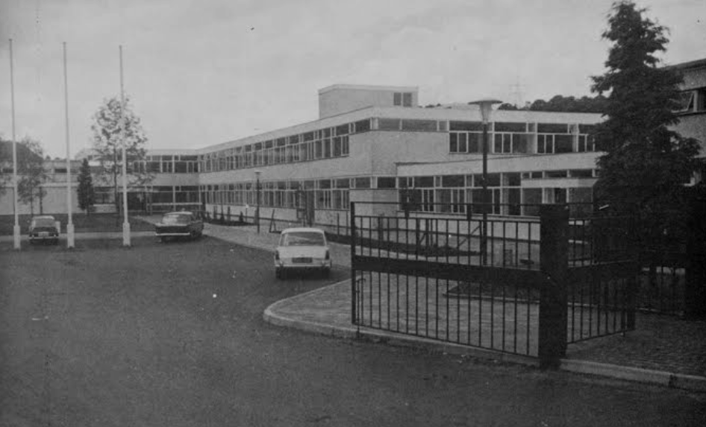
AFON TAF HIGH SCHOOL
GCSE Results Day
August 23rd 1990

Slide 12
My Research

Slide 13
Background & Context
WFECs provide academic and vocational pathways, supporting learners beyond compulsory schooling (Welsh Government, 2024)
Level 2 vocational education targets 16–19-year-olds, offering training in fields like healthcare, construction, and engineering and music (Pearson, 2025).
These programmes support learners with prior educational challenges, offering hands-on experience and clearer progression routes to employment or further study (Pearson, 2025).
The Tertiary Education and Research (Wales) Act promotes inclusive, skills-based education aligned with economic priorities, with student-centered learning enhancing engagement and outcomes (Welsh Government, 2022).

Slide 14
Aims & Objectives
The study will:
Explore how student-centred learning (SCL) is implemented in Level 2 vocational programmes at a Welsh Further Education College.
Examine the impact of SCL on learner engagement, progression, and overall experience.
Gather evidence from students, lecturers, coordinators, and managers.
Focus on learner characteristics, teaching strategies, management and support systems, and course delivery.
Make evidence-based recommendations to improve inclusivity and responsiveness in Level 2 vocational education.

Slide 15
The Literature
Level 2 vocational learners in Wales often face challenges with engagement and motivation (Wales Centre for Public Policy, 2024).
Many Level 2 students enter FE with low confidence, poor mental health, and limited access to higher-level qualifications (Darling-Hammond & Cook-Harvey, 2018).
Learners face complex barriers (Wixcey et al., 2025) and experience academic deficits (Packer et al., 2022)
Limited access to support services (Huddleston & Unwin, 2024)
Learner engagement at Level 2 is often inconsistent (Bashir et al., 2020a)
The transition from secondary school to FE can be disorienting (Hodgson & Spours, 2020).
Holistic support strategies are essential (Skilling et al., 2020)

Slide 16
The Literature
Student-centred learning can improve motivation and participation (Smothers et al., 2021).
Vocational programmes provide students with practical competencies (Creasy, 2017).
SCL is well-suited to Level 2 vocational learners (Pastini & Lilasari, 2023)
SCL requires systemic support, professional development, and a shift in educator roles to ensure it becomes transformative (Bashir et al., 2020b)
Technology in post-pandemic education has expanded student-centred learning (Ratten, 2023).

Slide 17
The Literature
There is a lack of Wales-specific empirical research on SCL in vocational FE settings, especially at Level 2
Structural challenges such as timetabling, funding, staffing, and access are under-researched (Wixcey et al., 2023)
The diverse learner population in Welsh FE which requires differentiated SCL strategies, which are not well-documented (Wixcey et al., 2023)
The creation of MEDR marks a new phase in Welsh tertiary education (MEDR, 2025), but there is no published research evaluating how SCL affects learner outcomes under its governance (Learning And Work Institute, 2024).

Slide 18
The Methodology
Qualitative case study design (Cohen et al., 2017), focusing on a single WFEC to explore SCL in Level 2 vocational education.
Allow an in-depth, contextualised understanding of complex educational environments and practices (Yin, 2017).
Data will be collected through focus groups and semi-structured interviews, questionnaires and observation (Cohen et al., 2017) within an interpretivist paradigm (Creswell & Poth, 2016)
The research is grounded in relativist ontology (Fink, 2024)
Findings will address pedagogical, structural, and support-related complexities in vocational education settings.

Slide 19
The Methodology Participants: Students
6 students
Broad range of perspectives (Patton et al., 2017)
Varying levels of academic achievement and learner engagement (Galloway, 2016)
Diverse backgrounds (Tummons & Duckworth, 2012)

Slide 20
The Methodology Participants : Lecturers
3 Lecturers
Direct involvement (Aburn et al., 2021)
Represent a range of artistic backgrounds, subject specialisms, and teaching experiences (Wesner, 2024)
Established credibility and commitment to reflective practice (Wesner, 2024)
Individual interview (Kvale & Brinkmann, 2015)

Slide 21
The Methodology Participants:
College Managers
2 College Managers
Withhold information or providing responses that are less candid (Roulston, 2021)
Transparency, confidentiality, and voluntary participation (Mercer, 2007)
Questionnaire (Bryman, 2016)

Slide 22
The Methodology
Triangulation across learner, practitioner, leadership viewpoints – based on different data sources (Bell et al., 2024)
A holistic account of enabling factors and barriers to effective SCL.

Slide 23
The Methodology: Data Analysis
Verbatim transcription and Thematic Analysis (Braun and Clarke, 2021)
Reflexivity and triangulation (Denzin, 2012)
NVivo software

Slide 24
Ethical Considerations
The research will comply with UWTSD’s Ethics & Integrity Code, Data Management Policy, and BERA (2024) guidelines, and own institutional policies
The researcher’s insider role introduces ethical complexity due to existing relationships with participants (Kvale & Brinkmann, 2015)
Informed and/or parental consent and student consent will be obtained from all participants (Kazembe et al., 2024)
Participant information written in plain English (Ward & Delamont, 2020)
Interviews will be scheduled outside teaching hours in neutral settings (Dunwoodie et al., 2023)

Slide 25
Ethical Considerations
No leading questions and voluntary participation (Kvale & Brinkmann, 2015)
Sensitive topics may cause discomfort; participants can decline questions (Cohen et al., 2017)
Data security will be maintained – especially given the work environment (Baumfield et al., 2008)
Anonymity will be protected using pseudonyms and removing identifiable details (Denzin & Lincoln, 2017)

Slide 26
Conclusion
Passionate about the topic
Participants are available
Inform my own practice
Support colleagues in their practice
Change college policy
IMPROVE THE STUDENT EXPERIENCE

Slide 27
References
Aburn, G. E., Gott, M. & Hoare, K., 2021. Experiences of an insider researcher - interviewing your own colleagues. Nurse Res, 29(3), pp. 22-28.
Bashir, M., Khan, M. & Ali, S., 2020b. The impact of effective timetable scheduling on student performance and well-being. Journal of Educational Research and Practice, 10(2), pp. 45-56.
Bashir, N., Sutherland, E. & & McCallum, D., 2020a. Effective teaching strategies in vocational education. Journal of Vocational Education and Training, 72(3), pp. 337-352.
Baumfield, V., Hall, E. & Wall, K., 2008. Exploring Your Own and Your Colleagues' Professional Knowledge. s.l.:SAGE.
Bell, J., Waters, S. & Johnson, H., 2024. Doing Your Research Project: A Guide for First-time Researchers. 3rd ed. s.l.:Open University Press.
BERA, 2024. Ethical Guidelines for Educational Research, fifth edition. [Online]
Available at: https://www.bera.ac.uk/publication/ethical-guidelines-for-educational-research-fifth-edition-2024-online
[Accessed 30 October 2024].
Braun, V. & Clarke, V., 2021. Thematic Analysis: A Practical Guide. s.l.:SAGE Publications.
Bryman, A., 2016. Social Research Methods. 5th ed. Oxford: Oxford University Press.
Cohen, L., Manion, L. & Morrison, K., 2017. Research Methods in Education. 8th ed. s.l.:Routledge.
Creasy, R., 2017. The Taming of Education. s.l.:Springer International Publishing.
Darling-Hammond, L. & Cook-Harvey, C. M., 2018. Educating the Whole Child: Improving School Climate to Support Student Success, s.l.: Learning Policy Institute.
Denzin, N. K. & Lincoln, Y. S., 2017. The SAGE Handbook of Qualitative Research. s.l.:SAGE Publications.
Dunwoodie, K., Macaulay, L., Newman & Alexander, 2023. Qualitative interviewing in the field of work and organisational psychology: Benefits, challenges and guidelines for researchers and reviewers. Applied Psychology, 72(2), pp. 863-889.
Fink, L. D., 2024. Creating Significant Learning Experiences: An Integrated Approach to Designing College Courses, Revised and Updated. 2nd ed. San Fransisco: Jossey-Bass.
Galloway, N., 2016. Researching your own students . In: J. McKinley & H. Rose, eds. Doing Research in Applied Linguistics. s.l.:s.n., p. Chapter 11.
Hodgson, A. & Spours, K., 2020. Young People and Transitions in Upper Secondary Education in England. In: K. Brunila & L. Lundahl, eds. Youth on the Move: Tendencies and Tensions in Youth Policies and Practices. Helsinki: Helsinki University Press, p. 127–147.
Hub, 2025. Curriculum for Wales, Cardiff: Crown.
Huddleston, P. & Unwin, L., 2024. Curriculum in FE Colleges over time. [Online]
Available at: https://www.edge.co.uk/documents/475/Edge_History_of_FE_curriculum_final.pdf
[Accessed 15th December 2024].
Kazembe, D. M., Woldeamanuel, Y. & Abay, S. M., 2024. Researchers experience and views on participants’ comprehension of informed consent in clinical trials in Malawi: a descriptive qualitative study. BMC Med Ethics, 27(25), p. 101.
Kvale, S. & Brinkmann, S., 2015. Interviews: Learning the Craft of Qualitative Research Interviewing. 3rd ed. s.l.:SAGE Publications.
Learning And Work Institute, 2024. Review of the Skills System in Wales, Cardiff: Learning And Work Institute.
Mercer, J., 2007. The challenges of insider research in educational institutions: wielding a double‐edged sword and resolving delicate dilemmas. Oxford Review of Education, 33(1), pp. 1-17.
Pastini, N. & Lilasari, L., 2023. Empowering EFL students: A review of student-centred learning effectiveness and impact.. Journal of Applied Studies in Language, 7(2), pp. 246-259.
Patton, D. U., Hong, J. S., Patel, S. & Kral, M. J., 2017. A Systematic Review of Research Strategies Used in Qualitative Studies on School Bullying and Victimization. Trauma, Violence, & Abuse , 18(1), pp. 3-16.
Pearson, 2025. BTEC Level 2 Skills. [Online]
Available at: https://qualifications.pearson.com/en/qualifications/btec-level-2-skills.html
[Accessed 16th September 2025].
Ratten, V., 2023. The post COVID-19 pandemic era: Changes in teaching and learning methods for management educators. The International Journal of Management Education., 21(2).
Roulston, K., 2021. Interviewing: A Guide to Theory and Practice. s.l.:SAGE.
Skilling, K., Bobis, J. & Martin, A. J., 2020. The “ins and outs” of student engagement in mathematics: shifts in engagement factors among high and low achievers. Mathematics Education Research Journal, Volume 33, pp. 469-493.
Smothers, N. et al., 2021. (Re)conceptualising effective teaching in further education: an exploratory study. Journal of Further and Higher Education, 46(5), pp. 620-635.
Tummons, J. & Duckworth, V., 2012. Doing Your Research Project in the Lifelong Learning Sector. s.l.:McGraw-Hill Education.
Wales Centre for Public Policy, 2024. Widening Participation in Tertiary Education, Cardiff: Wales Centre for Public Policy.
Ward, M. R. & Delamont, S., 2020. Handbook of Qualitative Research in Education. 2nd ed. s.l.:Edward Elgar Publishing.
Welsh Government, 2024. Curriculum for Wales: annual report 2024, Cardiff: Welsh Government.
Wesner, S., 2024. Researching the Creative and Cultural Industries. s.l.:Taylor & Francis.
WG, 2022. Tertiary Education and Research (Wales) Act. [Online]
Available at: https://www.gov.wales/tertiary-education-research-bill-wales
[Accessed 10th December 2024].
Wixcey, H., Cropley, B. & Shearer, D., 2025. An examination of the influence of mental well-being and resilience on academic outcomes in Further Education learners in Wales. Journal of Further and Higher Education, 49(2), pp. 137-152.
Yin, R. K., 2017. Case Study Research and Applications. 6th ed. s.l.:SAGE Publications, Inc.

