Slide 1
BMHP6026 – Digital Transformation in the Health and Care Professions
ORCHA
A Digital Health Innovation in UK Health and Social Care
Component 2 – Viva Voce Presentation
Gabriela Dinu | 2329564 | Lecturer: Zakiyyah Ahmed

Slide 2
Introduction
The Digital Health Landscape
The global digital health app market has grown dramatically over the past decade, with over 350,000 health-related apps available to consumers (ORCHA, 2025a). In the UK, health and social care professionals were expected to recommend these tools with no standardised framework to guide safe decision-making.
This presentation critically evaluates Organisation for the Review of Care and Health Apps (ORCHA) as a response to that challenge, focusing on:
Service Delivery
Patient & Service User Experience
350,000+
health apps available globally
(ORCHA, 2025a)
~300
assessment criteria
in ORCHA's review
(ORCHA, 2025a)

Slide 3
The Problem: An Unregulated Digital Health Market
1
2
3
No Standardised Quality Framework
Professionals Lacked Safe Guidance
Data Privacy Largely Unverified
Professionals had no nationally agreed criteria to assess whether a health app was clinically safe, evidence-based, or fit for purpose (ORCHA, 2025a).
App recommendation relied on informal judgement and word of mouth. NHS staff faced real professional risk in recommending digital tools (Leigh, Ashall-Payne and Andrews, 2020).
Health data is 'special category' data under UK GDPR, yet most apps entered use without documented Data Protection Impact Assessments (CMS Law, 2025).

Slide 4
The Solution: What is ORCHA?
Organisation for the
Review of Care and Health Apps
Founded 2015 by NHS clinicians in response to the unregulated growth of digital health apps. Now operates across the UK, serving NHS organisations, Integrated Care Boards (ICBs), and local authority adult social care services (ORCHA, 2025a; NHS Innovation Accelerator, 2020).
Assessment
App Libraries
Continuous Monitoring
Reviews ~300 criteria across clinical assurance, data & privacy, evidence, and usability for every app submitted (ORCHA, 2025a).
Curates trusted digital health libraries embedded in NHS, ICB, and local authority services, a formulary model for digital tools (ORCHA, 2025b).
Apps are re-reviewed as updates occur. Listed apps must maintain compliance with DTAC and NICE standards (NHS England Transformation Directorate, 2026).

Slide 5
Policy Alignment: The National Framework
ORCHA does not operate in isolation — it aligns with and reinforces multiple layers of UK health and social care policy:
DTAC
Digital Technology Assessment Criteria
NICE
Evidence Standards Framework
Mandatory NHS procurement baseline. ORCHA's review is cross-referenced to DTAC requirements, meaning listed apps meet the same standards as any commissioned NHS digital technology (NHS England Transformation Directorate, 2026).
Tiers digital health technologies by risk and required evidence level. ORCHA's assessment maps to this framework, ensuring proportionality of scrutiny (NICE, 2025).
WGLL
What Good Looks Like Framework
PLAN
A Plan for Digital Health & Social Care
GDPR
UK GDPR / Data Protection Act 2018
NHSE's framework for digital maturity identifies workforce confidence and capability as critical success factors, the same barriers ORCHA addresses through assured libraries (NHS England, 2021).
The UK government's 2022 national digital strategy commits to embedding digital tools in care pathways. ORCHA's library model is a direct enabler of this ambition (DHSC, 2022).
Health data is a special category of data under UK GDPR. DTAC's data protection criterion, incorporated into ORCHA’s review, requires that DPIAs be completed before any app reaches NHS use (CMS Law, 2025).

Slide 6
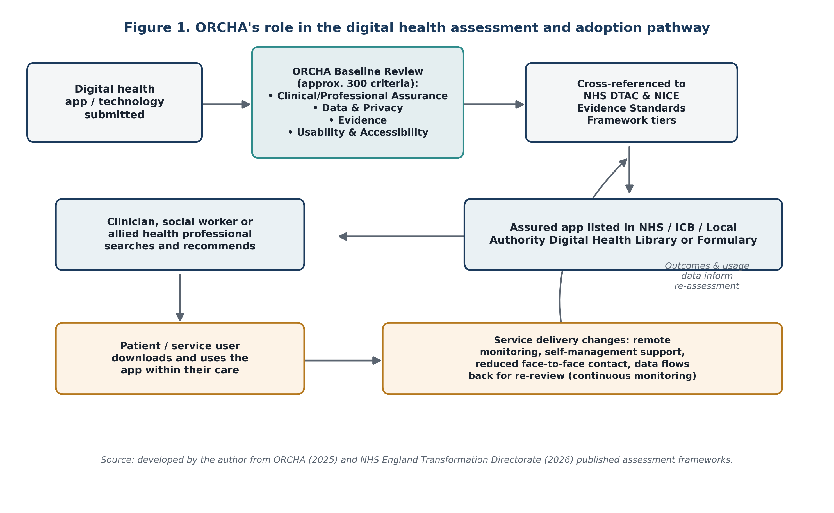
How ORCHA Works: From Assessment to Adoption
Figure 1. ORCHA's role in the digital health assessment and adoption pathway. Source: developed by the author from ORCHA (2025a) and NHS England Transformation Directorate (2026).

Slide 7
Service Delivery: Positive Outcomes
From Ad Hoc to Formulary Model
5.6M
ORCHA shifted app recommendation from an informal judgement to a structured library system, reducing duplicated assurance work across organisations (NHS England Transformation Directorate, 2021).
people reached via NHS Dorset
ICB App Library across 7 ICSs
(Mobi Health News, 2021)
Increased Workforce Confidence
5,400+
Staffordshire County Council reported ~4,000 sessions and 10,000 page views within 5 months of launch. Social workers reported greater confidence in recommending digital tools (ORCHA, 2020; DHSC, 2023).
app recommendations made by
NHS Dorset ICB App Library
(HTN, 2024)
Upstream GDPR Compliance
DTAC requires completed DPIAs before NHS adoption. ORCHA's review embeds this compliance step into procurement, reducing the number of non-compliant apps reaching care pathways (NHS England Transformation Directorate, 2026).
NHS stamp of approval = strongest
predictor of app prescription
(Leigh, Ashall-Payne & Andrews, 2020)

Slide 8
Service Delivery: Critical Evaluation
✓ Strengths
✗ Limitations
NHS-policy-aligned assurance reduces professional risk (Leigh, Ashall-Payne and Andrews, 2020)
Key evidence authored and funded by ORCHA Health Limited conflict of interest limits independence (Leigh, Ashall-Payne and Andrews, 2020; Hyzy et al., 2024)
Formulary model scales nationally demonstrated by NHS Dorset across 7 Integrated Care Systems (Mobi Health News, 2021)
Cultural barriers and uneven digital readiness persist despite library rollout (HTN, 2024; DHSC, 2023)
Embeds DTAC and GDPR compliance upstream in procurement (NHS England Transformation Directorate, 2026)
ORCHA changes what professionals are permitted to recommend, but not the workforce time or capacity to use digital tools in practice

Slide 9
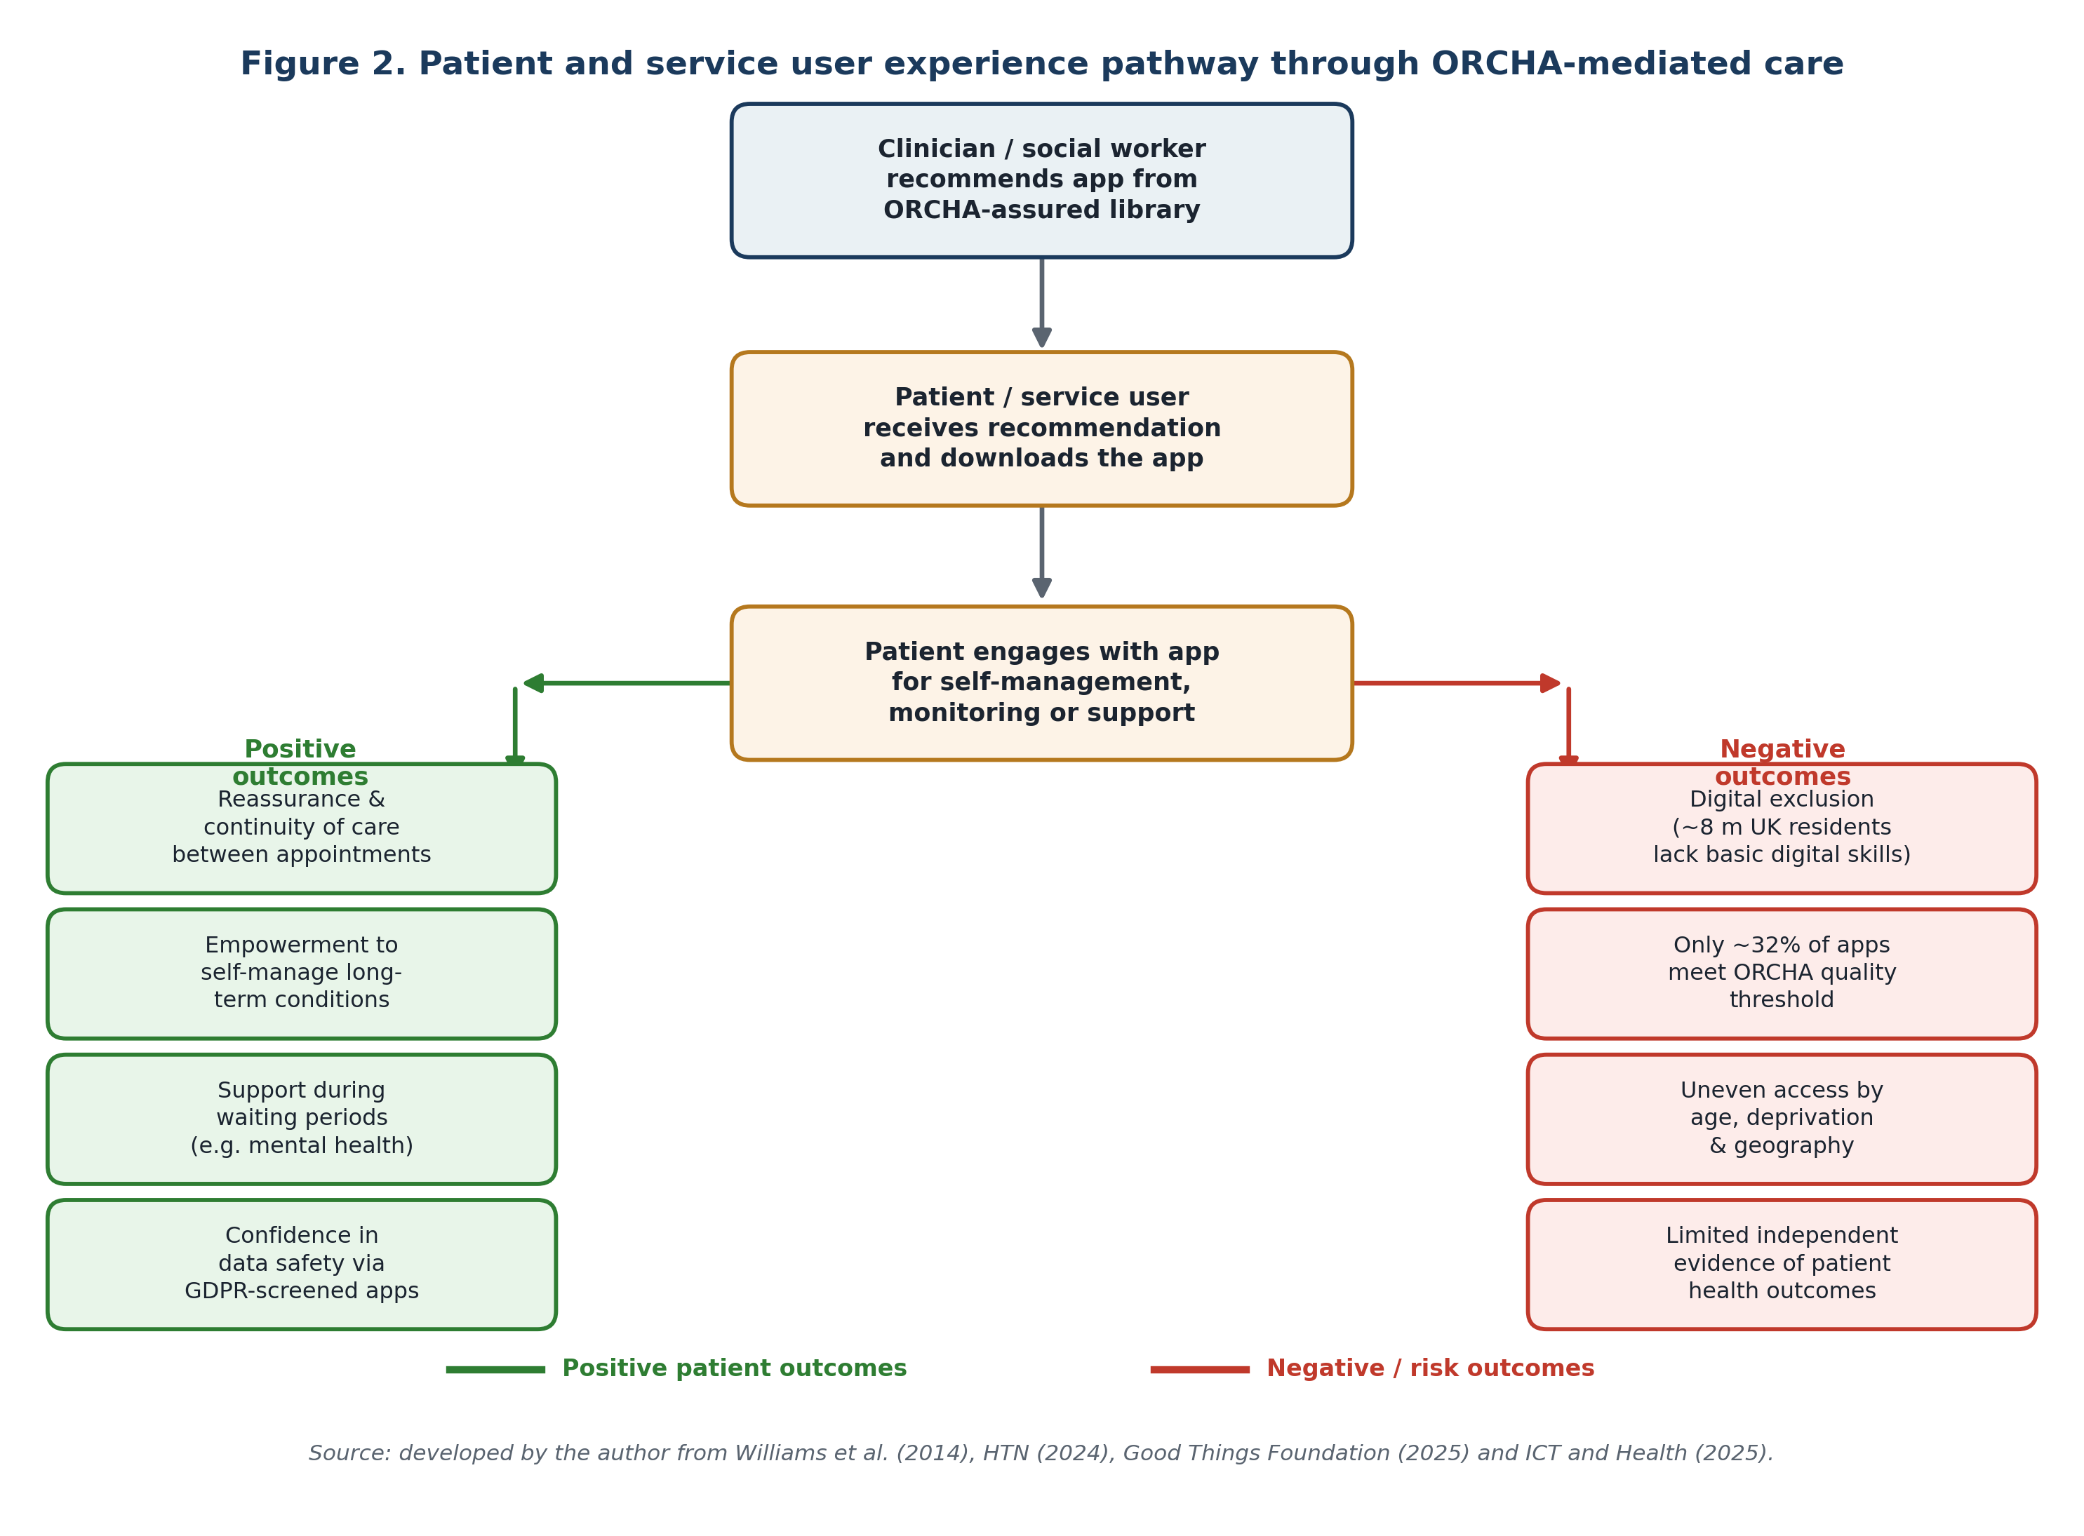
Patient & Service User Experience: The Benefits
Reassurance & Continuity
Support During Waiting
Patients with COPD reported greater confidence monitoring their condition between appointments, even those aged up to 85 (Williams et al., 2014).
NHS Dorset's library was particularly valued in supporting mental health patients during the period between referral and treatment commencement (HTN, 2024).
Empowerment to Self-Manage
Data Safety Assurance
Access to a clinician-recommended, quality-assured app shifts the patient's subjective experience of their condition from passive waiting to active engagement.
ORCHA-listed apps have passed GDPR and DTAC data privacy checks, giving patients greater protection than unvetted commercial app store alternatives (CMS Law, 2025).
Figure 2. Patient pathway through ORCHA-mediated care.
Source: Williams et al. (2014), HTN (2024), Good Things Foundation (2025), ICT and Health (2025).

Slide 10
Patient & Service User Experience: Critical Evaluation
8M
Digital Exclusion Paradox
ORCHA improves quality for those who can access and use digital tools. But older adults, those with disabilities, and people in deprived areas are disproportionately excluded from the very groups most in need (Good Things Foundation, 2025; NHS England, 2025).
UK residents lack basic
digital skills to access
online health services
(Good Things Foundation, 2025;
NHS England, 2025)
Quality Threshold Gap
Only ~32% of mental health apps reviewed by ORCHA meet its minimum quality standard. In condition areas where assured apps are sparse, patients may receive no digital support or turn to unvetted alternatives (ICT and Health, 2025; Zych et al., 2026).
NHS Long-Term Plan Warning
The NHS Long-Term Plan explicitly warned that digital-first approaches, without targeted digital inclusion support, risk widening rather than narrowing existing health inequalities (Open Access Government, 2025).

Slide 11
Key Challenges and Proposed Responses
Challenge
Proposed Response
Research Independence: Key outcome studies authored and funded by ORCHA Health Limited (Leigh, Ashall-Payne and Andrews, 2020; Hyzy et al., 2024) limit external validity.
Commission independent, longitudinal evaluation of patient health outcomes linked to ORCHA-curated app use, separate from ORCHA-funded research (Recommendation 1).
Digital Exclusion: ~8 million UK residents lack basic digital skills (Good Things Foundation, 2025). ORCHA's benefits are not equitably distributed across the population.
Develop a structured equity strategy targeting digitally excluded populations, building on existing library and community partnerships (Recommendation 2; NHS England, 2025).
Implementation Gap: Workforce time, training, and digital confidence are critical, but ORCHA's framework does not directly supply these (HTN, 2024; DHSC, 2023).
Invest in dedicated training and protected time for health and social care professionals to embed digital prescribing in routine practice (Recommendation 3; DHSC, 2023).

Slide 12
Recommendations
1
NHS England & ICBs
2
ORCHA & Partners
Commission an independent, longitudinal evaluation of patient outcomes linked to ORCHA app use, separate from ORCHA-funded research.
Develop a published equity strategy addressing digital exclusion barriers, including older adults, people with disabilities, and those in deprived areas.
3
Frontline Workforce
4
App Developers
Invest in dedicated time and accredited training for health and social care professionals to embed digital prescribing in routine practice.
Engage with ORCHA and NICE's Evidence Standards Framework early in development, treating GDPR compliance and clinical evidence as foundational requirements, not post-hoc obligations.

Slide 13
Conclusion
1
ORCHA has made a significant and largely positive contribution to digital health service delivery since 2015, lowering the barrier to safe digital prescribing and improving access to self-management tools for many patients and service users.
2
A critical evaluation must acknowledge three limitations: the evidence base is not yet independent of the organisation that created it; the quality threshold reveals how poor the broader mHealth marketplace remains; and digital exclusion leaves the most vulnerable populations least likely to benefit.
3
ORCHA is best understood not as a solution, but as a necessary piece of infrastructure within the UK's digital transformation agenda, one whose full potential depends on parallel investment in workforce development, digital inclusion, and independent outcome evaluation.
Thank you. I am happy to take your questions.

Slide 14
References (1 of 2)
1. CMS Law (2025) Digital Health Apps and Telemedicine in the United Kingdom. Available at: https://cms.law/en/int/expert-guides/cms-expert-guide-to-digital-health-apps-and-telemedicine/united-kingdom (Accessed: 22 June 2026).
2. Department of Health and Social Care (2022) A Plan for Digital Health and Social Care. Available at: https://www.gov.uk/government/publications/a-plan-for-digital-health-and-social-care (Accessed: 22 June 2026).
3. Department of Health and Social Care (2023) Digital Working in Adult Social Care: What Good Looks Like. Available at: https://www.gov.uk/government/publications/digital-working-in-adult-social-care-what-good-looks-like (Accessed: 22 June 2026).
4. Dorset HealthCare University NHS Foundation Trust (n.d.) The Dorset Health App Library. Available at: https://www.dorsethealthcare.nhs.uk/patients-and-visitors/dorset-health-app-library (Accessed: 23 June 2026).
5. Good Things Foundation (2025) Tackling digital exclusion in the future NHS. Available at: https://www.goodthingsfoundation.org/discover/digital-inclusion-insights/digital-inclusion-insights-2025/tackling-digital-exclusion-in-the-future-nhs (Accessed: 20 June 2026).
6. HTN Health Tech News (2024) NHS Dorset ICB App Library sees 5,400 app recommendations made. Available at: https://htn.co.uk/2024/05/08/nhs-dorset-icb-shares-case-study-on-development-of-dorset-app-library/ (Accessed: 24 June 2026).
7. Hyzy, M., Bond, R., Mulvenna, M., Bai, L., Frey, A-L., Carracedo, J.M., Daly, R. and Leigh, S. (2024) 'Don't judge a book or health app by its cover', PLoS ONE, 19(3), e0298977. doi: 10.1371/journal.pone.0298977. Available at: https://journals.plos.org/plosone/article?id=10.1371/journal.pone.0298977 (Accessed: 22 June 2026).
8. ICT and Health (2025) Digital health and mental wellbeing: A lifeline in tough times. Available at: https://www.icthealth.org/news/digital-health-mental-wellbeing-a-lifeline-in-tough-times (Accessed: 28 June 2026).
9. Leigh, S., Ashall-Payne, L. and Andrews, T. (2020) 'Barriers and facilitators to the adoption of mobile health among health care professionals from the United Kingdom', JMIR mHealth and uHealth, 8(7), e17704. doi: 10.2196/17704. Available at: https://mhealth.jmir.org/2020/7/e17704 (Accessed: 22 June 2026).
10. Mobi Health News (2021) Millions of people in England to get access to digital health libraries. Available at: https://www.mobihealthnews.com/news/emea/millions-people-england-get-access-digital-health-libraries (Accessed: 27 June 2026).
11. NHS England (2021) What Good Looks Like Framework. Available at: https://transform.england.nhs.uk/digitise-connect-transform/what-good-looks-like/ (Accessed: 26 June 2026).
12. NHS England (2025) Tackling digital exclusion and health literacy: How libraries can help bridge the gap. Available at: https://www.england.nhs.uk/blog/tackling-digital-exclusion-and-health-literacy-how-libraries-can-help-bridge-the-gap/ (Accessed: 22 June 2026).

Slide 15
References (2 of 2)
13. NHS England Transformation Directorate (2021) How to use the Digital Technology Assessment Criteria (DTAC). Available at: https://transform.england.nhs.uk/key-tools-and-info/digital-technology-assessment-criteria-dtac/how-to-use-the-dtac/ (Accessed: 24 June 2026).
14. NHS England Transformation Directorate (2026) Updated NHS England Digital Technology Assessment Criteria (DTAC) form and guidance. Available at: https://innovation.nhs.uk/news/updated-nhs-england-digital-technology-assessment-criteria-dtac-form-and-guidance/ (Accessed: 24 June 2026).
15. NHS Innovation Accelerator (2020) ORCHA: Organisation for the Review of Care and Health Apps. Available at: https://www.orchahealth.com/blog/orcha-partners-with-nhs-innovation-accelerator (Accessed: 22 June 2026).
16. NICE (2025) Evidence Standards Framework for Digital Health Technologies. Available at: https://www.nice.org.uk/corporate/ecd7/resources/evidence-standards-framework-for-digital-health-technologies-pdf-1124017457605 (Accessed: 27 June 2026).
17. Open Access Government (2025) Digital inclusion: Making the NHS Long Term Plan work for everyone. Available at: https://www.openaccessgovernment.org/ebook/digital-inclusion-making-the-nhs-long-term-plan-work-for-everyone/201195/ (Accessed: 23 June 2026).
18. ORCHA (2020) Staffordshire Public Health changes lives with digital health. Available at: https://us.orchahealth.com/staffordshire-public-health-changes-lives-with-digital-health/ (Accessed: 22 June 2026).
19. ORCHA (2023) What is the health of mental health apps? Available at: https://us.orchahealth.com/health-of-mental-health-apps/ (Accessed: 26 June 2026).
20. ORCHA (2025a) About ORCHA: Our story. Available at: https://www.orchahealth.com/about-orcha (Accessed: 25 June 2026).
21. ORCHA (2025b) Digital Health Library. Available at: https://www.orchahealth.com/solutions/health-app-library (Accessed: 24 June 2026).
22. Williams, V., Price, J., Hardinge, M., Tarassenko, L. and Farmer, A. (2014) 'Using a mobile health application to support self-management in COPD: a qualitative study', British Journal of General Practice, 64(624), pp. e392–e400. doi: 10.3399/bjgp14X680473. Available at: https://bjgp.org/content/64/624/e392 (Accessed: 22 June 2026).
23. Zych, M.M., Bond, R., Mulvenna, M., Martinez Carracedo, J., Bai, L. and Andrews, T. (2026) 'The quality and characteristics of digital mental health apps: mixed methods study', JMIR Human Factors, 13, e67944. doi: 10.2196/67944. Available at: https://humanfactors.jmir.org/2026/1/e67944/ (Accessed: 28 June 2026).

