Slide 1
Freshwater Conservation
M3X9631
SAMANTHA PENGELLY (Msc)
Notes:
Hello everyone, and welcome to Freshwater Conservation.
My name is Samantha Pengelly, and I’ll be covering the first semester of this module while Sergio is away.

Slide 2
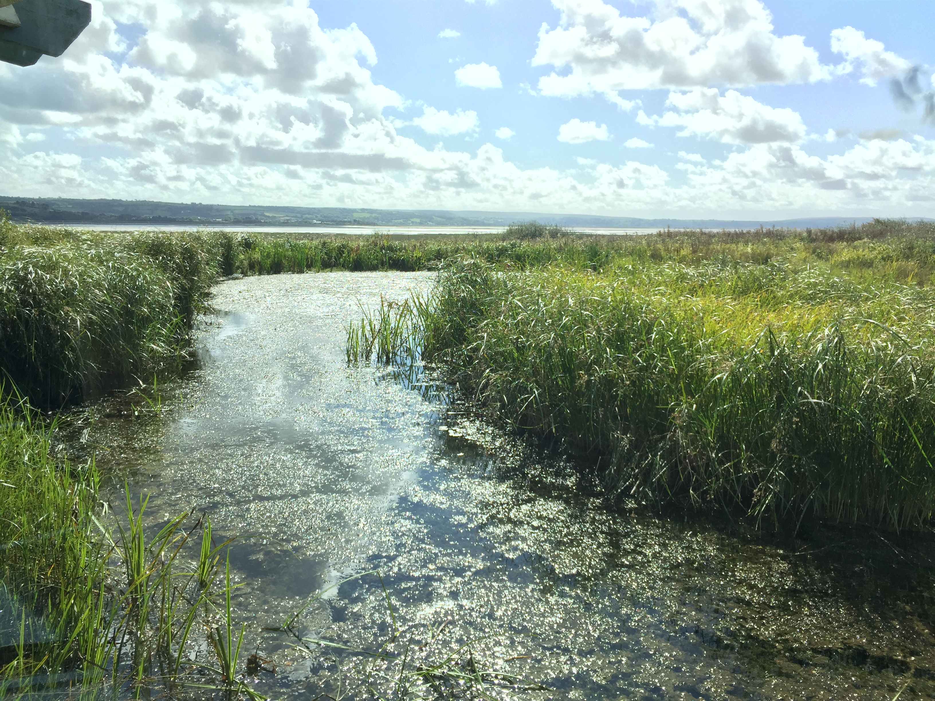
Module Overview
Aim(s)
Enable students to critically evaluate and appraise freshwater conservation from a multidisciplinary point of view.
Learning Outcomes
Appraise freshwater ecology and the physical, chemical, biological and human factors affecting it.
Determine the quality of freshwater environments and analyse the principles and concepts of watershed management.
Evaluate possible contradictions arising from economic development and the need to conserve a scarce resource.
Pengelly, 2015

Slide 3
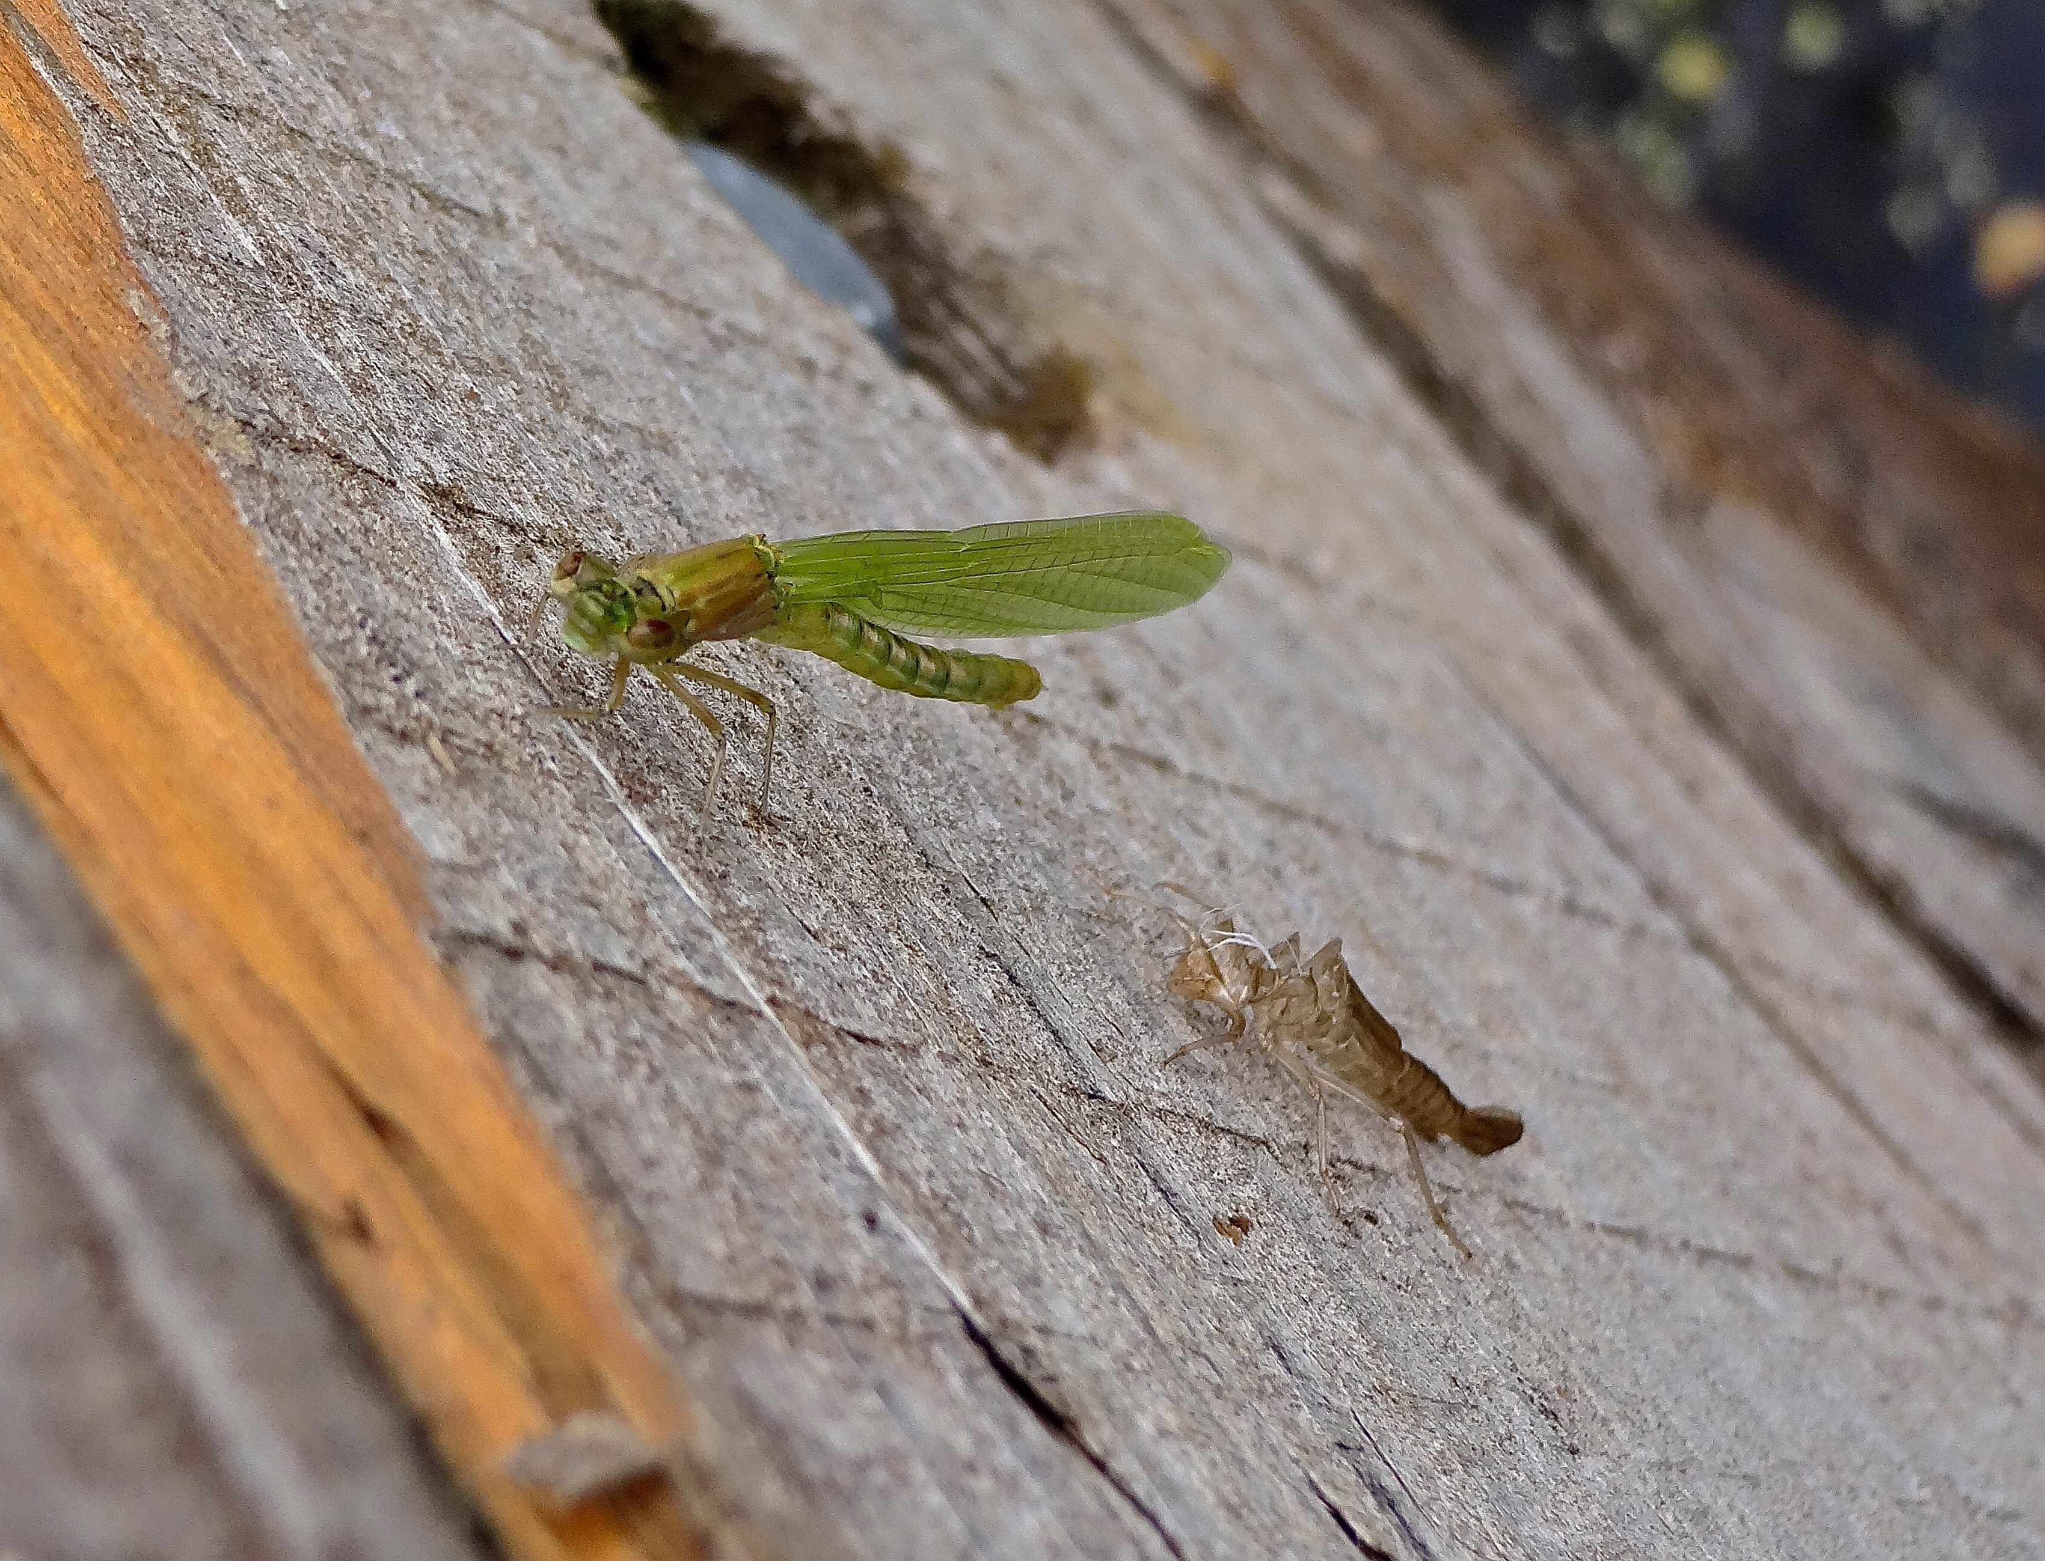
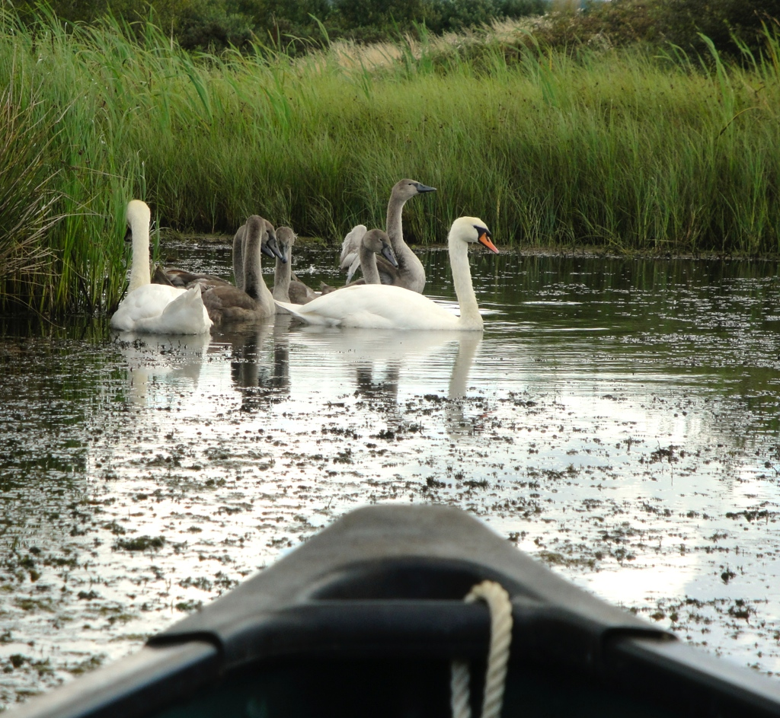
Assessment 1 (30%)
Pengelly, 2015
Fieldwork Data at WWT Llanelli:
Coursework report (1500 words)
Attend fieldwork where you will collect data (freshwater invertebrates) from WWT Llanelli’s ponds.
Produce a report which assesses & evaluates the quality and value of these ponds using biotic indices.
Identify key groups of aquatic invertebrates, including biodiversity indicator species.
Pengelly, 2011
Pengelly, 2014
Notes:
Yet to be fully confirmed, your first assessment will likely be undertaken at WWT Llanelli.
The plan so far is to ’Pond dip’ and assess the biodiversity of freshwater pond/lake habitats.
This will include identification skills of freshwater invertebrates and their ecosystem requirements.

Slide 4
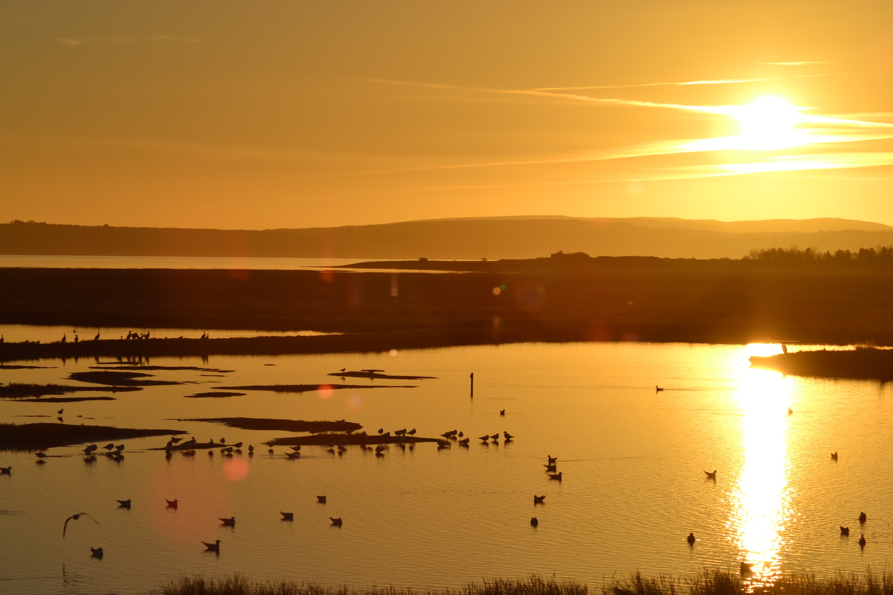
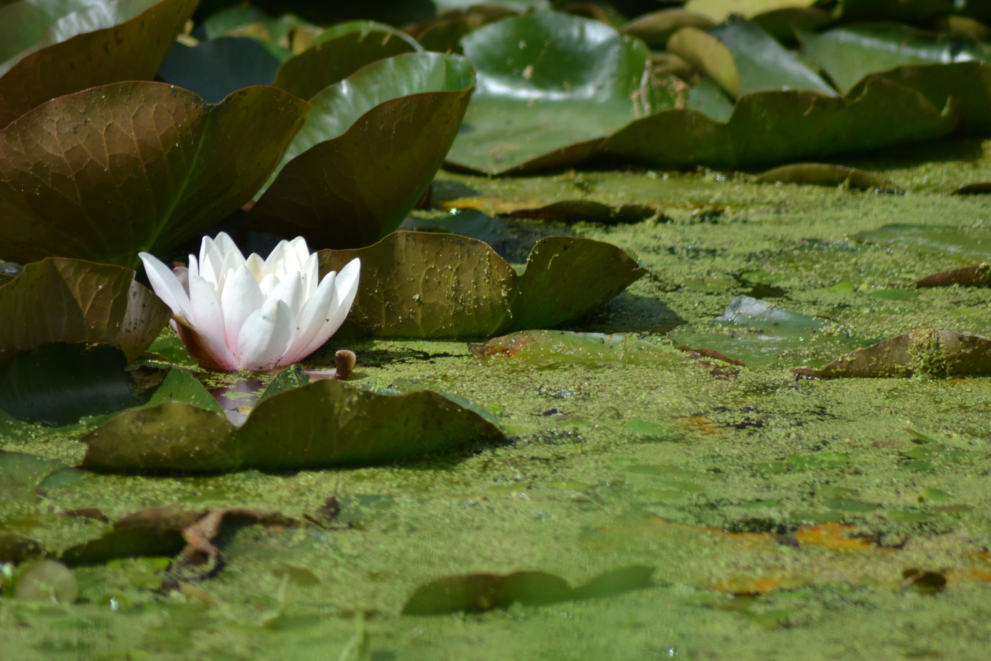
Assessment 2 (50%)
Pengelly, 2013
Freshwater Data Coursework:
Coursework report (1500 words)
Choose a named body of water anywhere in the world, with suitable amounts of data and information accessible to you.
Produce a report which evaluates the ecology and physical, chemical, biological and human factors affecting it.
Pengelly, 2014

Slide 5
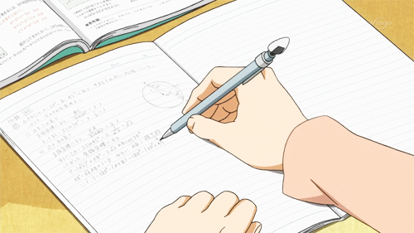
Assessment 3 (20%)
Formal Written Exam:
Students will undertake a formal written exam.
During lectures in the run-up to the exam, students will be told the question and have this opportunity onward to research the topic/area for the exam.

Slide 6
FLOW: For Love Of Water
Award winning documentary’s investigation into how our global water supply isn’t just at risk, but already in crisis.
https://www.youtube.com/watch?v=TvtnVQPxmzM
Notes:
Film – https://www.youtube.com/watch?v=Qb2Mu8Y-mAc
FLOW Study Guide – https://ogoapes.weebly.com/uploads/3/2/3/9/3239894/flow_study_guide.pdf

Slide 7

Take away
Key points and concerns noted in the documentary…
https://quizlet.com/105651849/film-flow-for-love-of-water-flash-cards/

