Slide 1
Virgin Media and British Airways
Name: Cristian Ioan Spridon
Student ID: 2118625
Module title and number: BMSW5106 – Knowledge and Information Management Skills for the Workplace
Lecturer’s name: Dr. Oluwaseun (Olu) Adegbite
Title of report: Task 2

Slide 2





Companies’ description
Virgin Media, a prominent subsidiary of Liberty Global, is one of the United Kingdom's leading entertainment and communications service providers. Established in 2006 through the merger of NTL, Telewest, and Virgin Mobile, the company has since established a solid foothold in the UK's telecommunications landscape, offering a comprehensive suite of services including broadband, television, mobile, and landline services (Liberty Global, 2016).
British Airways (BA) stands as one of the world's leading premium international airlines and the largest international carrier in the United Kingdom. Established in 1974 through the merger of the British Overseas Airways Corporation (BOAC) and British European Airways (BEA), BA has grown to service over 200 destinations worldwide, both directly and through its affiliations with the Oneworld airline alliance (Bamber et al., 2009).

Slide 3



Virgin Media TOWS Analysis:
 | Opportunities (O) | Threats (T)
Strengths (S) | SO Strategies: - Exploit technological prowess to enhance service offerings (Grant, 2016). - Utilize brand equity to explore new market segments. | ST Strategies: - Leverage strong brand image to maintain customer base in the face of growing competition. - Diversify service portfolio to decrease vulnerability to market changes (Johnson et al., 2017).
Weaknesses (W) | WO Strategies: - Address service disruptions by investing in resilient infrastructure. - Elevate customer satisfaction by integrating advanced customer service technologies (Peppers & Rogers, 2016). | WT Strategies: - Optimize cost structure to remain competitive against aggressive pricing by rivals. - Strengthen cybersecurity measures in response to escalating cyber threats (Kaplan & Haenlein, 2010).

Slide 4
British Airways TOWS Analysis:
 | Opportunities (O) | Threats (T)
Strengths (S) | SO Strategies: - Capitalise on the revival of global travel to expand flight operations (Gössling & Upham, 2009). - Leverage market dominance to form beneficial alliances. | ST Strategies: - Emphasize premium offerings to outperform low-cost competitors. - Adopt flexible strategies to cope with economic and geopolitical instabilities (Buckley & Ghauri, 2004).
Weaknesses (W) | WO Strategies: - Advance operational efficiency to seize opportunities in recovering tourism sectors (Kasemsap, 2017). - Modernize in-flight services and customer support to improve the travel experience. | WT Strategies: - Implement cost-effective measures and improve fuel efficiency against fluctuating fuel costs. - Develop dynamic response plans for international health crises and travel restrictions (Ritchie & Jiang, 2019).

Slide 5

Similarities/Differences in Knowledge Management
Similarities:
Cybersecurity Risks: Both BA and Virgin Media face threats related to data breaches due to their increased reliance on digital systems (Lawton, 2000; Virgin Media, 2019).
Technological Opportunities: Advances in technology offer both companies the potential to enhance their KM systems, be it through better data analytics or more integrated platforms.
Global Orientation: Both companies operate in a global context, necessitating a KM system that caters to diverse markets and cultures.
Differences:
Organisational Legacy: BA's long-standing history means it might have more legacy systems and institutionalised knowledge, which can be both a strength and a weakness (Bamber et al., 2009). In contrast, Virgin Media's relatively shorter history as an integrated entity might offer more agility in its KM approach (Liberty Global, 2016).
Industry Dynamics: The aviation and telecommunications industries have different knowledge requirements. For BA, knowledge related to safety, flight operations, and customer service is critical, while Virgin Media might focus more on technological knowledge and customer usage patterns.

Slide 6
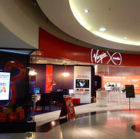
KM Value Chain in Virgin Media
Knowledge Acquisition:
Benefits from a rich pool of global knowledge resources.
Constant engagement with cutting-edge technologies and global markets
Customer feedback, acquired through their digital platforms.
Knowledge Storage: Digital platforms and cloud technologies
Knowledge Dissemination: Advanced Intranet platforms, collaborative tools, and cross-functional teams
Knowledge Application: Leveraging knowledge to enhance customer experiences, improve network connectivity, or develop innovative product offerings.
Supporting IT Systems: Enterprise Resource Planning (ERP) systems
Comparison with Other Organisations:
A company like British Airways, might focus more on safety, flight operations, and customer service in its KM approach. The knowledge they acquire, store, and apply would differ considerably from that of Virgin Media. However, the underlying IT systems supporting the KM initiatives (like ERP, CRM) might have similarities.
Critique:
An over-reliance on digital systems could lead to overlooking the tacit knowledge that resides within employees.
Fast-paced technological evolution in telecommunications could render certain knowledge obsolete quickly, necessitating constant updates to the KM system.
Cybersecurity remains a threat.

Slide 7
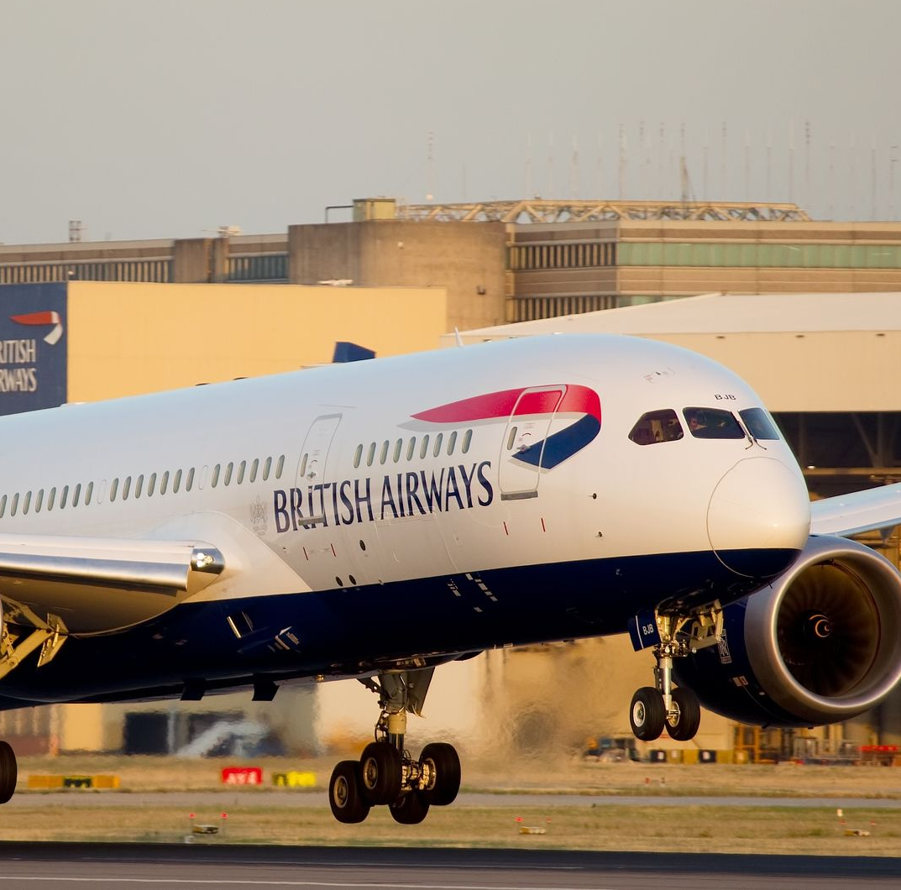
KM Value Chain in British Airways
Knowledge Acquisition: Extensive network of flights, customer feedback, crew experiences, and constant engagement with aviation technologies and regulations.
Knowledge Storage Advanced database systems, with a focus on cloud storage for scalability and accessibility. Institutional knowledge, standard operating procedures, and insights from flight data recorders could be examples of stored knowledge.
Knowledge Dissemination: Ensuring that flight crews, ground staff, and customer service representatives have access to real-time and relevant knowledge is crucial. BA uses advanced intranet systems, training modules, and perhaps augmented reality (AR) tools for training and knowledge sharing.
Knowledge Application: Improving flight routes based on weather data, enhancing in-flight service based on customer feedback, or addressing mechanical issues based on crew reports.
Supporting IT Systems: Enterprise Resource Planning (ERP) Systems
Comparison with Other Organisations: Compared to Virgin Media, the focus areas differ. While both would rely on ERP and CRM systems, BA’s emphasis would be more on safety, flight data, and global operations, whereas Virgin Media would be more oriented towards technology solutions, customer usage patterns, and network management.
Critique:
Legacy systems might not be agile enough for rapid KM adaptations.
The diverse and global nature of its operations might present challenges in standardising KM practices.
Cybersecurity, is another critical concern, given the increased reliance on digital KM systems (Lawton, 2000).

Slide 8

Recommendations
Embrace Advanced Analytics and AI
Strengthen Tacit Knowledge Capture
Improve Integration with Other IT Systems
Prioritise Cybersecurity
Promote a Knowledge-Sharing Culture
Ensure KM System Agility
Frequent Training and Workshops
Feedback Mechanism
Explore Augmented Reality (AR) and Virtual Reality (VR) for Training
Regular KM System Audits

Slide 9
References
Alavi, M., & Leidner, D.E. (2001). Knowledge management and knowledge management systems: Conceptual foundations and research issues. MIS quarterly, 107-136.
Bamber, G.J., Gittell, J.H., Kochan, T.A., & von Nordenflycht, A. (2009). Up in the Air: How Airlines Can Improve Performance by Engaging their Employees. Cornell University Press.
Becerra-Fernandez, I., & Sabherwal, R. (2014). Knowledge management: Systems and processes. Routledge.
Buckley, P. J., & Ghauri, P. N. (2004). Globalisation, economic geography and the strategy of multinational enterprises. Journal of International Business Studies, 35(2), 81-98.
Carmigniani, J., & Furht, B. (2011). Augmented reality: an overview. In Handbook of Augmented Reality (pp. 3-46). Springer.
Davenport, T.H., & Prusak, L. (1998). Working knowledge: How organizations manage what they know. Harvard Business Press.
Davenport, T.H., & Ronanki, R. (2018). Artificial intelligence for the real world. Harvard business review, 96(1), 108-116.
Doganis, R. (2006). The Airline Business. Routledge.
Dove, R. (2001). Response Ability: The Language, Structure, and Culture of the Agile Enterprise. Wiley.
Grant, R. M. (2016). Contemporary strategy analysis: Text and cases edition. John Wiley & Sons
Hansen, M.T., Nohria, N., & Tierney, T. (1999). What’s your strategy for managing knowledge? Harvard Business Review, 77(2), 106-116.
Johnson, G., Whittington, R., Scholes, K., Angwin, D., & Regnér, P. (2017). Exploring strategy: text and cases. Pearson Education.
Kapoor, K.K., Tamilmani, K., Rana, N.P., Patil, P., Dwivedi, Y.K., & Nerur, S. (2018). Advances in social media research: past, present and future. Information Systems Frontiers, 20(3), 531-558.
Kaplan, A. M., & Haenlein, M. (2010). Users of the world, unite! The challenges and opportunities of Social Media. Business Horizons, 53(1), 59-68.
Kasemsap, K. (2017). The role of operational efficiency in the modern business world. In Handbook of Research on Organizational Culture and Diversity in the Modern Workforce (pp. 1-20). IGI Global.
Lawton, T.C. (2000). Technology and the New Economics of Business. Journal of Air Transport Management, 6(1), 59-66.
Liberty Global. (2016). About Virgin Media. Retrieved from Liberty Global website.
Morrell, P.S. (2007). Airline finance: developments since 2000 for 126 airlines. Journal of Air Transport Management, 13(5), 351-355.
Nonaka, I., & Takeuchi, H. (1995). The knowledge-creating company: How Japanese companies create the dynamics of innovation. Oxford university press.
Peppers, D., & Rogers, M. (2016). Managing customer experience and relationships: A strategic framework. John Wiley & Sons.
Ritchie, B. W., & Jiang, Y. (2019). A review of research on tourism risk, crisis and disaster management: Launching the annals of tourism research curated collection on tourism risk, crisis and disaster management. Annals of Tourism Research, 79, 102812.
Rosenberg, M.J. (2001). E-Learning: Strategies for Delivering Knowledge in the Digital Age. McGraw-Hill.
Virgin Media. (2019). Annual Report & Accounts. Virgin Media Inc.

