Slide 1
IP Section 2
NATs
Firewalls

Slide 2

IP Section 3
Network Address Translator (NAT)
‘Private’ side
‘Public’ side
Internet
10.0.0.0 /24
10.0.0.1
194.66.73.0/27
NAT router
The Network Address Translator has a pool of assigned IP addresses from the Internet, which it ‘loans’ to users as they access the Internet.
It translates these public addresses to their private IP addresses for each transfer.

Slide 3
IP Section 3
Network Address Translator (NAT)
‘Private’ side
‘Public’ side
Internet
10.0.0.0 /24
10.0.0.1
194.66.73.0/27
NAT router
The addresses used on the private side of the network are never seen outside on the public side.
Hence this reduces the number of public IP4 addresses required, and also gives some security to the private network.

Slide 4
IP Section 3
Network Address Translator (NAT)
‘Private’ side
‘Public’ side
Internet
10.0.0.0 /24
10.0.0.1
194.66.73.0/27
NAT router
No. of PCs connected to Internet limited by NAT “pool size”
Here a /27 means….
…. 5 bits for hosts →2⁵ – 2 = 30 hosts possible.
When all used, no one else can get online.

Slide 5
IP Section 3
Network Address Translator (NAT)
‘Private’ side
‘Public’ side
Internet
10.0.0.0 /24
10.0.0.1
194.66.73.0/27
NAT router
The NAT hides the private network addresses.
This is also known as masquerading.

Slide 6
IP Section 3
Network Address Translator (NAT)
‘Private’ side
‘Public’ side
Internet
10.0.0.0 /24
10.0.0.1
194.66.73.0/27
NAT router
IP addresses for Private Networks
Three IP addresses reserved for private networks defined in RFC 1918, and which are never routed on the public Internet. They are:
one class A address: 10.0.0.0 / 8
one /12 address: 172.16.0.0 / 12
one /16 address: 192.168.0.0 / 16

Slide 7
IP Section 3
Network Address Translator (NAT)
‘Private’ side
‘Public’ side
Internet
10.0.0.0 /24
10.0.0.1
194.66.73.0/27
NAT router
IP addresses for Private Networks
These 3 private address ranges can be freely used by anyone without the need of registering.
The same address is used many times in the world on different LANs, but only once per LAN.
‘Private’ addresses will never appear on the Internet as they are translated into valid IP addresses by a NAT, PAT or Proxy Server.

Slide 8
Network Address Translator (NAT)
‘Private’ side
‘Public’ side
Internet
10.0.0.0 /24
10.0.0.1
194.66.73.0/27
NAT router
IP addresses for Private Networks
Also 169.254.0.0/16 is reserved for autoconfiguration, as mentioned in RFC 3330, where there is no DHCP server. Microsoft have created an implementation called Automatic Private IP Addressing (APIPA).
Also known as Zeroconf.

Slide 9
Port Address Translator (PAT)
‘Private’ side
‘Public’ side
Internet
10.0.0.0 /24
10.0.0.1
194.66.73.1/32
PAT router
Port Address Translator (PAT)
This is an advancement on the NAT in that it only requires a single public IP address.
Hence it is also known as a single address NAT or a one-to-many (1:many) NAT.
In Linux documentation it is known as IP-Masquerade.

Slide 10
Port Address Translator (PAT)
‘Private’ side
‘Public’ side
Internet
10.0.0.0 /24
10.0.0.1
194.66.73.1/32
PAT router
Port Address Translator (PAT)
How does the PAT manage with only one IP address?
By using a single out-going IP address with different port numbers for each private-side address, the PAT can keep track of which packet belongs to which host.

Slide 11
Port Address Translator (PAT)
‘Private’ side
PAT
‘Public’ side
Internet
10.0.0.0 /24
10.0.0.1
194.66.73.1
Example:
IP Port(in) IP Port (out)
10.0.0.01: 1024 194.66.73.1: 1056
10.0.0.05: 1044 194.66.73.1: 1050
10.0.0.11: 1036 194.66.73.1: 1060

Slide 12
Proxy server
‘Private’ side
Proxy Server
‘Public’ side
Internet
10.0.0.0 /24
10.0.0.1
194.66.73.1
Firewall
A proxy server is a computer or program that acts as a go-between to fetch the files requested by an authorised client on one network from a server on another network.
Proxy servers are often incorporated into firewalls (see next section).

Slide 13
Proxy server
‘Private’ side
Proxy Server
‘Public’ side
Internet
10.0.0.0 /24
10.0.0.1
194.66.73.1
Firewall
A proxy server only needs one IP address (like a PAT) by
clever use of Port Addresses.

Slide 14
Proxy server
‘Private’ side
Proxy Server
‘Public’ side
Internet
10.0.0.0 /24
10.0.0.1
194.66.73.1
Firewall
Proxy Server – cache
In addition to privacy considerations, a proxy server (especially a local one) can improve access times by keeping a cache of frequently accessed web pages.
E.g. if you access www.bbc.co.uk you might get fast access to the web-page as it may be held in the proxy’s cache as other people may have recently accessed it.

Slide 15
Firewall NAT vs. Proxy Server.
The following slides shows a connection via
(a) a Firewall NAT
(b) a proxy server.
Note:
1. In the NAT case, both parties are unaware that they are talking through the NAT.
2. In the Proxy server case, the client host knows that it is talking to the proxy (and requires special settings to do so). The server cannot ‘see’ the client, only the proxy server.

Slide 16
Private network
Firewall
NAT Router
Public network
Internet
10.0.0.2: 1234
(10.0.0.1) 194.66.73.5: 2345
132.185.132.204: 0080
www.bbc.co.uk
① GET
http://www.bbc.co.uk
132.185.132.204: 0080
from 10.0.0.2: 1234
② GET
http://www.bbc.co.uk
132.185.132.204: 0080
from 194.66.73.5: 2345
④ reply to
10.0.0.2: 1234
from http://www.bbc.co.uk
132.185.132.204: 0080
③ reply to
194.66.73.5: 2345
from http://www.bbc.co.uk
132.185.132.204: 0080
(a) Connection via a NAT

Slide 17
Private network
Firewall
Proxy Server
Public network
Internet
10.0.0.2: 1234
(10.0.0.1) 194.66.73.5: 2345
132.185.132.204: 0080
www.bbc.co.uk
① GET
http://www.bbc.co.uk
to 10.0.0.1: 8080 (proxy server)
from 10.0.0.2:1234
② GET
http://www.bbc.co.uk
[132.185.132.204: 0080]
from 194.66.73.254: 65000
④ reply to
10.0.0.2: 1234
from 10.0.0.1: 8080
(proxy server)
③ reply to
194.66.73.254: 65000
from http://www.bbc.co.uk
[132.185.132.204: 0080]
(b) Connection via a Proxy Server

Slide 18
Remote Proxy Server
Connections may also be made to a remote proxy server, of which there are 10,000 ’s in the Internet.
There are two ways you can use these:
via a web-page
setting Internet Explorer to use a proxy server.

Slide 19
Remote Proxy Server
Proxy server via a web page
Here the user accesses the web page of an anonymous proxy server,
e.g. http://www.anonymizer.com/ (download)
or http://proxify.com/
and on that web page types in the required web address.

Slide 20
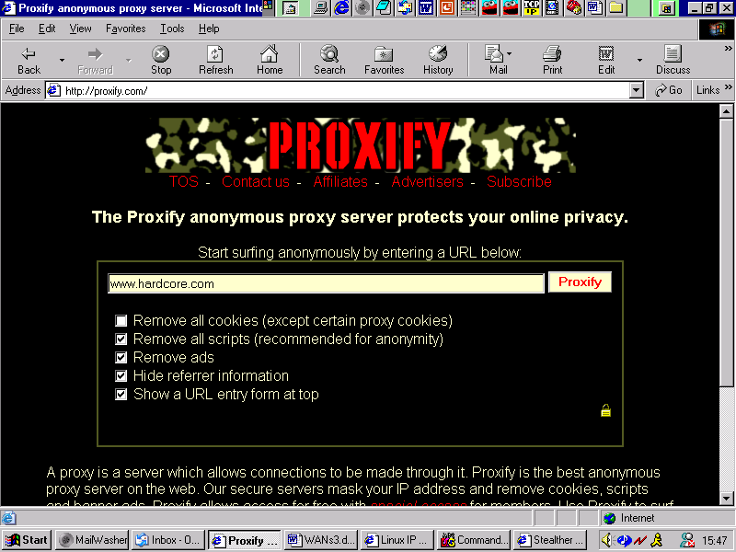
Remote Proxy Server

Slide 21
Remote Proxy Server
Try out…
http://proxify.com/

Slide 22
Remote Proxy Server
Anonymous proxy
12.13.14.15
Private network
Firewall
Public network
57.32.2.1
Internet
10.0.0.2
10.0.0.1 194.66.73.254
Connection via an Anonymous Proxy Server
www.hardcore.com
66.67.68.69
What IP address does the firewall think has been accessed? …………………………………..
(Note: the firewall administrator may think he has blocked access to www.hardcore.com .)
What does www.hardcore.com think is the address of the user? ……………………………….
12.13.14.15
57.32.2.1

Slide 23
Remote Proxy Server
Anonymous proxy
12.13.14.15
Private network
Firewall
Public network
57.32.2.1
Internet
10.0.0.2
10.0.0.1 194.66.73.254
Connection via an Anonymous Proxy Server
www.hardcore.com
66.67.68.69
The Anonymous Proxy Server replaces your IP address with its own IP address. The web-site knows the information has gone via a proxy server, but doesn’t know where to.
If you use a High Anonymity Proxy Server, your IP address is withheld as above, but in addition, the fact that a proxy server is being used, is also withheld.

Slide 24
Remote Proxy Server
Anonymous proxy
12.13.14.15
Private network
Firewall
Public network
57.32.2.1
Internet
10.0.0.2
10.0.0.1 194.66.73.254
Connection via an Anonymous Proxy Server
www.hardcore.com
66.67.68.69
A Transparent Proxy Server will reveal your IP address and the fact that it is acting as a proxy server for you.

Slide 25
Remote Proxy Server
Anonymous proxy
12.13.14.15
Private network
Firewall
Public network
57.32.2.1
Internet
10.0.0.2
10.0.0.1 194.66.73.254
Connection via an Anonymous Proxy Server
www.hardcore.com
66.67.68.69
For good FAQs on the use and types of proxy servers: http://www.freeproxy.ru/en/free_proxy/faq/index.htm and http://lockdowncorp.com/stealth/
For a good list of proxy servers see: http://atomintersoft.com/products/alive-proxy/proxy-list/
Also a list of free proxies available from: http://www.freeproxy.ru/download/lists/goodproxy.txt

Slide 26
Remote Proxy Server
Anonymous proxy
12.13.14.15
Private network
Firewall
Public network
57.32.2.1
Internet
10.0.0.2
10.0.0.1 194.66.73.254
Connection via an Anonymous Proxy Server
www.hardcore.com
66.67.68.69
Today a good list at http://www.proxy4free.com/page1.html
Or http://proxy-list.org/en/index.php

Slide 27
Setting Internet Explorer to use a proxy server
You can get Internet Explorer to automatically use a proxy server every time by setting it as follows:
To set Proxy settings in Internet Explorer 7
Click "Tools" \ "Internet Options";
Click "Connections";
If you use Dial-Up connection, choose your connection and click "Settings" button.
if you use LAN connection, click "LAN Settings" button in the "Local Area Network (LAN) Settings" group box;
Enable "use a proxy server";
In fields "Address" and "port", type IP address/proxy name and proxy port number;
Enable "bypass proxy server for local addresses";
Click "OK";
Click "OK" to close IE settings.

Slide 28
Dial-up and Broadband Home Users
Home users are dynamically allocated an IP address whenever they dial-up or connect to their ISP.
Hence there is some security in that the IP address is different every time.
However, for full security, it might be worth considering using a proxy server as shown below (from http://www.lockdowncorp.com/ ):

Slide 29
http://www.lockdowncorp.com/
Firewalls Sometimes Stealth Your Ports,
But They NEVER Block Your IP From ANYONE
That Wants To See Or Probe It for trusted open ports!
Lets face it, you really never know who you or your children are talking to. Firewalls do not stop IP information from leaking out! Every email, ICQ, AIM and Yahoo Pager message, along with EVERY web page that you view and picture or file that you download gives this information away freely!
Did you know that every time you connect to the Internet, you are leaving your IP and ISP domain name behind? Many times this is all that is needed for anyone to know what city and state that you live in. This information, along with your email address is all that anyone needs to retrieve your name address and telephone number within minutes.

Slide 30
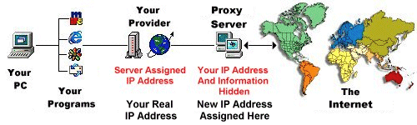
http://www.lockdowncorp.com/
How The Proxy Works
Our Anonymous Proxy Service Allows You To Hide Your Real Internet Connection AND IP, While You Are Using Virtually ANY Internet Service
Or Internet Program!

Slide 31
http://www.lockdowncorp.com/
Is there as big a threat as lockdowncorp.com would have us believe?
For broadband users they are offering a high anonymity proxy server web for $50 per month!
at http://theproxyconnection.com/

Slide 32
Proxy Anonymity
What information is transmitted to a web-server (by a browser or proxy server)?
a name and a version of your operating system
a name and a version of your browser
configuration of your browser (display resolution, color depth, java / javascript support, etc.)
IP-address of the client (could be your real IP)
proxy server information
Other information

Slide 33
Proxy Server Test
Anonymous proxy
12.13.14.15
Private network
Firewall
Public network
57.32.2.1
Internet
10.0.0.2
10.0.0.1 194.66.73.254
Connection via an Anonymous Proxy Server
Proxy server detector
http://www.proxyserverprivacy.com/adv-free-proxy-detector.shtml
Practical test using four different configurations:
No proxy server (Direct via NAT in F8)
Via Transparent Proxy
Via Anonymous proxy
Via High Anonymity (“Elite”) Proxy
Results overleaf…

Slide 34
Direct via F8 firewall
ProxyServerPrivacy detection
Your Ip Address: 86.136.47.157
Host: host86-136-47-157.range86-136.btcentralplus.com
Your Country: United Kingdom
City: London
Proxy HTTP_X_FORWARDED Variable: (none)
Proxy HTTP_VIA Variable: 1.1 F8INTERNET
Proxy HTTP_PROXY_CONNECTION: (none)
Cache Pragma: max-age=0
Your Browser: Mozilla/5.0 (Windows; U; Windows NT 5.1; en-US; rv:1.8.1.12) Gecko/20080201 Firefox/2.0.0.12 Tiscali Netphone v1.0.7
Type of Your connection: Keep-Alive
Server Protocol: HTTP/1.1
Your language: en-us
Accept: text/xml,application/xml,application/xhtml+xml,text/html;q=0.9,text/plain;q=0.8,image/png,*/*;q=0.5
Accept-Encoding: (none)
Referer - HTTP Request come from: http://www.google.com/search?q=proxy+detector&sourceid=navclient-ff&ie=UTF-8&rlz=1B2GGFB_enGB214GB235
Your Port: 26371
Conclusion after analyzing ip address:
You do not use proxy

Slide 35
Via Transparent Proxy (China)
Your Ip Address: 218.64.214.110
Host: 218.64.214.110
Your Country: China
City: Beijing
Proxy HTTP_X_FORWARDED Variable: 86.136.47.157
Proxy HTTP_VIA Variable: 1.0 proxy:3128 (squid/2.5.STABLE11)
Proxy HTTP_PROXY_CONNECTION: (none)
Cache Pragma: max-age=259200
Your Browser: Mozilla/5.0 (Windows; U; Windows NT 5.1; en-US; rv:1.8.1.12) Gecko/20080201 Firefox/2.0.0.12 Tiscali Netphone v1.0.7
Type of Your connection: keep-alive
Server Protocol: HTTP/1.0
Your language: en-us
Accept: text/xml,application/xml,application/xhtml+xml,text/html;q=0.9,text/plain;q=0.8,image/png,*/*;q=0.5
Accept-Encoding: gzip,deflate
Referer - HTTP Request come from: http://www.google.com/search?q=proxy+detector&sourceid=navclient-ff&ie=UTF-8&rlz=1B2GGFB_enGB214GB235
Your Port: 33487
Conclusion after analyzing ip address:
You use transparent Proxy server 218.64.214.110
that forward your real ip address 86.136.47.157

Slide 36
Via anonymous UK proxy
ProxyServerPrivacy detection
Your Ip Address: 155.136.224.10
Host: 155.136.224.10
Your Country: United Kingdom
City: Dunbar
Proxy HTTP_X_FORWARDED Variable: (none)
Proxy HTTP_VIA Variable: 1.0 F8INTERNET, 1.0 REDEMODMZP1
Proxy HTTP_PROXY_CONNECTION: (none)
Cache Pragma: (none)
Your Browser: Mozilla/5.0 (Windows; U; Windows NT 5.1; en-US; rv:1.8.1.12) Gecko/20080201 Firefox/2.0.0.12 Tiscali Netphone v1.0.7
Type of Your connection: Keep-Alive
Server Protocol: HTTP/1.0
Your language: en-us
Accept: text/xml,application/xml,application/xhtml+xml,text/html;q=0.9,text/plain;q=0.8,image/png,*/*;q=0.5
Accept-Encoding: (none)
Referer - HTTP Request come from: http://www.google.com/search?q=proxy+detector&sourceid=navclient-ff&ie=UTF-8&rlz=1B2GGFB_enGB214GB235
Your Port: 2848
Conclusion after analyzing ip address:
You do not use proxy

Slide 37
Via High Anonymity (“Elite”) Proxy (Japan)
ProxyServerPrivacy detection
Your Ip Address: 125.14.24.91
Host: 125-14-24-91.rev.home.ne.jp
Your Country: Japan
City: (Unknown City?)
Proxy HTTP_X_FORWARDED Variable: (none)
Proxy HTTP_VIA Variable: (none)
Proxy HTTP_PROXY_CONNECTION: (none)
Cache Pragma: (none)
Your Browser: Mozilla/5.0 (Windows; U; Windows NT 5.1; en-US; rv:1.8.1.12) Gecko/20080201 Firefox/2.0.0.12 Tiscali Netphone v1.0.7
Type of Your connection: close
Server Protocol: HTTP/1.0
Your language: en-us
Accept: text/xml,application/xml,application/xhtml+xml,text/html;q=0.9,text/plain;q=0.8,image/png,*/*;q=0.5
Accept-Encoding: (none)
Referer - HTTP Request come from: http://www.google.com/search?q=proxy+detector&sourceid=navclient-ff&ie=UTF-8&rlz=1B2GGFB_enGB214GB235
Your Port: 3075
Conclusion after analyzing ip address:
You do not use proxy

Slide 38
Firewalls
Firewalls – What are they and do I need one?
Topics:
What is a Firewall?
Why would I want a firewall?
What can firewalls protect against?
What can’t firewalls protect against?
What are the different types of firewall?

Slide 39

Firewalls - Analogy
Gatehouses
The Keep
Drawbridge
Moat

Slide 40
Firewalls – Castle Analogy
Note there are several gateways where you may be inspected (or obstacles to overcome) – this will be seen later to be analogous to the more secure firewall configurations.
In IP terms, a firewall is the equipment (computers, routers etc.) that you place between your network and the outside world with its hackers, crackers and vandals. You, and your trusted allies, will still have two-way access through a gateway.
The purpose of a firewall can be summarised that it should:
“keep the ‘good’ bits in, and the ‘bad’ bits out.”

Slide 41
Firewalls
Why would I want a firewall?
You will need a firewall if your computer network is connected to the Internet.
Unfortunately, the Internet is rather like an inner city area which contains all types of ‘undesirables’ who like
snooping (hackers)
stealing (crackers)
or just wrecking it for the hell of it! (vandals)
The Internet is fun for hackers and crackers, but a nightmare for corporate security managers.

Slide 42
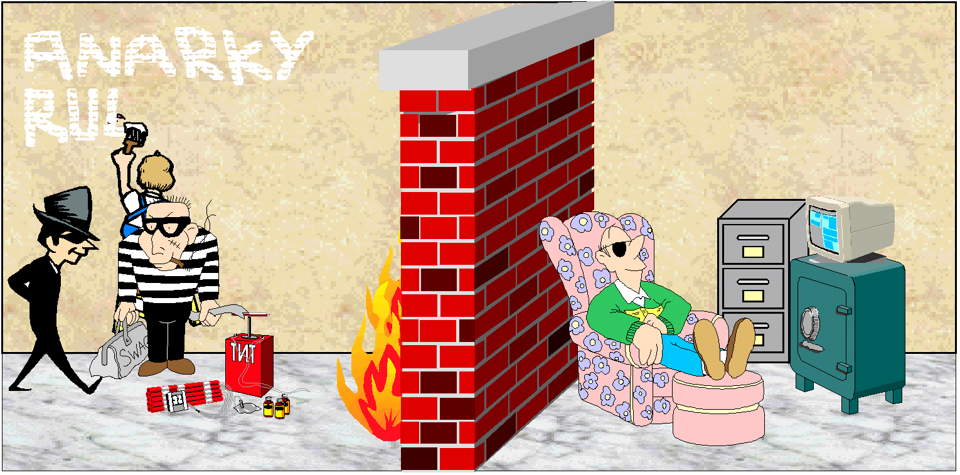
Firewalls
Vandal
Hacker and Cracker
Firewall
Network Admin

Slide 43
Firewall - analogy
Consider a large secure building in a city.
Entrance foyer
Guard
Recording
Free brochures.
IP traffic is inspected by a firewall

Slide 44
Simple Firewall
‘Public’ side
Internet
‘Private’ side
Firewall
The packet-filtering router rejects data packets which use unsafe protocols (see next section), and so provides some protection to the private network.

Slide 45
What can firewalls protect against?
Ideally, a firewall should prevent access from the public side to:
All intruders (hackers, crackers and vandals)
Unauthorised external users
Viruses
Prevent employees from accessing unauthorised Internet sites and downloading images or software.
Check e-mails for attached viruses or gigantic files.

Slide 46
What can firewalls protect against?
A firewall also undertakes monitoring, and can notify a manager of a current attack or suspicious probing so that measures can be taken to limit the damage.
Usage statistics – sites accessed, time-of-day traffic etc. are also logged, including any suspicious incidents.

Slide 47
What can firewalls protect against?
Firewalls can be configured to block certain types of ‘risky’ traffic that can be used to snoop around and find out important information.
This is done using a packet filter. The following protocols can be identified from the IP packet header and are normally totally blocked:
TFTP – Trivial File Transfer Protocol
X Windows, a graphical windowing system
Remote Procedure Call
UNIX ‘r’ commands (e.g. rlogin, rsh, and rexec)
finger

Slide 48
What can firewalls protect against?
Due to the large number of unsafe protocols, it is normal to apply the rules to allow a restricted number of defined protocols, rather than attempt to block all the unsafe ones. E.g. those protocols listed below:
TELNET for connecting to remote systems
FTP, File Transfer Protocol
SMTP, Simple Mail Transfer Protocol
DNS, Domain Name Service
UUCP, UNIX-to-UNIX CoPy
WWW/http

Slide 49
Firewalls
Firewalls:
Application Gateways
Proxy servers
Prevent outsiders spoofing internal addresses
Masquerading
Bastion Host
As a final resort – pull the plug on the firewall!

Slide 50
What can’t firewalls protect against?
Traffic not passing through the firewall
Viruses
Denial of Service (DoS) attacks

Slide 51
What can’t firewalls protect against?
1. Traffic not passing through the firewall
Firewalls cannot protect against attacks that don’t go through the firewall.
This may sound obvious, but, for example, are you sure that:
your employees never bring in disks from outside (maybe to play a game),
a modem is never used on an outside phone line
no electromagnetic radiation escapes (eg. from monitors).
Analogy: 6 inch steel door u/s if window open!

Slide 52
What can’t firewalls protect against?
2. Viruses
Firewalls aren’t very good at preventing viruses.
Signature analysis is time-consuming and difficult with mutating and encrypted viruses.
Virus protection required at each end station (PC or server).

Slide 53
What can’t firewalls protect against?
3. Denial of Service
A firewalls isn’t able to prevent a denial of service (DoS) attack, however it may be able to give a warning of an impending attack and possibly identify the source.
A denial of service attack is where a malicious attacker organises a large number of computers to continuously hit a website with thousands of bogus requests for service which it cannot possibly handle. This prevents legitimate users from accessing the service.

Slide 54
Different types of Firewall
Packet filtering firewall
Application Gateway
Screened Host Firewall
Screened Subnet Firewall

Slide 55
Different types of Firewall
Router
  ‘Public’ side
Internet
‘Private’ side
Firewall
a. Packet-filtering router which restricts the incoming packets to certain types and destinations.
There is little or no logging capability and is really only suitable for very simple sites.

Slide 56
Different types of Firewall
‘Public’ side
Internet
‘Private’ side
Application Gateway
Firewall
b. This Application Gateway has two network connections (dual-homed host) deals with all incoming packets, and acts as a go-between (proxy server) between the public and private side, restricting use according to the rules set.
It also ‘hides’ all the internal network so that no direct communication is possible, known as masquerading.

Slide 57

Different types of Firewall
Application Gateway
‘Public’ side
R₁
Internet
‘Private’ side
Info Servers
Firewall
c. Screened Host
This now combines the advantages of an application gateway and a packet filtering router.
All packets passed by the router should be sent to the application gateway or information servers.
The information servers will include a web-server and an e-mail server .

Slide 58
Different types of Firewall
Application Gateway
‘Public’ side
R₁
R₁
Internet
‘Private’ side
Info Servers
Firewall
Screened Subnet
d. Screened Subnet Firewall
This is the best of the four types of firewall as there are three barriers to subvert: the two routers and the Application Gateway.
The screened subnet area can also be known as the Demilitarized Zone (DMZ)!

Slide 59
Checkpoint Firewall
Check Point offers EAL4 certified security solutions for firewall, VPN, IDS, IPS, management, secure logging, and endpoint security.
Check Point Integrity is the only endpoint security solution from a major security vendor to achieve Common Criteria EAL 4 certification.

Slide 60
Evaluation Assurance Level (EAL)
EAL1: Functionally Tested
EAL2: Structurally Tested
EAL3: Methodically Tested and Checked
EAL4: Methodically Designed, Tested and Reviewed
EAL5: Semiformally Designed and Tested
EAL6: Semiformally Verified Design and Tested
EAL7: Formally Verified Design and Tested
http://www.cesg.gov.uk/find_a/cert_products/index.cfm
http://www.niap-ccevs.org/cc-scheme/vpl/?c=1

Slide 61
Checkpoint Firewall
screenshots follow….

Slide 62
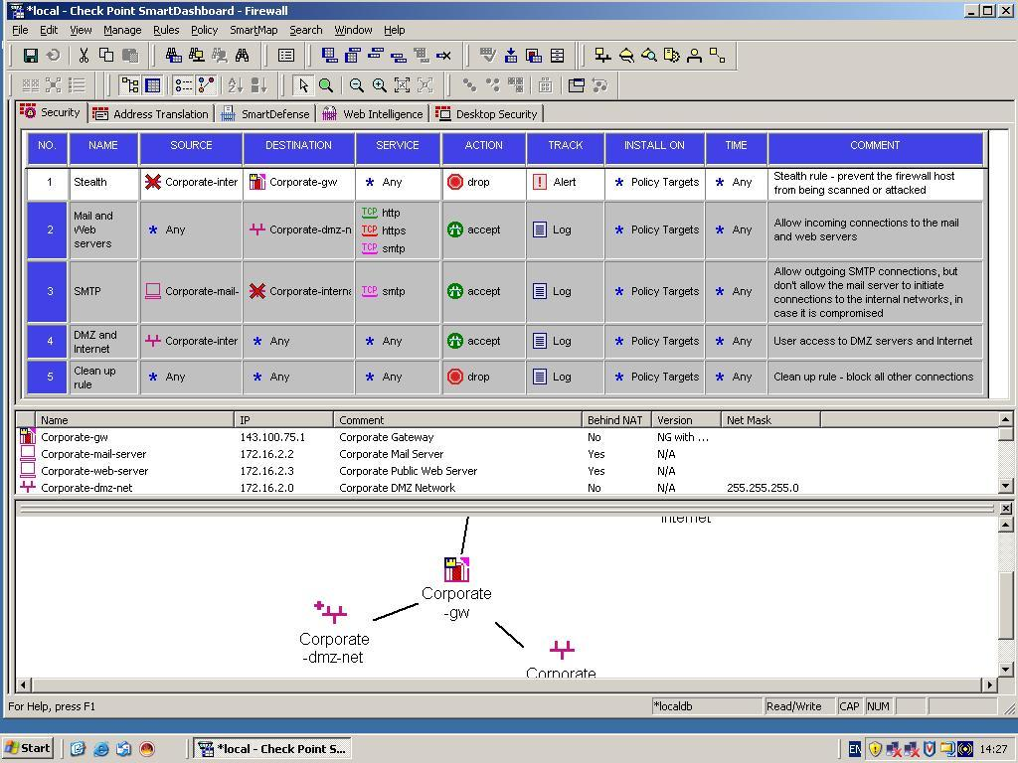

Slide 63
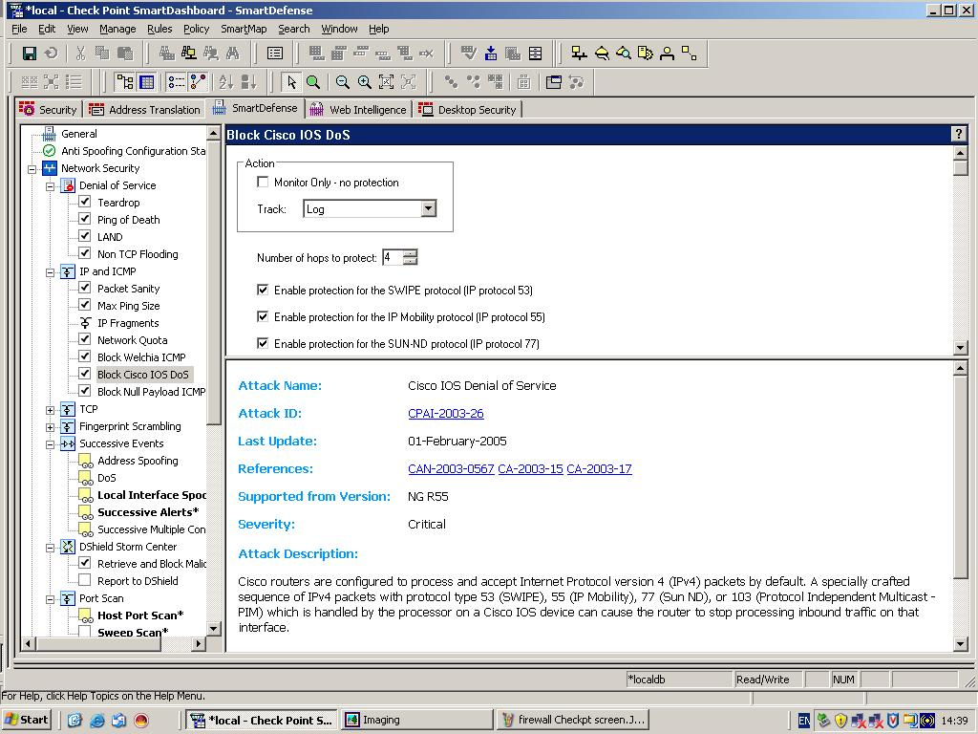

Slide 64
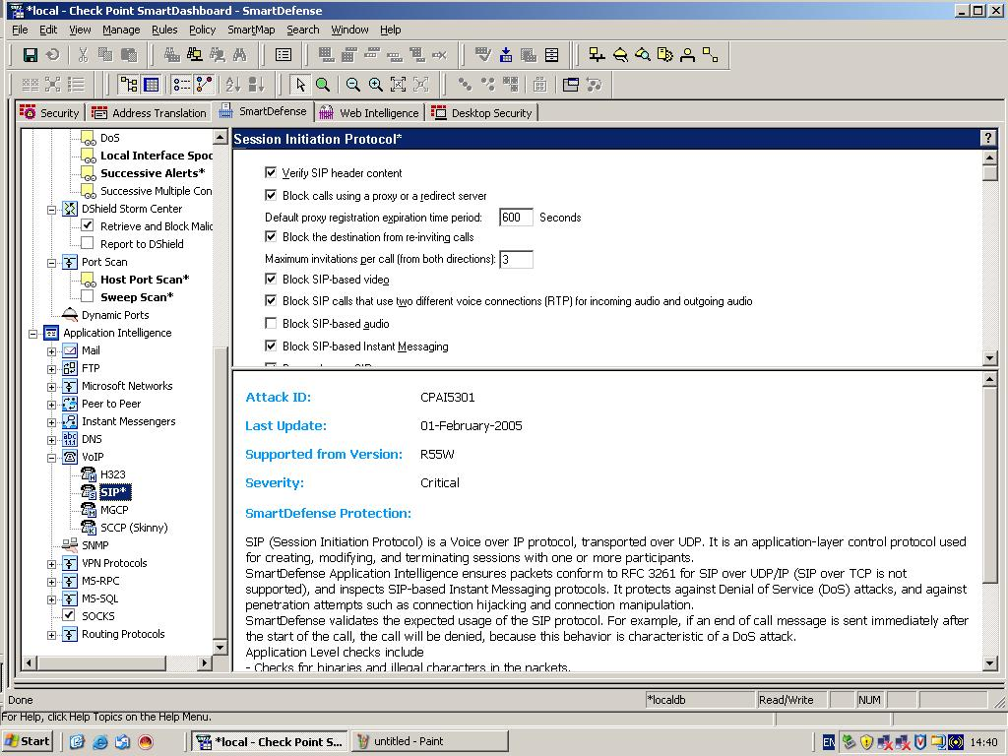

Slide 65
Firewalls - Conclusion
This section has introduced the concepts of a firewall as part of an overall security scheme.
Much further study would be required before specifying a system for a commercial or military site.
A glossary of firewall terms with a list of books and useful websites is at the end of this book.

