Slide 1


Academic and Employability Skills
Chiciuc Cristina 2023334

Slide 2
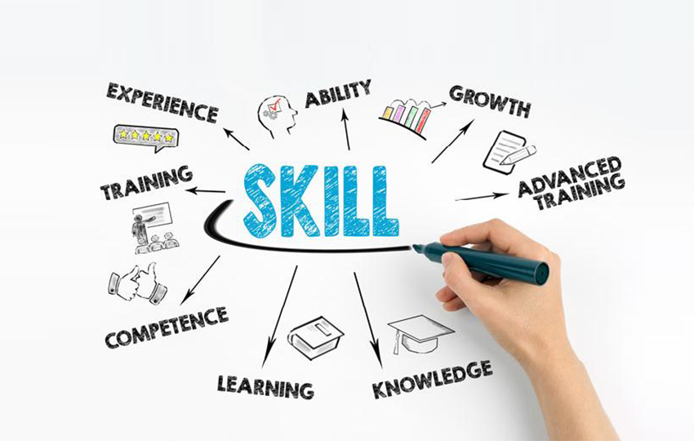
INTRODUCTION
Successful and effective students and employees are goal-oriented.
Organizational Psychology or Degrees depicts the behaviours of individuals and organisations in relation to arriving at their critical points.
In business, goal direction is a type of procedure that affects how a company approaches its revenues and plans for future projects.
Information is an important part of any corporation, academic institution, or society because it allows companies or educational institutions to adapt in response to client needs and financial conditions.
Information creates a general audience for the organisation based on its values and lifestyle.
The transition from a good student to a successful employee requires hard work and dedication, which is described as the demonstration of confining a person to a strategy.
Notes:
The foundation of advanced education in colleges around the world is changing, and the board of directors is working to create and represent the spaces they cover (Demirkesen and Ozorhon, 2017). The educational institutions, like any other organisation, are designed to be exclusively placed within the organisation based on their skill and professional abilities. The purpose of the project is to analyse self-development plants and discuss effective skills and methods that are required to implement to achieve certain employment goals from academic courses.

Slide 3
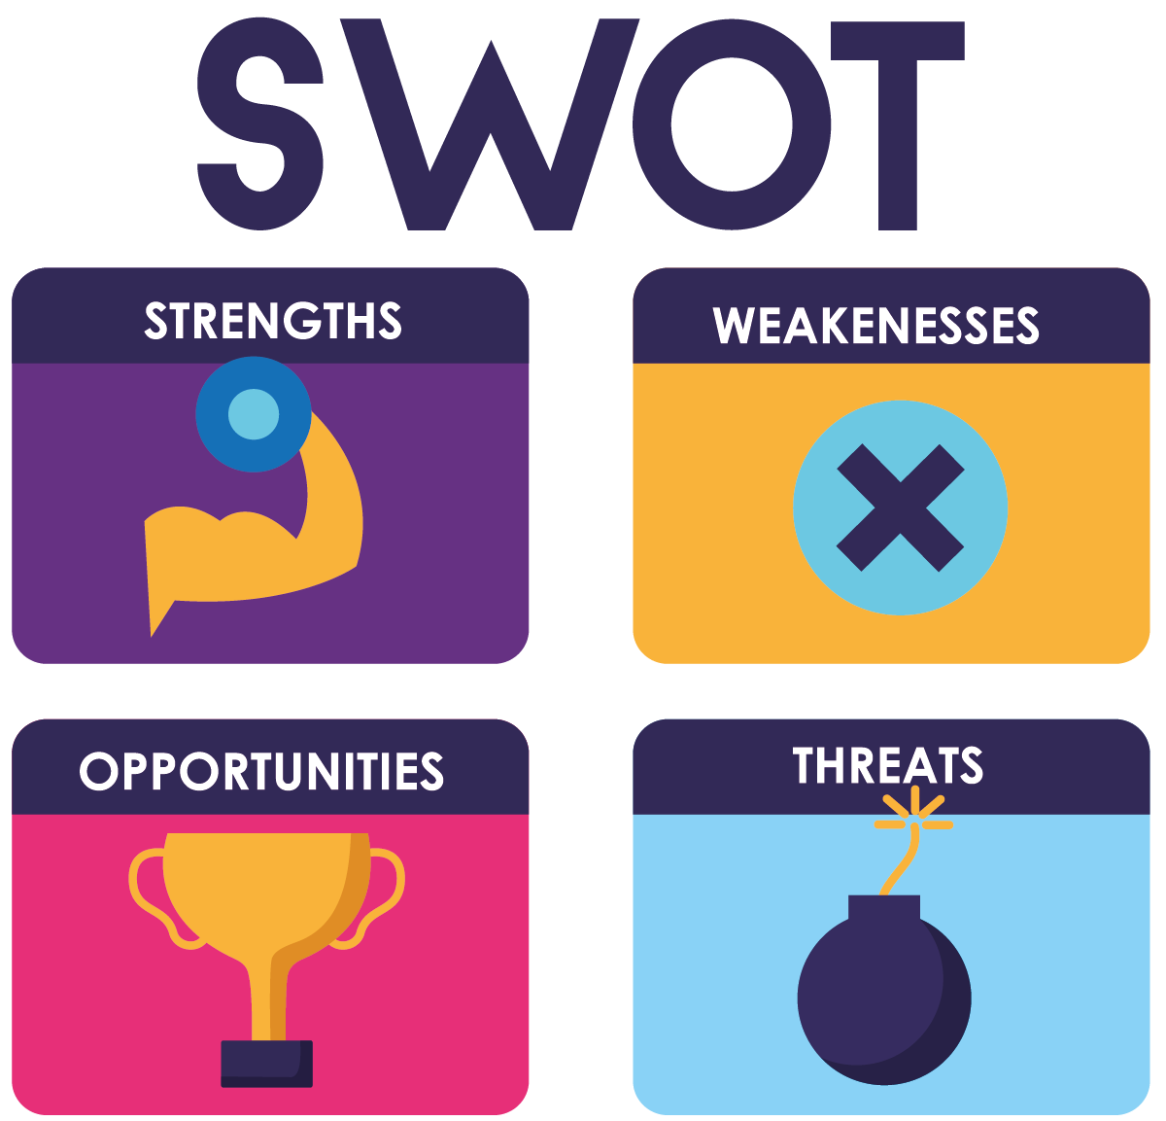
SWOT
STRENGTH
CONFIDENT & POSITIVE ATTITUDE
It is important that I maintain a positive attitude about my interactions with others. Certainty demonstrates to my collaborators that I am confident in what I am saying and that I will finish it. Visually connecting or using a strong yet pleasant tone can go a long way toward projecting trust. Avoid using terms that sound like questions (Swan et al., 2020). being careful not to come across as arrogant or pushy.
OPEN-MINDEDNESS
A good communicator should approach any conversation with an open, responsive mindset. Instead of simply stating your position, be open to hearing and respecting the other person's point of view. I'll want to have more legitimate, fruitful conversations if I'm able to engage in dialogue, including with people with whom I disagree
FEEDBACK
A significant correspondence skill is the ability to provide and receive appropriate feedback. Teachers, managers, and bosses can look for ways to provide valuable feedback to lawmakers on a regular basis, whether by email, phone calls, or weekly reminders (Usman, 2020). Essentially, I should be able to accept and even encourage feedback from others. Pay attention to the criticism I get, ask clarifying questions if I'm not sure what's going on, and make an effort to put the advice into practice.

Slide 4

SWOT
WEAKNESS
LISTENING
One of the easiest ways to be a good communicator is to be a good listener. No one enjoys conversing with someone who is only concerned with putting words on the page. I'm having trouble listening continuously. I often forget what was said and am unable to relate to the subject.
TIME MANAGEMENT
Efficient time management is one of the most important skills I can have as an online student. The more I control my time, the more easily I can accomplish my objectives (Hofmann et al., 2018). I have trouble organising my time because I really don't know how to prioritise my tasks.

Slide 5

SWOT
OPPORTUNITIES
The willingness to embrace feedback opens up a world of possibilities for growth and versatility. Employees who are willing to face challenges, adapt to changes, and work on suggestions for progress are admired by the company.
Positive attitudes build a happy and safe environment, which is something that any employer seeks. Confidence lifts an individual above their fears and obstacles (MFONDOUM et al.). As a result, it is an important component of any job task.
One of the most sought-after employee qualities is open-mindedness. Being open-minded means that I am able to listen to other people's thoughts and viewpoints and accept the possibility that I might be mistaken or change my mind.

Slide 6

SWOT
THREATS
TOO MANY DISTRACTIONS
The news of my favourite celebrity gossip website quickly distracts me. When I need to concentrate on my research, I am unable to stay focused and waste too much time on Facebook, Twitter, and other social media tools.
UNABLE TO CREATE A BALANCE
It's also crucial to strike a balance between coursework and other responsibilities, particularly if you're juggling school and work.

Slide 7

PERSONAL DEVELOPMENT PLAN
Focus area
To become an expert in managing time.
To be able to implement active listening and remembering the conversation.
Where now
Unable to set up priority tasks. Hence it delays my project works and I lose marks for a late submission.
Usually, I lose track of the topic. Especially in seminars or online classes or university lectures. I am unable to understand or recall things.
Activity
To manage my time I will be implementing Pomodoro Technique. It will make my task easier, i.e. I will try to focus for a short time and it will increase my concentration (MFONDOUM et al.).
To be able to implement active listening and remembering the conversation by taking notes is one of the best practices.

Slide 8

PERSONAL DEVELOPMENT PLAN
Resource
Attending time management courses that are offered by the university and making a diary on the time taken to complete one task in a day.
Attending notes, taking classes and the importance of conversation. Also how to understand the key points of a seminar.
Progress
Progress can be checked by evaluating subjects that have been completed from day one of implementation.
Progress can be checked by attending different classes and seminars and then explaining the scenario to fellow students. It will create an understanding.
Time taken
This will take 6 months.

Slide 9
TIME MANAGEMENT TECHNIQUES
The way to plan and monitor how much time to spend on explicit exercises is to use time management. The management of time allows them to accomplish more in a shorter amount of time, reduces stress, and promotes professional success.
There are over multiple time management solutions available for all of the different character types, profitability problems, and market requirements.
SMART Objectives
The concept is quite simple. Each SMART goal should be recorded according to the following guidelines:
The Eisenhower Matrix/The Eisenhower box
The Eisenhower Matrix is a method for prioritising your projects based on their urgency. It aids in determining which exercises are important and which do not, by any stretch of the imagination, warrant consideration. Dwight D. Eisenhower is the creator of the famous Eisenhower Matrix. The grid divides your tasks into four quadrants based on what you need to do at any given time during the day.
Kanban Board
A Kanban board is a visual representation tool that allows people
to improve the progress of their work. Using a Kanban
board to manage work within a community or organisation
can be beneficial. Visual nuances are shown in a single place on
a Kanban load up, reducing the amount of time spent looking
through progress updates or sitting in announcement meetings.
Pomodoro Technique
The Pomodoro Technique, developed by Italian Francesco Cirillo,
is a well-known time-management method. It's useful if people
get distracted when working on a project or need to figure out how
long an errand would take. It's perfect for a variety of tasks,
including writing, coding, planning, and studying.
Notes:
TIME MANAGEMENT TECHNIQUES
The way to plan and monitor how much time to spend on explicit exercises is to use time management. The management of time allows them to accomplish more in a shorter amount of time, reduces stress, and promotes professional success.
There are over multiple time management solutions available for all of the different character types, profitability problems, and market requirements.
SMART Objectives
The concept is quite simple. Each SMART goal should be recorded according to the following guidelines:
Specific – clearly defined the desired outcome, what you need to achieve
Measurable – a way to monitor progress should be available.
Achievable – the goal can be reached with readily available resources.
Relevant – it should (Rubens et al., 2018).
Time-bound – a fair deadline for when the goal will be completed.
The overwhelming majority of people do not have goals. Just about 10% of people have written down their goals. That means it takes effort, as well as some sincere reflection and thought, to properly document significant goals.
The Eisenhower Matrix/The Eisenhower box
The Eisenhower Matrix is a method for prioritising your projects based on their urgency. It aids in determining which exercises are important and which do not, by any stretch of the imagination, warrant consideration. Dwight D. Eisenhower is the creator of the famous Eisenhower Matrix. The grid divides your tasks into four quadrants based on what you need to do at any given time during the day.
There are the four quadrants:
Do - The Eisenhower Matrix's first quadrant, Do, is made up of major projects. The exercises must be completed as soon as possible. This category includes assignments that have a deadline approaching or that can't be postponed for the most part.
Decide - The Eisenhower Matrix's second quadrant is Decide (Khan). It determines the assignments that are important but not crucial. This may include a number of tasks ranging from professional messages to follow-up meet-ups to more personal arrangements and responsibilities.
Delegate is the third quadrant of the Eisenhower Matrix, and it represents the third quadrant of the Eisenhower Matrix. This class refers to assignments that are not only important but also crucial (MacFarlane, 2018). Despite the fact that it might seem illogical in light of the fact that, in most cases, the key meaning will be that aren't urgent projects also significant? Not at all!
Eliminate - The Eisenhower Matrix's final class is Exclude. These consist of errands, which are essentially your benefit executors. They don't help you achieve your goals in any way. Recognize and complete these exercises to increase your performance.
Kanban Board
A Kanban board is a visual representation tool that allows people to improve the progress of their work. Using a Kanban board to manage work within a community or organisation can be beneficial. Visual nuances are shown in a single place on a Kanban load up, reducing the amount of time spent looking through progress updates or sitting in announcement meetings.
The aim of a Kanban system is to limit the amount of work that can be done in a given amount of time so that the work going through the framework matches its capability.
The following are the essential components of a Kanban board:
Paths that discuss several characterised measures at the same time - The paths on a Kanban board are always addressing the means. Every vertical path should represent a clear progression in a person's interaction and pass sequentially from left to right: "To Do," "Doing," and "Done."
Cards that discuss work-related issues that arise during interactions - Each card on the Kanban board refers to a specific task. Individuals will have subtleties on the "face" of the card that makes it easy for all on the board to understand the vital subtleties of that piece of work, such as
What is this job thing called a title?
Who is in charge of this job thing, this card task?
What kind of job do you do with cards? (Shading is usually used to delegate this)
Is there a specific due date for this project?
Pomodoro Technique
The Pomodoro Technique, developed by Italian Francesco Cirillo, is a well-known time-management method. It's useful if people get distracted when working on a project or need to figure out how long an errand would take. It's perfect for a variety of tasks, including writing, coding, planning, and studying.
The technique can also be used if someone has a lot of tedious work to do, such as swimming through an overflowing inbox.
Make a daily schedule and a clock.
Set the timer for 25 minutes and focus on a single task before the timer goes off.
When your meeting is over, separate one from Pomodoro and write down what you accomplished.
At that point, a five-minute break is welcome.
After four pomodoros, take a longer, more restorative 15-minute break.
The Pomodoro Technique integrates three standards for making the most of each interval:
Distinguish complex behaviours. If an assignment involves more than four pomodoros, it should be broken down into smaller, more important steps. Following this standard will help you keep track of your projects' success.
Little tasks complement each other. Any tasks that may take longer than one Pomodoro should be combined with other important tasks. "Compose lease search," "set vet arrangement," and "read Pomodoro post" could all be done in one meeting, for example.
It should ring when a Pomodoro is ready. The Pomodoro is an unbreakable time unit that cannot be broken, particularly not to check for approaching texts, group chats, or instant messages. Any ideas, errands, or requests that arise should be noted and returned later. An advanced task manager like Todoist is a fantastic place to keep track of these, but pen and paper will suffice.

Slide 10

CONCLUSION
The Eisenhower Matrix is a method for prioritising projects based on their urgency.
The grid divides your tasks into four quadrants based on what you need to do at any given time.
There is the four-quadrant: Do, Decide, Delegate, Eliminate and Exclude.
A Kanban board is a visual representation tool that allows people to improve the progress of their work.
The aim of a Kanban system is to limit the amount of work that can be done in a given amount of time.
Notes:
CONCLUSION
The project determines the strength and weakness of the student. The opportunity that is created with the strengths and the challenges is faced by a student. To overcome the challenges a personal development plan is implemented which discuss the transitioning from a good student to a successful employee requires hard work and dedication. Efficient time management is one of the most important skills you can have as an online student. Time management is the best way to plan and monitor how much time to spend on explicit exercises. The Eisenhower Matrix is a method for prioritising your projects based on their urgency.

Slide 11

REFERENCE
Demirkesen, S. and Ozorhon, B., 2017. Impact of integration management on construction project management performance. International Journal of Project Management, 35(8), pp.1639-1654.
Swan, K., Danner, A., Hawkins, M., Grant, S.G. and Lee, J., 2020. Zooming Inquiry: Online Teaching with the Pomodoro Technique. Social Education, 84(4), pp.229-235.
Usman, S., 2020. Using the Pomodoro Technique® to help undergraduate students better manage technology-based multitasking during independent study: A design-based research investigation (Doctoral dissertation, Lancaster University).
Hofmann, C., Lauber, S., Haefner, B. and Lanza, G., 2018. Development of an agile development method based on Kanban for distributed part-time teams and an introduction framework. Procedia Manufacturing, 23, pp.45-50.
MFONDOUM, A.H.N., TCHINDJANG, M., Mfondoum, J.M. and Makouet, I., Eisenhower matrix* Saaty AHP= Strong actions prioritization? Theoretical literature and lessons drawn from empirical evidences. IAETSD-Journal for Advanced Research in Applied Sciences, 6, pp.13-27.
MFONDOUM, A.H.N., TCHINDJANG, M., Mfondoum, J.M. and Makouet, I., Eisenhower matrix* Saaty AHP= Strong actions prioritization? Theoretical literature and lessons drawn from empirical evidences. IAETSD-Journal for Advanced Research in Applied Sciences, 6, pp.13-27.
Rubens, A., Schoenfeld, G.A., Schaffer, B.S. and Leah, J.S., 2018. Self-awareness and leadership: Developing an individual strategic professional development plan in an MBA leadership course. The International Journal of Management Education, 16(1), pp.1-13.
Khan, M.Y., PERSONAL DEVELOPMENT PLAN.
MacFarlane, K., 2018. Higher education learner identity for successful student transitions. Higher Education Research & Development, 37(6), pp.1201-1215.
Pingel, S. and Holly, N., 2020. Supporting Successful Student Transitions through State Financial Aid Reform. Policy Brief. Education Commission of the States.

Slide 12

THANK YOU

