Slide 1
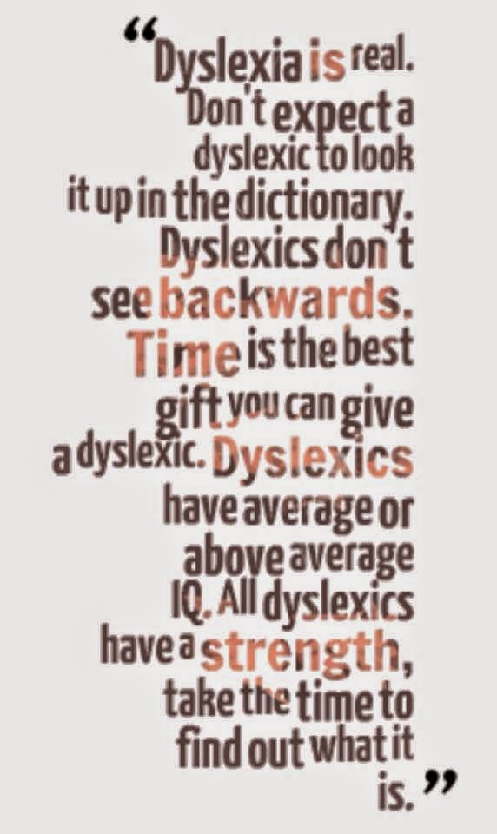
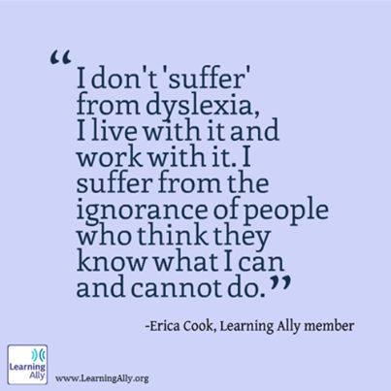
ECES5006/C
All Means All
Mae Pawb yn golygu Pawb
Sesiwn 6b / Session 6b

Slide 2

Llythrennedd
Literacy
“Literacy is the ability to read, write, speak and listen well. A literate person is able to communicate effectively with others and to understand written information.” (National Literacy Trust, 2012)
Llawer o anghytundeb – beth yw llythrennedd? Beth yw anllythrennedd?
“Literacy is the ability to read, write, speak and listen well. A literate person is able to communicate effectively with others and to understand written information.” (National Literacy Trust, 2012)
A contested area – what is literacy? What is illiteracy? When is illiteracy a need?

Slide 3
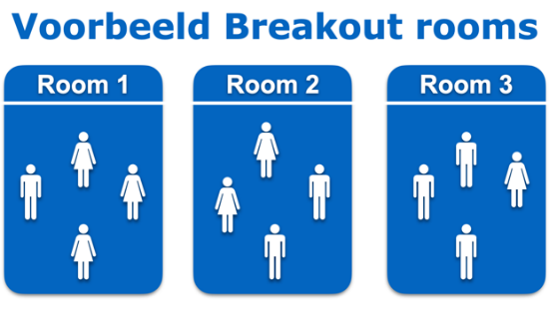
Llythrennedd
Literacy
Grŵp 1 – Beth yw’r sgiliau sydd ynghlwm â’r broses o ddarllen?
Grŵp 2 – Beth yw’r sgiliau sydd ynghlwm â’r broses o ysgrifennu?
  Meddyliwch nôl i’r gadwyn gyfathrebu yn sesiwn 5a.
  Mewn grwpiau bach, cynlluniwch fodel tebyg sy’n dangos y sgiliau angenrheidiol ar gyfer darllen/ysgrifennu.
Group 1 - What does it mean to read?
Group 2 - What does it mean to write?
  Think back to the ‘communication chain’ we studied in session 5a.
  In small groups, design a similar model which reflects the skills needed to read/write.

Slide 4
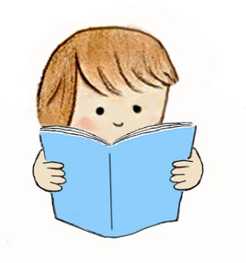
Achosion
Causes
Gall anhawster fod yn rhan o anghenion eraill
Nid yw ymchwilwyr yn gytûn ynglŷn â beth sy’n ‘achosi’ anawsterau.
Dadlau rhai ei fod yn amhosib gwahaniaethu rhwng ‘anawsterau llythrennedd’ a ‘dyslecsia’.
Literacy difficulties may arise from other additional learning needs.
What ‘causes’ literacy difficulties is a contested area of debate.
Some people argue that it is difficult to distinguish ‘literacy difficulties’ from ‘dyslexia’
(Crombie, 2016 in Peer and Reid, 2016)

Slide 5
Dyslecsia
Dyslexia
Anhawster dysgu penodol sy’n effeithio ar y gallu i ddarllen a sillafu
Effeithio tua 1 ymhob 10 person
Efallai ei fod yn etifeddol
Defnyddiol i feddwl am gontinwwm o ddifrifoldeb o ysgafn i ddwys
Dyslexia Action, N.D
A specific learning difficulty which affects the ability to learn to read and spell
An estimated 1 in 10 are affected by dyslexia
May be hereditary
Useful to consider a ‘continuum’ from mild to severe
Dyslexia Action, N.D

Slide 6

Dyslecsia
Dyslexia
Beth yn union yw dyslecsia?
  Does neb yn gytûn eto!
Damcaniaeth Frith – ‘Causal Modelling’
  Biolegol
  Deallusol
  Ymddygiadol
(Frith yn Reid a Wearmouth, 2002)
What exactly is dyslexia…?
  No-one quite agrees yet!
Frith’s Causal Modelling Theory
  Biological
  Cognitive
  Behavioural
  (Frith in Reid and Wearmouth, 2002)

Slide 7
Effeithiau Dyslecsia
Effects of Dyslexia
Gwyliwch y fideo ar beth yw dyslecia ac ystyriwch sut allai dyslecsia effeithio person.
Ystyriwch:
  Sut all hyn effeithio ar blentyn mewn amgylchedd ddysgu.
  Pa strategaethau all gefnogi dysgu plentyn?
Watch the video on what dyslexia is and consider how dyslexia may affect a person
Consider:
  How might dyslexia affect a child in a learning environment?
  What strategies are likely to work well to support a child’s learning?

Slide 8

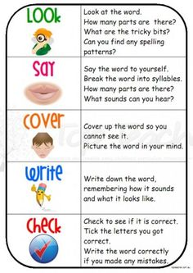
Strategaethau i Gefnogi Sillafu
Strategies to Support Spelling
  Dau prif ffordd:
    Strategaethau clywedol
    Gweler fideo Tric a Chlic isod
    Strategaethau gweledol
  Hall, 2009
Two main approaches:
  Auditory strategies (phonics)
    See videos below for Jolly Phonics and Tric a Chlic
  Visual strategies (Look and Say)
  (Hall, 2009)
SATPIN/DEM
RAINBOW/DEM
Jolly Phonics
Tric a Chlic

Slide 9

Gemau Sillafu
Spelling Games
Gemau ffoneg
Gemau gweledol/cof
Gemau gwrando/cof
Phonics games
Visual/memory games
Listening/memory games

Slide 10
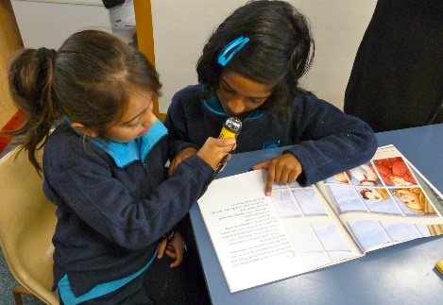
Meddwl am Ddarllen
Thinking about Reading
Gall anawsterau darllen gynnwys:
  Trafferth adnabod sain llythyron
  Methu adnabod patrwm synau mewn gair
  Anghofio patrwm synau i greu gair a adnabyddir
  Gallu dweud geiriau ond dim cofio nhw i’w defnyddio’n gywir mewn brawddeg
  Trafferth adnabod ffont
  Cam-ynganu geiriau
  Camddeall neu ddim adnabod atalnodi sy’n cefnogi ystyr wrth ddarllen yn uchel.
Difficulties with reading may include:
  Not recognising sounds of letters
  Not able to sequence sounds in a word
  Forgetting the sequence of letters to make a recognisable word
  Being able to say words but not remember them in a sentence of use them for meaning
  Not being able to ‘generalise’ fonts
  Mispronouncing words
  Misunderstanding or not recognising punctuation which supports meaning when reading aloud.
Hall, 2009

Slide 11
Gemau Darllen
Reading Games
Dulliau aml-synhwyraidd
Llenwi’r bylchau
Darganfod yn gyflym:
Multi-sensory approaches
Cloze activities
Quick find:
Cyfaill pennaf dyn yw ei gi. Roedd y Tywysog Llywelyn bob amser yn credu mai ei gi ffyddlon, Gelert, oedd ei gyfaill pennaf. O leiaf, dyna'r oedd yn ei feddwl, tan y noson dyngedfennol honno pan aeth allan i hela a gadael ei annwyl fab yng ngofal Gelert.
Mark turned the corner and stared at the empty bus stop in Lavender Street. He swallowed hard and his hands started to shake. Being the first one there wouldn’t be a problem if the old oak tree that marked the bus stop wasn’t haunted.

Slide 12

Beth sy’n effeithiol?
What is effective?
Nid yw dysgu ‘arferol’ yn mynd i alluogi plentyn gydag anawsterau llythrennedd i ddal i fyny.
Mae angen cynlluniau sy’n strwythuredig iawn, sy’n canolbwyntio ar strategaethau sillafu ac sy’n cynnig cyfleodd i ymarfer yn aml.
Mae angen defnyddio dulliau ffoneg a gweledol ar y cyd.
Mae Cynorthwywyr Dysgu sydd wedi’u hyfforddi yn gallu cefnogi'r broses yma.
‘Ordinary teaching’ won’t enable children with literacy difficulties to catch up.
Schemes which are highly structured, focus on regular spelling strategies and use little and often approaches are most effective.
Phonic and visual approaches need to be used in combination.
Skilled and highly trained TAs can support development of literacy.
Brooks, 2016

Slide 13
Beth sy’n effeithiol?
What is effective?
Dulliau wedi’u personoli
Sesiynau strwythuredig, dyddiol sy’n cefnogi cynnydd
Targedu ‘ymddygiad diymadferth’
Sicrhau bod athrawon a chynorthwywyr wedi’u hyfforddi i safon uchel (gan gynnwys darpariaeth arbenigol)
Gweithio yn agos gyda rhieni
Personalised approaches
Structured, daily sessions with continuity of learning
Address ‘learned helplessness’
Ensure a highly trained workforce with specialist provision
Work closely with parents
Rose, 2009

Slide 14

A Critical Approach - Example
Supporting learners with dyslexia means recognising that without meaningful support, progress is likely to be slow (Brooks, 2016). Rose (2009) stresses the importance of tailored support for individual children with dyslexia, remembering Frith’s (2002, in Reid and Wearmouth, 2002) caution that no two children are likely to experience it in the same way. Both Rose (2009) and Brooks (2016) are in agreement that highly structured, phonetic approaches to support is likely to be most effective. Both advocate a ‘little and often’ approach, however, Rose (2009) also highlights the risk to ‘continuity of learning’ (p.14) which can happen over the holidays.

Slide 15
Dadansoddi Beirniadol
Mae cefnogi dysgwyr gyda dyslecsia yn meddwl cydnabod y bydd eu datblygiad yn debygol o fod yn araf heb gefnogaeth ystyrlon (Brooks. 2016). Noda Rose (2009) y pwysigrwydd o gefnogaeth wedi’i deilwra ar gyfer disgyblion unigol gyda dyslecsia, gan gofio bod Frith (2002, yn Reid a Wearmouth, 2002) yn rhybuddio nad yw unrhyw ddau blentyn yn ei brofi yn yr un ffordd. Mae Rose (2009) a Brooks (2016) yn cytuno mae dulliau ffonetig gyda lefel uchel o strwythur sydd yn debygol o fod yn fwyaf llwyddiannus. Mae’r ddau yn cefnogi’r dull ‘little and often’, ond, mae Rose (2009) hefyd yn nodi’r risg i ‘continuity of learning’ (t.14) sydd yn gallu digwydd dros y gwyliau.

Slide 16

Eich Canllaw Ymarferwyr?
Your Practitioner’s Guide?
Hygyrch
Gwybodaeth damcaniaethol
Trafodaethau astudiaethau achos
Awgrymiadau ymarferol
Esiampl o ysgrifennu proffesiynol bywyd go-iawn.
Pa rwystr y byddwch yn ffocysu arno?
A fyddwch chi’n ymateb i adborth o asesiadau blwyddyn 1?
Accessible
Theoretical knowledge
Case study discussions
Practical suggestions
Real-life example of professional writing
Which barrier will you focus on?
Will you respond to feedback from last year’s assessments?

Slide 17
Darllen Pellach Defnyddiol
Useful Follow-Up Reading
Pennod / Chapter 3:
  Reid, G. and Wearmouth, J. (eds.) (2002) Dyslexia and Literacy, Chichester: John Wiley and Sons Ltd.
Pennod / Chapter 2:
  Hall, W. (2009) Dyslexia in the Primary Classroom, London: Sage.

Slide 18
Llyfryddiaeth
Bibliography
Brooks, G. (2016) What Works for Children and Young People with Dyslexia, Sheffield: Dyslexia-SpLD Trust. Available at: http://www.dyslexiaaction.org.uk/files/dyslexiaaction/what-works-5th-edition.pdf (Accessed 11/10/17).
Dyslexia Action (N.D.) About Dyslexia, Available at: http://www.dyslexiaaction.org.uk/page/about-dyslexia-0 (Accessed 11/10/17).
Hall, W. (2009) Dyslexia in the Primary Classroom, London: Sage.
Peer, L. and Reid, G. (eds.) (2016) Special Educational Needs, London: Sage.
Reid, G. and Wearmouth, J. (eds.) (2002) Dyslexia and Literacy, Chichester: John Wiley and Sons Ltd.
Rose, J. (2009) Identifying and Teaching Children and Young People with Dyslexia and Literacy Difficulties, Nottingham: DCSF Publishing. Available at: http://www.interventionsforliteracy.org.uk/assets/Rose-Report.pdf (Accessed 11/10/17).
The Dyslexia SpLD Trust (2014) Children with Persistent Difficulties, Available at: http://www.interventionsforliteracy.org.uk/assets/documents/2014/SPLD_S3_Final.pdf (Accessed 11/10/17).
The National Literacy Trust (2012) The State of the Nation – a picture of literacy in the UK today, London: National Literacy Trust.

