Slide 1
Contemporary Themes In the Hospitality Sector
Ana Maria Ndreka
2118393

Slide 2
Table of Contents
Introduction…………………………………….………………..3
Literature Review………………………………………………4-5
Application to the hotel and hospitality sector………………… 6-8
Future policy and management options for Sustainability………9
Conclusion………………………………………………………. 10
References ……………………………………………………….. 11

Slide 3
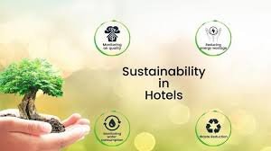
Introduction
The hotel and hospitality sector is experiencing huge pressure to find the environmental impacts and promote sustainable approaches.
Sustainable principles play a significant role for hotels or hospitality organisations to attract a wide range of eco-conscious people.
The following presentation will explore the key concepts and terminologies related to the promotion of sustainable practices within hotel organisations through a literature review.
Furthermore, the evaluation of the management options and future policy will be also portrayed in this presentation.
Notes:
The hotel and hospitality sector is experiencing huge pressure to find the environmental impacts and promote sustainable approaches. The implementation of this kind of initiative provides financial opportunities to the businesses by improving the brand value and image. Sustainable principles play a significant role for hotels or hospitality organisations to attract a wide range of eco-conscious people. The use of environment-friendly approaches is essential for the hospitality industry to reduce the ecological footprint and ensure the well-being of the environment and society as well. The following presentation will explore the key concepts and terminologies related to the promotion of sustainable practices within hotel organisations through a literature review. The application of the chosen theme to the hotel industry will be evaluated here by using the PESTLE framework. Furthermore, the evaluation of the management options and future policy will be also portrayed in this presentation.

Slide 4

Literature Review
As per the opinion of Costa and Costa (2022), sustainable practices are increasingly imperative to the health of the people and economy and the resilience of any organisation in recent times.
Sustainable hospitality will be the key trend to this sector and make the respective industry successful for the long-term period.
The reduction of the environmental impacts, cost advantages or long-term financial growth and improved brand reputation through enhancing customer satisfaction are some of the major benefits of implementing sustainable approaches.
Costa and Costa (2022),
Notes:
As per the opinion of Costa and Costa (2022), sustainable practices are increasingly imperative to the health of the people and economy and the resilience of any organisation in recent times. Sustainable hospitality will be the key trend to this sector and make the respective industry successful for the long-term period. Industry players should ensure the businesses are focused on minimising the environmental impact while increasing the positive influence on the communities, consumers and planet. The reduction of the environmental impacts, cost advantages or long-term financial growth and improved brand reputation through enhancing customer satisfaction are some of the major benefits of implementing sustainable approaches.

Slide 5
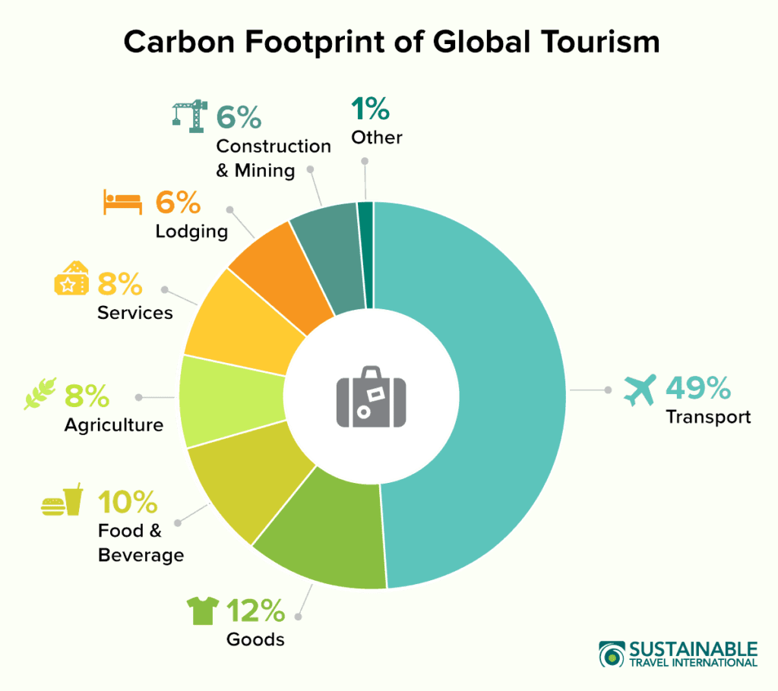
Contd…
According to Olya et al. (2021), hotels are facing tremendous challenges in introducing sustainable initiatives.
Sustainable initiatives require a massive range of initial investment which is challenging for some hotels.
Olya et al. (2021) proposed that finding reliable suppliers with sustainability commitments is also another problem for hotels in recent times.
Organisations have to use the TBL or triple bottom line framework to deal with sustainability practices and meet sustainability commitments.
Olya et al. (2021)
Notes:
According to Olya et al. (2021), hotels are facing tremendous challenges in introducing sustainable initiatives. Sustainable initiatives require a massive range of initial investment which is challenging for some hotels. The organisation should focus on adequate funds for implementing waste management and proper recycling programs. Besides that, the lack of awareness and open communication are the notable barriers for the hotels. According to, the introduction of the training programs related to the education related to sustainability requires the minimum capital investment. Olya et al. (2021) proposed that finding reliable suppliers with sustainability commitments is also another problem for hotels in recent times. Organisations have to use the TBL or triple bottom line framework to deal with sustainability practices and meet sustainability commitments. Costa and Costa (2022) stated that the use of the circular economy will be effective in mitigating the challenges related to high waste generation and optimising valuable resources properly.

Slide 6
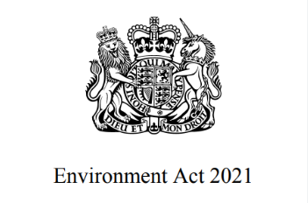
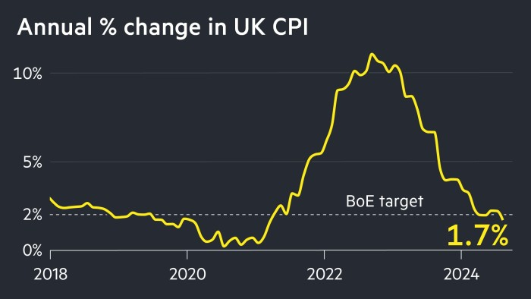
Application to the hotel and hospitality Sector
Political Factors
Political factors are some of the most critical elements which directly impact businesses operating in the hotel and hospitality industry.
For instance, The UK government has implemented the Environment Act 2021 to promote sustainability in the country (gov.uk, 2024).
(gov.uk, 2024)
Economic Factors
There are several economic factors such as inflation and corporate tax that pose a significant impact on the hospitality industry.
As an example, government data shows that the inflation rate of the UK has been decreasing and reached 2.6% in September 2024 (gov.uk, 2024).
(gov.uk, 2024)
Notes:
Notes:
Application to the hotel and hospitality Sector
The hospitality industry has been rapidly growing over the years. There are multiple external factors which directly or indirectly impact the industry. In this section, six key external factors have been evaluated involving the PESTLE analytical tool.
Political Factors
Political factors are some of the most critical elements which directly impact businesses operating in the hotel and hospitality industry. For instance, The UK government has implemented the Environment Act 2021 to promote sustainability in the country (gov.uk, 2024). This initiative has encouraged businesses to maintain sustainable business activities which positively impact the hotel and hospitality industry by promoting sustainable growth. On the other hand, the political stability index of the UK suggests that there is political instability in the country and its rating stands at 0.50 (theglobaleconomy, 2022). This can pose a significant challenge for businesses operating in the hospitality sector to make changes in their operations smoothly.
Economic Factors
There are several economic factors such as inflation and corporate tax that pose a significant impact on the hospitality industry. As an example, government data shows that the inflation rate of the UK has been decreasing and reached 2.6% in September 2024 (gov.uk, 2024). The decreasing inflation rate is a good symbol that businesses have a good opportunity to make investments and foster their revenue. Contrary to this, the UK government has increased the corporate tax and reached 25% in the fiscal year 2023-24, rising from 19% in the last fiscal year (gov.uk, 2024). Because of a high corporate tax, hospitality businesses may have to compromise their revenue and they have to ponder before investing in sustainable practices.

Slide 7
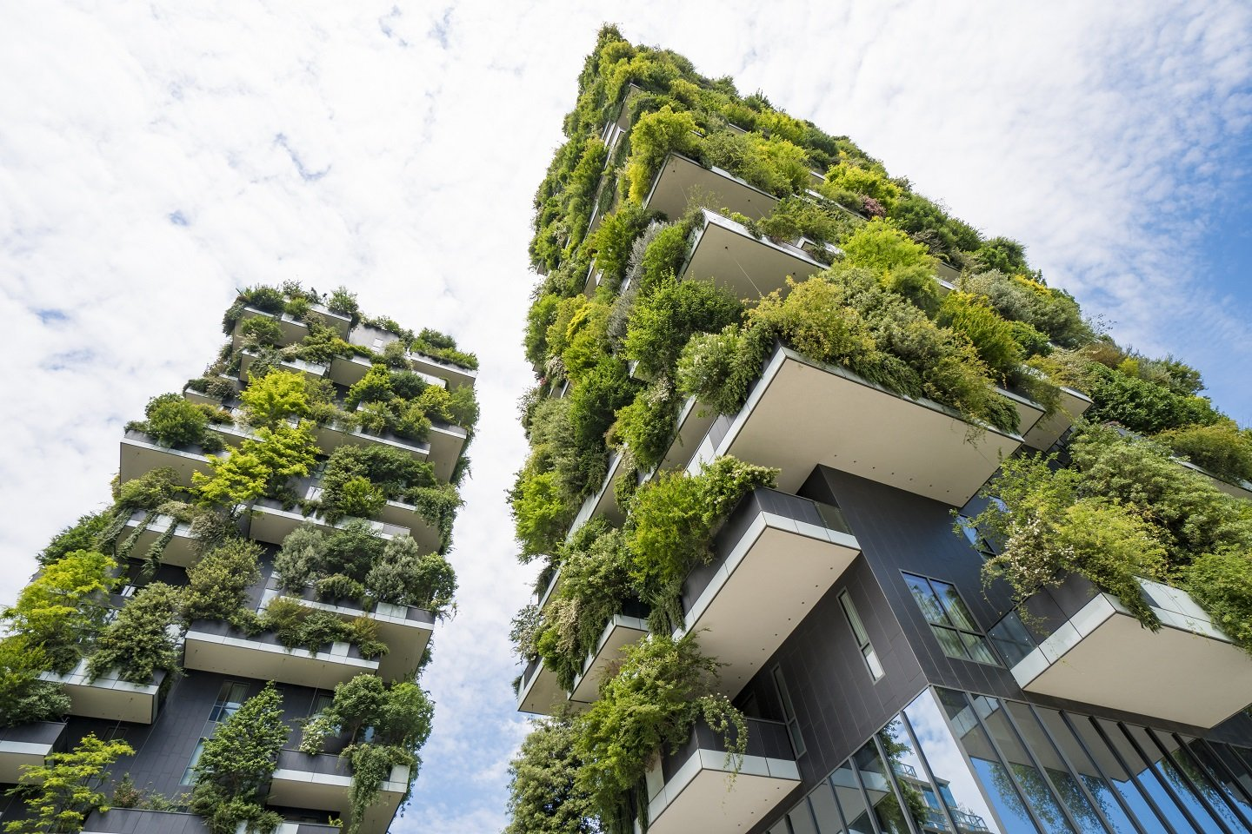

Social Factors
There are multiple social factors such as changing consumer behaviour which broadly impact a business.
For instance, the trends of sustainability have significantly grown in the UK and people in the country prefer buying sustainable products and services (deloitte, 2023).
(deloitte, 2023)
Technological Factors
With the growth in technological advancement, multiple digital trends have emerged in the hotel and hospitality industry.
Automated waste management, contactless payment, online booking, AI and Augmented Reality are some of such trends (Barten, 2024).
(Barten, 2024)
Notes:
Notes:
Social Factors
There are multiple social factors such as changing consumer behaviour which broadly impact a business. For instance, the trends of sustainability have significantly grown in the UK and people in the country prefer buying sustainable products and services (deloitte, 2023). This is a positive sight for the hospitality industry, aiming to integrate sustainable practices. Apart from that, changing consumer preferences is a severe challenge for businesses operating in the hotel and hospitality industry. It has been observed that consumers in the sector are looking for more personalised and technology-embedded services. This can be critical for organisations as they may have to make high investments in their operations to meet customer demands which can impact their profit margin.
Technological Factors
With the growth in technological advancement, multiple digital trends have emerged in the hotel and hospitality industry. Automated waste management, contactless payment, online booking, AI and Augmented Reality are some of such trends (Barten, 2024). These trends play a vital role in increasing the experience of customers and making better services for businesses. However, regardless of these trends, the threat of cybercrime has been broadly increasing which makes a significant impact on the operations of businesses. This can be understood by data which highlights that 9% of overall cyberattacks occurred in the hospitality industry (Rowe, 2023). This leads to decreased trust among customers and decreased competitive advantage of businesses.

Slide 8

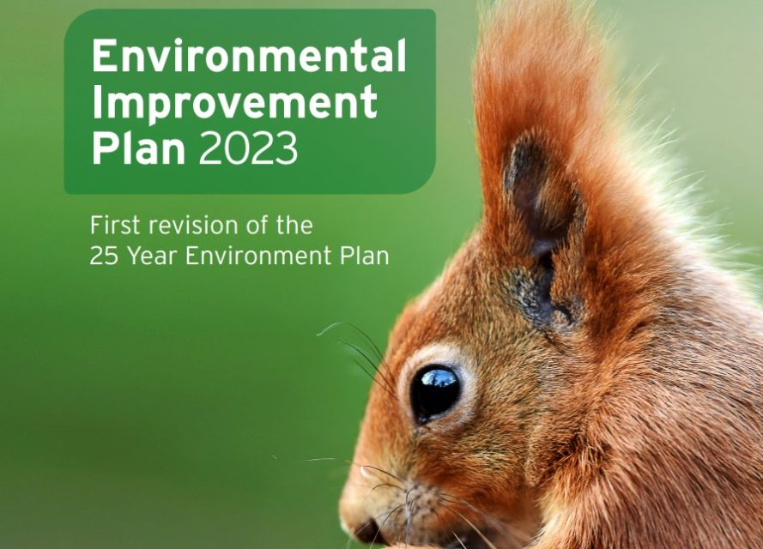
Legal Factors
There are several rules and regulations imposed by the government of a country which significantly affect businesses.
As an example, the UK government has clearly defined rules and regulations for workplaces under its Employment Rights Act 1996 .
(gov.uk, 2024)
Environmental Factors
The parliament of the UK has established an environmental improvement plan for 2023 which encourages businesses to maintain eco-friendly practices and put efforts into protecting the environment.
This plan is a revised form of the 25-Year Environment Plan (25YEP) which aims to promote nature and retain good health (gov.uk, 2023).
(gov.uk, 2024)
Notes:
Notes:
Legal Factors
There are several rules and regulations imposed by the government of a country which significantly affect businesses. As an example, the UK government has clearly defined rules and regulations for workplaces under its Employment Rights Act 1996. This law emphasises maximum weekly working hours, wage payment and providing appropriate atmosphere for working to employees (gov.uk, 2024). This law helps hospitality businesses maintain transparency in their process and provide a healthy atmosphere to their employee. This leads to fostering productivity and performance of businesses, making a positive impact on their revenue. On the other hand, there is a high tax duty on the import and export processes of businesses which negatively impacts the global operations of businesses operating in the hospitality industry (gov.uk, 2024).
Environmental Factors
The parliament of the UK has established an environmental improvement plan for 2023 which encourages businesses to maintain eco-friendly practices and put efforts into protecting the environment. This plan is a revised form of the 25-Year Environment Plan (25YEP) which aims to promote nature and retain good health (gov.uk, 2023). This regulation has encouraged hospitality businesses to adopt sustainable practices and promote environmental protection. Contrastingly, in August 2024, the average temperature reached 1.56⁰c which was the warmest since the pre-industrial period (co2.earth, 2024). The increasing global warming poses a severe threat to hospitality businesses that may have to face challenges in maintaining the sustainability of their services.

Slide 9

Future policy and management options for Sustainability
The renewable source of energy plays a vital role in reducing carbon footprint (Cooper and Hall, 2019).
In the process of sustainable business practices, waste generation is one of the critical factors which reduce the efficiency of sustainable growth (deloitte, 2023).
The involvement of local people is an important aspect of practising sustainable business practices.
Thus, it is suggested that hospitality businesses to increase their engagement with local communities and give them social and economic growth opportunities.
(deloitte, 2023)
Notes:
Notes:
Future policy and management options for Sustainability
Use of Renewable Energy: With increasing carbon footprint and changing climate, it is important for businesses to develop strategic planning to reduce their carbon emission. In this regard, the involvement of renewable energy can be very effective. The renewable source of energy plays a vital role in reducing carbon footprint (Cooper and Hall, 2019). By using renewable energy from sources such as solar and wind power, businesses can reduce their carbon emission. Additionally, they can also increase the quality of air which will be critical for sustainable growth. Thus, it is suggested that hospitality businesses should increase their usage of renewable energy.
Waste Management: In the process of sustainable business practices, waste generation is one of the critical factors which reduce the efficiency of sustainable growth (deloitte, 2023). Regarding this, waste management strategies can be a useful tool which would allow businesses to manage their waste generation and promote sustainability. Considering this aspect, it is suggested that hospitality businesses should develop comprehensive waste management strategies to ensure sustainable business operations. It will protect the environment as well as save costs or reduce disposal costs.
Increasing involvement of the local community: The involvement of local people is an important aspect of practising sustainable business practices. It allows businesses to build their engagement with local people and promote their brand awareness. It would also empower local people and give them growth opportunities. Thus, it is suggested that hospitality businesses to increase their engagement with local communities and give them social and economic growth opportunities.

Slide 10
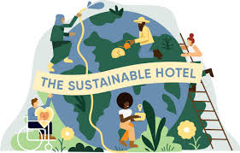
Conclusion
The respective presentation has outlined the influence of sustainable approaches on the growth of the hotel and hospitality sector.
The various impacts and key challenges of using sustainable practices and mitigation strategies have been discussed here with the help of a literature review.
To promote sustainable operations and manage them, the organisation should establish the right waste management plan, use renewable energy, and increase involvement with local communities.
Notes:
The respective presentation has outlined the influence of sustainable approaches on the growth of the hotel and hospitality sector. The various impacts and key challenges of using sustainable practices and mitigation strategies have been discussed here with the help of a literature review. Six elements such as political, economic, technological, environmental, legal and social and their impacts on the hospital industry have been stated here concerning the chosen contemporary theme of sustainability. To promote sustainable operations and manage them, the organisation should establish the right waste management plan, use renewable energy, and increase involvement with local communities. It will be effective for the hotel businesses to minimise the environmental footprint and protect the planet and environment from degradation.

Slide 11
References
Barten, M., (2024). The Latest Technology Trends in the Hospitality Industry of 2024. [Online] Available at: https://www.revfine.com/technology-trends-hospitality-industry/ [Accessed 12 October 2024].
co2.earth, (2024). Global Temperatures. [Online] Available at: https://www.co2.earth/global-warming-update#:~:text=August%202024%20Global%20Temperature%20Change&text=The%20Earth's%20global%20average%20surface,comparison%20period%20of%201880%2D1920. [Accessed 12 October 2024].
Cooper, C. and Hall, M. (2019) Contemporary Tourism: An International Approach, 4th Edn. Goodfellows, Oxford.
Costa, V. and Costa, C. (eds) (2022) Sustainability and competitiveness in the hospitality industry. Hershey, Pennsylvania: Business Science.
deloitte, (2023). The Sustainable Consumer 2023. [Online] Available at: https://www.deloitte.com/uk/en/Industries/consumer/research/sustainable-consumer.html [Accessed 12 October 2024].
gov.uk, (2023). Environmental Improvement Plan 2023. [Online] Available at: https://www.gov.uk/government/publications/environmental-improvement-plan [Accessed 12 October 2024].
gov.uk, (2024). Corporation Tax rates and allowances. [Online] Available at: https://www.gov.uk/government/publications/rates-and-allowances-corporation-tax/rates-and-allowances-corporation-tax [Accessed 12 October 2024].
gov.uk, (2024). Employment Rights Act 1996. [Online] Available at: https://www.legislation.gov.uk/ukpga/1996/18/contents [Accessed 12 October 2024].
gov.uk, (2024). Environment Act 2021. [Online] Available at: https://www.legislation.gov.uk/ukpga/2021/30/contents [Accessed 12 October 2024].
gov.uk, (2024). Inflation and price indices. [Online] Available at: https://www.ons.gov.uk/economy/inflationandpriceindices [Accessed 12 October 2024].
gov.uk, (2024). Tax and customs for goods sent from abroad. [Online] Available at: https://www.gov.uk/goods-sent-from-abroad/tax-and-duty [Accessed 12 october 2024].
Olya, H., Altinay, L., Farmaki, A., Kenebayeva, A. and Gursoy, D., (2021). Hotels' sustainability practices and guests' familiarity, attitudes and behaviours. In Sustainable Consumer Behaviour and the Environment (pp. 43-61). Routledge.
Rowe, B., (2023). Cybersecurity in Hospitality – The Latest Trends. [Online] Available at: https://securuscomms.co.uk/cybersecurity-in-hospitality-the-latest-trends/ [Accessed 12 October 2024].
theglobaleconomy, (2022). United Kingdom: Political stability. [Online] Available at: https://www.theglobaleconomy.com/United-Kingdom/wb_political_stability/ [Accessed 12 October 2024].
Notes:
Notes:
References
Barten, M., (2024). The Latest Technology Trends in the Hospitality Industry of 2024. [Online] Available at: https://www.revfine.com/technology-trends-hospitality-industry/ [Accessed 12 October 2024].
co2.earth, (2024). Global Temperatures. [Online] Available at: https://www.co2.earth/global-warming-update#:~:text=August%202024%20Global%20Temperature%20Change&text=The%20Earth's%20global%20average%20surface,comparison%20period%20of%201880%2D1920. [Accessed 12 October 2024].
Cooper, C. and Hall, M. (2019) Contemporary Tourism: An International Approach, 4th Edn. Goodfellows, Oxford.
Costa, V. and Costa, C. (eds) (2022) Sustainability and competitiveness in the hospitality industry. Hershey, Pennsylvania: Business Science.
deloitte, (2023). The Sustainable Consumer 2023. [Online] Available at: https://www.deloitte.com/uk/en/Industries/consumer/research/sustainable-consumer.html [Accessed 12 October 2024].
gov.uk, (2023). Environmental Improvement Plan 2023. [Online] Available at: https://www.gov.uk/government/publications/environmental-improvement-plan [Accessed 12 October 2024].
gov.uk, (2024). Corporation Tax rates and allowances. [Online] Available at: https://www.gov.uk/government/publications/rates-and-allowances-corporation-tax/rates-and-allowances-corporation-tax [Accessed 12 October 2024].
gov.uk, (2024). Employment Rights Act 1996. [Online] Available at: https://www.legislation.gov.uk/ukpga/1996/18/contents [Accessed 12 October 2024].
gov.uk, (2024). Environment Act 2021. [Online] Available at: https://www.legislation.gov.uk/ukpga/2021/30/contents [Accessed 12 October 2024].
gov.uk, (2024). Inflation and price indices. [Online] Available at: https://www.ons.gov.uk/economy/inflationandpriceindices [Accessed 12 October 2024].
gov.uk, (2024). Tax and customs for goods sent from abroad. [Online] Available at: https://www.gov.uk/goods-sent-from-abroad/tax-and-duty [Accessed 12 october 2024].
Olya, H., Altinay, L., Farmaki, A., Kenebayeva, A. and Gursoy, D., (2021). Hotels' sustainability practices and guests' familiarity, attitudes and behaviours. In Sustainable Consumer Behaviour and the Environment (pp. 43-61). Routledge.
Rowe, B., (2023). Cybersecurity in Hospitality – The Latest Trends. [Online] Available at: https://securuscomms.co.uk/cybersecurity-in-hospitality-the-latest-trends/ [Accessed 12 October 2024].
theglobaleconomy, (2022). United Kingdom: Political stability. [Online] Available at: https://www.theglobaleconomy.com/United-Kingdom/wb_political_stability/ [Accessed 12 October 2024].

