Slide 1

Risk Management
Rhodri Thomas

Slide 2
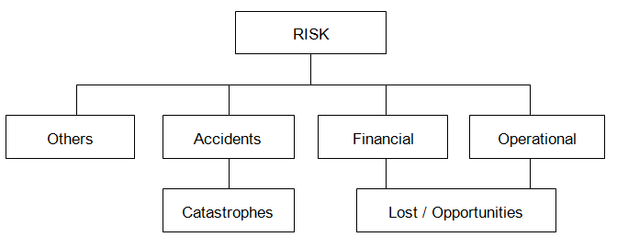
A risk may have one or more causes and, if it occurs, it may have one or more impacts which in turn may have positive and negative effects on the project objective

Slide 3
The construction industry has a high rate of accidents and a poor reputation for coping with problems, with many projects failing to meet deadlines, cost and quality targets.
In extreme cases the risk of time and cost overruns can compromise the economic viability of the project, making a potentially profitable investment unfeasible.
Compared to many other activities, construction is subject to more risks due to its unique features, such as long duration, complicated processes, unpredictable environment, financial intensity and dynamic organisational structures.

Slide 4
Stages of Risk Management
Identifying the hazards.
Evaluating the associated risks.
Controlling the risks.

Slide 5
Risk will be peculiar to each particular project and each project participant, however, it is recognised that all construction projects share some common risks…
Try to think of some risks to construction projects

Slide 6
Construction
Changes in the work
Subsurface geological and geotechnical conditions
Site access
Level of detail design delivered by the owner
Late drawings and instructions
Availability of resources
Accidents (such as collision, fire and so on)
Damage to persons or property
Defective design
Cost of tests and samples
Actual quantities of work
Equipment commissioning
Financial and economic
Inflation
Funding
Performance
Productivity of labour
Productivity of equipment
Suitability of materials
Defective work
Conduct hindering performance of the work
Labour disputes

Slide 7
Security
Vandalism
Terrorism
Corruption
Assaults
Negligence
Intrusion
Political and societal
Soil availability for construction
Environmental pressures
Regulations (safety or labour laws)
Public disorder
Strike
Physical
Subsurface geology geotechnical conditions
Conditions
Subsurface conditions and ground water
Topography
Natural catastrophes
Contractual and legal
Delayed dispute resolution
Delayed payment on contracts and extras
Change order negotiation
Insolvency of contractor or a subcontractor

Slide 8
Risk register for building design and construction

Slide 9
In a Risk assessment…
Risk:
The likelihood that a specified undesired event will occur due to the realisation of a hazard by, or during work activities or by the products and services created by work activities.
Risk = Likelihood x Severity

Slide 10
Likelihood | Score | Severity | Risk
Very Unlikely (difficult to see how this can occur) | 1 | Minor Injury (no treatment or absence from work) | 1
Unlikely (not expected to happen, but can’t be ruled out) | 2 | Minor Injury (requiring first aid / possible absence up to 3 days) | 2
Likely (could happen at some stage) | 3 | Injury (requiring over three days absence) | 3
Very Likely (may occur on a regular basis) | 4 | Major Injury (RIDDOR reportable injury / long term absence / health effect) | 4
Certain (no doubt about it – it will happen) | 5 | Death | 5
Risk = Likelihood x Severity

Slide 11
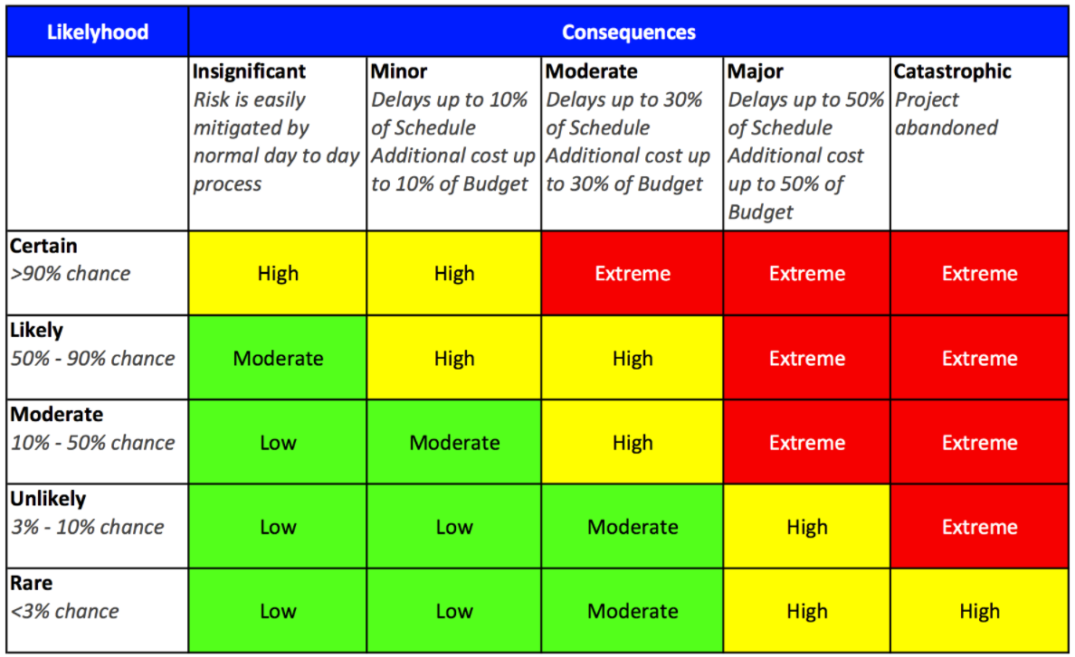
The previous table indicates how severity and probability combine to produce a risk score.
Ratings are assigned as follows:
1 – 8 = Low risk green – risk is being controlled
9 – 15 = Medium risk orange – risk is controlled but needs further
controls to reduce risk further
16 – 25 = High risk red – risk is high and should stop or immediate
In a Risk Register “Consequences” is similar to “Severity”

Slide 12
Risk Register
Step 1:
Identify all possible project risks. This can be done from reports and project documents, but bringing all the project team together at a risk workshop is usually considered to be the best approach.
Risk workshops are held to identify all the risks associated with a project that could have an impact on cost, time or performance of the project.
In addition, obtained information on the impact of the risk and the probability of its occurrence as this will be required later.

Slide 13
Remember that risks, both in terms of impact and probability can change over the life of the project.
Finally, it is worth considering whether there is any correlation between risks.
This allows the first element in the risk register, a description of the risk, to be prepared.

Slide 14
Step 2:
The risks that have been identified then need to be analysed for their probability and impact on the project (such as cost, time and resource).
Two basic approaches, 'qualitative' and 'quantitative' risk analysis:
In a qualitative analysis, descriptive terms are used such as 'low Impact' and 'high probability'.
In a quantitative analysis, risks will have values attributed to them, such as 'an impact of £10m' or 'a probability of 65%'.

Slide 15
The approach adopted will be influenced by the information available. It is possible to mix qualitative and quantitative analysis, although care must be taken if doing this to ensure there is not an unintentional over focus on the quantitatively defined risks.
Finally, the analysis of probability and impact are combined into a single risk score. Again, this risk score can be presented qualitatively or quantitatively, with quantitative methods often using colours (green, amber and red) as well as words. Once again, this analysis is then entered into the risk register. Risks are often listed from highest to lowest score so as to more clearly highlight the priority risks.

Slide 16
Step 3:
This initially requires the highlighting of warning signs for each risk. Often this focuses on the priority risks.
It is then necessary to identify a plan of action to bring about risk resolution. While there is an inevitable tendency to focus on negative threats, thought should also be given to more positive opportunities.
Those with a high risk score value will need action plans that respond with utmost urgency while those with a low risk score can simply be monitored without having a detailed action plan identified.

Slide 17
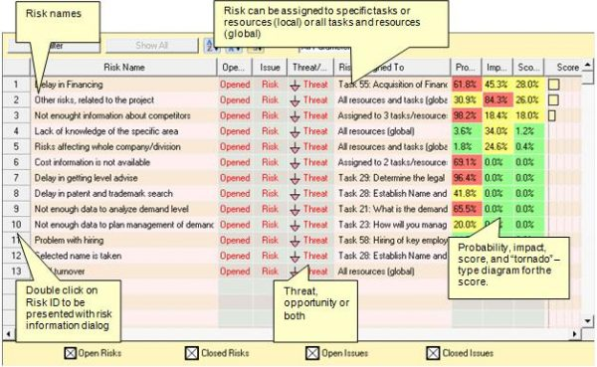
Appendix 3 - Risk Management Plan Risk Register (windows.net)

Slide 18
Risk resolution
Can be achieved in a number of ways:
Risk mitigation seeks to reduce the probability of occurrence or impact of a risk to below an acceptable threshold through a proactive parallel management action taken in advance of a negative impact arising.
1. Work with the right people
2. Plan and Prioritise
3. Probability v Consequence
4. Have options
5. Stick to the law
6. Test and Review
7. Ask for certifications, guarantees, assurances

Slide 19
Risk resolution
Can be achieved in a number of ways:
Risk transfer seeks to shift the impact of a threat to a third party, together with ownership of the response. However, care must be taken with this approach to ensure that there are no residual unaddressed risks left within the project from a retained correlated risk.

Slide 20
Risk resolution
Risk avoidance is achieved by making changes to the actual project, to either eliminate the risk or to protect the project objectives from its impact. Generally, risk avoidance involves relaxing the time, cost, scope, or quality objectives.
Risk acceptance means there is no change to the project to deal with a risk, and is often a reflection that it has not been possible to identify an appropriate risk resolution strategy.

Slide 21
When developing risk resolution strategies, especially for the most critical risks, it is important to avoid reliance on a single control or counter measure.
As before, all the above information needs to be recorded within the risk register.

Slide 22
The last step in developing a Risk Register is the allocation of an owner for each risk, and its associated monitoring and risk resolution plan.
While it is essential that all the above information is recorded in the risk register at the start of the project, it is equally important that the risk register is treated as a living document, being reviewed and updated on a regular basis.

Slide 23
While risk registers are an essential project management tool for large construction projects the following issues need to be kept in mind:
Encourage openness and avoid blame to ensure honesty about identifying and quantifying risks.
If risks are incorrectly assessed and therefore prioritised, they can divert resources away from more profitable activities.

Slide 24
If information is not presented logically and is biased it can unintentionally mislead.
Unless it is regularly updated the risk register might create a false sense of security with important risks going unrecognised.
Finally, no matter how good your risk register is, do not make the mistake of believing you can totally cover every risk your project will face.

Slide 25
Happold, B. (2012)
Sources

