Slide 2
ECEY4009: Professional Practitioner

Slide 3
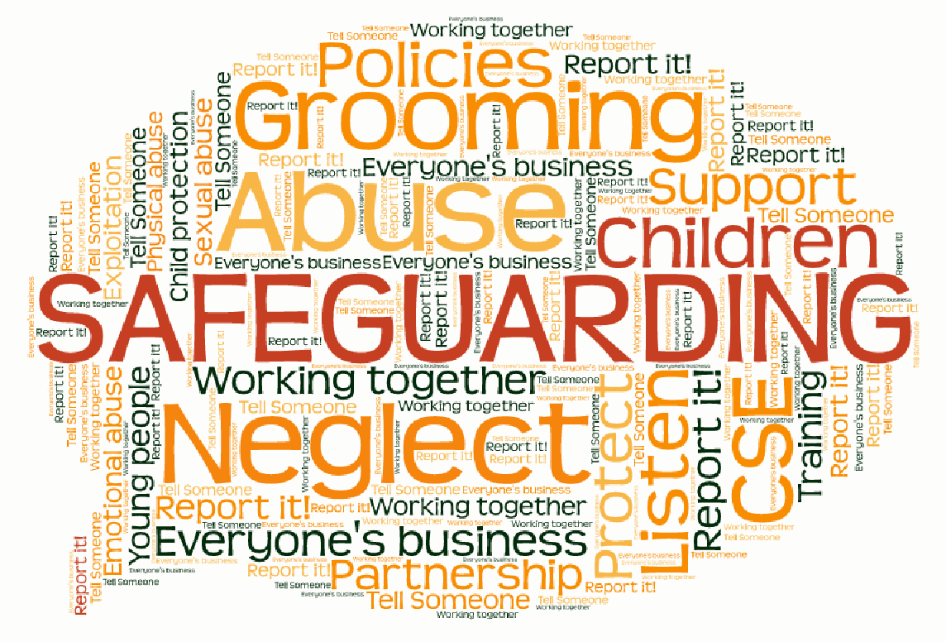
ECEY4009
Lecture 7:
Safeguarding
Module Coordinator:
Bhavisha Bhanderi
Rachel Iles
Module team:
Colin Barr
Debra Odeh

Slide 4

Group discussion
Why is it necessary to understand history and legislation relating to safeguarding children?
What do you believe will be your/is your role working with children?
Notes:
We have learnt from previous mistakes, certain case studies have lead to reports which have lead to legislation.
Jasmine Beckford = Children Act 1989
Holly and Jessica = Bichard report = enhanced CRB and now enhanced DBS
Victoria Climbie = Laming report = Children Act 2004
Everyone is legally responsible for safeguarding children

Slide 5

Definitions
What is child protection?
What is child abuse?
What is Safeguarding
Notes:
5
Task – can students find a definition of each?
Child protection is part of the safeguarding process. It focuses on protecting individual children identified as suffering or likely to suffer significant harm.
Child abuse is a negative, harmful or damaging experience that can have serious and long lasting impacts on the lives of children.
Safeguarding is the action that is taken to promote the welfare of children and protect them from harm.

Slide 6
Safeguarding
Safeguarding is the proactive steps that we take towards keeping all our children safe
Child Protection
Child protection is the reactive actions that occur as a result of a concern
Notes:
Safeguarding is the action that is taken to promote the welfare of children and protect them from harm.
Child protection is part of the safeguarding process. It focuses on protecting individual children identified as suffering or likely to suffer significant harm.
Child abuse is a negative, harmful or damaging experience that can have serious and long lasting impacts on the lives of children.

Slide 7

Abuse
Physical Abuse
Emotional Abuse
Sexual Abuse
Neglect
https://www.nspcc.org.uk/what-is-child-abuse/types-of-abuse/
Notes:
Domestic abuse, child trafficking and modern slavery, online abuse, - show webpage

Slide 8
Harm
…harm may be the result of a direct act or by a failure to act to provide proper care or both. (Great Britain, Department of Health, 1999).
…ill treatment or the impairment of health or development. (Bentovim et al., 2009).
Notes:
Direct harm or neglect that leads to harm

Slide 9
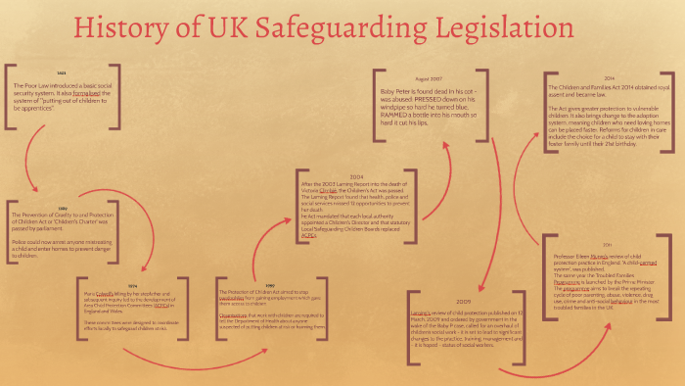
Background
Previous cases
Local Safeguarding Boards (LSCB)
Legislation
Notes:
As mentioned significant previous cases of child abuse and murder have lead to important pieces of legislation as well as the establishment of local safeguarding boards.
Following Lord Laming's inquiry into the death of Victoria Climbie, the Children Act 2004 required all Local Authorities across England and Wales to set up a Local Safeguarding Children Board (LSCB). The task of each LSCB is to safeguard and promote the welfare of children and young people in their area.
All Local Authorities in England have a safeguarding board:
They are responsible for:
coordinating local work to safeguard and promote children’s welfare
ensuring the effectiveness of member organisations
By Law all local authorities must have procedures to protect children and vulnerable adults.
All organisations working with children and adults must follow their LSCB online safeguarding policies and procedures.
Further information about the functions of the LSCB can be found in Chapter 3 of Working Together

Slide 10
Ethos
Safeguarding children is an activity that is done with our children rather than to them.
Peter Clarke
Notes:
Highlights the importance of working together with children, listening to them and respecting their wishes.

Slide 11

https://learning.nspcc.org.uk/child-protection-system/history-of-child-protection-in-the-uk/
1989 – Children Act for England and Wales
1998 – Human Rights Act
2002 – Education Act
2004 – Children Act, UNCRC
2010 – Equality Act
Notes:
A few examples of legislation important in England
We’re going to look at the main points of the Children Act 1989 and 2004

Slide 12
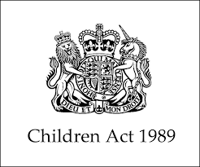
The Children Act 1989
Key Points
Supersedes the Children Act 1948
Influenced by Jasmine Beckford, Tyra Henry, Heidi Koseda and others
Section 17 and 47
Significant harm
Child’s voice
Policies
Child’s welfare as paramount
Notes:
Children Act 1989
The Children Act 1989 supersedes the Children Act 1975. This Act was influenced heavily by the deaths of Jasmine Beckford, Tyra Henry, Heidi Koseda and others in the preceeding years. Amongst other duties, this legislation placed a specific duty – section 17 on local authorities to provide services to children in need in their area, and section 47 – to undertake enquiries if they believe a child has suffered or is likely to suffer significant harm. It was under this legislation that the term significant harm was first used. For the first time, the child’s voice was identified as important in an issues surrounding their care. This Act states that there is a duty for local authorities to provide care for children and families in need. The Act identified a need for chidldren’s services to provide policies and procedures specific to the needs of children. The welfare of the child is of paramount consideration under this Act. It stated that the welfare of the child should be promoted by working in partnership between the family and local authorities.

Slide 13
Children Act 1989
Whenever, wherever possible: children to be cared for within their own families
Children in need
Race, culture, religion and language
Parental responsibility
Notes:
Working together under the Children Act 1989 was developed to improve working together. The Act identified that it was best for children to be cared for within their own homes by their families, where this wasn’t possible, parents should continue to be involved with matters concerning their children. The term ‘Children in Need’ first used within this legislation. For the first time an emphasis and a consideration was placed on race, culture, religion and language as a result of this legislation This Act introduced the concept of ‘parental responsibility, defined as ‘the rights, duties, powers and responsibilities which by law a parent of a child has in relation to the child’. This term replaced the concept of ‘parental custody.

Slide 14
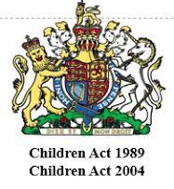
Children Act 2004
Runs alongside the Children Act 1989
Children’s Commissioner for England
Child Centred
Local Safeguarding Children’s Boards
Legislative basis for sharing information
Notes:
The Children Act 2004 does not replace the Children Act 1989, rather it works alongside it. The Children Act 2004 set out the processes for integrating children’s services, and creating the post pf Children’s commissioner for England. The post of Children’s commissioner here in Wales had been introduced several year earlier in response to Sir Ronald Waterhouse’s report into abuse in care homes across North Wales. This Act ensures a child centred approach is taken with regards to childrens services. Statutory Local safeguarding childrens boards were introduced, to replace the non statutory Area Child Protection Committees. For the first time, there was a legislative basis for effective sharing of information to ensure a cohesive and comprehensive approach to safeguarding children.

Slide 15
Children Act 2004
Clearer Accountability
Serious Case Review
Influenced the Wales Safeguarding Procedures
Recommendations
Additional provision for children with ALN
The Green Paper: Every Child Matters
Notes:
This Act ensures that there is a clearer accountability for individuals and agencies involved with safeguarding children. Serious Case Reviews (SCR’s) were established under the Children Act 2004. Children Act 2004 also influenced the introduction of Wales Safeguarding procedures here in Wales. As a result of the Lord Laming report there were a total of kflskl; recommendations made, lessons to be learned.

Slide 16
United Nations Convention on the Rights of the Child
1991
54 articles (42 rights)
Not yet been made part of domestic law in England.
Wales 2011 Children and Young Persons (Wales Measure)
Notes:
In 2019, uncrc celebrated 30 years. The United Nations Convention on the Rights of the Child is a comprehensive statement on children’s rights covering all aspects of children’s life. The convention was ratified (signed and taken on by Wales in 2004. In 2011, Welsh Government passed the Children and Young Persons (Wales) Measure 2011, which makes children’s rights part of its domestic law, the only nation in the UK to do so. This ensures that any policy, report or regulation being passed by Welsh Government considers the rights within the UNCRC. It is vital for practitioners working with children to have a good understanding of children’s rights.
Children should be aware of their rights, ask students if their settings educate children on their rights?

Slide 17
7 core aims (Wales)
Have a flying start in life;
Have a comprehensive range of education and learning opportunities;
Enjoy the best possible health and are free from abuse, victimisation and exploitation;
Have access to play, leisure, sporting and cultural activities;
Are listened to, treated with respect, and have their race and cultural identity recognised;
Have a safe home and a community which supports physical and emotional well being;
Are not disadvantaged by poverty.
Notes:
Welsh Government 7 core aims for children and young people
Based upon UNCRC and children’s rights in Wales

Slide 18
Keeping Children Safe in Education (2023)
This is a statutory guidance that must be read by all who work with children. Part 1 and Annex B MUST BE READ.
Each Local Authority has their own Safeguarding Board.
It is important to know what your setting procedures are.
Look onto the websites for further learning and support
Notes:
Show students the Birmingham safeguarding website, where they can access further training.

Slide 19

For whom?
EVERYONE is responsible for protecting children and young people from harm
  Individuals
  Agencies
Notes:
Practitioners should understand their role and responsibilities in order to safeguard and promote the welfare of children.
Practitioners should be familiar with and follow their organisation’s procedures and protocols for safeguarding and promoting the welfare of children, know who their child protection officer is, be alert to indicators of abuse and neglect and have had appropriate training,
If any person has knowledge, concerns or suspicions that a child is suffering, has suffered or is likely to be at risk of harm, it is their responsibility to ensure that the concerns are referred to social services or the police, who have statutory duties and powers to make enquiries and intervene when necessary.
An important and useful framework is: Working Together to Safeguard Children 2018 (publishing.service.gov.uk)
Working Together to Safeguard Children (2018): A guide to inter-agency working to safeguard and promote the welfare of children – HM Government

Slide 20
The role of the practitioner
Promoting the child’s welfare
Collaboration
  Social Services
  Police
  NSPCC
  This is not a matter of individual choice
Notes:
Everyone who works with children has a responsibility for keeping them safe. They must know how to report concerns about physical, emotional or sexual abuse; neglect; trafficking or exploitation so that those concerns can be addressed quickly and appropriately.
According to UK child protection data from National Society for the Prevention of Cruelty to Children (NSPCC) one in five children today have experienced serious abuse at some point in their lifetime.

Slide 21
References
Batty, D. (2005) ‘Timeline: A History of Child Protection’ https://www.theguardian.com/society/2005/may/18/childrensservices2 [Accessed: 8th September 2016].
Bentovim, A., Cox, A., Miller, L. B. and Pizzey, S. (2009) Safeguarding Children Living With Trauma and Family Violence: Evidence Based Assessment, Analysis and Planning Interventions. London: Jessica Kingsley Publishers.
Department for Education (DfE) (2023) Keeping children safe in Education 2023: Statutory guidance for schools and colleges. Available at: https://www.gov.uk/government/publications/keeping-children-safe-in-education--2 (Accessed: 21st September 2023)
Great Britain: Department of Health. (1999) Working Together to Safeguard Children. London: HMSO.
NSPCC. (2021) ‘History of child protection in the UK’ https://learning.nspcc.org.uk/child-protection-system/history-of-child-protection-in-the-uk
Social Care Wales (2019) Wales Safeguarding Procedures. Available at: ://safeguarding.wales/ (Accessed: July 2022).

